Slide 1
The myth of Narkissos and Echo, according to Ovid's Metamorphoses
Narkissos born in Boeotia, the son of the nymph Liriope and the river god Cephissus.
Possessed an unsurpassed beauty
Liriope asked the blind prophet Tiresias about his future
“If he fails to recognize himself, a long life he may have”
Narkissos was loved by many, but such was his pride that he spurned then all

Slide 2
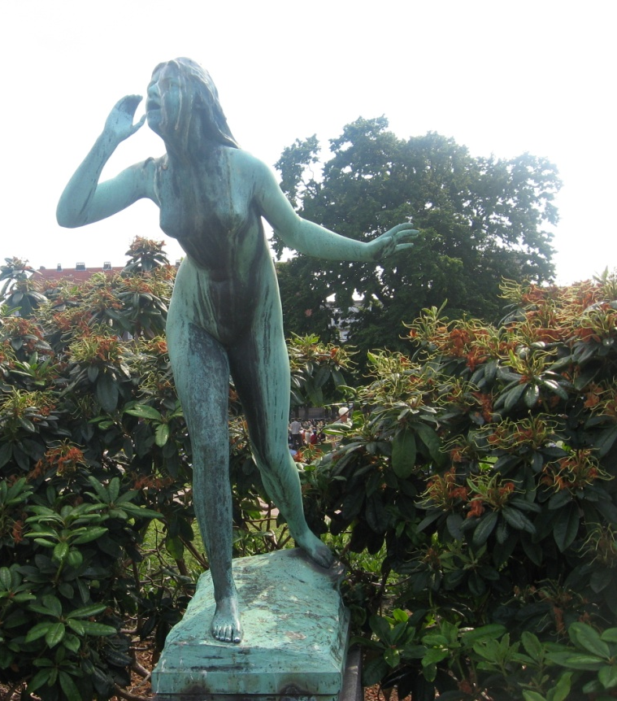
The myth of Narkissos and Echo
Echo, a nymph punished by Hera to repeat the last words of a person, depriving her of the ability to communicate
Echo meets Narkissos, falls in love with him but she is rejected and she wastes away out of passion
… only her voice remains

Slide 3
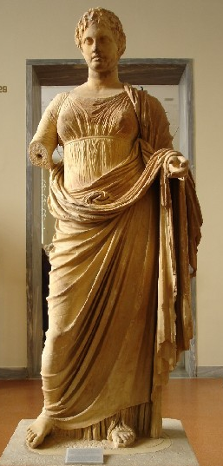
The myth of Echo and Narcissus
Narcissus is cursed by a male rejected lover who prayed to Goddess Nemesis for punishment:
If he should love, deny him what he loves

Slide 4

The myth of Narkissos and Echo
Narcissus falls in love with his reflection in a pool of water and wastes away…
…only a flower remains

Slide 5
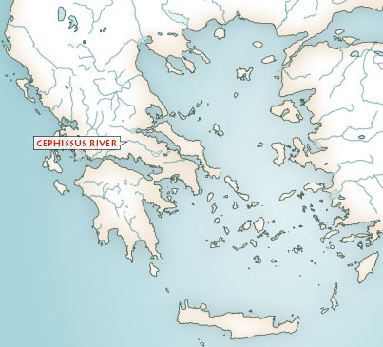
The myth of Narkissos and Echo
Spelling: Narkissos, Narcissus
Source: From Ovid’s Metamorphoses
http://www.theoi.com/Text/OvidMetamorphoses3.html#5
Specific information unlike Fairy Tales:
At Boeotia, the area of Thespiae
Liriope + river Kephissos
Narkissos
(Cephissus)

Slide 6
The myth of Narkissos and Echo
Motifs (common patterns)
The prophecy/ the curse
The punishment - Hera’s (related to philandering Zeus)
- Nemesis (related to hubris)
The transformations (metamorphoses): In this myth, serve as aetiologies (explanations) mostly of nature ( in this case the daffodil and he phenomenon of echo)

Slide 7
Narcissus and narcissism in psychoanalysis
Excessive selfishness, arrogance (hubris)
S. Freud on narcissism (self love)
Narcissistic personality disorder:
  Inflated sense of self-importance,
  A need for excessive admiration,
  Self absorption and a sense of entitlement
  Lack of empathy for others
Notes:
Diagnostic criteria
A pervasive pattern of grandiosity (in fantasy or behaviour), need for admiration, and
lack of empathy, beginning by early adulthood and present in a variety of contexts, as
indicated by five (or more) of the following:
1.) has a grandiose sense of self-importance (eg., exaggerates achievements and
talents, expects to be recognized as superior without commensurate achievements)
2.) is preoccupied with fantasies of unlimited success, power, brilliance, beauty, or
ideal love
3.) believes that he or she is “special” and unique and can only be understood by, or
should associate with, other special or high-status people (or institutions)
4.) requires excessive admiration
5.) has a sense of entitlement (eg., unreasonable expectations of especially favourable
treatment or automatic compliance with his or her expectations)
6.) is interpersonally exploitative (eg., takes advantage of others to achieve his or her
own ends)
7.) lacks empathy: is unwilling to recognize or identify with the feeling and needs of
others
8.) is often envious of others or believes that others are envious of him or her
9.) shows arrogant, haughty behaviours or attitudes

Slide 8
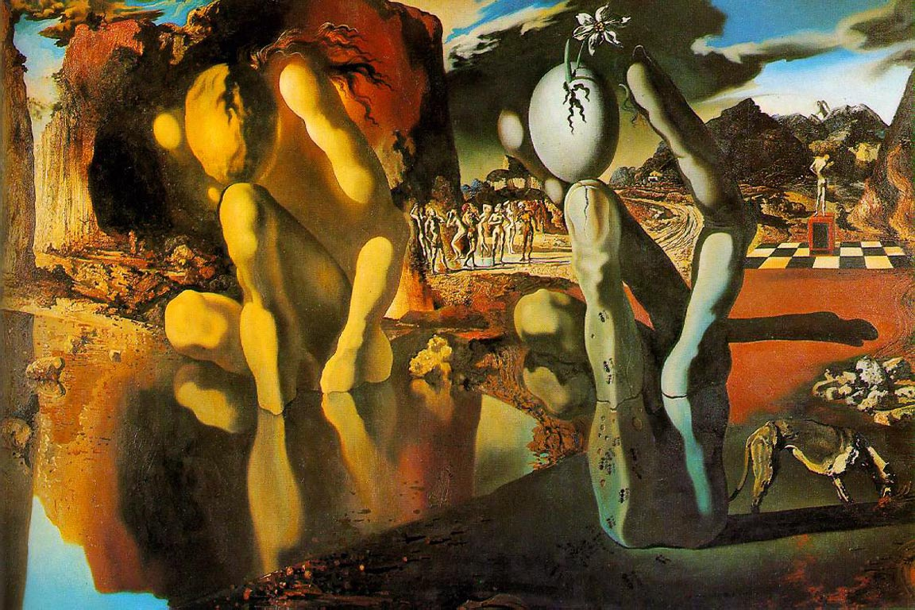
The Metamorphosis of Narcissus by Salvador Dali (1937)
http://www.authenticsociety.com/about/MetamorphosisOfNarcissus_Dali
Notes:
Dali's inspiration for this painting came from a conversation overheard between two fishermen discussing a local man who would stare at himself in a mirror for hours. One of the men described the man as having a "bulb in his head"; a colloquium meaning that he was mentally ill. Dali combined this image with the ancient Greek myth of Narcissus, who fell in love with his own reflection and was transformed into the flower that bears his name after his death. The hand on the right that holds an egg, out of which a narcissus flower grows, echoes the configuration of Narcissus and his reflection in the lake. The same configuration occurs again at the top of the mountains that are directly above the figure of Narcissus, who stands on a dais admiring his body. The familiar sight of ants and a scavenging dog both appear around the hand, symbolizing the death and decay that has taken place. The Metamorphosis of Narcissus was painted using oil on canvas, while Dali and Gala were traveling in Italy. The influence of the great Italian masters on Dali can be seen in the Classical mythic theme to his use of color and form.

Slide 9
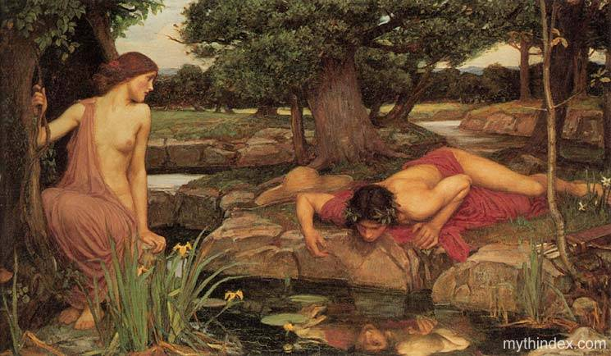
Structuralism
Myths reflect the binary structure of human mind : It perceives the world in forms of opposites.
In myths, opposites are brought together

Slide 10
Structuralism
Echo : desire for effective communication
desire but not effective communication
Narcissus: desire for no communication
desire but not effective communication
_______________________________________
Reflection of sound (echo)
Reflection of image (mirror)
No communication
Disastrous effects of refusing reciprocity
communication

Slide 11
For an easy to read and brief summary of the modern interpretations of myths in general, see
http://www.livingmyths.com/What.htm

Slide 12
Michael Jackson
Narcisstic obession killed the man in the mirror

