Slide 1
INTRODUCTION TO JOINTS (Chapter 8)
Classification of Joints:
• a joint is a site where 2 or more bones meet
• classified by structure (what holds the joint together? Is there a cavity?) & by function (how much freedom of movement is allowed at that joint?)
• structurally – 3 types:
fibrous
cartilaginous
synovial
• functionally – 3 types:
synarthroses
amphiarthroses
diarthroses
[arthro = joint]
Notes:
Up to slide ten for first midterm

Slide 2
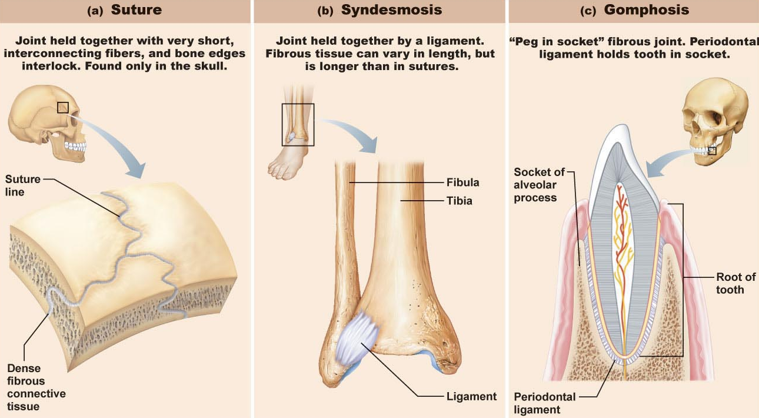
FIBROUS JOINTS:
bones joined by fibrous CT; no joint cavity so very little to no movement at joint
Sutures (=Synostose; NO movement):
• seams only found between bones of skull
• overlapping or interlocking of 2 bones; junction filled with very short CT fibers
Syndesmoses (very LIMITED movment):
cord (ligament) or sheet (interosseous membrane) of fibrous CT
Gomphoses: (gompho = nail [Greek])
• peg-in-socket; only example = tooth in bony socket

Slide 3
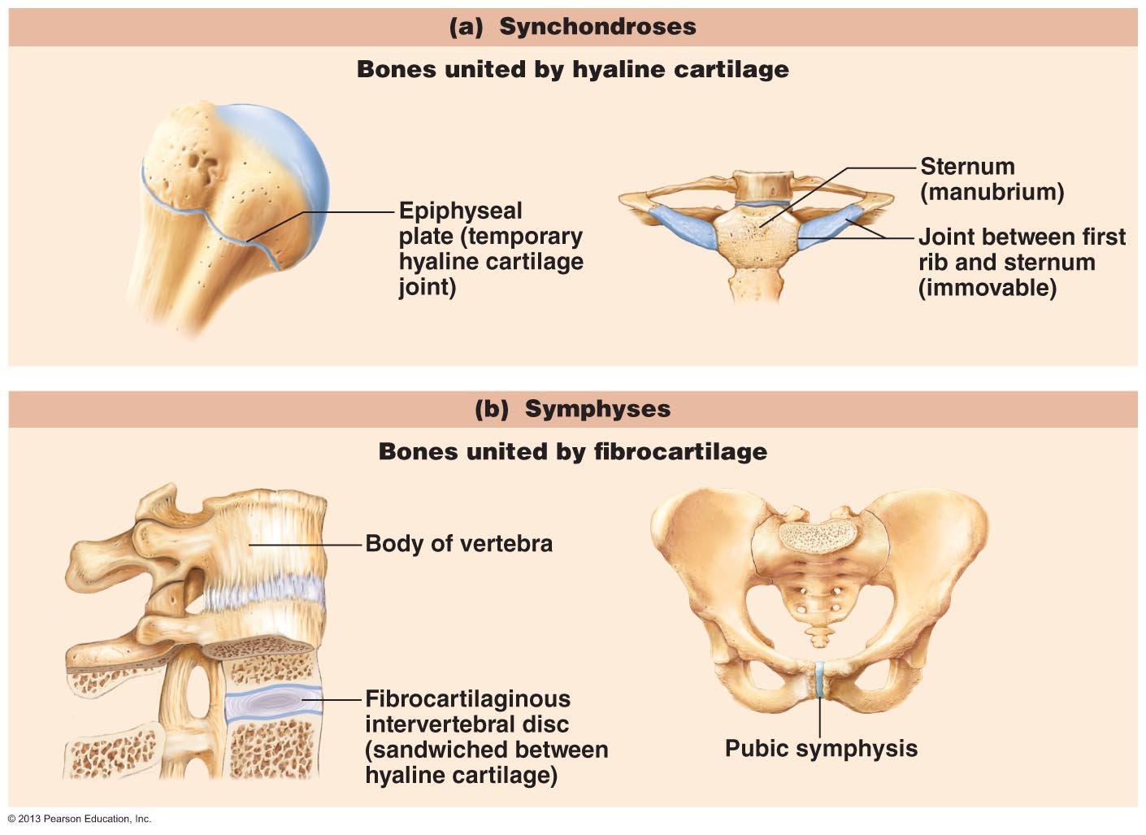
CARTILAGENOUS JOINTS: bones are united by cartilage (no joint cavity)
Synchondroses:
• areas of growth: eg: epiphyseal plates, between each of 1st 7 ribs & sternum
Symphysis:
• articular surfaces covered with hyaline cartilage - linking plate of fibrocartilage
• strength with flexibility: eg: pubic symphysis, intervertebral joints
Fig. 8.2

Slide 4
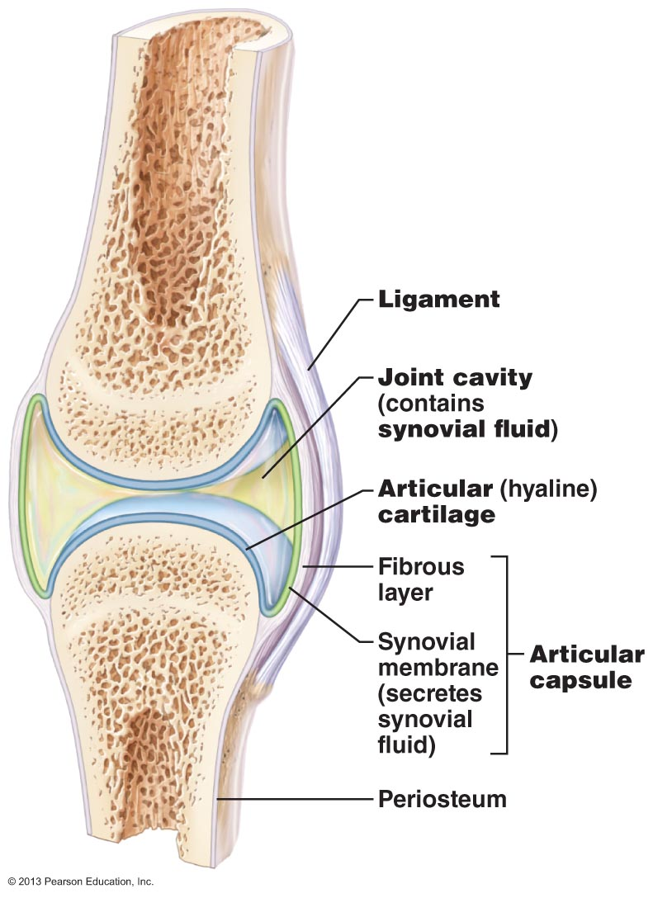
SYNOVIAL JOINTS
most joints - lots of movement
5 characteristics:
1. Articular cartilage:
covers opposing bone surfaces
cushioning so bone not crushed
2. Joint cavity:
= synovial cavity; fluid-filled
3. Articular capsule:
double-layered
4. Synovial fluid:
fills joint cavity; reduces friction
Reinforcing ligaments:
restrict movement of joint
some synovial joints have fatty pads for cushioning (hip/knee joints) or articular discs to improve fit (knee/jaw joints)
Fig. 8.3: General structure of a synovial joint

Slide 5
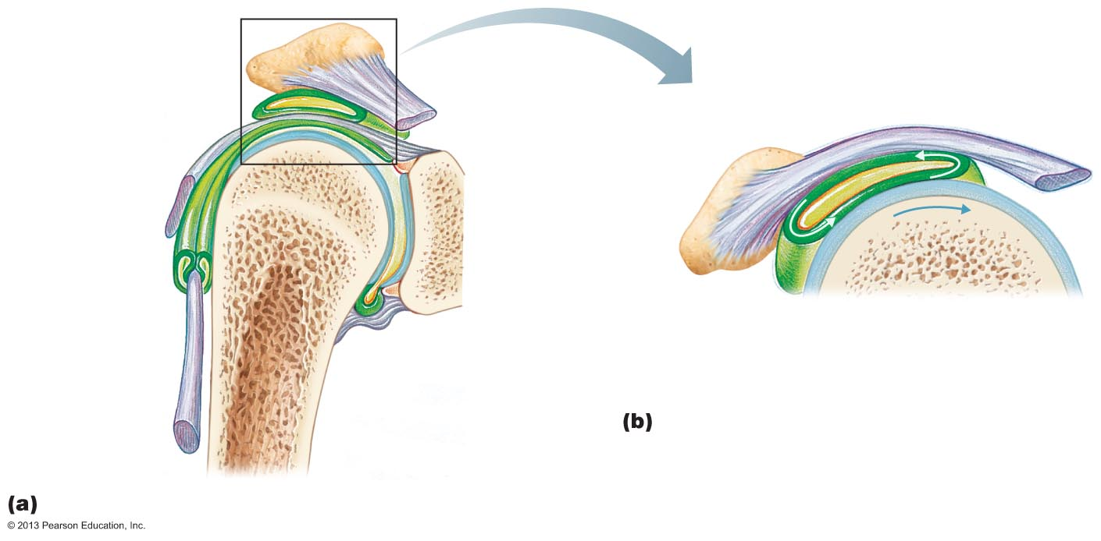
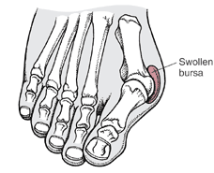
what is a bunion?
enlarged bursa
base of big toe
Fig. 8.4 Bursae & tendon sheaths
Bursae & tendon sheaths:
bags of lubricant ➢ reduce friction
(1) bursa is a sac lined with synovial membrane & containing a thin film of synovial fluid; found where ligaments, muscles, skin or muscle tendons overlie & rub against bone
(2) tendon sheath = elongated bursa that wraps around a tendon

Slide 6
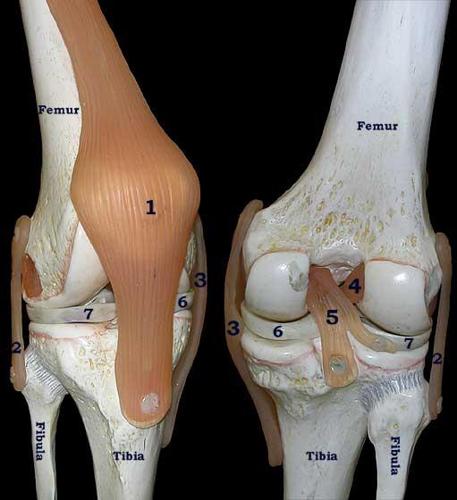
Factors that influence stability of synovial joints
• synovial joints allow lots of movement, so not as stable as fibrous/cartilaginous joints
3 factors influence joint stability:
(1) articular surfaces:
• shape of articular surfaces of many joints such that don’t contribute stability
• deep ball & socket joints have good shape for stability
(2) ligaments:
• more ligaments = more strength
• ligaments can only stretch ~6% of length before they break - stretched ligaments stay stretched
(3) muscle tone:
• tendons of muscles crossing joints usually most important stabilizing factor - kept taut by muscle tone
• esp: shoulder, knee, arches of foot
www.uky.edu/.../110Lab7/ Lab7Images/KneeJoint.jpg

Slide 7
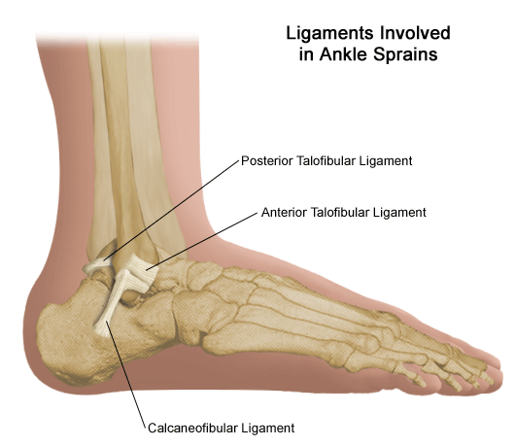
Common Joint Injuries
Sprains:
partially torn ligaments repair themselves (slowly due to poor vascularization)
completely torn ligaments require surgery
Cartilage injuries:
usually the knee - because cartilage has no blood supply, cannot repair itself
pieces break off / interfere with joint function »» arthroscopic surgery
Dislocations:
bones forced out of their normal positions at a joint; need to be reduced
repeat dislocations common because ligaments get stretched
www.stlouischildrens.org/. ../images/ei_0190.gif

Slide 8
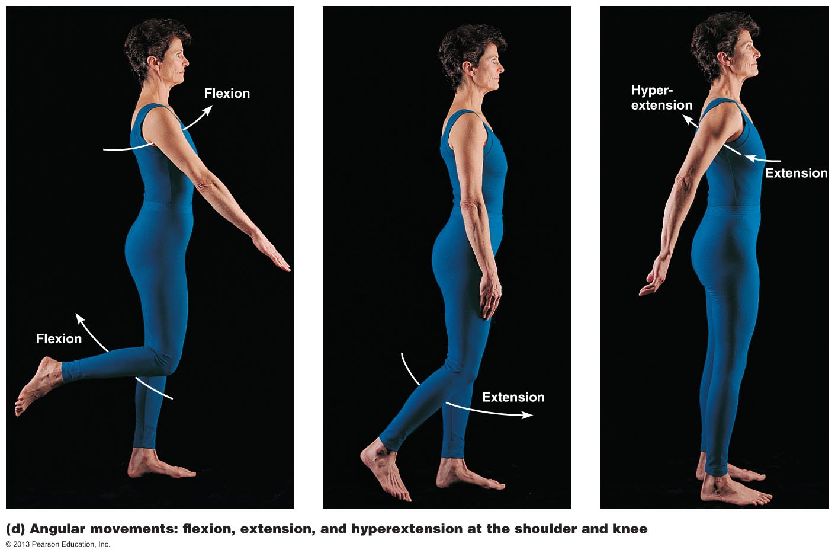
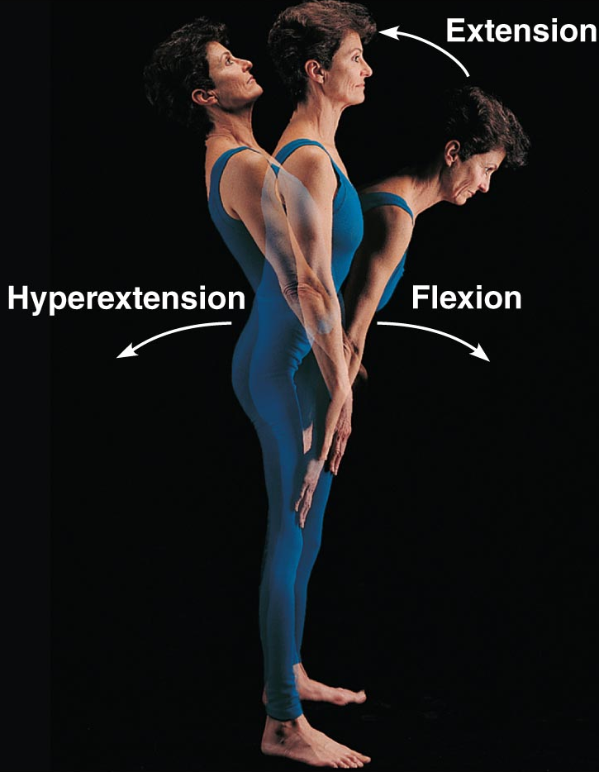
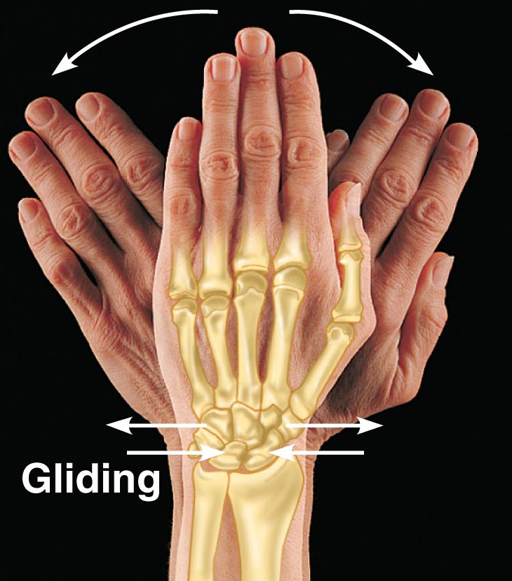
Movements allowed by Synovial Joints
Angular Movements

Slide 9
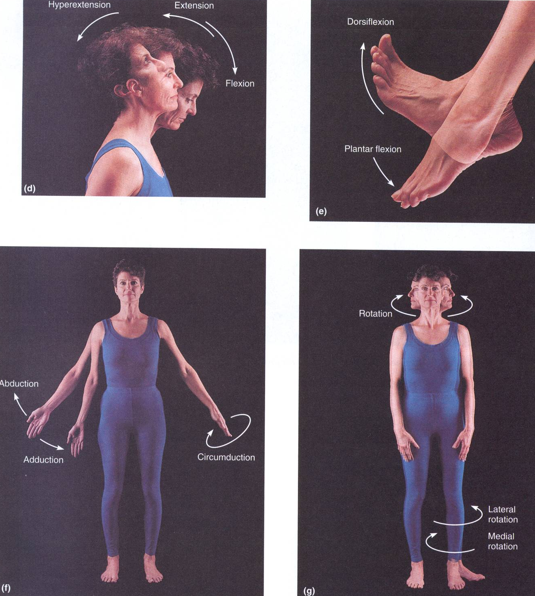
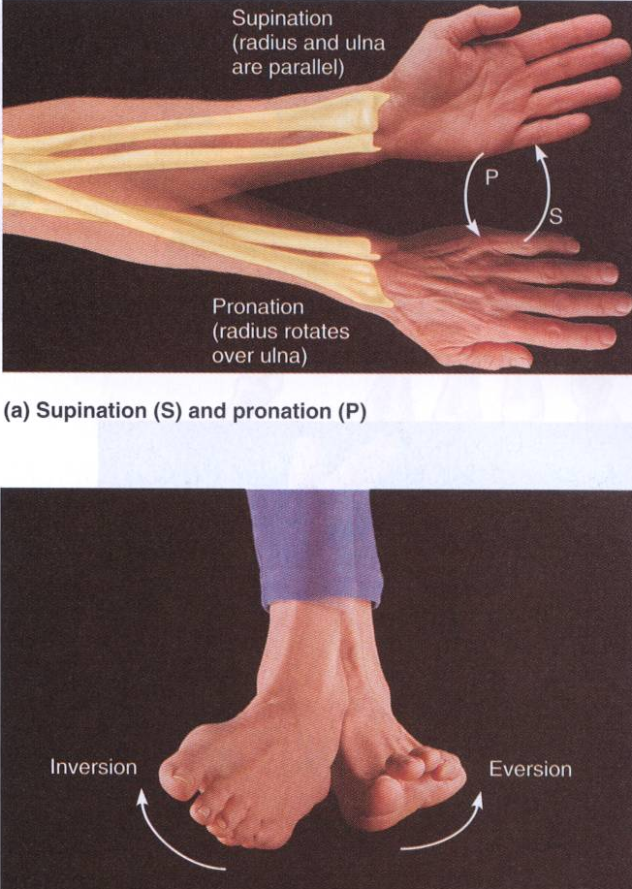
Angular movements
Rotations

Slide 10
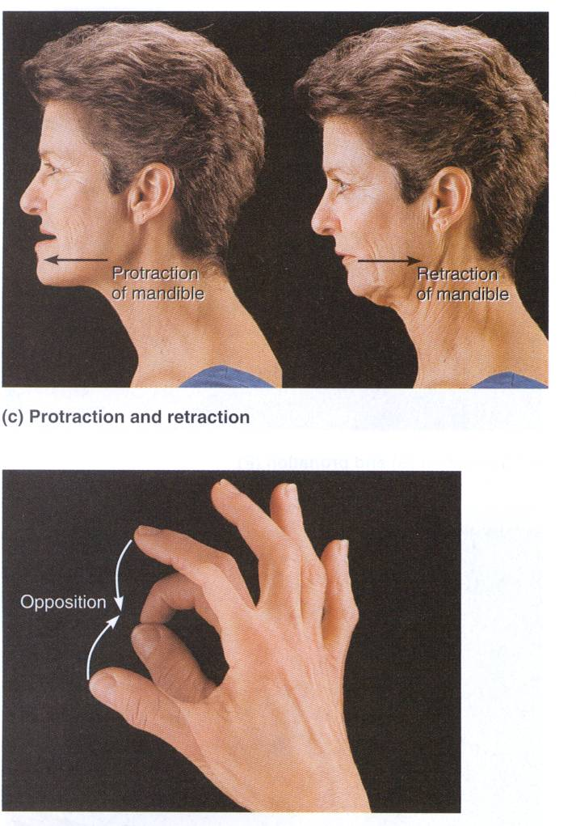
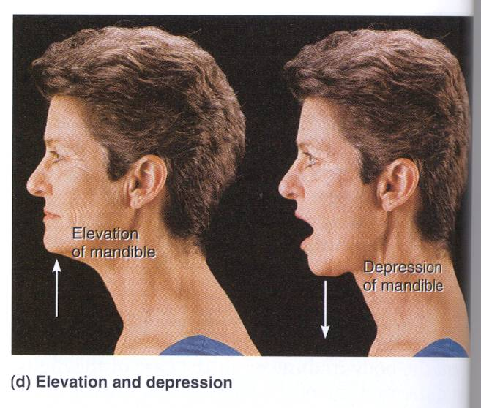
Special movements

Slide 11
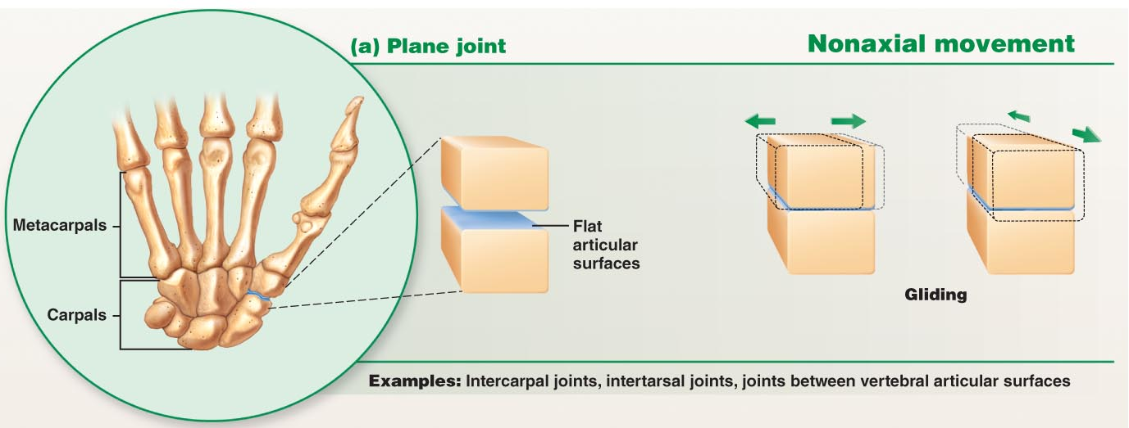
Shape of articulating surfaces determines types of movements permitted by these synovial joints
plane joint:
2 flat opposing surfaces
gliding
e.g. intercarpal joints
Fig. 8.7

Slide 12
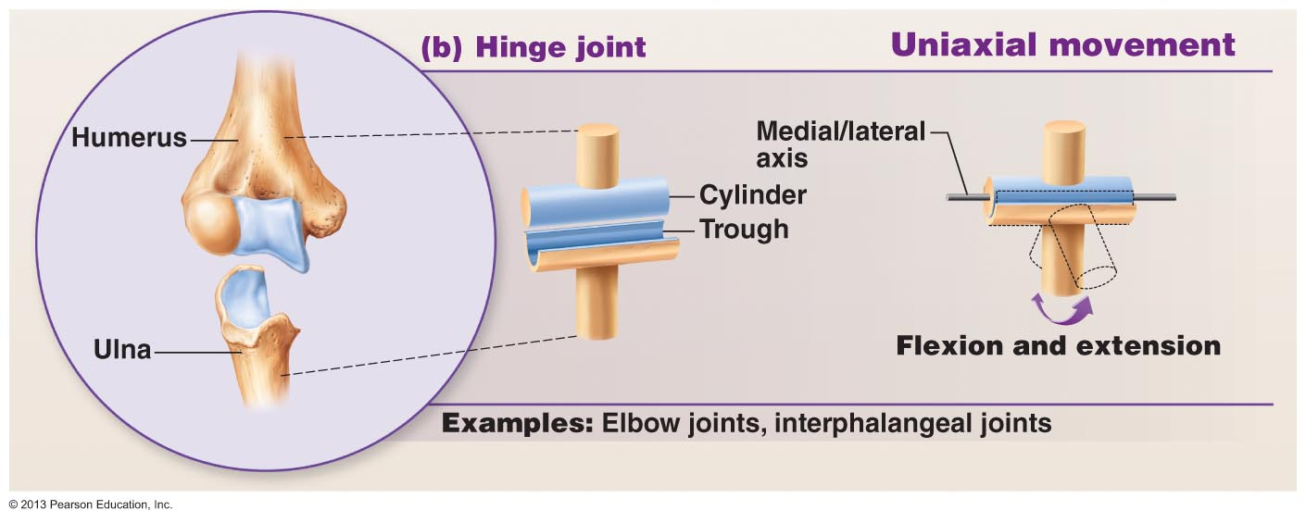
hinge joint: cylinder into trough – flexion/ extension e.g. elbow
Fig. 8.7 (cont)

Slide 13
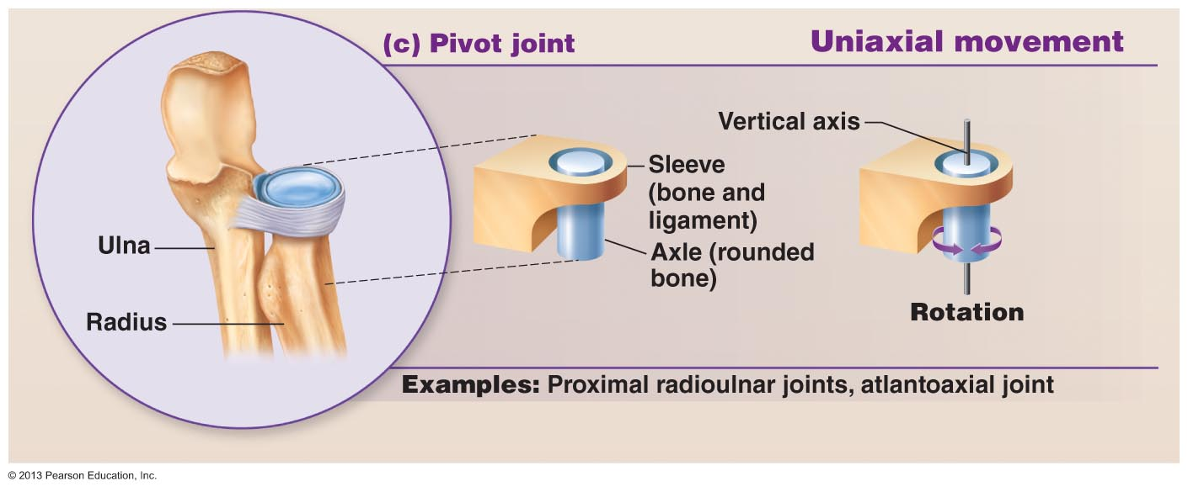
(3) pivot joint :
insertion into a ring or sleeve eg: between atlas & dens of axis
Fig. 8.7 (cont)

Slide 14
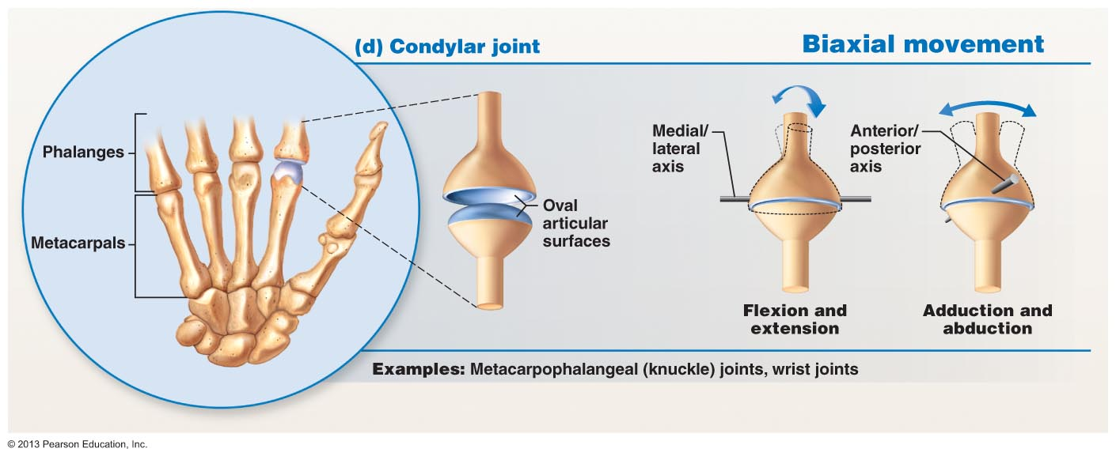
(4) condylar joint = “knuckle-like”- both articulating surfaces oval
all planes of motion
Fig. 8.7 (cont)

Slide 15
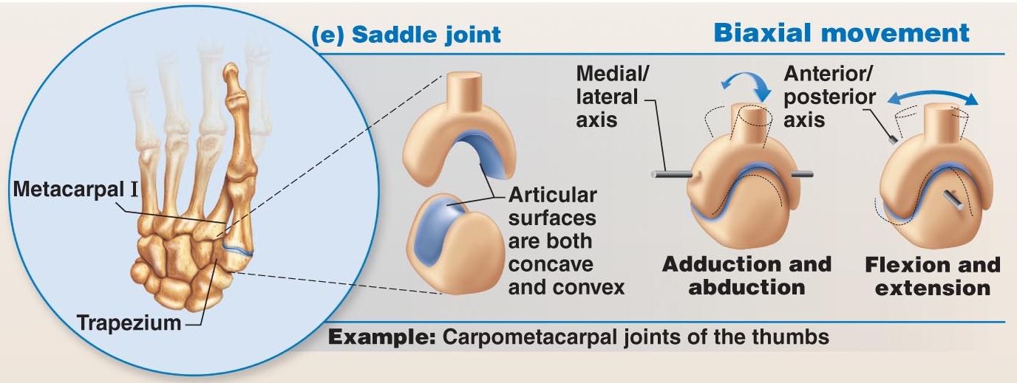
(5) Saddle joint – similar to condylar, but saddle shape permits even more freedom of movement
Fig. 8.7 (cont)

Slide 16
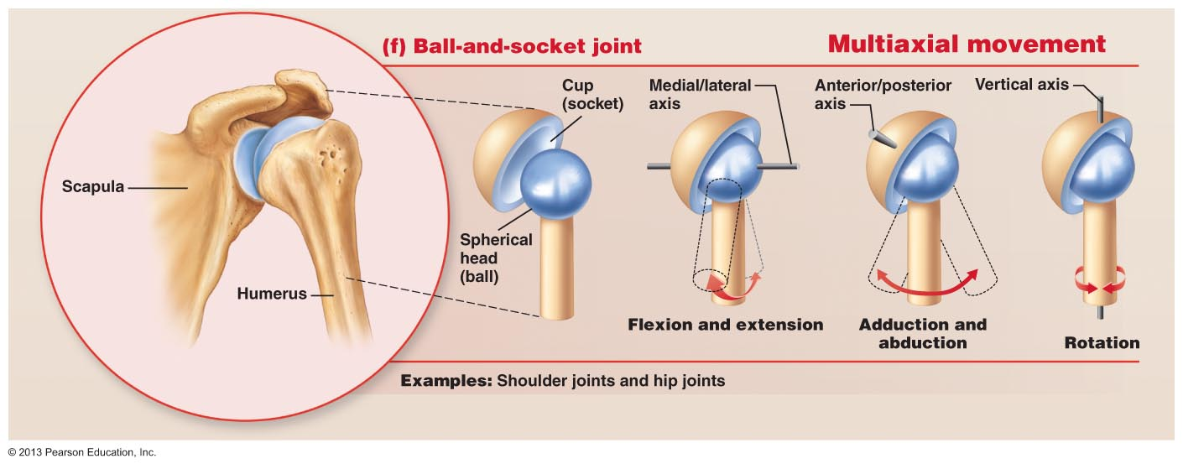
(6) Ball-and-socket joint

Slide 17
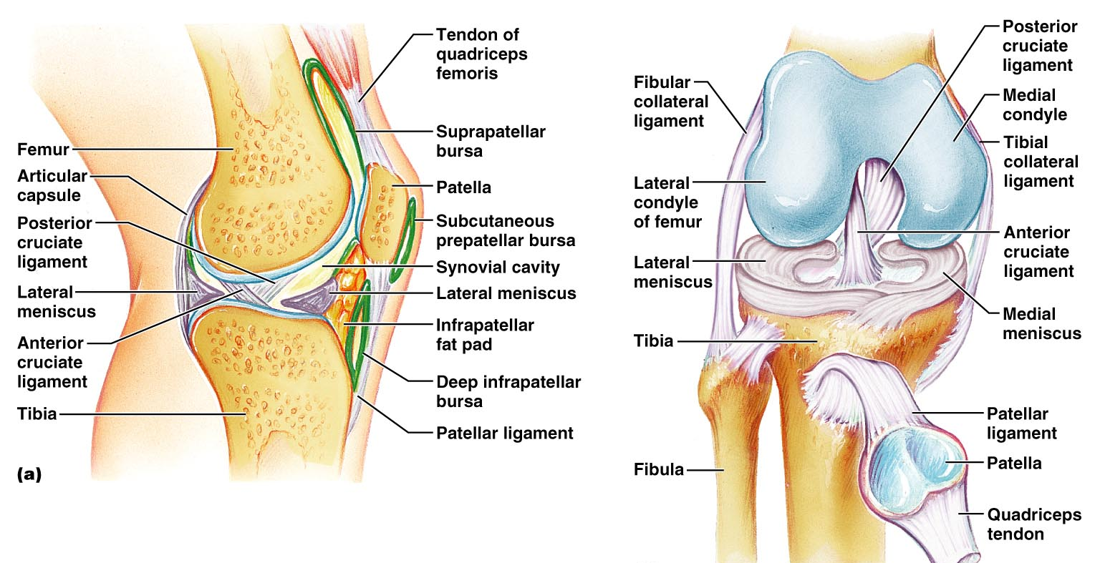
Knee joint
Lateral view
Knee joint – flexion extension and slight rotation
Three joints – femoropatellar, lateral tibiofemoral and medial tibiofemoral
Anteriorly the joint capsule is replaced by three broad ligaments that are continuous with the quadiceps tendon. There are two intracapsular ligaments (anterior and posterior cruciate), two menisci (medial and lateral, attached at the fibrous capsule) and two extracapsular ligaments (fibular collateral and tibial collateral). Note the subcutaneous prepatellar bursa (water on the knee).
Frontal view
Figure 8.8

Slide 18
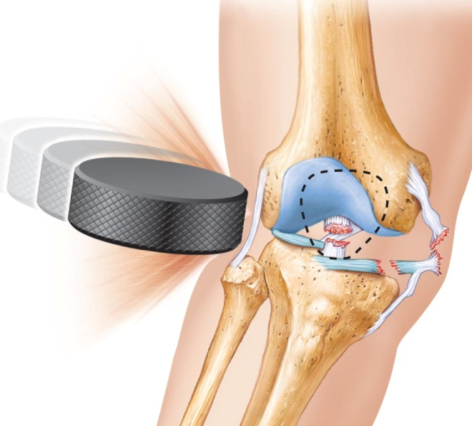
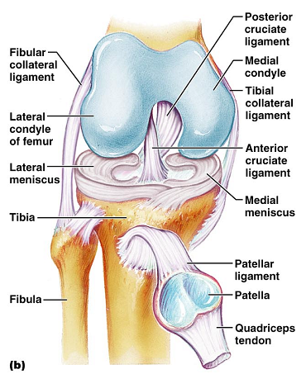
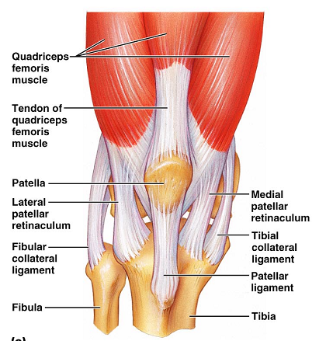
Tearing of: tibial collateral & anterior cruciate ligaments and medial meniscus
Knee joint
This slide is not to introduce new material, but to show the joint in context of muscle attachments – Note that the cruciate ligaments are covered by synovial membrane and therefore are outside the synovial cavity and that the knee locks by rotating medially.

Slide 19
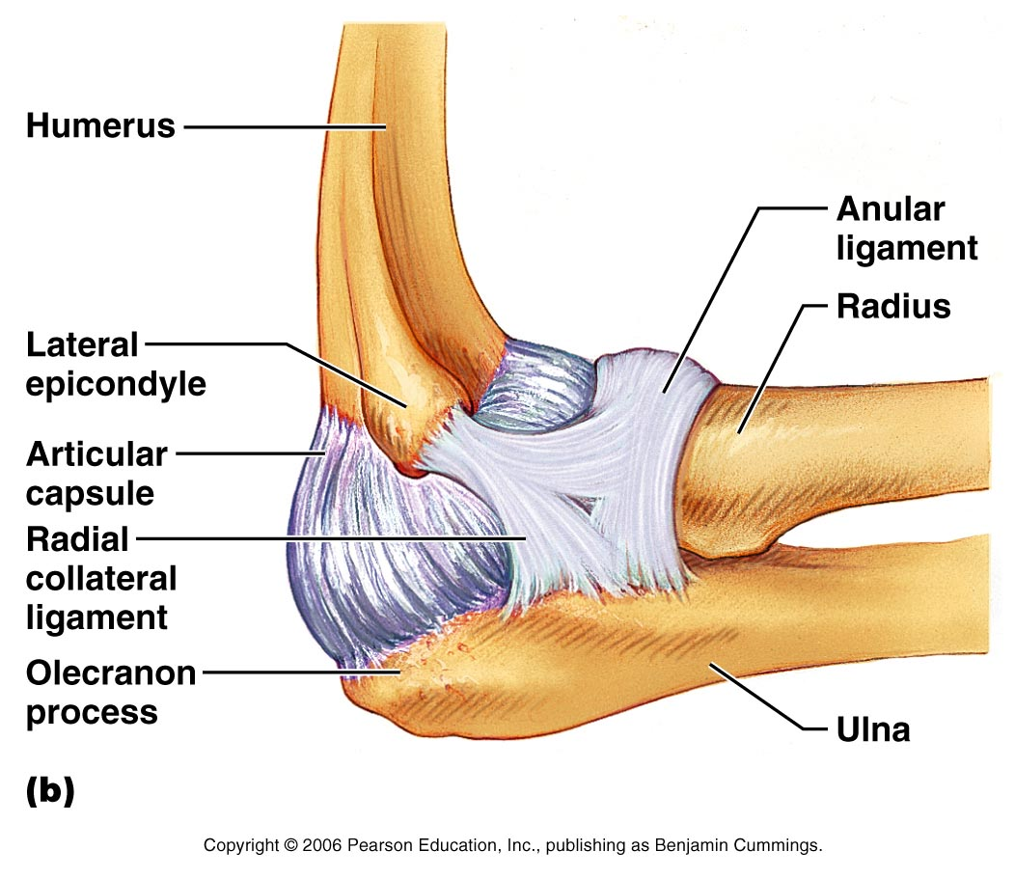
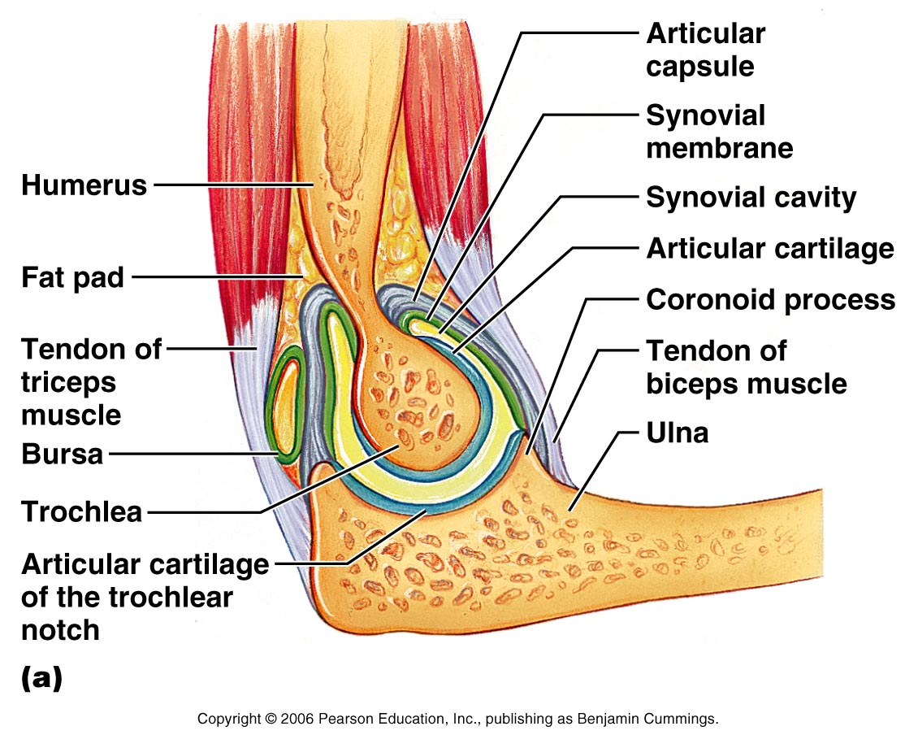
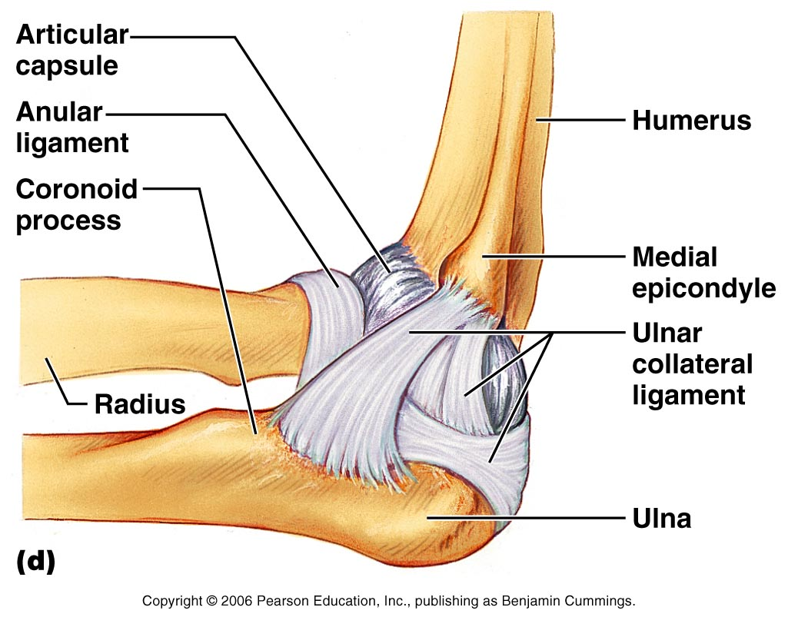
Elbow joint
Hinge joint: - largely through the articulation of the trochlea of the humerus with the trochlear notch on the ulna. The joint is stabilized by collateral ligaments and of note is the annular ligament allowing rotation of the radius during pronation and supination.
Figure 8.11a

Slide 20
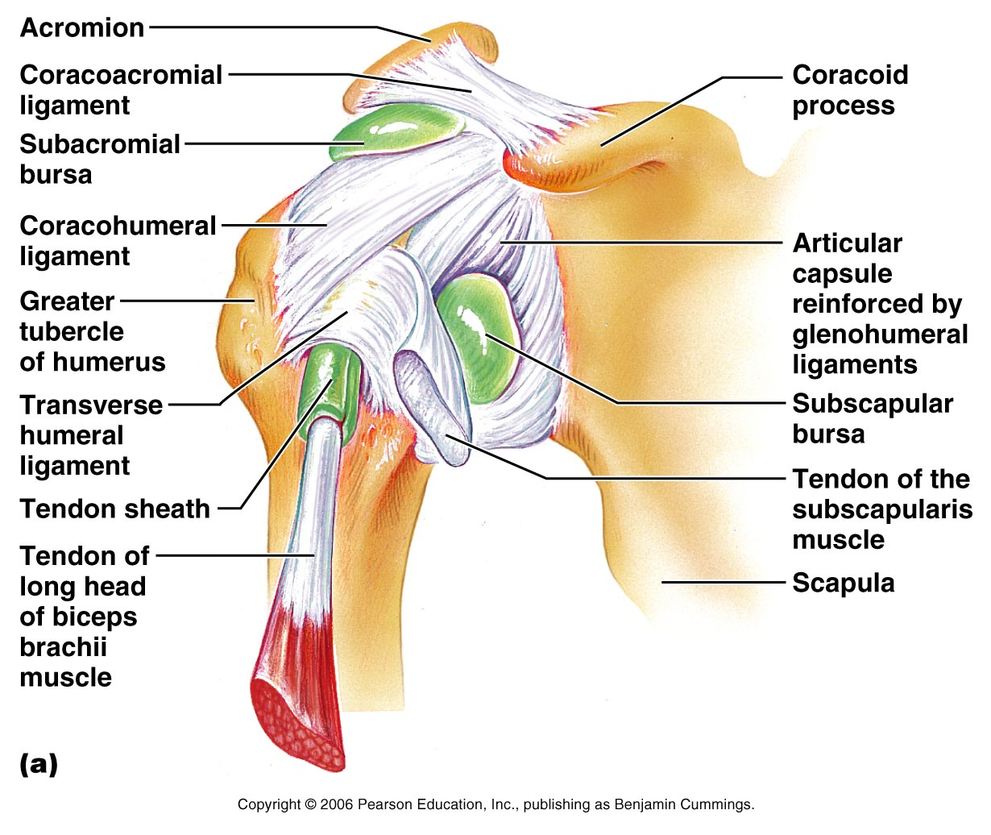
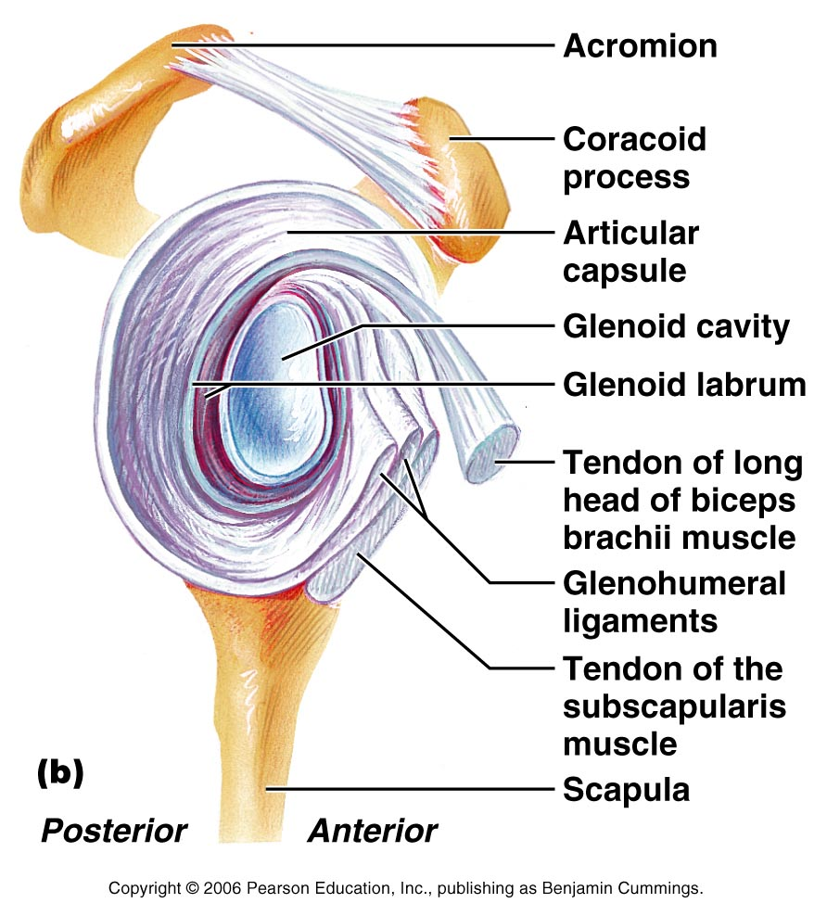
Shoulder joint
Figure 8.10
Glenohumoral joint – the glenoid cavity is broadened slightly by the glenoid labrum (fibrocartilagenous rim) but is still only 1/3rd the size of the head of the humerus. The only ligament of note is the coracohumeral. It is largely the tendons of the rotator cuff muscles that stabilize this joint.

Slide 21
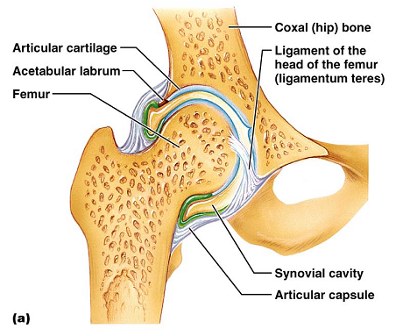
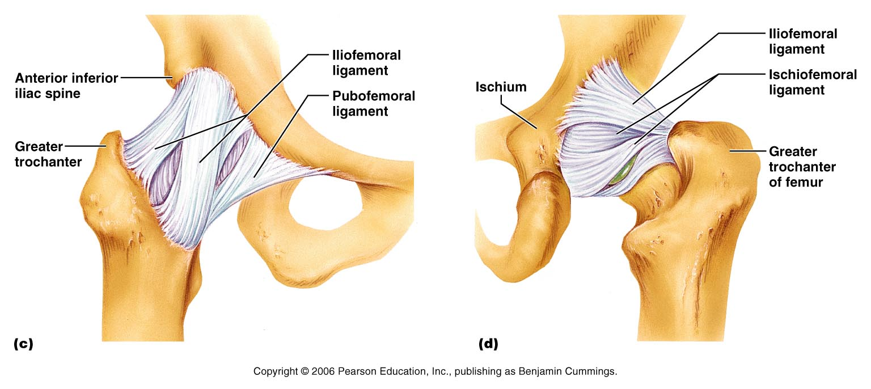
Hip joint A deep ball and socket joint. There is an intracapsular ligament (ligament of the head of the femur –ligamentum teres) but its function in humans is unclear – damage to its artery however may lead to arthritis of the hip joint.
Extracapsular ligaments to note are the iliofemoral, pubofemoral and ischiofomoral ligaments.
Figure 8.12

Slide 22
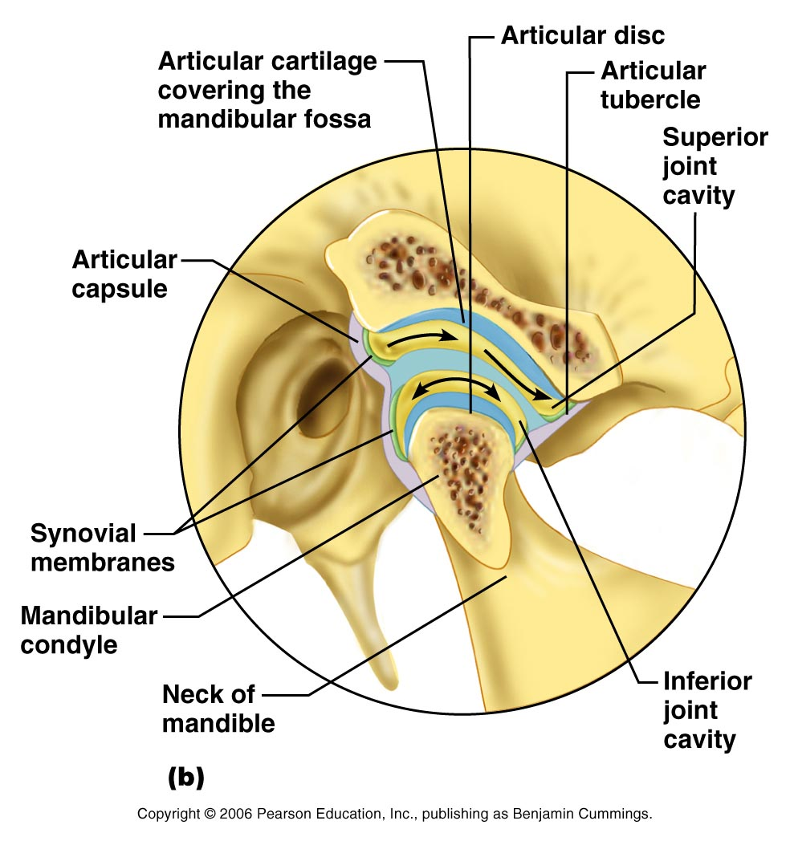
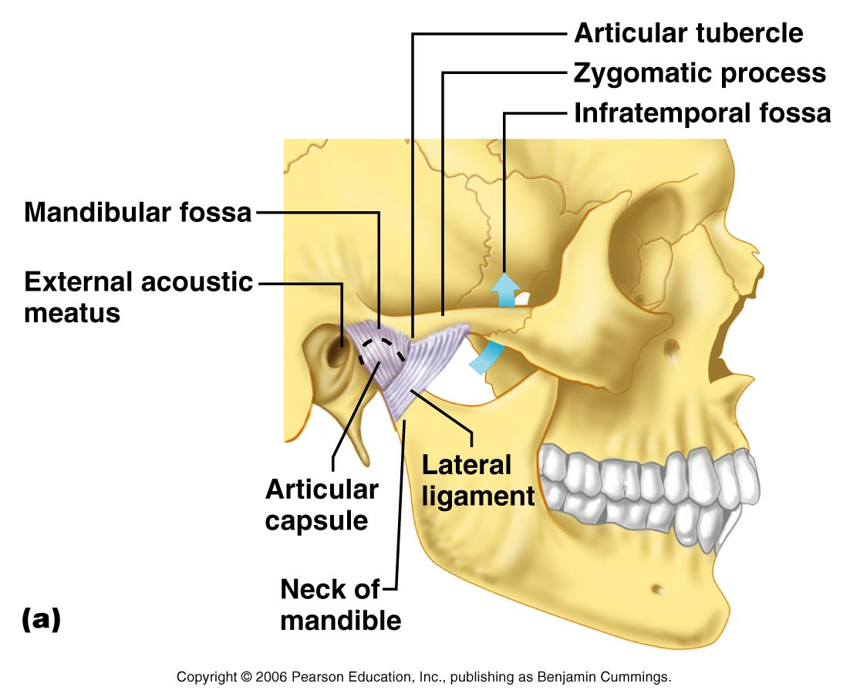
Temporomandibular joint
*
Articulation of the mandibular condyle with the mandibular fossa and the articular tubercle of the temporal bone. Stabilized by a lateral ligament. There is an articular disk * that divides the synovial cavity into superior and inferior compartments.
Initial jaw opening is hinged (mandibular condyle within the temporal fossa). There is gliding when the condyle articulates with the articular tubercle.
Figure 8.13

