Slide 1
Language acquisition II
LIN 1300 Study Notes

Slide 2
12 months- The naming insight
Children’s first utterances usually serve 3 purposes:
To get someone’s attention
To direct attention to an object or event
To get something they want
Children begin by naming the thing referred to. This is called the naming insight
Many of the remarks at this stage are single words, either the names of things or words such as there, look, want, more, allgone.
They are often referred to as operators because here (as opposed to their function in adult speech), they serve to convey the whole of the child’s meaning or intention.

Slide 3
4. 18 months- 2-word utterances
2 word utterances/ simple utterances
Ex. Daddy car= their father’s car
Children start speaking not fully for the purpose of drawing attention to themselves
Their lexicon contains about 50 words
Developments are measured by questionnaires given to the parents to observe in their children
Acquisition is slow, about 50 words learned in about 6 months
Common utterances include:
Making rudimentary statements, Ex. all gone milk
Making requests Ex. more milk
Relating objects to other things, places, people etc.
Ex. daddy car
In common with the one word stage, children typically concentrate on the present state of things – describing or relating things and events in their world.

Slide 4
5. 24 months- Multi word utterances
Function words missing; sequence of acquisition of grammatical morphemes is the same for all children
Contain content not function words.
Huge vocabulary spurt as well as emergence of morphemes.
Telegraphic style utterances
They will produce multiple word sentences
Can express fairly complex meaning by expressing statements in a few word sentences
Will leave out articles and morphemes, only uses very simple ways of expression
Lexical explosion- A period in which a child learns 4-10 new words a day
The lexicon grows quickly to 200-300 words
Multi word “telegraphic” utterances
Ex. He no bite you

Slide 5
6. 30 months- complex sentences
The grammar becomes more complex
Development of morphological system
Use of more complex syntactic structures
30 months- adult/ complex sentences
From 30 months onwards, will acquire the morphosyntactic system required of their first language
You don’t need to teach a child how to speak a first language, they pick it up if they are exposed to it
This is attributed to the guidance we receive from Universal Grammar

Slide 6
30 months+
Children often around 3 begin to use increasingly complex sentence structures, they also begin to make a range of requests , explain things and ask for explanations and question things
Because children are now able to use complex sentence structures, they have flexible language tools for conveying a wide range of meanings. Perhaps the most striking development is their grasp of language/ language competence and use/ language performance of abstract verbs
Children in this stage begin to express meaning indirectly replacing imperatives (give me) with questions (can I have) when these suit their purposes better.
Children use questions and negation easily
Children start to use (often implied) relative clauses, e.g. I want the pen (that) Mummy gave me.

Slide 7
5 years +
By around age 5 children frequently use language to do all the things they need it for:
Giving information
Asking and answering questions of various kinds
Requesting (directly and indirectly)
Suggesting
Offering
Stating intentions/asking about those of others
Expressing feelings and attitudes and asking about those of others.
In terms of meaning, children are now able to talk about things hypothetically or conditionally (if you do that, it’ll…) or explain the conditions required for something to happen (you’ve got to switch that on first…).
They start to make references to past and future – they talk about particular times (e.g. before bedtime).
They are able to estimate the nature of actions or events, e.g. that things are habitual, repetitive or just beginning.

Slide 8
Brown’s study
Brown’s study- the position of morphemes in English, recording children over a year and a half every few months to record their morphological developments
Discovered that all of his patients learned the same morphemes at the same time
The morphemes which can be acquired acoustically are the most easily learned
Ex. /Ing/

Slide 9
L2 acquisition
L2 acquisition is highly systematic
L2 learners go through developmental stages as the L1
Different L1-L2 combinations can be harder/easier, some stages faster
This is based on external factors ie. Language type

Slide 10
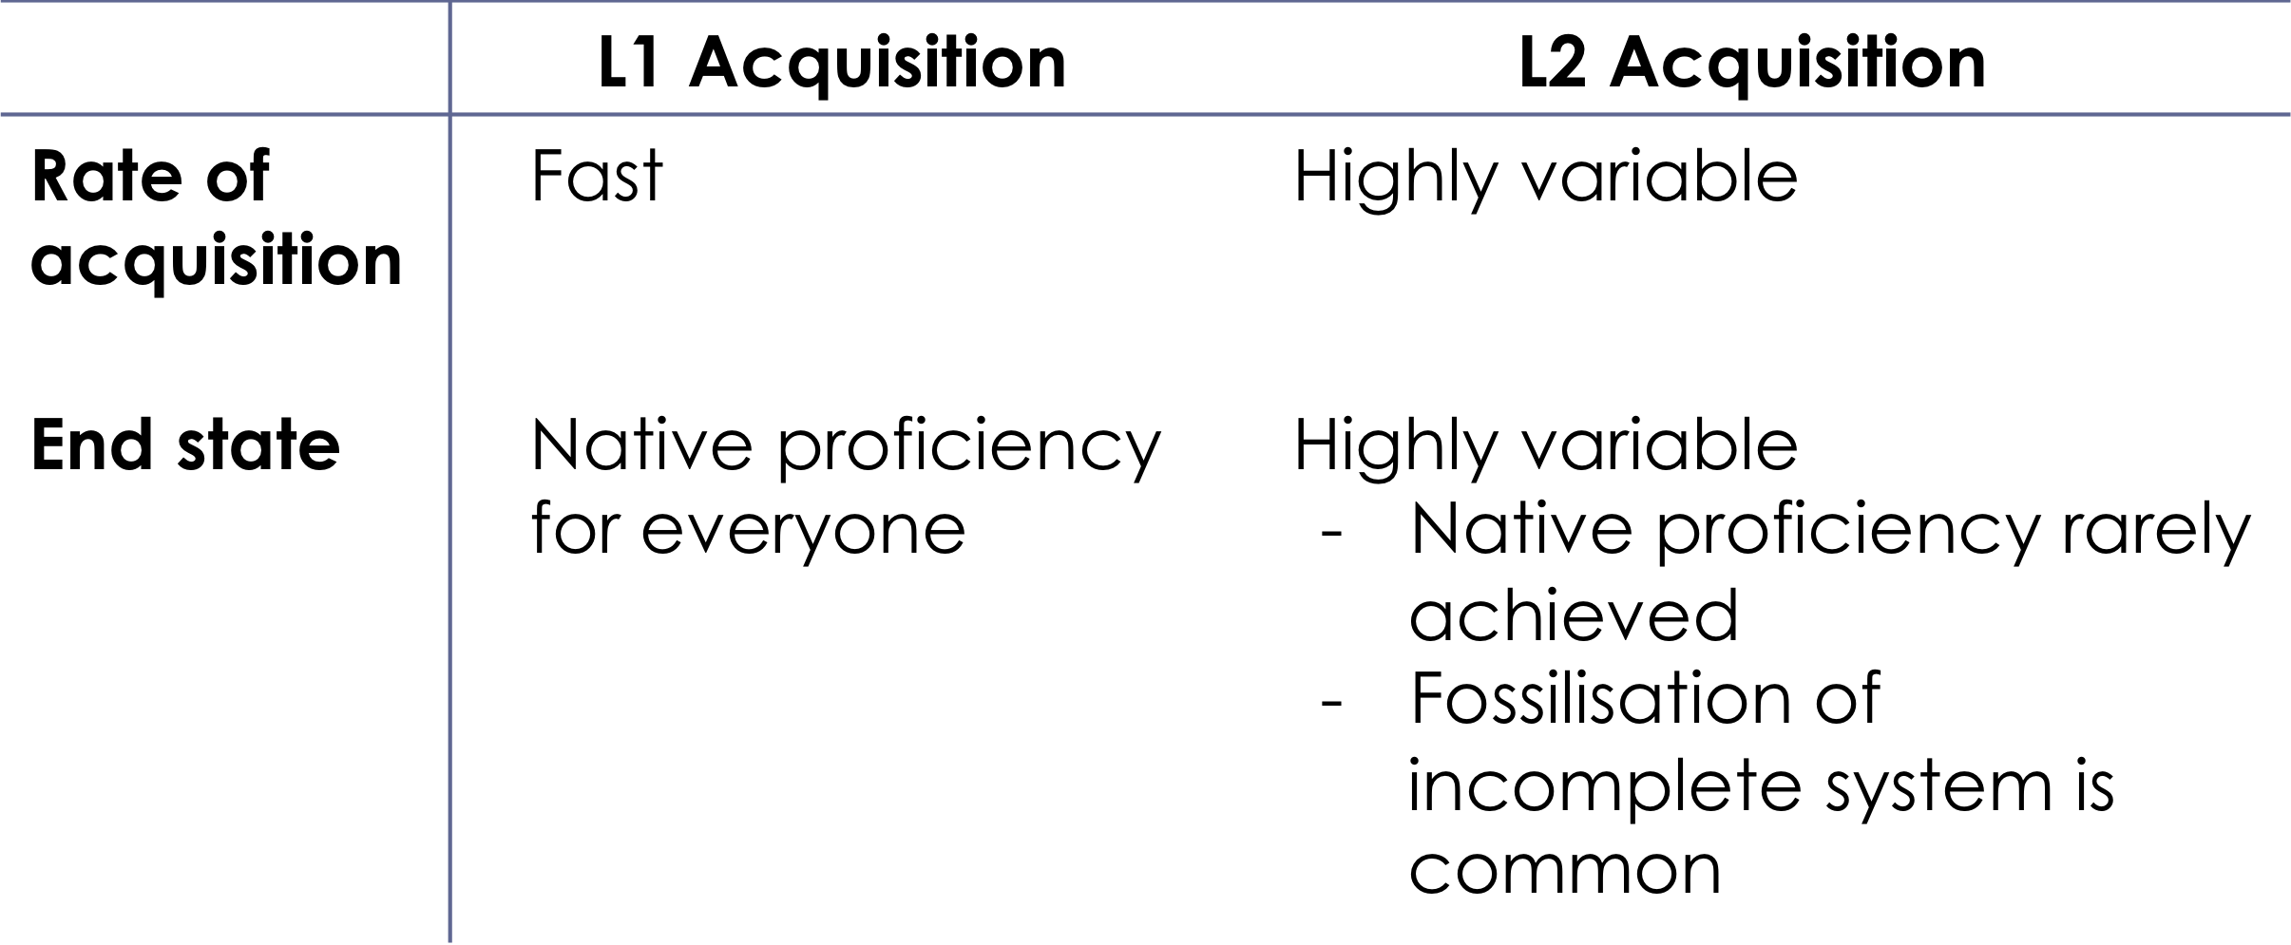
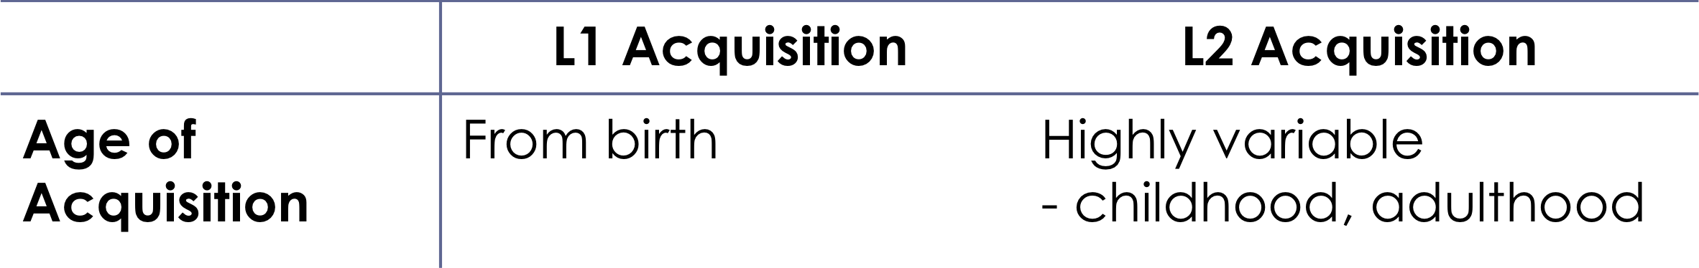
L1 vs. L2 acquisition differences
Rate vs. end state

Slide 11
Challenges with learning a second language:
Learning after the critical period
You always learn your second language in relation to what your first language is
Learn the second language though a “filter” of the first
First language acquisition is the fastest and easiest; by the time the child is 5 years old it can express itself very well in its first language
Rate/ end state

Slide 12
Metalanguage distinction- in a bilingual child, they can’t tell the distinction between which language is what; language is a means of communication for them only

Slide 13
Factors that cause differences in L1 and L2
  Cognitive development
  - Knowledge of the world
  - Reasoning
  - Metalinguistic awareness
  - Ability to treat language as an object
  It’s what makes it possible to pay attention to the form and structure of language (define the meaning of a word, talk about which sounds a word is made up of or about grammar rules)
  Context of acquisition
    Informal
      Acquisition by exposure to language, without explicit teaching
    Formal
      Acquisition with explicit teaching

Slide 14
Con’t
  Crosslinguistic influence
    The influence one language has on another
    E.g. L1 French + L2 English
    Phonology (pronunciation): “that” [dat]
    Phonology (perception) “hope” [op]
    Lexicon: “library” vs. “librairie”
    Morpho-syntax: “I go at the school” (je vais à l’école)
    Factors that influence L2 acquisition
    Linguistic factors
      Characteristics of languages (known and being learned)
    Extra-linguistic factors
      Characteristics of the learner
      Structure of the language being learned
      Similarity between languages

Slide 15
Starting point
  E.g.
  Acquisition of Japanese vs. German by a native speaker of English
    Japanese
      こんにちわ 私の名前は マリークロード です。
      (konnichiwa watashi wa mari-kulodo desu.)
      あなたは 日本語を 話せますか？
      (anata wa nihongo wo hanasemasu ka?)
    German
      Hallo. Mein Name ist Marie-Claude.
      Kannst du Deutsch sprechen?

Slide 16
Influence of the L1 on the L2
Correlation between the perceived level of crosslinguistic similarity and the amount of crosslinguistic influence
Influence can be positive or negative
  E.g.
  L1 English + L2 German
  vs.
  L1 English + L2 Japanese
    Greater similarity between English and German

Slide 17
Influence types
  Negative influence
      slow down the acquisition process
      often makes it impossible to acquire the language completely
  Positive influence
    Facilitates acquisition
      Acquisition is faster and requires less effort

Slide 18
L2 acquisition factors
Characteristics of the learners
  Motivation
  Aptitude
  Personality
  Age
  etc.

Slide 19
Motivation
No language is more difficult to learn as a first language, however this is different for languages later on
Motivation to learn a language can be intrinsic or extrinsic
Intrinsic or personal reasons vs. extrinsic or rewarded behavior
  Types of motivation
    Integrative (intrinsic)
      Based on affective factors
        E.g. personal reasons
        -Instrumental (extrinsic)
      Based on reward
        E.g. professional, monetary, etc.

Slide 20
Aptitude
Correlation between language aptitude and language ability
Extroverts with limited inhibitions are better usually at learning and expressing themselves through language (determined through personality tests etc.)
Study of alcohol consumption/ lowering inhibitions vs. performance
One drink helps you to speak better in your second language based on studies done
Language aptitude is undefined
Intelligence plays a large role in a formal context vs. some other factors that could be an influence in a less formal and natural setting
Aptitude for languages
Intelligence (in general; IQ)
Personality factors
  Degree of extraversion, level of anxiety
    Inhibition: prevents us from taking risks
        Important for L2 acquisition
        Study on alcohol consumption vs. performance in L2

Slide 21
Age
Correlation between your age and at what time you learn a second language
Critical period for language has some sort of influence on L2 acquisition
Related to phonology- some people can never fully lose their accent from their first language
A bird can’t sing natively after 7 weeks if it didn’t learn its song
With humans, language is more gradual

Slide 22
Critical period: the neurological hypothesis
Critical period is determined by the biological clock
Lasts until late into teenagehood
Cause: lateralization of language functions in the brain
Loss of plasticity after this time
Impact: language acquisition is more difficult after the critical period

Slide 23
Problems
  Age of the Critical Period
    Exact age is not known
    Effect of aging is gradual
  Several factors are affected by the onsets of aging
    Input, motivation, attitudes, identity, etc.
    * Trying to implement a new term, the “sensitive period” to express a time where language learning is easiest
    But this is not confirmed in any study yet

