Slide 1
Semantics
Models of Representation of Meaning
LIN 1300 Study Notes

Slide 2
Semantics → the scientific study of meaning
How we construct meaning is arbitrary
Meaning is different in each language
The two faces of meaning:
The language-specific or semantic face- reflects the structure of the language (is arbitrary)
The conceptual or encyclopedic face- informs us about the actual word and is independent from language

Slide 3
Defining Words
Ex. A dictionary uses words to define words
What is arbitrary however, is the choice of words
Dictionaries use other words to describe the meaning of words
Someone else that isn’t you chooses the words, which makes the meaning of those words arbitrary to them

Slide 4
Models of Representing Meaning
Semantic features
Prototypes

Slide 5
1. Semantic Features
Each feature has a plus or minus value
Ex. A dog = -human (not human)
A man= +human (is human)
Each word has a unique feature composition
No two words have exactly the same feature composition
Can be used to describe groups of words that are a part of a larger category
Groups of words that share a set of characteristics belong to a category
*The categories themselves are arbitrary
There are no limits to the amount of features a category can have while it tries to distinguish between 2 meanings
The method of semantic features allows us to easily group meanings together

Slide 6
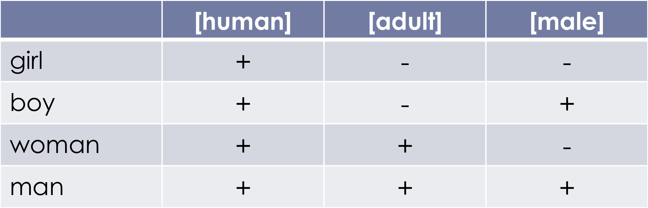
Model of Semantic Features

Slide 7
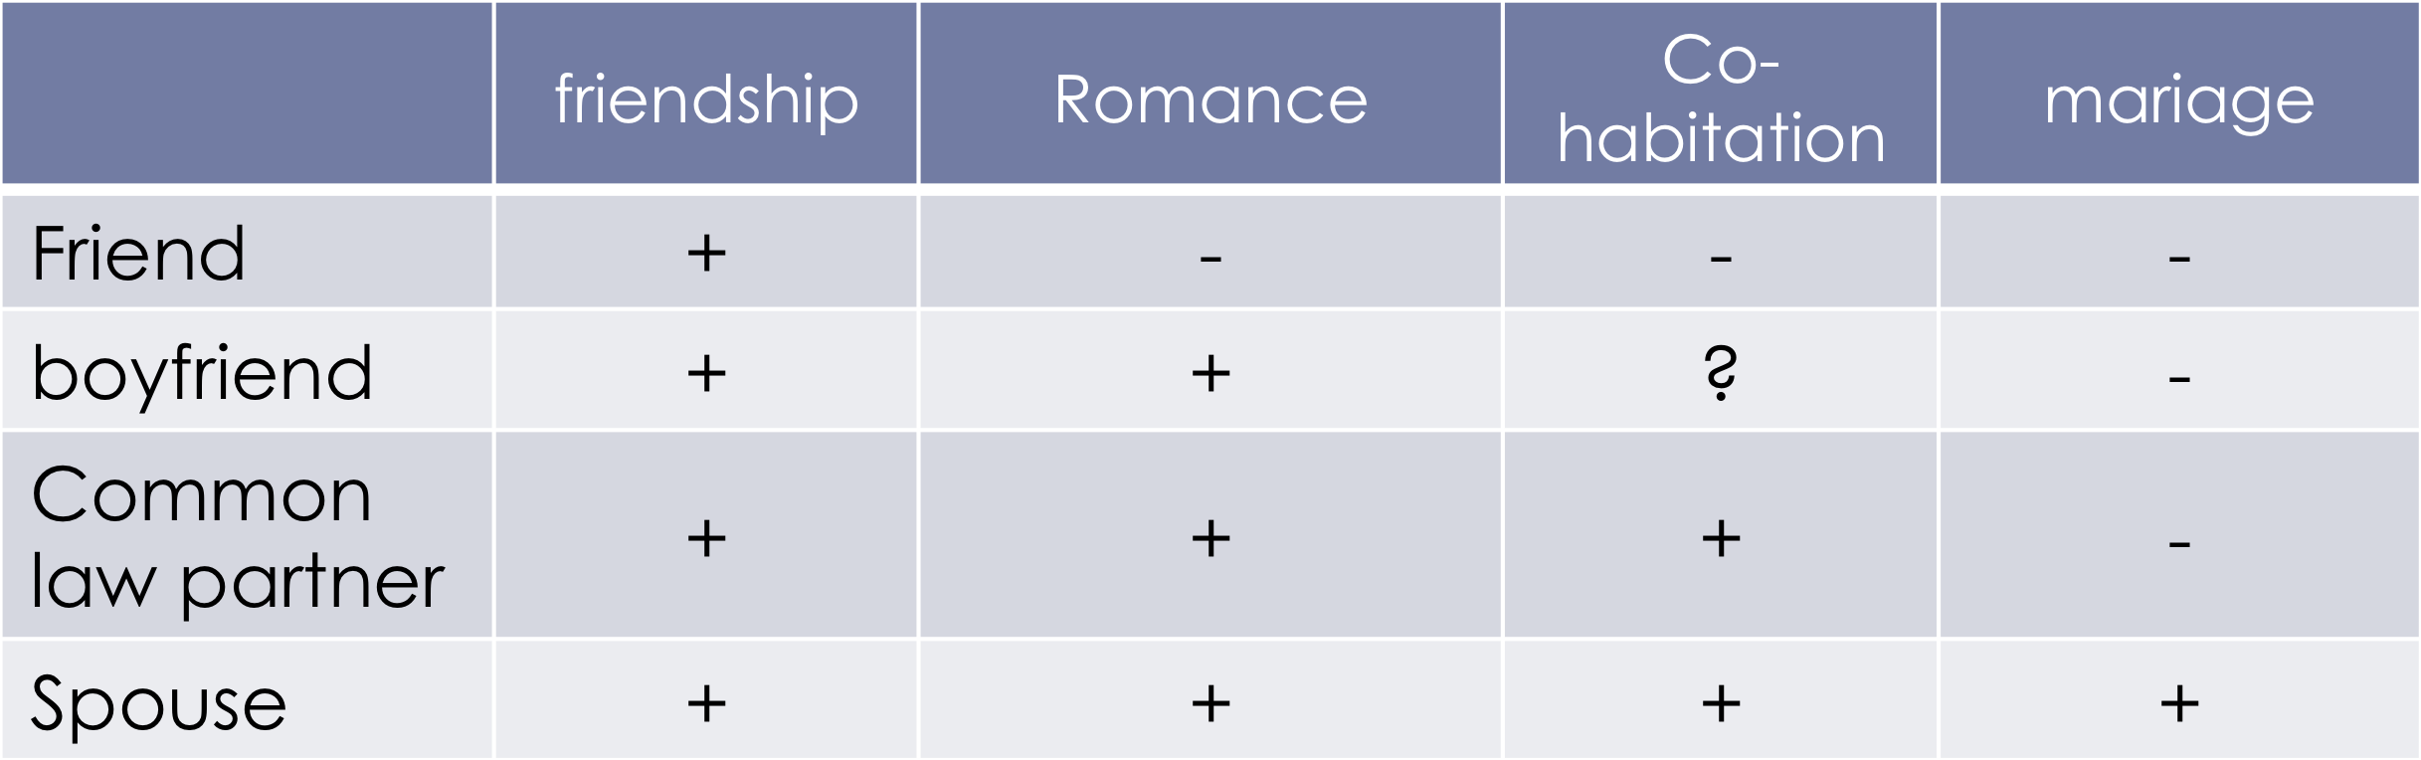
Negative Aspects of the Semantic Features Model
The intended meaning of words is not always black or white
The meaning of words isn’t always clear or obvious
Features can only have a positive or negative value
Ex.

Slide 8
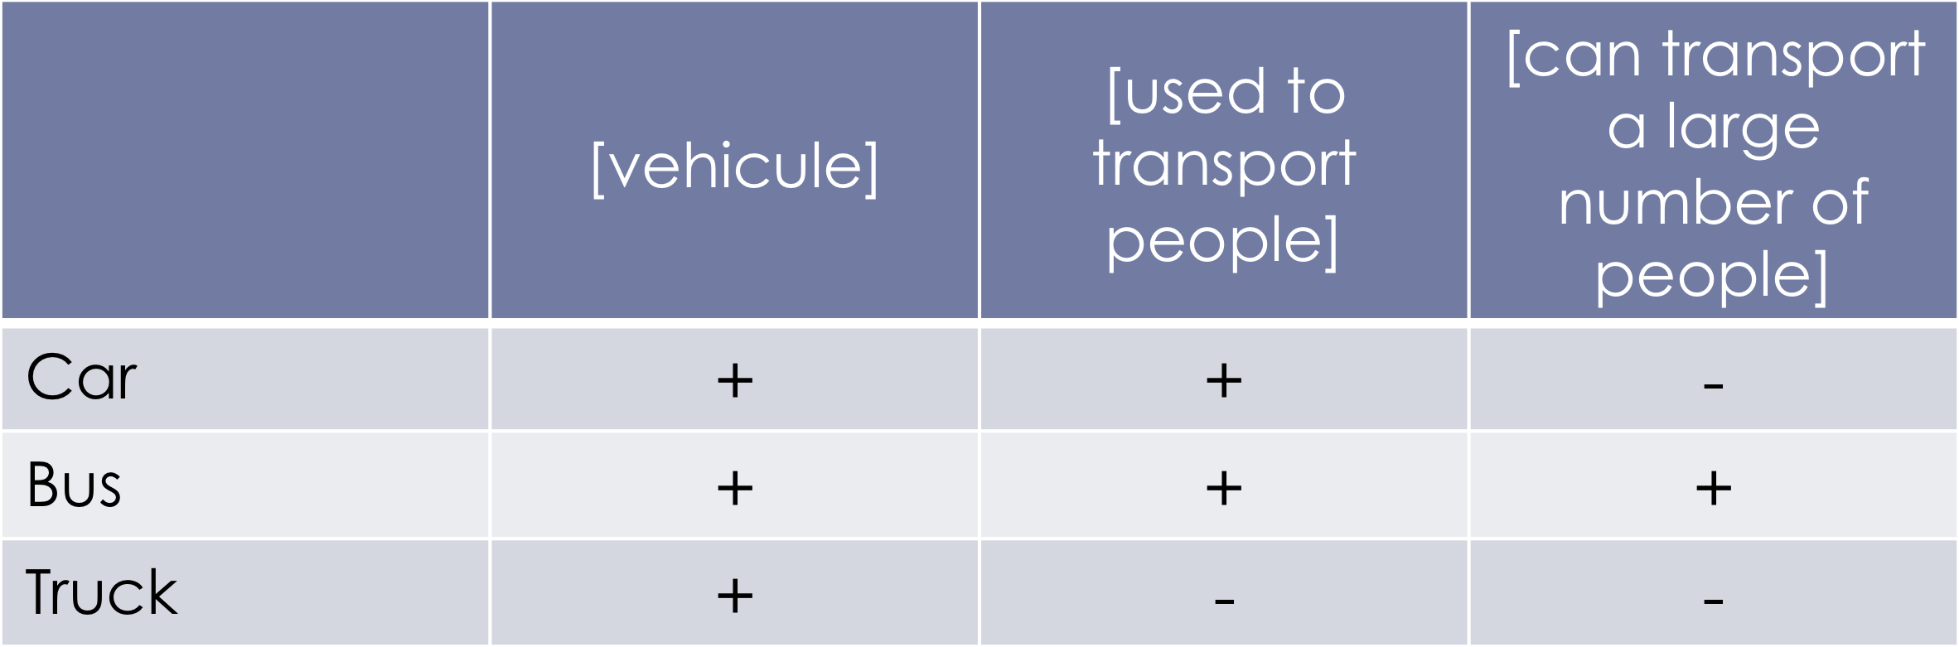
The description of words is arbitrary based on the choice of features judged as being relevant to the category
The feature table never contains the full set of characteristics of a word
Ex. Doesn’t take into account the size/weight

Slide 9
2. Prototypes
→ The meaning of words based on prototypes
We use prototypes to describe the meaning of words
The concept revolves around the fact that different things are perceived as being the best representative of its kind
Things are classified based on their prototype and their resemblance to the prototype of that thing
Ex. You base your idea of a stool/ chair based on what your personal idea of it is
Cultural variation occurs often; what means something in one language can mean something different in another language

Slide 10
Prototypes- cups and bowls
You would consider how all of them could be used as a cup or a bowl; how they could serve the same function
They may be able to all be used, but certain ones are the most typical of their kind and fit the description most accurately
Ex. Cup #3 is defined as the most typical of its kind
Characteristics: balanced height/width ratio, used to handle hot drinks, has a handle

