Slide 1
Historical Linguistics
Lin 1300 Study notes

Slide 2
The history of language is interested in studying how and why languages evolve
Sources of data- Written (using dead and modern languages); oral (using modern languages only)

Slide 3
Dead Languages
→ A language which is no longer used as a means of communication
Ex. Ancient Greek, Latin
About 30 000 languages that were born and then became extinct or unused
Possible causes for extinction:
Too small number of speakers
Military colonization and cultural imperialism
Political domination by other countries
Dead language studies are carried out through archived texts only, which can sometimes be hard to decipher or hard to track down over the passing of time
About 100 000 speakers are necessary to ensure the survival of a language, and only half of the world’s languages have that many speakers

Slide 4
Modern Languages
→ Any languages who have living native speakers practicing it
Studied from oral and written text
The purposes for studying modern languages for historical linguistics is to document existing endangered languages and to study changes in modern languages in hopes of understanding their evolution over time and their ongoing changes
Ex. English, French, Japanese etc.
About 6700 modern languages spoken throughout the world
Some are not extinct, but are however, endangered
Ex. Aboriginal languages in Canada, Africa, Australia etc.

Slide 5
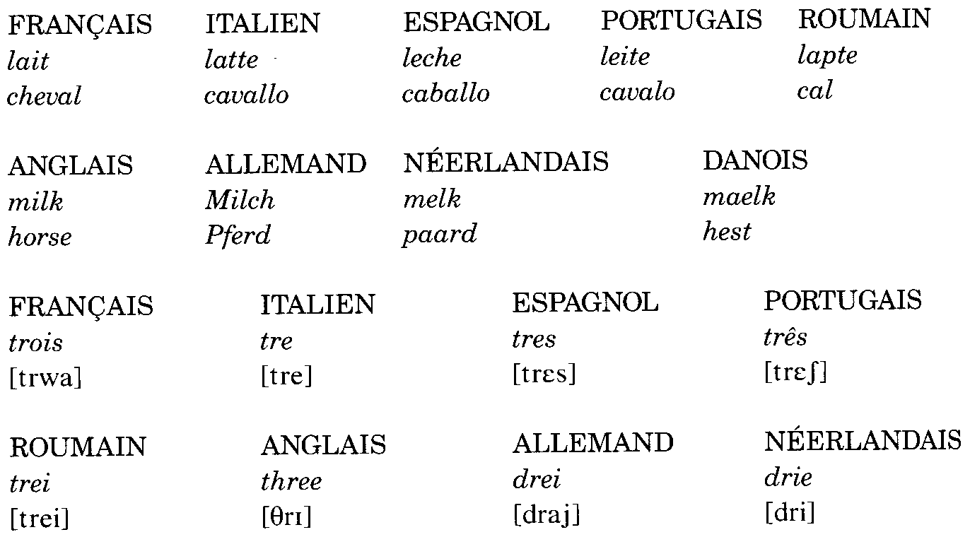
Comparative Linguistics
→ Compares languages in order to identify similarities
Contributes to historical linguistics
Can show the evolution of several languages from one common language, and demonstrate different language families

Slide 6
Language Fragmentation
→ When a language evolves differently in different regions, causing a new language or languages to be born
Can evolve from a parent language or an unattested parent language
Parent language
Ex. Latin as a parent language, gave “birth” to languages such as Italian, Spanish, French, Portuguese and others
*Latin was isolated in several regions, and evolved differently in each of these regions, creating languages which while similar in ways were vastly diverse
Unattested parent language
The similarities within the languages “birthed” by the unattested common language suggest a common origin, this being the parent language itself
Ex. With common Slavic as an unattested parent language, gave “birth” to languages such as Polish, Czech, Russian and others

Slide 7
Language Reconstruction
→ The reconstruction of a language based on comparative analysis of languages where a genetic relationship has been established
Aspects of comparative analyses: phonetic, morphological, syntactical, semantic

Slide 8
Proto- Language
→ Hypothetical language that has been reconstructed thanks to comparative analyses, and is believed to be the ancestor of other languages
Ex. Common Slavic, common Germanic, Indo-European
Identifies similarities in word forms; words with the same meaning
Ex.
Father
Latin- Pater
Greek- Pater
English- Father
Shows similarities/ evolution and possibly a common origin

Slide 9
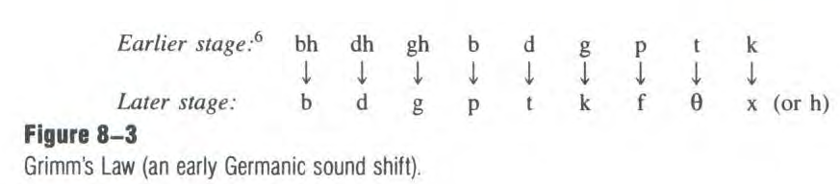
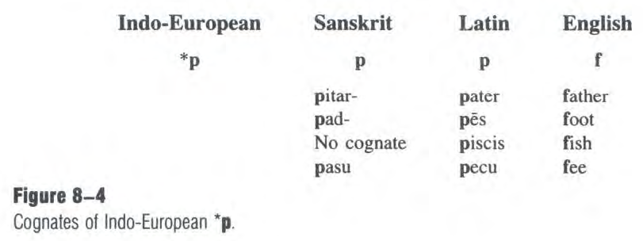
Laws of evolution
→Rules that explain language change over time
Ex. “Father”, Indo-European (proto language) explained through the law of evolution, Grimm’s law

Slide 10
Reconstructing Social Institutions
Historical linguistics allows us to hypothesize the existence, period of time and geographic location of ancient populations of which we have no real evidence
Hypotheses on the period of time at which a population existed based on similar words in other languages from the same language family
    Ex. « copper »: similar form in Indo-European languages
    Hypothesis: Indo-Europeans existed at least until the beginning of the Metal Age (around 3000 BC)
    « bronze » and « iron »: different forms
    Hypothesis: Indo-Europeans had started to migrate to different places before cooper and bronze were distinguished (around 000 BC)
Hypotheses on geographic location based on vocabulary
E.g. Indo-Europeans
    Words: beech, birch, salmon, etc.
    Hypotheses: probably area near southern of Russia

Slide 11
Exercise
Look at the words below and suggest reconstruction rules which could explain the consonantal changes which are underlined based on the word in the parent language.
Parent language: Latin word: caballus
French Italian Spanish Portuguese
cheval cavallo caballo cavalo
  The rules should be generalisations
  Use phonetic terminology to formulate the rules
    E.g. The voiced alveolar stop bacome a ...

