Slide 1
Psycholinguistics
Lin 1300 Study Notes

Slide 2
→ the psychology of language
The study of the psychological and neurobiological factors that enable humans to acquire, use and understand language
Methods- Behavioral and neurophysiological studies
How people behave linguistically based on how they acquired their language
How the language functions in the brain relate to how we use language
How language is activated
Levels of linguistic analysis
Ex. Phonology, lexicon/ how we structure meaning, morphological information stored in the brain, syntax/ how the brain analysis syntactic information

Slide 3
How the mental lexicon is structured
Phonology
Orthography- same strain of letters, whether or not they have links
Semantics- relationships
Morphology- are words that contain the same morphemes linked in the lexicon
Studies the pattern of word activation

Slide 4
Priming with lexical decision task
Behavioral method to test relationships- Priming technique
Whether or not a word can prime the activation of another word that share characteristics
Combined with a lexical decision task
Present word (prime) which is the source of activation for other words
Lexical decision task- ask the participant to identify if the target word is a word or not
Use real and non-words
Ex. <apple> activates <fruit>
Which equals a faster reaction time to the word fruit, so we say the word apple primes the word fruit, and is a lexical relationship
Masked priming- 50 ms
The prime is presented for such a short period of time that most people aren’t aware of seeing it
Encourages automatic lexical processes with the lexical decision task

Slide 5
Test method using regular priming
A word is presented → Prime
Another word is presented → Target
The patient is instructed to indicate whether or not the “target” word is a word or not
Ex. Chair/ fruit
Apple/ fruit
Fruit = target word
Result- the reaction time is slower when the word chair is the prime, and faster when the word apple is the prime due to the fact that most people know the words apple and fruit are more correlated than the words apple and chair

Slide 6
Types of priming
Priming (regular)
  The prime is presented long enough to be consciously perceived
    E.g. 200-250 ms
  Controlled lexical processing occurs in the patient
Masked Priming
  The prime is presented for such a short period of time that most people are not aware of seeing it
    E.g. 50 ms
  Automatic lexical processing occurs in the patient

Slide 7
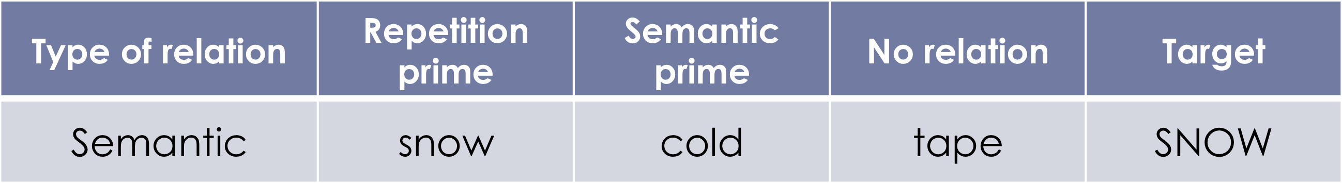
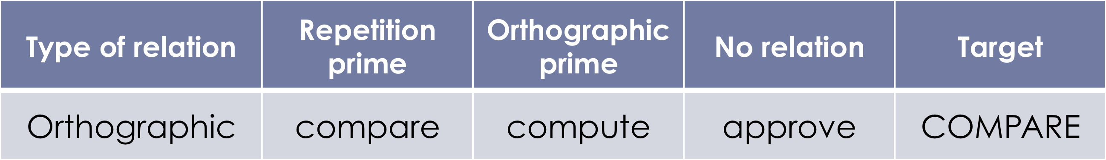
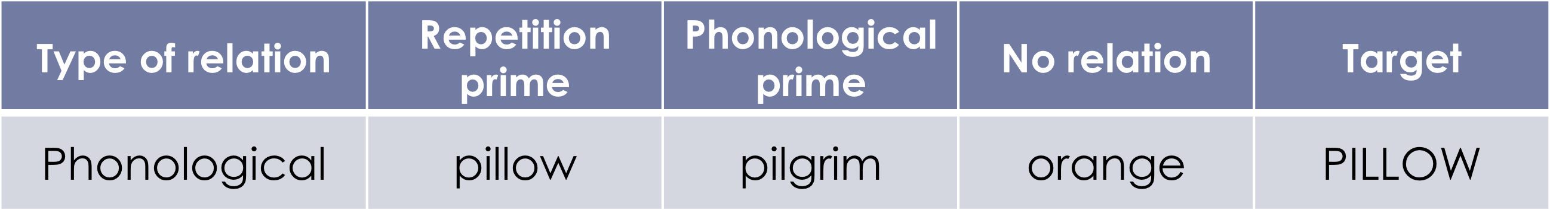
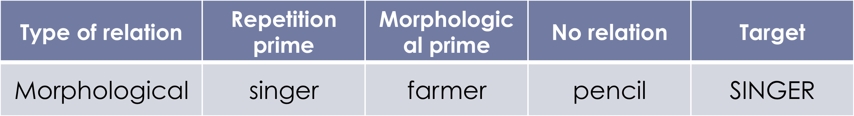
Priming can be used to test various types of relationships between words

Slide 8
Type of association – potential relations between words
Semantic- word meaning
Orthographic- number of letters, purely in the presentation, ex. presenting compute with compare
Phonological- without going into orthographical presentation, ie. Pillow and pilgrim
Morphological- words that contain the same morpheme, primes the activation of a word of the same morpheme ie. Singer, farmer

Slide 9

Priming and the bilingual lexicon
Practices cross linguistic priming
Structure of the lexicons; are the lexicons in both languages being compared
Separated (1 lexicon for each language)
Integrated (1 big lexicon for both of the languages)
Fish Poisson
Fish
Poisson

Slide 10
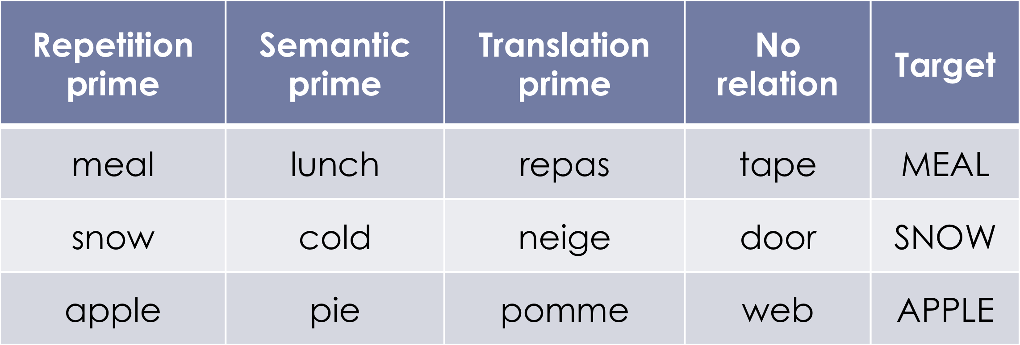
Example- French/ English
Bilingual priming- more effective with a non-masked controlled priming
Unidirectional- when we hear words in our 1st language, it activates words in our second language
Simultaneous bilingual- a person who learns 2 languages at birth
Conclusion- the L1 and L2 lexicon seem to be integrated for some bilinguals

Slide 11
Speech Perception
A huge impact in the field of second language acquisition
How we perceive sound in the second language
Critical period for language acquisition
The phonology of our 1st language has an effect on the other languages we know
1st language acts as a “filter”, we hear thru the sounds we already know
Ex. Different phonological system for each language
Does not have the potential of distinguishing meaning
Ex. [y] vs. [u]
Phonemic contrast in French
NO phonemic contrast in English
Tries to compare to other sounds in its language (English) and use the closet sound available
Sounds that are actually produced vs. sounds we think we heard
Heard though the L1 phonemic filter
Sound perception in the 2nd language (L2) are perceived in effect to the sound categories that already exist in the L1

Slide 12
Behavioral methods test- Ax discrimination task
AX= a pair of sounds
Used to determine- does the patient discriminate between sound A and X?
Presented over and over again in pairs
EX. Ny- Nu/ Ny- Ny/ Nu-Ny/ Nu- Nu
Patient is to indicate whether or not the pairs are the same sound or different
Identify accuracy rates of patients

Slide 13
Identification test
2 sounds that you want to test are played at random
Ex. Nu Nu Ny Nu Ny Ny Nu
The patient is to identify sound pairs
Used to determine the patient accuracy at determining sounds

Slide 14
Behavioral methods- negative aspects
Correlation between accuracy rates and the ability to perceive sound difference is important
Weaknesses- influenced by personal performance of patience, intrinsic motivation for money etc.
Not paying attention to stimulus (15-20 minute blocks)

Slide 15
Neurophysiological methods
Electroencephalography (EEG)
Used also in neurology
Measures brain activity by measuring electricity; measures the electricity at the surface of the scalp with electrodes
Used in linguistics to identify patterns of activation
Measure the output of electricity from the brain
Electrodes are placed on the scalp to pick up electricity
  Event-related potentials (ERP); presentation of a linguistic stimulus
    Potential = electricity
    Event-related = related to the stimuli

Slide 16
Information provided is by voltage and can be positive or negative
  Timing
    precision in milliseconds
    Very high level of temporal resolution
      Compared to brain imaging techniques
  Localisation
    On the scalp only
    Not in the brain of the patient

