Slide 1
Language and Society
Lin 1300 Study notes

Slide 2
The way we speak says a lot about who we are as a person
We can determine many things about a person by listening to the way they talk
Sociolinguistics →the study of the relationship between language and social factors related to the speaker and the context; and the study of language variation in relation to social factors
Language varies from one person to the other based on their background
Linguists don’t judge variation, they only observe and describe it
One way of speaking a language is not intrinsically better than others

Slide 3
Types of variation
Language variation can be related to several factors
  Region
  Socio-economic factors
    Social class, education
  Sex
  Age
  Context
    Degree of formality determined by the context, relationship between the speakers, topic, etc.

Slide 4
Language variation at various general levels
  Pronunciation ask [ ask ] vs. [ aks ]
  Lexicon truck (American English) vs. lorry (British English)
  running shoes vs. sneakers
  chesterfield vs. sofa
  Grammar (syntax and morphology)
    I’m not going vs. I ain’t going
    I say vs. I says

Slide 5
More variation
In an individual
  idiolect:
    Variety of a language as it is spoken by an individual; Idiolect: own personal dialect, “parole”, (idiolect is the parole of an individual)
In a group of individuals
  Similarity in the speech of members of the same speech community
  Differences in the speech of members of different speech communities

Slide 6
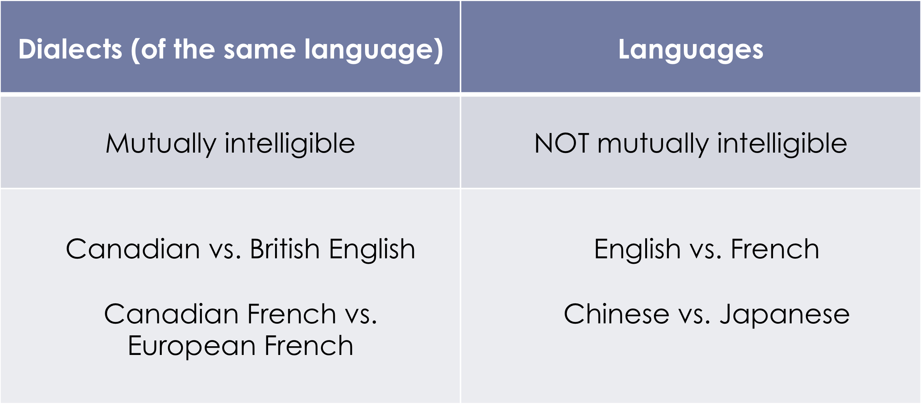
Dialectal variation
Variation related to region
Dialect- a regional variety of a language
Ie. American English vs. British English

Slide 7
Dialect vs. language
Sometimes geopolitical factors determine the status of languages and dialects
    Some dialects are not mutually intelligible
      E.g. Chinese (Cantonese vs. Mandarin)
      They are dialects of the same language, but are NOT the same language
    Some languages are mutually intelligible
      E.g. Scandinavian languages (Norwegian, Danish, Swedish)
Dialect- mutually intelligible, to qualify to be a dialect it must correlate with dialects of the same language and be generally understood
Language- cannot (generally) be mutually understood by other languages

Slide 8
Stylistic variation
→ Variation related to the register
Register- a variety of language which is associated with specific contexts
Divided according to the degree of contextual formality
    Formal
      E.g. Political speech, church, university
    Informal
      E.g. conversations with friends, family member

Slide 9
Socialectal variation
→ Variation related to social factors
Sociolect – a variety of language associated with a particular social group
Socio-economic status
We can identify the socio economic status of an individual by the way they speak
Ie. Truck driver vs. university professor
Accommodation of speech depending on context
Sex
Gender does influence the way we speak
Ie. Female vs. male speech, more precise articulation, fewer slang forms, fewer swear words, more expressive intonation vs. male language being more monotone
Studies have shown that women speak less than men and interrupt left
Conclusion: REMOVE STEROTYPES
Age

Slide 10
Diglossia
Diglossia (for a whole speech community)- high and low variety
High- more prestigious status, used in formal situations, society has a more positive attitude towards high diglossia
Low- less prestigious status/ people see it as having less prestige, used almost always in informal situations
2 different “dialects” in a way
Ie. Arabic- Classic Arabic (high) vs. dialectal Arabic (low)
Modern Greek- used in written text (high) vs. common Greek
Haiti- French (high) vs. Haitian Creole (low)

Slide 11
Acquisition
Low- L1 acquired at home
High- L2 acquired later in a formal context
Implications
For people who do not speak the high variety at home and don’t have a social advantage from speaking at home, education is the key to success

Slide 12
Diglossia without hierarchy
Ie. Standard German and Swiss German in the German speaking areas of Switzerland
Swiss- People will learn Swiss German at home and then when going to school will learn the standard form
This is similar to British/ American English
Requires a certain level of bilingualism
Code switching- when an individual switches between 2 languages/ codes while speaking

Slide 13
Pidgins and Creoles
Have their origins in language context situations
Language context that results in the formation of a new language
Origins in colonization and slavery
Language developed in order to allow communication between colonizers/ traders and natives/ slaves
Lexifying language
Language of colonizers, modern creoles have a base in these languages ie. England, Portugal, Dutch

Slide 14
Pidgin vs. creole
Pidgin- Invented by people because they could not communicate together, simple structure, limited social functions and will only be used in informal situations, no native speakers
Creole- when a pidgin becomes the native language of some individuals, structure of language becomes more complex and similar to other languages, considered not pure or evolved, has native speakers, fusion of two languages/ born because 2 languages came into contact
127 creoles or pidgins worldwide
Rarely have an official status, low rate of diglossia
Exceptions- Haitian creole, Seychelles creole
Lexifying languages are from colonizing countries

Slide 15
Caribbean creoles
Ie. Jamaican, Trinidad, Guyanese, Haitian
European language+ language from West Africa
Ie. Jamaican creole – English based creole, expresses tense mainly by pre verb particles, takes a lot of English words

