Slide 1
Chapter 4

Slide 2
Morphology
Languages combine “elements” to form meaning
Morphology- “The analysis of the structure of words.”
Morpheme
  “Minimal unit of grammatical function”
  building blocs used to form meaning
    Words, sentences

Slide 3
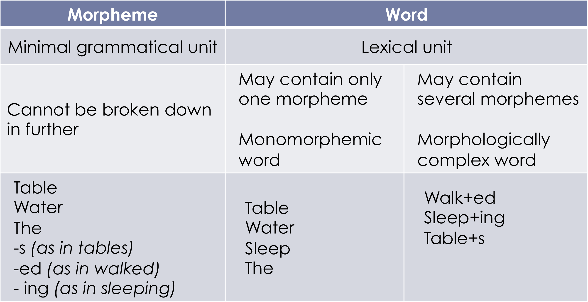
Morphemes vs. Words

Slide 4
Identifying morphemes
Is a word monomorphemic or morphologically complex?
Questions to ask:
  Can the word be broken down any further into smaller meaning and grammatical functions?
  Are some parts of the word found in other contexts with a similar form and meaning?

Slide 5
E.g. “singer”
Meanings
  Sing
    to utter a series of words or sounds in musical tones
  -er
    someone who...
Forms found in other contexts
  Sing
    e.g. sing, singer, singing
  -er
    e.g. dancer, writer, teacher

Slide 6
E.g. “quickly”
Meanings
  quick
    with speed
  -ly
    manner, way of being
Forms found in other contexts
  quick
    quick, quicker, quickest
  -ly
    slowly, plainly, openly

Slide 7
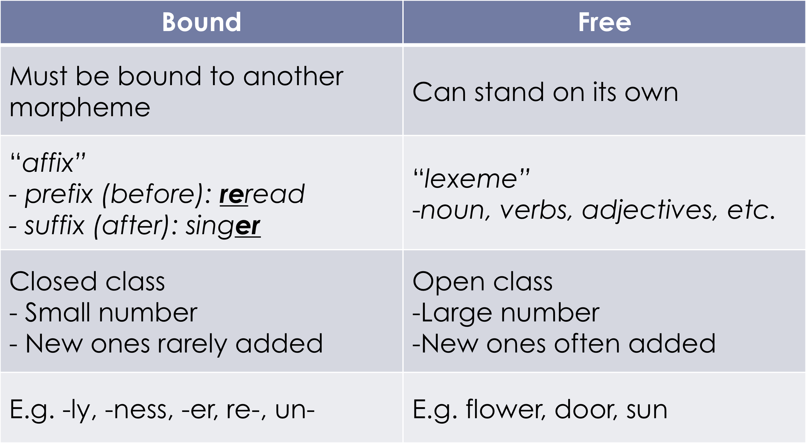
Types of morphemes

Slide 8
Types of Morphemes
Root vs. stem
    E.g.
    Stem
    Root
    Care + less + ness
        free bound

Slide 9
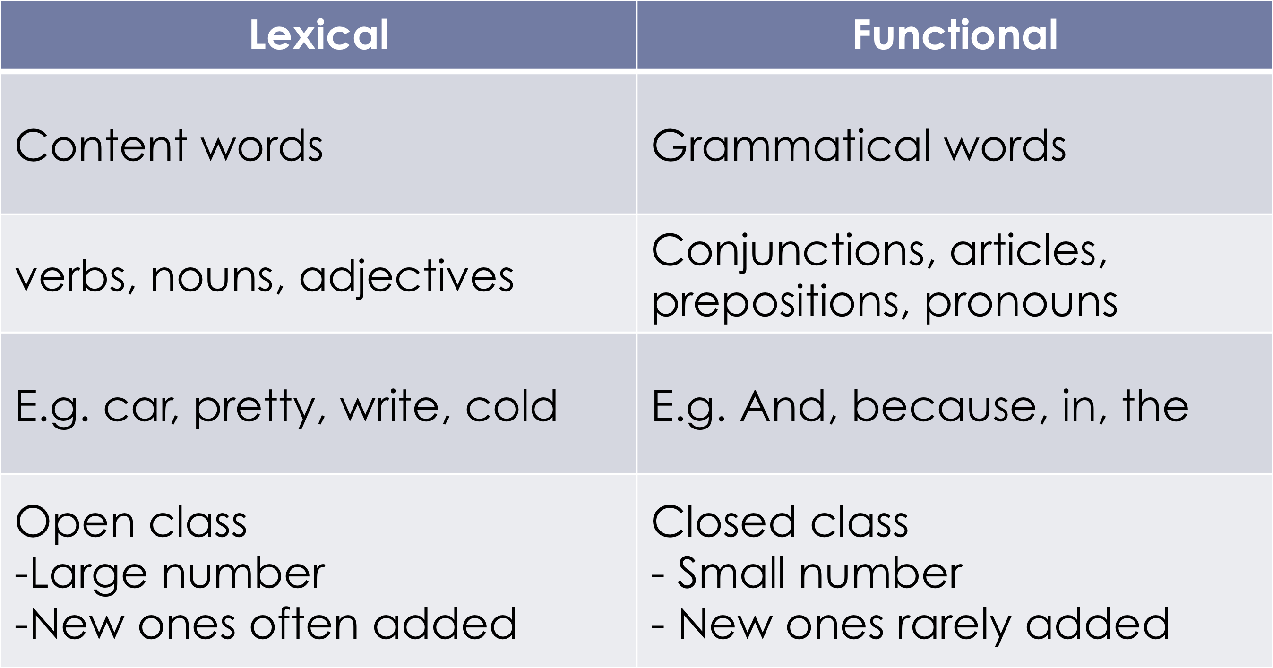
Free morphemes

Slide 10
Bound morphemes
Derivational morphemes
  Creates new words
Creates new words
  May involves a change of word class:
E.g.
    adjective → noun soft – softness;
    noun → adjective taste – tasteless; love – lovely
    verb → noun pay – payment; teach - teacher
  No change
    E.g. legal – illegal; do – undo; wife – ex-wife; etc.
  Prefix
    Re-, pre-, ex-, co-, un-, etc.
  Suffix
    -ly, -ness, -ful, -ment, -less, -ish, er, etc.

Slide 11
Bound morphemes
Inflectional morphemes
  Adds grammatical information to the same word
  Adds grammatical information to a word
    Does not change the category
  8 inflectional morphemes in English
    Plural books; churches;
    Possessive John’s
    Present participle playing
    3rd person singular she plays
    Past played
    Past participle (have) taken, (have) played
    Comparative faster
    Superlative fastest

Slide 12
  Julie’s inflectional
  - teacher derivational
  Tallest Inflectional
  Prepay derivational
  - basically derivational

