Slide 1
Chapter 3
Phonetics

Slide 2
Structure of Language
Sounds- phonetics
phonology
Phonetics- the study of the characteristics of speech sounds
Articulatory phonetics- how speech sounds are produced and articulated
Acoustic phonetics- physical properties of speech sounds
Auditory phonetics- perception of speech sounds

Slide 3
Articulatory Phonetics
Describing how sounds are produced
Consonants
Voicing- vibration of vocal folds and cords
Place of articulation- lips, teeth, tongue, palate, vocal folds
Manner of articulation- obstruction, friction, gliding; cavity- vocal or nasal

Slide 4
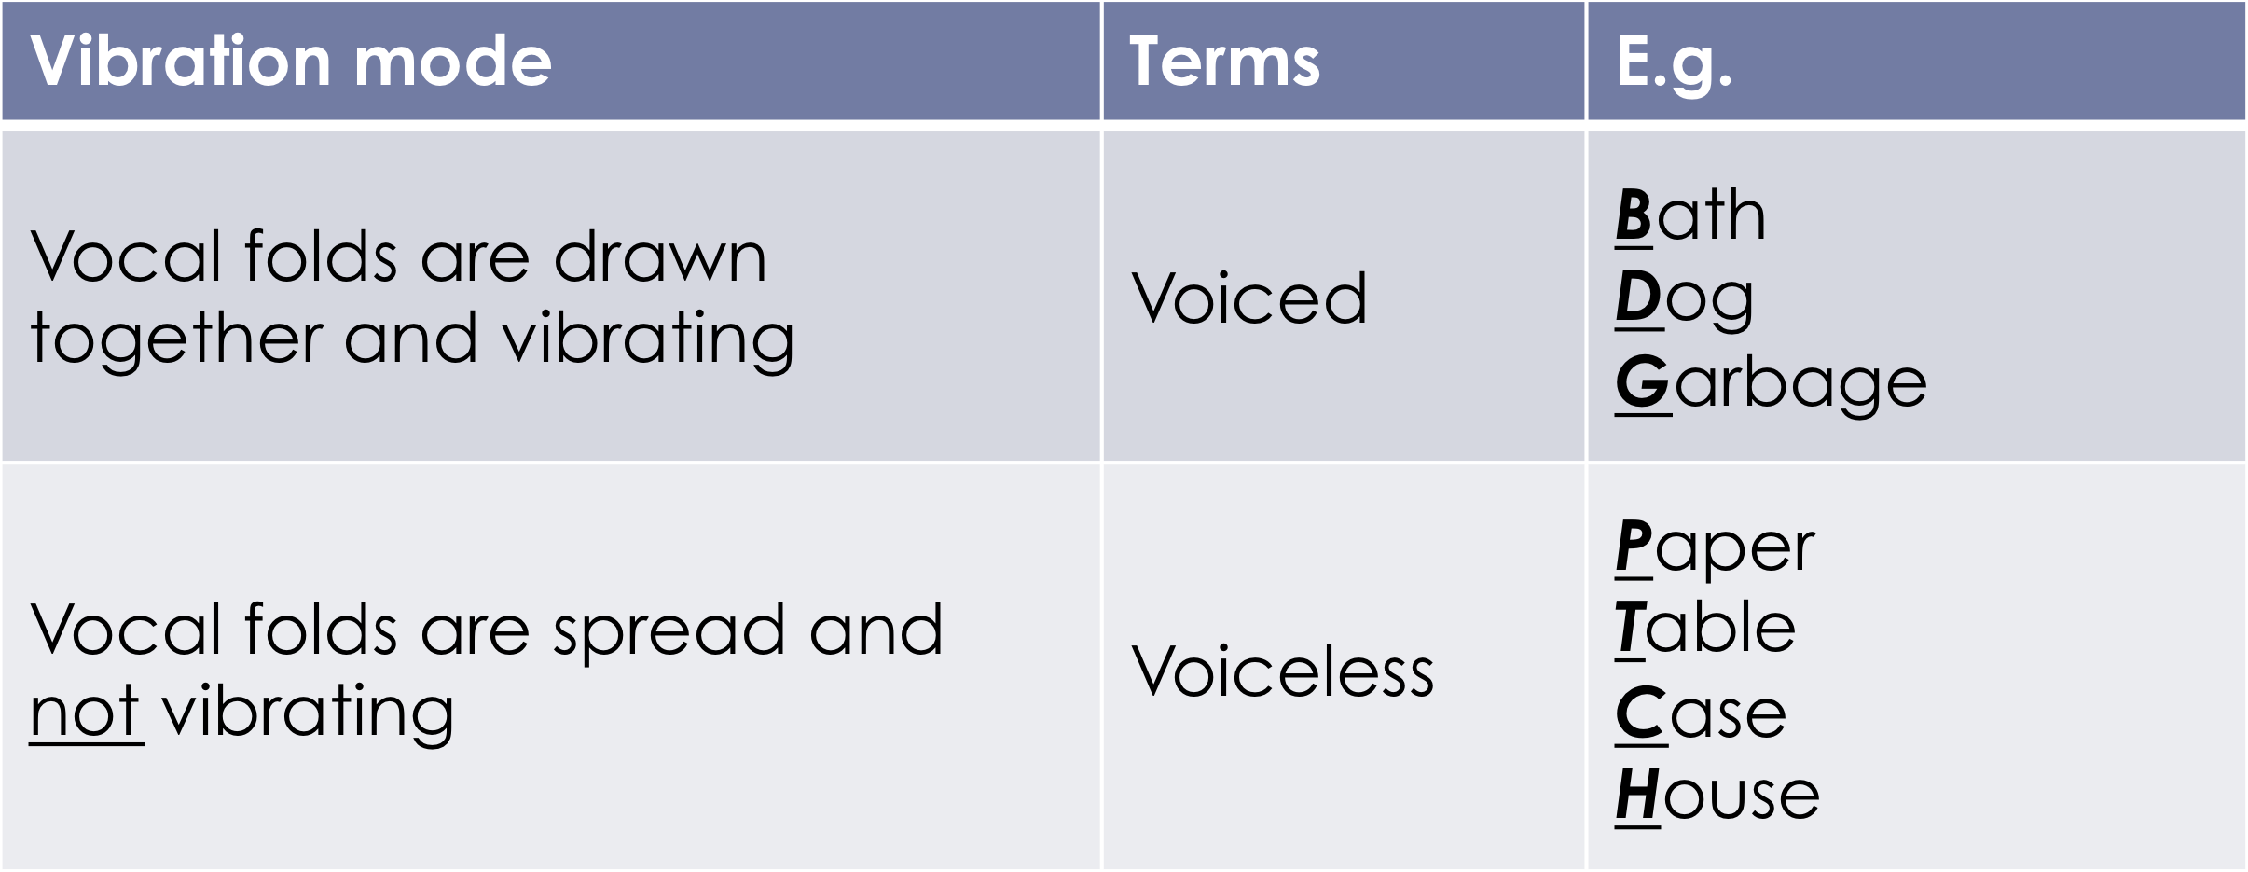

Slide 5
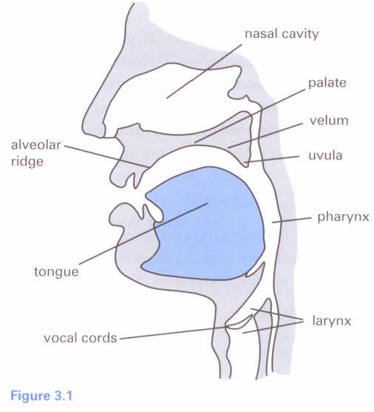

Slide 6
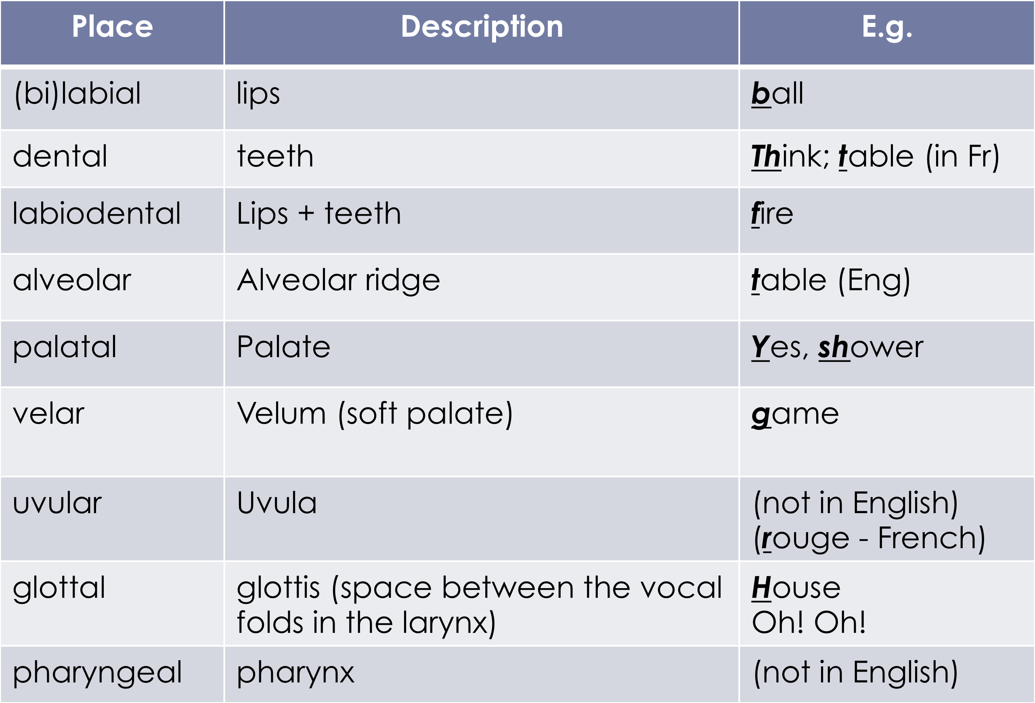
Consonants/ Place of Articulation

Slide 7
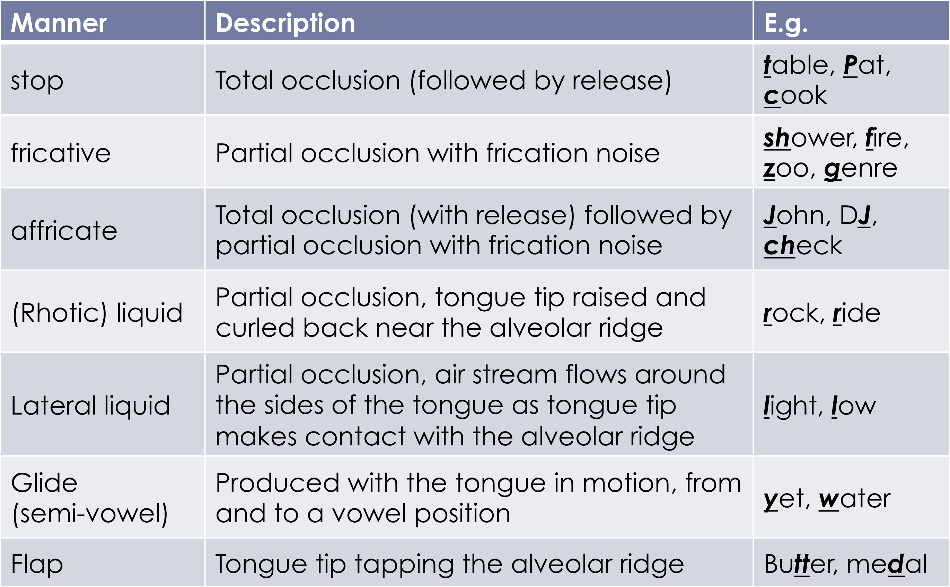
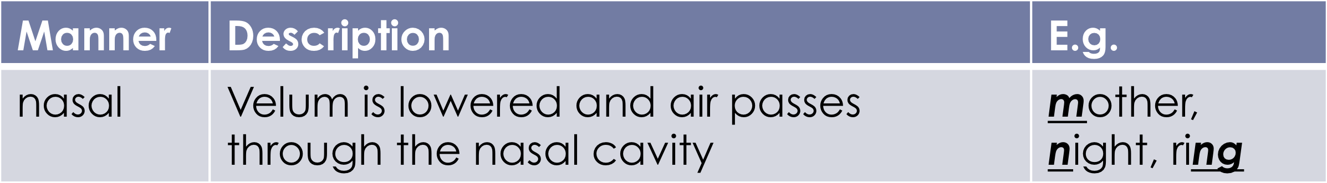
Consonants/ Manner of Articulation

Slide 8
Every sound in the human language has a symbol
International Phonetic Alphabet (IPA)
IPA is to determine what sound is going to be used
Vs. Orthography
Sound- Same pattern can be used in other things/ used differently

Slide 9
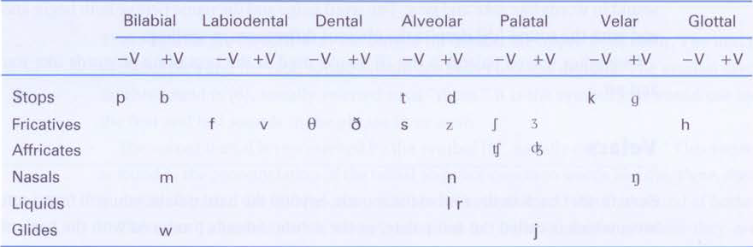
API Chart to Phonetically Transcribe Consonants
Flap ɾ/D

Slide 10
Transcription Conventions
Phonetic transcription
  Square brackets
    Individual sounds (segments) E.g [ t ]
    Words E.g. [ foto ] [ tap ]
  No punctuation, apostrophe, etc. E.g. it’s = [ Its ]
Orthographic transcription
  Quotation marks “ ”
    Letters E.g. “f”
    Words E.g. “table”

Slide 11
Transcribing Sounds Phonetically
Use square brackets when defining something as a sound
For a single sound: isolate sound
Brackets for the entire word go around
For a sentence: brackets at the beginning and end
Punctuation is not used
No capital letters used
Indicate symbols as they are

Slide 12
In orthographic transcription: use quotation marks
Modified chart, from page 30
Summarizes all consonantal sounds used in the English language, helps visualize
“TH” sound, dental fricative
IPA- different symbol for each sound
J=Y sound
Ing- nasal velar
Inverted question mark- glottal stop

Slide 13
Tenseness
Tense and lax vowels
Tense- produced with an advanced tongue root, feels like your tongue is going forward
Retracted tongue root- tongue is lax

Slide 14
Articulatory Phonetics
Vowels
  Tongue
    Front-back
    Height (opening of the mouth)
    Tenseness
  Lip rounding
  Note:
    Vowels are typically voiced so we do not have to specify « voiced »
    Voiceless vowels exist
      « voiceless » needs to be specified

Slide 15
Articulatory Phonetics
Less vowels within system to use versus consonant sounds
Vowels are usually voiced
Voiceless vowels exist in some languages and phonetical contexts, but it will be mentioned if applicable
Chart modification, page 34
Tongue positions in the mouth
Vowels that are ‘high’/’closed’ (closes oral cavity) and ‘low’/open (opens lower cavity)
Tongue position is important

Slide 16
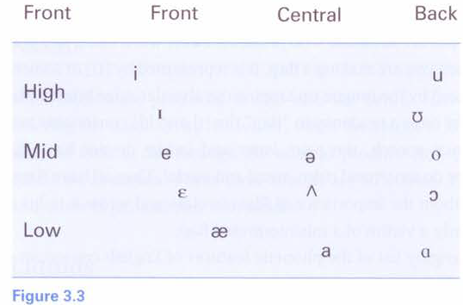
Vowels

Slide 17
Leave, you, rod= tense
Live, the, bread, bad, book= lax
leave
you
live
book
bread
the
(bad) (amer.Eng.)
bad
rod

Slide 18
Vowels
leave
you
book
live
the
bread
(bad) (amer.Eng.)
bad
rod

Slide 19
Lip Rounding
Spread/unrounded vs. rounded
English mostly uses unrounded vowels
Ea- most common sound used
Unstressed/ stressed
Tense- push tongue forwards
Retracted- tongue is more lax
American/ Canadian ‘a’ sound difference
-> height+ front back+ lip rounding+ tenseness
Chart in book is more for American accent

Slide 20
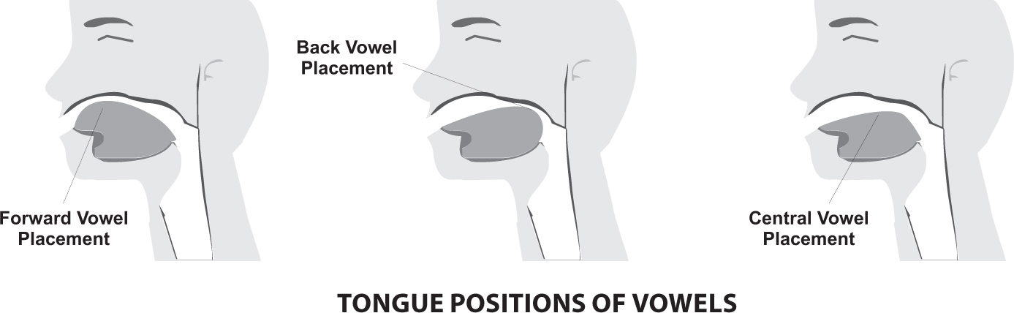
Tongue Positions of Vowels
Front/ Back

Slide 21
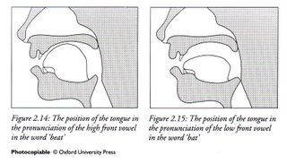
Tongue Position: Height
High (closed) Low (open)

Slide 22
Transcribing Sounds
No capitalization
Learn one word for each sound to compare examples against
Cat- low, central
Dog- low, back *spelled with ‘o’ but not o symbol
Eat- high, front
Soup- high, back
*Pure vowels

Slide 23
Diphthongs
Combination of 2 vowel sounds
Change in vocalic positions
ie. French is mostly pure vowels
‘EI’ diphthong- ie. trade
‘AI’ diphthong- ie. time
‘Au’ diphthong- ie. now
‘Ou’ diphthong- ie. boat
‘OI’ diphthong- ie. boy (open o sound and symbol)

Slide 24
Transcribing Diphthongs
Same- ei diphthong
Show- ou diphthong
Proud- au diphthong
Try- ai diphthong
Enjoy – oi diphthong

Slide 25
Phonetics
Phonetics- the study and the characteristics of speech sounds; articulation of sounds
Phonology-the description and patterns of speech sounds in a language, smallest unit of measurement in language; abstract representation vs. actual speech
Aspirated sounds (Th)
What are the sounds that we encode in our phonetical system
Each language has a different phonetical system
Prototype of what a sound should sound like, we expect to hear these sounds in language

Slide 26
We “ignore” differences
ie. Star (t) vs. Table (Th) vs. writer (D)
It’s hard to learn a second language because of these
Some meaningful differences cannot be ignored, called phonemic distinction/contrast
Phonemic distinction- a difference in pronunciation which corresponds to a difference in meaning
Phoneme- smallest unit of meaning in language; an abstract representation of a sound we have encoded
Phonemes are transcribed within slashes / /

Slide 27
Phonemes
If we change one phoneme for another, the meaning of the word is altered, not found in phonologic transcription
Phonemes are contrastive
ie. /d/ and /t/ are phonemes in English.
Can appear in any part of a word
Phonemes are specific to a language, large amount of variation
Phonemes are not relative to spelling
ie. Cat= kat, not cat

Slide 28
Minimal Pairs
Two words which differ in only one sound in the exact same place and which have a different meaning
ie. Fat, rat
Hip, lip
Rap, rat
Doesn’t apply if the word meaning stays the same

Slide 29
Distribution of Allophones
Free variation- sounds that appear in the same environments and where substituting one sound for the other does not change the meaning of the word; no rule of governance of which sound will be produced
Complementary distribution- sounds that are never found in the same environment,
Before a vowel= onset position
After a vowel= coda position
ie. minimal pairs
ie. ph vs. p
ph p
Pit= phit Spit= spit
Pot= phot Deep= dip
Poor= phur Hyper=haiper

Slide 30
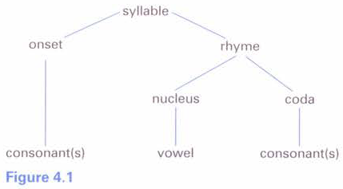
Complementary Distribution

Slide 31
Complementary Distribution
  [l] [ɫ] (dark l or velarized l)
  [lɪp] “lip” [seɪɫ] “sail”
  [loʊ] “low” [boʊɫ] “bowl”
  [lup] “loop” [tɛɫ] “tell”
  Before a vowel- onset position
  After a vowel- coda position

Slide 32
Phonemes vs. Allophones
Phoneme- abstract representation of a sound type; can have more than one phonetic realization
Allophones- variants of the same phoneme
ie. (t) and (D) are allophones of the same phoneme
“letter”- (leter) or (leDar)
Allophones vary according to dialect and language
Allophones are not contrastive; if you change one allophone, it does not change the meaning of the word
Different phonemes: Same phoneme with allophones:
/t/ /d/ /t/
(t) (d) (t) (D)

Slide 33
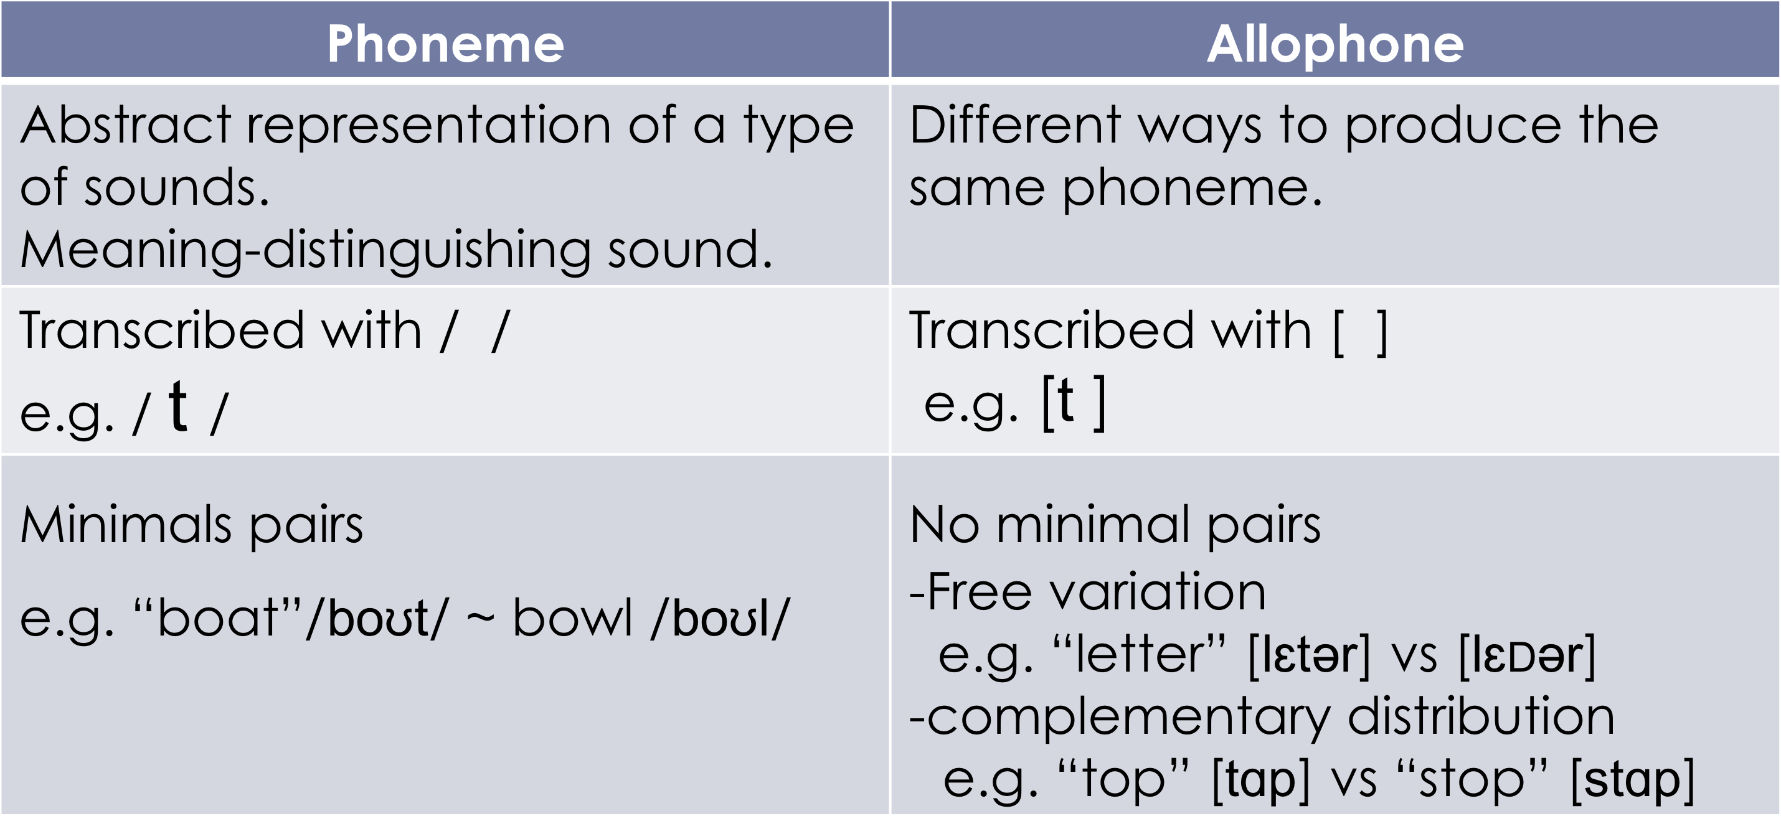

Slide 34
Cross- linguistic Differences
Languages differ with respect to their phonetic inventory; differ in relation to the set of phonemes used to distinguish meaning
ie. Nasal vowels
English- “seen” (sin) or (sĩn)- small distinction
French- “seau” (so)
“son” (sõ)
English vs. Japanese
Night vs. light, Japanese speakers have no phoneme for l or r

Slide 35
Exercise- Yoruba
    Data
  a) [ʃi] c) [eso] e) [ʃe] g) [si]
  b) [se] d) [ɑʃɑ] f) [oʃu] h) [ɑso]
    Can you find minimal pairs? If yes, give an example.
  Yes
  E.g. [ʃi] ~ [si]
  [ʃe] ~ [se]

Slide 36
    Data
  a) [ʃi] c) [eso] e) [ʃe] g) [si]
  b) [se] d) [ɑʃɑ] f) [oʃu] h) [ɑso]
Are the 2 sounds in free variation? Why (not)?
  No, they are not in free variation because if you change [ʃ] for [s] as in [ʃi] for [si] you get 2 different words with 2 different meanings

Slide 37
    Data
  a) [ʃi] c) [eso] e) [ʃe] g) [si]
  b) [se] d) [ɑʃɑ] f) [oʃu] h) [ɑso]
Are the 2 sounds in complementary distribution? Why (not)?
  No
  Because they appear in the same environment.
    E.g. Both [ʃ] and [s] appear word initially and they both appear before the same vowels.

Slide 38
    Data
  a) [ʃi] c) [eso] e) [ʃe] g) [si]
  b) [se] d) [ɑʃɑ] f) [oʃu] h) [ɑso]
Based on the answers you provided, are [ s ] and [ ʃ ] 2 different phonemes or are they allophones of the same phoneme? Why?
  Different phonemes
  Because we can find minimal pairs so substituting one sound for the other changes the meaning of the word.

Slide 39
Which representation (a or b) reflects the structure of the phonological system in Yoruba for [ s ] and [ ʃ ]?
(a) / s / / ʃ / (b)
[ s ] [ ʃ ]
Different
phonemes
/ s /
[ s ] [ ʃ ]

