Slide 1
Language disorders
LIN 1300 Study notes

Slide 2
Language faculty
Language abilities are independent from other cognitive abilities
  Specific language impairment (SLI)
    Linguistic competence affected while cognitive development can be normal
  Williams Syndrome
    High level of linguistic competence achieved alongside a cognitive development that can be severely compromised

Slide 3
Language disorders
Abnormal language development in children
  Specific Language Impairment (SLI)
Language disorders in adults
  Aphasia

Slide 4
Specific Langage impairment (SLI)
  Neurological disorder that affects production of language or production and comprehension
  Family history
    Greater probability for children who have family members with SLI
  Twins
    Monozygotic (same genes) vs.
    Dizygotic (different genes)
The cause is not environmental, but genetic
Abnormal development of language
  Not caused by cognitive development issues

Slide 5
First signs
  First developmental milestones in speech not being achieved on time or at all
  The characteristics in development are very specific:
  Late emergence of language
  Development is slower and atypical
Diagnostic
  Linguistic test
    Performance is inferior to that of same age children
    Delays in learning process
  Difficult to diagnose
    Each case is different

Slide 6
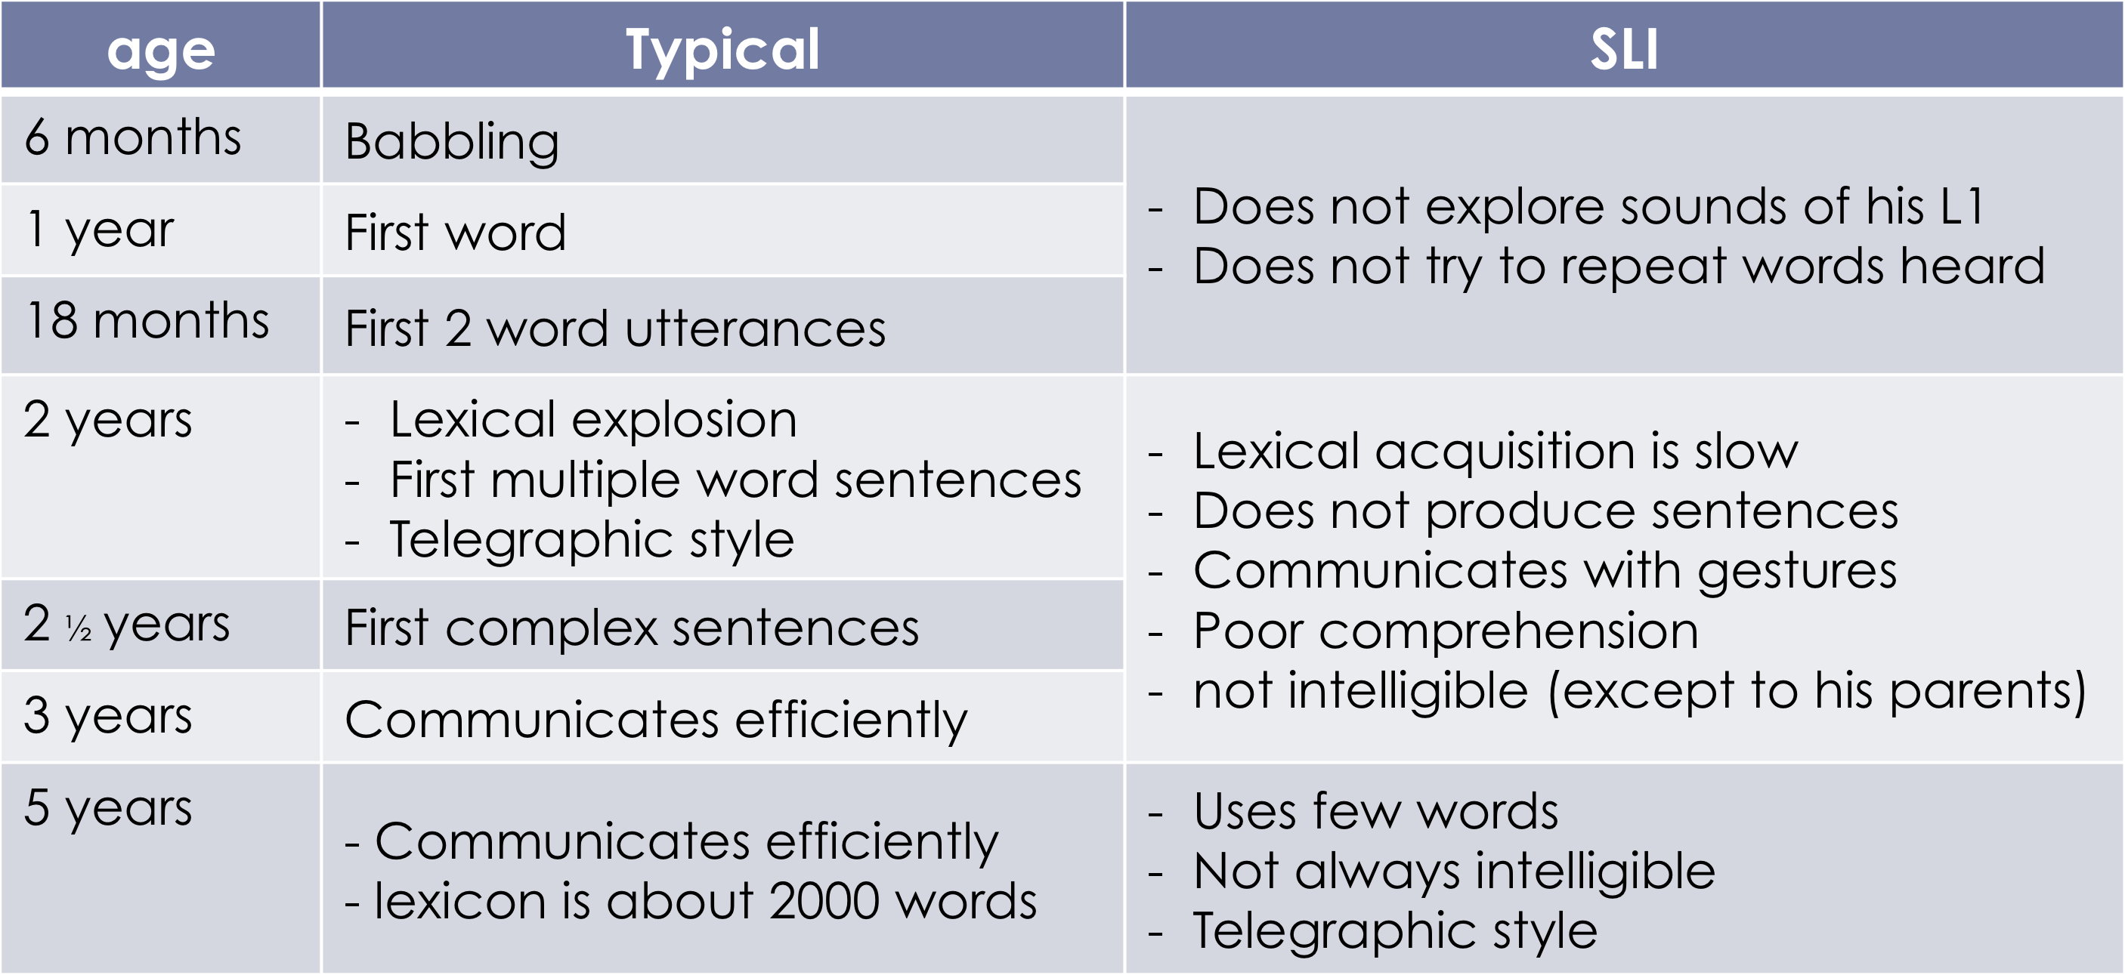

Slide 7
Language structure impairments
Language structure
  Phonology
    Difficulty perceiving certain sounds
    Difficulty producing certain sounds
  Lexicon
    Lexical access is difficult
    Vocabulary is not precise
  Morphology and syntax
    Inflectional morphology is affected
    Syntax errors
  Mainly affects verbal morphology
    subject – verb agreement
  Other types of morphemes also affected
    Gender (feminine – masculine)
    Plural

Slide 8
Morphology impairments
Verbal morphology
  Verbs in the infinitive, telegraphic style
    No subject-verb agreement
      « he eat »
      Note:
      If the morpheme is there, it is usually the right one used in context
        He eats vs. * he eatings
  Omission of “do”
      « he no eat »
      * Difficulty determining the gender of words as well

Slide 9
Difficulty with generalisations
  Plural
    In general, children with SLI make the same overgeneralisations as normally developing children do
      E.g. « foots »
    Difficulty with applying the rule to new words
      E.g.: « wug » – « wugs »

Slide 10
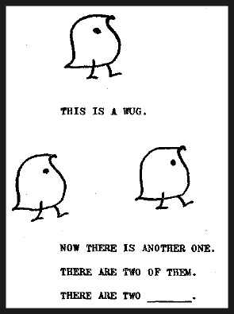
Wug Test

Slide 11
SLI
Summary
  Serious language development issues
  The cause is genetic
  Affects various aspects of the language
  Can affect both production and comprehension
  Lasts until school age and sometimes until adulthood

Slide 12
Aphasia
“Language impairment that results from brain damage”
Cause of brain injury
  E.g. caused by head trauma after an accident, a stroke, etc.
Main types
  Broca’s aphasia
  Wernicke’s aphasia
  Global aphasia

Slide 13
Broca’s aphasia
Cause: damage to Broca’s area
Characteristics
  Difficulty with the articulation of sounds
    Coordination of muscles in the vocal tract is difficult
    Results: speech rate in slower and some phonemes are not articulated well
  Lack of words
    Lexical access is difficult
    Telegraphic style, slow speech rate
    Ex. “me drive car”
  Oral comprehension is usually normal (or little affected)
  Difficulty with writing (in some cases)
    Writing letters, spelling of words
    Writing comprehension can also be affected

Slide 14
Wernicke’s aphasia
Cause
  Damage to Wernicke’s area
Characteristics
  Speech rate is normal and sometimes fast
  Articulation of sounds is normal
  Oral comprehension is problematic
  Incomprehensible discourse
    Void of meaning
    Repetition of same words
  2 types
    Phonemic paraphasia
      Words are deformed
        substitution or omission of phonemes
    Semantic paraphasia
      Substitution of words (which are related semantically)

Slide 15
Global phasia
Cause
  Damage to multiple language areas, from Broca’s area to Wernicke’s areas
Characteristics
  Severe or total loss of language abilities
    Production and comprehension affected
    Oral and written language affected
    Only very few words are uttered
    No syntax
  Only a few automated forms of emotional exclamations

Slide 16
Aphasia recovery
Birth-4 years: Re-acquisition of normal speech is easy, usually they don’t need to learn anything again because it hasn’t been learned yet anyways and all can be learned in one process
4-10 years: recovery is fairly easy and often complete
10 years- adulthood: very difficult and sometimes impossible, serious consequences

Slide 17
Aphasia
Summary
  Language impairment that results from brain damage
  Various types which lead to different language disorders
  Recovery differs based on age

