Slide 1
Chapter 11
Globalization

Slide 2
What is globalization?
Global village
Western influence
Social networking
Colonization
Integration of culture
There’s a history behind globalization and what it entails
Is globalization a new or old phenomenon?

Slide 3
Globalization
The process of international integration as a result of the exchange of world views and aspects of culture
Accepted as a reality in the 90’s, as opposed to in previous years where it was denied as existing
Old globalization: In history, has been considered also as “empire building”
The competition was on to build the better and stronger empire
New globalization: The world is “shrinking” due to technologies, thanks to the internet
This brings on a new wave of economical, political, cultural etc. influences and forces

Slide 4
There is a constant fear that globalization will inflict a monoculture upon all of us, everyone in society will become the same in conformity to the monoculture
→ Globalization is not a disjunctive ideology; there is no one or the other
It is a little bit of everything coming together at once

Slide 5
Technology has allowed flows of information at a degree that was previously unknown to us:
1. The speed at which info travels around the world is now faster than ever
2. The amount of information travelling (large) and amount of networks is also large
3. Intensity of relationships between countries
4. Quantity/ volume of information
5. The extent of global networks that technology has facilitated

Slide 6
Sub-classes
Internationalization: A vague/ loose interdependence countries establish with each other
Liberalization: A borderless economy between countries
Universalization: Cultures becoming the same, cultures can either become homogenous, in most cases more Western, but hybrids can also emerge, like Bollywood
Westernization: Becoming more “western” or American
Deterritorilization: Countries having less control over their borders

Slide 7
Media’s role in globalization
Media acts as:
1. Tools/ channels of encounter that facilitate our encounters
Can expand relationships over vast distances
* Can also exclude people if they don’t have skills/access to technology
2. Tools of governance and administration
Can coordinate businesses from a distance
Ex. Can have a head office in Ottawa with a sweat shop in India
3. Situating us around the world with the technology we receive, technology is a means of transmitting information
We see ourselves through technology
4.Technology is an industry in itself

Slide 8
Ideologies within globalization
1. Globalization is about liberalization and integration of markets
2. Globalization is irreversible, we can’t go back in time and take back what has happened in the past
→ Not a lot of debate about these two

Slide 9
The next three are up for debate:
3. No one’s in charge of globalization, it’s just a process that happens, we’re riding a tide
Counter debate- it’s not uncontrolled, the West controls it. If not the west, then corporations do
4. Assertion that everyone benefits from Glob.
Catch- yes, not everyone benefits economically, but we don’t know how false it is in other aspects like culture, politics etc.
5. Globalization spreads democracy
A free market= free politics
Ex. Canada should expand trade to China because it will help their government become a democracy

Slide 10
Theorists of globalization
1950’s/1960’s
W. Rostow’s Stages of economic growth/ Modernization theory
All countries develop and grow through a variety of stages over the process of a few hundred years
Measuring development and globalization by the measure of a country’s economic wealth
The 5 stages
1. Traditional society (primary society, “hunting/ gathering times”)
2. Preconditions for takeoff
3. Take-off
4. Drive to maturity
5. Age of High mass consumption (the modern age)
All societies move through this timeline in a linear fashion; one step cannot be overlooked in order to move to the next

Slide 11
1960’s
Marshal McCluhan's “global village”
1960’s/ 1970’s
Buckminster Fuller’s “Spaceship earth”
Wrote a book called “A Manuel for Spaceship Earth” about globalization from an environmental perspective
Asserts that we can assure the prosperity of the human race by putting faith in science
If humans don’t use up all the natural resources we will survive (faith in humanity to not use up resources)

Slide 12
1970’s
I. Wallerstein’s “World systems theory”
Wallerstein sees the development of the capitalist world economy as negative to the world’s population
Wallerstein predicts that capitalism will be replaced by a socialist economy
Theory is similar to Marxism
He dived the world into 3 categories of countries:
Core- strong, dominant economy
Ex. The United States
Semi periphery- mid range economies
Periphery- Developing nations
Ex. Venezuela

Slide 13
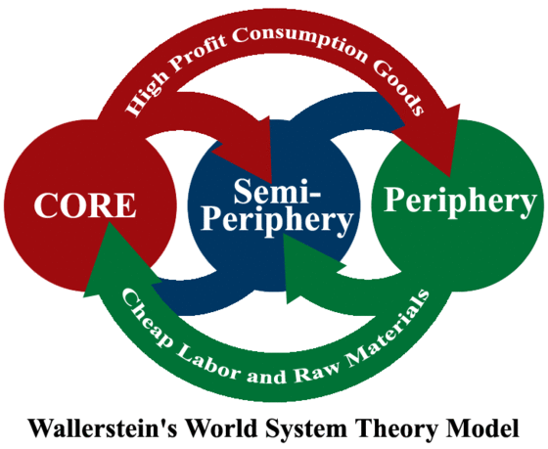

Slide 14
1970’s/1980’s
Let the market reign outside of the government’s regulation
The less privatization/ regulation the better
Their argument- have a negative view on public broadcasters; they have an unfair intrusion into the market apparently

Slide 15
1980’s/1990’s
F. Fukuyama’s “End of history”
Written at the time of the fall of the Berlin wall/ fall of Soviet communism
Throughout the 20th century, the world was ruled by neo-capitalism and Marxist-Leninism
Capitalism has won, so now the world is going to move to being liberal democracies AND will never again revert back to communism
The world of ideologies has passed; we will now all accept and have capitalism without disputing different ideologies that we could have
Capitalism will be the new norm for everyone

Slide 16
Consequences of globalization
1. A decline/ reduction in the authority of nation-states and policies, the idea that states are the members of international agreements etc. with policies on domestic laws
Ex. Canada being a member of the World Trade Agreement
2. Transnational flows- things moving around between countries, worldwide etc.
Of people, commodities, information, technologies
3. Transnational finance and capital gain
Foreign investment will occur
4. A growth/ rise in international agreements and institutions
5. Transnational production/ production of goods internationally
Ex. a car being made out of parts from all over the world

Slide 17
Space and time
Social relations become stronger through the collapse of space and time
The media mediates time and space
Ex. Being able to video call on Skype with someone overseas
Relations stretch over space and time; things that happen far away can now affect us at a local level

Slide 18
Time is no longer relevant
24-hour news
We can shop/consume anytime of the day
Messages received virtually instantaneously
Place becoming less important:
Experience events in distant places in real time; we can experience events from all over the world almost instantly
We aren’t grounded to a particular place
Can communicate from anywhere with the technologies we have now
New spaces for consumption, like the internet

Slide 19
Media and cultural imperialism
Promotion of:
Global cultural items; global superpowers like Mcdonald’s,
Incorporation of foreign or ethnic culture to satisfy the search for the exotic in the consumer’s life
Results:
Destruction of indigenous culture
Decline of tradition
Distortion of local culture
Loss of language
=
Culture becomes homogenized
Biased toward Americanization
Destruction of diversity

Slide 20
Media starts to shape our consciousness; tells us how to think and act
Media messages have unpredictable consequences

Slide 21
Castell’s network society
Technology allows the organization of society though networks
Network Society: a new economy organized around competitive global networks
Network: a set of interconnecting flows of information with no center
Networks become extremely powerful, more powerful then having information centered in one place like a city
Information technology like networks are a catalyst of globalization

Slide 22
Free flow doctrine of information
A notion developed by the US and other Western nations
A free flow of information would be a means of promoting peace and understanding and allow for technological advancement around the world
In a negative sense however, this could be used as a strategy to dominate global communication markets

Slide 23
Technological apartheid- the divide of not everyone having access to technology, due to financial or location issues
Only people with means can access technology in this sense

Slide 24
New International Economic Order (NIEO)
1970’s
Advocated change in development opportunities for developing/ peripheral nations
No large advances at this time

Slide 25
New World International Communications Order (NWICO)
A free flow of information will result in democracy for the peripheral nations
Argued that the right to communicate is very fundamental to democracy

Slide 26
World Summit on the Information Society
A summit called by the United Nations
Geneva (2003) and Tunisia (2005)
Debated same issues of technology being a right and how they should regulate the right
Internet regulation was an important topic for debate
At the end, very little took place
Lots of discourse, no action

