Slide 1
Chapter 5

Slide 2
6 approaches to audience theory
Effects/ agenda setting/ cultivation analysis
Uses and gratifications/ U&G
Frankfurt school
Cultural studies
Feminist studies
Reception analysis

Slide 3
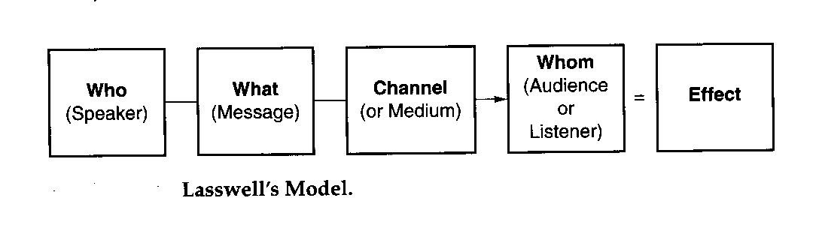
Lasswell’s Narrative Model

Slide 4
1. Effects
Lasswell’s model
Interested mainly on the effects of propaganda on audiences and how it influences peoples’ attitudes
Anyone who communicates is trying to influence or persuade someone on the receiving end
Therefore, all communication should be treated as an attempt at persuasion
Who is the person? (Control analysis)
What are they saying? (Content analysis)
What is the communication channel? (Media analysis)
Who are they communicating to? (Audience analysis)
What is the effect of the communication? (Effect analysis)

Slide 5
Agenda Setting/Cultivation Analysis
Agenda setting: the media serves as this, meaning that they work selectively to bring the audience’s attention to particular events and circumstances
Cultivation analysis: content is studied for its ability to encourage or cultivate certain attitudes in viewers towards other persons or perspectives
Gerbner’s Cultivation Theory: watching large amounts of television resulted in audiences seeing the world in a different way, a “mean world” theory where the more television you watch, the more likely you are to think that the outside world is dangerous
Also, the more people adhere to television, the more likely they are to adopt certain stereotypes

Slide 6
2. Uses and Gratification (U&G)
Based in social psychology
Functionalist theory
States that the audience is NOT passive
Main focus question: What do audiences do with the media?
Focuses on the agency of audience members and explores their motivations in the active selection of media content
This approach is attentive to audience variables and the different perspectives audience members bring to their personal selection and interpretation of media content
Puts much more emphasis on agency than the effects theory does

Slide 7
4 Needs Fulfilled by Media
  1. Diversion (escape from everyday pressures)
  2. Personal relationships (identification with characters and discussion with other people)
  3. Personal identity (compares ones own life with characters)
  4. Surveillance (information about what's going on in the world)

Slide 8
Hypodermic needle model
Media is “injected” directly into our brains
We react accordingly
Rooted in propaganda studies from the 1900’s
The hypodermic needle model says the audience is passive, with no individuality of its members and is part of a mass society

Slide 9
3. Frankfurt School
Formed in the interwar period
Forced to leave Germany
Argued that the capitalist methods of mass production had negative effects on culture
Capitalism brought on a wave of new media, that replaced older forms of high culture
Peoples’ wants and needs were satisfied via the market
Coined the term “the culture industry”

Slide 10
4. Cultural Studies (British)
Began as a reaction to Marxist theories downplaying the role of the human agency
The public is not a passive media consumer machine
Individuals can manipulate media to create new meaning ie. punk movement
The roles of ideology in controlling a society
The impact of growing mass culture on post-war Britain, particularly the working class
1950’s to present:
1. The analysis of working class culture, particularly males
2. In response to feminist critique, studies of working class female culture

Slide 11
Stuart Hall’s Preferred, Negotiated, and Oppositional readings of media texts
Preferred- agreement with marketer
Negotiated- agreement somewhat, under conditions
Oppositional- completely disagree

Slide 12
5. Feminist Research
Analyzes male social dominance as the root of inequality and injustice (i.e. patriarchy)
The relationship between media and society’s dominant ideas about gender roles
Gender class and media
3 dimensions of feminist study:
Feminism, difference and identity
Feminism and the public sphere
New technologies and the body

Slide 13
6. Reception analysis
Takes into account the social setting in which audiences respond to contemporary popular culture products
Reception analysis focuses on how an individual interprets what the media has to offer and how media consumption is reintegrated into the personal aspects of their life

Slide 14
Information is unmediated
Also called the ‘limited effects paradigm’
HYPODERMIC NEEDLE MODEL
TWO STEP FLOW MODEL
Dating from 1920s
Passive audience
Opinion leaders influence how audiences consume texts
Texts have preferred meaning
RECEPTION ANALYSIS/ THEORIES
USES AND GRATIFICATIONSTHEORY
Stuart Hall’s Encoding/Decoding model
Audiences consume texts for different reasons and in different ways

