Slide 1
Discrete Probability Distributions

Slide 2
Outcomes
At the end of this section you should be able to:
  Know how to determine probabilities associated with Uniform, Binomial and Poisson distribution applications.

Slide 3
Discrete Probability Distributions
A random variable is a variable that assigns a numerical value to each outcome of a random experiment or trial.
E.g. the number of faulty products out of a
sample of 1000

Slide 4
Discrete Distribution Organization Chart
Discrete
Distributions
Probability of each
option is the same
Uniform
Distribution
Calculate probability
that x out of n
are special
Known probability
of being special
Binomial
Distribution
Population N
of which S are
known to be special
HyperGeometric
Distribution
Known Arrival Rate
Poisson
Distribution

Slide 5

Uniform Probability Distributions
P(x)
If I’m a fair die, each probability (1,2,3,4,5,6) is the same: 1/6.
m
n
The uniform probability distribution is a probability distribution that has equal probabilities for all possible outcomes of the random variable

Slide 6
Discrete Uniform Distribution
Lead Time for Product Delivery
Uniform Probability Distribution
0.3
0.25
0.2
0.15
0.1
0.05
0
1 week
2 weeks
3 weeks
4 weeks
Delivery Lead Time

Slide 7
Class Discussion
0.3
0.25
0.2
0.15
0.1
0.05
0
1 week
2 weeks
3 weeks
4 weeks
Calculate the mean and standard deviation of the uniform distribution.

Slide 8
Discrete Distribution Diagrams
P(x)
Prob p
n-x
x
a
b
Not special Special
Uniform: a, b
Binomial: n, p
N
S
Time
x
n
# of events
Per unit time: λ
Hypergeometric: N, S, n
Poisson: λ

Slide 9
Discrete Distribution Organization Chart
Discrete
Distributions
Probability of each
option is the same
Uniform
Distribution
Calculate probability
that x out of n
are special
Known probability
of being special
Binomial
Distribution
Population N
of which S are
known to be special
HyperGeometric
Distribution
Known Arrival Rate
Poisson
Distribution

Slide 10
Hypergeometric Distribution
N
S
x
n
Out of N items, S are “special”.
I take a sample of n from the N items.
What is the probability that x of those n are “special”?

Slide 11
HyperGeometric Distribution
Example
Using an experimental procedure 7 out of 12 cancer patients have been cured.
6 of those patients were treated by Doctor X and 5 were cured. What is the probability that 5 were cured if Doctor X is as good as the average doctor treating the 12 patients?
Prob = 0.1136
A reason for calculating probabilities is to figure out whether something is exceptional.
Is Dr X exceptional?

Slide 12

Raising a Red Flag
If Prob < 0.05 we raise a red flag.

Slide 13
Discrete Distribution Diagrams
P(x)
Prob p
n-x
x
a
b
Not special Special
Uniform: a, b
Binomial: n, p
N
S
Time
x
n
# of events
Per unit time: λ
Hypergeometric: N, S, n
Poisson: λ

Slide 14
Discrete Distribution Organization Chart
Discrete
Distributions
Probability of each
option is the same
Uniform
Distribution
Calculate probability
that x out of n
are special
Known probability
of being special
Binomial
Distribution
Population N
of which S are
known to be special
HyperGeometric
Distribution
Known Arrival Rate
Poisson
Distribution

Slide 15
Binomial Probability Distribution:
Examples
Only 2
possibilities
A firm bidding for a contract will either get the contract or not.
A marketing research firm receives survey responses of “yes I will buy” or “no I will not”.
Students offered university places either accept the offer or reject it.

Slide 16




Slide 17



A food processing plant
tests food for quality
control purposes.

Slide 18
Combinations
How many ways can we select x things out of a batch of n things?
where:
n! =n(n - 1)(n - 2) . . . (2)(1)
x! = x(x - 1)(x - 2) . . . (2)(1)
0! = 1

Slide 19
Number of Ways of Getting x Defective Products in a Sample of Size n
Take a sample of products.
The products are either good (G) or defective (D)
The number of ways of getting x=1 defective product in a sample of n=4 is 4, i.e. GGGD, GGDG, GDGG, DGGG.
n!/(x!(n-x)!) = 4!/(1!*3!) = 24/6 = 4

Slide 20

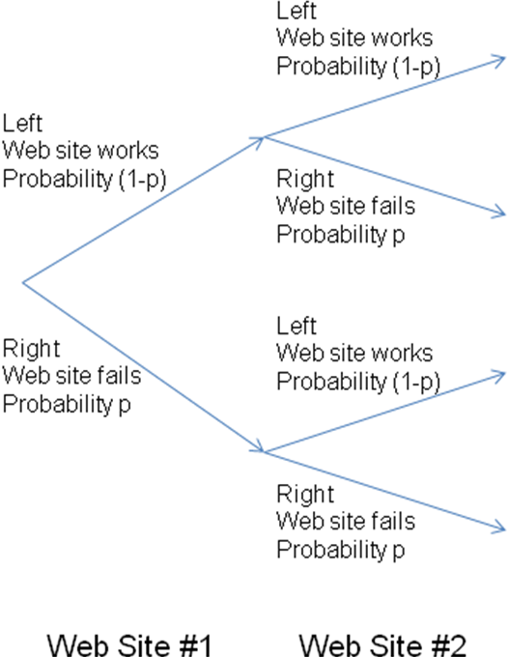
The Branching Path
Testing a Browser

Slide 21
Binomial Distribution
Prob p
n-x
x
Not special Special
There is a probability p that an item is “special”.
I take a sample of n items.
What is the probability that x of those n are “special”?

Slide 22
Binomial Probability Distribution:
Assumptions
A trial has only two possible outcomes – a success or a failure.
There is a fixed number, n, of identical trials.
The trials of the experiment are independent of each other.
The probability of a success, p, remains constant from trial to trial.
If p represents the probability of a success, then (1-p) = q is the probability of a failure.

Slide 23
Binomial Probability Distribution
BINOMIAL FORMULA
where:
n = sample size
x = number of successes
n - x = number of failures
p = probability of a success
q = 1 - p = probability of a failure
n! =n(n - 1)(n - 2) . . . (2)(1)
x! = x(x - 1)(x - 2) . . . (2)(1)
0! = 1
p is independent of how many successes we have. This is called “sampling with replacement”.

Slide 24
Binomial Example
Suppose the probability of a product being defective is p=0.1.
The probability of getting DGGG is:
  p*(1-p)³ = 0.1*0.9*0.9*0.9 = 0.0729
The probability of getting x=1 defective product in a sample of n=4 is:
  p*(1-p)³*n!/(x!(n-x)!) = 0.0729*4 = 0.2916
Class discussion: What is the probability of getting 3 defective products out of a sample of 5?

Slide 25



Agriculture
Consumer Testing
Environment
Industrial
Life Science
Minerals
Oil, Gas and Chemicals
SGS CANADA INC.
Mississauga, ON
Content, shrinkage, and colourfastness

Slide 26




Slide 27
Testing Products
Suppose on average 1% of products
  is known not to pass tests.
We need to check whether we are exceeding this limit.
We test 10 products and find 1 fails the test. Should we raise a red flag?
P(X=1) = (10! / (1! * 9!) ) * 0.01¹ * 0.99⁹ = 0.091
Class discussion: calculate P(X=0) and P(X=2)?

Slide 28

Frequency of Parkinsons Disease
Michael J Fox, who starred in Back to the Future and Family Ties has Parkinson’s Disease.
In the late 1970s, when he was 15, he worked on the sitcom Leo and Me. 4 out of the 125 people involved in Leo and Me now have Parkinson’s disease.
The incidence of Parkinson’s disease in the general population in Mickael Fox’s demographic group is 1:300
What is the chance of 4 people out of a group of 125 having Parkinson’s disease?
Source: National Post March 23, 2002

Slide 29
What did we get out of those 3 examples?
3 defective products in a sample of 5?
  Application of the Binomial formula
Michael J Fox and Parkinson’s disease.
  125!/121! = 125 x 124 x 123 x 122
Prob 0 defective products in a sample of 10
  0! = 1

Slide 30

The probability of rainfall over 1cm in one day in November in Vancouver, BC, is 0.2.
The city is interested in controlling flooding, which will occur if there is over 1 cm of rain on 3 out of 4 days.
What is the probability of flooding in Vancouver in November?

Slide 31
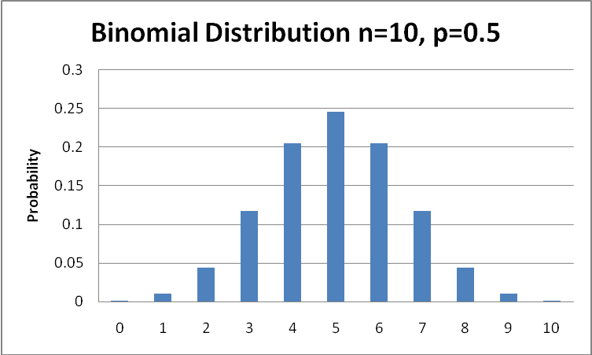
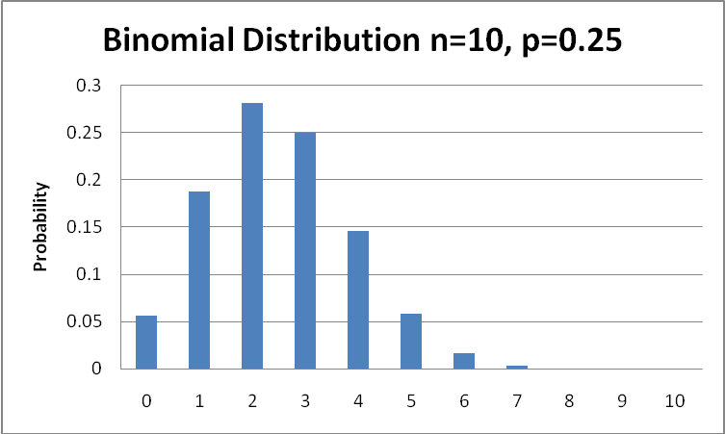
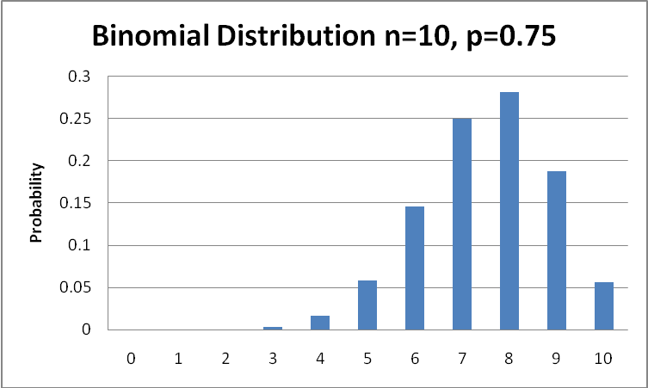

Slide 32
Binomial Distribution in Excel
Enter p=0.01,…,0.09 in B1,…,J1 and x=0,…,10 in A2,…,A12
Goto B2; Function; Statistical; Binomial
  Number $A2; Trials 10; Prob B$1; Cumul FALSE.
Use FALSE as last parameter to get point distribution, instead of cumulative distribution
Make a table (by copying the function) for
  n=10
  p=0.01,…,0.09
  x=0,…,10

Slide 33
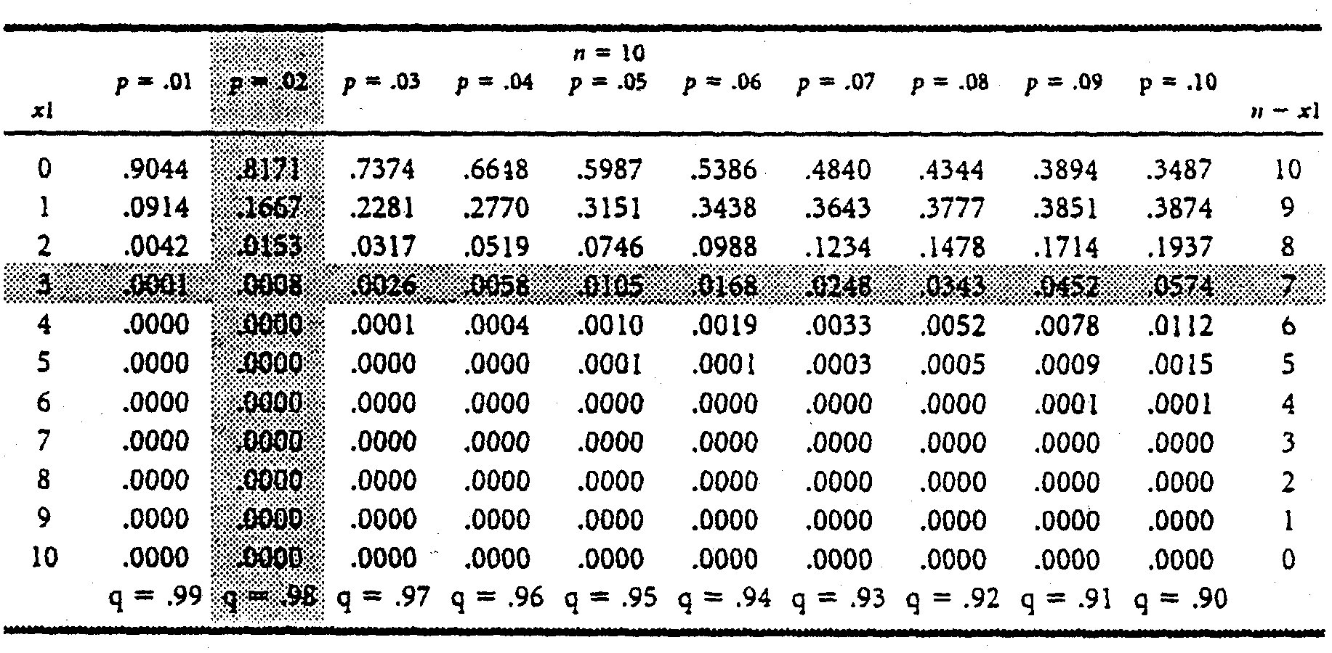
Binomial Probability Distribution

Slide 34
Class Discussion
Telemarketers make phone calls. On any phone call there is 5% chance of selling a product.
What is the chance of selling 2 or more products out of 10 phone calls?
Hint: Use table on previous slide

Slide 35
Story
The evil dragon had locked the beautiful princess in a room at the top of the tower.
The prince helped her onto his horse and rode off into the sunset.
The princess shouted out the window for help
She heard the prince riding by.
The prince kissed the princess and she woke from 100 years of sleep
The prince drew his magic sword and killed the dragon
The dragon is the staircase
He ran up the staircase to the princess’s room.
They ran back down the staircase to freedom.

Slide 36
Story #1
Binomial >= 2 out of 10
p = 0.05 = 1 – P(0) – P(1)
P(x) = L^{x} e^{-L} / x!
= 1 – 0.8171 – 0.1667
= 0.162
P(0) = 0.8171
P(1) = 0.1667

Slide 37
Story #2
Probability of selling = p = 0.05.
Require probability of >= 2 sales out of 10 calls.
“Out Of” implies Binomial.
P(>=2) = 1 – P(0) – P(1)
P(0) = 0.8171
P(1) = 0.1667
Therefore P(>=2) = 1 – 0.8171 – 0.1667
=0.162

Slide 38
Binomial Probability Distribution
MEAN OF THE BINOMIAL DISTRIBUTION
where:
n = Sample size
p = Probability of a success
The average number of defective products in a sample
of size 4 is 4*0.1=0.4 (assuming p=0.1).

Slide 39
Binomial Probability Distribution
STANDARD DEVIATION FOR THE BINOMIAL DISTRIBUTION
where:
n = Sample size
p = Probability of a success
q = (1 - p) = Probability of a failure
σ
=
npq
The SD of the number of defectives is (4*0.1*0.9)^{0.5}=0.6

Slide 40
Binomial Distribution Summary
Prob p
n-x
x
Not special Special
There is a probability p that an item is “special”.
I take a sample of n items.
What is the probability that x of those n are “special”?

Slide 41
What Can Go Wrong?
A model is just a model. If the assumptions don’t apply, the results of the model will be wrong.
Check assumptions:
  Binomial
    Independent trials
    Two outcomes
    Same probability of success/failure for each trial.

Slide 42
Discrete Distribution Diagrams
P(x)
Prob p
n-x
x
a
b
Not special Special
Uniform: a, b
Binomial: n, p
N
S
Time
x
n
# of events
Per unit time: λ
Hypergeometric: N, S, n
Poisson: λ

Slide 43
Discrete Distribution Organization Chart
Discrete
Distributions
Probability of each
option is the same
Uniform
Distribution
Calculate probability
that x out of n
are special
Known probability
of being special
Binomial
Distribution
Population N
of which S are
known to be special
HyperGeometric
Distribution
Known Arrival Rate
Poisson
Distribution

Slide 44
Suppose there is no Max
Binomial/HyperG
  Calculates P(x) where x<n
Poisson
  Calculates P(x)
x cannot be > n for Binomial/HyperG distributions. If there is no such limit, we may need the Poisson Distribution.

Slide 45
Binomial/Poisson Examples
Binomial
  Calculates P(x) where x<n
Examples
  Number of defective products in a sample of 10
Poisson
  Calculates P(x)
Examples
  Number of customers returning products per month
  Number of phone calls per minute on Mothers Day
  Number of cracks per Km of highway
Often the Poisson Dist is based on time segments. Other types of segment can also be used

Slide 46
Poisson Distribution
Assumptions
Time
# of events
Per unit time
The average number of events per segment is λ.
The events are independent of each other, (the occurrence of one event does not influence the chances of another event).
The probability that an event occurs in a given time segment is the same for all segments.

Slide 47



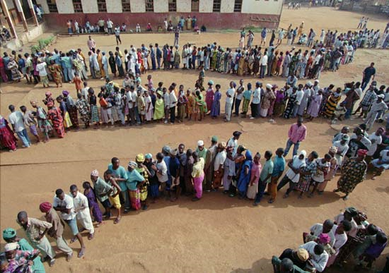
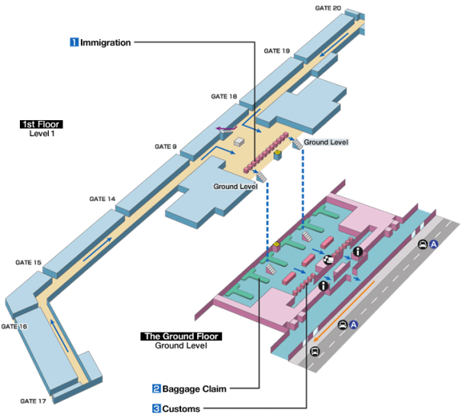


Class discussion.
What about airports?

Slide 48
Typical Applications of the Poisson Distribution
Customers arriving for service PER UNIT TIME at:
  Drive through banking, Canadian passport office.
Occurrence of Earthquakes, automobile accidents, meteorites hitting space stations, PER UNIT TIME.

Slide 49


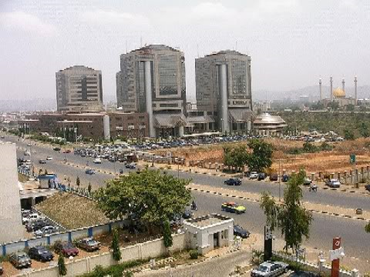
Abuja

Slide 50
Poisson Probability Distribution
POISSON PROBABILITY DISTRIBUTION
where:
x = number of successes in segment t
λ = expected number of successes in a segment t
e = base of the natural number system (2.71828)
λ
x
−
λ
(
)
e
P
=
(
x
)
x
!

Slide 51
Poisson Distribution Using Excel
Make a column of values of x=0,…,10 in A1,…,A11
Goto B1
Function; statistical; Poisson
  X=A1
  Mean = 6
  False (not a cumulative distribution)
Copy the function from B1 to B11

Slide 52
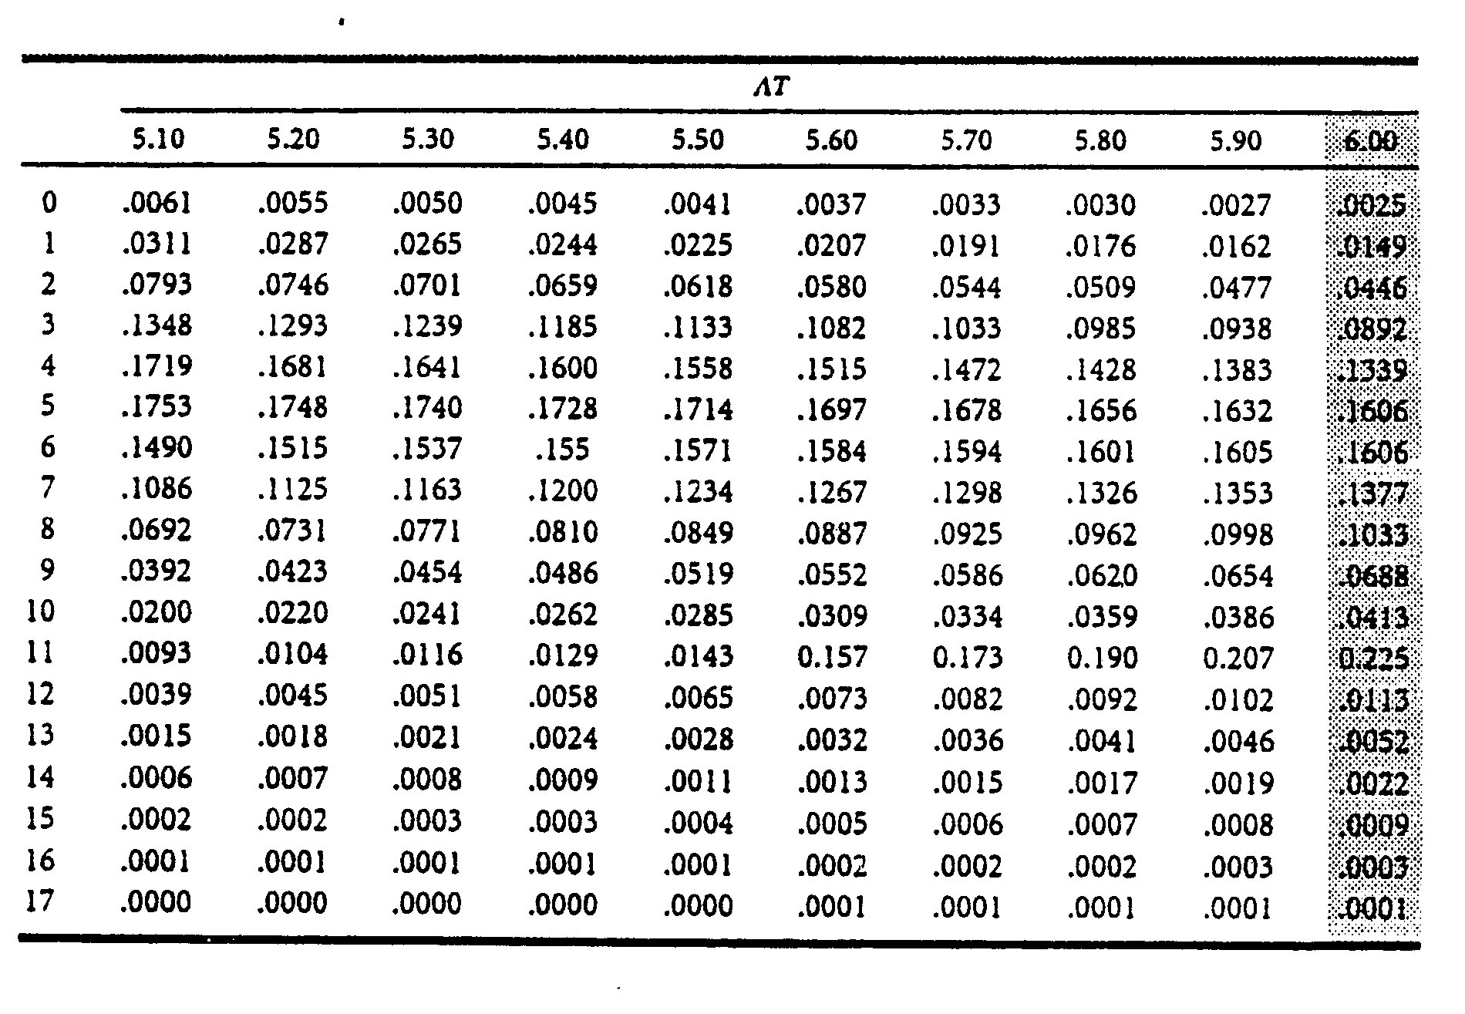
Poisson Probability Distribution

Slide 53
Poisson Example
A fast food restaurant has customers arriving for drive-through service at a rate of 60 per hour. What is the chance of getting more than 4 customers in 5 minutes?
NB scale the arrival rate to the time interval of interest. Arrival rate = 5 customers per 5 minutes.
P(0 customers) = 5⁰ e⁻⁵ / 0!
P(1 customer) = 5¹ e⁻⁵ / 1!
P(0 or 1 or 2 or 3 or 4 customers)
  = (1/1 + 5/1 + 25/2 + 125/6 + 625/24) e⁻⁵ = 0.4405
P(>4 customers) = 1-0.4405 = 0.5595

Slide 54
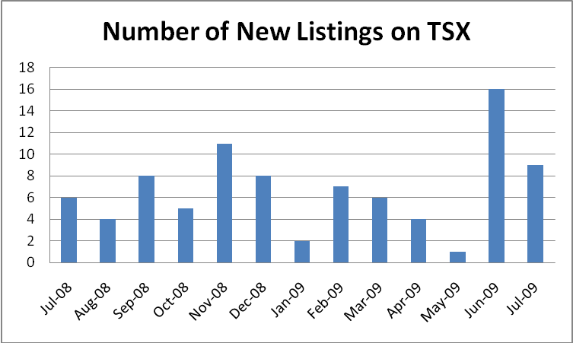

Toronto Stock Exchange
Lets list in Toronto
The average # of new listings is 6.69 per month.
  Suppose next month only 3 companies listed, should the TSX regard this month as exceptional and start to investigate how to attract more listings?
  Suppose next month 15 companies listed. Should the TSX regard this as a departure from past trends an start to expand its New Listings Department?

Slide 55
This is a Red Flag Question
P(X=<3) = P(X=0) +P(X=1) +P(X=2) +P(X=3)
=e^{-6.69}[ 6.69⁰/0! + 6.69¹/1! + 6.69²/2! + 6.69³/3!]
=0.001243[1+6.69+22.38+49.90]
= 0.0994
P(X>=15) =1-P(X<15)
= 1 – P(X=0) – P(X=1) – … - P(X=14)
=1 - e^{-6.69}[ 6.69⁰/0! + 6.69¹/1! + … + 6.69¹⁴/14! ]
= 1- 0.001243*801.24
= 0.00406
If 3 is exceptionally low then so is 2, 1, 0.
Class discussion: Should we raise a red flag?

Slide 56
Class Discussion
On average, customers return 2 products per day to a clothing store.
What is the probability that there will be 4 or more products returned tomorrow?
What is the probability that there will be 2 or more products returned tomorrow morning (I.e. during half of tomorrow)?
Given that there were 2 products returned this morning, what is the probability that there will be 2 or more products returned this afternoon?

Slide 57
What Can Go Wrong?
A model is just a model. If the assumptions don’t apply, the results of the model will be wrong.
Check assumptions:
  Poisson
    Independent events
    Average number of events same for each time period.

Slide 58
Mean and Standard Deviation for the Poisson Probability Distribution
MEAN OF THE POISSON DISTRIBUTION
STANDARD DEVIATION FOR THE POISSON DISTRIBUTION
μ
=
λ
σ
=
λ
Class discussion: What are the units for
σ
λ
μ

Slide 59
TSX New Listings
Mean = 6.69
Variance = 15.56
SD = 3.95
Class Discussion.
Is it Poisson?

Slide 60
Discrete Distribution Summary
P(x)
Prob p
n-x
x
a
b
Not special Special
Uniform: a, b
Binomial: n, p
N
S
Time
x
n
# of events
Per unit time: λ
Hypergeometric: N, S, n
Poisson: λ

Slide 61
Discrete Distribution Summary
Discrete
Distributions
Probability of each
option is the same
Uniform
Distribution
Calculate probability
that x out of n
are special
Known probability
of being special
Binomial
Distribution
Population N
of which S are
known to be special
HyperGeometric
Distribution
Known Arrival Rate
Poisson
Distribution

