Slide 1
Using Probability and Bayes Rule

Slide 2
Outcomes
After studying this material, you should be able to:
Understand the three approaches to assessing probabilities.
Apply the common rules of probability including Bayes Theorem.

Slide 3
Probability
Assessing Probability
Events
Combining Events
  A “OR” B
  A “given” B
  A “AND” B
Bayes Theorem.

Slide 4
Probability
Probability
P
0 1
Probability refers to the chance that a particular event will occur.
The probability of an event will be a value in the range 0.00 to 1.00. A value of 0.00 means the event will not occur. A probability of 1.00 means the event will occur. Anything between 0.00 and 1.00 reflects the uncertainty of the event occurring.

Slide 5
The Rules of Probability
PROBABILITY RULE 1
This isn’t rocket science.

Slide 6
Assessing Probabilities
Theoretical: Number of Possibilities
Relative Frequency: Empirical
Subjective

Slide 7
Theoretical Probability Assessment
Theoretical Probability Assessment refers to the method of determining probability based on the ratio of the number of ways the event of interest can occur to the total number of ways any event can occur.

Slide 8
Theoretical Probability Assessment
THEORETICAL PROBABILITY MEASUREMENT

Slide 9
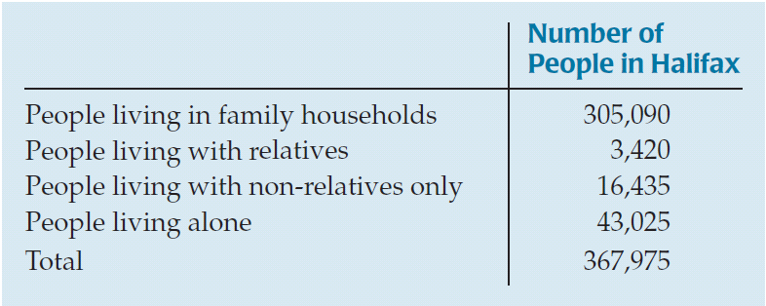
Telemarketing in Halifax
The Canadian Census of 2006 Source: http://www40.statcan.gc.ca/l01/cst01/famil123a-eng.htm
Telemarketers call people in Halifax in 2006 at random to sell products designed for family households. We can calculate the probability that the household will be of that type by dividing the number of people in that type of household by the total number of people: 305,090/367,975 = 0.829.

Slide 10
Relative Frequency of Occurrence
(Empirical Probability)
Relative Frequency of Occurrence refers to a method that defines probability as the number of times an event occurs, divided by the total number of times an experiment is performed in a large number of trials.
E.g. Results of a survey:
Out of 100 respondents, 50 said they preferred Pepsi to Coke

Slide 11
Relative Frequency of Occurrence
Example
On a production line products are tested
throughout a day.
Out of 10000 products, 52 are found to be
defective.
Probability of defective product
= 52/10000
= 0.52%

Slide 12
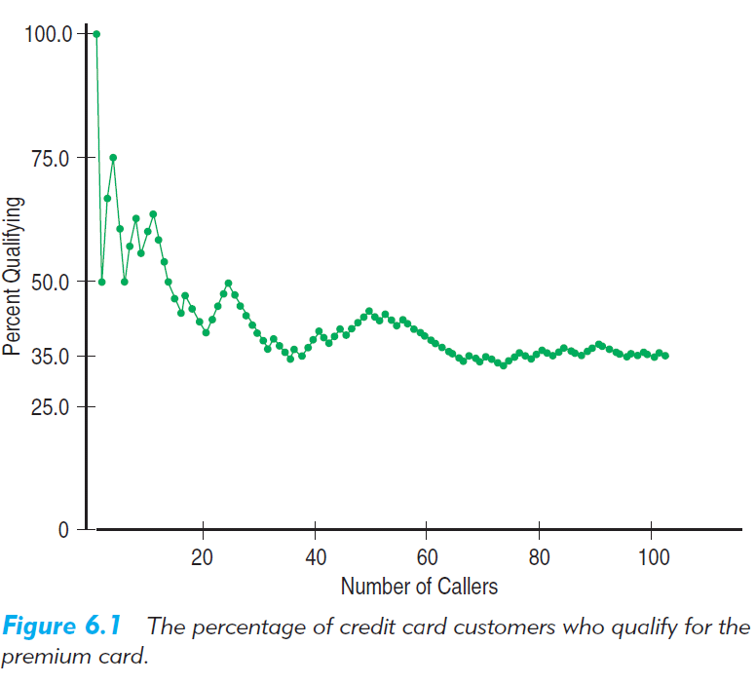
Law of Large Numbers (LLN)
If the events are independent, then as the number of trials increases, the long-run relative frequency of an event gets closer and closer to a single value.

Slide 13
Subjective (Personal) Probability Assessment
Subjective Probability Assessment refers to the method that defines probability of an event as reflecting a decision maker’s state of mind regarding the chances that the particular event will occur.
Partner in consulting company puts in a bid for
a contract, and subjectively assesses the chance
of getting the contract as 70%.

Slide 14



Subjective Probability Assessment in Law
In Canada, …, there is only one civil standard of proof … and that is proof on the balance of probabilities.
I thought it was “innocent until proven guilty beyond reasonable doubt”
That’s for criminal cases.
Justice Marshall Rothstein
Canadian Supreme Court
Source: National Post Oct 3, 2008

Slide 15
Class Discussion
Which probability assessment method was used in the following examples?
  A construction company bids on a contract to build a new bridge over a river, and assesses the probability of getting the contract to be 0.6
  A bank analyses the balances in customers chequing accounts and assesses that when the balance exceeds $5000, the probability of a that customer transferring some money to a savings account is 0.87
  A gambler tosses two dice and assesses the probability of getting two 6’s to be 1/36

Slide 16
Comparison
Theoretical Probability Assessment
Relative Frequency of Occurrence
Subjective Probability Assessment

Slide 17
Class Discussion
Canadian Entrepreneurs. Researchers studying government records of small businesses found that the probability that a newly established small business would still be operational in 5 years was 0.35. However entrepreneurs starting new businesses estimate that the chance of their own business still being in operation in 5 years is 0.75 on average. Which methods of probability assessment were used by (a) the researchers and (b) the entrepreneurs.

Slide 18
Probability
Assessing Probability
Events
Combining Events
  A “OR” B
  A “given” B
  A “AND” B
Bayes Theorem.

Slide 19
Trials
A trial is a process that produces a single outcome whose result cannot be predicted with certainty.
An audit is done on a company’s accounts
A product is launched into a test market
An interviewee is asked how they would vote

Slide 20
Sample Space
The sample space is the collection of all possible outcomes of a trial.
S = Sample
Space
Something’s Gotta Happen
PROBABILITY RULE 2
P(S) = 1

Slide 21
Events
An event is an outcome or a collection of outcomes of a trial.
Sample
Space
Event
Example Event:
When the product was launched into
the test market, the profit was >$1m

Slide 22
Example
A mining company explores a site for copper and zinc using exploratory drilling to obtain samples. The probability that a sample
  contains copper is 0.2 (Event 1)
  contains zinc is 0.3 (Event 2)
Class Discussion
What is the probability that a sample:
  Contains copper or zinc
  Contains copper and zinc

Slide 23
Complement of an Event
The complement of E is the same as “not E”
PROBABILITY RULE 3
P
(
E
)
=
1
−
P
(
E
)
Something’s Gotta Happen
E
E
Sample Space

Slide 24
Probability
Assessing Probability
Events
Combining Events
  A “OR” B
  A “given” B
  A “AND” B
Bayes Theorem.

Slide 25
Four Types of Probability
Marginal
“Straight”
Union
“OR”
Conditional
Joint
“AND”
The probability of X occurring
The probability of X or Y occurring
The probability of X occurring given that Y has occurred
The probability of X and Y occurring
X
X
Y
X
Y
Y
Notes:
22

Slide 26
The “AND” Rule for Independent Events
Rule 4
The “AND” rule for independent events E₁ , E₂:
Definition of independence:
Two events are independent if the occurrence of one
does not affect the occurrence of the other. More on this later.

Slide 27
Mutually Exclusive (Disjoint) Events
Two events are mutually exclusive (disjoint) if the occurrence of one event precludes the occurrence of another event.
You can’t have your cake and eat it too.
Sample
Space
Event # 1
Event # 2
Cake Eat it too

Slide 28
Special Case of the “OR” Rule
Probability Rule 5
The “OR” rule for mutually exclusive events E₁ and E₂:
P(E₁ or E₂) = P(E₁) + P(E₂)
E₁
E₂
Sample Space
Venn Diagram

Slide 29
The “OR” Rule
Union
“OR”
The probability of X or Y occurring
PROBABILITY RULE 6
The “OR” rule for any two events E₁ and E₂:
P(E₁ or E₂) = P(E₁) + P(E₂) - P(E₁ and E₂)
X
Y
E₁
E₂
Sample Space

Slide 30
Survey Results
Joint (AND) Probability
Contingency Table
 | Age < 40 | Age > 40
Prefer Pepsi | 0.2 | 0.3
Prefer Coke | 0.4 | 0.1
Discussion: Calculate the marginal probabilities
Prob(Pepsi or <40) = Prob(Pepsi) + Prob(<40) – Prob(Pepsi and <40)
= 0.5 +0.6 –0.2
= 0.9

Slide 31
Class Discussion
A mining company explores a site for copper and zinc using exploratory drilling to obtain samples. The probability that a sample
  contains copper is 0.6
  contains zinc is 0.5
  contains both zinc and copper is 0.4.
What is the probability that a sample contains zinc or copper?

Slide 32
Conditional Probability
Conditional probability refers to the probability that an event will occur given that some other event has already happened.

Slide 33
Baffin Bay Class Discussion
Baffin Bay, located between Canada and Greenland is being explored for oil and natural gas. First an energy company conducts a geological survey and if the data look promising, it starts drilling. A recent survey of one area cost $65m and a meeting of the geologists and engineers came to a consensus that drilling a first well would be successful with a probability of 0.2. Company data from previous drilling indicates that if the first well is successful, the probability of the second well being successful in this area is increased from 0.2 to 0.6.
Which of these probabilities is a conditional probability?

Slide 34
Conditional Probability
Conditional
PROBABILITY RULE 7
Conditional probability for any two events E₁ , E₂:
The probability of X occurring given that Y has occurred
Y
X
Y

Slide 35
Survey Results
Contingency Table
Conditional Probabilities
 | Age < 40 | Age > 40
Prefer Pepsi | 0.2 | 0.3
Prefer Coke | 0.4 | 0.1
Prob(Pepsi | <40) = Prob(Pepsi and <40)/Prob(<40)
= 0.2/0.6
= 0.3333

Slide 36
Class Discussion
Contingency Table
 | Age < 40 | Age > 40
Prefer Pepsi | 0.2 | 0.3
Prefer Coke | 0.4 | 0.1
What is Prob (Coke | >40)
Which of the 3 methods of assessing probability is being used in the Coke/Pepsi example? Could one of the other 2 methods be used instead?

Slide 37
Class Discussion
A mining company explores a site for copper and zinc using exploratory drilling to obtain samples. The probability that a sample
  contains copper is 0.6
  contains zinc is 0.5
  contains both zinc and copper is 0.4.
What is the probability that a sample containing zinc also contains copper?
06ffx #2(a)

Slide 38
Planet B
Making a Contingency Table
Planet B. Environmentalists concerned that global warming may make planet Earth uninhabitable sometimes emphasise their point of view by saying “There is no Planet B”. But space agencies around the world have been cataloguing planets orbiting other stars to try to find potential candidates for Planet B. Not many planets are suitable for human life. The chance of having an acceptable surface gravity is 0.09. The chance of having an acceptable surface temperature is 0.02.
Assuming that surface gravity and surface temperature are independent, construct a contingency table to represent this information.
HINT: Contingency tables consist of “AND” (joint) probabilities.

Slide 39
Ethics in Action
Hair Salon: Facials or Massages?
Survey of salons offering facials and massages
  50% of customers wanting hair styling also want facials
  90% of customers want hair styling or massages
Therefore we should offer massages.
Ethical Issue
  Item A: Probabilities not comparable (conditional/OR)
Ethical Solution
  Report all details of survey.

Slide 40
Tree Diagrams
Another way of organizing events of an experiment that aids in the calculation of probabilities is the tree diagram.

Slide 41
Tree Diagrams
Drink Survey
P(<40) = 0.6
P(>40) = 0.4

Slide 42
Tree Diagrams
Drink Survey
P(Pepsi|<40) = 0.33
P(<40) = 0.6
P(Coke|<40) = 0.66
P(Pepsi|>40) = 0.75
P(>40) = 0.4
P(Coke|>40) = 0.25

Slide 43
Tree Diagrams
Drink Survey
P(Pepsi & <40) = 0.33*0.6=0.2
P(Pepsi|<40) = 0.33
P(<40) = 0.6
P(Coke|<40) = 0.66
P(Coke & <40) = 0.66*0.6=0.4
P(Pepsi|>40) = 0.75
P(Pepsi & >40) = 0.75*0.4=0.3
P(>40) = 0.4
P(Coke|>40) = 0.25
P(Coke & >40) = 0.25*0.4=0.1

Slide 44
Testing New Drugs
Clinical testing of chemical compounds for approval as drugs goes through 3 successive stages:
  Phase 1: testing on about 50 healthy individuals to investigate possible side effects. 70% success rate. Cost $7.3m per compound
  Phase 2: testing on about 200 patients to investigate effectiveness in curing illness. 43% success rate. Cost $18.9m per compound
  Phase 3: testing on about 3000 patients to investigate effectiveness in curing illness. 67% success rate. Cost $43.3m per compound
Are the %s given in the text conditional probabilities?
Succeed
Succeed
Succeed
Ph 3
Ph 2
Fail
Ph 1
Fail
Fail

Slide 45
Independent and Dependent Events
Being independent is a totally different thing that being mutually exclusive
Two events are independent if the occurrence of one event does not change the probability of the occurrence of the other event.
Definition of independence:
Two events are independent if:
P(A|B)=P(A)
Must check this formula to prove independence

Slide 46
Drink Preferences
 | Age < 40 | Age > 40
Prefer Pepsi | 0.2 | 0.3
Prefer Coke | 0.4 | 0.1
Is Preferring Pepsi independent of being >40?
P(Pepsi) = 0.5
P(Pepsi | >40) = 0.3/0.4 = 0.75
Since these are not equal, preferring Pepsi is not independent of being >40. (Drink preference depends on age)

Slide 47
Class Discussion
A mining company explores a site for copper and zinc using exploratory drilling to obtain samples. The probability that a sample
  contains copper is 0.6
  contains zinc is 0.5
  contains both zinc and copper is 0.4.
Is the presence of copper and zinc in samples (i) mutually exclusive (ii) independent? State your reasons clearly?
06ffx #2(b)

Slide 48
Independent
IS NOT THE SAME AS Mutually Exclusive
Independent | Check whether P(B|A) = P(B) Or Check whether P(A|B) = P(A) Or Check whether P(A and B) = P(A) * P(B)
Disjoint (mutually exclusive) | Check whether P(A and B) = 0 Or Check whether the events A and B overlap in the sample space diagram. Or Check whether both events can occur together

Slide 49
The “AND” Rule
PROBABILITY RULE 7a
The “AND” rule for two events E₁ and E₂:
Joint
“AND”
The probability of X and Y occurring
X
Y
Rule 7 revisited

Slide 50
Special Case of the “AND” Rule
Rule 4
The “AND” rule for independent events E₁ , E₂:
Recall: Definition of independence:
Two events are independent if:
P(A|B)=P(A)

Slide 51
Testing New Drugs: Class Discussion.
Clinical testing of chemical compounds for approval as drugs goes through 3 successive stages:
  Phase 1: testing on about 50 healthy individuals to investigate possible side effects. 70% success rate. Cost $7.3m per compound
  Phase 2: testing on about 200 patients to investigate effectiveness in curing illness. 43% success rate. Cost $18.9m per compound
  Phase 3: testing on about 3000 patients to investigate effectiveness in curing illness. 67% success rate. Cost $43.3m per compound
What is the probability that a chemical compound is successful in passing all 3 phases of testing.
How many compounds should we start with (on average) in order to get one clinically tested drug.
HINT: Copy the tree diagram from a few slides back

Slide 52
Designer Drugs: Pharmacogenomics
Homework
Drugs can be developed that are specific to people with certain genes. If we only test these drugs on people with the genes for which they were designed, the success rate of clinical tests improves:
  Phase 1 80%; Phase 2 65%; Phase 3 85%.
Answer the 2 questions on the previous slide.
Tree diagram again
McKinsey Quarterly, Bhandari et al. “Genetic Revolution in Health Care”

Slide 53
Class Discussion
Barrick Gold. The Canadian mining company Barrick Gold operates the Donlin Creek mining project in the Yukon-Kuskokwin region, today providing stable employment with 90% First Nations people as employees and supervisors.
When another mining company started the project in 1996, employment conditions were much worse. There was a 50% probability of employees failing drug screening tests and hence being fired. Of those who passed the test, there was a 70% chance of they would resign from their jobs.
  What was the probability that an employee would leave employment either as a result of failing the drug test or as a result of resignation?
Surely you don’t need my help this time

Slide 54
Class Discussion: Cycling Accidents
Car speed (Km/hr) | Probability of an accident being fatal to a cyclist
30 | 0.04
50 | 0.65
60 | 0.8
The probability of a cyclist being killed in a car accident depends on the speed of the car.
On a stretch of road in Ottawa with a cycle lane, the chance of a car having an accident with a cyclist during the course of a year is 0.73. The speed limit is 50 Km/hr and half the cars travel at that speed. The other half travel at 60 Km/hr.
What is the probability of a cyclist being killed on this stretch of road during the course of a year?

Slide 55
What Can Go Wrong?
Beware of probabilities that don’t add up to 1.
Don’t add probabilities of events unless they are disjoint.
Don’t multiply probabilities of events unless they’re independent.
Don’t confuse disjoint and independent.

Slide 56
Probability
Assessing Probability
Events
Combining Events
  A “OR” B
  A “given” B
  A “AND” B
Bayes Theorem.

Slide 57
Bayes Theorem
When to Use it
I know P(X|Y)
I want to know P(Y|X)
I have an initial estimate of P(Y)
I do a test and find that X is true
I update my initial estimate to get P(Y|X)

Slide 58
The Rules of Probability
Given k mutually exclusive and exhaustive events E₁ ,…, E_{k}, then the probability of another event, B, is given by:
P(B) = P(B & E₁) + … + P(B & E_{k})
= P(B | E₁) P(E₁)+ … + P(B | E_{k}) P(E_{k})
Bayes Rule:
P(Ei | B) = P(Ei & B)/P(B)
      = P(Ei) P(B | Ei) / P(B)
      Contd next slide
This rule looks tough, but it’s pretty obvious, if you draw a diagram.
P(Coke) = P(Coke & <40) + P(Coke & >40)

Slide 59
Bayes’ Theorem
General Formulation
BAYES’ THEOREM
where:
E_{i} = ith event of interest of the k possible events
B = new event that might impact P(E_{i})
P
(
E
)
P
(
B
|
E
)
P
=
i
i
(
E
|
B
)
i
P
+
+
+
(
E
)
P
(
B
|
E
)
P
(
E
)
P
(
B
|
E
)
P
(
E
)
P
K
(
B
|
E
)
1
1
2
2
k
k

Slide 60
Medical Example of Bayes Theorem
Doctor assesses probability of patient having diabetes as P(D)=0.7 from clinical examination, and orders lab test.
Lab test has been confirmed on patients who are known to either have diabetes (D) or not have diabetes (Well)
  Probability of positive lab test on a diabetic patient is P(+|D)=0.99
  Probability of positive lab test on a well patient is P(+|Well)=0.05
The Lab test comes out positive for this patient. Calculate revised (posterior) probability that the patient has diabetes: P(D|+).

Slide 61
Medical Example of Bayes Theorem
Doctor assesses probability of patient having diabetes as P(D)=0.7 from clinical examination, and orders lab test.
Lab test has been confirmed on patients who are known to either have diabetes (D) or not have diabetes (Well)
  Probability of positive lab test on a diabetic patient is P(+|D)=0.99
  Probability of positive lab test on a well patient is P(+|Well)=0.05
The Lab test comes out positive for this patient. Calculate revised (posterior) probability that the patient has diabetes: P(D|+).
I know P(+|D)
I want to know P(D|+)

Slide 62
Medical Example of Bayes Theorem
Doctor assesses probability of patient having diabetes as P(D)=0.7 from clinical examination, and orders lab test.
Lab test has been confirmed on patients who are known to either have diabetes (D) or not have diabetes (Well)
  Probability of positive lab test on a diabetic patient is P(+|D)=0.99
  Probability of positive lab test on a well patient is P(+|Well)=0.05
The Lab test comes out positive for this patient. Calculate revised (posterior) probability that the patient has diabetes: P(D|+).
I have an initial estimate of P(D)
I do a test and find that + is true
I update my initial estimate to get P(D|+)

Slide 63
Probability Tree Approach
P(+ve|D) = 0.99
P(+ve & D)=0.7*0.99 = 0.693
P(D|+ve)
P(D) = 0.7
P(-ve|D) = 0.01
P(-ve & D)=0.7*0.01=0.007
P(+ve|W) = 0.05
P(+ve & W)=0.3*0.05=0.015
P(W) = 0.3
P(W|-ve)
P(-ve|W) = 0.95
P(-ve & W)=0.3*0.95=0.285
P(D|+ve) = P(D & >ve)/P(>ve) = 0.693/(0.693+0.015) = 0.979

Slide 64
Solution to Medical Example
Initial estimate
P(D) = 0.7
P(W) = 0.3
Discussion. Are these conditional or “AND” probabilities?
What is a false –ve (+ve) ?
 |  | Diabetes | WELL
Test +ve |  | 0.99 | 0.05
Test -ve |  | 0.01 | 0.95
P(D)=0.7
P(D|+)=P(D)*P(+|D)/ [P(D)*P(+|D)+P(Well)*P(+|Well)]
(0.99*0.7)/(0.99*0.7 + 0.05*0.3)=0.979

Slide 65
Solution to Medical Example
Table Layout
 |  | Diabetes | WELL
Test +ve |  | 0.99 | 0.05
Test –ve |  | 0.01 | 0.95
Prior | P(D) | 0.7 | 0.3
Condit | P(+ | D) | 0.99 | 0.05
Joint (AND) | P(+ and D)= P(D) P(+|D) | 0.693 | 0.015
Posterior | P(D | +)=P(+ and D) / {P(+ and D) + P(+ and W)} | 0.979 | 0.021

Slide 66
Designing Medical Tests
 | Patient is ill | Patient is OK
Test indicates illness | 0.99 | 0.05
Test indicates no illness | 0.01 | 0.95
Suppose this is a screening test. I.e. we have no particular reason to think this patient might have diabetes, but we know that 0.1% of the patients in this demographic group do have diabetes.
  What is the probability that the patient has diabetes if the test is positive?
  If you were designing a new and better test, which of the numbers in the above table would you try to change?

Slide 67
Accounting Example
Auditor checks a small company’s accounts.
  average error rate P(error) = 0.05.
  Auditors may audit perfectly good accounts and think there is an error,
    P(report an error | no error) = 0.04. (false positive)
  Can the auditors find an error that is really there?
    P(report an error | error) = 0.94,
    P(report no error | error) = 0.06, (false negative).
Suppose the auditor reports an error, what is the probability that there really is an error, P(error | report an error)?
Bayes Rule because it fits our two criteria.
  We know P(report an error | error) = 0.94 and would like to know P(error | report an error).
  We have an initial estimate, P(error), and would like to update it to, P(error | report an error).

Slide 68
Probability Tree for Accounting Example
Error
And 0.047
Report an error
Report an error
0.94
Report no error
0.06
Error
And 0.003
Report no error
Error
0.05
0.95
No Error
No Error
And 0.038
Report an error
Report an error
0.04
Report no error
096
No Error
And 0.912
Report no error
P(error | report an error) = P(error AND report an error) / P(report an error)
= 0.047 / (0.047 + 0.038)
= 0.55.

Slide 69
Personnel Example Class Discussion
I’m 70% sure Helen should be promoted to a management position. I’ll send her for a psych test.
The psych test isn’t always accurate, but at least we know how accurate it is on our (un)successful managers.
She passed! That will help me revise my estimate.
P(pass | successful) = 0.95
P(pass | unsuccessful) = 0.1
P(successful | pass) = ?
Soln. 0.96
P(successful)=0.7

Slide 70
Class Discussion Faulty Products
0.2% of the products coming off our production line are faulty
We test each product
If the test indicates a fault what is the probability that the product is faulty?
 | Product is faulty | Product is OK
Test indicates a fault | 0.9 | 0.05
Test indicates no fault | 0.1 | 0.95
Soln. 0.035

