Slide 1
Agenda: Foundations of Sociology
Philosophical Foundations
Sociology and Common Sense
Sociological Explanation of Suicide
Social Structures
Theory, Research and Values
Four broad theoretical traditions
Approaching Theory
In-Class Activity: Theory in Action
Sociology Today
Online Participation & Group Projects

Slide 2
3 in 5
What is Sociology?
Study of the “Social” and its enabling and constraining influence
The Compass, the Lenses and the Snowflake

Slide 3
Philosophical Foundations
Underlying Sociology is Philosophy and its concepts of:
Ontology: What is real?
Epistemology: How do we know what we know?
Early social philosophers contributed to classical sociology theory through these fundamental tenets:
Thomas Hobbes’s assertion that government’s appropriate role lies in preserving peace while allowing individuals to pursue their self-interests
John Locke’s belief in individual freedom and autonomy
Charles de Montesquieu’s comparative methodology and his appreciation for cultural diversity
Jean-Jacques Rousseau’s analysis of the social contract and his belief in individual autonomy

Slide 4
Sociology and Common Sense
In the first place sociology, unlike common sense, makes an effort to subordinate itself to the rigorous rules of responsible speech.
Second, there is the size of the field from which the material for sociological thinking is drawn.

Slide 5
Sociology and Common Sense
Third, sociology and common sense differ in the way that each makes sense of human reality in terms of how they understand and explain events and circumstances. (intentions-us vs not)
Finally, the power of common sense depends on its self-evident character: that is, not to question its precepts and to be self-confirming in practice.

Slide 6
The Sociological Perspective
Sociological perspective illustrated through considering causes of suicide
Suicide often regarded as a supremely antisocial and non-social act
Yet there are hidden social causes of suicide

Slide 7
Sociological Explanation of Suicide: Durkheim’s Contribution
Émile Durkheim ⇨ At end of 19th century, demonstrated suicide rates were strongly influenced by social forces
Examined association between rates of suicide and rates of psychological disorder for different groups
Found suicide rates and rates of psychological disorder did not vary directly, and often appeared to vary inversely

Slide 8
Durkheim’s Contribution
Durkheim argued suicide rates varied as result of differences in degree of social solidarity in different categories of the population
Social solidarity refers to:
  - the degree to which group members share beliefs and values; and
  - the intensity and frequency of their interaction
Mechanical vs Organic forms of social solidarity

Slide 9
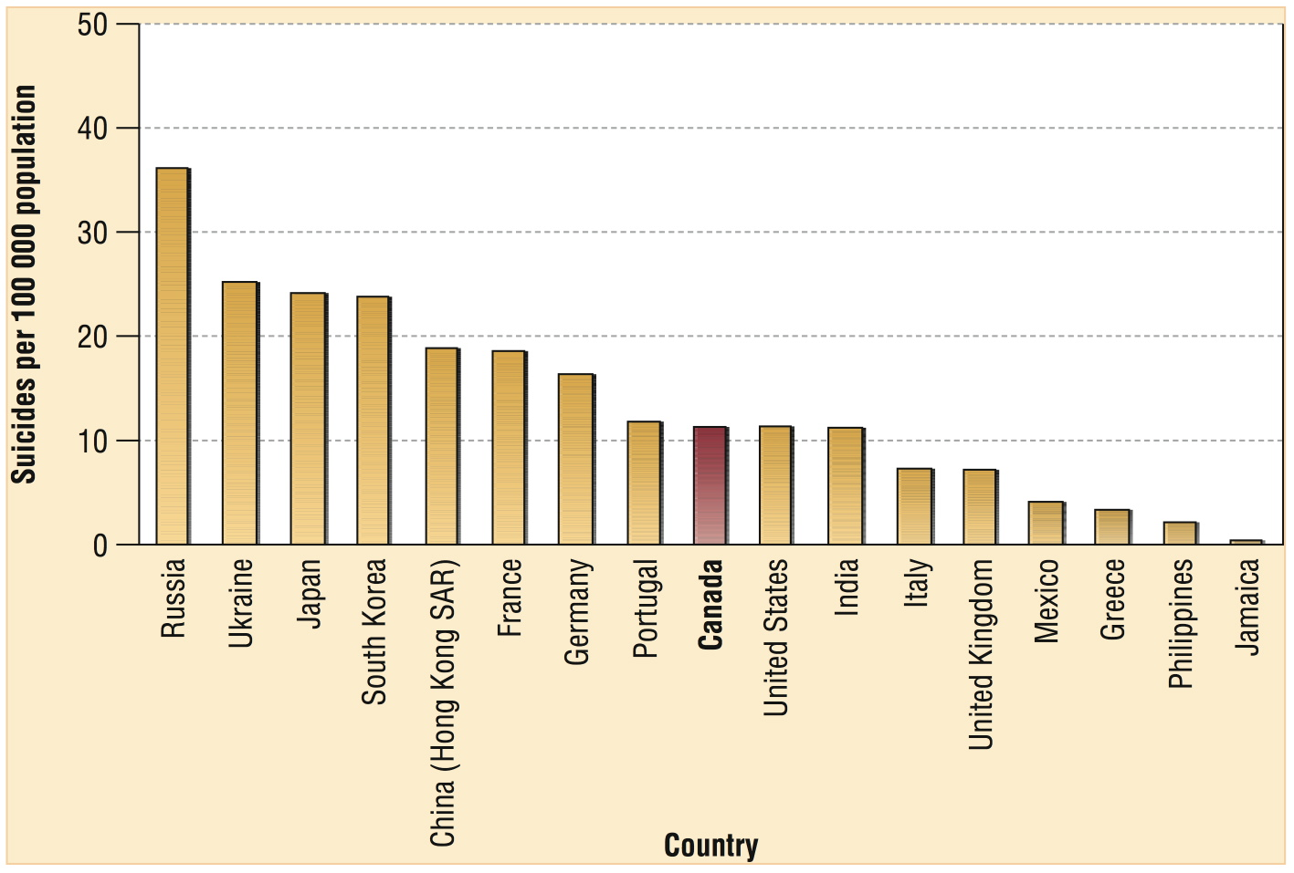
Suicide Rates, Selected Countries, circa 2004

Slide 10
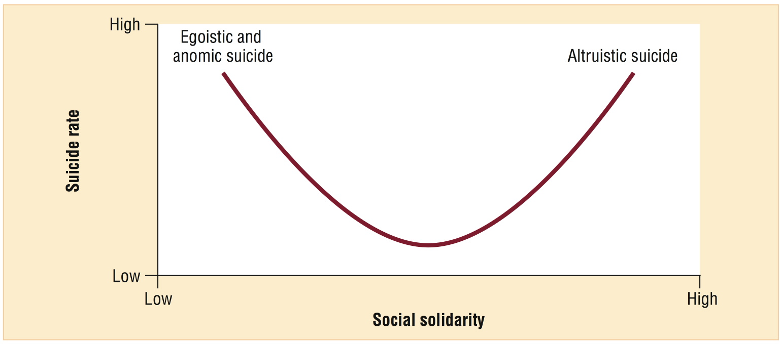
Durkheim’s Theory of Suicide

Slide 11
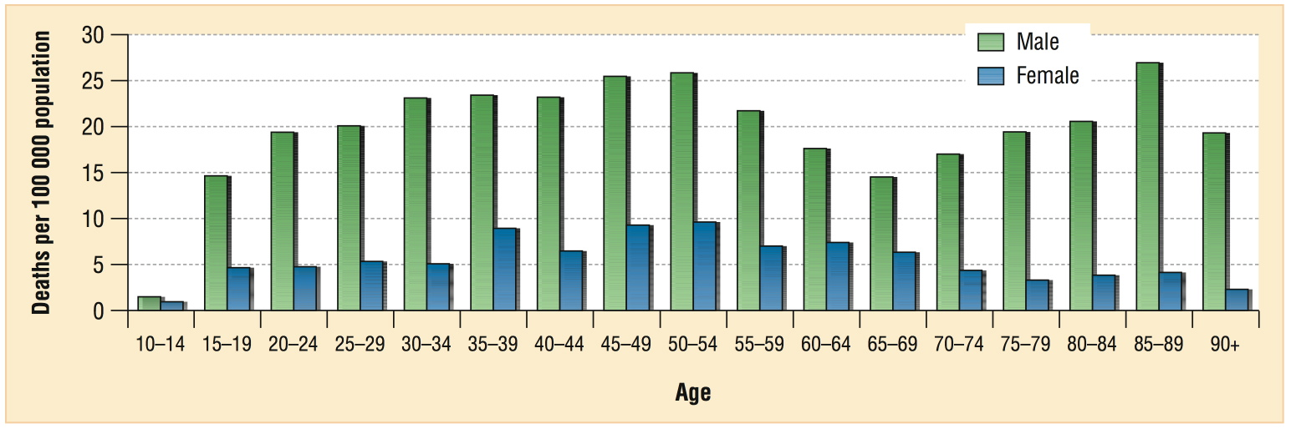
Suicide Rate by Age and Sex,
Canada, 2004

Slide 12
Social Structure
Social structure: Relatively stable patterns of social relations that affect our thoughts, feelings, actions, and identity
Are three levels of social structure:
  Microstructures (patterns of intimate social relations formed during face-to-face interaction)
  Macrostructures (patterns of social relations outside and above one’s circle of intimates and acquaintances)
  Global structures (patterns of social relations outside and above the national level)

Slide 13
Theory, Research, and Values
Auguste Comte (1798-1857): Sought to understand the social world using scientific method of research
Coined the term, “sociology”
Had vision of ideal society but never conducted any research
Herbert Spencer (1820-1903): Made claim for discovering scientific laws governing operation of society
Like Comte, never conducted any research

Slide 14
Theory, Research, and Values
Is tension between (i) belief in importance of science, & (ii) vision of ideal society
Tension reflected in works of important early figures in sociology (e.g., Karl Marx, Émile Durkheim, Max Weber) and continues today
Tension becomes clear when considering the following: Theory, research, and values…

Slide 15
Theory, Research, and Values
Theory: Tentative explanation of some aspect of social life that states how & why certain facts are related
  After sociologists formulate theories, can conduct research
Research: Process of carefully observing social reality, often to “test” a theory or assess its validity
Values/Interests: Ideas about what is right and wrong
  Values help sociologists formulate and favour certain theories over others
  Models of Science: Objectivity & Reflexivity

Slide 16
Historically: Sociology’s Four Major Theoretical Traditions
Functionalism: How is social order supported by macrostructures?
Conflict Theory: How is social inequality maintained and challenged?
Symbolic Interactionism: How do people create meaning when they communicate in microlevel settings?
Feminism: What are the social sources of patriarchy in both macro and micro settings?

Slide 17
Emile Durkheim (1858-1917)
Born to deeply religious Jewish family, Durkheim was an excellent student as a young man and went on to become one of the most influential scholars at the most elite French universities
Initially a professor of education, Durkheim was a widely trusted scholar who helped reform the French national education system.
More so than the other major classical theorists we will discuss, Durkheim made the development of a separate discipline of sociology a major life goal
When he died the same year his son was killed fighting for France in World War I, he left a rich legacy of sociology professorships and journals that shaped twentieth-century sociology and anthropology throughout the Western world

Slide 18
Functionalism
Stresses that human behaviour is governed by stable patterns of social relations (“social structures”)
Shows how social structures can either maintain or undermine social stability
Suggests social structures are based mainly on shared values or preferences
Argues that re-establishing equilibrium is best way to solve most social problems
Durkheim, Parsons, Merton

Slide 19
Conflict Theory
Focuses on large, macro-level structures (e.g., class relations)
Shows how major patterns of inequality produce social stability in some circumstances & social change in others
Stresses how members of privileged groups seek to maintain advantages while members of subordinate groups struggle to increase theirs
Typically recommends eliminating privilege as a means of reducing social conflict and increasing the sum of human welfare

Slide 20
Karl Marx (1818-1883)
Born in Trier, Germany, to a Jewish couple with a long tradition of rabbis on both sides of the family, Marx inherited a moral approach to politics and scholarship
Forced to drop out of academic philosophy and then made to leave his native Germany as a consequence of persecution for his political views and his defence of freedom of the press
More of an activist than a scholar, Marx was not himself a sociologist per se but his focus on class conflict played a central role in the development of both historical-comparative and conflict theories in our discipline
Marx was relatively poor most of his life and was supported by his long-time friend and collaborator, Friedrich Engels

Slide 21
Conflict Theory and Karl Marx
Central to Marx’s ideas was class conflict (struggle between classes to resist & overcome opposition of other classes)
Marx believed workers would…
Ultimately become aware of their exploitation (i.e., develop class consciousness)
Form trade unions & labour parties, which would end private ownership of property & bring about a “communist” society

Slide 22
Max Weber (1864-1920)
The son of a powerful and authoritarian German politician and a shy and religious Protestant mother, Max Weber dealt with issues of politics and religion in a lifetime of extremely influential scholarly works.
Trained in law, history, and economics, Weber became one of the central founders of sociology in Germany.
Weber’s wife Marianne was an important early feminist in Germany, and Weber helped to educate and support some of the most creative German intellectuals.
Ever practical as well as a theoretical intellectual, Weber left an enormous legacy of historical and interpretive sociology that is still being used today

Slide 23
Conflict Theory and Max Weber
Weber noted growth of the service sector of economy, with its many manual workers & professionals
Argued many members of these occupational groups stabilize society because they enjoy higher status & income than manual workers employed in manufacturing (middle class)
Showed class conflict is not the only driving force of history
Argued politics & religion also are important sources of historical change

Slide 24
Symbolic Interactionism
Focuses on interpersonal communication in microlevel social settings
Emphasizes social life is possible only because people attach meanings to things
Stresses people help to create their social circumstances, not merely react to them
Sometimes validates unpopular and unofficial viewpoints thereby increasing our understanding and tolerance of people who may be different from us

Slide 25
Symbolic Interactionism
Arose out of influence of Weber, Mead, & Goffman:
Weber emphasized importance of Verstehen: Empathetically understanding people’s motives & meanings they attach to things to gain a clear sense of the significance of their actions
Mead argued individual’s sense of self is formed in the course of interaction with other people
Goffman compared social interaction to a carefully staged play, complete with front stage, backstage, defined roles, & wide range of props

Slide 26
Social Constructionism
Is a variant of symbolic interactionism
Argues that when people interact, they typically assume things are naturally or innately what they seem to be
Suggests apparently natural or innate features of life are often sustained by social processes that vary historically and culturally

Slide 27
Feminist Theory
Focuses on various aspects of patriarchy (system of male domination in society)
Suggests male domination and female subordination are determined by structures of power and social convention rather than biological necessity
Examines operation of patriarchy in both microlevel and macrolevel social settings
Recommends eliminating patterns of gender inequality

Slide 28
Approaching Theory: Sociology of Knowledge
Affinity vs Dogmatism
Theories are ways of looking (i.e. understanding) parts of the world
All of them are models, they each offer you a set of lenses to maybe notice something you had not noticed before
Concepts are clusters of cases that allow to distinguish two things from each other
Don’t be dismissive

Slide 29
Contemporary: Four Sociological Lenses/Perspectives
Asking different set of questions
Functionalism – Role, Function, Purpose
Conflict – Inequality, Power, Who Benefits
Interpretive – Meaning, Construction of Meaning
Feminist – Interrogating categories

Slide 30
In-Class Activity – Apply Theoretical Perspectives to Sports
Groups of 2 to 5 students (no groups of more than 5, although you can work alone if you prefer)
One single sheet of paper to turn in (you can use both sides)
Student name in block letters followed by student ID number for all group members at the top of the sheet
i.e. CHRISTIAN CARON – 100258475 NATASHA WILSON – 100259653
Question:
Give an example of a question someone would ask about sports from each of the four theoretical perspectives? (i.e. how would they look at sports)
And briefly explain why they’d ask that question

Slide 31
Sociology Today
Sociology of Race Sociology of Gender
Sociology of Class Sociology of Education
Sociology of Mass Media Sociology of Technology
Sociology of Environment Sociology of Family
Sociology of the Body Sociology of Religion
Sociology of Culture Sociology of Deviance
Sociology of Health Sociology of Work
Sociology of Science Sociology of Knowledge
Industrial Sociology Sociology of Sexuality
Sociology of Social Movements Sociology of Crime
Sociology of Sports Sociology of Addictions
Sociology of Space Sociology of Time
Sociology of Art Sociology of Sex
Historical Sociology Governmentality
Political Sociology Economic Sociology

Slide 32
Online Participation
(1) Offer clarification on some aspect of readings or course material
(2) Help other students with their questions or with resources you think would be helpful
(3) Using sociological concepts or language, provide informed opinion or perspective on issues raised in readings of lectures
(4) Bring in information from another course relevant to the topics and discussion of this class
(5) Submit weblink to a useful site (dictionary, bibliography, government sites or clips, blog, news site, video, etc) with a few sentences describing its potential value/usefulness to fellow students

Slide 33
Online Participation
For weblinks, you must include both an http address and a few lines describing how this site/link could be useful to fellow students.
For contributions to discussion, it isnt as helpful to retype a definition from the text, but it is helpful to use your own words to summarize or explain something.
Offering an opinion on subjects is a significant contribution for the course if you do it using sociological language or perspective. Common sense opinions are very valuable also, but wont be counted towards "significant contributions" to the course for our purposes here.

Slide 34
Online Participation
The rule of thumb is that if is helpful for your colleagues within the scope of learning, understanding or appreciating sociology, it will be deemed a significant contribution.
The marks you accumulate towards this will be updated regularly in the gradebook.
If you make ten meaningful contributions during the course of the semester, you will get full marks.
The course of the semester does not mean ten quick contributions made in the last 48h of class. It means through the course of the whole semester.
If you have any questions about what counts and does not count, feel free to come and see me

Slide 35
Term Project
Content analysis of your TV show along the themes of race, class and gender
Must work in groups of 3
Ask people
1) Expectations for the project, 2) Work habits and 3) About topics
If you would like some assistance with finding colleagues to work with, send me a Virtual Campus mail I will help you find a group
First stage is a two page mini-proposal that will be discussed on Sept 24th and due on Oct 17th
You will be assigned your own TA to work with soon after you submit a mini-proposal on the 17th

Slide 36
Topic Sign-Up
Must be in group of 3
Discussion Board will open up at 11pm on Wednesday Sept 26th
Submit full student name all three group members along with your choice of TV show
Must be available in English (or English Subtitles)
Must be from 2002 or more recent
Your responsibility to see if another group has submitted your TV show (see posts above yours or use search function)
Once your topic has been officially assigned to you, it will appear in your mygrade

Slide 37
For next week
Reading:
4-Human Inquiry and Science, p35-60
5-How Sociologists Do Research, p61-94 (not appendix)
Groups should be mostly formed
I will release documents on weekend about mini-proposals and group projects, we will discuss them both in detail next week
Have a great week

