Slide 1
Culture
Research in Action
Defining Culture
Ethnocentrism vs Cultural Relativism
Culture, Language and Globalization
Wade Davis talk on Culture
Culture and Power
Popular Culture & Consumerism
Two Faces of Culture
Cultural Change

Slide 2
Operationalization in Action
Human Development Index
HDI is an index used to rank countries by level of “human development”
Operationalized as
Life expectancy at birth, as an index of population health and longevity
Education index, mean years of schooling
Standard of living, as measured by gross national income per capita (GNIpc)
Released on Nov 2nd, 2011 – Canada was 6th

Slide 3
Culture
Culture refers to the shared values, beliefs, behaviour, and material objects that together form a people’s way of life
Culture includes: How we think, How we act, What we own
In effect, everything we create with our hands and our minds
Culture is both our link to the past and our guide to the future

Slide 4
Culture
To understand culture, we must consider both thoughts and things
Nonmaterial culture is the ideas created by members of a society, ideas that range from art to Zen
Material culture, in contrast, refers to the physical things created by members of a society – everything from zippers to our homes and satellites in space

Slide 5
Culture
Culture shapes not only what we do but also what we think and how we feel – elements of what we commonly, but wrongly, describe as “human nature”
Culture is shared
Culture is learned
Culture is taken for granted
Culture is symbolic
Culture varies across time and place

Slide 6
Culture
Given the extent of cultural differences in the world and people’s tendency to view their own way of life as “natural”, it is no wonder that travelers often find themselves uneasy as they encounter an unfamiliar culture (i.e. culture shock)
No way of life is “natural” to humanity, even though most people around the world view their own behaviour that way

Slide 7
Culture and Judgment
Ethnocentrism: Tendency for person to judge other cultures exclusively by standards of their own culture
Danger: hierarchy of cultures, prejudice & discrimination
Cultural Relativism: Judging cultural practices and beliefs exclusively in the cultural context in which they appear
Danger: mostly incompatible with idea universal human rights

Slide 8
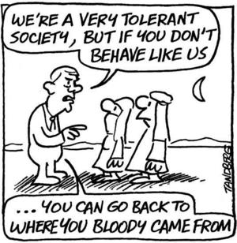
Ethnocentrism

Slide 9
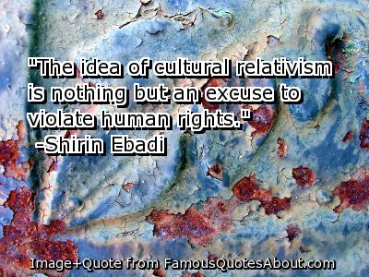
Cultural Relativism
Shirin Ebadi is Iranian lawyer and human rights activist
First Muslim woman and Iranian to be awarded Nobel Peace Prize (in 2003) for her work on democracy and human rights
She is exiled in Canada since 2009

Slide 10
Culture and Language
Language provides the categories through which social reality is understood
Wade Davis – Canadian born Anthropologist on Endangered Cultures
Ted.com – Ideas worth spreading
This video is on Ethnosphere – A strong argument for cultural diversity
http://www.ted.com/talks/lang/eng/wade_davis_on_endangered_cultures.html

Slide 11
Globalization of Language = Globalization of Culture
Globalization: The process by which formerly separate economies, states, and cultures are tied together and people become aware of their growing interdependence
One of most important roots of globalization is expansion of international trade and investment

Slide 12
Globalization
Consequences of globalization:
Destroys political, economic, and cultural isolation by bringing people together in “global village” (McLuhan)
People less obliged to accept culture into which they are born and freer to combine elements of culture from wide variety of historical periods and geographical settings

Slide 13
The Globalization of English
1600: English was mother tongue of between 4 and 7 million people
Today: More than 1 billion people speak English worldwide (more than half as a second language)
Consequence: Endangerment of several thousand languages worldwide and potential for homogenization of cultures

Slide 14
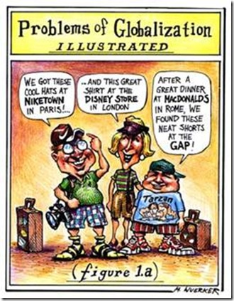
Homogenization of Cultures

Slide 15
Culture and Power
Dominant Culture is the culture of the most powerful group in society. It is the cultural form that receives most support from major institutions and constitutes the major belief system
Popular Culture comprises the beliefs, practices, and objects mass-produced and mass distributed, such as popular music and films, mass-marketed books and magazines, large-circulation newspaper and increasingly the Internet (71h of media per week)
Enormous power to share public opinion and behavior
Shapes people’s perception and awareness of social issues
Promotes narrow definition of who people are and what they can be (Body, Race, Gender, Sex, etc)

Slide 16
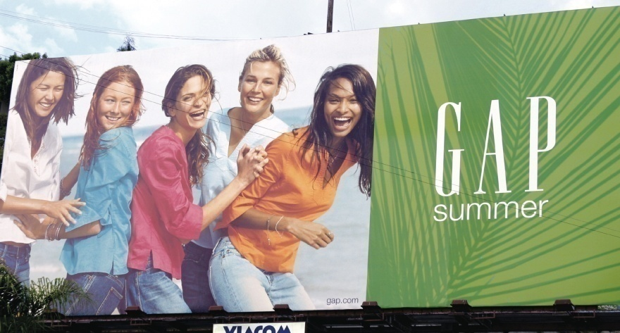
Consumerism
Consumerism: Tendency to define ourselves in terms of goods we purchase (e.g., we are what we wear, drive, etc.)
Consumers motivated to make purchases because of bombardment of advertising in form of North America’s “shop-till-you-drop” lifestyle
Can also choose to buy items that help define us as members of particular subculture: Adherents of a set of distinctive values, norms, and practices within a larger culture

Slide 17
Taming Counterculture and Subculture
Consumerism is remarkably effective at taming countercultures: Subversive subcultures that oppose dominant values and seek to replace them
Examples: Hippies of 1960s, and environmentalists today
Consumerism acts as social control mechanism that normally prevents countercultures from disrupting social order
Accomplishes this by (i) transforming deviations from mainstream culture into means of making money, and (ii) by enticing rebels to become entrepreneurs

Slide 18
Two Faces of Culture
Culture as constraining influence which limits certain amount of our choices
Culture as enabling influence which increases our choices

Slide 19
Cultural Diversity
We are increasingly able to choose how culture influences us is that there is more to choose from:
Tastes in music, food, clothes are more diverse
Inter-racial marriage increasingly accepted
Canada, an officially multicultural society
People now freer to piece together own cultural interests, practices, identity, from a world of possibilities

Slide 20
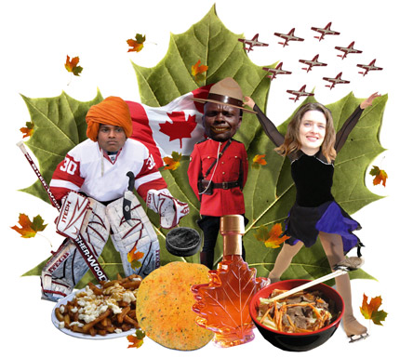
Multiculturalism

Slide 21
Multiculturalism: Advocates
At political level though, cultural diversity has become source of conflict
Disagreement especially evident in debates over curricula in Canadian educational system for example
Advocates of multiculturalism want school curricula to:
  Reflect growing ethnic and racial diversity
  Stress that all cultures have equal value
  Promote self-esteem and economic success

Slide 22
The Rights Revolution:
A Conflict Analysis of Culture
Underlying cultural diversification is rights revolution: Process by which socially excluded groups have struggled to win equal rights under the law and in practice
Began in second half of 20th century
Through rights revolution, democracy has been widened and deepened, but has raised some difficult issues
Example: Determining extent of obligation of current citizens to compensate for past injustices

Slide 23
Culture Change
Cultures change in response to changed conditions in the society
Culture changes through cultural diffusion
Culture changes as the result of innovation
Cultural changes can be imposed
Globalization, consumerism, popular culture, the link between culture and power is never very far

Slide 24
In-Class Activity: Culture
Discuss the link between the issue of ‘power’ and the issue of ‘judgment’ as it pertains to culture
Draw from textbook and course material to discuss what role judgment and power play in the interactions between cultures. You can draw on ethnocentrism and cultural relativism, globalization and Wade Davis talk. Use real life examples to demonstrate understanding of these ideas

Slide 25
Online Participation
Updated once a week – posted in announcement
Lots of nice posts on various topics, which is great
Not all posts are “significant contributions” - Operationalized in a very specific set of ways in document Online Participation – How is it measured?
If unsure, come and speak to us

Slide 26
Groups & Mini-Proposals
If you do not have a full group, come and see me at the end of class and give your name and student number – we will match you
First bonus mark: All students who turn in mini-proposals electronically (sent to me on Virtual Campus) by Oct 17th will receive a 1% bonus

Slide 27
For Next week
Readings for next Monday:
None
Readings for next Wednesday:
7-Socialization, p.125-150
Have a Great week!

