Slide 1
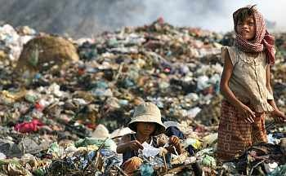

Environment: Climate Change
“Where you live should not decide
Whether you live or whether you die
Three to a bed
Sister Ann, she said
Dignity passes by” (U2 2005)
Lecture 12
Dr. L.Kilmurray

Slide 2
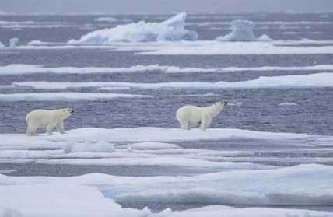
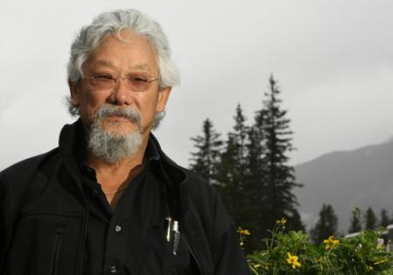
Outline
Consumption, Pollution
Weather, ‘natural’ disasters?
Climate Change
Nature’s Pharmacy
Strategy

Slide 3
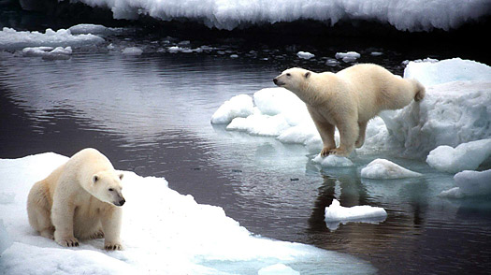
Reading
Climate Change: A Catastrophe in Slow Motion
R.T. Pierrehumbert
Chicago Journal of International Law, Winter 2006, Vol. 6, no. 2
“What makes global warming unique in the four billion year history of the planet is that the causative agents—humans—are sentient”.
16 students

Slide 4
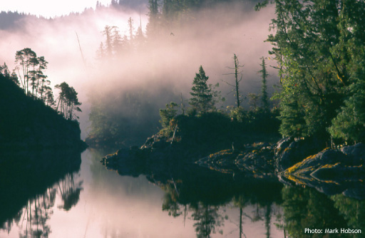
Biosphere
All the Earth's ecosystems considered as a single, self-sustaining unit
12 miles in depth
From bottom of ocean floor to top of mount Everest

Slide 5
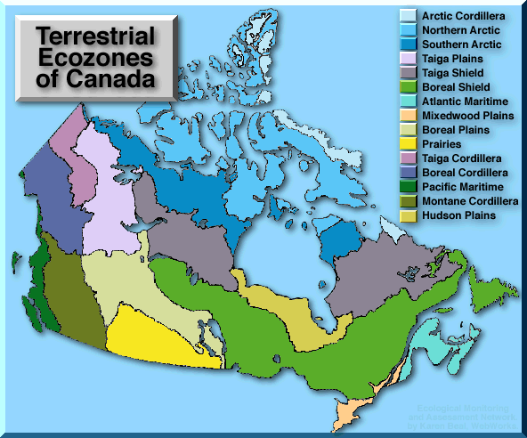
Ecozone
A broad geographic area in which there are distinctive climate patterns, ocean conditions, types of landscapes and species of plants and animals.
Local, Regional

Slide 6
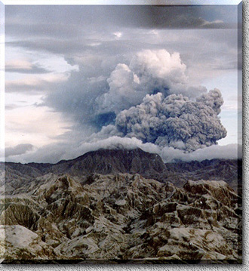
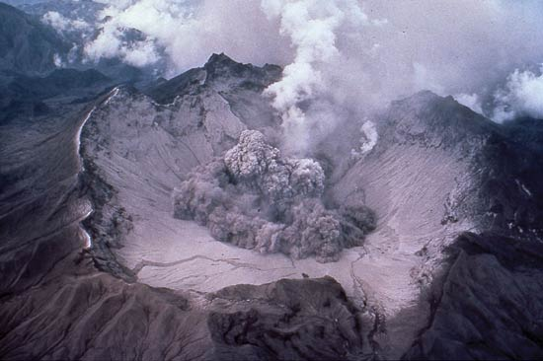
Mount Pinatubo

Slide 7
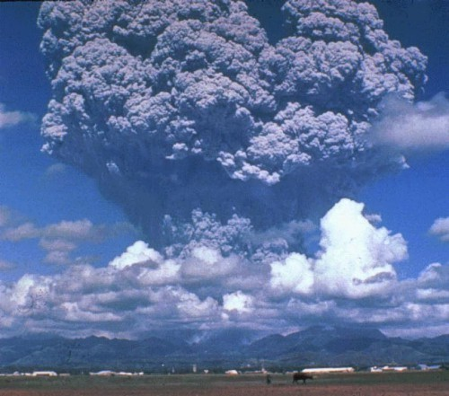
Mount Pinatubo ejected 10 billion metric tons of magma, & 20 million tons of sulphur dioxide, bringing vast quantities of minerals & metals to the surface environment.
It injected large amounts of aerosols into the stratosphere — more than any eruption since Krakatoa in 1883.
The aerosols formed a global layer of sulphuric acid haze.
Global temperatures dropped by about 0.9 F (0.5 C) , and ozone destruction increased substantially.
Mount Pinatubo

Slide 8
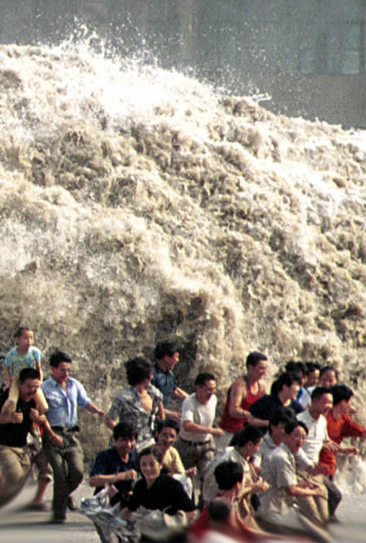
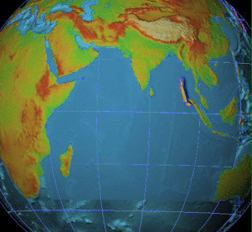
Tsunami
December 26, 2004
Indonesia, Sri Lanka, India, and Thailand
225,000 Dead

Slide 9
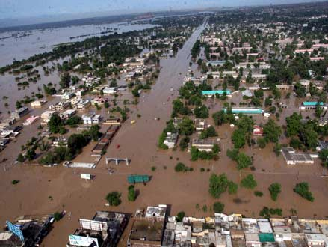
Pakistan 2010
About 20 million people affected by the flooding, and about 1,600 people killed.
Pakistan's federal flood commission estimated that 300,000 homes have been destroyed or seriously damaged and 2.6m acres (105,000 sq km) of croplands submerged.

Slide 10
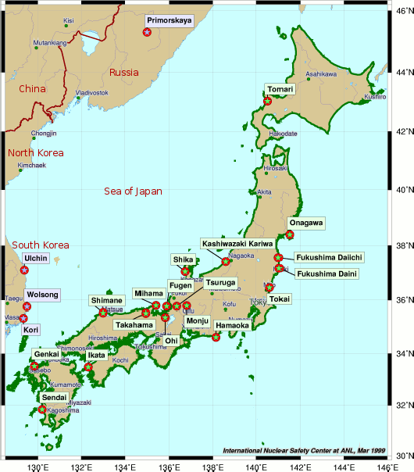
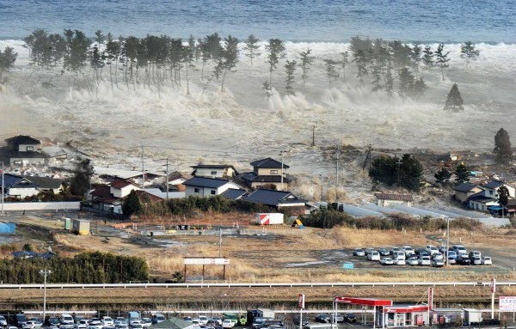
Japan
6.2 Magnitude
18,000 dead
Fukushima Nuclear plant leaks

Slide 11
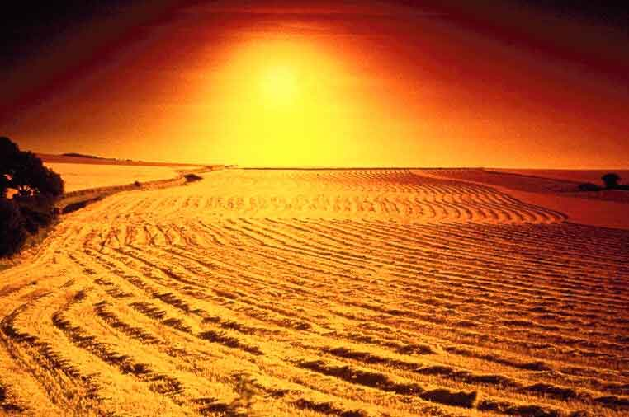
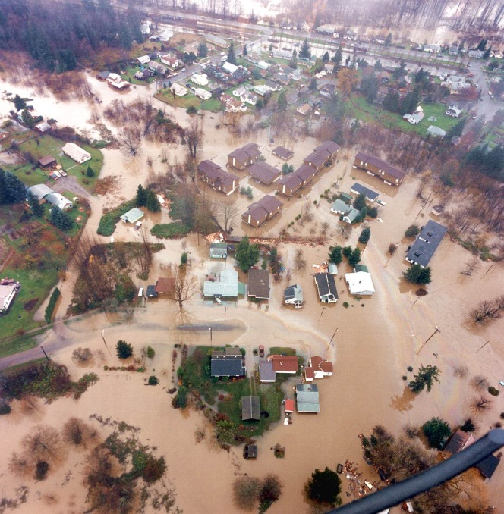
ICCP 2009 report
It is very likely (90-99% probability) that the earth’s mean surface temperature will increase by 1.4 – 5.8 degrees centigrade between 2000 – 2100
There is new and stronger evidence that most of the warming observed over the last 50 years is attributable to human activities.

Slide 12
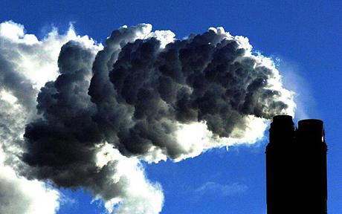
CO2
Carbon dioxide is implicated in virtually all of the great climate shifts in Earth’s history, including the coming and going of the Ice Ages; the eons of warm ice-free states that the dinosaurs lived in some seventy million years ago; the collapse of the Earth into a globally frozen state in the Neoproterozoic era some six hundred million years ago
One has to go back perhaps ten million years to find another time when the carbon
dioxide concentration was as high as we will make it during the next century

Slide 13
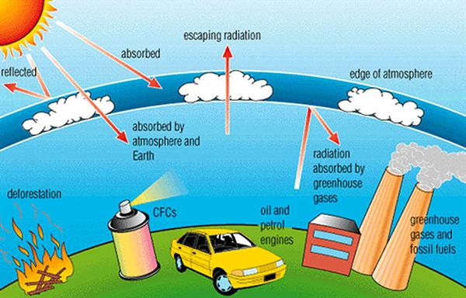
Greenhouse effect
Sun’s energy hits the atmosphere as solar radiation. Some bounced back into space by the atmosphere, but most passes through the atmosphere to warm the surface of the earth.
Once earth warmed by the short-wave solar energy, excess heat is radiated back into the environment as long-wave infrared radiation.
Some of the gases in earth's atmosphere act like the glass in the car windows. They let in solar energy and block or absorb infrared energy. As a result, the atmosphere gets warmer.

Slide 14
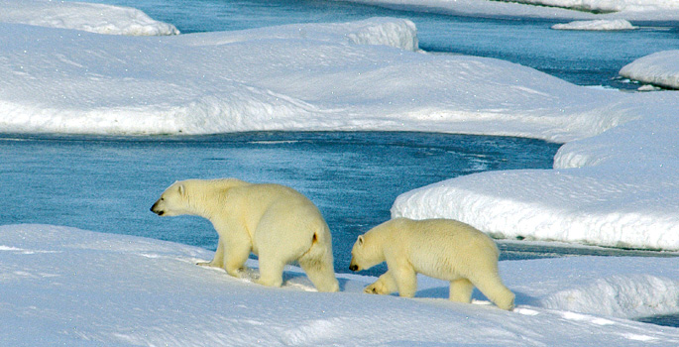
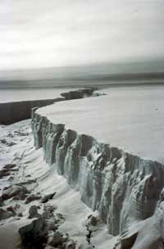
Reading
Climate Change
Arctic summer ice may be gone in 50 years
The Larsen B ice-shelf in the Antarctic has collapsed for the first time in ten millennia
One has to go back 10 million years to find carbon levels as high as today
Need for alternate fuels or capture technology
Honest Information Brokerage Needed: = ACADEMIA?

Slide 15

Nature's Pharmacy
Of the estimated 250,000 to 500,000 plant species in the world, more than 85 percent are in environments that are the traditional homes of indigenous people.
Nearly 75 percent of 121 plant-derived prescription drugs used worldwide were discovered following leads from indigenous medicine.

Slide 16
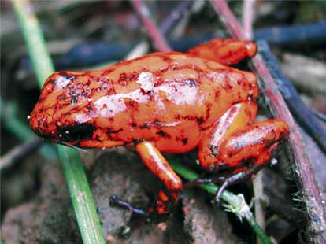
Medicinal resources
Ecuadorian tree frog produces painkiller 200 times stronger than morphine
Caribbean sponge produces chemicals that combat viral disease
Barnacles produce cement used in dentistry

Slide 17



Damage..what damage..?
The Homer Simpson Philosophy:
“it was like that when I got here…”
The Capitalist/Industrialist Philosophy:
“Market forces will right the situation”
The Marxist Perspective:
“The nature of Capitalism leads to social inequality and environmental degradation”

Slide 18
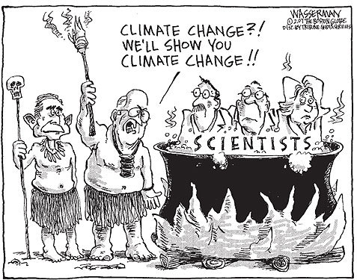
Opposition
The oil and energy lobby
The Libertarian economic focus
More research is required….

Slide 19

Strategy 1 (Adaptation)
Wait and see:
Neoclassical argument, linked with Libertarian economic school of thought
The Market forces will right the situation
Government action will prevail

Slide 20
Strategy 2 (Mitigation)
Precautionary act now, minimise the risks
Defeatist?
It may be too late already
Government, people, should just do what is necessary (minimum)

Slide 21

Strategy 3 (Geo-engineering)
Act now broadly, can only help
Geo-engineering strategies
Reforestation
Space mirrors?

