Slide 1
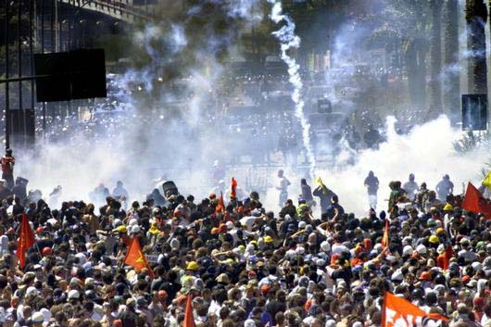
Sociology 1105
SOCIAL CONFLICTS, ACTIVISM, CHANGE
Introduction

Slide 2
What is Sociology?
The word Sociology is derived from the Latin word socius, meaning companion: and the Greek word logos, meaning thought or reason.
  The relationships between humans and the social organizations they inhabit
  The interactions between humans and their social environment
  The study of human societies using empirical investigation and critical analysis

Slide 3

Class Structure
Tuesday, 11:30 a.m. – 12:50 p.m.
Friday 1 p.m. – 2:20 p.m.

Slide 4

Soc 1105 Textbook
Suzanne Staggenborg 2008. Social Movements. Toronto: Oxford University Press. Available at the University Bookstore

Slide 5
Evaluation
Assignment | Date | Weight (%)
Mid Term | Oct 19th | 25%
Essay | Nov 23rd | 35%
Final Examination | TBA | 40%

Slide 6
Essays
See course data file on essays
Clear and coherent structure
Do an outline before you start to write
Make sure spelling and grammar are correct
Correct citations required
Original contribution
Bibliographic Requirements

Slide 7

Plagiarism, Cheating, Excuses
Correct citation
Zero Tolerance
Methods of Detection
Consequences

Slide 8
Teaching Assistants
Name: Trevor Rous
Office: FSS 2028
Hours: Fridays, 10:30 am -12:30 pm
Email: trous024@uottawa.ca
Name: Esma Mneina
Office: TBA
Hours: Mon 10:30 – 11:30
Email: TBA
Name: Nima Jangouk
Office: TBA
Hours: TBA
Email TBA

Slide 9
CONTACT INFORMATION
Office Location: FSS, Room 8053
Office Hours: Tuesday 9:30-11:00 a.m.
Office phone #: 562-5800, ext. 4731
Email: lkilmurr@uottawa.ca

Slide 10
What is a Social Movement?
“There is no agreement among social theorists as to what constitutes a social movement. The term has been blurred and stretched, so that everything from a local vigil to a major revolution has been called a movement, prompting one researcher (Alberto Melucci) to comment that everything that moves is a movement”
Louis Maheu (1995:57)

Slide 11
Social Movement: one Definition
A recurrent pattern of polymorphous and value-charged protest activities.
A distinction is thus made between social movements and occasional protests, organised political groups, and regimes.

Slide 12
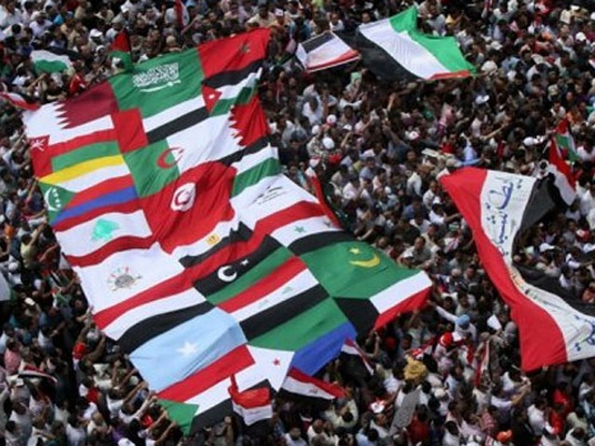
Upcoming Presentation
Dr. Jonathan Fine: The Arab Spring: between Hopes and Challenges
Wednesday, 12 September
2:30 p.m. to 4:30 p.m.
Faculty of Social Science building, FSS4006

