Slide 1
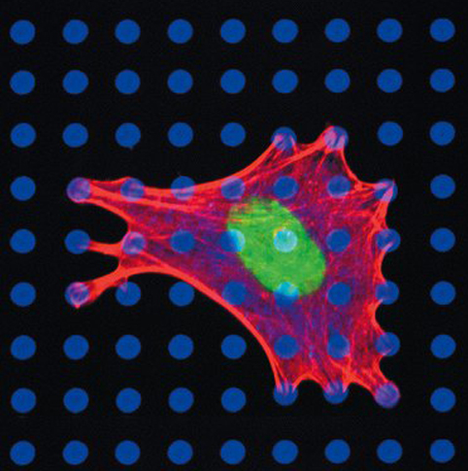
Topic 1 – Introduction to cell biology
Reading
  Chapter 2
  Purple pages F-11 to F-34
  See BIO 1140 website
Objectives
  Cell Theory
  Basic properties of cells
  Cell diversity: prokaryotic vs
  eukaryotic cells
  Cell chemistry is water- and
  carbon-based
  Macromolecules
Karp 2008

Slide 2
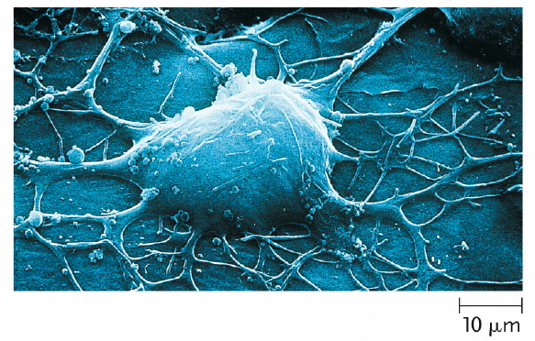
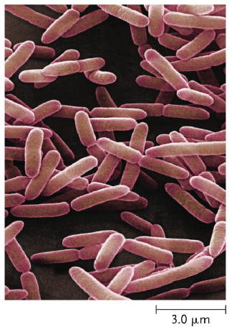
What is a cell?
Fig. 33.3
Fundamental unit of life
  Every organism either consists of cells
  or is itself a single cell
Cell Theory
  I. All organisms consist of one or more cells
  II. The cell is the basic unit of structure for
  all organisms
    Theodor Schwann,1839 (Matthias Schleiden, 1838)
  III. All cells arise only from pre-existing cells (i.e. the cell is the basic unit of reproduction)
    Rudolf Virchow, 1855
Fig. 21.2

Slide 3
Can one speak of the cell?
  Enormous diversity in form, function and size
  Similar basic chemistry (unity)
    Similar chemical composition
    Metabolism
    Use of ATP as the cellular energy currency
    Use of DNA for genetic information
Fig. 33.3
Fig. 21.2

Slide 4
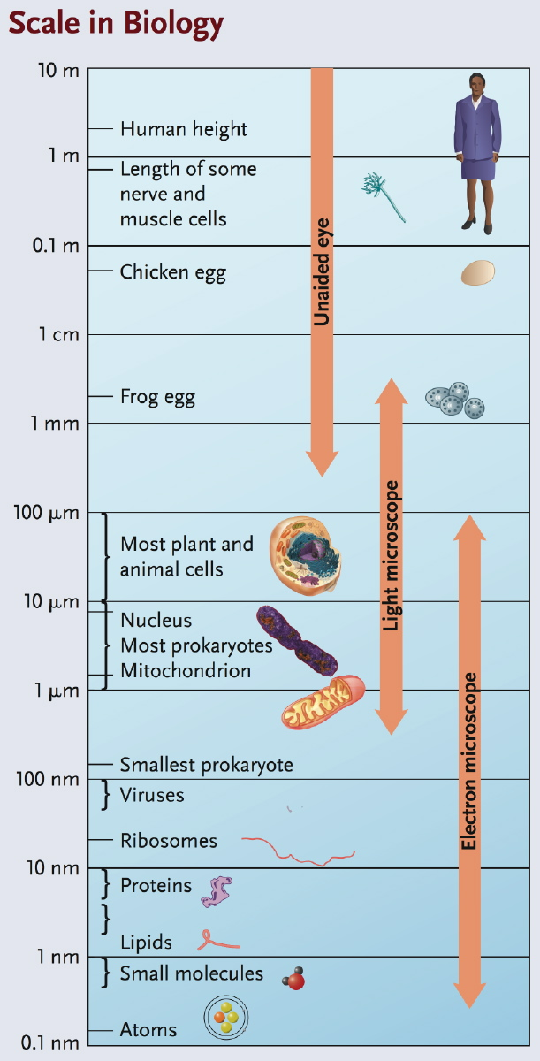
Purple pages F2
Size matters!
  Units relevant to cell biology
    1 µm = 10⁻⁶ m
    1 nm = 10⁻⁹ m
    1 Å = 10⁻¹⁰ m = 0.1 nm
  Cells are small
    ‘typical’ prokaryote 1 – 5 µm
    ‘typical’ eukaryote 10 – 30 µm
  Why are cells small?

Slide 5
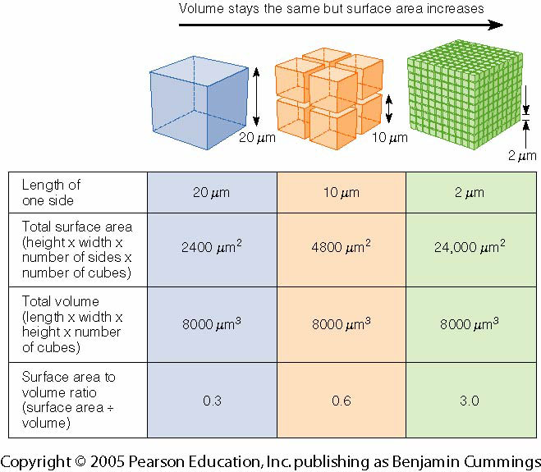
  Why are cells small?
    SA:V ratios
    Rates of diffusion
    Synthetic capacity
Time to 95% equilibration
of O₂ by diffusion
X
0.1 mm
1 mm
1 cm
1 m
time
0.067s
6.7 s
10.9 min
78 d
Length = L
Surface area = 6· L· L = 6L²
Volume = L· L· L = L³
SA:V =
Length = 2L
Surface area = 6· 2L· 2L = 24L²
Volume = 2L· 2L· 2L = 8L³
SA:V =
(see Fig. 2.27)
Fig. 4-1 Becker et al. 2009

Slide 6
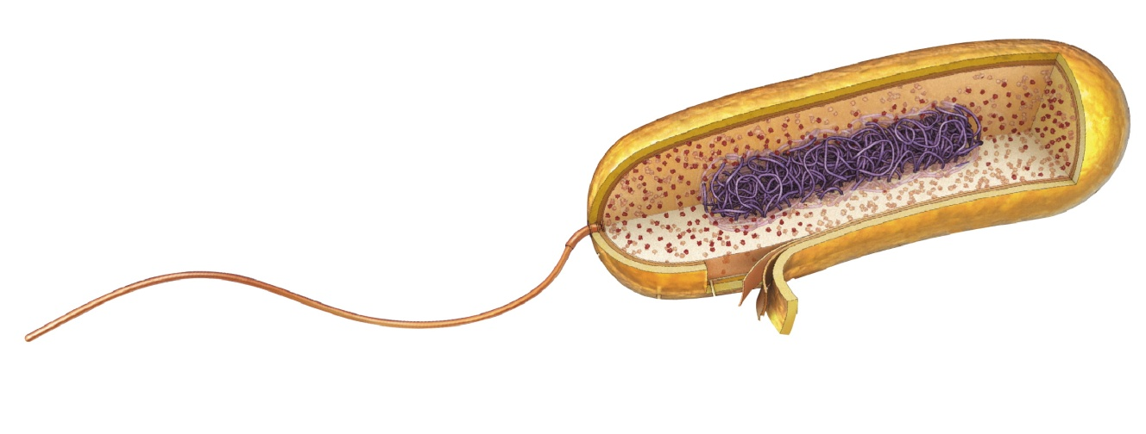
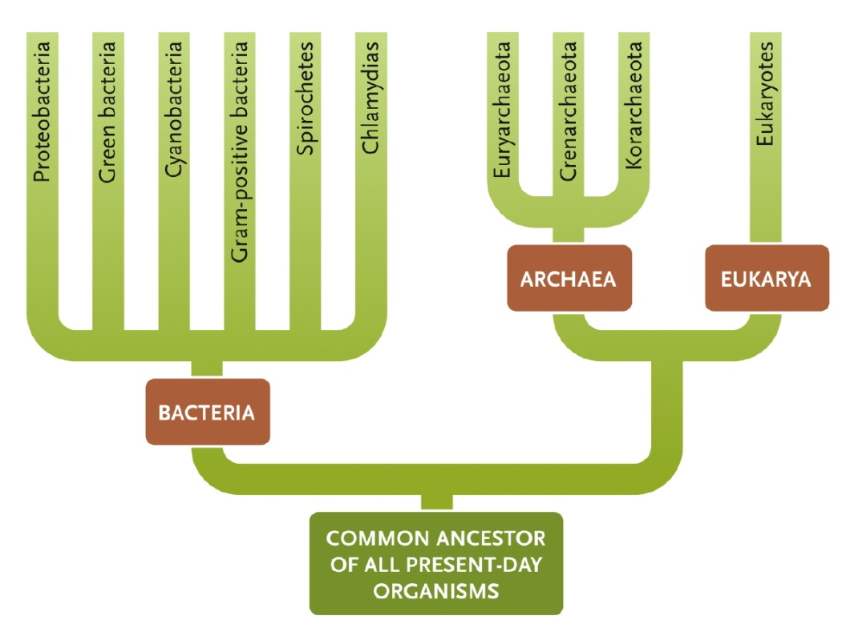
  Prokaryotic and eukaryotic cells differ in their solutions to the
  problem of size
    Prokaryotes
      For review, see http://salinella.bio.uottawa.ca/BIO1130/Lectures/PDF/BIO1130_lct03_StudentX6.pdf
      Solution → stay small, typically 1-5 µm
      Simple structure: cell wall, plasma membrane, cytoplasm that lacks organelles (cyanobacteria possess photosynthetic membranes), ribosomes, nucleoid, flagellum
prokaryotes
Ribosomes
Cytoplasm
Nucleoid
Plasma
membrane
Capsule
Bacterial
flagellum
Cell
wall
Fig. 21.15

Slide 7
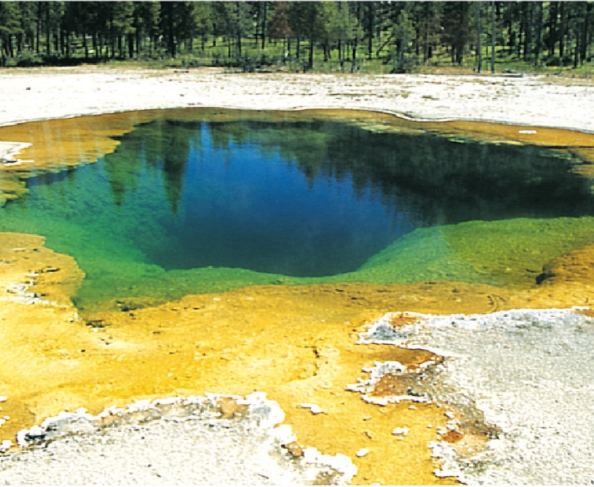
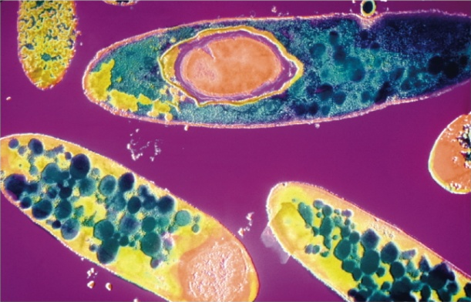
  Prokaryotic and eukaryotic cells differ in their solutions to the
  problem of size
    Prokaryotes
      For review, see http://salinella.bio.uottawa.ca/BIO1130/Lectures/PDF/BIO1130_lct03_StudentX6.pdf
      Solution → stay small, typically 1-5 µm
      Simple structure: cell wall, plasma membrane, cytoplasm that lacks organelles (cyanobacteria possess photosynthetic membranes), ribosomes, nucleoid, flagellum
Archaea (extremophiles)
prokaryotes
Bacteria
Clostridium butyricum
Fig. 21.20
Fig. 21.11
Fig. 21.15

Slide 8
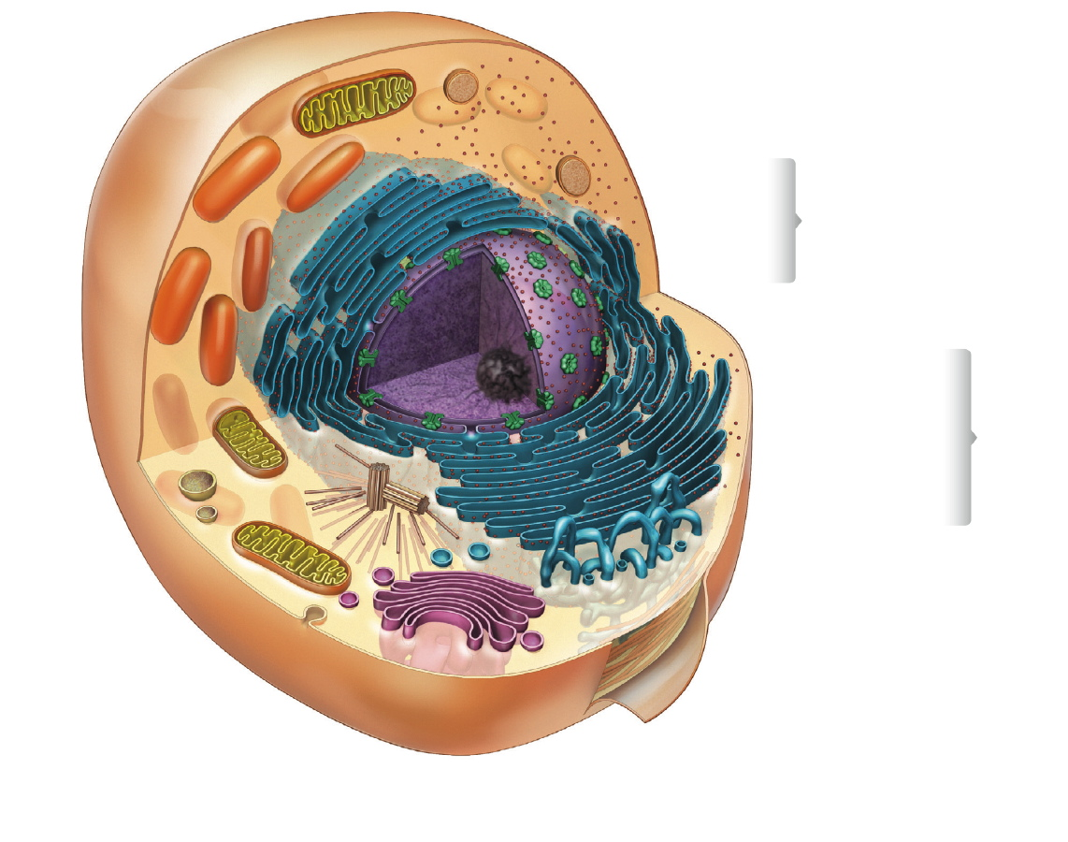
  Prokaryotic and eukaryotic cells differ in their solutions to the
  problem of size
    Eukaryotes
      Protists (single-celled organisms), Fungi, Animals, Plants (multicellular)
      Solution → compartmentalization of cellular functions
Mitochondrion
Nuclear envelope
Nucleus
Nucleolus
prokaryotes
Free
ribosomes
Rough ER
Lysosome
Smooth ER
Cytosol
Vesicle
Plasma
membrane
Fig. 2.18
Golgi
complex
Fig. 21.15

Slide 9
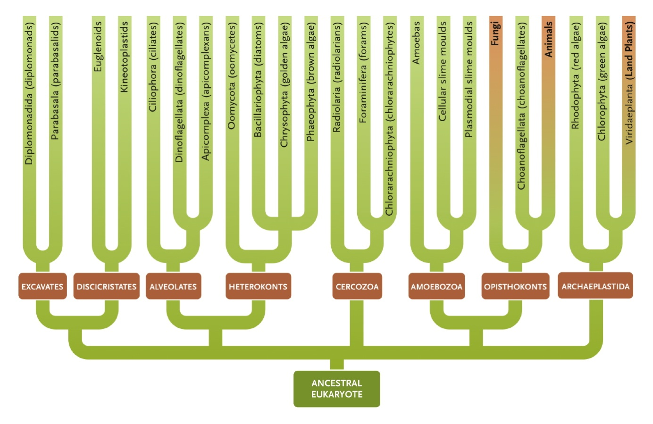
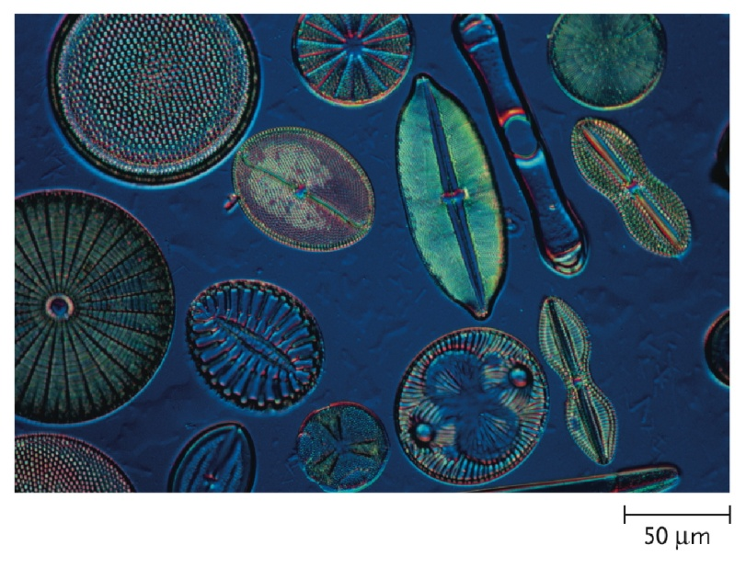
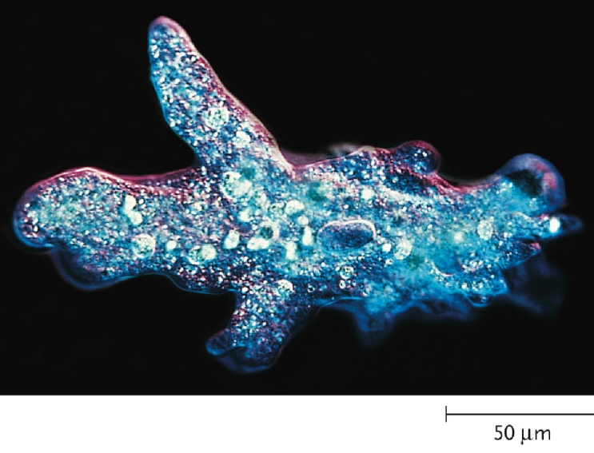
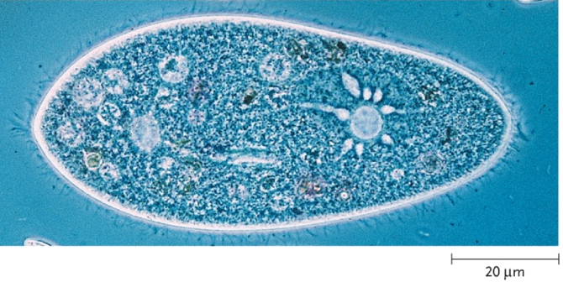
  Prokaryotic and eukaryotic cells differ in their solutions to the
  problem of size
    Eukaryotes
      Protists (single-celled organisms), Fungi, Animals, Plants (multicellular)
      Solution → compartmentalization of cellular functions
Fig. 23.18
Fig. 23.6
Fig. 23.2
Fig. 23.4

Slide 10
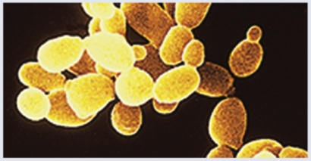
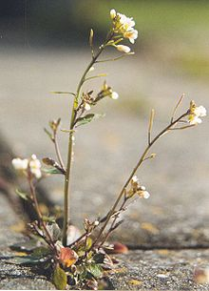
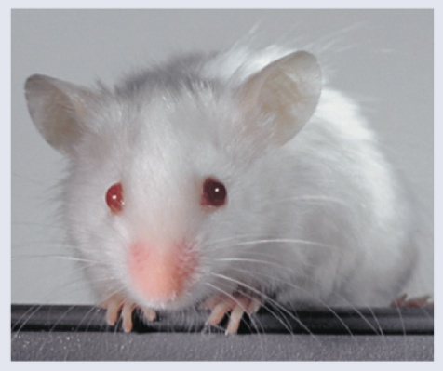
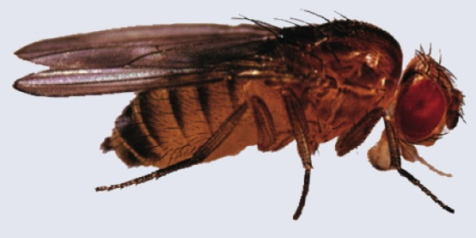
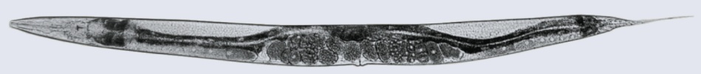
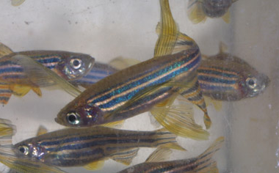
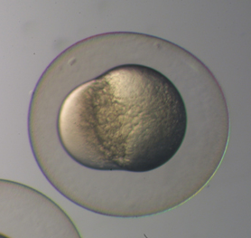
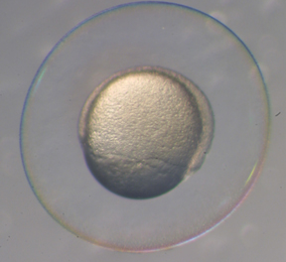
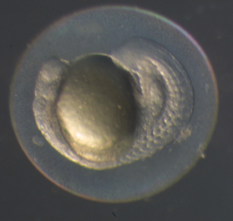
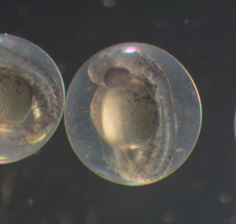
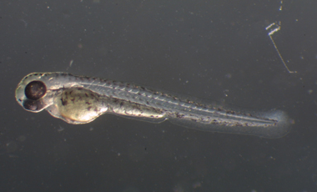
  Prokaryotic and eukaryotic cells differ in their solutions to the
  problem of size
    Eukaryotes
      Protists (single-celled organisms), Fungi, Animals, Plants (multicellular)
      Solution → compartmentalization of cellular functions
Purple pages F35-F39
http://www.cas.vanderbilt.edu/bioimages/

Slide 11
A gallery of eukaryotic cell organelles
Major structural features
  Plasma membrane
  Nucleus
  (membrane-bound)
  Membrane-bound organelles
  Cytosol (vs cytoplasm)
Mitochondrion
Nucleus:
Nuclear
envelope
Nucleolus
Free
ribosomes
Rough ER
Lysosome
Smooth ER
Cytosol
Vesicle
Plasma
membrane
Golgi
complex
Fig. 2.18

Slide 12
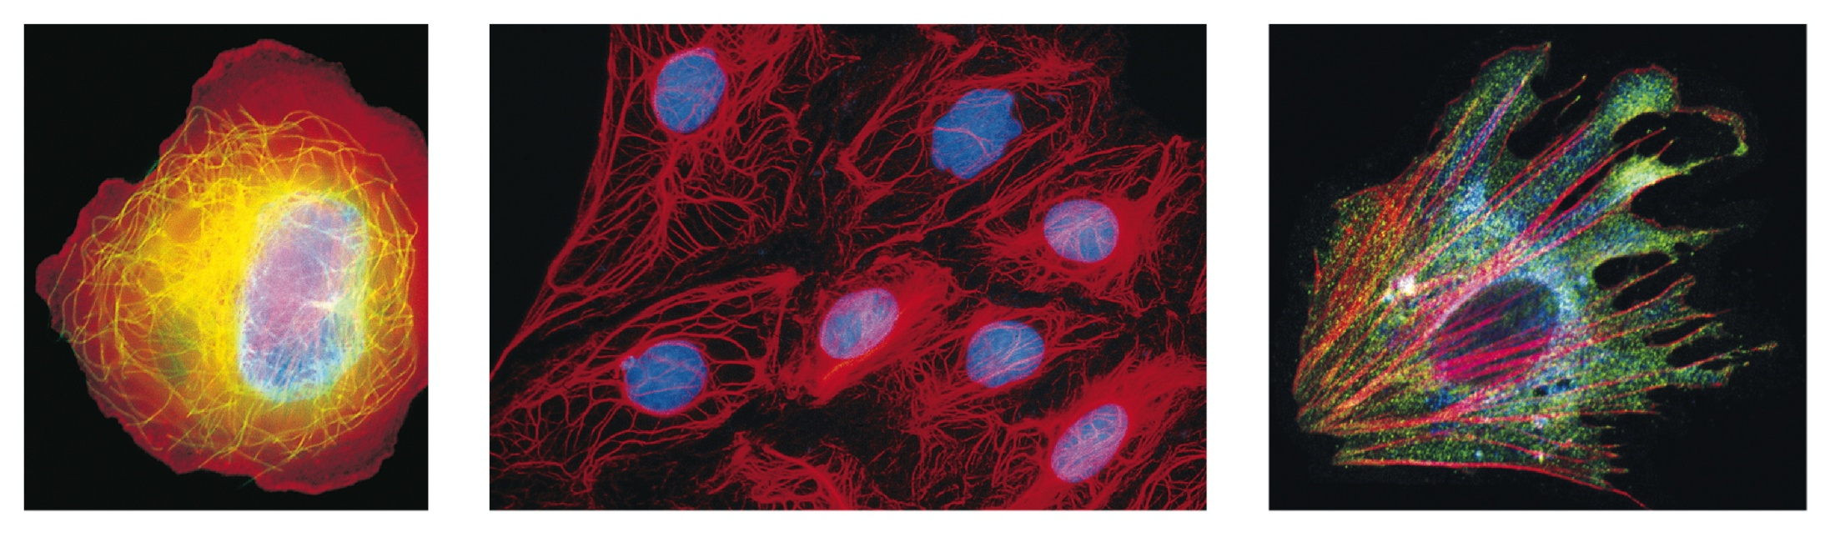
Non-membrane bound organelles
  Cytoskeleton
    Support/shape, internal organization, movement of cell, movement within cell
    Microfilaments, microtubules, intermediate filaments
  Ribosomes
    Protein synthesis
Microtubule
Intermediate filament
Microfilament
Fig. 2.22

Slide 13
Membrane bound organelles
  Nucleus
    Nuclear envelope
    Nuclear pores
    Nucleolus
    DNA and protein organized into chromosomes (chromatin)
  Endoplasmic reticulum
    Tubular membranes and cisternae
    Rough – ribosomes, for membrane protein and secreted protein synthesis
    Smooth – for lipid and steroid synthesis, detoxification
Fig. 2.18

Slide 14
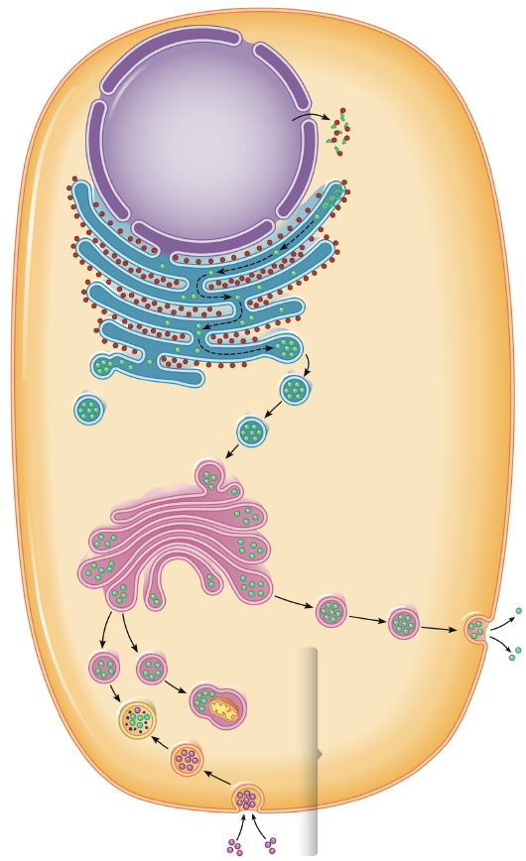
  Golgi complex
    Stack of flattened vesicles
    Sorting, modification and packaging of proteins
  Vesicles
    Transport among organelles and/or to plasma membrane
  Lysosomes, peroxisomes
    Contain hydrolases, catalases
  Vacuole
    Temporary storage
    Turgor pressure in plant cells
Nucleus
Rough ER
Golgi
complex
Vesicles
Lysosome
Fig. 2.20

Slide 15
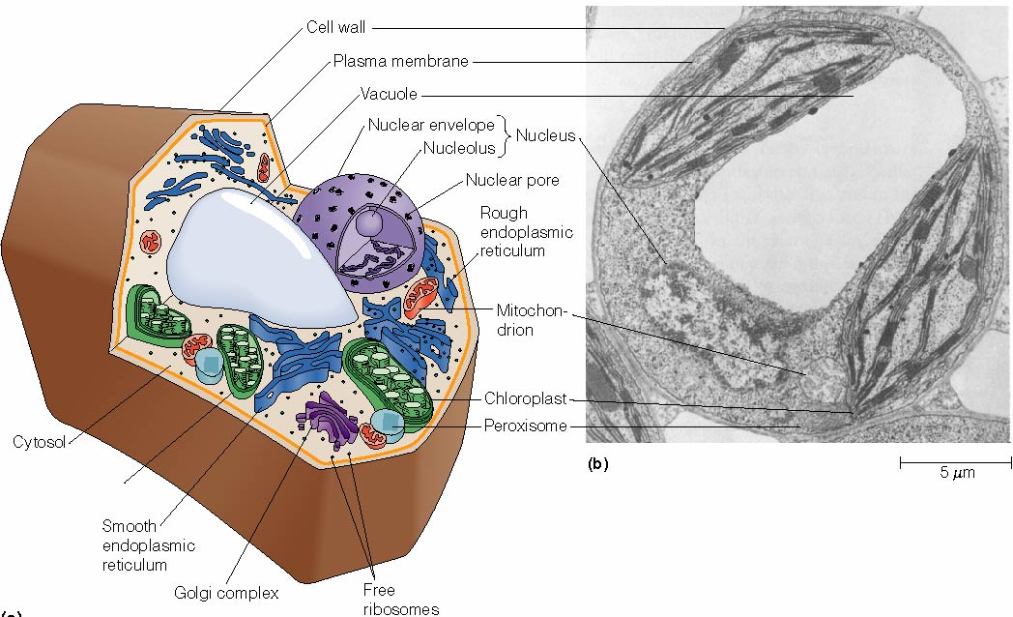
  Golgi complex
    Stack of flattened vesicles
    Sorting, modification and packaging of proteins
  Vesicles
    Transport among organelles and/or to plasma membrane
  Lysosomes, peroxisomes
    Contain hydrolases, catalases
  Vacuole
    Temporary storage
    Turgor pressure in plant cells
Fig4-6 Becker et al. 2009

Slide 16
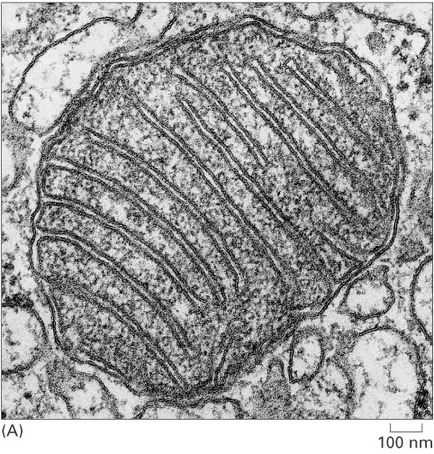
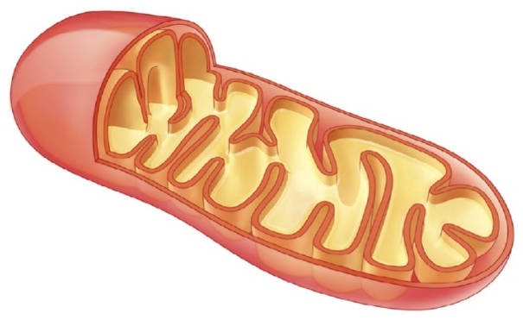
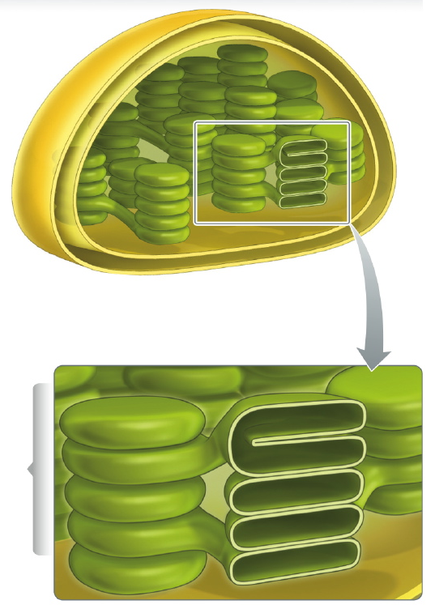
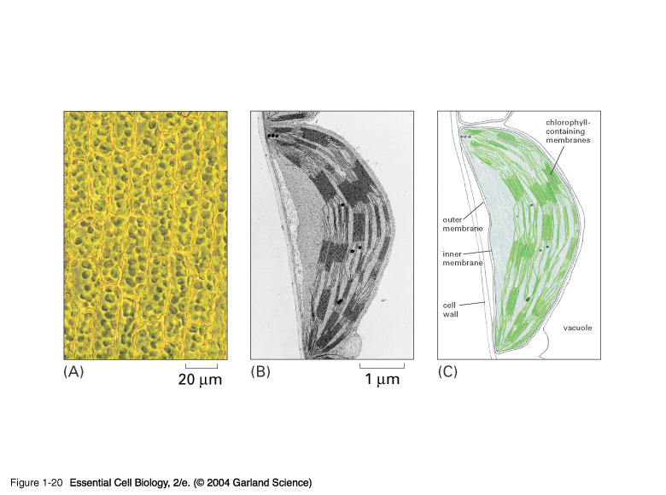
  Mitochondrion
    ~2 µm
    Double membrane, cristae
    Oxidative metabolism yielding ATP
    Circular mDNA
    Reproduce by fission
  Chloroplast
    ~5 µm
    Double membrane + thylakoids
    Conversion of light energy to chemical energy (complex carbohydrates)
    Circular cpDNA
    Reproduce by fission
Fig. 6.8
Fig. 7.3
Figs. 1-18, 1-20, Alberts et al. 2004

Slide 17
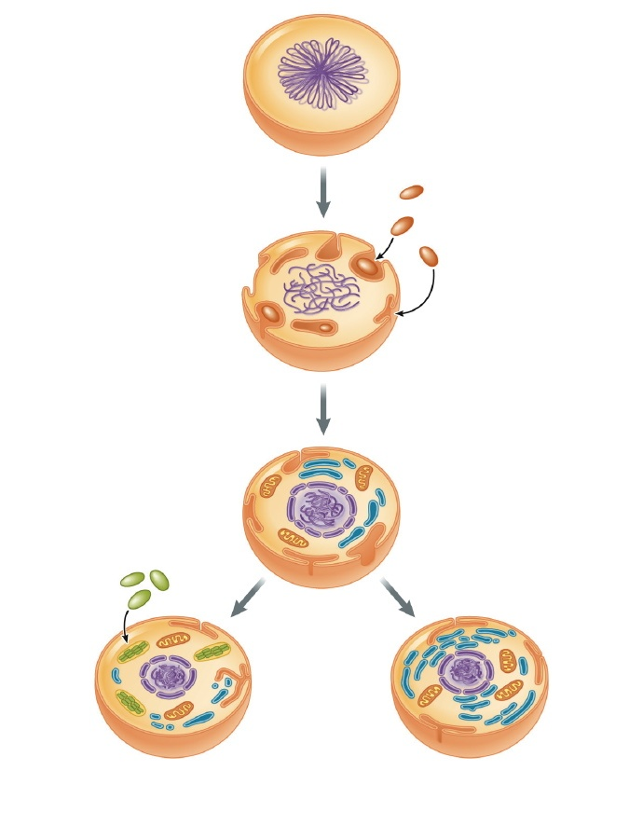
  Endosymbiont theory
    Mitochondria from incorporation of aerobic prokaryote
    Chloroplast from (later) incorporation of cyanobacterium
    Support – size, circular DNA, ribosomes, fission
      Current examples:
      - symbiotic animals
      containing green
      photobionts
      - kleptoplasty
      (solar-powered
      sea slugs!)
Original
prokaryotic cell
Fig. 2.21
Aerobic
bacteria...
... become
mitochondria
Photosynthetic
bacteria...
... become
chloroplasts
Eukaryotic cells
(plants, some protists)
Eukaryotic cells
(animals, fungi, some protists)

Slide 18
  Endosymbiont theory
    Mitochondria from incorporation of aerobic prokaryote
    Chloroplast from (later) incorporation of cyanobacterium
    Support – size, circular DNA, ribosomes, fission
      Current examples:
      - symbiotic animals
      containing green
      photobionts
      - kleptoplasty
      (solar-powered
      sea slugs!)
See:
Rumpho et al. 2011 JEB 214, 303-311
http://sbe.umaine.edu/symbio/

