Slide 1
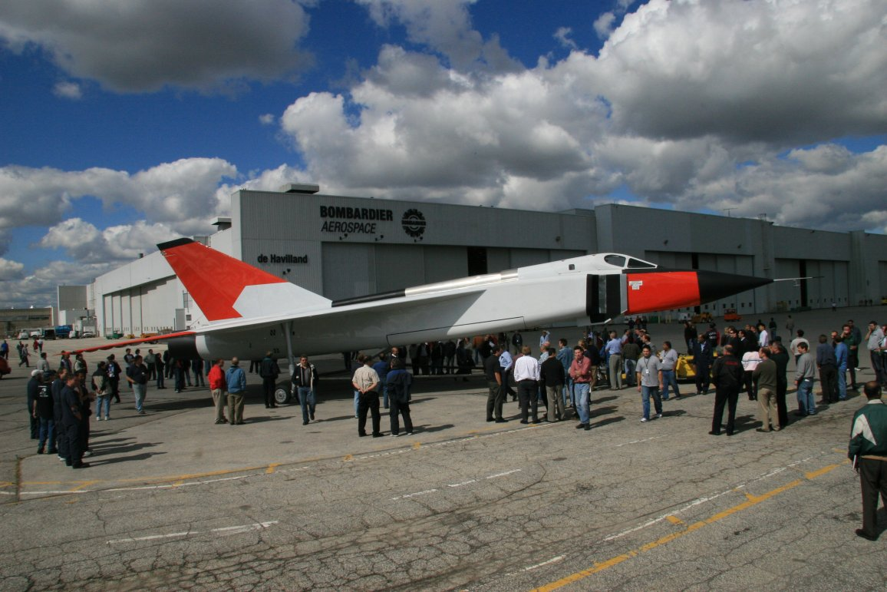
GNG 1105
Chap. 2 Statics of Particles
Prof.: Philippe Girault

Slide 2
Agenda
  Definitions
  Forces in Plane
  Forces on a Particle; Resultant of 2 Forces
  Vectors
  Addition of Vectors
  Resultant of Several Concurrent Forces
  Resolution of Forces into Components
  Rectangular Components of a Force; Unit Vectors
Notes:
Introductory notes.

Slide 3
Agenda (Cont’d)
  Addition of Forces by Summing x & y Components
  Equilibrium of a Particle
  Newton’s First Law of Motion
  Problems about the Equilibrium of a Particle; Free Body Diagrams
  Forces in Space
  Rectangular Components of a Force in Space
  Forces Defined by its Magnitude and 2 points in its Line of Action
  Addition of Concurrent Forces in Space
  Equilibrium of a Particle in Space
Notes:
Introductory notes.

Slide 4
Agenda
  Definitions
  Forces in Plane
  Forces on a Particle; Resultant of 2 Forces
  Vectors
  Addition of Vectors
  Resultant of Several Concurrent Forces
  Resolution of Forces into Components
  Rectangular Components of a Force; Unit Vectors
Notes:
Introductory notes.

Slide 5
Definitions
Particles
Resultant: Single force having the same effect of 2 or several forces on a particle
Notes:
Relative vocabulary list.

Slide 6
Agenda
  Definitions
  Forces in Plane
  Forces on a Particle; Resultant of 2 Forces
  Vectors
  Addition of Vectors
  Resultant of Several Concurrent Forces
  Resolution of Forces into Components
  Rectangular Components of a Force; Unit Vectors
Notes:
Introductory notes.

Slide 7
Force on a Particle.
Definition of a Force
Notes:
Relative vocabulary list.

Slide 8
Resultant of 2 Forces
Parallelogram Law:
Purely experimental
a Force is a Vector
Notes:
Relative vocabulary list.

Slide 9
Agenda
  Definitions
  Forces in Plane
  Forces on a Particle; Resultant of 2 Forces
  Vectors
  Addition of Vectors
  Resultant of Several Concurrent Forces
  Resolution of Forces into Components
  Rectangular Components of a Force; Unit Vectors
Notes:
Introductory notes.

Slide 10
Vectors
Definitions:
  Mathematical expressions possessing magnitude and direction which adds according to the parallelogram law.
Displacements , velocities, accelerations & moments are mathematically represented by vector
Volume, mass & energy are scalars (not vectors)
In illustration: represented by arrow
Notes:
Relative vocabulary list.

Slide 11
Vectors (Cont’d)
Forces on a particle: Fixed or bound vector
Moment on a particle: Free vector
Force on a Rigid body: Sliding vector
Equal vector: Not necessary the same application point
Notes:
Relative vocabulary list.

Slide 12
Vectors (Cont’d)
Negative vector of P: equal & opposite = - P
Notes:
Relative vocabulary list.

Slide 13
Agenda
  Definitions
  Forces in Plane
  Forces on a Particle; Resultant of 2 Forces
  Vectors
  Addition of Vectors
  Resultant of Several Concurrent Forces
  Resolution of Forces into Components
  Rectangular Components of a Force; Unit Vectors
Notes:
Introductory notes.

Slide 14
Addition of Vectors
Parallelogram Law
Notes:
Relative vocabulary list.

Slide 15
Addition of Vectors (Cont’d)
All Quantity represented by arrows are not necessarily vector’s
Notes:
Relative vocabulary list.

Slide 16
Addition of Vectors (Cont’d)
Triangle Method
Notes:
Relative vocabulary list.

Slide 17
Addition of Vectors (Cont’d)
Substraction
Notes:
Relative vocabulary list.

Slide 18
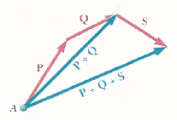
Addition of Vectors (Cont’d)
Sum of n vectors
Notes:
Relative vocabulary list.

Slide 19
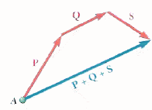
Addition of Vectors (Cont’d)
Polygon Rule
Notes:
Relative vocabulary list.

Slide 20
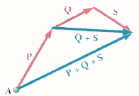
Addition of Vectors (Cont’d)
Associative
Notes:
Relative vocabulary list.

Slide 21
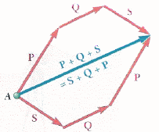
Addition of Vectors (Cont’d)
Permutable
Notes:
Relative vocabulary list.

Slide 22
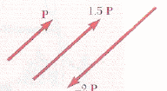
Addition of Vectors (Cont’d)
Product by a Scalar: Change only the magnitude
Notes:
Relative vocabulary list.

Slide 23
Agenda
  Definitions
  Forces in Plane
  Forces on a Particle; Resultant of 2 Forces
  Vectors
  Addition of Vectors
  Resultant of Several Concurrent Forces
  Resolution of Forces into Components
  Rectangular Components of a Force; Unit Vectors
Notes:
Introductory notes.

Slide 24
Resultant of Several Concurrent Forces
Notes:
Relative vocabulary list.

Slide 25
Agenda
  Definitions
  Forces in Plane
  Forces on a Particle; Resultant of 2 Forces
  Vectors
  Addition of Vectors
  Resultant of Several Concurrent Forces
  Resolution of Forces into Components
  Rectangular Components of a Force; Unit Vectors
Notes:
Introductory notes.

Slide 26
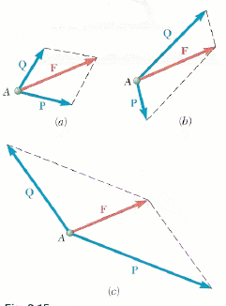
Resolution of Forces into Components
Resolving a force F into components:
Notes:
Relative vocabulary list.

Slide 27
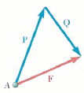
Resolution of Forces into Components (Cont’d)
One of the 2 Components P is known
Notes:
Relative vocabulary list.

Slide 28
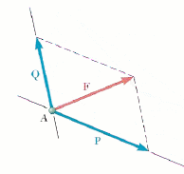
Resolution of Forces into Components (Cont’d)
The line of action of the Components is known
Notes:
Relative vocabulary list.

Slide 29
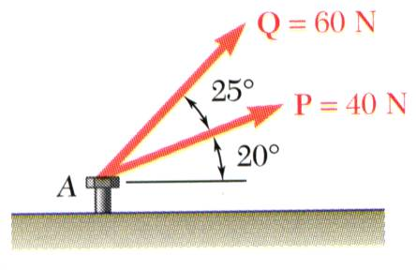
Sample Problem 2.1
SOLUTION:
Graphical solution - construct a parallelogram with sides in the same direction as P and Q and lengths in proportion. Graphically evaluate the resultant which is equivalent in direction and proportional in magnitude to the the diagonal.
The two forces act on a bolt at A. Determine their resultant.
Trigonometric solution - use the triangle rule for vector addition in conjunction with the law of cosines and law of sines to find the resultant.

Slide 30
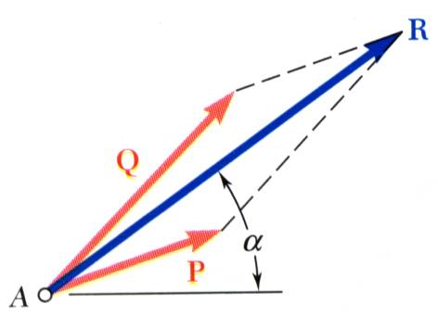
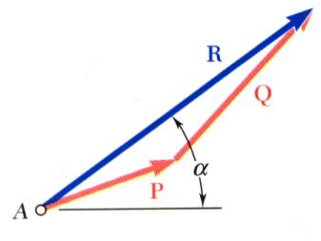
Sample Problem 2.1 (Cont’d)
Graphical solution - A parallelogram with sides equal to P and Q is drawn to scale. The magnitude and direction of the resultant or of the diagonal to the parallelogram are measured,
Graphical solution - A triangle is drawn with P and Q head-to-tail and to scale. The magnitude and direction of the resultant or of the third side of the triangle are measured,

Slide 31
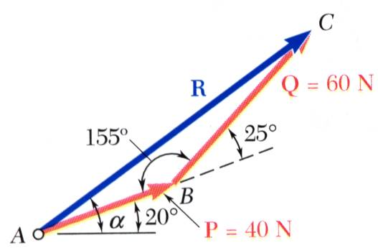
Sample Problem 2.1 (Cont’d)
Trigonometric solution - Apply the triangle rule.
From the Law of Cosines,
From the Law of Sines,

Slide 32
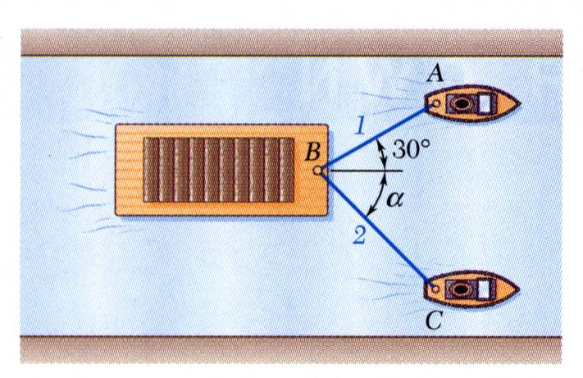
Sample Problem 2.2
SOLUTION:
Find a graphical solution by applying the Parallelogram Rule for vector addition. The parallelogram has sides in the directions of the two ropes and a diagonal in the direction of the barge axis and length proportional to 5000 N.
A barge is pulled by two tugboats. If the resultant of the forces exerted by the tugboats is 5000 N directed along the axis of the barge, determine
Find a trigonometric solution by applying the Triangle Rule for vector addition. With the magnitude and direction of the resultant known and the directions of the other two sides parallel to the ropes given, apply the Law of Sines to find the rope tensions.
the tension in each of the ropes for α = 45º,
the value of α for which the tension in rope 2 is a minimum.
The angle for minimum tension in rope 2 is determined by applying the Triangle Rule and observing the effect of variations in α.

Slide 33
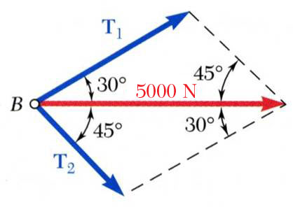
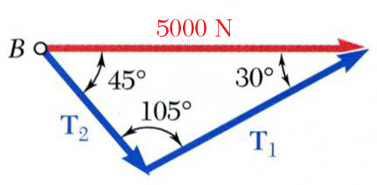
Sample Problem 2.2 (Cont’d)
Graphical solution - Parallelogram Rule with known resultant direction and magnitude, known directions for sides.
Trigonometric solution - Triangle Rule with Law of Sines

Slide 34
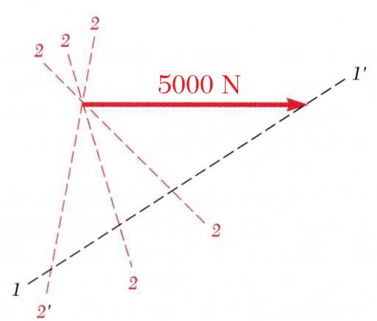
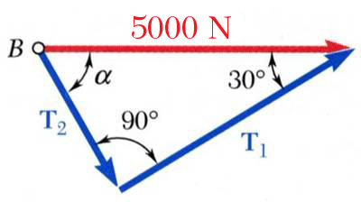
Sample Problem 2.2 (Cont’d)
The angle for minimum tension in rope 2 is determined by applying the Triangle Rule and observing the effect of variations in α.
The minimum tension in rope 2 occurs when T₁ and T₂ are perpendicular.

Slide 35
Agenda
  Definitions
  Forces in Plane
  Forces on a Particle; Resultant of 2 Forces
  Vectors
  Addition of Vectors
  Resultant of Several Concurrent Forces
  Resolution of Forces into Components
  Rectangular Components of a Force; Unit Vectors
Notes:
Introductory notes.

Slide 36
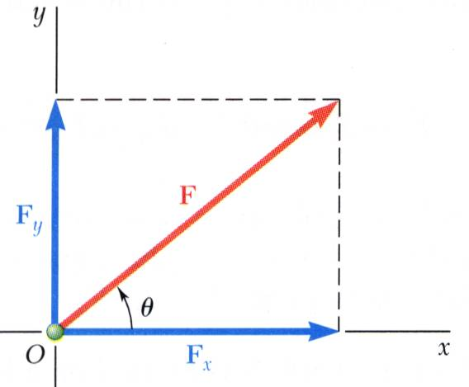
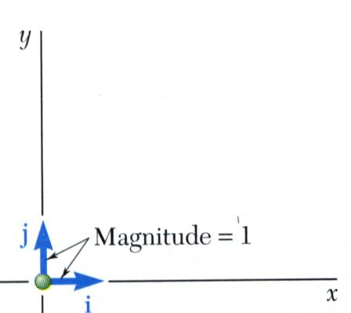
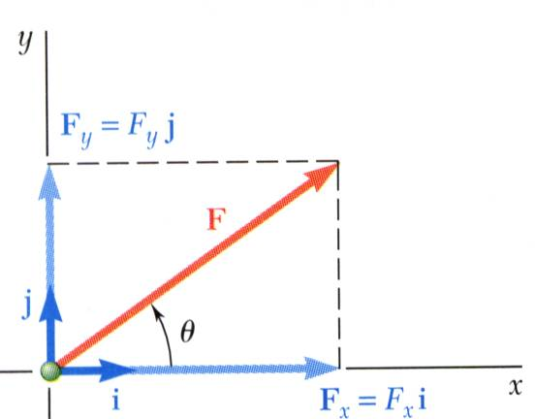
Rectangular Components of a Force; Unit Vectors
May resolve a force vector into perpendicular components so that the resulting parallelogram is a rectangle. are referred to as rectangular vector components and
Define perpendicular unit vectors which are parallel to the x and y axes.
Vector components may be expressed as products of the unit vectors with the scalar magnitudes of the vector components.
F_{x} and F_{y} are referred to as the scalar components of

Slide 37
Rectangular Components of a Force; Unit Vectors (Cont’d)
Example 1
Notes:
Relative vocabulary list.

Slide 38
Rectangular Components of a Force; Unit Vectors (Cont’d)
Example 2
Notes:
Relative vocabulary list.

Slide 39
Rectangular Components of a Force; Unit Vectors (Cont’d)
Example 3
Notes:
Relative vocabulary list.

Slide 40
Agenda (Cont’d)
  Addition of Forces by Summing x & y Components
  Equilibrium of a Particle
  Newton’s First Law of Motion
  Problems about the Equilibrium of a Particle; Free Body Diagrams
  Forces in Space
  Rectangular Components of a Force in Space
  Forces Defined by its Magnitude and 2 points in its Line of Action
  Addition of Concurrent Forces in Space
  Equilibrium of a Particle in Space
Notes:
Introductory notes.

Slide 41
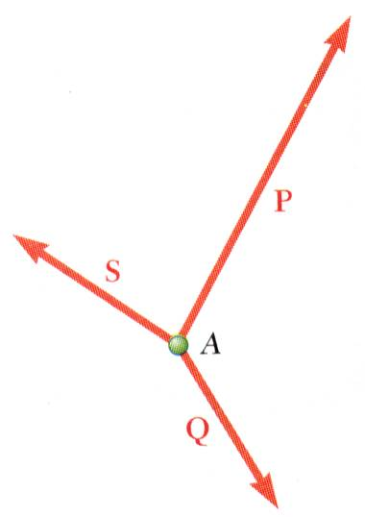
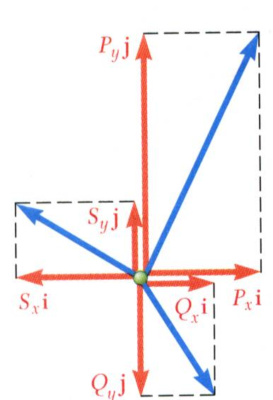
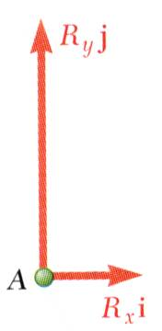
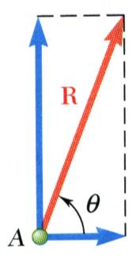
Addition of Forces by Summing Components
Wish to find the resultant of 3 or more concurrent forces,
Resolve each force into rectangular components
The scalar components of the resultant are
equal to the sum of the corresponding scalar components of the given forces.
To find the resultant magnitude and direction,

Slide 42
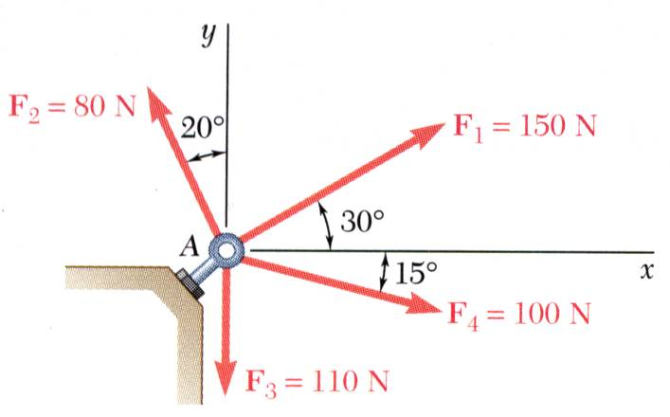
Sample Problem 2.3
SOLUTION:
Resolve each force into rectangular components.
Determine the components of the resultant by adding the corresponding force components.
Calculate the magnitude and direction of the resultant.
Four forces act on bolt A as shown. Determine the resultant of the force on the bolt.

Slide 43
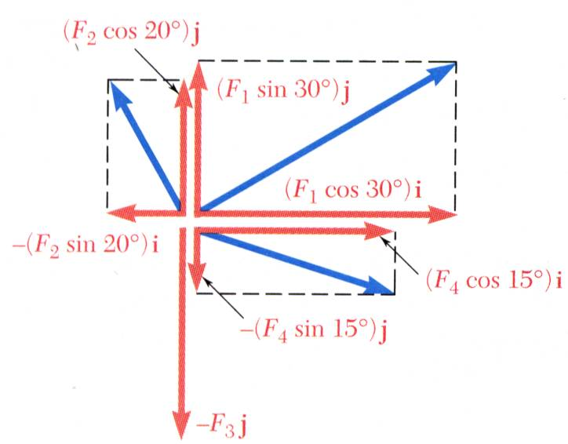
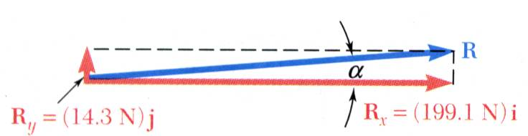
Sample Problem 2.3 (Cont’d)
SOLUTION:
Resolve each force into rectangular components.
Determine the components of the resultant by adding the corresponding force components.
Calculate the magnitude and direction.

Slide 44
Agenda (Cont’d)
  Addition of Forces by Summing x & y Components
  Equilibrium of a Particle
      Newton’s First Law of Motion
  Problems about the Equilibrium of a Particle; Free Body Diagrams
  Forces in Space
  Rectangular Components of a Force in Space
  Forces Defined by its Magnitude and 2 points in its Line of Action
  Addition of Concurrent Forces in Space
  Equilibrium of a Particle in Space
Notes:
Introductory notes.

Slide 45
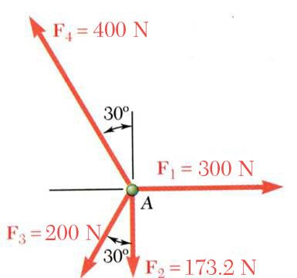
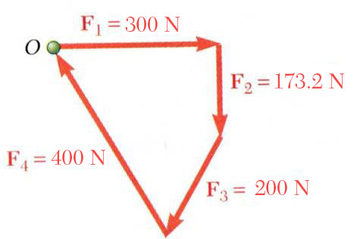
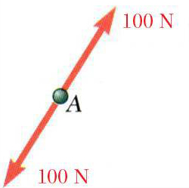
Equilibrium of a Particle
When the resultant of all forces acting on a particle is zero, the particle is in equilibrium.
Newton’s First Law: If the resultant force on a particle is zero, the particle will remain at rest or will continue at constant speed in a straight line.
Particle acted upon by two forces:
  equal magnitude
  same line of action
  opposite sense
Particle acted upon by three or more forces:
  graphical solution yields a closed polygon
  algebraic solution

Slide 46
Agenda (Cont’d)
  Addition of Forces by Summing x & y Components
  Equilibrium of a Particle
      Newton’s First Law of Motion
  Problems about the Equilibrium of a Particle; Free Body Diagrams
  Forces in Space
  Rectangular Components of a Force in Space
  Forces Defined by its Magnitude and 2 points in its Line of Action
  Addition of Concurrent Forces in Space
  Equilibrium of a Particle in Space
Notes:
Introductory notes.

Slide 47
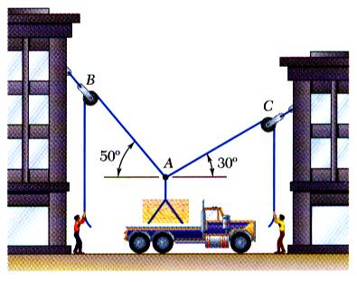
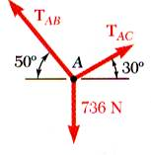
Free-Body Diagrams
Space Diagram: A sketch showing the physical conditions of the problem.
Free-Body Diagram: A sketch showing only the forces on the selected particle.

Slide 48
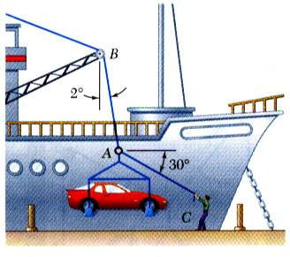
Sample Problem 2.4
SOLUTION:
Construct a free-body diagram for the particle at the junction of the rope and cable.
Apply the conditions for equilibrium by creating a closed polygon from the forces applied to the particle.
Apply trigonometric relations to determine the unknown force magnitudes.
In a ship-unloading operation, a 3500-N automobile is supported by a cable. A rope is tied to the cable and pulled to center the automobile over its intended position. What is the tension in the rope?

Slide 49
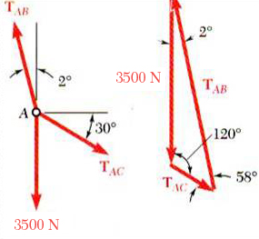
Sample Problem 2.4 (Cont’d)
SOLUTION:
Construct a free-body diagram for the particle at A.
Apply the conditions for equilibrium.
Solve for the unknown force magnitudes.

Slide 50
Sample Problem 2.5
SOLUTION:
Construct a free-body diagram for the particle at the junction of the rope and cable.
Apply the conditions for equilibrium by creating a closed polygon from the forces applied to the particle.
Apply trigonometric relations to determine the unknown force magnitudes.
In a ship-unloading operation, a 3500-N automobile is supported by a cable. A rope is tied to the cable and pulled to center the automobile over its intended position. What is the tension in the rope?

Slide 51
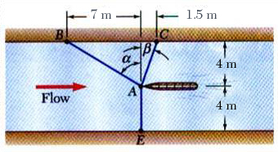
Sample Problem 2.6
SOLUTION:
Choosing the hull as the free body, draw a free-body diagram.
Express the condition for equilibrium for the hull by writing that the sum of all forces must be zero.
It is desired to determine the drag force at a given speed on a prototype sailboat hull. A model is placed in a test channel and three cables are used to align its bow on the channel centerline. For a given speed, the tension is 40 N in cable AB and 60 N in cable AE.
Determine the drag force exerted on the hull and the tension in cable AC.
Resolve the vector equilibrium equation into two component equations. Solve for the two unknown cable tensions.

Slide 52
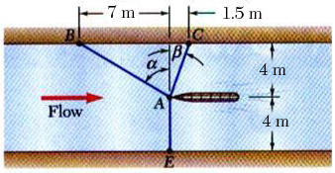
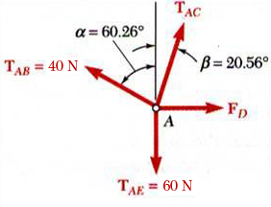
Sample Problem 2.6 (Cont’d)
SOLUTION:
Choosing the hull as the free body, draw a free-body diagram.
Express the condition for equilibrium for the hull by writing that the sum of all forces must be zero.

Slide 53
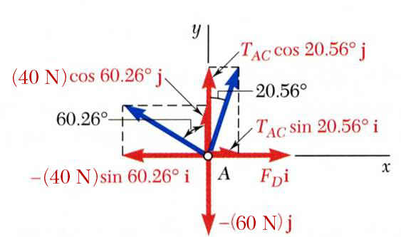
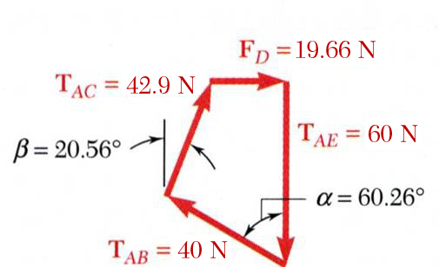
Sample Problem 2.6 (Cont’d)
Resolve the vector equilibrium equation into two component equations. Solve for the two unknown cable tensions.
r
(
)
r
(
)
r
T
=
−
40
N
sin
60
.
26
°
i
+
40
N
cos
60
.
26
°
j
AB
r
r
=
−
(
34
.
73
N
)
i
+
(
19
.
84
N
)
j
r
r
r
T
=
T
sin
20
.
56
°
i
+
T
cos
20
.
56
°
j
AC
AC
r
AC
r
=
0
.
3512
T
i
+
0
.
9363
T
j
r
AC
AC
(
)
r
T
=
−
6
0
N
i
r
r
F
=
F
i
D
D
r
R
=
0
(
)
r
=
−
34
.
73
+
0
.
3512
T
+
F
i
AC
D
r
+
(
19
.
84
+
0
.
9363
T
−
60
)
j
AC

Slide 54
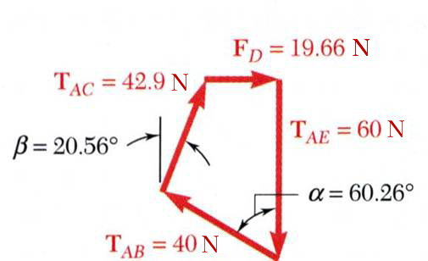
Sample Problem 2.6 (Cont’d)
This equation is satisfied only if each component of the resultant is equal to zero.

Slide 55
Agenda (Cont’d)
  Addition of Forces by Summing x & y Components
  Equilibrium of a Particle
      Newton’s First Law of Motion
  Problems about the Equilibrium of a Particle; Free Body Diagrams
  Forces in Space
  Rectangular Components of a Force in Space
  Forces Defined by its Magnitude and 2 points in its Line of Action
  Addition of Concurrent Forces in Space
  Equilibrium of a Particle in Space
Notes:
Introductory notes.

Slide 56
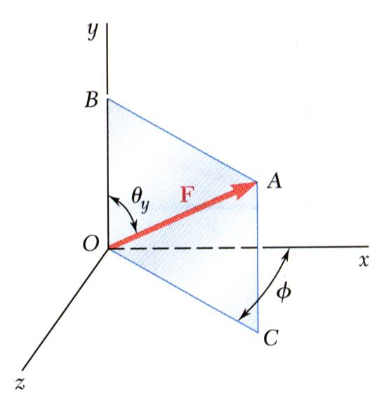
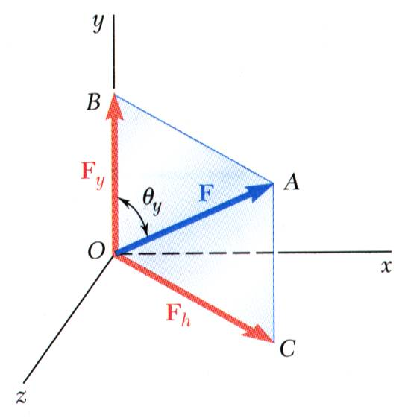
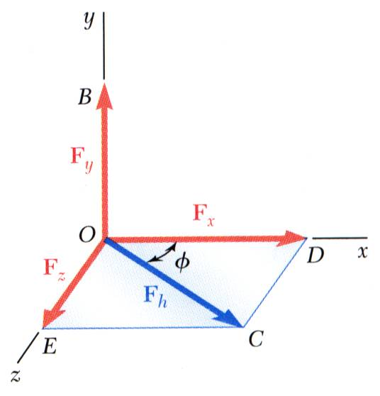
Rectangular Components in Space
The vector is contained in the plane OBAC.
Resolve into horizontal and vertical components.
Resolve into rectangular components.

Slide 57
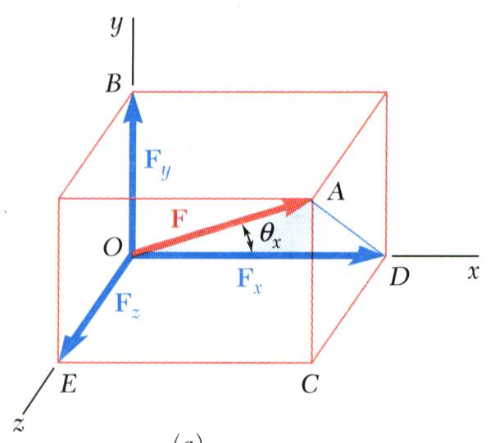
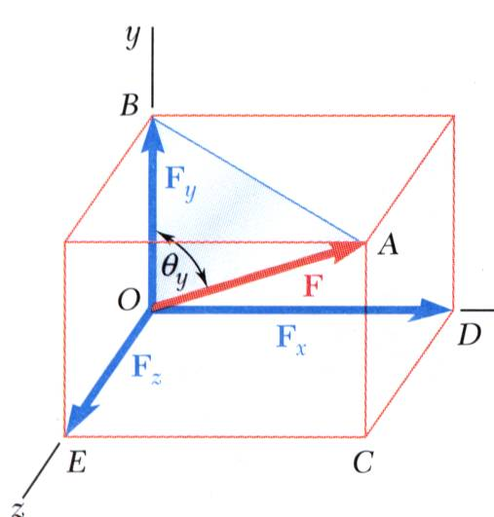
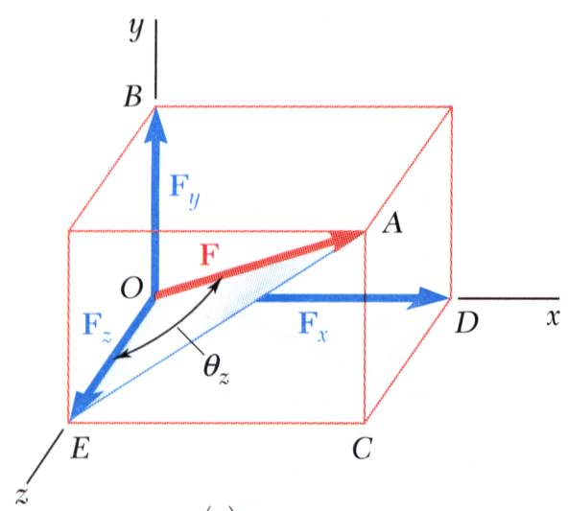
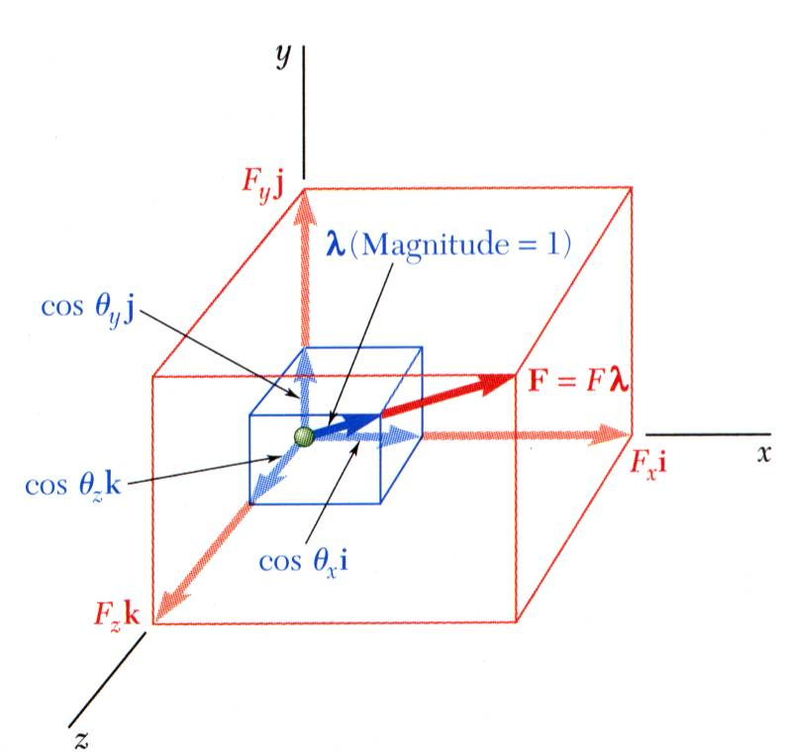
Rectangular Components in Space (Cont’d)
With the angles between and the axes,
is a unit vector along the line of action of
and are the direction cosines for

Slide 58
Agenda (Cont’d)
  Addition of Forces by Summing x & y Components
  Equilibrium of a Particle
      Newton’s First Law of Motion
  Problems about the Equilibrium of a Particle; Free Body Diagrams
  Forces in Space
  Rectangular Components of a Force in Space
  Forces Defined by its Magnitude and 2 points in its Line of Action
  Addition of Concurrent Forces in Space
  Equilibrium of a Particle in Space
Notes:
Introductory notes.

Slide 59
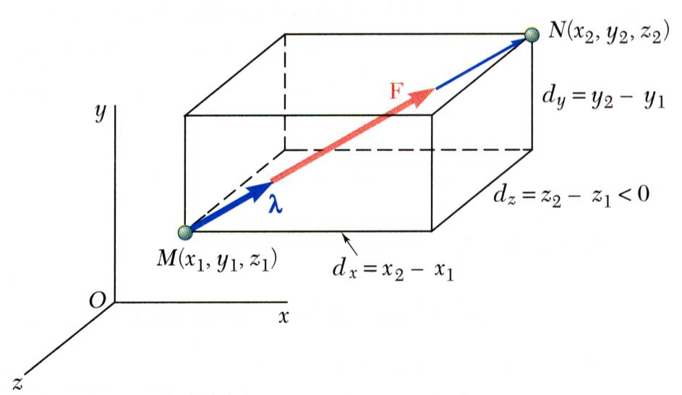
Forces Defined by its Magnitude and 2 points in its Line of Action
Direction of the force is defined by the location of two points,

Slide 60
Agenda (Cont’d)
  Addition of Forces by Summing x & y Components
  Equilibrium of a Particle
      Newton’s First Law of Motion
  Problems about the Equilibrium of a Particle; Free Body Diagrams
  Forces in Space
  Rectangular Components of a Force in Space
  Forces Defined by its Magnitude and 2 points in its Line of Action
  Addition of Concurrent Forces in Space
  Equilibrium of a Particle in Space
Notes:
Introductory notes.

Slide 61
Addition of Concurrent Forces in Space
Same as in 2D

Slide 62
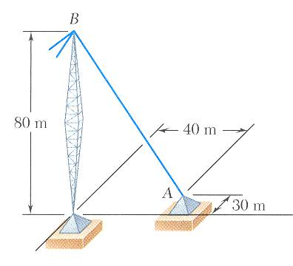
Sample Problem 2.7
SOLUTION:
Based on the relative locations of the points A and B, determine the unit vector pointing from A towards B.
Apply the unit vector to determine the components of the force acting on A.
Noting that the components of the unit vector are the direction cosines for the vector, calculate the corresponding angles.
The tension in the guy wire is 2500 N. Determine:
a) components F_{x}, F_{y}, F_{z} of the force acting on the bolt at A,
b) the angles θ_{x}, θ_{y}, θ_{z} defining the direction of the force

Slide 63

Sample Problem 2.7(Cont’d)
SOLUTION:
Determine the unit vector pointing from A towards B.
Determine the components of the force.

Slide 64

Sample Problem 2.7(Cont’d)
Noting that the components of the unit vector are the direction cosines for the vector, calculate the corresponding angles.

Slide 65

Sample Problem 2.8

Slide 66

Sample Problem 2.8 (Cont’d)

Slide 67
Agenda (Cont’d)
  Addition of Forces by Summing x & y Components
  Equilibrium of a Particle
      Newton’s First Law of Motion
  Problems about the Equilibrium of a Particle; Free Body Diagrams
  Forces in Space
  Rectangular Components of a Force in Space
  Forces Defined by its Magnitude and 2 points in its Line of Action
  Addition of Concurrent Forces in Space
  Equilibrium of a Particle in Space
Notes:
Introductory notes.

