Slide 1
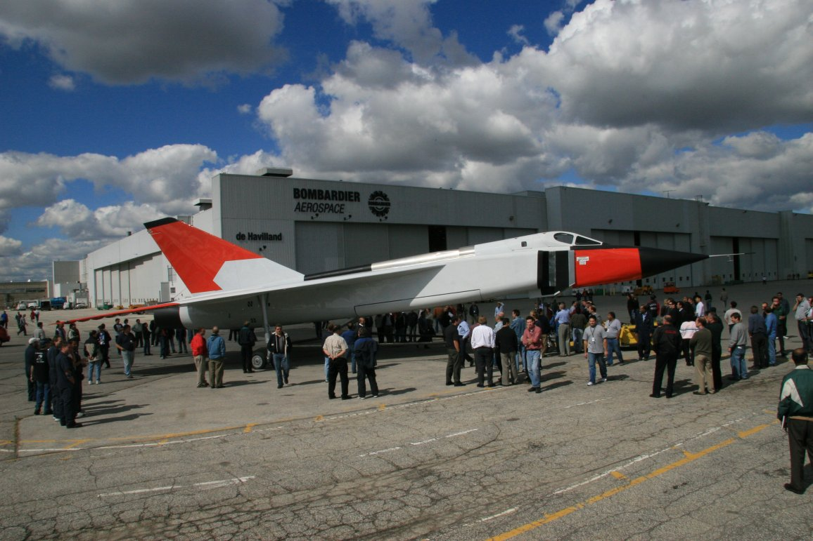
GNG 1105 Engineering Mechanics Introduction
Prof.: Philippe Girault

Slide 2
Agenda
  What is Mechanics
  Fundamental Concepts & Principles
  Systems of Units
  Conversion from one system to another
  Method of Problem Solution
  Numerical Accuracy
Notes:
Introductory notes.

Slide 3
Agenda
  What is Mechanics
  Fundamental Concepts & Principles
  Systems of Units
  Conversion from one system to another
  Method of Problem Solution
  Numerical Accuracy
Notes:
Introductory notes.

Slide 4
Definitions
Science which modelise the conditions of motion of bodies under the action of forces
Physical Science
Applied Sciences not a pure abstraction
Foundation of most Engineering Sciences, therefore a prerequisite
Notes:
Relative vocabulary list.

Slide 5
Definitions
Mechanics
Rigid Bodies
Deformable Bodies
Fluids
Mechanics of Materials
Incompressible: Hydraulics & Slow Aerodynamics
Statics
Dynamics
Elasticity & Plasticity
Compressible: High Speed Aerodynamics
Fatigue & Fracture mechanics
Notes:
Relative vocabulary list.

Slide 6
Agenda
  What is Mechanics
  Fundamental Concepts & Principles
  Systems of Units
  Conversion from one system to another
  Method of Problem Solution
  Numerical Accuracy
Notes:
Introductory notes.

Slide 7

Fundamental Concepts & Principles
History
  Statics:
    Egyptians :Imhotep Pyramid of Pharaoh Zoser (3rd dynasty) ((2790 to 2694BC) at Sakkara - Empirical knowledge ?
    Greeks: Archimedes (287 to 212 BC) Beginning of theoretical statics with Momentum , Center of Gravity and Lever.
Notes:
A list of procedures and steps, or a lecture slide with media.

Slide 8
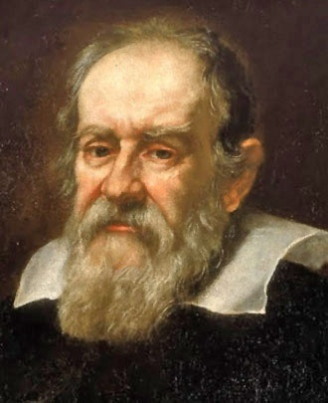
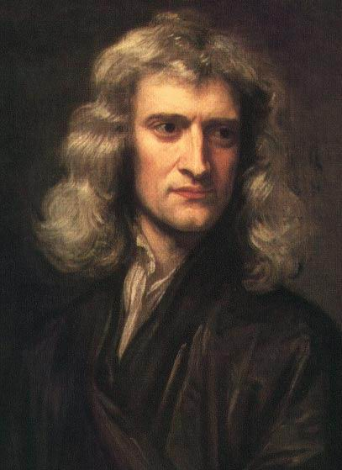
Fundamental Concepts & Principles_{(Cont’d)}
History (cont’d)
  Dynamics:
    Galileo (1564-1642) :
      Study of uniformly accelerated Motion
      Parabolic trajectory
    Newton (1643-1727):
      Theory of Newtonians mechanics or Classic Mechanics. (Mass is invariant)
Notes:
A list of procedures and steps, or a lecture slide with media.

Slide 9
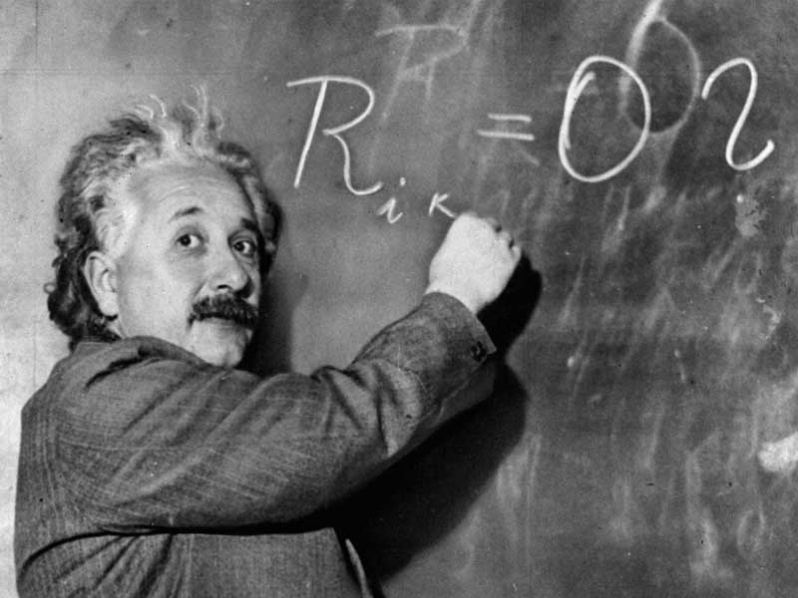
Fundamental Concepts & Principles_{(Cont’d)}
History (cont’d)
  Relativity:
    Einstein (1879-1955) :
      Special Theory of Relativity (1905)
      General Theory of Relativity (1916)
      Mass = function of Speed
Despite the limitation due to Relativity Theory Newtonian Mechanics remains the basis of Engineering Sciences
Notes:
A list of procedures and steps, or a lecture slide with media.

Slide 10
Fundamental Concepts & Principles_{(Cont’d)}
Basic Concepts:
Space
Time
Mass
Force
Those concepts are of a
Principles nature.
In Newtonian Mechanics: Space, Time, Mass → Absolute Concept
Force → Dependant Concept
Notes:
A list of procedures and steps, or a lecture slide with media.

Slide 11
Fundamental Concepts & Principles_{(Cont’d)}
Particles
Rigid Bodies
6 Fundamental principles
  Parallelogram for addition of forces
  Transmissibility (can be demonstrated)
  1st Newton’s Law: if F = 0 ...(derived from 4)
  2nd Newton’s Law: F = ma
  3^{d} Newton’s Law: Action ↔ Reaction
  Law of Gravitation:
Notes:
A list of procedures and steps, or a lecture slide with media.

Slide 12
Agenda
  What is Mechanics
  Fundamental Concepts & Principles
  Systems of Units
  Conversion from one system to another
  Method of Problem Solution
  Numerical Accuracy
Notes:
Introductory notes.

Slide 13
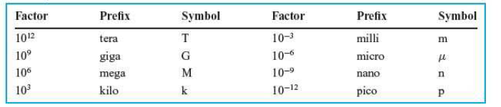
Unit Systems (SI, British Std etc)
Basic Units
  Length, Mass, Time (SI) or Length, Force, Time (Engineering or technical)
Derived Units
Unit Prefixed
Notes:
A list of procedures and steps, or a lecture slide with media.

Slide 14
Unit Systems (SI, British Std etc)
 | SI | Cgs | Engineering Metric | British Std | Engineering British
L | M | Cm | M | Ft | Ft
M | kg | g | masseau | Slugs | Lbm
T | s | s | s | s | S
F | N | Dyne | kgf | Lb | Lb
P | Pa | Bar | Kgf/mm² | psf | Psi
W or E | Joule | erg | Kgf m | Lb ft | Lb ft
Heat | Joule | erg | Calorie | Lb ft | BTU
Power | Watt |  | CV | Lb ft/s | HP
Volume | m³ | cm³ | Litre | ft³ | Gallon
Notes:
A list of procedures and steps, or a lecture slide with media.

Slide 15
Agenda
  What is Mechanics
  Fundamental Concepts & Principles
  Systems of Units
  Conversion from one system to another
  Method of Problem Solution
  Numerical Accuracy
Notes:
Introductory notes.

Slide 16
Conversion of Units systems
Length
  1 ft =0.3048 m ⇒ 1mi =1609m ⇒ 1NM = 1.852 m
  1 in = 1/12 ft = 0.0254m = 25.4 mm
Force
  W = Mg ⇒ 1lb = 0.4536 kg x 9.807m/s² =4.448 N
Mass
Notes:
A list of procedures and steps, or a lecture slide with media.

Slide 17
Agenda
  What is Mechanics
  Fundamental Concepts & Principles
  Systems of Units
  Conversion from one system to another
  Method of Problem Solution
  Numerical Accuracy
Notes:
Introductory notes.

Slide 18
Method Of Problem Solution
Statement of a problem
  Clear & precise
  Contain the given data
  Indicate what information is required
Separate sketch(es)
  Free body diagram per bodies
  Including all quantities involved
  Indicating clearly all the forces
Usage of fundamental principles
  To write equations
  Each equations clearly related to the free body diagram
Notes:
A list of procedures and steps, or a lecture slide with media.

Slide 19
Method Of Problem Solution (Cont’d)
Solutions of the equation
  Strict application of rules of Algebra
  Record every step
Careful check
  Reasoning mistake detected by checking units
  Computation checked by usage of an equation not yet used
Notes:
A list of procedures and steps, or a lecture slide with media.

Slide 20
Agenda
  What is Mechanics
  Fundamental Concepts & Principles
  Systems of Units
  Conversion from one system to another
  Method of Problem Solution
  Numerical Accuracy
Notes:
Introductory notes.

Slide 21
Numerical Accuracy
It is useless to compute with extreme accuracy
§ 1.2 optimistic i.e.
  Very often the accuracy of the forces is not better than 2 %.
Calculation accuracy should be of the order of magnitude the accuracy of the data or the accuracy of the computation method whichever is less.
Notes:
A list of procedures and steps, or a lecture slide with media.

