Slide 1
English 1112C:
Technical Report Writing
Gefen Bar-On Santor
Teaching Assistants:
Marie Comisso
Lia Talia

Slide 2
Course objective
To practice the rules and principles of clear, concise and accurate writing and to develop the literacy skills that are necessary for producing effective academic and workplace documents.

Slide 3
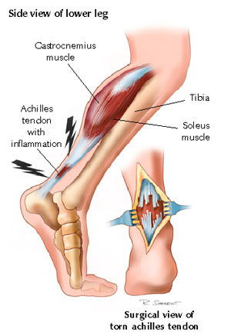
Achilles’ Heel
“Poor communication skill is the Achilles’ heel of many engineers . . . [P]oor communication skills have probably claimed more casualties than corporate downsizing.”
H.T. Roman

Slide 4
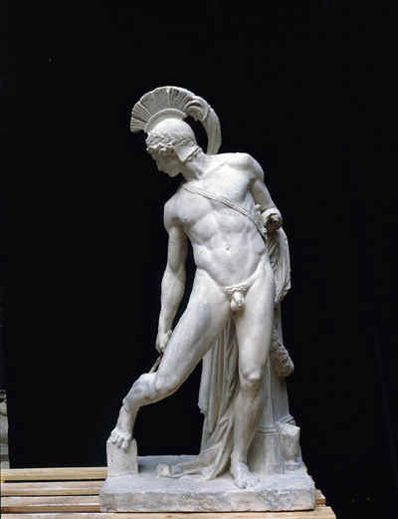
Sing, goddess, the anger of Peleus’ son Achilleus
and its devastation
Iliad

Slide 5
Achilles’ Heel: a metaphor
A weakness in someone who is otherwise strong.
Many scientists and engineers are weaker in writing than they are in their professions.

Slide 6
Effective writing: a scientific duty
"Great spirits have always found violent opposition from mediocre minds. The latter cannot understand it when a man does not thoughtlessly submit to hereditary prejudices but honestly and courageously uses his intelligence and fulfills the duty to express the results of his thoughts in clear form.“
Albert Einstein

Slide 7
Good communication turns ideas into results
“If language is not correct, then what is said is not what is meant; if what is said is not what is meant, then what ought to be done remains undone.”
Confucius

Slide 8
Language: an essential tool
Many scientists and engineers spend much, sometimes most, of their day writing.
Good writing skills are often correlated with promotion to management positions.

Slide 9
reflect
What is the difference between language and other scientific tools (such as mathematics)?
What makes writing less “teachable” than other tools?

Slide 10
language is
A complex and vast tool.
less subject to absolute principles and codes than mathematics.
Acquired naturally (but often imperfectly) through imitation and subconscious learning. Naturally acquired habits are hard to modify.

Slide 11
Many people do not maximize their writing potential because of
Lack of time to immerse themselves in reading and writing.
The temptations of electronic entertainment.
Is literacy the Achilles’ heel of our culture?

Slide 12
Class structure
Friday, 13:00-14:30, Arts 257
Lecture
Given by Gefen Bar-On Santor

Slide 13
Tuesday, 11:30-1:00
Discussion groups
Practice and elaborate the material covered in the lectures.

Slide 14
DGD 1: Tabaret 325 with Gefen Bar-On Santor
DGD 2: Morisset 252 with Marie Comisso
DGD 3: Tabaret 323 with Lia Talia

Slide 15
important
To correct uneven registration in the discussion groups, students listed as 38-45 in DGD 1 and 2 should move to DGD 3.
Please see me after class to obtain a modification of registration form.

Slide 16
Required weekly handouts: print from virtual campus
No later than midnight on the Sunday before each discussion group, I will post a handout on virtual campus in a folder called “print please.”
Print that handout and bring it to the discussion group (you do not need to read it in advance).

Slide 17
No handout for first workshop
Diagnostic activity
Bring your course pack
No need to prepare for the diagnostic activity

Slide 18
Required course pack
Buy NOW at University Centre 0024 (bin C07).
Bring to every lecture and workshop.
Read the assigned pages from the course pack before class.
Pages listed under lecture also apply to the discussion group after it.

Slide 19
Recommended textbooks
Beer, David and David McMurrey. A Guide to Writing as an Engineer. 3rd ed. New York: John Wiley, 2009.
Buckley, Joanne. Checkmate: A Writing Reference for Canadians. Second ed. Scarborough: Thomson Nelson, 2008.

Slide 20
Virtual campus
Powerpoint presentations used in the lectures and workshops will be posted on virtual campus after each meeting.
Regular attendance is crucial for your success.

Slide 21
Marking scheme
Test 1 (October 2) 10%
Report 1 (October 16) 20%
Test 2 (October 30) 20%
Test 3 (November 20) 20%
Final report (December 11) 30%

Slide 22
tests
Test your knowledge of the writing principles and texts discussed in class. For example:
Recognize and correct a problem.
Choose the correct word or answer from the options given.
Answer reading comprehension/vocabulary questions.

Slide 23
Next slides
Sample test questions (non comprehensive)

Slide 24
What’s wrong?
Obesity is a major problem in North America, it is associated with many illnesses.

Slide 25
Comma splice
Independent clauses are spliced together with no coordinating conjunction.
Obesity is a major problem in North America, since it is associated with many illnesses.
Obesity is a major problem in North America. It is associated with many illnesses.

Slide 26
Which is correct?
The factor that showed the most abnormalities was/were the red blood cells
Notes:
Iverson, Cheryl. American Medical Association Manual of Style. Baltimore: Williams and Wilkins, 1989. page 94.

Slide 27
Verb should agree with subject
The factor that showed the most abnormalities was the red blood cells
Notes:
Iverson, Cheryl. American Medical Association Manual of Style. Baltimore: Williams and Wilkins, 1989. page 94.

Slide 28
What’s wrong?
Once having completed needed modifications and adjustments, the equipment operated correctly and met all specifications.

Slide 29
Who completed the modifications?
Once we completed needed modifications and adjustments, the equipment operated correctly and met all specifications.

Slide 30
He worked on this project for two months longer than I /me.

Slide 31
Think about the words left out
He worked on this project for two months longer than I.
He worked on this project for two months longer than I have (not me have).

Slide 32
What’s wrong?
The professor told me to edit my paper carefully and don’t leave it to the last minute.

Slide 33
Awkward Shift from indirect to direct quote
The professor told me to edit my paper carefully (indirect)
The professor told me: “don’t leave it to the last minute” (direct)

Slide 34
correct
Indirect reporting: The professor told me to edit my report carefully and to not leave it to the last minute.
Direct reporting: The professor told me: “edit your report carefully and don’t leave it to the last minute.”

Slide 35
What’s wrong?
With sincere apologies I am writing to inform you that in light of being extremely busy at this point in time I will not be able to accept your invitation to present at the energy solutions conference.

Slide 36
Solution: eliminate wordiness
I regret that I will not be able to accept your invitation to present at the energy solutions conference.

Slide 37
What’s wrong?
The opportunity to change the course of ones career with one crucial experiment does not come often.

Slide 38
An apostrophe typo
The opportunity to change the course of one’s career with one crucial experiment does not come often.

Slide 39
usage
To keep the patient alive, the breathing machine must work continually/continuously.

Slide 40
To keep the patient alive, the breathing machine must work continually/continuously.

Slide 41
What’s wrong?
By taking about 5 minutes a day to review effective words and sentences recorded in a reading journal will in the long run help to improve one’s writing.
“take pains . . . to admire what is good” (William Strunk and E.B. White’s The Elements of Style)

Slide 42
Writer lost track of logic of expression
By Taking about five minutes a day to review effective words and sentences recorded in a reading journal will in the long run help to improve one’s writing.
By taking about 5 minutes a day to review effective words and sentences recorded in a reading journal, one will in the long run improve one’s writing.

Slide 43
What’s wrong?
Awkward sentences are often when there are unnecessary shifts.

Slide 44
Unique=one of a kind
Most unique=the most one of a kind
Nonsensical

Slide 45
Avoid “is when”
“Is when” refers to time. Noon is when we eat lunch.
Awkward sentence often involve unnecessary shifts.

Slide 46
What’s wrong ?
New Beauty is the world’s most unique beauty magazine.

Slide 47
Commas or no commas?
Engineers, who can use CAD programs, are currently in demand.
Engineers who can use CAD programs are currently in demand.

Slide 48
no commas—restrictive element
Engineers who can use CAD programs are currently in demand.

Slide 49
Commas: non-restrictive element
My brother, who is older than I am, is an engineer.

Slide 50
Ambiguity: how to punctuate?
A woman without her man is nothing

Slide 51
One possibility . . .
A woman, without her man, is nothing.

Slide 52
Another possibility . . .
A woman: without her, man is nothing.

Slide 53

Importance of punctuation
“I was working on the proof of one of my poems all the morning, and took out a comma. In the afternoon, I put it back again.”
Oscar Wilde

Slide 54
Which word would best describe Randy Shilt’s attitude when he calls the National Institute of Health “Golf courses of science?”
Relaxed
Cynical
Reverent
Indignant

Slide 55
Which word would best describe Randy Shilt’s attitude when he calls the National Institute of Health “Golf courses of science?”
Relaxed
Cynical
Reverent
Indignant

Slide 56
For Naomi Baron, what is the primary manifestation of “linguistic whateverism?”
Grammatical errors
Stylistic errors
Indifference for tradition
Indifference for consistency

Slide 57
For Naomi Baron, what is the primary manifestation of “linguistic whateverism?”
Grammatical errors
Stylistic errors
Indifference for tradition
Indifference for consistency

Slide 58
Reports: your research project
Instructions on pages 5-6 of syllabus.
Please start as soon as possible.

Slide 59
September 28: Librarian guest lecture
Explore library subject guides:
http://www.biblio.uottawa.ca/content-page.php?g=en&s=biblio&c=src-suj

Slide 60
Classroom etiquette
Refrain from chatting, electronic entertainment or any other disruptive behaviour during lecturesand workshops.

Slide 61
Office change
My office (Arts 340) might change.
An announcement will follow.

