Slide 1
Sensation and Perception

Slide 2
Sensation & Perception
Information comes in through our senses
Our brains interpret this information
  You LOOK with your eyes - You SEE with your brain
    Contribution of context (e.g. in class… |3 can be read as B or 13)
Sensation
  Stimulus-detection process
  Organs translate stimuli into nerve impulses
Perception
  Organizing & giving meaning to input

Slide 3
Sensory and Perceptual Processes
receives and translate physical energies into nerve impulses by which the brain receives, organizes, and confers meaning on them (constructs a perceptual experience)
Process from Sensation to Perception
  stimulus is received by sensory receptors
  Receptors translate stimulus properties into nerve impulses (transduction)
  Feature detectors analyze stimulus features
  Stimulus features are reconstructed into neural representation
  Neural representation is compared with previously stored information in the brain
  Matching process results in recognition and interpretation of stimuli

Slide 4
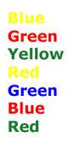
The Stroop Effect
Looking at the word “colour” and the colour of the word.
  e.g. the word “yellow” is written in red. Although the eyes will see the colour red, the brain will process it as a word and read it as “yellow”

Slide 5
Absolute Threshold
Intensity at which a stimulus can be detected 50% of time
  Lower the absolute threshold - Higher the sensitivity
  E.g. Vision, hearing, taste, smell, touch

Slide 6
Absolute Threshold
A key distinction here is that absolute threshold measures the level that we can actually report sensing a stimuli.
We therefore have to consciously be aware of the stimuli to successfully report it.
What about stimuli that is just below our conscious awareness or our absolute threshold?
Is it still processed?

Slide 7
Subliminal Perception
Subliminal stimulus – a stimulus that is so weak or brief that, although it is received by the senses, it cannot be perceived consciously.
The stimulus is well below the absolute threshold.
What areas of our life are thought to use subliminal stimulus?

Slide 8
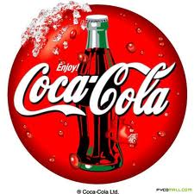
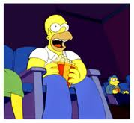
Subliminal Messages
Late 1950’s James Vicary (P.R. executive), arranged to have subliminal messages flashed on a theatre screen during a movie.
Messages said:
“Drink Coca-Cola”
“Eat Popcorn”

Slide 9
Vicary’s results…
Increased popcorn sales by 50%
Increased soft-drink sales by 18%
Public were outraged.
Fear of brainwashing.
National Association of Broadcasters outlawed subliminal messages on American TV
Problem:
Vicary’s results under controlled experimental conditions failed to be replicated.
Admitted later that his study was a hoax to revive his advertising agency.

Slide 10
But…it sparked large amounts of research in the area
Studies were finding that subliminal messages didn’t really change consumer behaviour.
But research started to focus on more subtle processes, like our attitudes.
Can subliminal messages impact our attitudes towards people or things?

Slide 11
Krosnick (1992)
Showed participants 9 slides of a particular person.
Half of participants received negative subliminal messages just prior.
Half received positive subliminal messages just prior.
Results
  Participants expressed somewhat negative attitudes towards negatively “primed” individuals, compared with their positively primed counterparts.

Slide 12
Subliminal Messages
So apparently won’t impact consumer behaviours, but will impact our attitude towards some things.
Advertisers have discovered that stimuli above absolute threshold is more powerful than subliminal messages.
So have advertisers avoided these sneaky tactics?

Slide 13
Signal Detection Theory
How certain are we that a stimulus is present?
  You are walking alone. Did you hear something?
What criteria do we use to determine if a stimulus is present?
    Fatigue, importance of stimulus, expectation, etc..
Decision Criterion – A standard of how certain an individual must be that a stimulus is present before they will say they detect it.

Slide 14
Difference Threshold
Smallest difference between 2 stimuli that can be detected 50% of the time
  Just noticeable difference (JND) (Weber, 1830)
Weber’s Law
  JND is proportional to magnitude of stimulus for which comparison is being made
Proportion is called Weber Fraction
  Amount of increase needed to make a difference
    carry 2 kg (2000 grams), 1 additional gram will not make a difference
    carry 20 grams, 1 gram will make a difference
    For weight is about 1/50 - Breaks down at very high & low intensities

Slide 15
Sensory Processes
Sensory adaptation (habituation)
  Diminishing sensitivity to unchanging stimulus
  Occurs in all sensory modalities
    Adaptive value
      Frees senses from the unchanging to be more sensitive to changes in environment

Slide 16
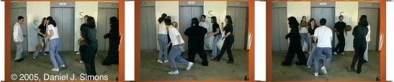
Visual Attention (Attentional Capture)
Inattentional blindness
  Failure to notice obvious change in visual scene
  Sometimes termed change blindness
  Simons and Chabris (1999)
    Subjects watched and attended to a video
    Over ½ failed to notice bizarre event

Slide 17
Change Blindness
75% of participants DON’T NOTICE the change.
Would you?
What factors would impact whether someone notices or not?

Slide 18
Sensation vs. Perception
Sensation is the activities by which our sense organs receive and transmit information.
Perception involves the brain’s processing and interpretation of the information.

Slide 19
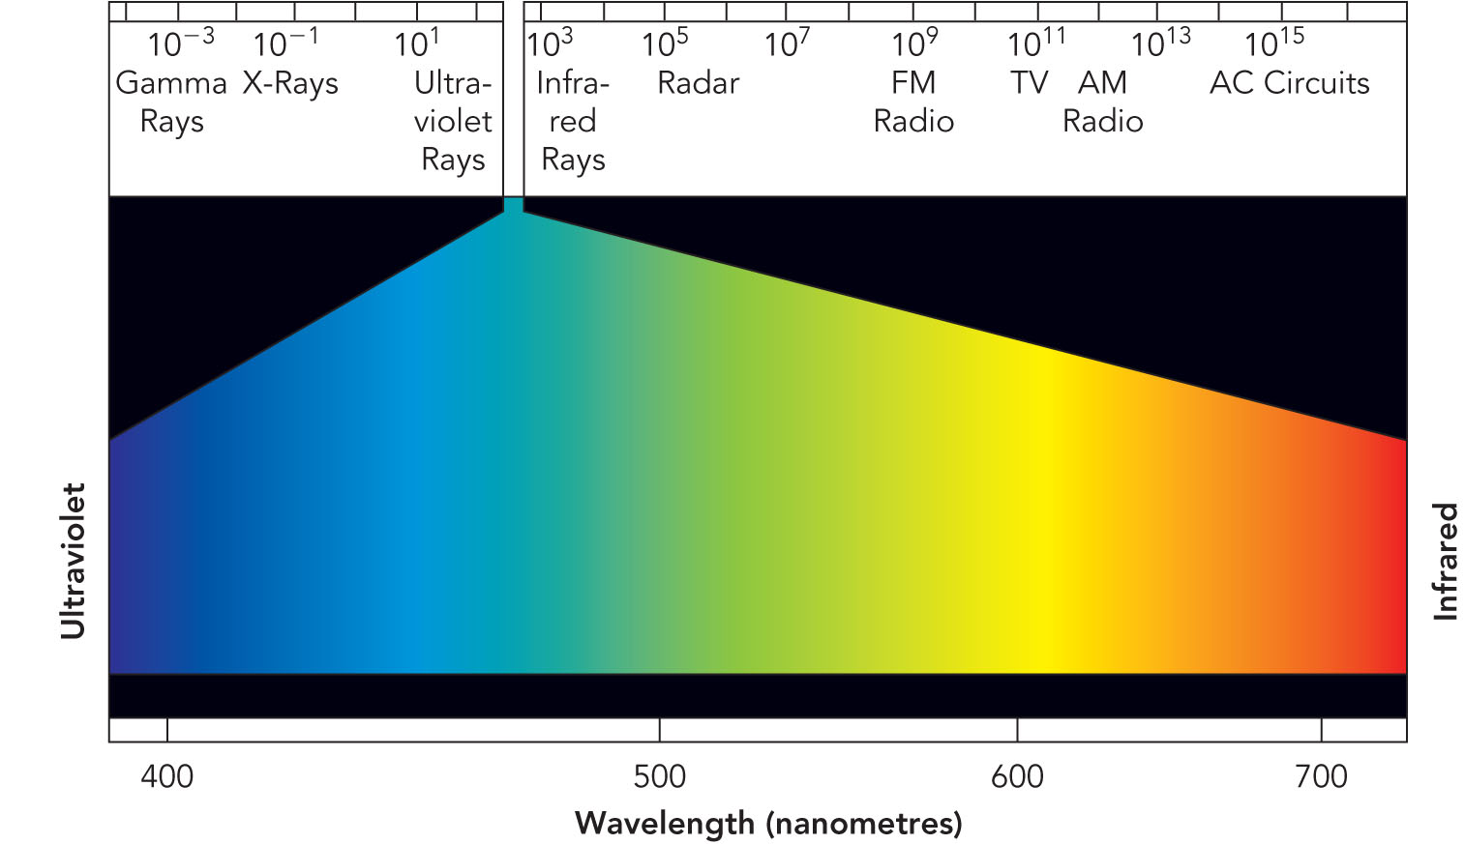
Vision
Perceive small part of electromagnetic (EM) spectrum
Light waves measured in nanometers (billionths of meter)
  From 700 nm to 400 nm

Slide 20
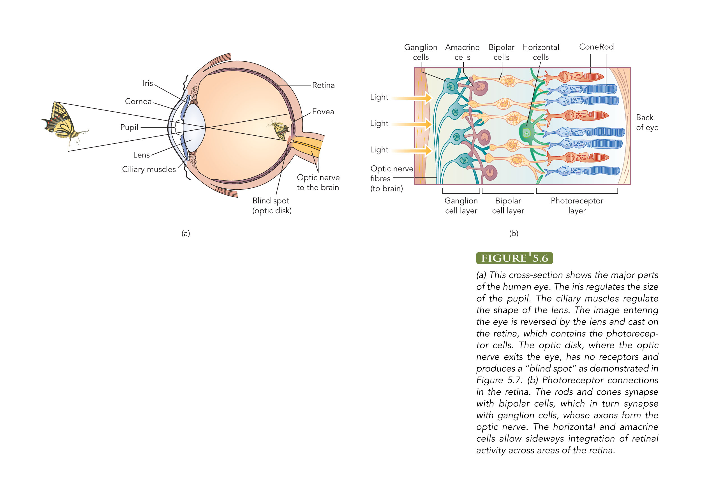
Structures of Visual System

Slide 21
Anatomy of Visual System
Cornea
  Transparent protective structure
Pupil
  Adjustable opening that controls amount of light
Lens
  Elastic structure for focusing
  Thinner to focus on distant objects
  Thicker to focus on nearby objects
Retina
  Photoreceptors transduce light energy into electrical impulses

Slide 22
Anatomy of Visual System
Myopia
  Nearsightedness
    Difficulty seeing far away objects
  Eyeball is longer - back to front
  Lens focuses light in front of retina
Hyperopia
  Farsightedness
    Difficulty seeing close-up objects
  Eyeball is too short
  Lens focuses light behind retina

Slide 23
Photoreceptors
Cones
  For colour and detail
  Function best in high illumination
  Concentrated in centre of retina
  Fovea (in centre of retina) contains only cones
Rods
  Function best in low illumination
  500 times more sensitive to light than cones
  Mostly in periphery of retina - though everywhere in retina except fovea

Slide 24
From Light to Nerve Impulses
Transduction
  Converting characteristics of stimulus to nerve impulses
Visual transduction
  Action of photopigments
  Absorption of light changes rate of neurotransmitter release
  Greater rate of release = the stronger the signal passed on

Slide 25
Brightness & Dark Adaptation
Have ‘dual visual system’
  Some animals see in daylight
  Some at night
  Human visual system adapted for both high & low light conditions
Dark adaptation
  Progressive improvement in brightness sensitivity in low illumination

Slide 26
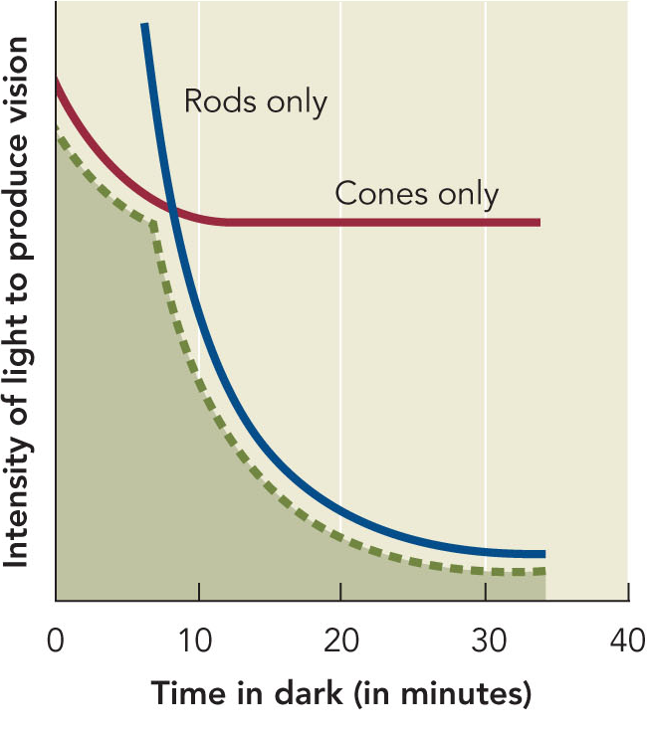
Dark Adaptation
Rely on rods for vision in low light conditions
Rods & cones adapt differently
  Cones adapt after 10 minutes - sensitivity has reached its maximum
  Rods adapt after 30 minutes

Slide 27
Colour Vision
Trichromatic theory (Young-Helmholtz)
  Three types of color receptors in retina
  Cones most sensitive to blue, green, red wavelengths
  Visual system combines activity from these cells
  Colours are perceived by additive mixture of impulses
  If all are equally activated - white colour is produced

Slide 28
Colour Vision
Trichromatic theory cannot explain:
  Red-green colour blind individuals should not be able to perceive yellow (red + green = yellow)
  Afterimages
    Another theory developed to explain this

Slide 29
Colour Vision
Opponent-Process theory (Hering, 1870)
  Three cone types
  Each responds to two different wavelengths
    Red or green
    Blue or yellow
    Black or white
Explains Afterimages
  Stare at certain colour
  Neural processes become fatigued
  Have ‘rebound’ effect with receptor responding with its opponent opposite reaction

Slide 30
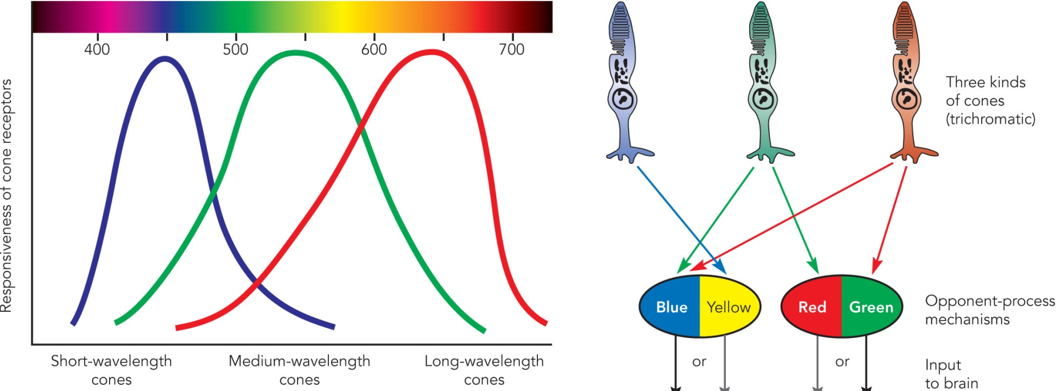
Current view of colour vision
Dual process theory
  Combines trichromatic & opponent-process theories
  3 types of cones sensitive to short (blue) medium (green) and long (red) wavelengths stimulate opponent-process reactions
    Opponent processes occur in ganglion cells, neurons in relay stations & visual cortex

Slide 31
Colour Deficient Vision
Trichromats
  Normal colour vision
Dichromats
  Deficient in one system (red-green is most common)
Monochromat
  Sensitive to black-white only

Slide 32
Reconstructing Visual Scenes
Impulses go from
  Thalamus to primary visual cortex (occipital lobe)
  Fovea has large representation in visual cortex
Feature detectors
  Fire to specific characteristics of stimuli
    Respond to bars, slits, edges in certain orientations
    Others respond to colour, depth, movement

Slide 33
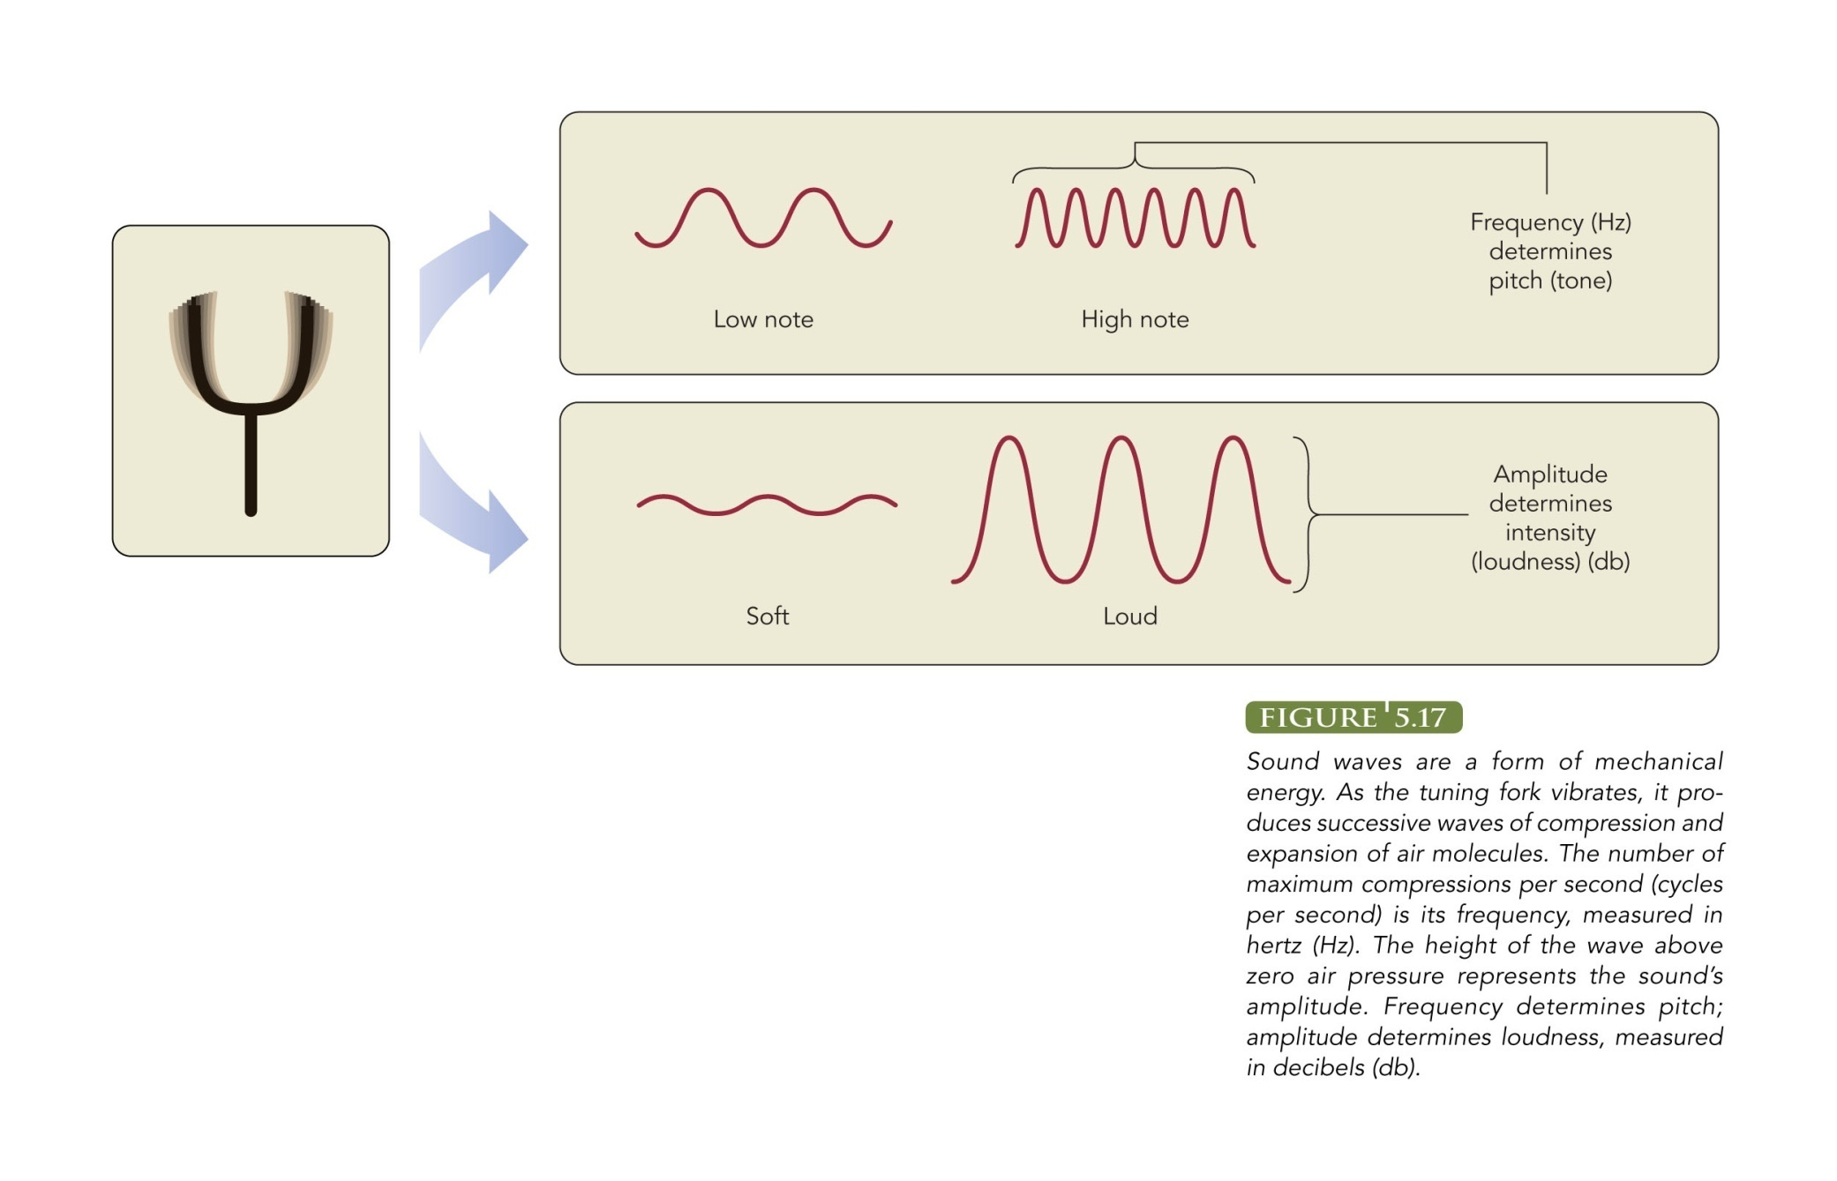
Audition
Stimulus for hearing = sound waves
Described by 2 characteristics
  Frequency & Amplitude

Slide 34
Anatomy of Hearing
Outer ear
  Pinna
  Sound enters auditory canal
  Causes tympanic membrane (eardrum) to vibrate
Middle ear
  Vibration cause malleus, incus, stapes (3 tiny bones) to vibrate
  Amplify sound more than 30X
  Cause oval window to move in and out

Slide 35
Anatomy of Hearing
Inner ear
  Contains cochlea
  Houses basilar membrane - which moves as oval window moves
  On top of membrane is organ of Corti
  Contains hair cells = sound receptors
  Hair cells synapse with auditory nerve
  Send impulses to auditory relay station thalamus - then to auditory cortex (temporal lobe)

Slide 36
Coding of Pitch & Loudness
Loudness
  Use firing rate & type of receptor cell
  High amplitude waves cause greater release of neurotransmitter
  Results in higher firing rate of neuron
  Certain neurons fire only to specific amplitudes

Slide 37
Sound Localization
Binaural hearing (2 ears) helps localize sound
Timing of sounds
  Sounds arrive at closest ear first
  Use differences in arrival time
Intensity of sounds
  Sound arriving at closest ear will be more intense
  Use differences in intensities

Slide 38
Hearing Loss
Conduction deafness - mechanical system of hearing
    E.g., punctured eardrum, loss of function of bones of middle ear
Nerve deafness - damaged receptors
    Exposure to loud sounds can damage hair cells
      Musicians clinic of Canada

Slide 39
Perception: Top-Down vs. Bottom-Up Processing
Bottom-up Processing – the system takes in individual elements of the stimulus and then combines them into a unified perception. Example – reading text.
Top-Down Processing – sensory information is interpreted in the light of existing knowledge, concepts, and expectations.
* Top-down processing accounts for many of the psychological influences on perception (e.g. motives, expectations, culture, experiences)

Slide 40
The role of attention
Involves two processes of selection:
1. Focusing on certain stimuli
2. Filtering out other incoming information
Shadowing – participants wear earphones and listen simultaneously to 2 messages. Asked to repeat or “shadow” one of the messages.

Slide 41
Shadowing Experiments
Participants can usually repeat the one message successfully.
However, they generally have a very difficult time remembering the other message.
Shadowing experiments demonstrate that we cannot attend completely to more than one thing at a time.
But we can shift our attention rapidly back and forth between the messages.

Slide 42
Environmental & Personal Factors
Our attention is strongly influenced by the nature of the stimulus and by personal factors.
Personal interests will direct your attention.
Motives will also influence your attention….if you are hungry, you have an increases sensitivity to food-related cues.

Slide 43
Attention and well-being
If stimuli is threatening, people will quickly focus their attention on that stimulus.
Hansen & Hansen (1988) – found that people respond more quickly to angry-looking faces in a crowd compared to smiling faces.

Slide 44
Reaction to projectiles
Jeffrey Lin et al (2009).
Sat participants in front of a video screen and tested their reaction times in response to images that sped from the background.
Significantly faster reaction times for images that were coming towards their head compared to images that would just miss their head.

Slide 45
Perceptions have an organization and a structure - Gestalt principles
Gestalt psychologists proposed principles of organization:
  Figure-Ground
  Similarity
  Proximity
  Good continuation
  Closure
  Common region

Slide 46
Gestalt: Figure - Ground
We tend to organize stimuli into a central or foreground figure and a background.
The central figure is usually in front of or on top of what we perceive to be the background.
The figure tends to be more striking and more memorable than the background.

Slide 47
Gestalt principles
Also interested in perceptional organization.
These include the gestalt laws of:
  Similarity
  Proximity
  Closure
  Continuity

Slide 48
Perceptual Sets
Readiness to perceive stimuli in a particular way.
Like being primed to expect something and therefore perceiving it.
Examples – USS Vincennes in battle 1988
Study by Kelley (1950) – guest lecturer……”warm” vs. “cold” descriptor.

Slide 49

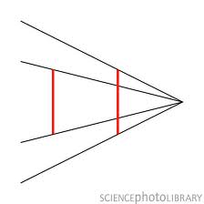
Perceptual hypotheses
Ponzo Illusion

Slide 50
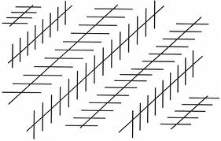
Are the long lines parallel?

Slide 51
Cultural differences and perception
Our cultural experiences and the type of perceptions we are used to experiencing can influence HOW we perceive stimuli.
People from different cultures could look at the same stimuli but perceive it differently.

Slide 52
Consciousness

Slide 53
Chapter 6 - Consciousness
What is consciousness?
  Moment-to-moment awareness of ourselves and the environment.
Consciousness is:
  Subjective
  Dynamic
  Self-reflective

Slide 54
Levels of consciousness: Psychodynamic Perspective
Freud:
  3 levels of awareness
1. The conscious mind – contains our thoughts, perceptions, and other mental events we are aware of.
2. Preconscious – mental events that are out of our current awareness but that can be easily retrieved under certain conditions.
3. Unconscious – events cannot be brought into conscious awareness under ordinary circumstances.

Slide 55
Levels of consciousness:
Cognitive perspective
Views the conscious and unconscious as working together not as in constant conflict with each other like the psychodynamic approach.
Controlled vs. Automatic processing
  Controlled processing – requires voluntary use of attention and conscious effort.
  Automatic processing – activities can be performed with little or no conscious effort.

Slide 56
Automatic processing
Learning to type, use utensils etc.
More practice leads to increased performance and brain regions involved in conscious thought become less active.

Slide 57
Divided attention
Automatic processing also assists us in our ability to have divided attention.
The ability to perform more than one activity at a time.
We can do it. But we are not great at it. Remember Gavin trying to do two simple tasks? Not good.

Slide 58
Emotional Unconscious
Some believe that emotional and motivational processes operate unconsciously and have an influence on our behaviour.
Studies by Bargh and Chartrand (1999) –
  Subliminally presented participants with nouns that were
    Strongly negative
    Mildly negative
    Mildly positive
    Strongly positive
Then rated their mood.

Slide 59
Circadian Rhythm
We have become adapted to a 24-Hour day-night cycle.
Biological based but can be impacted by the environment.
Regulated by our suprachiasmatic nuclei (SCN), located in our hypothalamus.
But is also impacted by the day-night cycle.

Slide 60
Early Birds vs. night owls
Are you a “morning person” or a “night person”?
Morning people go to bed earlier and wake up earlier. Alertness peak earlier in the day.
Perform better in morning classes compared to “night owls”
Night owls perform better in later afternoon or early evening classes.

Slide 61
Sleep and dreaming
Stages of sleep
Approximately every 90 minutes of sleep we cycle through different stages.
Stage 1 through 4
REM sleep

Slide 62
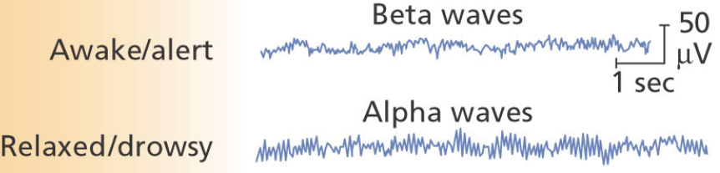

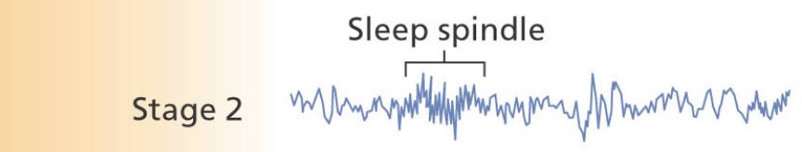
Stages of Sleep
Stage 1
  Light sleep
  May experience ‘body jerks’
Stage 2
  Sleep deepens - muscles more relaxed - harder to awaken
  Sleep spindles

Slide 63
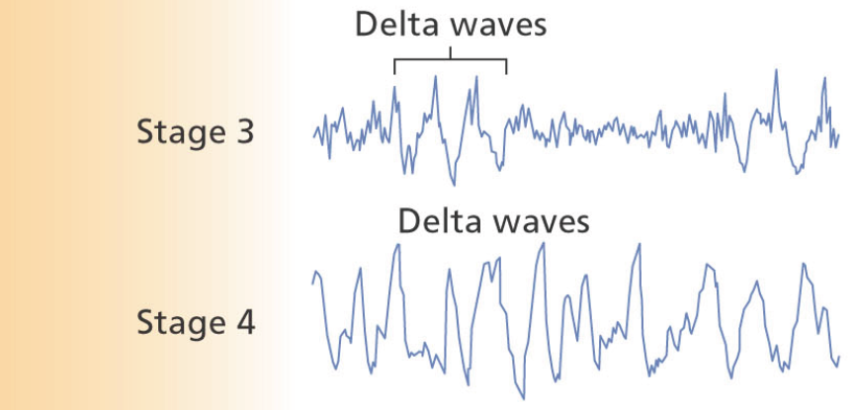
Stages of Sleep
Stage 3
  Sleep deepens
  Delta waves
Stage 4
  Delta waves dominate pattern
Stages 3-4: ‘slow-wave sleep’

Slide 64
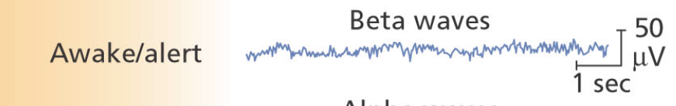
Stages of Sleep
REM sleep
  Rapid eye movements
  High arousal (heart rate, breathing, brain wave activity)
  REM sleep paralysis
    Difficult for voluntary muscles to contract
  Frequent dreaming

Slide 65
Sleep deprivation
How many of you have pulled an “all-nighter” to study?
Pilcher & Bradley (1996) studied sleep deprivation.
Short-term sleep deprived (up to 45 hours without sleep)
Long-term sleep deprived (more than 45 hours without sleep)
Partial deprivation (sleep no more than 5 hours per night for one or more consecutive nights)
Responses on: Mood, Mental tasks, Physical tasks

Slide 66
Sleep deprivation
University students who pull all-nighters
Perform more poorly on critical thinking tasks than students allowed to sleep.
But sleep deprived students actually report that they performed better and concentrated harder etc.
People seem to underestimate the negative impact sleep deprivation has on their abilities.

Slide 67
Sleep disorders
Insomnia
  The chronic difficulty in falling asleep, staying asleep, or experiencing restful sleep.
  Most common sleep disorder. Affects 10-40% of the population
  Has biological, psychological, and environmental causes.

Slide 68
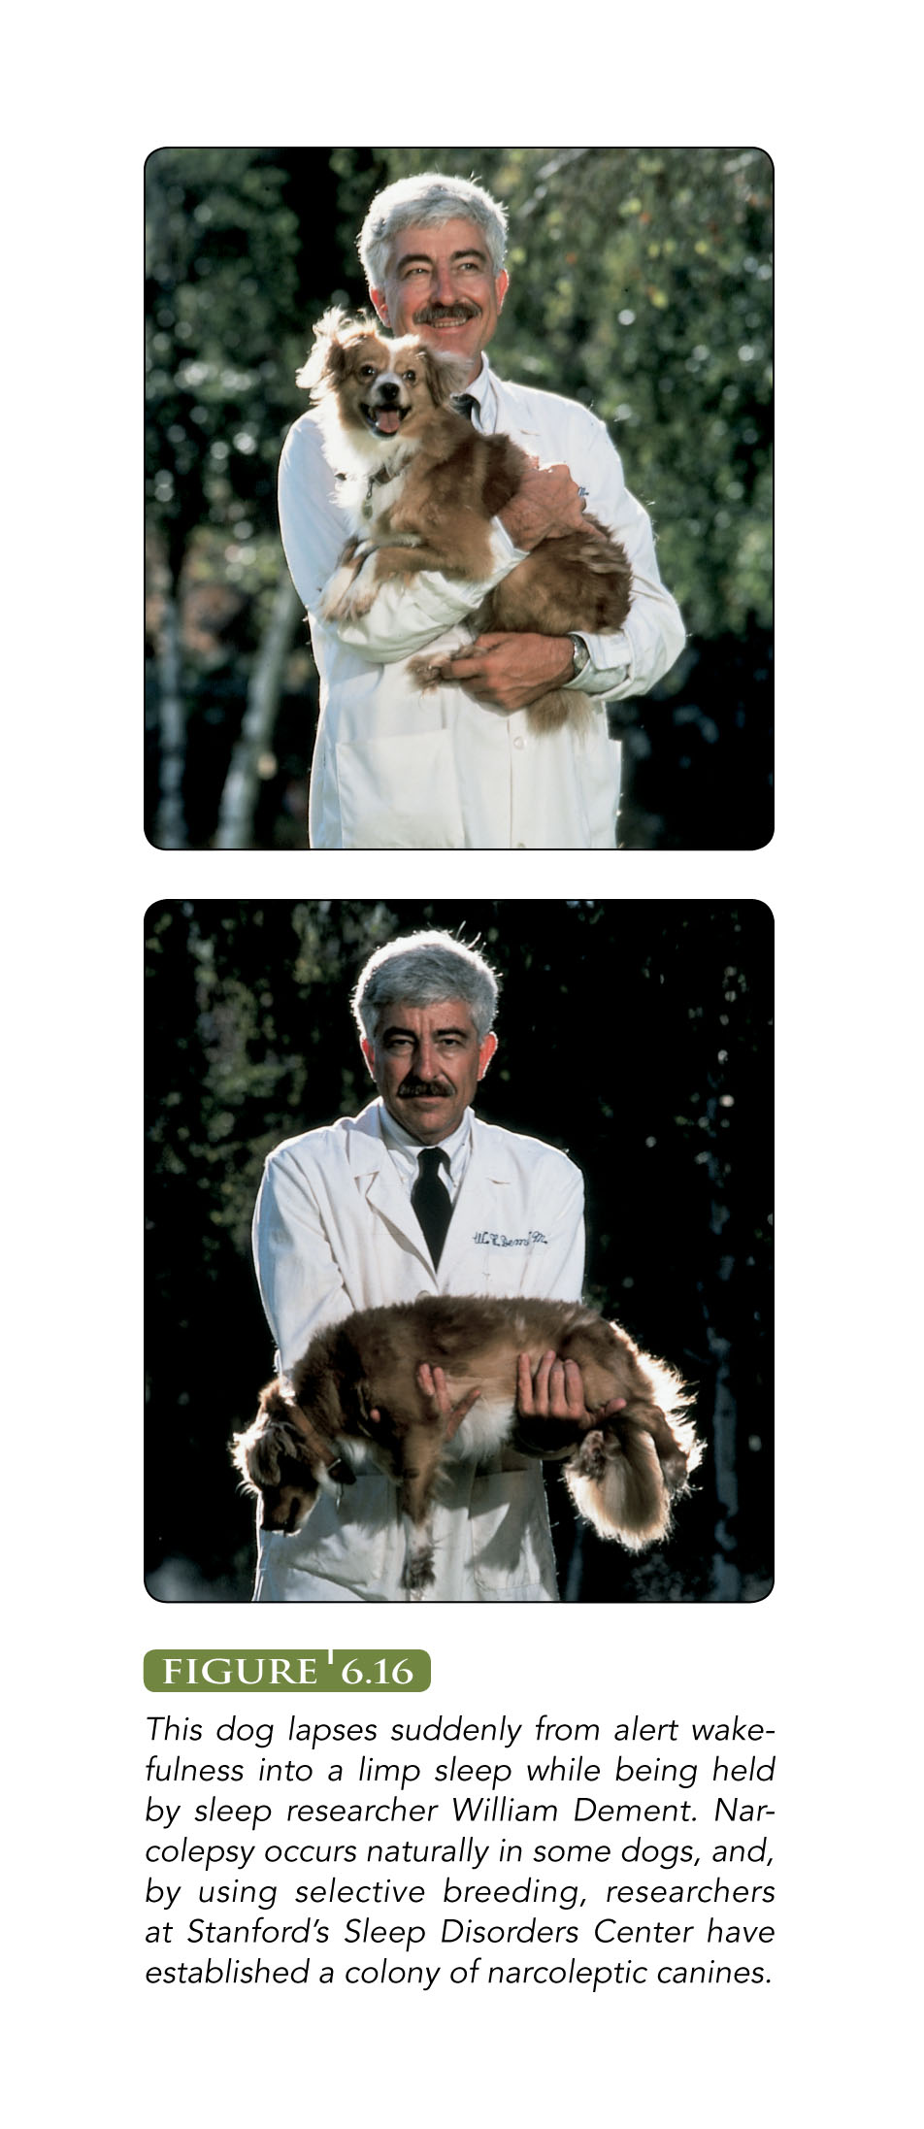
Sleep disorders
Narcolepsy
  Extreme daytime sleepiness and sudden, uncontrollable sleep attacks.
  Can last from less for a minute to an hour.
  May also experience cataplexy.
    Sudden loss of muscle tone triggered by laughter, excitement, and other strong emotions.

Slide 69
Sleep disorders
REM-Sleep Behaviour Disorder
  Loss of muscle tone that causes normal REM sleep paralysis is absent.
  RBD sleepers may kick violently, throw punches, or get out of bed and move about wildly.
  Often injure themselves while sleeping and sometimes injure their sleeping partners as well.

Slide 70
Sleep disorders
Sleepwalking
  Typically occurs during stage 3 or 4 sleep.
  Often have a blank stare and are unresponsive to other people.
  About 10-30% of children sleepwalk but only 5% of adults.

Slide 71
Sleep disorders
Nightmares and Night terrors
  Nightmares are frightening dreams. Virtually everyone has them at some point.
  Night terrors (sleep terrors) more intense than nightmares. Occur during stage 3 or 4 sleep.
    Sleeper sits up and starts screaming. Terrified and near panic.
    6% of children
    Only 1-2% of adults.

Slide 72
Dreams
When do we dream?
    Not just during REM sleep, but the majority of dreaming does take place during REM sleep.
    The final hours of sleep contains more dreaming compared to the beginning of sleep.
What do we dream about?
  Other than nightmares, dreams are wonderful, blissful things….right?
  Actually dreams are generally quite “ordinary” with familiar settings.
  Large proportion contain negative emotions and/or contained aggressive acts.

Slide 73
Why Do We Sleep?
Restoration Model
  Sleep allows us to recharge our bodies and recover from fatigue
  Tend to sleep a bit longer on days we exercise
Evolutionary/ circadian rhythm model
  Sleep’s main purpose is to increase survival chances
  Mechanism for conserving energy (metabolic rate 10-25% slower during sleep)

Slide 74
What do we dream?
Are dreams pleasant experiences?
  Is a stereotype
  Negative/unpleasant content is common
  50% of content may reflect experiences of recent day

Slide 75
Why do we dream?
No agreed-upon theory
Freud’s Psychoanalytic Theory
  Wish fulfillment
  Manifest content
    “Surface” story of dream
  Latent content
    Disguised psychological meaning of dream
Notes:
https://paris.mcgraw-hill.com:443/sites/0070985928/instructor_view0/discovery_videos.htm

Slide 76
Why do we dream?
Activation-synthesis theory
  Activation = random neural activity
  Synthesis = brain making ‘sense’ of this
Dreams serve no functional purpose
  by-product of neural activity
  Brain synthesizes ‘best-fit’ story in response to random neural activation

Slide 77
Canadian Alcohol and Drug Use Monitoring Survey (2009)
% Use
In Past Yr
77

Slide 78
Psychoactive Drugs
Drugs that influence subjective experience and behavior by acting on the nervous system
Tolerance
  User becomes less affected by the drug, so requires larger doses to achieve the same effect
Compensatory Responses
  Physiological reactions opposite to drug effect
  Body adjusting to drug
Withdrawal
  Compensatory responses after drug is discontinued
78

Slide 79
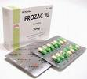
Psychoactive Drugs
  Influence activity of neurotransmitters
    Agonists
      Increase activity of neurotransmitter
    Antagonists
      Decrease activity of neurotransmitter
Prozac (an antidepressant) works by increasing serotonin levels
79

Slide 80
Drug Categories
Depressants
  Decrease nervous system activity
  Small doses
    Reduce tension and anxiety, produce relaxation
  Very high doses
    Slow down vital life processes to the point of death
80

Slide 81
Depressants - alcohol
Most widely used recreational drug in many countries.
Alcohol increases GABA (main inhibitory neurotransmitter)
Why are many people “livelier” when drinking, especially initially?
Because it slows down the inhibitory control centres of the cerebral cortex.
Less inhibited.

Slide 82
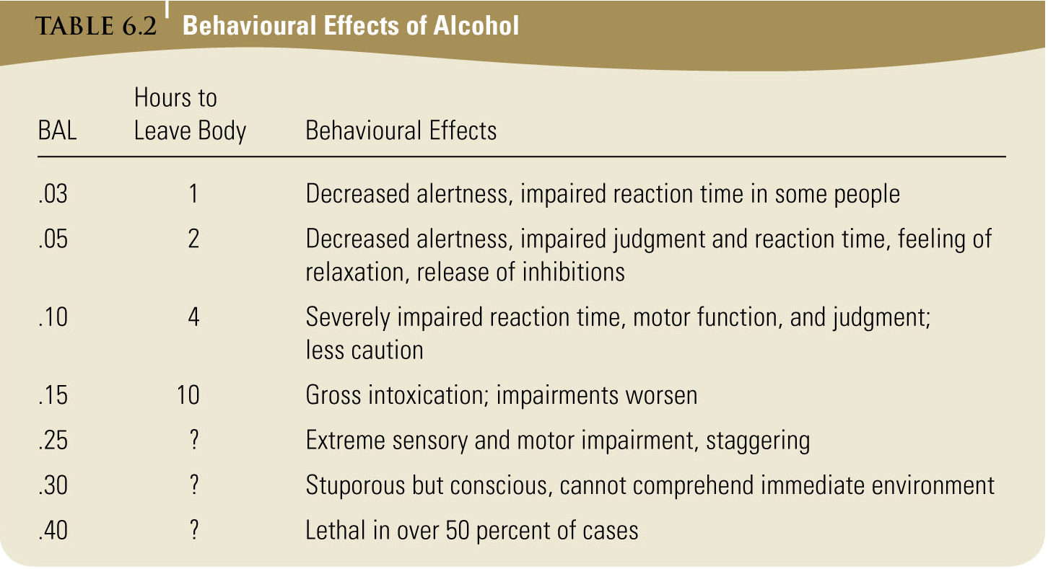
82

Slide 83
Alcohol
Withdrawal symptoms
  “Hangover” (mild withdrawal)
    Headache, nausea, vomiting, tremors
  Full-blown withdrawal
    Phase 1 (begins 5-6 hrs after cessation of drinking)
      Severe tremors, agitation, headache, nausea, vomiting, abdominal cramps, profuse sweating, hallucinations
    Phase 2 (begins 24-48 hrs after cessation of drinking)
      Convulsions
    Phase 3 (begins 2 or 3 days after…)
      Delirium tremens (“DT’s”)
        Hallucinations, delusions, agitation, confusion, hyperthermia
        can be lethal

Slide 84
Alcohol
Chronic consumption
  Brain damage
  Korsakoff’s syndrome
    Severe memory loss, dementia, sensory/motor dysfunction
  Causes scarring of the liver
  Erodes muscles of heart → heart attack
  Higher risk of many cancers
84

Slide 85
Alcohol & Time Perception
Temporal myopia
  Increased attention to immediate events and decreased attention to more distant events
  E.g. more likely to engage in risky behavior, ignoring longer-term consequences
85

Slide 86
Drug Categories
Stimulants
  Increase blood pressure, respiration, heart rate, alertness
  Improve mood, produce euphoria
  May improve concentration, attention
86

Slide 87
Tobacco
Nicotine
  Note: many other toxic chemicals are also absorbed by the lungs (carbon monoxide, formaldehyde, etc..)
  Withdrawal symptoms
    Depression, anxiety, irritability
87
Notes:
87
Nicotine → nicotinic acetylcholine receptors

Slide 88
Long-Term Effects of Tobacco
Risk of infections of the respiratory tract
Increased risk of cancers
Increased risk of heart attack
And many, many more…
88

Slide 89
Amphetamines
Usually ingested, injected
Increases dopamine and norepinephrine activity.
Heavy use can lead to “amphetamine psychosis”
  Schizophrenia-like hallucinations and delusions
Withdrawal symptoms
  Sleep for 1 or 2 days
  Wake up depressed, exhausted, irritable
89

Slide 90
Amphetamines
Ecstasy (MDMA)
  Derivative of amphetamine
  Synthesized in 1914, emerged on drug scene in 1960s
  Originally thought to be safe drug
Ecstasy (MDMA)
  Adverse effects
    MDMA is a neurotoxin
      Kills/damages neurons that produce serotonin
        Linked to cognitive impairment, depression, suicide, sudden death
90

Slide 91
Cocaine
Coca bush
Was widely used as an anaestetic.
Eaten, smoked, snorted or injected
Free-base form (Crack) -> smoked or injected
Effects:
  Well-being, self-confidence, alertness, energy, strength, socially outgoing, fidgety, talkativeness
91
Notes:
91
Blocks reuptake of dopamine

Slide 92
Cocaine
Often consumed in binges
  Binge ends when the drug is gone, or the toxic effects become serious
    Risk of seizures, loss of consciousness, stroke, lung failure
    Cocaine psychosis
      Sleeplessness, tremors, nausea, psychotic behavior
  Major withdrawal effects are lethargy and depression
92

Slide 93
Opiates
Opium is a product of the opium poppy.
Drugs derived from opium – called Opiates.
For example:
  Morphine, codeine, and heroin.
Two major effects:
  pain relief
  mood changes (intense euphoria)

Slide 94
Opiates
Oxycodone (also known as Ocycontin and Percocet)
Powerful painkillers that have intense mood-altering effects.
Increase dopamine activity.
Bayer use to market heroin as a cough suppressant.

Slide 95
Hallucinogens
Powerful mind-altering drugs that produce hallucinations.
Some are from natural sources – Mescaline (peyote)
Some are synthetic – LSD and phencyclidine (angel dust).

Slide 96
Chapter 7- LEARNING

Slide 97
Adapting to the Environment
What is learning?
  Process by which experience produces a relatively enduring change in behaviour or capabilities (knowing how)
Distinguish between
  ‘Knowing how’ or learning and ‘doing’ or performance
  Experience may provide knowledge but in science we must measure the actual performance.

Slide 98
The Study of Learning
Behaviourism
  Focused on how organisms learn
  Examined processes by which experience influences behaviour
  Laws of learning applied to virtually all organisms

Slide 99
Oh Behave!
Behaviourism cont.
  Treated organism as tabula rasa
  Explained learning solely in terms of directly observable events
  Avoided unobservable ‘mental states’

Slide 100
Habituation - Simple Learning
Habituation
  Decrease in response strength to a repeated stimulus.
  Many consider this the simplest form of learning.
  It would be exhausting to constantly respond to every single stimulus. For example - The feeling of our clothing on our skin.

Slide 101
Sensitization
The increase in the strength of response to a repeated stimulus.
Found across many species and its purpose to increase the response to dangerous stimuli.
Example – Shock when you touch something metal. The second time you actually jump more and probably swear.

Slide 102
Classical Conditioning
Associating one stimulus with another
Basic form of learning
Learn to associate two stimuli
  One stimulus elicits a response that was originally elicited only by the other stimulus

Slide 103
Acquisition
4 important elements
Unconditioned stimulus (UCS)
  Stimulus that elicits a reflexive or innate, unconditoned response (UCR) without prior learning
Unconditioned response (UCR)
  Reflexive or innate response elicited by the UCS without prior learning

Slide 104
Acquisition
Conditioned stimulus (CS)
  Stimulus, that, through association with the UCS, comes to elicit a conditioned response similar to the original UCR
Conditioned response (CR)
  Response elicited by a conditioned stimulus
Note: UCR & CR are same thing
  What elicits them is different!

Slide 105
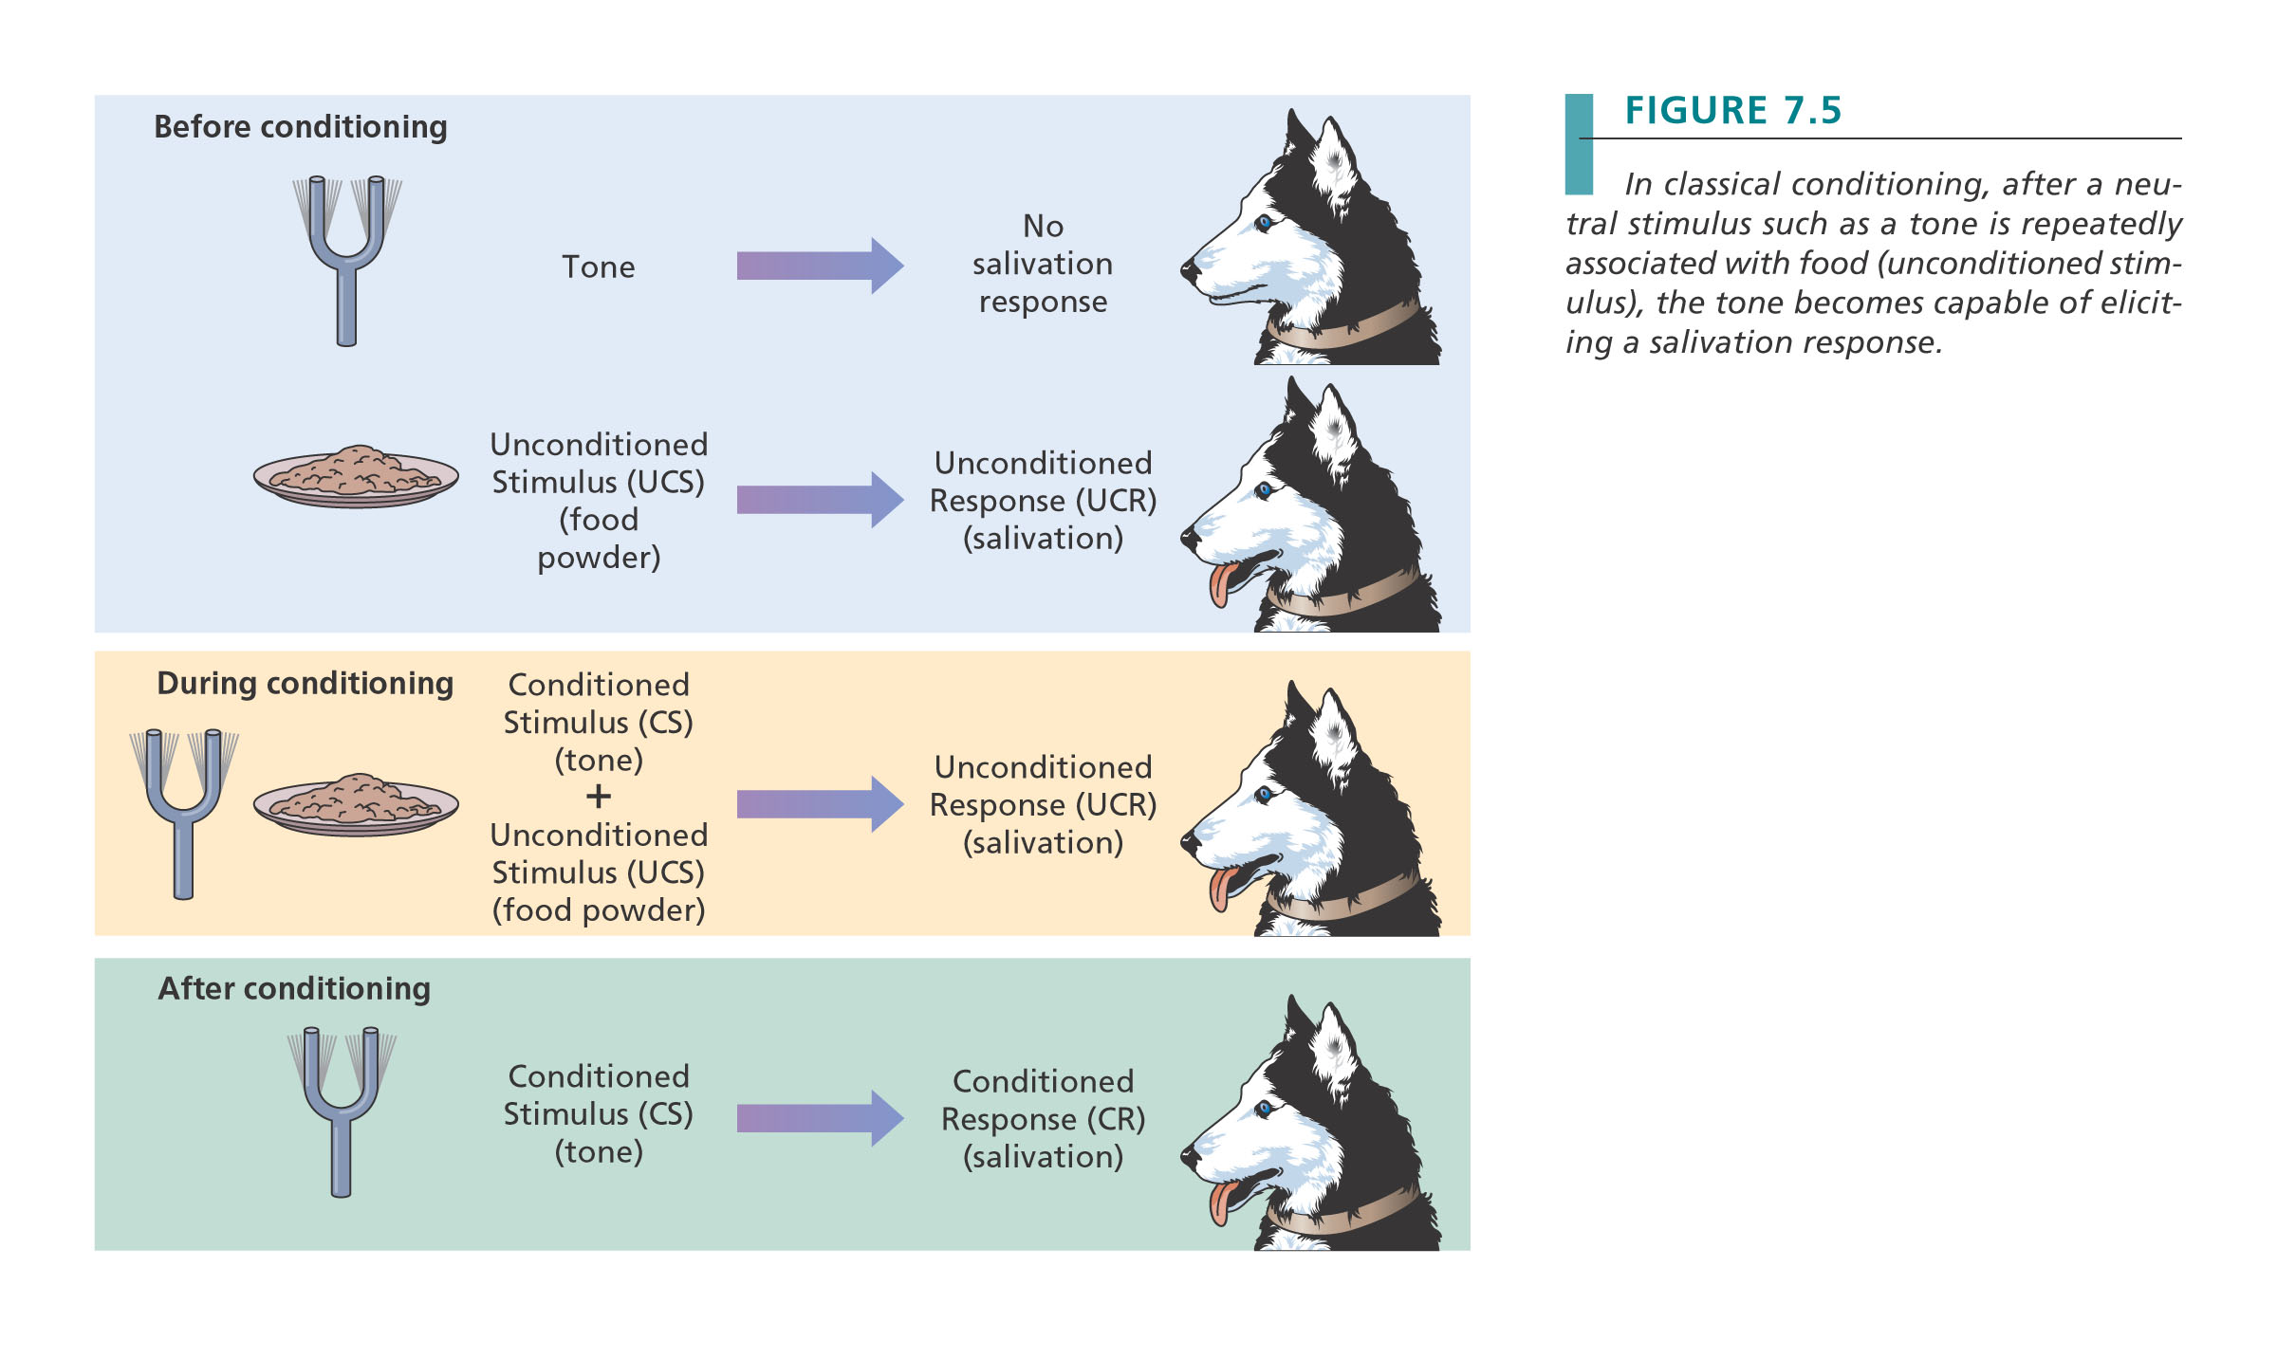

Slide 106
Common Conditioning Procedures
Short-delayed conditioning
  CS still present when UCS present
  Optimal learning
CS
UCS
Time
106
Notes:
106
CS may continue during US or end when US begins

Slide 107
Common Conditioning Procedures
Trace Conditioning
  Gap in time separates end of CS and start of UCS
  Learning occurs if delay 2/3 sec or less
CS
UCS
Time
107

Slide 108
Common Conditioning Procedures
Simultaneous conditioning
  CS and UCS presented at same time
  Slow learning
CS
UCS
Time
108

Slide 109
Factors Influencing Classical Conditioning
1. Number of Pairings for the Conditioned and the Unconditioned stimulus.
2. The intensity of the unconditioned stimulus.
3. How reliably the conditioned stimulus predicts the unconditioned stimulus.
4. The timing (temporal relationship) between the conditioned stimulus and the unconditioned stimulus.

Slide 110
Extinction & Spontaneous Recovery
Extinction
  Process in which CS is presented in absence of UCS
  CR weakens
Spontaneous Recovery
  Reappearance of a previously extinguished CR
  Usually weaker than initial CR, extinguishes more rapidly

Slide 111
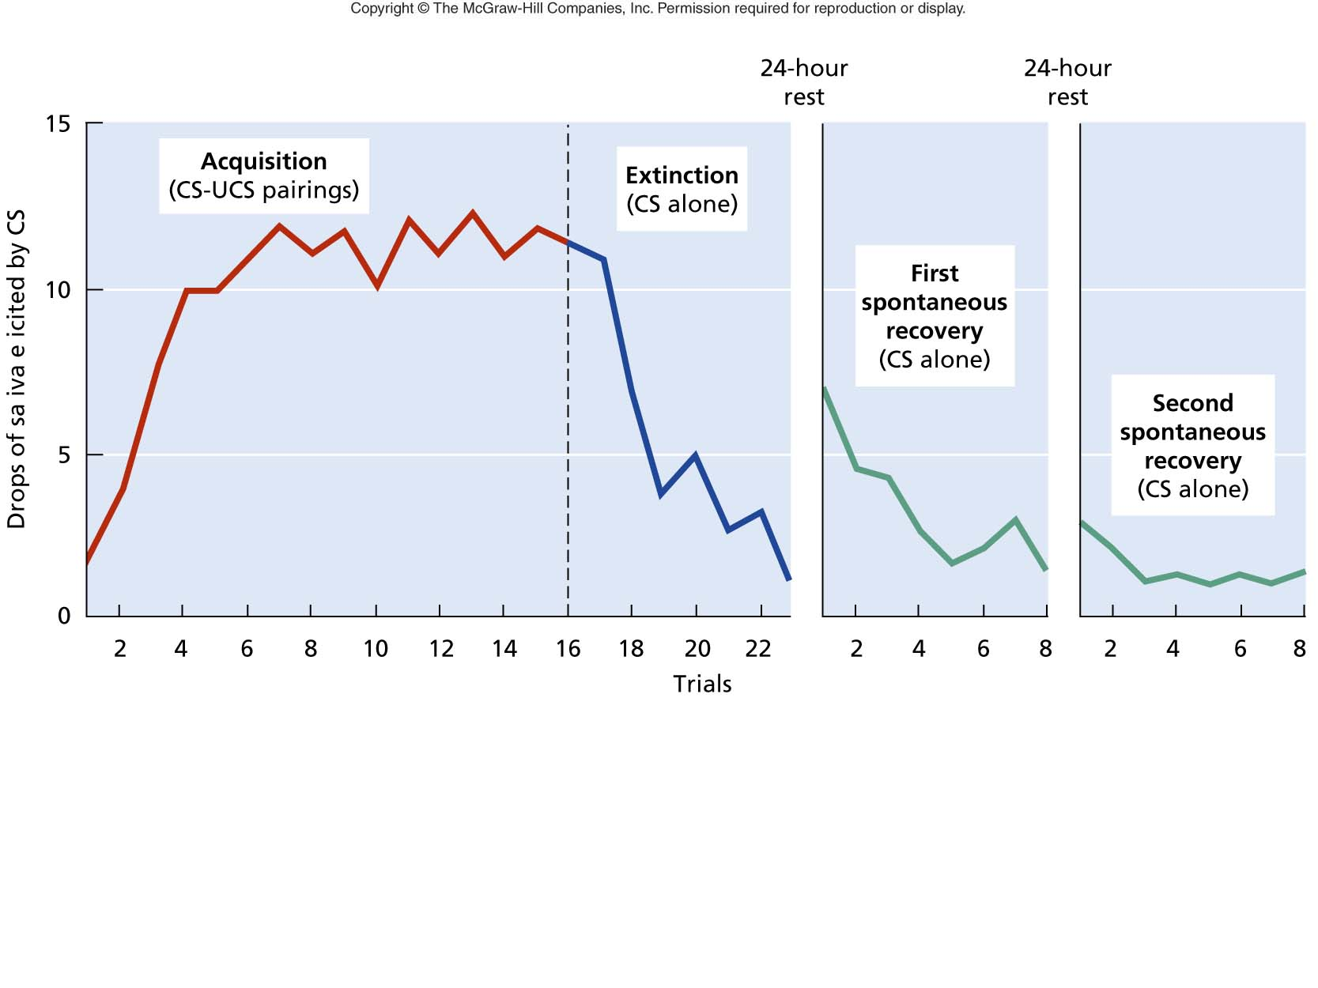

Slide 112
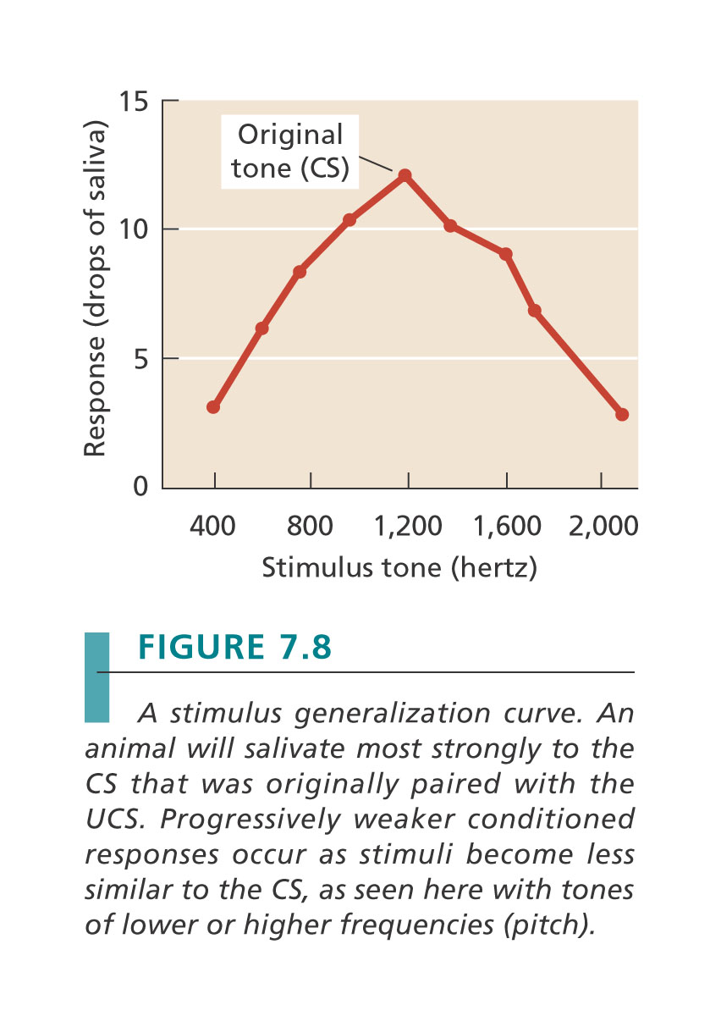
Generalization & Discrimination
Generalization
  Stimuli similar to initial CS elicit a CR
  Aids in survival
Discrimination
  CR occurs to one stimulus but not to another

Slide 113
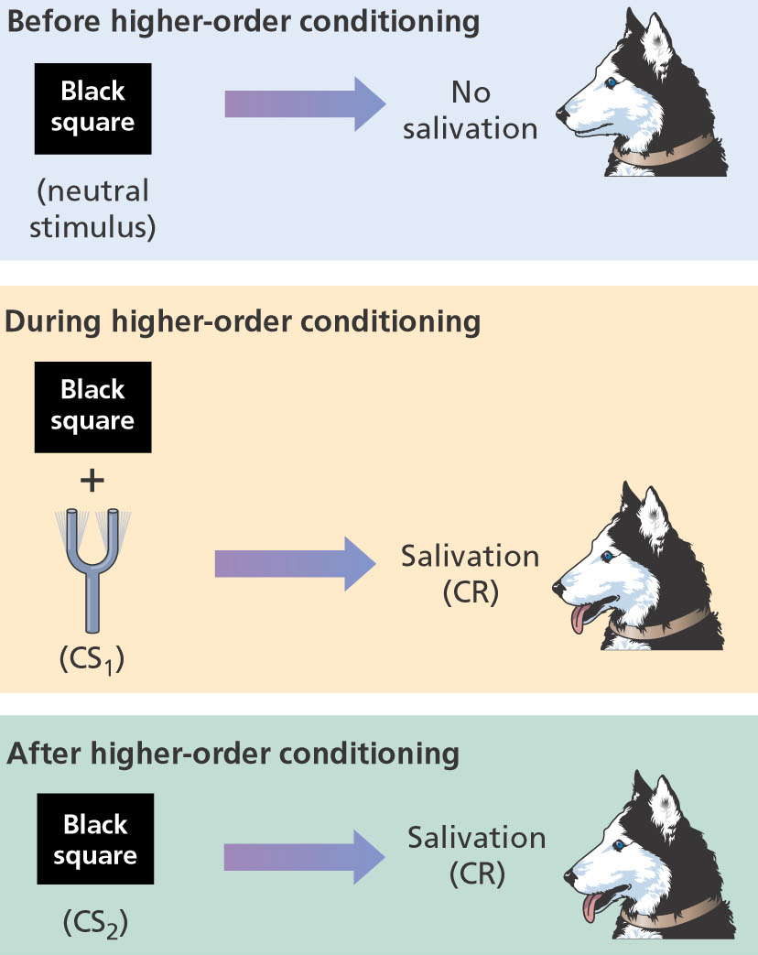
Higher Order Conditioning
Chain of events which has 2 CS stimuli
Expands influence of classical conditioning on behaviour

Slide 114
Classical Conditioning
Applications: Overcoming Fear
- Exposure Therapy
  Extinction of CR through exposure to CS without presence of UCS
- Systematic desensitization
  Muscular relaxation paired with gradual exposure to fear-inducing stimulus
- Flooding
  Exposure to fearful stimulus

Slide 115
Classical Conditioning – Exposure Therapies
Anyone here have a phobia? Intense fear of something? Spiders? Heights? Etc
Exposure Therapy takes aspects of classical conditioning and applies it to eliminating phobias.
Basic goal is to expose the phobic patient to the feared stimulus (CS) without and UCS, allowing extinction to occur.

Slide 116
Classical Conditioning – Aversion Therapy
Attempts to condition an aversion or repulsion to a stimulus that triggers unwanted behaviour by pairing it with a noxious UCS.
Example – Giving alcoholic patients a drug that induces vomiting any time alcohol is consumed.
Aversion therapy has shown mixed results that are often extinguished over time.

Slide 117
Operant Conditioning
Learning in which behaviour is influenced by its consequences.
Responses that produce favourable consequences tend to be repeated, whereas responses that produce unfavourable consequences become less likely to occur.

Slide 118
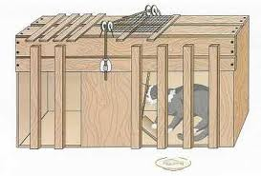
Thorndike’s Law of Effect
Placed a hungry cat in a box and put food outside the box.
Eventually the cat would accidently step on the pedal that opened the door.
Slowly they learned to step on the pedal to get out of the box.
Law of Effect – A response followed by a “Satisfying” outcome will become more likely to occur.

Slide 119
Thoughts?
BF Skinner seems skeptical of the presence of free will?
Agree? Disagree?

Slide 120
Operant Conditioning
Changing the probability that a behavior occurs
Learning a new behavior

Slide 121
Operant Conditioning
Behavior has consequences
  If the consequence is +
    The behavior more likely to occur again
  If the outcome is –
    The behavior less likely to occur again

Slide 122
Operant Conditioning
Reinforcement – used to increase the likelihood that a behavior occurs again
  Positive reinforcement – deliver something good
  Negative reinforcement – remove something aversive

Slide 123
Operant Conditioning
Changing the probability that a behavior occurs
Learning a new behavior
Operant Conditioning has 3 types of events.
  A – Antecedents (stimuli present before the behaviour.
  B – Behaviours
  C – Consequences that follow the behaviour

Slide 124
Operant Conditioning
Behavior has consequences
  If the consequence is +
    The behavior more likely to occur again
  If the outcome is –
    The behavior less likely to occur again

Slide 125
Operant Conditioning
B.F. Skinner
  Used reinforcement to get an individual to produce a new behavior.
Reinforcement – used to increase the likelihood that a behavior occurs again
  Positive reinforcement – deliver something good
  Negative reinforcement – remove something aversive

Slide 126
Operant Conditioning
Punishment – used to decrease the likelihood that a behavior occurs again
  Positive punishment – deliver something aversive
  Negative punishment – remove something positive

Slide 127
Operant Conditioning Techniques
Shaping
  Mold a particular behavior by reinforcing responses that get closer to it.
  Aka “method of successive approximations”

Slide 128
Operant Conditioning Techniques
Chaining – develop a sequence (or chain) or behaviours by reinforcing each response with the opportunity to perform the next response.
Example – Rat has learning to press a lever for food when a light is on. Then a bell is placed nearby. Rat accidently bumps the bell, which turns on the light, which cues the rat to press the lever. Eventually the rat will learn to ring the bell to get the light to go on to allow them to press the lever for food. A chain has been created.

Slide 129
Reinforcers
Primary reinforcers
  Fulfill basic physical needs
  Value is not learned
    E.g. food
Secondary reinforcers
  Gains value because it has been paired with other reinforcers
  Value is learned
    E.g. $$$

Slide 130
Schedules of Reinforcement
Fixed-Ratio (FR) Schedule
  Subject is given a reinforcement after every ___ responses
    E.g. FR-5 schedule: reinforcement after the 5th response
    E.g. piece-work
        Make 100 pairs of Nikes, earn a dollar
      Officer gains promotion after catching specific # of criminals

Slide 131
Schedules of Reinforcement
Variable-Ratio (VR) Schedule
  Subject is given a reinforcement after an average of ___ responses
    E.g. VR-5 schedule: reinforcement after the 2nd, 5th and 8th responses (average is 5)
    Another example: slot machines
        Slots pay off on a VR schedule

Slide 132
Schedules of Reinforcement
Fixed-Interval (FI) Schedule
  Subject is given a reinforcement if the response occurs after a fixed amount of time has elapsed
    E.g. FI-5 s schedule: reinforcement after the 1st response that occurs after 5 seconds has gone by
    Another example: studying
        Pretend a test is the reinforcer and tests are scheduled 1 month apart

Slide 133
Schedules of Reinforcement
Variable-Interval (VI) Schedule
  Subject is given a reinforcement if the response occurs after an average ____ amount of time has elapsed
    E.g. VI-5 s second schedule: reinforcement after the 1st response that occurs after 8 s, 2 s, and 5 s has gone by
    Another example: car trips with mom and dad
        Are we there yet?

Slide 134
Operant Extinction
The weakening and eventual disappearance of a response because it is no longer reinforced.
Degree to which non-reinforced responses persist is called resistance to extinction.

Slide 135
Immediate vs. Delayed Consequences
Training animals typically requires immediate or very quick reinforcements.
For humans it can a little different. We often weigh immediate consequences against future consequences.

Slide 136
Generalization & Discrimination
An operant response occurs to a new antecedent stimulus or situation that is similar to the original one.
Discrimination – An operant response will occur to one antecedent stimulus but not to another.

Slide 137
Escape and Avoidance Conditioning
Escape conditioning – organism learns a response to terminate an aversive stimulus. Learned through negative reinforcement.
Avoidance conditioning – learn a response to completely avoid an aversive stimulus.

Slide 138
Escape vs. Avoidance Example
Animal is placed in a shuttle box.
Separated into two sides, with a doorway.
Experimenter applies a shock to the floor on one side.
Animal has to learn to go through the door way to escape the shock.
If the experiment gives a “warning signal” that lets the animal know that the floor is about to be shocked.
The animal can move to the other side to AVOID feeling the shock.

Slide 139
Two-Factor Theory of Avoidance Learning
Both Classical and Operant conditioning are involved in avoidance learning.
Warning light becomes classically conditioned to elicit fear of the shock.
Then the operant conditioning of moving to the other side kicks in to allow for avoidance to occur.

Slide 140
Two-Factor Theory of Avoidance Learning
Good at explaining how we learn some avoidance behaviours.
Has trouble explaining why we fear and develop phobic avoidance to some stimuli (ex. Snakes) vs. others (ex. Squirrels).

Slide 141
Availability Heuristic
Ability to make judgments based on the information available.
Example: Are there more words in the dictionary starting with “R” or with “r” as the third letter?

Slide 142
Availability Heuristic
Schwarz et al (1991):
Two groups of participants
1st group: Think of 6 examples of assertive behaviour
2nd group: Think of 12 examples of assertive behaviour
12 example group usually struggled to come up with enough examples (less available).
  Less available → Less likely

Slide 143
Representative Heuristic
A strategy used to make predictions based on experience.
Allows us to extrapolate information we have experienced to make predictions about the current situation.
Examples:
  You stay 2 or 3 nights at the Marriot Hotel; you conclude that all hotel rooms have Bibles in them.
  Your friend is an engineer; you conclude that she is probably comfortable with math.

Slide 144
Framing Effect
Risk-seeking – quite willing to gamble
Risk-aversive – unwilling to gamble

Slide 145
Framing effects
Gain frame: people become risk aversive.
Loss frame: people become risk prone (more willing to take a risk to avoid a loss)

Slide 146
Applying Learning
  Heuristics: general strategies, or rules of thumb, that can be applied to various problems
    No guarantee of correct solution
    Quicker, more efficient than algorithms
    Specific heuristics can be developed for any problem

Slide 147
Two Major Concepts of Kahneman and Tversky
Availability Heuristic
  Which is a more likely cause of death in the United States?
    being killed by falling airplane parts?
    being killed by a shark?
Representative Heuristic
  Flip of the coin eight times:
1. H T H H T T H T
2. H H H H T T T T

Slide 148
Biology and Learning
Behaviourists believed that they could condition any animal to do whatever behaviour they wanted them to (as long as it was physically possible, they knew they couldn’t make a rat fly).
However, “conditioned” animals didn’t always behave as they expected.
Didn’t take into account that behaviour is influenced by an organisms evolutionary history.

Slide 149
Biology and Learning
Preparedness – through evolution, animals are biologically “prewired” to easily learn behaviours related to their survival as a species.
Behaviours that are contrary to an organism’s natural tendencies are learned slowly….if at all.

Slide 150
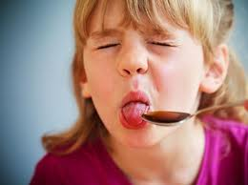
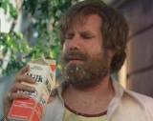
Conditioned Taste Aversion
Ever eaten something that made you sick? How long before you could eat that again?
Were you quickly conditioned to avoid that food?
Pairing a smell or taste of a food with a toxin or ill-producing agent. The taste and smell of that food now disgusts you.

Slide 151
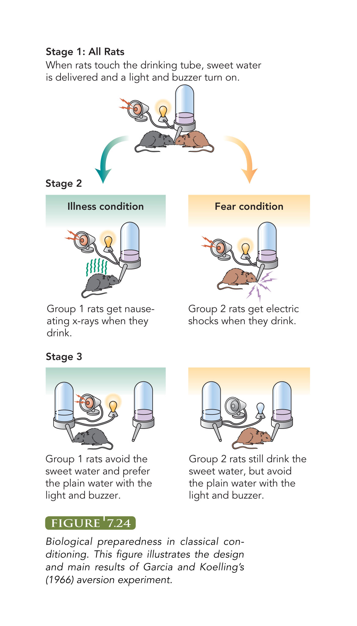
Constraints
Classical Conditioning
Learned taste aversions (Garcia et al., 1985)
Rats easily learn taste aversion
Lights & sounds don’t matter

Slide 152
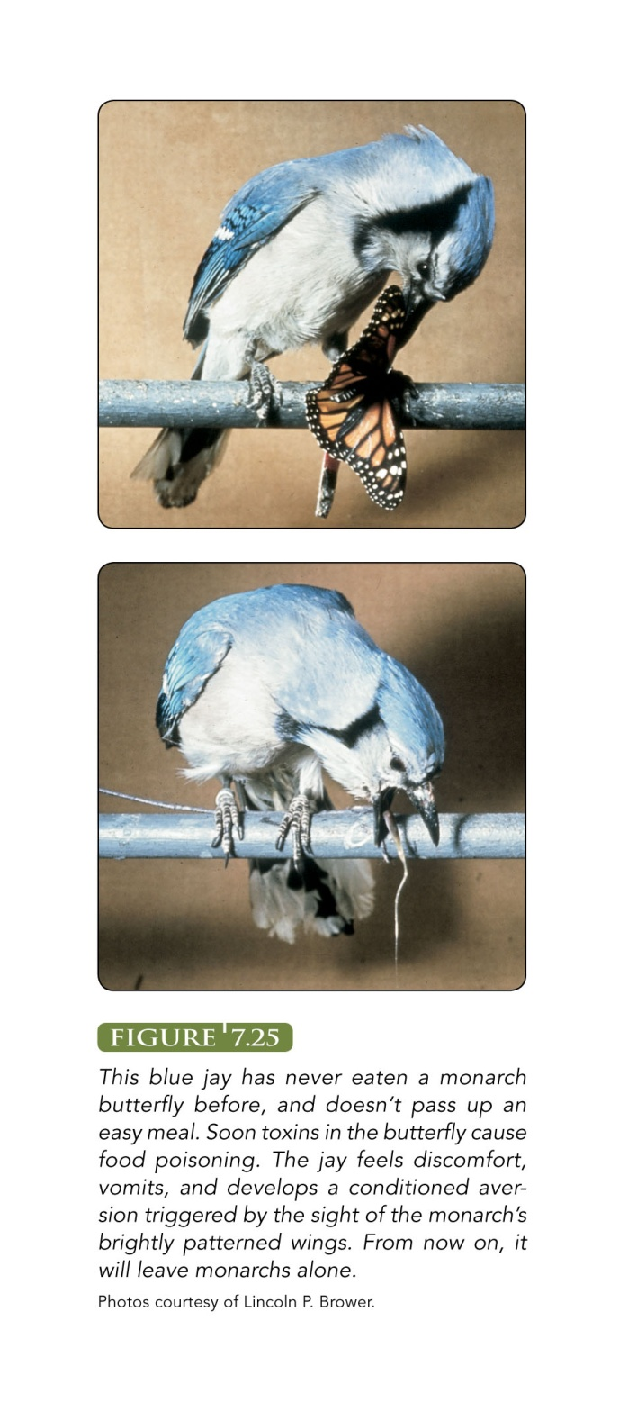
Applications: Conditioned Taste Aversion
Blue jay eats a monarch butterfly. The toxins in the butterfly cause food poisoning. The jay feels discomfort, vomits, and develops a condiitonaed aversion triggered by the sight of the monarch’s brightly patterned wings.
A blue jay eating a monarch
and the results moments later

Slide 153
Conditioned Taste Aversion
Ader (1974) Learned taste aversion in rats.
Remained after the illness producing drug was removed.
Cancer patients often develop aversions to food they eat just prior to treatment, even though it wasn’t the food that made them sick.

Slide 154
Classical Conditioning - Applied
Classical conditioning via taste aversion can make it sick.
However, can it be used to help us get well?
Cancer patients:
Helpful drugs become paired with sweet water.
Later, just drinking the sweet water can cause the immune system to react.

Slide 155
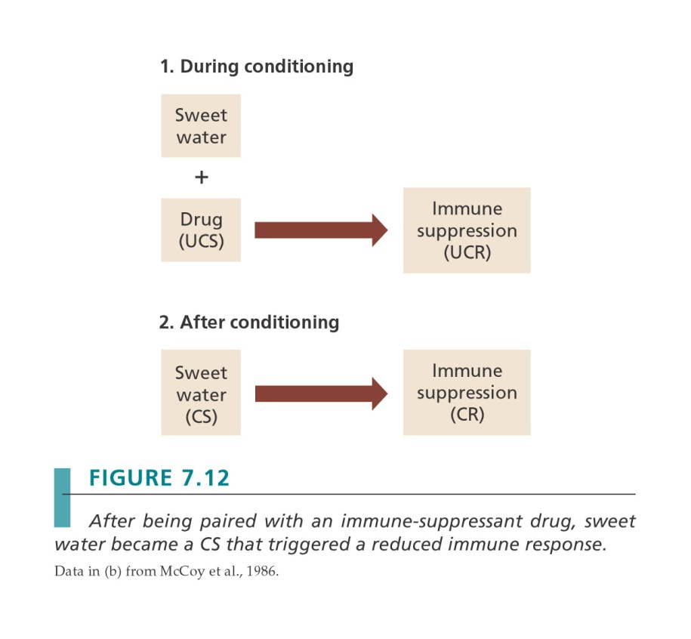
Classical Conditioning
Immune system responses can be classically conditioned
Can increase or decrease immune functioning
Can help fight disease

Slide 156
Biologically Prepared to Fear Certain Things?
Seligman (1971) and others propose that humans and other animals are biologically prepared to acquire certain fears more readily than others.
I.e. we are biologically wired to have the predisposition to fear certain things, certain animals etc. compared to others.

Slide 157
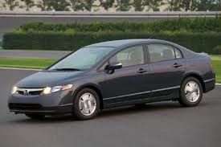
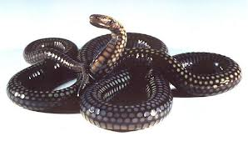
Biologically Prepared to Fear – Case Studies
A 4-year old girl saw a snake and then had her hand slammed in a car door.
OUCH!
So she became phobic of….Cars. Right?

Slide 158
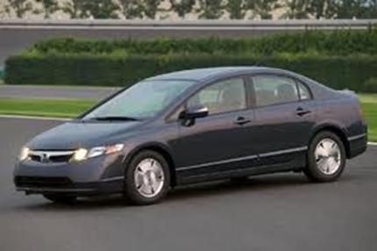

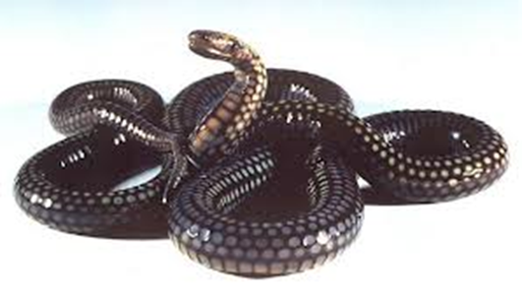
Biologically Prepared to Fear – Case Studies
An 18-year old was looking through a magazine and just happened to be looking at a picture of a snake when the car she was in got into an accident.
Fear of cars?
Magazines?
Photographs?

Slide 159
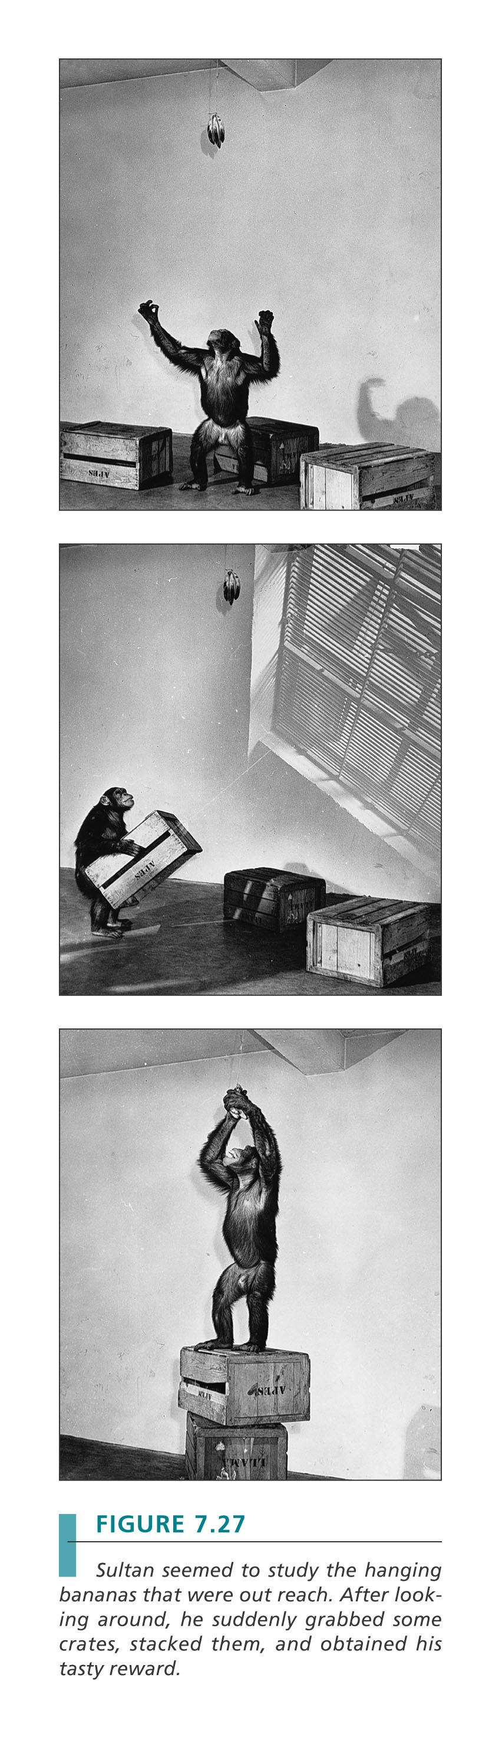
Insight & Learning
Insight (Kohler, 1925)
  The ‘Eureka Moment’!
  Sudden perception of useful relationships

Slide 160
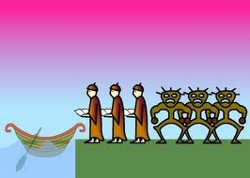
Insight Problems
Remember our friends the Missionaries and Cannibals?
How did Mike eventually get to the solution?
  Trail and error
Was there a trick? Some key piece of information that enabled success?

Slide 161
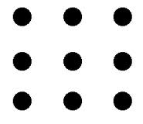
Insight Problems
Now. Remember the Nine-dot problem?
How was it solved? Is there a moment in reaching the solution that enables success?
A “Aha!” moment.
“Eureka!”

Slide 162
Learning – Children and Apes
So are humans programmed to learn by copying more than other animals?
Thoughts?

Slide 163
Observational Learning
The learning that occurs while observing the behaviour of a model.
Much of our learning takes place by watching others perform tasks or behave in certain ways. If it seems to work for them…we will copy.

Slide 164
Chapter 8 Memory

Slide 165
Memory
Refers to the processes that allow us to record and later retrieve experiences and information.

Slide 166
Memory as Information Processing
The advent of computers gave rise to the metaphorical comparison that the mind is a processing system that encodes, stores, and retrieves information.

Slide 167
Memory as Information Processing
1. Encoding – getting information into the system by translating it into a neural code that your brain processes.
  Like what happens when you type on a computer keyboard.
  Your keystrokes are translated into an electrical code that the computer can understand.
2. Storage – retaining information over time.
  Once information is in the system it must be filed away and saved for future access.

Slide 168
Memory as Information Processing
3. Retrieval – the ability to pull information out of storage when we want to use it.
  With a computer we would give a command like “Open file” to retrieve specific information

Slide 169
Remembering
Involves all three of these processes.
1. Encoding
2. Storage
3. Retrieval
Failure in any one of these processes can result in memory failure.

Slide 170
Unconscious Transference Example
Dr. Thompson: Psychologist who studied (ironically) Human Memory
Accused of sexual assault and brought in for questioning.
Matched perfectly the victims description of perpetrator.
Alibi: doing a live TV interview on how to better remember faces.
Victim had watched the interview just prior to incident.

Slide 171
Memory
Three memory processes
Three levels of memory
Different types of memory

Slide 172
The advent of computers gave rise to the metaphorical comparison that the mid is a processing system that encodes, stores,a dn retrieves info

Slide 173
Memory as Information Processing
Encoding- getting info into the system by translating it into a neural code that your brain processes
Storage- retaining info over time
Retrieval- ability to pull info out of storage when we want to use it

Slide 174
Remembering
Involves 3 processes
  Encoding
  Storage
  Retrieval
  Failure in any one of these process can result in memory failure

Slide 175
Unconscious Transference Example
Dr. Thompson: Psychologist who studied (ironically) Human Memory
Accused of sexual assault and brought in for questioning
Matched perfectly the victims description of perpetrator
Alibi: doing a live TV interview on how to better remember faces
Victim had watched the interview just prior to incident

Slide 176
Remember H.M.?
Epilepsy sufferer who developed amnesia after surgery to alleviate seizures
He could discuss his childhood, teen years, up to his early 20’s
But can’t seem to form new memories

Slide 177
3 component model
3 levels of memory
  Sensory memory: holds info coming through the sense for a period of about a fraction of a second to several seconds
    Holds the incoming info just long enough for it to be recognized
    Subsystems called sensory registers:
      Visual sensory register= iconic store
      Auditory sensory register= echoic store

Slide 178
  Short-term/ working memory: Holds info we are conscious of at any given time; called “working memory” b/c consciously processes, codes and “works on” info we are focusing on
    Transfer from sensory to short-term must be represented in a code (are mental representations of information
  Long-term memory

Slide 179
Memory Codes
Different types
  Mental image- visual encoding
  Coding by sound= phonological encoding
  Focus on the meaning= semantic encoding
  Physical actions= motor encoding
There isn’t always a clear match between the type of info and the encoding

Slide 180
Human Camera
Daniel Tammet and Kim peek have amazing ability to store and retrieve particular types of info
Steven Whiltshire displays a different type of skill

Slide 181
Short Term Memory
Second stage of memory, holds about 7 items for less than 30 seconds with rehearsal
Miller (1956): memory studies found that the capacity for short term memory is 7 + or -2 (i.e. Between 5-9 items)
Rehearsal: Purposely repeating info to maintain it in short-term memory or to transfer it to long-term memory

Slide 182
Chucking: organizing or grouping bits of info into larger units
  Short term memory requires some amount of rehearsal
  Easier to deal with the info
Two types of rehearsal
  Maintenance
  elaborate

Slide 183
Maintenance Rehearsal
The simple repetition of information over and over
Look up a telephone # and say it silently to yourself over and over until you get to the phone

Slide 184
Elaborative rehearsal
Focusing on the meaning of the information or relating it to other things that we already know
This type is more effective overall than maintenance rehearsal for transferring info into long-term memory

Slide 185
Long term memory
The vast library of durable sorted memories
Barring brain damage, we remain capable of forming new long-term memories until we die
The storage capacity of long-term memory is essentially unlimited

Slide 186
Serial Position Effect
Recall of an item is influenced by the positon in a series of items
Two components:
  Primary effect- superior recall of early words
  Recency effect- superior recall of the most recent words

Slide 187
Serial Position Effect
Primacy Effect
Causes:
First few words are rehearsed and transferred to long term memory. But as the list grows the short-term memory fills up and there are too many words to and they can’t be rehearsed and transferred.
Recency Effect
Causes:
The last few words aren’t bumped out of short term memory by new information.
Therefore the last few words can remain in short term memory long enough to be included in the recall.

Slide 188
Long Term memory
Two main sub-types:
  Declarative: facts, info, and personal life events that can be brought to mind verbally or in the form of images
    Episodic memory
    Semantic memory

Slide 189
Declarative Memory
Semantic Memory:
Our memory of general knowledge; made up of facts and general information.
Examples: The capital of Canada; what 3 X 7 equals; First president of the USA.

Slide 190
Long term Memory
Procedural Memory:
Motor skills, habits, and simple classically conditioned responses.
Examples: eating with a fork; driving a car; riding a bicycle.

Slide 191
3 Memory Systems
1. Sensory Memory
2. Short Term Memory
3. Long Term Memory
  Procedural
  Declarative
    Episodic
    Semantic

Slide 192
Superior Autobiographical Memory
6 individuals have “Superior Autobiographical Memory”
People with superior autobiographical memory can recall any day of their life

Slide 193
3 Memory Systems
1. Sensory Memory
2. Short Term Memory
3. Long Term Memory
  Procedural
  Declarative
    Episodic
    Semantic

Slide 194
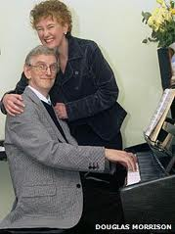
Long term Memory
Procedural Memory:
  Motor skills, habits, and simple classically conditioned responses.
  Examples: eating with a fork; driving a car; riding a bicycle.

Slide 195
Declarative Memory
Episodic Memory:
  Contains the memory of events we have experienced personally.
  The people we have known, the places we have seen, and the personal experiences we have had.

Slide 196
Declarative Memory
Semantic Memory:
  Our memory of general knowledge; made up of facts and general information.
Examples: The capital of Canada; what 3 X 7 equals; First president of the USA.

Slide 197
Memory Ability
Extrodinary individuals with amzing memory ability
  Daniel Tammet
  Kim Peek
  Stephen Wiltshire
  Superior Autobiographical Memory
Memoriad: olympics for memorization
  Techniques used: giving card or number a meaning and make it into a story
    Method of chunking
  ** individuals have this amazing gift but have consequences such as autism, seizures etc.
http://www.youtube.com/watch?v=6vsYCSmBcM0
Memoriad

Slide 198
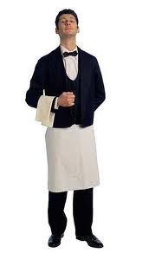
Organization and Imagery
J.C. the waiter
Can take the orders for you and 20 of your friends and get them all perfectly right.
Ericsson & Polson (1988) studied J.C.
He organized orders into 4 categories: Entrees, temperatures, side dish, dressing)
Used different systems to encode the orders in each category.
For example – 4 salad dressings orders of Thousand Island, Oil & Vinegar, Blue Cheese, Oil & Vinegar become TOBO.
TOBO makes it easier to remember 4 separate orders.

Slide 199
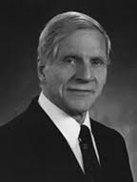
Visual Imagery
The Dual Coding Theory
Pavio proposes that information is stored in long-term memory in two forms: Verbal and non-verbal.
Using both codes enhances memory because the odds improve that at least one of the codes will be available to support recall.

Slide 200
Method of Loci
Memory improvement technique to help visualize items.
Imagine a physical environment with a sequence of distinct landmarks. For example – Rooms in your house etc.
To remember a list of items, you then take a “stroll” through that familiar environment and link an item with the location in your environment.

Slide 201
How Prior Knowledge Shapes Encoding
Schemas - A mental framework that organizes our thoughts and knowledge about some aspect of the world.
A pattern that connects characteristics associated with a particular concept or idea.

Slide 202
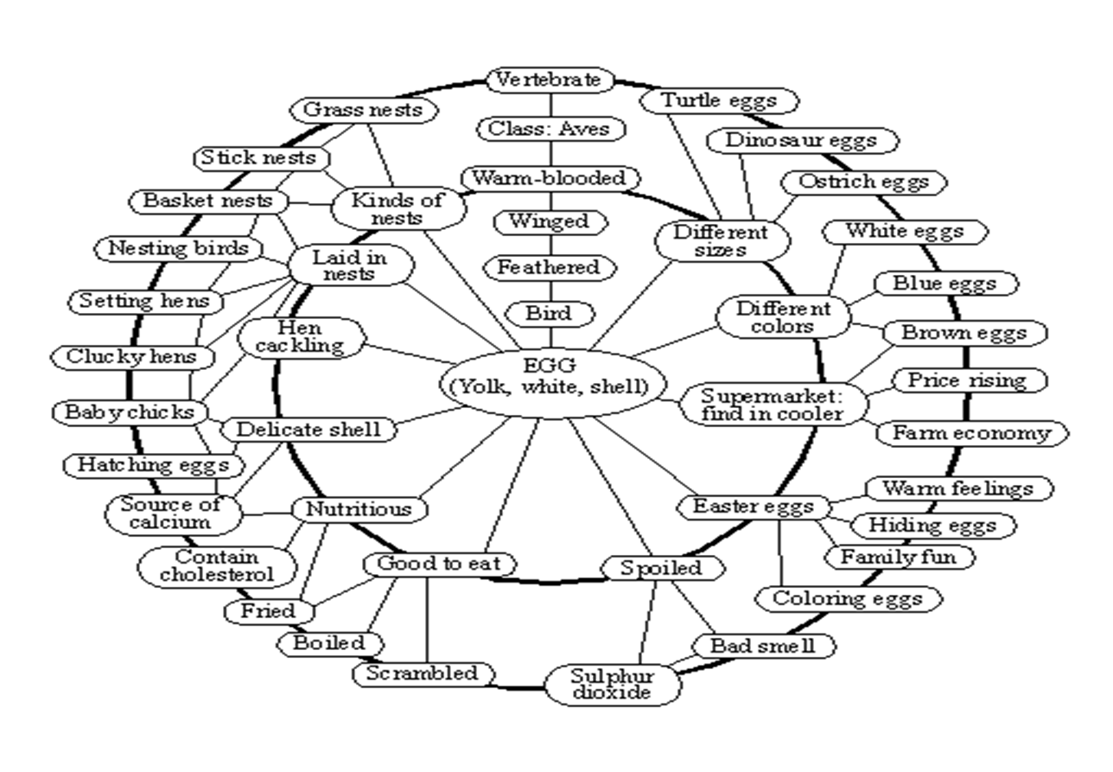
How Prior Knowledge Shapes Encoding
Schema for EGG

Slide 203
Read the following passage…
The procedure is actually quite simple. First you arrange things into different groups. Of course one pile may be sufficient depending on how much there is to do. If you have to go somewhere else due to lack of facilities that is the next step, otherwise you are pretty well set. It is important not to overdo things. That is, it is better to do too few things at one time than too many. In the short run this may not seem important but complications can easily arise. A mistake can be expensive as well. At first the whole procedure will seem complicated. Soon, however, it will become just another facet of life. It is difficult to foresee any end to the necessity for this task in the immediate future, but then one can never tell. After the procedure is completed one arranges the materials into different groups again. Then they can be put into their appropriate places. Eventually they will be used once more and the whole cycle will then have to be repeated. However, that is a part of life.
Notes:
Label changes thea bility to process and store information

Slide 204
Verbal Coding of Visual Materials
Labels assist us in remembering images long-term.
Carmichael, Hogan & Walters (1932).
Presented participants with images then asked them later to reproduce them.

Slide 205
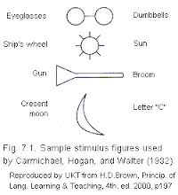
Carmichael, Hogan & Walters (1932)
The researchers presented participants with a set of images.
The images were labelled with one of two different set of words.
The participants were later asked to recreate the images for each label.
Notes:
The label significantly altered what the partiipants reproduced later on

Slide 206
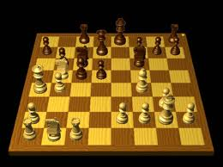
Encoding and Expertise
Chase & Simon (1973)
Tested the memory of chess players.
Novice
Intermediate
Expert
25 chess pieces on a board for 5 seconds

Slide 207
What do you think they found?
  Novices- 4
  Intermediate- 8
  Experts-16
However when pieces on the board were placed randomly the performance of all three groups worsened and became the same
  2 or 3 pieces
  No longer able to chunk meaningful relationships between the pieces

Slide 208
Mnemonic Devices
Any type of memory aid.
Any strategy used to help in your ability to remember information.
Examples:
Chunking
Method of Loci
Acronyms
Acrostics

Slide 209
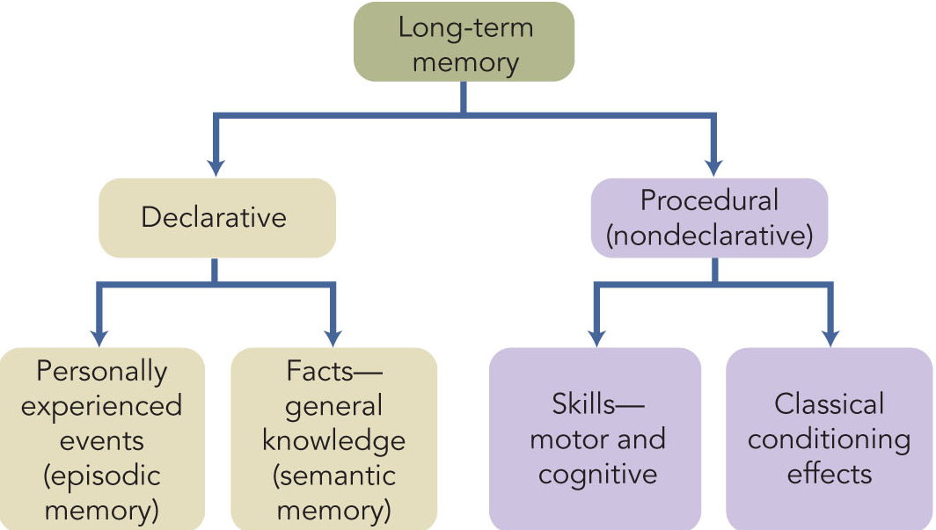

Slide 210
Mnemonic Devices
Any type of memory aid.
Any strategy used to help in your ability to remember information.
Examples:
Chunking
Method of Loci
Acronyms
Acrostics

Slide 211
Visual Imagery
The Dual Coding Theory
Pavio proposes that information is stored in long-term memory in two forms: Verbal and non-verbal.
Using both codes enhances memory because the odds improve that at least one of the codes will be available to support recall.

Slide 212
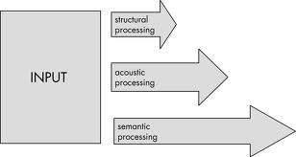
Memorization
But it is more than creating multiple pathways.
It is also impacted by how deeply we process the items when encoding the information.
Level of processing is also key

Slide 213
Encoding

Slide 214
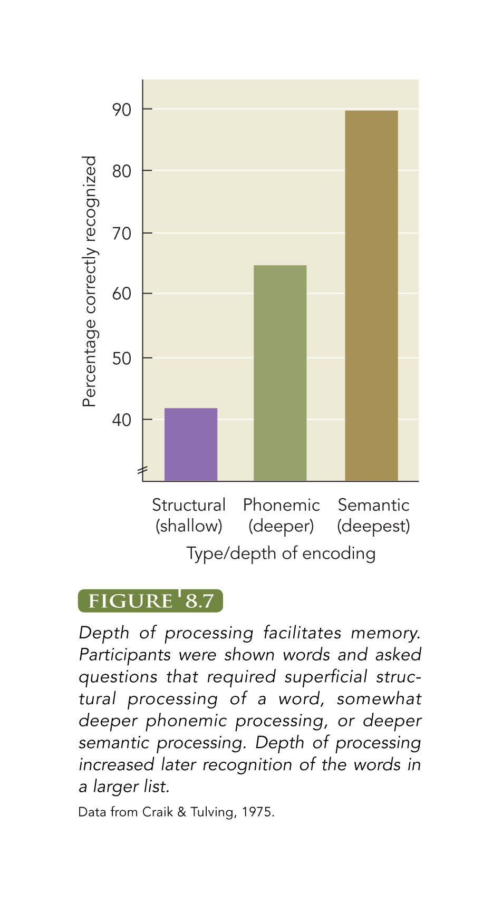
Encoding: Levels of Processing
Depth of processing increases recall
POTATO - is word in capitals? (structural)
Horse - does it rhyme with course? (phonological)
TABLE - does it fit in sentence ‘The man peeled the __’? (semantic)

Slide 215
Encoding: Exposure & Rehearsal
Maintenance rehearsal
  Rote repetition of information
  Not an optimal method
Elaborative rehearsal
  Focuses on information’s meaning
  Organizing
  Understanding
  Applying to one’s life
  Relating to already learned concepts
  Using imagery

Slide 216
Encoding
More effective encoding into LTM = greater likelihood of retrieval
Effortful Processing
  Intentional and conscious
  Studying for this course!
Automatic Processing
  Unintentional and requiring minimal attention
  Recalling what you did yesterday (no need to have written it down to recall it)

Slide 217
Encoding
Organizing information
  Organizing information in a way that is meaningful can enhance memory
  Scheme serves as cue for retrieving information
Hierarchy
  Memory is enhanced by associations
  Enhances understanding of how elements are related
Chunking
  Combining items into larger units of meaning

Slide 218
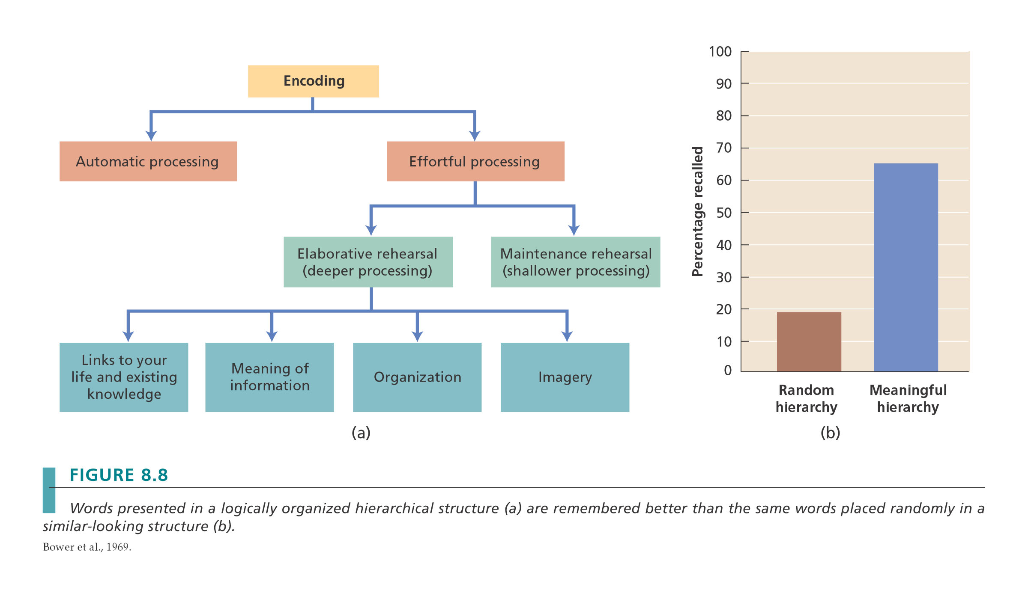

Slide 219
Storage

Slide 220
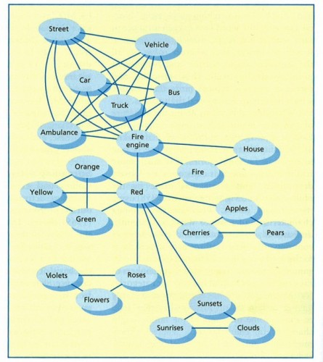
Association Network
Our memory consists of a network of associations.
Nodes: Representations of individual ideas in the network.
Nodes are “tied” to each other by connections called associations or association links.

Slide 221
Spreading Activation
When a node is activated, it can in turn activate other nodes.
Energy will spread out from the just activated node via its associations, and this will activate nodes connected to it.
Helps explain “priming”
Priming is the activation of one concept by another.

Slide 222
Supporting Evidence
Sentence Verification Task (Collins & Quinllian, 1969)
Participants shown sentences on a screen such as:
  “A robin is a bird.”
  “A robin is an animal.”
  “Cats have claws.”
  “Cats have hearts.”
  Asked to give True of False responses as quickly as possible

Slide 223
Explicit & Implicit Memory
Explicit Memory
  Conscious or intentional memory retrieval
Implicit Memory
  Memory influences behavior but …
  No conscious awareness
  Seen in priming tasks
    E.g., shown list of words - includes STORE - not required to consciously remember them
    Later shown STO __ if respond store and not stork = implicit memory

Slide 224
Retrieval

Slide 225
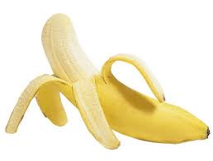
Value of multiple and self-generated cues
Mantyla (1986)
Participants were shown a list of 504 words.
One group was asked to come up with 1 association for each word.
Another group was asked to come up with 3.
Example:
Banana – Fruit
Banana – Fruit, Peel, Monkey

Slide 226
Flashbulb Memories
Recollections that seem so vivid, so clear, that we can picture them as if they were a snapshot of a moment in time
Most likely to occur for distinctive, positive, or negative events that evoke strong emotional reactions.

Slide 227
Flashbulb memories – How accurate?
OJ Simpson’s murder trial verdict.
University students were asked “how, when, with whom, and where they had learned of the verdict”
Also reported whether they agreed with it or not and how emotional they were about it.
Retested 15 months later – only 10% made major errors.
Retested 32 months later – 43% made major errors.
Key factor in accuracy?
Their emotional response – stronger = better recall

Slide 228
Flashbulb memories – how accurate?
September 11th
  569 students asked to complete a memory questionnaire.
  One of the items was:
  On September 11th, did you see the videotape on television of the first plane striking the first tower?”
  73% said yes.
  ?
  This is not possible because it wasn’t shown on September 11th
  Incorrect responders were actually MORE confident than those who said “No”.

Slide 229
Flashbulb memories – how accurate?
Princess Diana
  Study in England asked participants if they remember seeing the video of the car crash on the TV news.
  44% of the individuals said “Yes”.
  Again….not possible. Video didn’t exist.
  BUT confidence level was just as high as those who said “No”.

Slide 230
Context, State, & Mood
Encoding Specificity Principle
  Memory enhanced when conditions present during retrieval match those present during encoding
  Stimuli associated with event may be encoded as part of event
    E.g., exams written in the same lecture hall as where the lecture was delivered
Notes:
Jogger raped; couldn’t remember it, even when returned to scene; remembered it when she was jogging

Slide 231
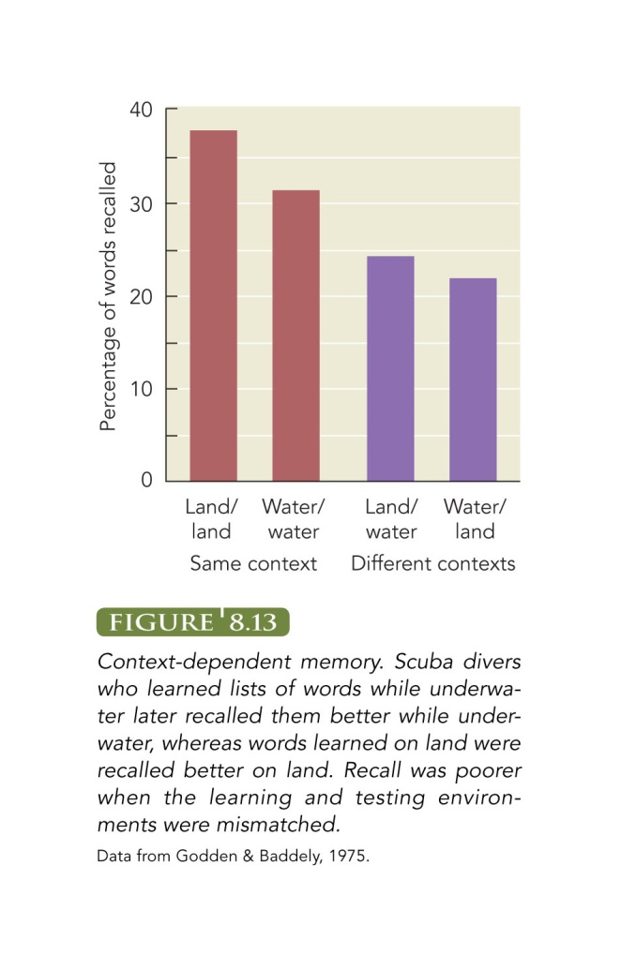
Context, State, & Mood
Context-Dependent Memory
  Easier to remember something in same environment where encoded

Slide 232
Context, State, and Mood Effects
State- Dependent Memory
  Ability to retrieve better when internal state at retrieval matches that at encoding
    Arousal, drug
Mood-Congruent Recall
  Tend to recall information or events congruent with current mood

Slide 233
Forgetting

Slide 234
Forgetting – Hermann Ebbinghaus
Pioneered the study of Forgetting by testing himself.
Studied thousands of “nonsense syllables” (e.g. biv, zaj, xew) and then tested himself.
Measured his memory using relearning.
Rate of forgetting is decreases greatly for the first minutes but then it plateaus

Slide 235
Encoding Failure
Encoding failure
  Lack of attention?
  Lack of deep precessing?
E.g. Failure to encode details that are not important to us

Slide 236
Forgetting: Why do we forget?
Decay of memory trace
  Long-term physical trace in nervous system fades away over time and with disuse
Interference Theory
  Information forgotten because other items in LTM impair ability to retrieve it

Slide 237
Interference
Interference Theory
  Proactive Interference
    Past material interferes with recall of newer material
    E.g. Getting a new phone # and your previous number keeps interfering with your recall of the new one.
  Retroactive Interference
    New information interferes with ability to recall older information.
    E.g. New phone # is finally learned but now recall of the old number is difficult.
Tip-Of-The-Tongue (TOT) State
  On verge of remembering but can’t recall

Slide 238
Forgetting: Why do we forget?
Motivated forgetting
  Based on Freudian concepts
  Conscious or unconscious processes?
  E.g. Repression of anxiety-arousing memories
Controversial
  Difficult to verify
  ‘Repression’ vague

Slide 239
Amnesia
Types of Amnesia
  Retrograde Amnesia
    Memory loss for events before amnesia
      Mild retrograde amnesia in H.M.
  Anterograde Amnesia
    Memory loss for events after amnesia
      Severe anterograde amnesia in H.M.
Alzheimer’s Disease
  Severe retrograde and anterograde amnesia

Slide 240
Amnesia
Infantile Amnesia
  Memory loss for early childhood experiences
  Typically for events before ages of 3-4
Causes?
  immature brain, encoding failures

Slide 241
Forgetting
Retrospective Memory
  Memory for past events
Prospective Memory
  Remembering to perform an activity in future
Changes in prospective memory
  Evidence is mixed
  Outside lab settings, healthy elderly adults perform same as young adults on some tasks
    E.g. pill-taking
  Some difficulty with time-signaled tasks in laboratory

Slide 242
Memory as a Constructive Process
Retrieving memory is not like watching a replay of a video recording.
We do not simply rewind and hit play.
Instead, it seem we reconstruct our memories by piecing information together.

Slide 243
Boundary Extension in Picture Memory
People remember a picture as including more than it actually did.
We extend the boundaries of the picture.

Slide 244
Boundary Extension in Picture Memory
Why?
Perceptual Schema
We look for information beyond what is seen in order to help us understand it.

Slide 245
Misinformation effect
The distortion of memory by misleading post-event information.
If memories are constructed, then information that occurs AFTER an event may shape the construction process.

Slide 246
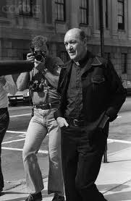
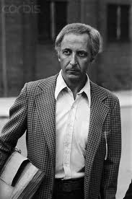
Misinformation Effect
Misinformation effect & Eyewitness testimony.
Famous case of Father Bernard Pegano
7 eyewitnesses identified him as the perpetrator of a series of armed robberies in Delaware.

Slide 247
Misinformation Effect – Eyewitness Testimony
Two key pieces of information contributed to Father Pagano’s near conviction.
1. “Gentleman” robber. Characteristics consistent with a “priest” schema.
2. Before being presented with photos of suspects, eyewitnesses were informed that the robber “may be a priest. (Father Paganos picture was the only one with a clerical collar…!?)

Slide 248

Misinformation effect – Loftus & Palmer (1974)
You witness an accident and the police officer asks “About how fast were the cars going when they smashed into each other?”
Smashed = 65.3 Km/hr
Collided = 62.9 km/hr
Bumped = 61 km/hr
Hit = 54.4 km/hr
Contacted = 50 km/hr

Slide 249
Accuracy of Children’s Memories
Critical issue = Suggestive Questioning
  Can distort children’s memories
  Younger children more susceptible to misleading & suggestive questions (Ceci et al., 2000)
  Observers could not tell false from true reports by children
    Not intentionally lying / believe memory is accurate
Non-suggestive interviewing is critical

Slide 250
Recovered Memories
Are memories accurate?
  If accurate, what caused memory to be forgotten?
Controversial
  Was memory repressed?
    Difficulties in demonstrating experimentally
    May have been consciously forgotten or forgotten in ordinary ways
Full /partial memory loss for traumatic events been documented
  Accurate memories can return

Slide 251
Lineups - Recap
Present the suspect photos one at a time.
Make it clear that the perpetrator may not be one of the people photographed.
Have someone else administer the lineup to the witness.
Have that person “blind” as to who the perpetrator is or if they are even in the lineup.

Slide 252
Biology of Memory
Search for the Engram
  Engram = physical trace stored in brain when memory formed, Lashley (1950)
Engram doesn’t exist
Memory stored throughout brain

Slide 253
Where in the Brain are Memories?
Three basic approaches
Human Lesion Studies
  Study memory loss due to brain damage
Nonhuman Animal Lesion Studies
  Deliberate damage to brain regions
Brain-Imaging Studies

Slide 254

Many Brain Structures Involved

Slide 255
Hippocampus & Cerebral Cortex
Hippocampus
  Encoding station
  Convert short-term memories to long-term
Memory Consolidation
  Binding process in the brain for:
    Where something happened
    What the scene or people looked like
    Sounds heard
    Meaning of events

Slide 256

Hippocampus & Cerebral Cortex
Cerebral cortex
  Encoding information from sensory registers
  Store semantic information
Prefrontal cortex
  Involved in functions of working memory
Deep processing increased brain activity in specific regions of left prefrontal cortex

Slide 257
Other Brain Regions
Thalamus
  Role is unclear
  Damage results in extensive anterograde & retrograde amnesia
Amygdala
  Emotional aspects of memory
Cerebellum
  Procedural memory

Slide 258
Neuroscience of Accurate and Fabricated Memories
Emotional memories may be associated with limbic system activity
Increased activity in amygdala and frontal lobes
Accuracy of retrieved memories moderated by activity in many areas
Faulty source monitoring
  Incorrect attribution as to where and how memory was formed
  May seem very real to individual

Slide 259
Exceptional Memory
Is it real?
Mnemonists
  Display exceptional memory skills
Exceptional memory
  Exceptional in its accomplishments
  Not in its underlying mechanisms
  May reflect motivation & application of basic memory principles

