Slide 1
Pop Quiz Answers
Ec 2128
Prof. T. Sicular
Sept., 2012

Slide 2
1. Who is China’s current paramount leader?
34% correct

Slide 3
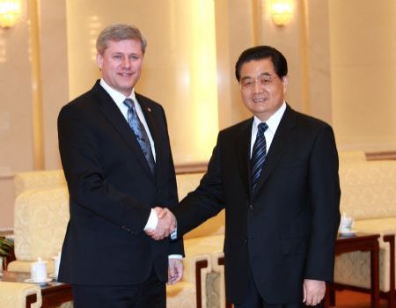
1. Who is China’s current paramount leader?
Hu Jintao: (胡锦涛 ) Born 1942. Engineer trained at Qinghua (MIT of China). In
1980s-90s held leadership posts in Guizhou, Tibet. In the early 1990s assumed several
central posts, e.g., member of standing committee of the Politburo, vice-chair of
Central Military Commission. Nov., 2002, succeeded Jiang as General Secretary
of the CCP Central Committee.

Slide 4
Who is expected to become China’s new paramount leader later this year?
22% correct

Slide 5
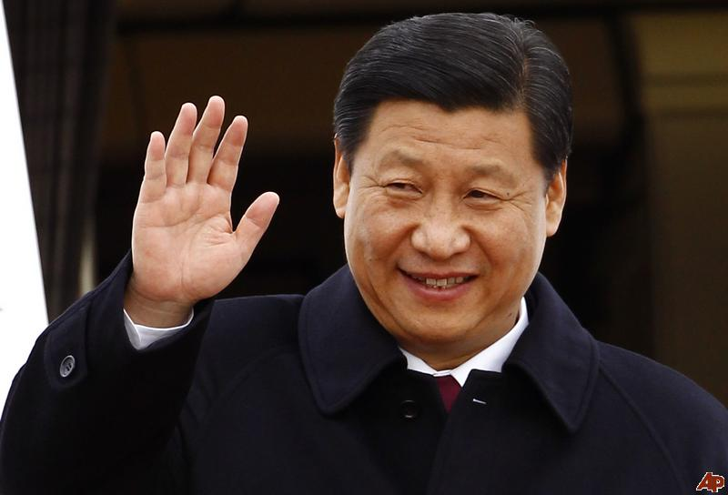
Who is expected to become China’s new paramount leader later this year?
Xi Jinping: (习近平) Born 1953, currently the top-ranking member of
the Secretariat of the Communist Party of China, Vice President,
Vice-Chairman of the Central Military Commission, President of the
Central Party School and the 6th ranked member of the
Politburo Standing Committee, China's de facto top power organ.

Slide 6
2. Name China’s past three paramount leaders.
First one: 22% correct
Second one: 25% correct
Third one: 25% correct
All three: 3% correct

Slide 7
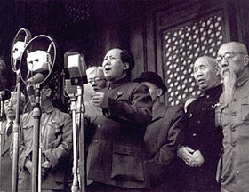
2. Name China’s past three paramount leaders.
Mao Zedong: (毛泽东) Born 1893, died 1976. Revolutionary Leader and Chairman
of the CCP. Paramount leader in China until his death. Hugely influential, but
disagreement over the extent to which his influence was positive or negative. After
his death, eliminated the position of “Chairman” of the CCP. Now “Secretary General”
is the top job.)

Slide 8
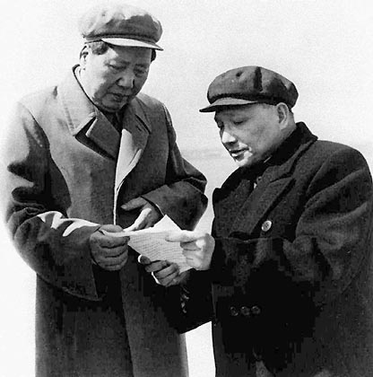
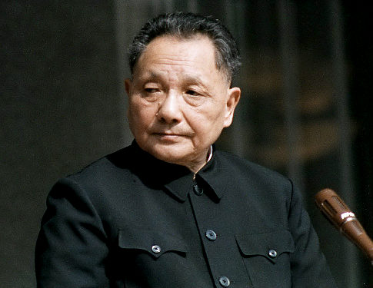
Deng Xiaoping: (邓小平) Born 1905, died 1997. Succeeded Mao as paramount leader,
From about 1978 until his death at the age of 92. Although he did not necessarily hold
The highest official posts, he was the paramount leader. An old-time revolutionary,
involved in Chinese politics as member of the Central Committee, Politburo, and
Secretary General of the CCP under Mao, but out of power in some periods.

Slide 9
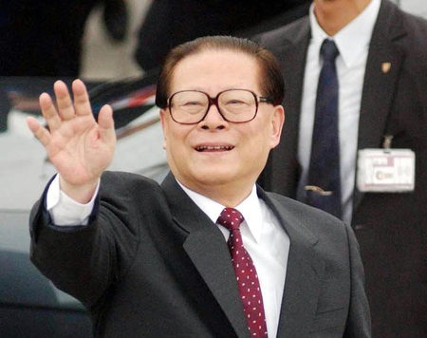
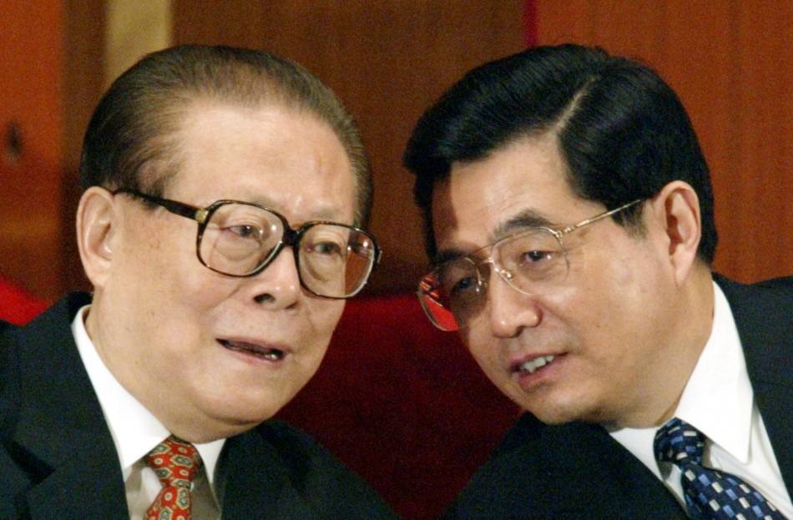
Jiang Zemin: (江泽民) Born 1926. Engineer, various posts under Mao including
a factory manager. Became mayor of Shanghai in 1985, member of Politburo in 1987,
President of China and Chair, Central Military Commission, in 1993. Became heir
apparent to Deng and Secretary General of the Central Committee of the CCP in
June 1989 after Tiananmen. Full leadership in 1997 after Deng’s death.
Stepped down as Secretary General in Nov., 2002. He is thought to still wield power
behind the scenes.

Slide 10
3. In what year was the People's Republic of China established?
25% correct

Slide 11
3. In what year was the People's Republic of China established?
1949

Slide 12
4. In about what year did China begin to reform its planned socialist economy and introduce market reforms?
31% correct

Slide 13
4. In about what year did China begin to reform its planned socialist economy and introduce market reforms?
Typically dated from 1978 meeting
of 3rd Plenary Session of the 11th Central Committee of the CCP. At this meeting, discarded emphasis on “class struggle” as key link, and replaced it with socialist modernization and development of the productive forces.

Slide 14
5. When did China join the WTO?
22% correct

Slide 15
5. When did China join the WTO?
December 11, 2001.
Note: China was a founding member of the GATT , the parent organization of the WTO, which was established in 1948. So, technically speaking, China “acceded to” rather than “joined” the WTO in 2001.

Slide 16
6. In the past two decades, China’s economic performance has been…
  The best in the world 38%
  Above average 56%
  Average 6%
  Below average 0%

Slide 17
6. In the past two decades, China’s economic performance has been…
It depends on the definition of economic performance.
  The best in the world
  Above average
  Average
  Below average
  Note: From 1990-2010, China’s GDP growth averaged about 9% (constant prices, IMF data). Equatorial Guinea has had higher growth, but based on oil (with pop of only 1.1 million). Qatar’s growth has been very slightly lower than China’s; Cambodia, Mozambique, Vietnam and the Maldives are the next fastest group (in the 6.5-7.0% range).

Slide 18
…sorry—no question 7 on the quiz.

Slide 19
8. According to recent reports, China’s GDP per capita in US$ terms is about…
  $5000 28%
  $8000 47%
  $11000 13%
  All of the above 6%
  None of the above 3%

Slide 20
8. According to recent reports, China’s GDP per capita in US$ terms is about…
  $5000
  $8000
  $11000
  All of the above
  None of the above

Slide 21
9.a Before the market reforms, China’s economic policies followed Marx’s blueprint for economic development.
  Disagree Agree
  1 2 3 4 5
  3% 19% 19% 31% 19%

Slide 22
9.a Before the market reforms, China’s economic policies followed Marx’s blueprint for economic development.
  Disagree Agree
  1 2 3 4 5

Slide 23
9.b China’s economic market reforms have transformed it into a capitalist market economy.
  Disagree Agree
  1 2 3 4 5
  9% 31% 22% 28% 6%

Slide 24
9.b China’s economic market reforms have transformed it into a capitalist market economy.
  Disagree Agree
  1 2 3 4 5

Slide 25
9.c China is entering a “middle income trap,” and economic growth will soon slow markedly.
  Disagree Agree
  1 2 3 4 5
  3% 6% 28% 25% 28%

Slide 26
9.c China is entering a “middle income trap,” and economic growth will soon slow markedly.
  Disagree Agree
  1 2 3 4 5

Slide 27
9.d Strict population control is necessary if China wants to sustain growth in per capita incomes.
  Disagree Agree
  1 2 3 4 5
  6% 25% 16% 28% 22%

Slide 28
9.d Strict population control is necessary if China wants to sustain growth in per capita incomes.
  Disagree Agree
  1 2 3 4 5

Slide 29
9.e In the post-Mao reform era China has experienced rising inequality and poverty
  Disagree Agree
  1 2 3 4 5
  13% 19% 16% 16% 34%

Slide 30
9.e In the post-Mao reform era China has experienced rising inequality and poverty
  Disagree Agree
  1 2 3 4 5

Slide 31
9.f China’s growth in recent decades has been export-led, i.e., exports have been a key driver of GDP growth.
  Disagree Agree
  1 2 3 4 5
  6% 6% 3% 38% 47%

Slide 32
9.f China’s growth in recent decades has been export-led, i.e., exports have been a key driver of GDP growth.
  Disagree Agree
  1 2 3 4 5

Slide 33
9.g Privatization of China’s farmland will protect farmer’s rights and promote efficient agricultural growth.
  Disagree Agree
  1 2 3 4 5
  6% 28% 19% 28% 16%

Slide 34
9.g Privatization of China’s farmland will protect farmer’s rights and promote efficient agricultural growth.
  Disagree Agree
  1 2 3 4 5

