Slide 1
Why don’t populations expand infinitely?
Readings from Cain et al.
Question #1: 199-200; 207-216
Question #2: 242-251
Question #3: 262-271
Question #4: 237-238; 333-334; 438-442

Slide 2
LEARNING GOALS 1.
Explain the difference between geometric, exponential, and logistic growth using examples from natural populations.
Explain why the geometric and exponential growth curves overlap.
Give examples of factors that limit and factors that regulate population growth and how they do so.
Explain how a resource and a physical factor differ.
Explain how population size may be influenced by density-dependent, density- independent, and inversely density-dependent factors.
Explain why the Allee effect slows down the recovery of nearly extinct populations.

Slide 3
ECOLOGY IS EASY IF YOU UNDERSTAND THESE TERMS
geometric growth, exponential growth, logistic growth
finite rate of increase, intrinsic rate of increase (r)
density-dependence, density-independence, inverse density dependence
facilitation
Allee effect
carrying capacity (K)
population regulation, population limitation
Lotka-Volterra competition model
biotic factors, abiotic factors

Slide 4
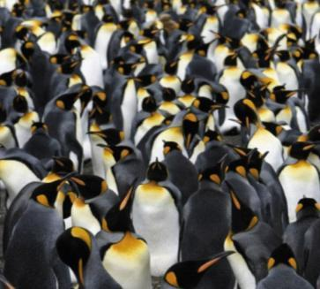
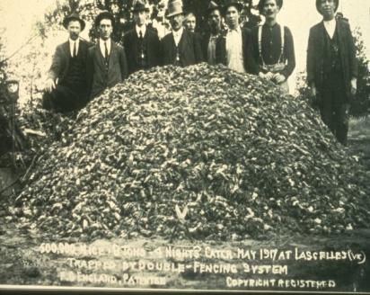

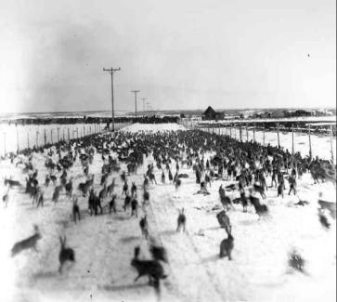
Populations can grow exponentially when conditions are favorable, but exponential growth cannot continue indefinitely.
What would be some of the potential consequences if the world human population continued to increase at the current rate?
Or, why is the world not eyeball-deep in penguins, mice, locusts or rabbits?

Slide 5


Slide 6
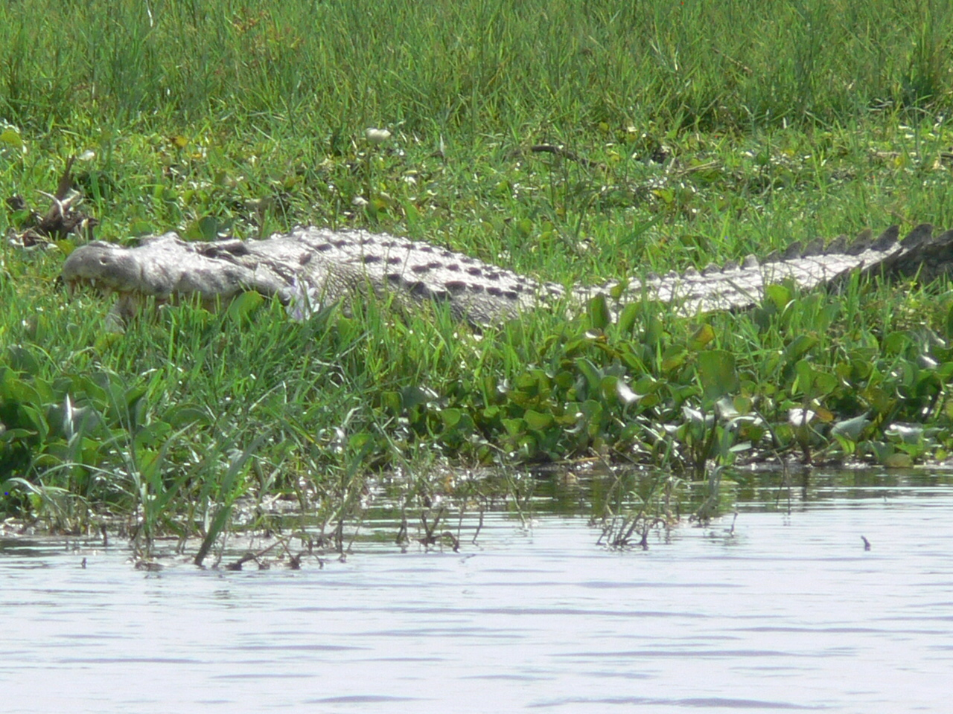
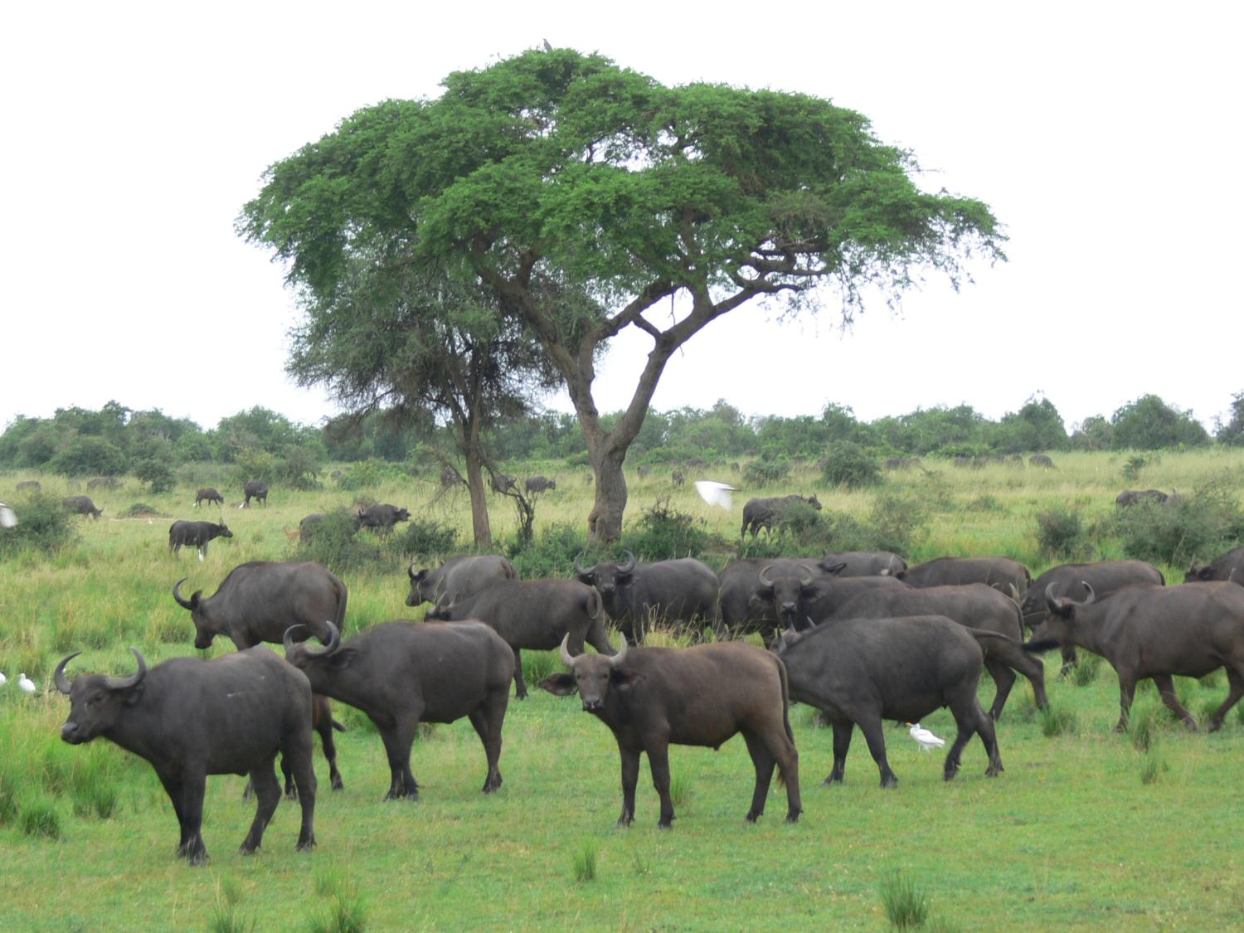

Slide 7
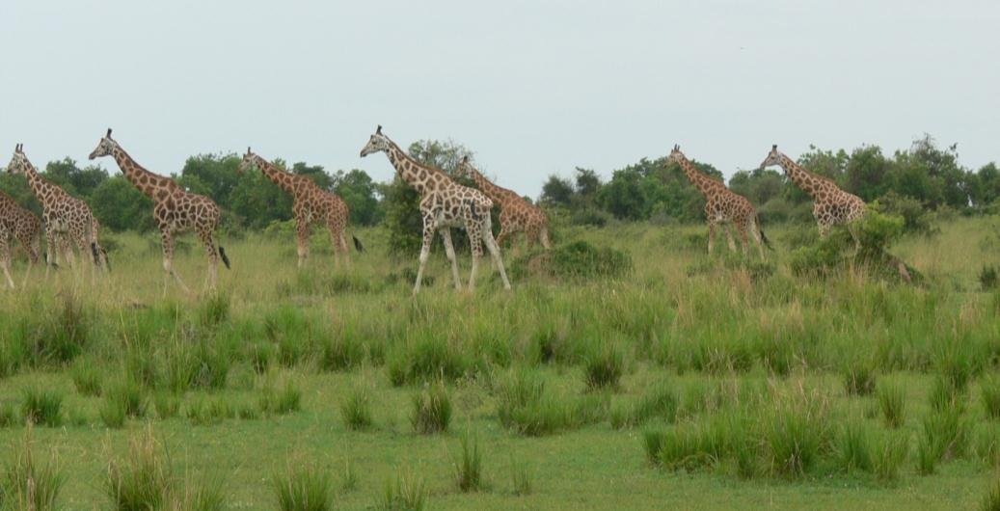
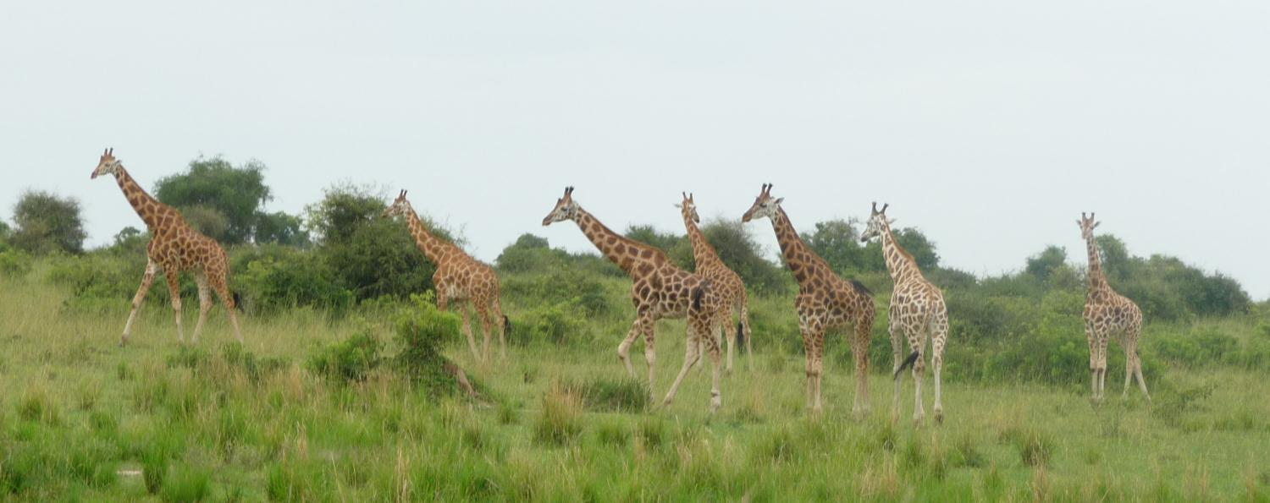

Slide 8
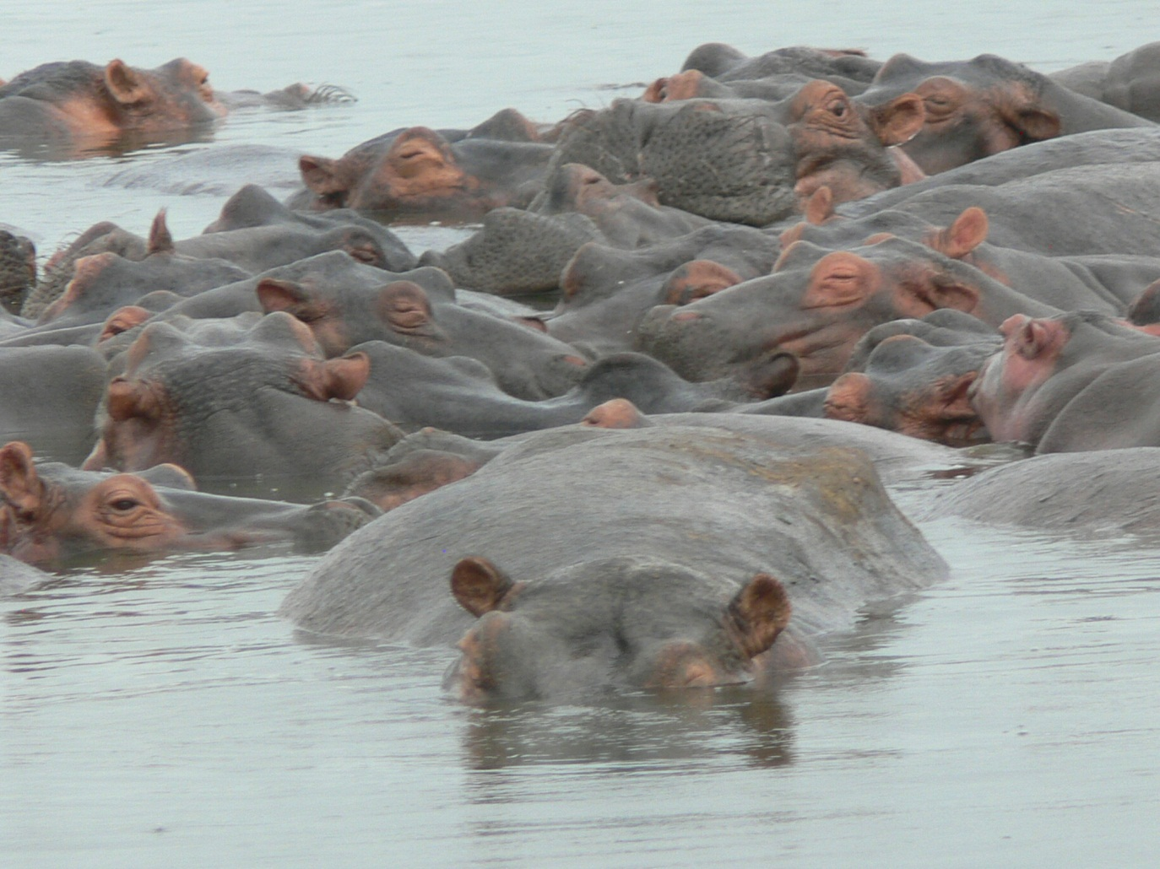

Slide 9
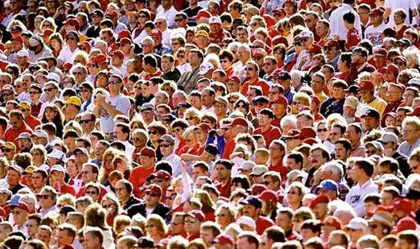
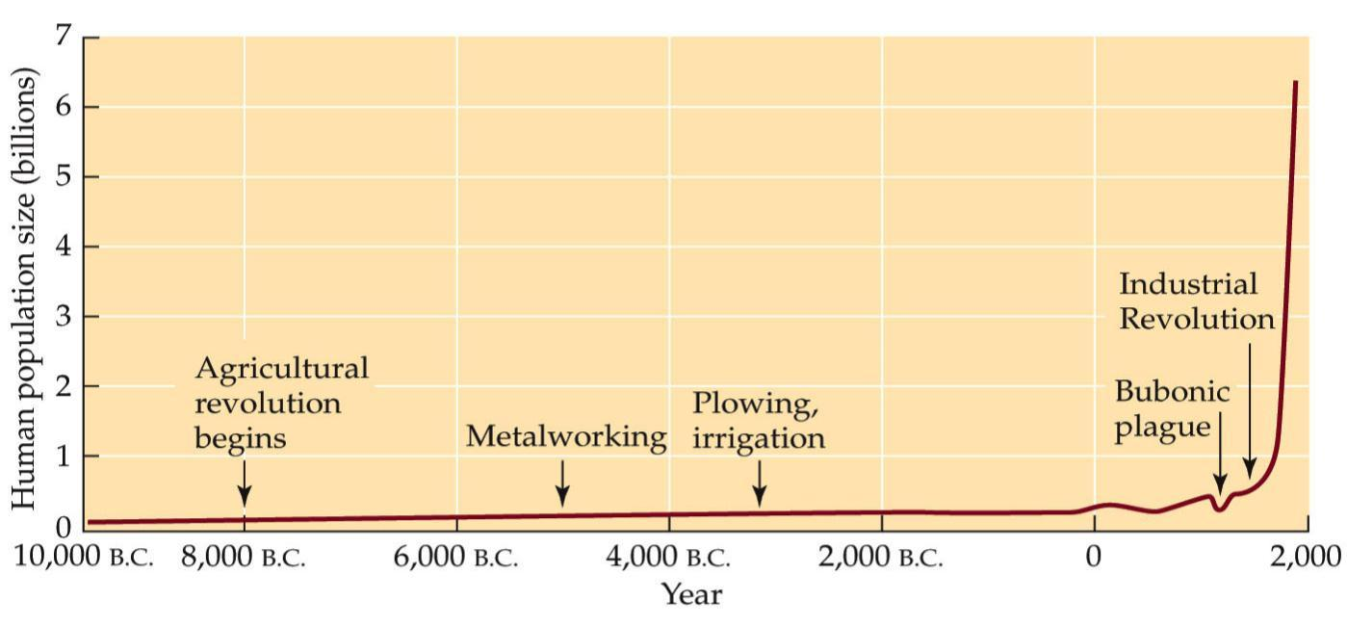
Fig. 9.2 Explosive Growth of the Human Population
Why do we (humans) believe that factors and natural laws governing all other species survival, do not apply to us?
Notes:
ecology-fig-09-02-0.jpg

Slide 10
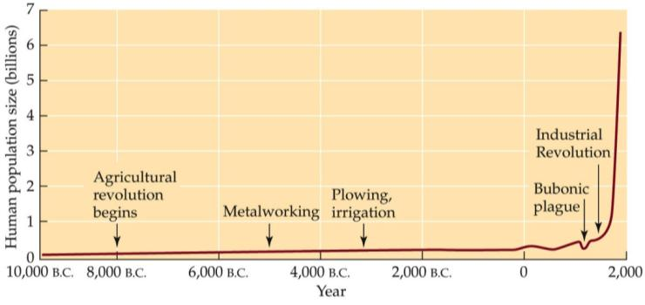

Human population reached 6.6 billion in 2007, more than double the number of people in 1960.
From 1860 to 1991 human population quadrupled in size, and energy consumption increased 93-fold.
For thousands of years our population grew relatively slowly, reaching 1 billion for the first time in 1825.
Now we are adding 1 billion people every 13 years.

Slide 11
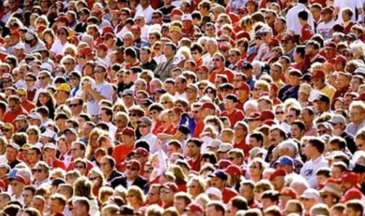
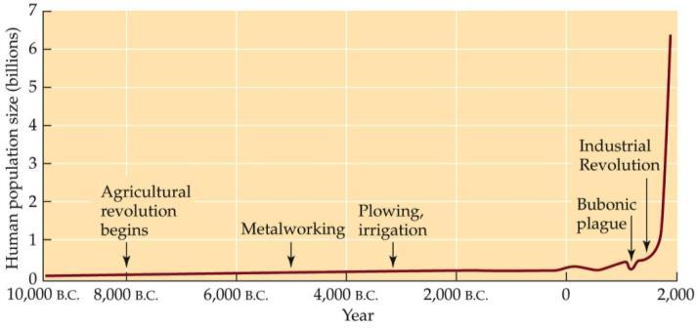
In 1975, the population was growing at an annual rate of nearly 2%.
At this rate, a population will double in size every 35 years.
If this growth rate were sustained, we will reach 32 billion by 2080.

Slide 12
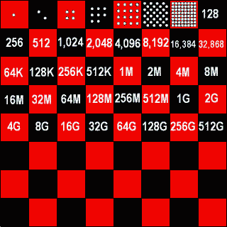
We will begin by deriving the equation for
exponential population growth
(Cain et al. pp. 207-211)

Slide 13
Exponential Growth
Cain et al. 207-211
If a population reproduces in synchrony at regular time intervals (discrete time periods), and growth rate remains the same, geometric growth occurs.
The population increases by a constant proportion, so the number of individuals added to the population becomes larger with each time period.

Slide 14
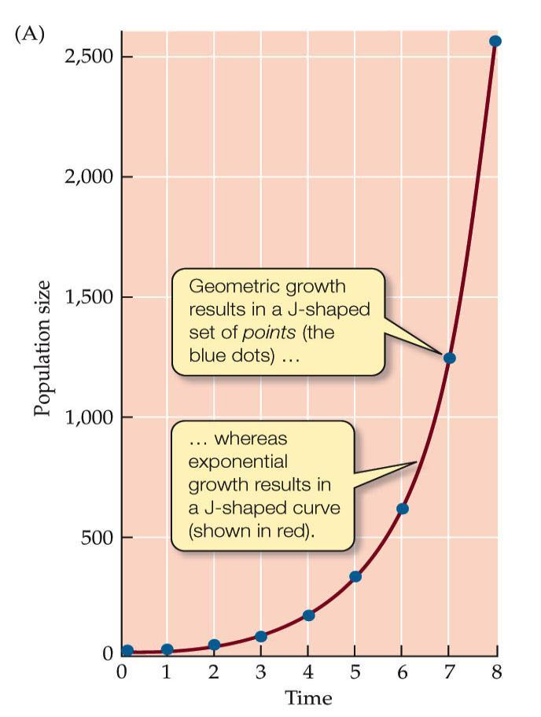
Fig. 9.10 Geometric and Exponential Growth
Exponential Growth
Notes:
ecology-fig-09-09-0.jpg

Slide 15
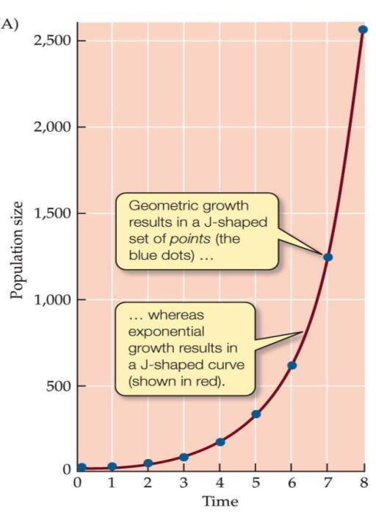
Exponential Growth
Geometric growth:
λ (lamda)= geometric growth rate; also known as the (per capita) finite rate of increase.
This can also be expressed as:
Where N₀ is the initial population size.

Slide 16
Exponential Growth
In many species, individuals do not reproduce in synchrony at discrete time periods, they reproduce continuously, and generations can overlap.
When these populations increase by a constant proportion, the growth is exponential growth.

Slide 17
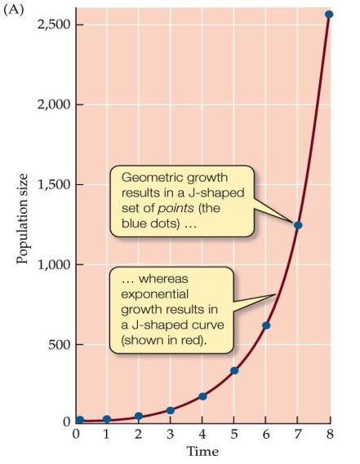
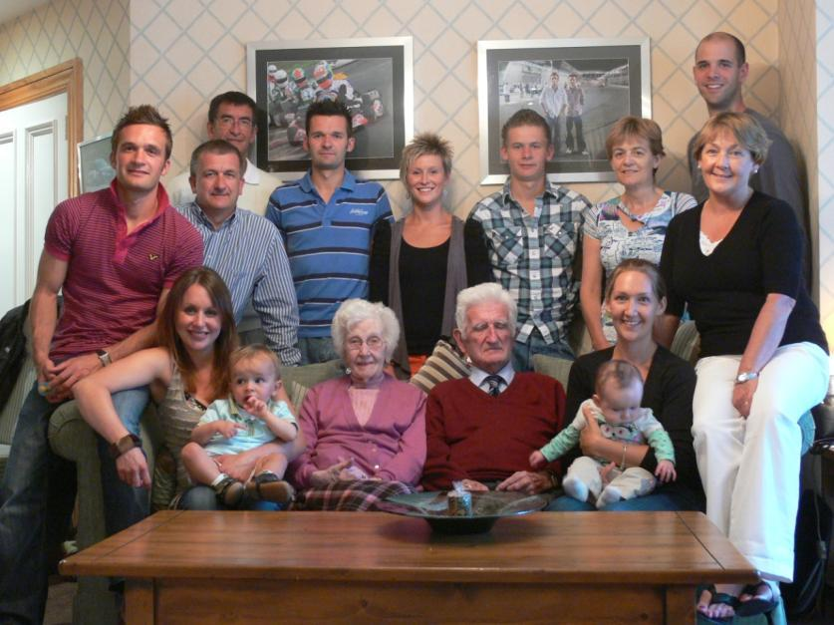
Fig. 9.10 Geometric and Exponential Growth
Exponential Growth
Notes:
ecology-fig-09-09-0.jpg

Slide 18
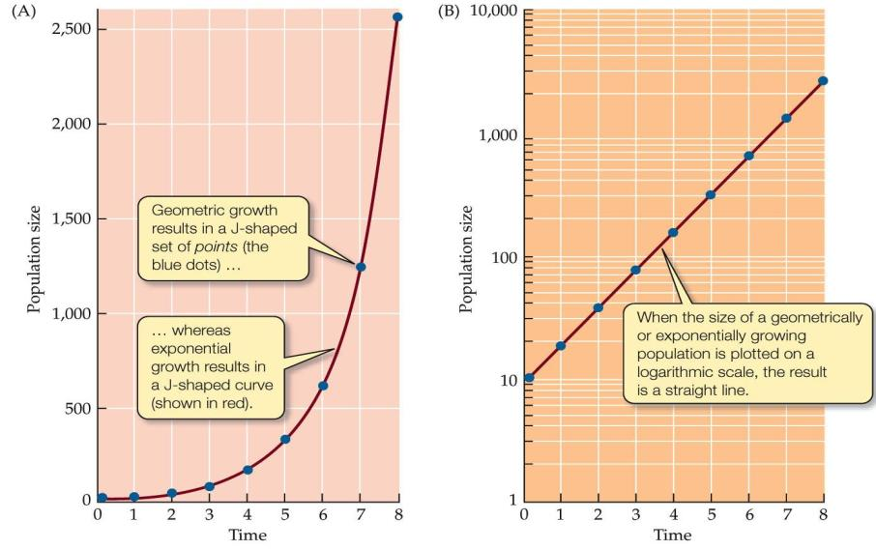
Fig. 9.10 Geometric and Exponential Growth
Exponential Growth
Notes:
ecology-fig-09-09-0.jpg

Slide 19
Exponential Growth
Exponential growth is described by
= the rate of change in population size at each instant in time .. or ..
the speed at which a population increases in size with time
r is the exponential population growth rate or the (per capita) intrinsic rate of increase.

Slide 20
Exponential Growth
Geometric and exponential growth curves overlap because the equations are similar in form, except that λ is replaced by e^{r}.

Slide 21
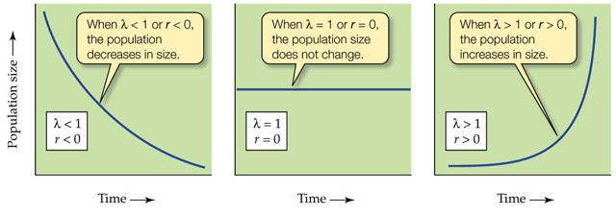
Exponential Growth
When λ = 1 or r = 0, the population stays the same size.
When λ < 1 or r < 0, the population size will decrease.
When λ > 1 or r > 0, the population grows geometrically or exponentially.

Slide 22
Why don’t populations expand infinitely?

Slide 23
LEARNING GOALS 1.
Explain the difference between geometric, exponential, and logistic growth using examples from natural populations.
Explain why the geometric and exponential growth curves overlap.
Give examples of factors that limit and factors that regulate population growth and how they do so.
Explain how a resource and a physical factor differ.
Explain how population size may be influenced by density-dependent, density- independent, and inversely density-dependent factors.
Explain why the Allee effect slows down the recovery of nearly extinct populations.

Slide 24
ECOLOGY IS EASY IF YOU UNDERSTAND THESE TERMS
geometric growth, exponential growth, logistic growth
finite rate of increase, intrinsic rate of increase (r)
density-dependence, density-independence, inverse density dependence
facilitation
Allee effect
carrying capacity (K)
population regulation, population limitation
Lotka-Volterra competition model
biotic factors, abiotic factors

Slide 25
Why don’t populations expand infinitely?
1. They run out of resources
Cain et al. pp. 207-216

Slide 26
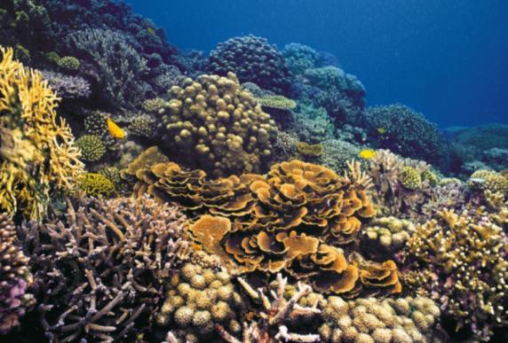



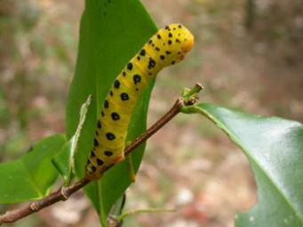
1. They run out of resources
What is a resource?

Slide 27
Organisms compete for resources:
features of the environment that are in short supply and
are required for growth, survival, or reproduction, and
can be consumed to the point of depletion
Physical factors affect population growth rates but are not consumed or depleted e.g. temperature, wind, pH

Slide 28
1. They run out of resources
What is a resource?
Animals – food such as other animals, or plant parts
- mates, nesting sites, space, etc.
Plants – food such as N, P, K, H₂0, light
- pollinators, space, etc.

Slide 29
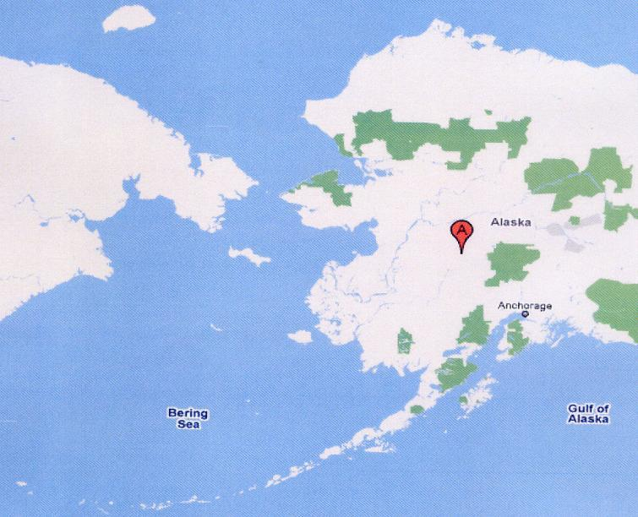
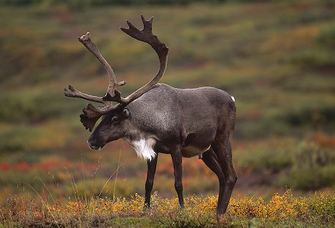
Reindeer on Pribilof Islands, Alaska
In 1910, 4 male and 22 female reindeer (Rangifer tarandus) introduced to St. Paul’s Is., and increased to 2000 animals in 30 years (1940).
In 1944, 5 male and 24 female reindeer, introduced to St. Matthew Is. , and increased to 6000 in 19 years (1963).
St. Matthew Is.
St. Paul Is.

Slide 30
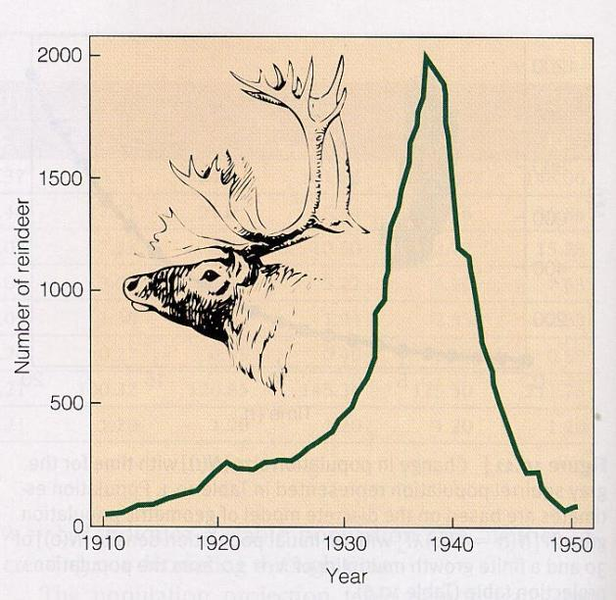
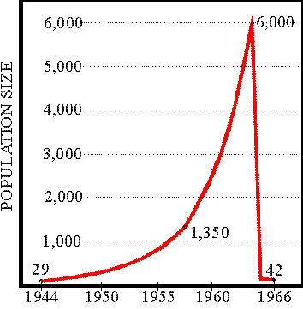
St. Paul Population
St. Matthew Population
In 1963, the density of reindeer on the island was 47 per square mile. Lichens had been completely eliminated as a significant component of the winter diet.

Slide 31
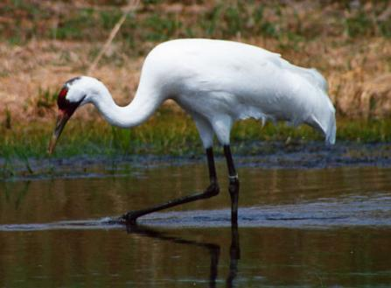
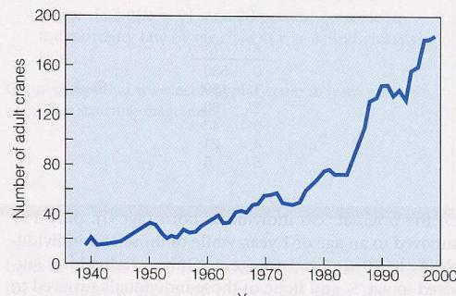
The Whooping Crane
On the brink of extinction when first protected in 1916; only 15 birds in 1941.
Breeds in the Northwest Territories and overwinters on the Texas coast

Slide 32
Population size can be determined by density-dependent and density-independent factors.
(Cain et al. pp. 211-214)
Under ideal conditions, λ > 1 for all populations.
But conditions rarely remain ideal. What factors cause λ to fluctuate over time?

Slide 33
The Effects of Density
Cain et al. 211-214
Some factors are a function of population density, other are not dependent on density—density-independent factors.
Factors such as floods, fires, drought or hurricanes.

Slide 34
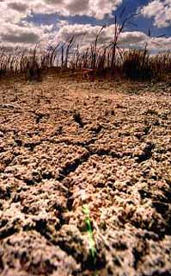
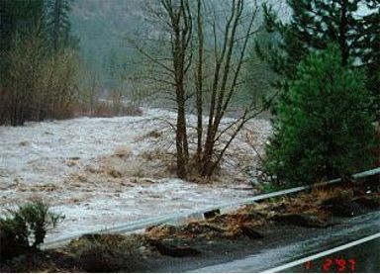
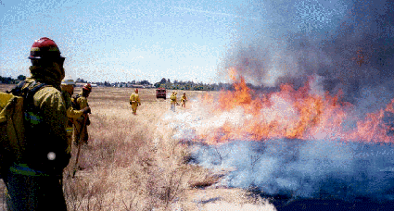
Life history characteristics – r vs. K
Periodic disturbances
Fire, floods, drought etc.
Often result in catastrophic mortality independent of density
Populations grow in irregular bursts

Slide 35
Life history characteristics – r vs. K
Periodic disturbances
Fire, floods, drought etc.
Often result in catastrophic mortality independent of density
Populations grow in irregular bursts

Slide 36
Life history characteristics – r vs. K
In a “rarefied environment” the best strategy is often to put energy into reproduction and to produce as many offspring as possible, ASAP. Due to lack of competition, even quite small individuals can thrive. (r-selected)
In a “saturated environment” best strategy is often to put energy into competition and maintenance and to produce offspring with more substantial competitive abilities (K-selected) (reduced ‘r’ but increased survival)

Slide 37
The Effects of Density
Density dependent factors: Cause birth rates, death rates, and dispersal rates to change as the density of the population changes.
As densities increase birth rates often decrease, death rates increase, and dispersal from the population (emigration) increases, all of which tend to decrease population size.

Slide 38
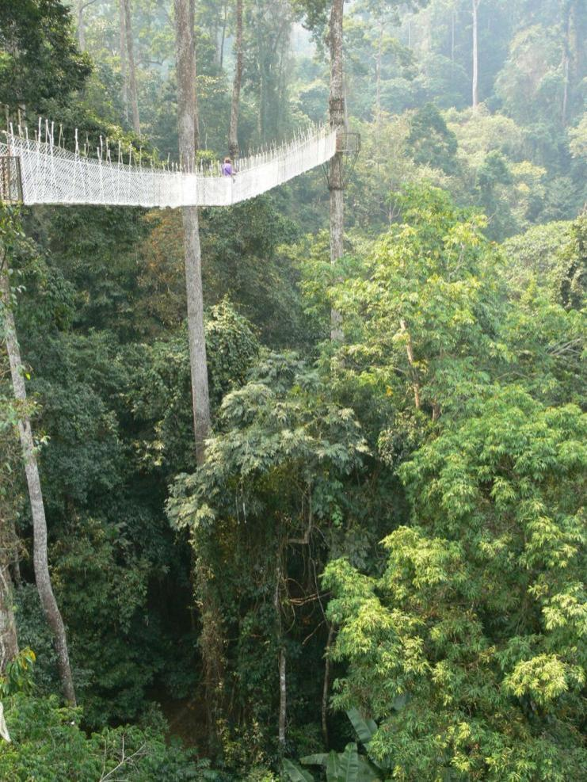
Life history characteristics – r vs. K
2. Quite stable
mortality more directed and dependent upon density.
favoring individuals better able to cope with high densities and strong competition.

Slide 39
Life history characteristics – r vs. K
2. Quite stable
mortality more directed and dependent upon density.
favoring individuals better able to cope with high densities and strong competition.

Slide 40
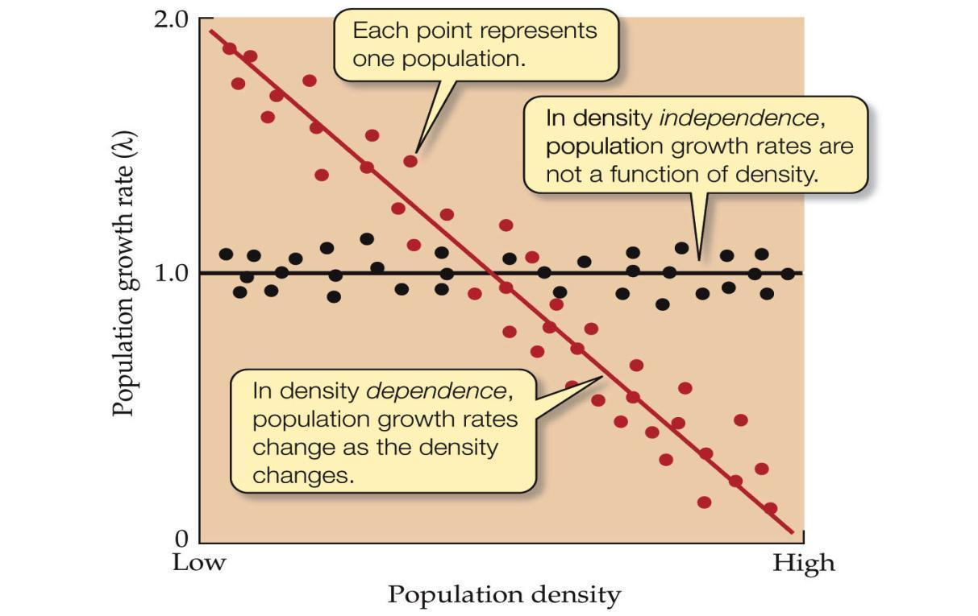
Fig. 9.14 Density Dependence and Density Independence
The Effects of Density
Notes:
ecology-fig-09-13-0.jpg

Slide 41
The Effects of Density
Population regulation occurs when density dependent factors cause population to increase when density is low and decrease when density is high.
Ultimately, food, space, or other essential resources are in short supply and population size decreases.

Slide 42
The Effects of Density
Regulation refers to the effects of factors that tend to increase λ or r when the population size is small and decrease λ or r when the population size is large.
Density independent factors can have large effects on population size, but they do not regulate population size – they can cause population limitation.

Slide 43
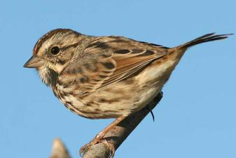
The Effects of Density
Density dependence has been documented in natural populations.
In song sparrows, the number of eggs laid per female decreased with density, as did the number of young that survived (Arcese and Smith 1988).

Slide 44
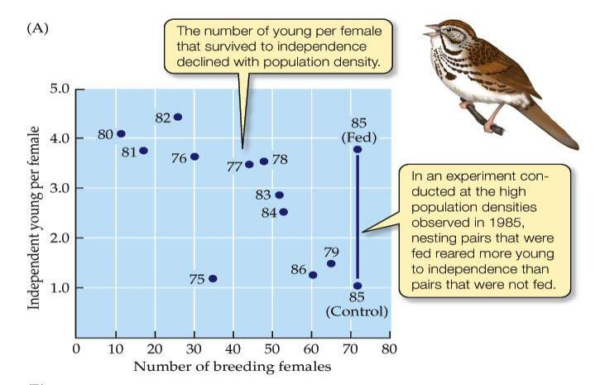
Fig. 9.15 Examples of Density Dependence in Natural Populations
The Effects of Density
Notes:
ecology-fig-09-14-0.jpg

Slide 45

The Effects of Density
In an experiment where eggs of the flour beetle Tribolium confusum were placed in glass tubes, death rates increased as the density of eggs increased.

Slide 46
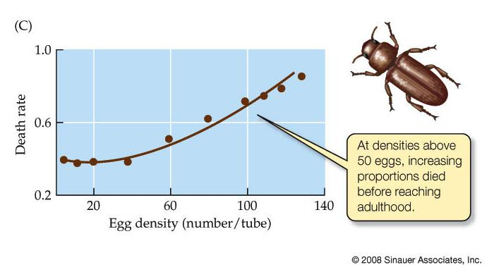
Fig. 9.15 Examples of Density Dependence in Natural Populations
The Effects of Density
Notes:
ecology-fig-09-14-0.jpg

Slide 47
The Effects of Density
When birth, death, or dispersal rates show strong density dependence, population growth rates may decline as densities increase.
If densities become high enough to cause λ = 1 (or r = 0), the population stops growing.

Slide 48
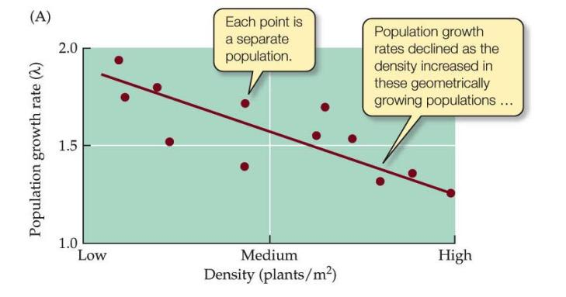
Fig. 9.16 Population Growth Rates May Decline at High Densities
The Effects of Density
1. Is the population subject to density dependent effects?
2. Is the population always increasing in size?
Notes:
ecology-fig-09-16-0.jpg

Slide 49
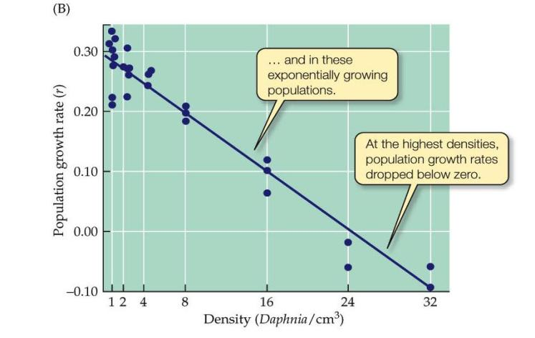
Fig. 9.16 Population Growth Rates May Decline at High Densities
1. Is the population subject to density dependent effects?
2. Is the population always increasing in size?
Notes:
ecology-fig-09-16-0.jpg

Slide 50
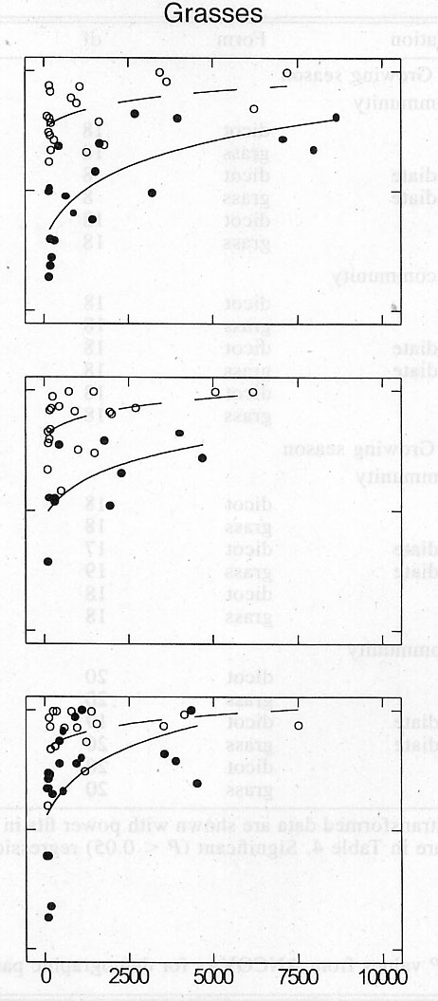
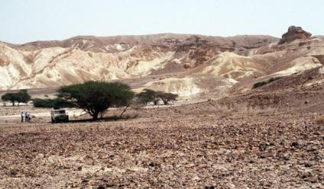
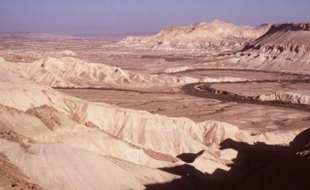
The Effects of Density - facilitation
The proportion of seedlings surviving in populations of different densities, under 3 levels of watering, at 2 different desert sites.
High water
Inverse density
dependence
“facilitation”
Proportion surviving
Med water
Low water
Seedling density

Slide 51
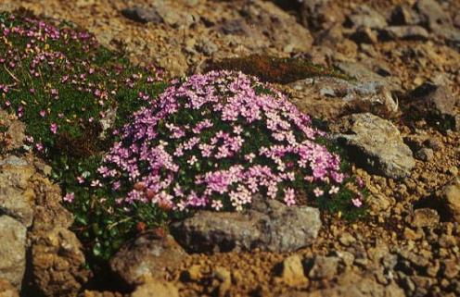
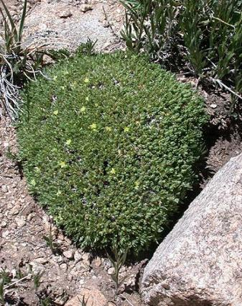
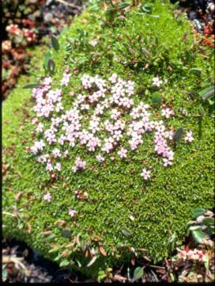
The Effects of Density - facilitation
Facilitation is generally a situation where one species benefits from the presence or action of another.

Slide 52
The Effects of Density - Allee
Allee effects - population growth rate decreases as population density decreases; individuals have difficulty finding mates at low population densities.
In small populations, Allee effects can cause the population growth rate to drop, which causes the population size to decrease even further.

Slide 53
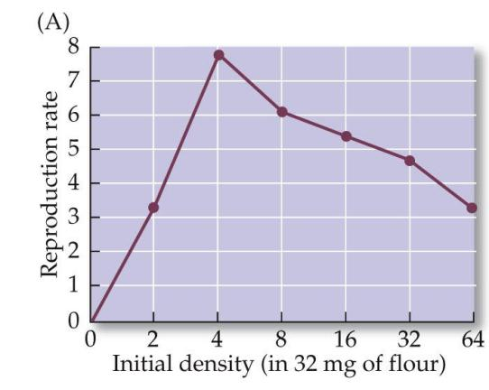
Fig. 10.14 Allee Effects Can Threaten Small Populations
The Effects of Density - Allee
Notes:
ecology-fig-10-14-0.jpg

Slide 54
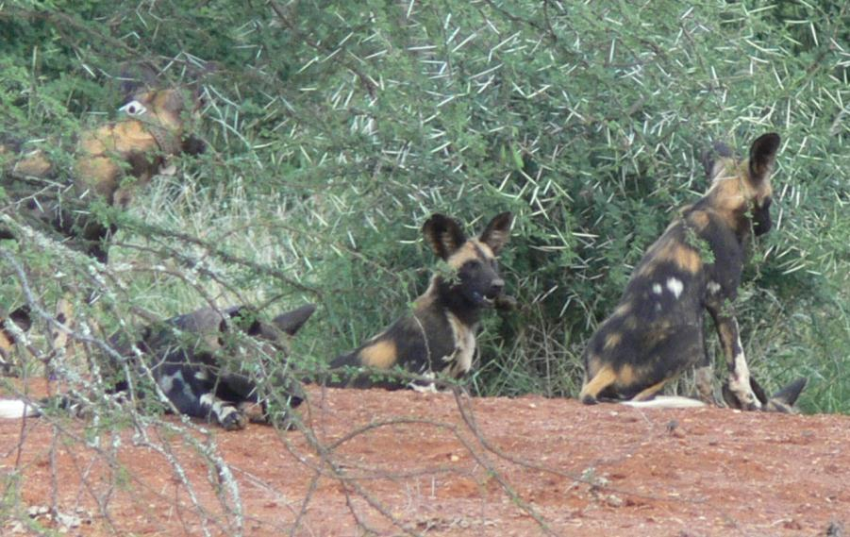
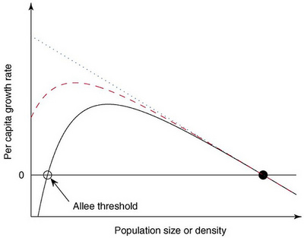
No Allee effect
Weak Allee effect
Strong Allee effect

Slide 55
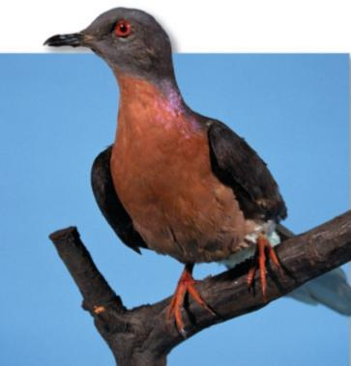
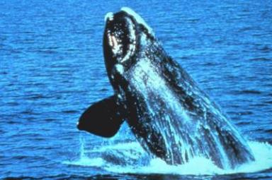
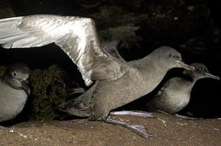
The Effects of Density - Allee
Allee – an extinction vortex
This is believed to have caused the extinction of the American passenger pigeon (Ectopistes migratorius) (Cain et al. 479).
Northern right whales (Eubalaena glacialis) were formerly abundant in the NW Atlantic, but by 1900 they had been hunted to near extinction. After the end of commercial whaling the population was thought to be recovering slowly; however, evidence indicates that it has been declining since about 1990 and currently numbers about 200.
Shearwaters nesting on New Zealand coastal areas and islands.

Slide 56




25,000
` 9000
1900 - <100
Now 20,000
2,400

Slide 57



25,000
1,800
2,400

Slide 58
To test for DD, DI, IDD
Rate
Density

Slide 59
Logistic Growth
The logistic equation incorporates limits to growth and shows how a population may stabilize at a maximum size, the carrying capacity. (Cain et al. pp. 214-216)
Logistic growth: Population increases rapidly at first, then stabilizes at the carrying capacity (K) (maximum population size that can be supported indefinitely by the environment).

Slide 60

Fig. 9.17 An S-shaped Growth Curve in a Natural Population
The growth rate decreases as the population size nears carrying capacity because resources such as food, water, or space begin to run short.
At carrying capacity, the growth rate is zero, so population size does not change.
Notes:
ecology-fig-09-17-0.jpg

Slide 61

Logistic Growth
In the exponential growth equation
(dN/dt = rN), r is assumed to be constant.
To make it more realistic, we will assume that r declines in a straight line as density (N) increases.

Slide 62
Logistic Growth
This results in the logistic equation:
N = population density
r = per capita growth rate
K = carrying capacity
or,

Slide 63

Fig. 9.18 Logistic and Exponential Growth Compared
Logistic Growth
Notes:
ecology-fig-09-18-0.jpg

Slide 64
Logistic Growth
When densities are low, logistic growth is similar to exponential growth.
When N is small, (1 – N/K) is close to 1, and a population with logistic growth increases at a rate close to r.
As density increases, growth rate approaches zero.

Slide 65





What will limit human populations?
Cain et al. 216-217
Resources
Disease
Overgrazing (often leads to drought)
Loss of top soil
Firewood and deforestation
Sahel region
Your ecological footprint

Slide 66


