Slide 1

BCH2333 – Introduction to Biochemistry
Lecture 5
Amino Acids & Peptides
BCH2333-2020 L5-1

Slide 2
BCH2333 – Introduction to Biochemistry
Free Energy:
ΔG=ΔH-TΔS
Gibbs Free Energy
The overall energy change of a process, and whether it requires energy or gives off energy (measure of useful work)
Enthalpy
The absorption (>0) or release (<0) of energy during a reaction, measured in the form of heat evolution
Entropy
The degree of randomness of a system (disorder)
ΔG, ΔH, and ΔS are all state functions: they depend on the initial and final states of the system under study and not on the pathway taken between states.
In bioenergetics, thermodynamics (2nd law) allows us to tell two things about a process:
1. Is it reversible?
2. Is it favored to occur?
Importantly: Biological systems are open (i.e. they exchange energy with their surroundings), and operate at constant(ish) temperature and pressure.
BCH2333-2020 L5-1

Slide 3
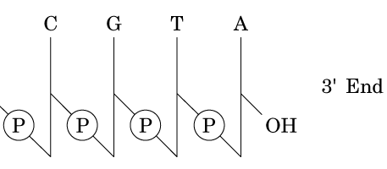
BCH2333 – Introduction to Biochemistry
Primary Structure of Nucleic Acids:
Sequence = Genetic Information
-
NH₂
Can differentiate DNA from RNA by looking for 2’-OH and bases in sequence (U vs. T)
Convention for writing is from 5’ to 3’
Purines connected to sugar phosphate backbone at N₉
Pyrimidines connected to backbone by N₁
All bases are connected to anomeric C (C₁’) by β-linkage
O
-
N
O
P
O
C
O
N
O
O
NH₂
-
O
N
N
O
P
O
O
N
N
A
O
O
-
O
N
N
H
O
P
O
G
O
N
N
NH₂
O
NH₂
C A G C
O
N
3’
-
5’ End
3’ End
O
P
O
C
O
N
O
O
5’
5’-CAGC-3’
O
H
BCH2333-2020 L5-1

Slide 4
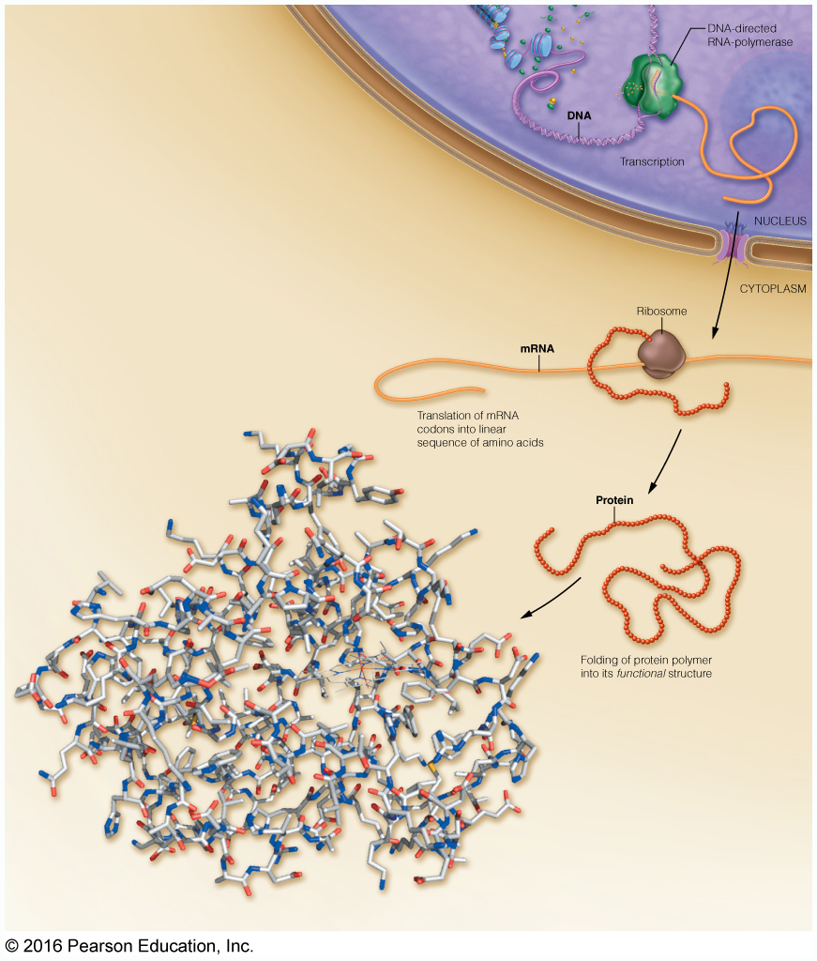
BCH2333 – Introduction to Biochemistry
Central Dogma:
Just like nucleic, proteins are the result of hierarchical structures defining form and function.
And just like nucleic acids they are derived from various combinations of monomeric building blocks in their primary structure.
Importantly, there is a richer chemical diversity of monomers available for building proteins, significantly diversifying the resultant possible primary, secondary, and tertiary structures.
BCH2333-2020 L5-1

Slide 5
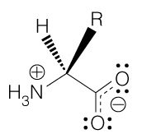
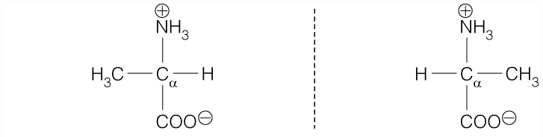
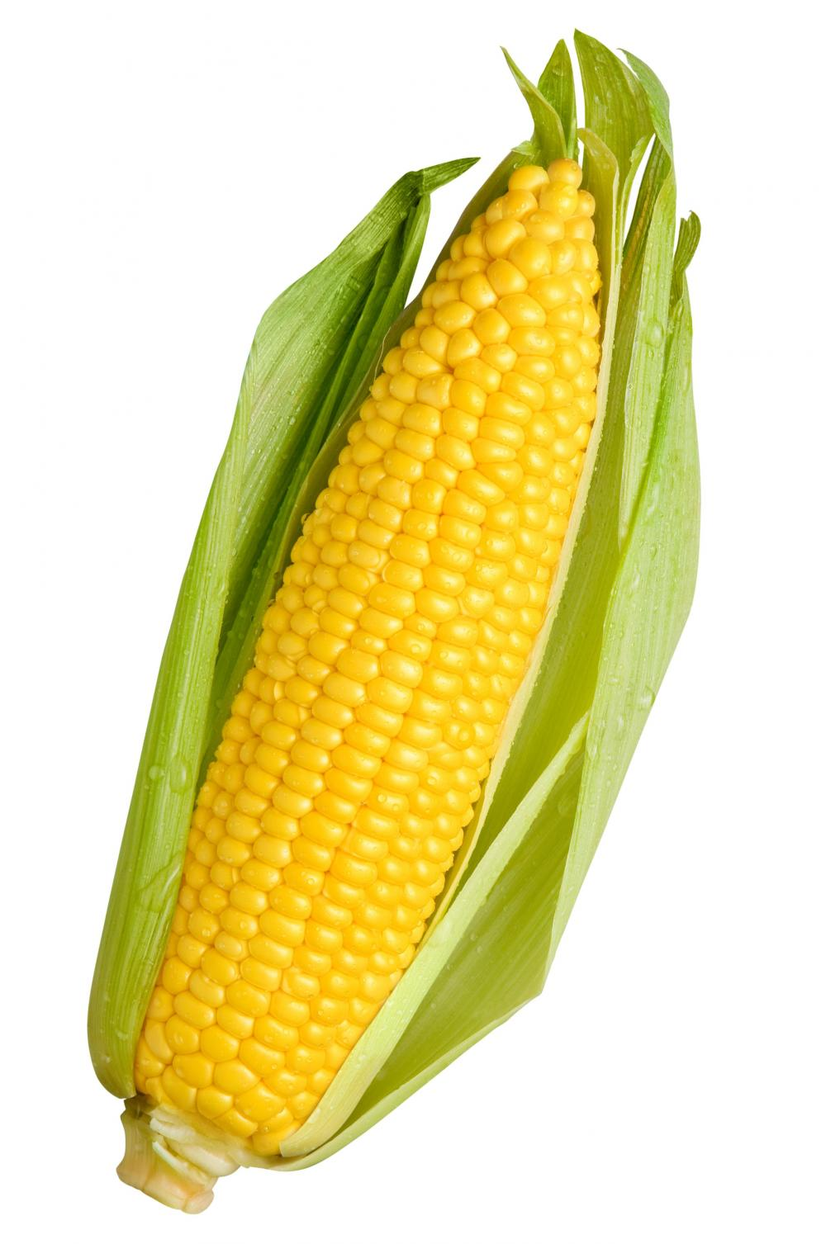
BCH2333 – Introduction to Biochemistry
General Amino Acid Structure:
The sp³-C_{α} is asymmetric (or chiral); the stereochemistry of this center is key in understanding biochemistry of proteins.
Side Chains
pK_{a}~9.5
Fischer Projections
This stereochemistry can be represented in a Fischer projection: horizontal bonds come out of the page, vertical bonds go into the page.
pK_{a}~2
C_{α}
=
The chirality of C_{α} results in two possible enantiomers of amino acids (non-superimposable mirror images): D- and L- (Fischer-Rosanoff convention)
Nearly all amino acids in biochemistry assume the L- form
Orient the H towards you
“Look” down the H-C_{α} bond
Determine direction of CO-R-N groups
Clockwise = L, counter-clockwise = D
How do you tell D- from L- ?
CORN
L-Alanine
D-Alanine
BCH2333-2020 L5-1

Slide 6
BCH2333 – Introduction to Biochemistry
Chirality Practice:
L-
D-
The C_{α}-H needs to be oriented towards you for CORN to work! This requires rotation in 3-D OR reversal of the directions of the rule (clockwise = D, counter-clockwise=L)
L-
D-
There is an important outcome of amino acid chirality on biochemistry. The chirality of amino acids and the preference for L-enantiomers results in:
Protein surface asymmetry that results in very specific recognition and binding events (e.g. enzyme-substrate, protein-drug, protein-protein interactions)
The formation of protein secondary structures that are major determinants of protein structure (and consequently protein function).
The D-form of amino acids exist in biochemistry, but they are not players in protein structure/function
BCH2333-2020 L5-1

Slide 7
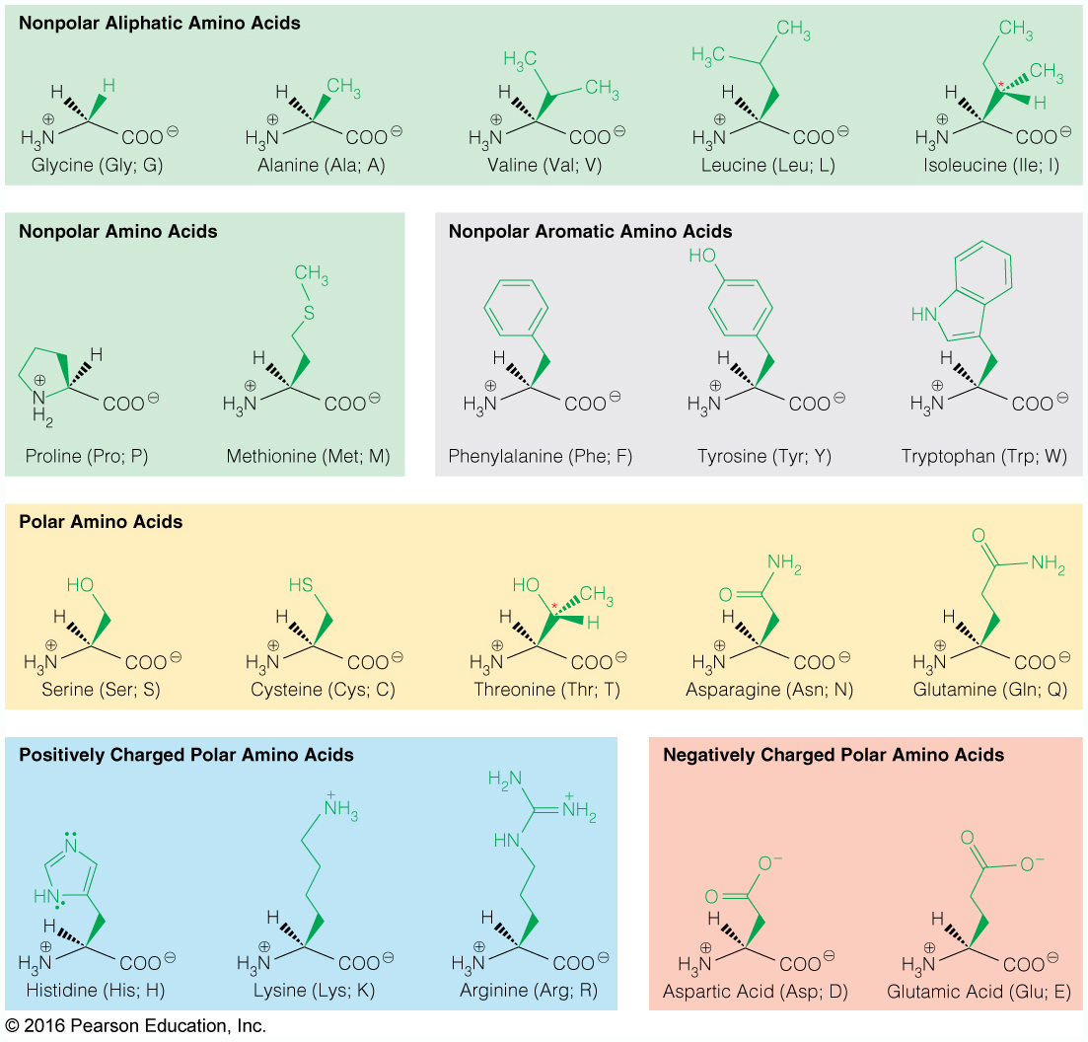
BCH2333 – Introduction to Biochemistry
The 20 Amino Acids:
BCH2333-2020 L5-1

Slide 8
BCH2333 – Introduction to Biochemistry
Beta Branches With Stereochemistry:
2
1
3
3
1
2
L-L
L-D
BCH2333-2020 L5-1

Slide 9
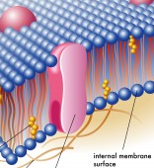
BCH2333 – Introduction to Biochemistry
Non-Polar Aliphatics:
The ability to control the hydrophobicity of protein microregions is key for structure, function, and sub-cellular location (compartmentation)
Hydrophobicity is a driving force of protein folding.
Side chain hydrophobicity
Achiral
Chiral R
Val & Ile have C_{β} substituents – β-branched amino acids
Leu and Ile are isomers that differ in structure by position of R-group CH₃.
2º amine
Sulfur has the same electronegativity as C and similar size as CH₂, resulting in a thioether side chain that is aliphatic and hydrophobic. The thiol does allow some interactions with polar molecules.
Provide for turns of the protein structure
BCH2333-2020 L5-1

Slide 10
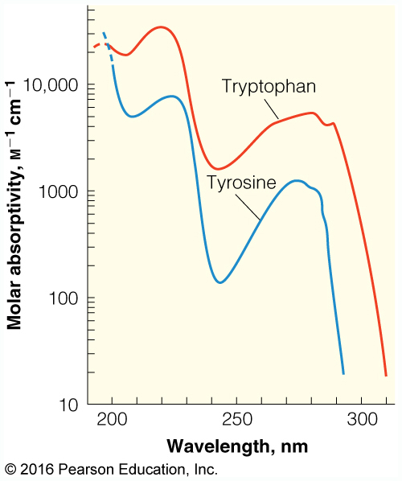
BCH2333 – Introduction to Biochemistry
Non-polar Aromatic:
Phe is one of the most hydrophobic amino acids
The hydrophobicity of Tyr and Trp is reduced by the polar groups in their side chains amenable to H-bonding with water
Tyr has a basic OH (pK_{a}=10.1), and Trp has an indole ring. The basic OH of Tyr results in some polar character (gray area)
The aromatic character of the side chains provides pi-conjugated electron systems that absorb light
The limited pi-conjugation makes these systems high energy and results in the absorption of photons at 280 nm. This photon absorption can be used to quantify protein levels in solution.
Why doesn’t Phe show absorption peak at 280 nm?
BCH2333-2020 L5-1

Slide 11
BCH2333 – Introduction to Biochemistry
Polar Uncharged:
Key residues involved in enzyme catalysis driven by Nu:⁻
Chiral R
These amino acids form multiple H-bonds with water and other polar species, and are often found on the aqueous surfaces of proteins.
Both Ser and Cys posses R-groups that are good nucleophiles, delegating these amino acids to the active sites of enzymes to assist in catalysis
Cys is unique in two other aspects:
Cystine
2. The oxidation of 2 Cys yield a disulfide bond that is important in the stabilization of higher order protein structures. Disulfide bonds are ~40% weaker than C-C bonds.
1. The pK_{a} of the thiol falls into the biochemically relevant range, so some fraction of Cys is in the thiolate form
pK_{a}=8.4
[O]
[R]
Thiolate
BCH2333-2020 L5-1

Slide 12
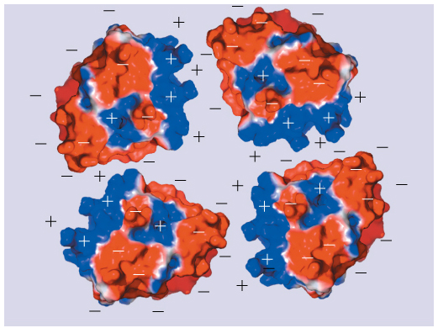
BCH2333 – Introduction to Biochemistry
Polar Charged:
Acids play roles in:
Metal chelation
Nu:⁻ reactions
Electrostatic interactions
Acidic amino acids are ionized at pH 7
Tend to be on solvent-exposed/accessible surfaces of proteins
pK_{a} 3.9 4.1 (we will assume 4.0 for both for now)
Side chain alkilinity
guanidinium
imidazolium
Why is Arg more basic than Lys?
Bases play roles in:
Electrostatic interactions
H+ transfer (His)
amine
Basic amino acids tend to be on solvent-exposed/accessible surfaces of proteins
pK_{a} 6.0 10.5 12.5
BCH2333-2020 L5-1

Slide 13
BCH2333 – Introduction to Biochemistry
His Proton Transfer:
⁻OOC
⁻NH3⁺
⁻OOC
⁻NH3⁺
⁻OOC
⁻NH3⁺
Proton transfers can be mediated by His due to resonance stabilization of +ve charge
⁻OOC
⁻NH3⁺
⁻OOC
⁻NH3⁺
⁻OOC
⁻NH3⁺
H-D
D
A
A-H
Donors (H-D) and acceptors (A) can be substrates or, more often, amino acids (e.g. acidic residues and amide bonds, respectively) in active site of enzymes to drive reactions.
BCH2333-2020 L5-1

Slide 14
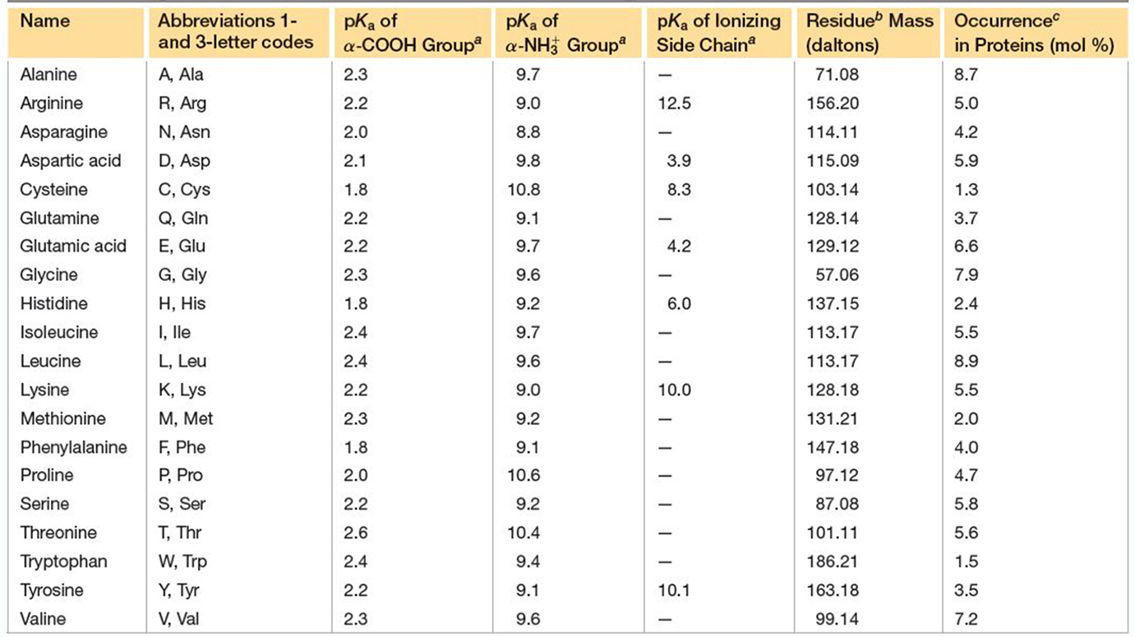
BCH2333 – Introduction to Biochemistry
Properties of Amino Acids:
4.0
8.4
4.0
2
9.5
10.5
10.5
These pK_{a} are for isolated amino acids; these values can change by as much as ±3 pH units depending on the microenvironment of the residue.
BCH2333-2020 L5-1

Slide 15
BCH2333 – Introduction to Biochemistry
Peptides As Polyampholites:
Recall that the pK_{a} listed previously were for isolated amino acids, and it was said that these values can change by as much as ±3 pH units depending on the microenvironment of the residue.
The stability (energy change) of resulting conjugate acid/base dictates change in pK_{a}
pK_{a} = 4.0
The close proximity of two carboxylate anions results in charge repulsion, favouring maintained protonation.
pK_{a} 4.0 and the aspartyl becomes acidic
> less
The close proximity of cation results in charge stabilization, favouring deprotonation.
pK_{a} 4.0 and the aspartyl becomes acidic
< more
BCH2333-2020 L5-1

Slide 16
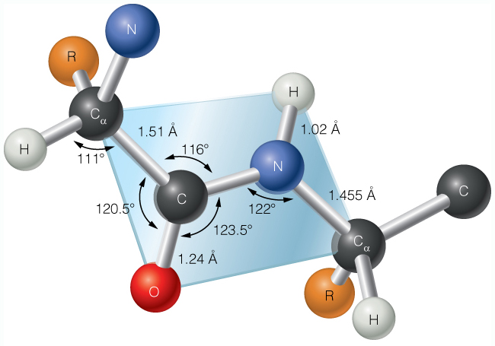
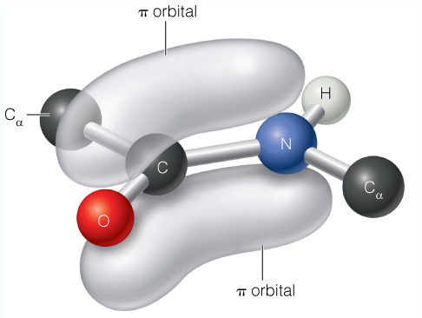
BCH2333 – Introduction to Biochemistry
The Peptide Bond:
Amino acids are linked covalently by dehydration of the α-COO⁻ of one residue and the α-NH₃⁺ of the subsequent residue to result in an amide bond (or peptide bond).
Glycyl residue
Alanine Glycine Valine
Alanyl-glycyl-valine
(tripeptide)
N-terminus (N_{T})
C-terminus (C_{T})
Bond Geometry:
6 atoms are coplanar (protein backbone)
Protein backbone rigidity derives from double bond-like character of C-N bond, a result of the resonance delocalization of carbonyl and amine lone pair electrons
BCH2333-2020 L5-1

Slide 17
BCH2333 – Introduction to Biochemistry
The Peptide Bond:
Free rotation around the peptide bond (C-N) is further limited by side chain steric clashes. The trans conformation is favoured to avoid steric clashes of the side chains
cis is more allowed with α=Pro
trans
cis
Bond Formation & Stability:
-H₂O
+
ΔG’=10 kJ/mol
+H₂O
Like polynucleotides, polypeptides are metastable, allowing their formation and destruction to readily occur under the control of the cell
Both peptide bond formation & hydrolysis are very slow at physiological conditions, requiring extreme conditions (e.g. acidic conditions for dehydration) or catalysis. This requirement for catalysis affords the cell control over these processes.
BCH2333-2020 L5-1

Slide 18
BCH2333 – Introduction to Biochemistry
Central Dogma:
BCH2333-2020 L5-1

Slide 19
BCH2333 – Introduction to Biochemistry
Peptide Bond Formation:
Polypeptide formation is highly regulated within cells and occurs through a complex series of steps involving RNA, DNA, and proteins…
For now, the following is important to understand:
+ ATP
+ PP_{i}
ΔG’≈ -19 kJ/mol
tRNA
2 GTP +
+
+H₂O +2GDP +P_{i}
ΔG’≈ -60 kJ/mol
Coupling of thermodynamically unfavourabe reactions (e.g. condensation to an amide bond) with more favourable ones (e.g. hydrolysis of high energy phosphate bonds) drives polypeptide formation.
BCH2333-2020 L5-1

Slide 20
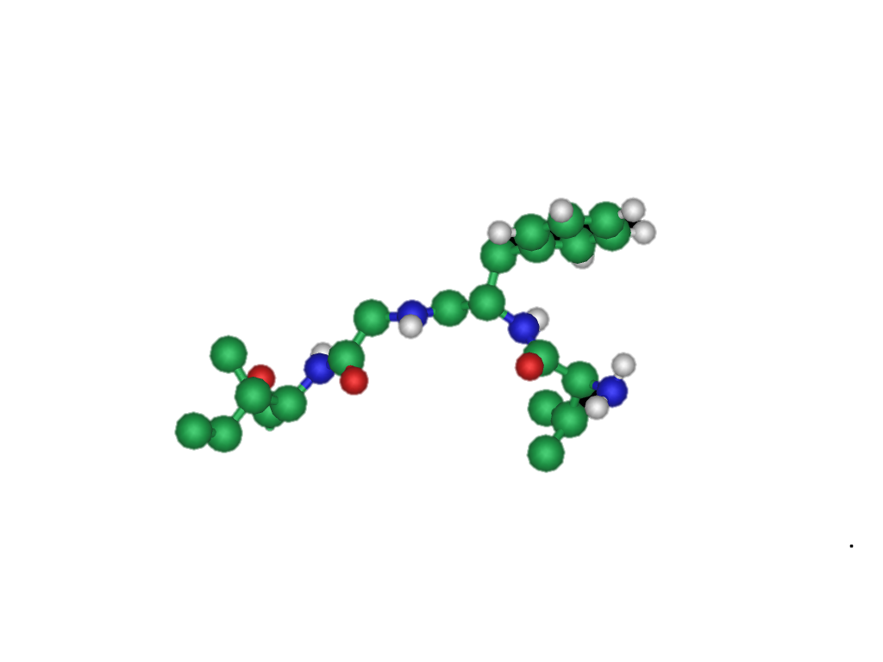
BCH2333 – Introduction to Biochemistry
Peptide Representation :
VFGI
1. Identify the N- and C- termini
N-terminus (N_{T})
C-terminus (C_{T})
2. Identify the backbone (main chain) N-C-C(O)
3. Identify side chains
N_{T}
C_{T}
BCH2333-2020 L5-1

Slide 21
BCH2333 – Introduction to Biochemistry
Test 1 Review:
1. What is the pH of an aqueous solution with [OH-] = 5x10⁻¹² M?
-11.13
5
11.3
2.7
2. At pH 10 what will the ratio of ammonium to ammonia be? (pKa ammonium is 9.24)
5.7
0.76
0.17
1.3
3. What non-covalent forces can occur between the side chains of M and L?
Electrostatic
H-bonds
London Forces
Dipole-Ion interactions
BCH2333-2020 L5-1

Slide 22
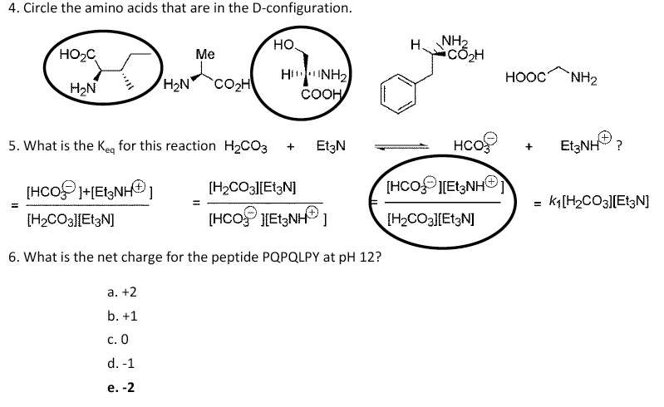
BCH2333 – Introduction to Biochemistry
Test 1 Review:
4. Circle the amino acids in D-configuration
5. What is Keq for this reaction: H2CO3 + Et3N ⬄ HCO3- + Et3NH3+
6. What is the net charge for the peptide PQPQLPY at pH 12?
+2
+1
0
-1
-2
BCH2333-2020 L5-1

Slide 23
BCH2333 – Introduction to Biochemistry
Test 1 Review:
7. What is the net charge of Ala-His-Cys-Ser at pH 5?
+2
+1
0
-1
-2
8. Which two amino acids have amides in their side chains?
Serine and Thr
F and Trp
Arginine and Gln
Q and Asparagin
9. Which bases pair together in DNA?
Guanine and cysteine
Adenine and uracil
Guanine and adenine
Cytosine and guanine
BCH2333-2020 L5-1

Slide 24
BCH2333 – Introduction to Biochemistry
Test 1 Review:
10. Circle the structure that corresponds to β-D-deoxyribose from DNA
11. Circle the structure that corresponds to the amino acid L-threonine
12. What is the side chain pKa of Arg?
4.0
6.0
8.4
10.5
12.5
BCH2333-2020 L5-1

Slide 25
BCH2333 – Introduction to Biochemistry
Test 1 Review:
13. What is the pKa of the carboxylic acid of Tryptophan?
-2
0
2
4
5
14. What is the net charge on the peptide ACE at pH 9.0?
+2
+1
0
-1
-2
15. What is the net charge on the peptide WCE at pH 1.0?
+2
+1
0
-1
-2
BCH2333-2020 L5-1

Slide 26
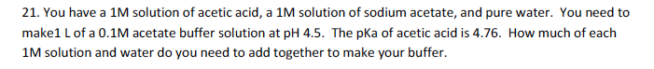
BCH2333 – Introduction to Biochemistry
Test 1 Review:
BCH2333-2020 L5-1

Slide 27
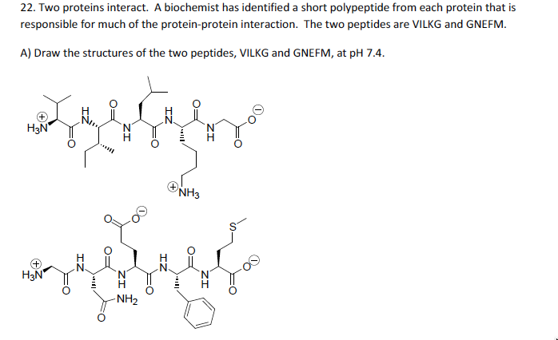


BCH2333 – Introduction to Biochemistry
Test 1 Review:
BCH2333-2020 L5-1

Slide 28


BCH2333 – Introduction to Biochemistry
Test 1 Review:
BCH2333-2020 L5-1

