Slide 1

MICROECONOMICS Ch. 1
LO 1.1 Explain the economic concept of scarcity.
LO 1.2 Explain the economic concepts of performance and decision making.
LO 1.3 Explain the economic concept of incentives.
LO 1.4 Explain the economic concept of efficiency.
LO 1.5 Distinguish between correlation and causation.
LO 1.6 List the characteristics of a good economic model.
LO 1.7 Distinguish between positive and normative analysis
PowerPoint produced by Brian Cowan MEd
1

Slide 2
MICROECONOMICS Ch. 1
Economics is the study of how people manage resources.
resource decisions are made by individuals, groups, firms, governments
resources - tangible and intangible things: cash, land, time, ideas, technology, experience, relationships
Traditionally, economics has been divided into two highly related and interdependent fields:
microeconomics - study of how individuals/firms manage resources
macroeconomics - study of the economy on a regional, national, international scale
2

Slide 3
MICROECONOMICS Ch. 1
ECONOMIC THEORIES
Classical theory - focuses on an equilibrium condition where supply and demand interact
suggests if demand and supply are not equal, the market will adjust so equilibrium prevails
Great Depression contradicted Classical theory that demand will always equal supply
General Theory of Employment, Interest, and Money (Keynesian economics) - markets may not need to be in equilibrium for the economy to operate
3

Slide 4
MICROECONOMICS Ch. 1
Economic problem-solving boils down to asking four main questions:
What are the wants and constraints of those involved? (Scarcity)
What are the trade-offs? (Performance and Decision Making)
How will others respond? (Incentives)
Why isn’t everyone already doing it? (Efficiency)
4

Slide 5
MICROECONOMICS Ch. 1
Scarcity - condition of wanting more than we can get with available resources
scarcity is a fact of life
people make decisions aimed at getting the things they want, but are constrained by limited resources
Performance and decision making - economic measurements are our performance indicators
tell us where we are, help us set goals
Gross Domestic Product (GDP) - usually a measurement of national income (dollar value of all the final goods and services a country has produced domestically for a specific period of time)
business cycles - short-run output fluctuations
5

Slide 6
MICROECONOMICS Ch. 1
Performance and decision making
Unemployment rates - measure unemployed workers in the labour force
tells labour utilization in economy
labour is significant input into economy’s production capacity
high unemployment decreases output
some unemployment inevitable
Policy-makers are more concerned with unemployment that comes from growth stagnation
6

Slide 7
MICROECONOMICS Ch. 1
Performance and decision making
Consumer Price Index (CPI) - overall price level
Inflation - state of overall price increases as measured by the CPI
rapid inflation may disrupt the saving–investment process
businesses may not borrow money to expand because the cost of borrowing rises
households don’t want to save money because the future value of their money may be lower
leads to lower economic output and affects long-run economic growth
7

Slide 8
MICROECONOMICS Ch. 1
Performance and decision making
policy-makers decide for long-term growth and reducing recession to keep economic output consistent with full employment
Monetary policy - conducted by Bank of Canada
controls money supply, sets interest rates
low interest rates stimulate output/employment but may create higher inflation
high rates tend to lower inflation, but may lower output/employment
8

Slide 9
MICROECONOMICS Ch. 1
Performance and decision making
Fiscal policy - conducted by federal government
uses spending/taxation to raise economic output
higher government spending/lower taxes will boost economic output but may bring a higher level of inflation and public debt
lower government spending/higher taxes will keep inflation and public borrowing in check but may lead to lower output and employment
9

Slide 10
MICROECONOMICS Ch. 1
Performance and decision making
all decisions in life involve weighing trade-offs vs. benefits
true cost of something is not what you pay for it, but also the opportunity you lose to do something else
Opportunity cost - equal to the value of what you have to give up in order to get something
Marginal decision making - rational people compare the additional benefits of a choice against the additional costs, without considering related benefits and costs of past choices
Sunk costs - costs that have already been incurred and cannot be recovered
10

Slide 11
MICROECONOMICS Ch. 1
Incentives
asking how others will respond can prevent bad decisions by predicting undesirable side effects
trade-off changes affect choices people make
Incentive - something that causes people to behave in a certain way by changing the trade-offs they face
positive incentive - makes people more likely to do something
negative incentive (disincentive) - makes them less likely to do it
11

Slide 12
MICROECONOMICS Ch. 1
Efficiency - resources used in the most productive way to produce goods/services with greatest societal value
under normal circumstances, individuals and firms will act to provide the things people want
increasing efficiency - finding ways to better use resources to produce the things that people want
disruptors of efficiency include:
innovation
market failure
intervention
goals other than profit
12

Slide 13
MICROECONOMICS Ch. 1
CORRELATION AND CAUSATION
Economic analysis requires combining theory and observation with scrutiny before drawing conclusions.
correlation - if events appear to occur in relation to each other
positively correlated - events seem to occur at the same time and move in the same direction
negatively correlated - increase in one event appears related to a decrease in another (move in opposite directions)
uncorrelated - no consistent variable relationship
causation - one event brings about the other
13

Slide 14
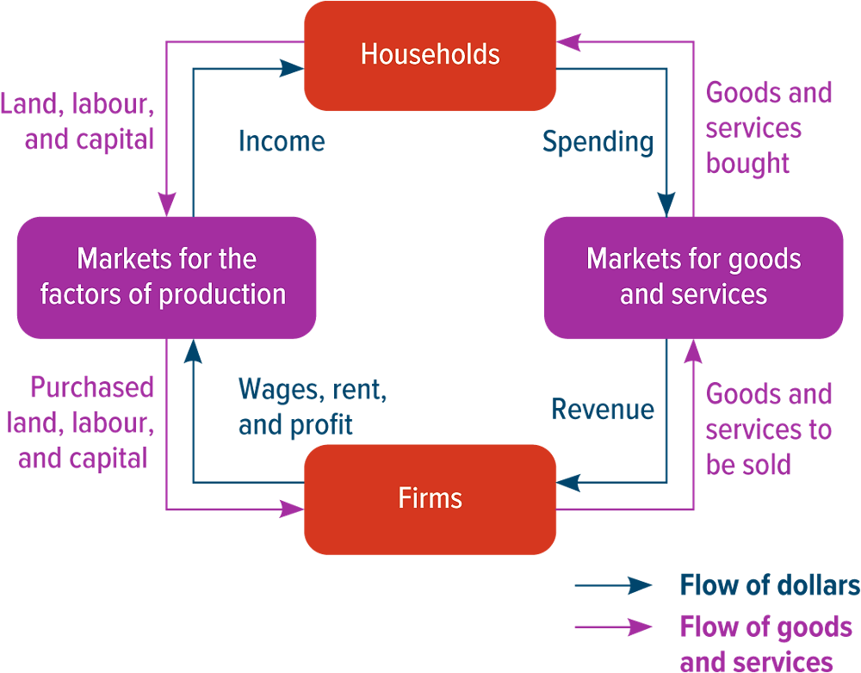
MICROECONOMICS Ch. 1
CORRELATION AND CAUSATION
reverse correlation - distinguishing dependent from independent variables
model - simplified representation of a complicated situation
circular flow model - flow of economic transactions in an economy
14

Slide 15
MICROECONOMICS Ch. 1
CORRELATION AND CAUSATION
Good models
predict cause and effect
make clear assumptions
describe real world accurately
15

Slide 16
MICROECONOMICS Ch. 1
CORRELATION AND CAUSATION
Positive and Normative Analysis
positive statement - statement that makes a factual declaration about how the world actually works
normative statement - statement that makes a claim about how the world should be
16

Slide 17
MICROECONOMICS Ch. 1
SUMMARY
Economists usually assume that people behave rationally and live within a condition of scarcity. Answering the question What are the wants and constraints of those involved? tells you what to expect from each player in the situation you are analyzing. Given rational behaviour and scarcity, you can expect people to work to get what they want (their motivations) using the limited resources at their disposal (their constraints).
17

Slide 18
MICROECONOMICS Ch. 1
SUMMARY
Trade-offs arise when you must give up something to get something else. Answering What are the trade-offs? will tell you about the costs and benefits associated with a decision. The full cost of doing something is the opportunity cost. Economists assume that rational people make decisions at the margin, by comparing any additional benefits from a choice to the extra costs it brings. If people are behaving rationally when they face trade-offs, they will always choose to do something if the marginal benefit is greater than the opportunity cost. They will never do it if the opportunity cost is greater than the marginal benefit.
18

Slide 19
MICROECONOMICS Ch. 1
SUMMARY
The collective reaction to changing trade-offs is a central idea in economics. Asking How will others respond? will give you a complete picture of how a particular decision affects the world. You can assume that any action will bring a response, because people react to changes in their incentives.
19

Slide 20
MICROECONOMICS Ch. 1
SUMMARY
Efficiency occurs when resources are used in the most productive way possible to produce the goods and services that have the greatest total economic value to society. In other words, efficiency means using resources to produce the things that people want. Under normal circumstances, markets are efficient. So when you see what seems to be unexploited opportunity, you should ask, If it’s such a great idea, why isn’t everyone already doing it? Markets usually allocate resources efficiently. When they don’t, a market failure may have occurred, government may have intervened in the economy, there may be goals other than profit involved, or there may be a genuine opportunity for innovation.
20

Slide 21
MICROECONOMICS Ch. 1
SUMMARY
When there is a consistently observed relationship between two events, we say they are correlated. This is different from a causal relationship, in which one event brings about the other. Three common ways in which correlation and causation are confused are correlation without causation, omitted variables, and reverse causation.
21

Slide 22
MICROECONOMICS Ch. 1
SUMMARY
A model is a simplified representation of the important parts of a complicated situation. In economics, models usually show how people, firms, and governments make decisions about managing resources and how their decisions interact. The circular flow model is a representation of how the transactions of households and firms flow through the economy. A good economic model should predict cause and effect, describe the world accurately, and state its assumptions clearly. Economists test their models by observing what happens in the world and collecting data that can be used to support or reject their models.
22

Slide 23
MICROECONOMICS Ch. 1
SUMMARY
A statement that makes a factual claim about how the world actually works is called a positive statement. A statement that makes a claim about how the world should be is called a normative statement. Economics is a field in which people frequently confuse positive statements with normative statements. However, you do not have to adopt a particular moral or political point of view to use economic concepts and models.
23

Slide 24
End of Ch. 1

