Slide 1
Module 1: Recognizing Arguments + Rhetorical Appeals

Slide 2
Essay writing starts with strong critical analysis skills
Explain and Evaluate
Explain and evaluate how rhetoric contributes to the writer’s argument
Analyze
Analyze the credibility and effectiveness of an argument
Identify
Identify rhetorical strategies
Notes:
An important step in the process of writing effective arguments is understanding the concept of argumentation—and how rhetoric is an essentially part of developing sound arguments.
The ability to read critically will help develop these skills
Making an argument—expressing a point of view on a subject and supporting it with evidence—is often the aim of academic writing.
- Interested in how you understand the material and how you apply that understanding
Instructors may call on you to examine that interpretation and defend it, refute it, or offer some new view of your own. In writing assignments, you will almost always need to do more than just summarize information (another important skill that we will review next week) that you have gathered or regurgitate facts that have been discussed in class. You will need to develop a point of view on or interpretation of that material and provide evidence for your position.
Instructors are usually looking for two things:
Proof that you understand the material
A demonstration of your ability to use or apply the material in ways that go beyond what you have read or heard.
This second part can be done in many ways: you can critique the material, apply it to something else, or even just explain it in a different way. In order to succeed at this second step, though, you need to fully understand the material and how rhetoric may influence your own understanding of material.

Slide 3
What is Rhetoric?
The ability to persuade an audience using knowledge to resolve practical issues
In ancient Greece, formal education began with training in rhetoric
Study and use of written, spoken and visual language
Notes:
Rhetoric encompasses all the ways that humans write, speak, and use visual. Rhetoric is how language is used to organize and maintain social groups, construct meanings and identities, coordinate behavior, mediate power, produce change, and create knowledge.
(you use rhetoric when you argue with your parents / you are subject to rhetoric when you open up your email and see an ad for
How do we explain how a text is constructed?
What is Rhetoric?
Rhetoric began 2500 years ago as the study of the forms of communication and argument essential to public, political and legal life in Ancient Greece.
Where the ability to deliver formal arguments was highly valued. Formal education started with training in rhetoric (persuasive speech). All participants in public institutions required the ability to speak publicly and deliver formal arguments (defending themselves in court dates, public debates).
Capacity to be a rhetorician significant – encompasses any way that we share information, try to influence people, how we present our argument (even this power point is a type of rhetoric — I’m presenting you with organized slides and considered how I would organize the argument)

Slide 4
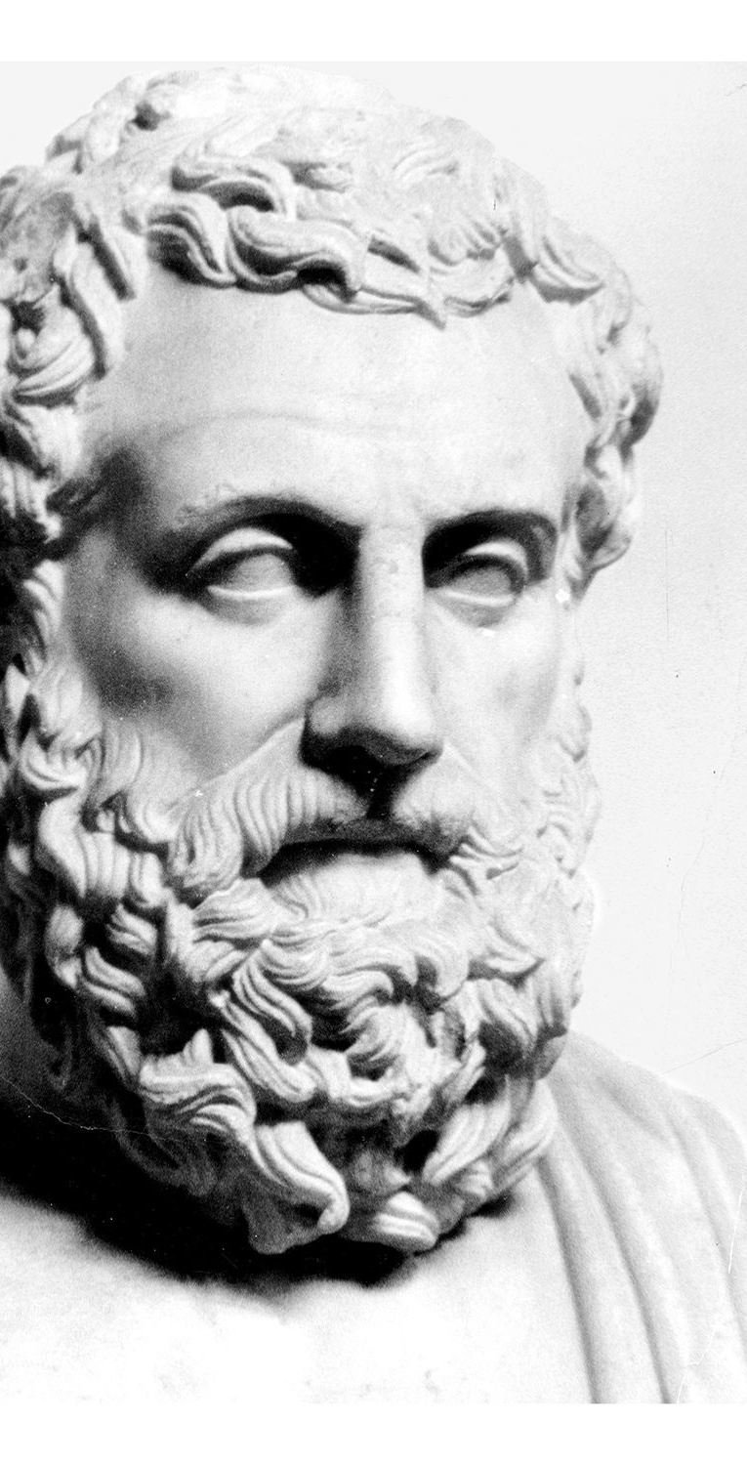
Aristotle
384-322 BC
Rhetoric = means of persuasion
Rhetorician identifies what type of speech or writing is persuasive and why
Rhetoric a neutral tool (can help or harm)
Balance of logos, ethos, and pathos
Notes:
What is Rhetoric?
Rhetoric began 2500 years ago as the study of the forms of communication and argument essential to public, political and legal life in Ancient Greece.
Where the ability to deliver formal arguments was highly valued. Formal education started with training in rhetoric (persuasive speech). All participants in public institutions required the ability to speak publicly and deliver formal arguments (defending themselves in court dates, public debates).
Capacity to be a rhetorician significant – encompasses any way that we share information, try to influence people, how we present our argument (even this power point is a type of rhetoric — I’m presenting you with organized slides and considered how I would organize the argument)
Enormous influence on development of rhetoric (study of and use)
Defined the goal of rhetoric as not merely persuasion itself but as the means of discovery and the consideration of all means of persuasion
A rhetorician can identify what type of speech or writing is persuasive and why.
Aristotelian rhetoric is a neutral tool that can be used by persons of virtuous or depraved character—can help or harm.
Think of propaganda examples – sometimes we make arguments that are not based on logic and evidence- this happens when rhetorical tools are unbalanced.

Slide 5
Logos,
Ethos, Pathos
“Of the modes of persuasion furnished by the spoken word, there are three kinds. The first kind depends on the personal character of the speaker; the second on putting the audience into a certain frame of mind; the third on the proof, provided by the words of the speech itself.” – Aristotle, On Rhetoric.

Slide 6
Logos (logical appeal)
The strategic use of logic, claims, and evidence to persuade your audience.
Correct Use
Incorrect Use
Strong, clear claim (supported by evidence)
Appropriate evidence
Unbiased / Acknowledge opposition
Generalized claims
Logical fallacies
Misused (or ignored) evidence
No recognition of opposing views
Notes:
Logical appeal is the strategic use of logic, claims, and evidence to convince the audience of a certain point.
Each argument you make is composed of premises (this is a term for statements that express your reasons or evidence) that are arranged in the right way to support your conclusion (the main claim or interpretation you are offering). You can make your arguments stronger by:
- using good premises (ones you have good reason to believe are both true and relevant to the issue at hand),
- making sure your premises provide good support for your conclusion (and not some other conclusion, or no conclusion at all),
- checking that you have addressed the most important or relevant aspects of the issue (that is, that your premises and conclusion focus on what is really important to the issue), and
- not making claims that are so strong or sweeping that you can’t really support them.

Slide 7
Effective Evidence
Logical Fallacy
Facts + statistics
Expert authority
Interviews
Observations + anecdotes
Valid conclusions
breakdown of logic
Hidden assumptions, factual irrelevancy
Invalid conclusion
Substituting emotion for thought
​
“Studies show that students who eat breakfast in the morning are able to pay better attention in school”
vs.
“Erin aced her biochemistry test this morning, even though she did not eat breakfast. Therefore, breakfast is not important.”
Notes:
Fallacies are defects that weaken arguments. By learning to look for them in your own and others’ writing, you can strengthen your ability to evaluate the arguments you make, read, and hear.
It is important to realize two things about fallacies: first, fallacious arguments are very, very common and can be quite persuasive, at least to the casual reader or listener. You can find dozens of examples of fallacious reasoning in newspapers, advertisements, and other sources—fallacious arguments usually evoke strong emotions, so it’s quite relevant when you are thinking about emotional appeals as well.
It is particularly easy to slip up and commit a fallacy when you have strong feelings about your topic—if a conclusion seems obvious to you, you’re more likely to just assume that it is true and to be careless with your evidence
Second, it is sometimes hard to evaluate whether an argument is fallacious. An argument might be very weak, somewhat weak, somewhat strong, or very strong. An argument that has several stages or parts might have some strong sections and some weak ones.
Goal: help you look critically at your own arguments and move them away from the “weak” and toward the “strong” end of the continuum.

Slide 8
A few logical fallacies:
Ad hominem (redirect)
Ad nauseum (repeat)
Appeal to belief, common practice, or expertise ("educators fear …")
Oversimplification (strawman)
Red Herring (unimportant tangents)
Relativist ("well, that's your opinion")
Begging the question ("I've failed the test twice! Begs the question …")
Overgeneralization (“most student’s didn’t complete the reading; all first year students are lazy”)
Slippery Slope
Notes:
Ad hominem: This is an attack on the character of a person rather than his or her opinions or arguments. Example:
Green Peace's strategies aren't effective because they are all dirty, lazy hippies.
In this example, the author doesn't even name particular strategies Green Peace has suggested, much less evaluate those strategies on their merits. Instead, the author attacks the characters of the individuals in the group.
Ad nauseum: repetition (Trump repeating that the Coronavirus will disappear does not make it go away)
Appeal to belief / expertise: Often we add strength to our arguments by referring to respected sources or authorities and explaining their positions on the issues we’re discussing. If, however, we try to get readers to agree with us simply by impressing them with a famous name or by appealing to a supposed authority who really isn’t much of an expert, we commit the fallacy of appeal to authority.
Example: “We should abolish the death penalty. Many respected people, such as actor Brad Pitt, have publicly stated their opposition to it.” While Brad Pitt may be an authority on matters having to do with acting, there’s no particular reason why anyone should be moved by his political opinions—he is probably no more of an authority on the death penalty than the person writing the paper (irrelevant authority)
“Because the Doctor said so …” Ok – but what information did the doctor present?
Straw Man: This move oversimplifies an opponent's viewpoint and then attacks that hollow argument.
People who don't support Universal Basic Income hate the poor.
In this example, the author attributes the worst possible motive to an opponent's position. In reality, however, the opposition probably has more complex and sympathetic arguments to support their point. By not addressing those arguments, the author is not treating the opposition with respect or refuting their position.
Red herring
Diverting attention from the real issue by focusing on an issue that may have only surface relevance to what is really at stake.
“It’s hard to make a living on minimum wage”; Reply: “Consider yourself lucky, when I was your age, the minimum wage was 6 dollars and I only made 40 dollars a week.
Begging the Question
An argument that begs the question asks the reader to simply accept the conclusion without providing real evidence; the argument either relies on a premise that says the same thing as the conclusion (which you might hear referred to as “being circular” or “circular reasoning”), or simply ignores an important (but questionable) assumption that the argument rests on.
- This is a common one because some arguments seem more obvious than others (or are morally accepted); still need to use evidence to support argument.
Other Fallacies:
Overgeneralization: generalization on the basis of insufficient evidence; reliance on small sample or an unrepresentative sample
Most of the students in my DGD did not complete the reading; All first year students are lazy .
Slippery Slope: This is a conclusion based on the premise that if A happens, then eventually through a series of small steps, through B, C,..., X, Y, Z will happen, too, basically equating A and Z. So, if we don't want Z to occur, A must not be allowed to occur either. Example:
If we ban Hummers because they are bad for the environment eventually the government will ban all cars, so we should not ban Hummers.
In this example, the author is equating banning Hummers with banning all cars, which is not the same thing.
Here are some general tips for finding fallacies in your own arguments:
Pretend you disagree with the conclusion you’re defending. What parts of the argument would now seem fishy to you? What parts would seem easiest to attack? Give special attention to strengthening those parts.
List your main points; under each one, list the evidence you have for it. Seeing your claims and evidence laid out this way may make you realize that you have no good evidence for a particular claim, or it may help you look more critically at the evidence you’re using.
Learn which types of fallacies you’re especially prone to, and be careful to check for them in your work. Some writers make lots of appeals to authority; others are more likely to rely on weak analogies or set up straw men. Read over some of your old papers to see if there’s a particular kind of fallacy you need to watch out for.
Be aware that broad claims need more proof than narrow ones. Claims that use sweeping words like “all,” “no,” “none,” “every,” “always,” “never,” “no one,” and “everyone” are sometimes appropriate—but they require a lot more proof than less-sweeping claims that use words like “some,” “many,” “few,” “sometimes,” “usually,” and so forth.
Double check your characterizations of others, especially your opponents, to be sure they are accurate and fair.

Slide 9
Pathos (emotional appeal)
Can mislead the reader or hide an argument that is logically weak
Incorrect Use:
Correct Use:
Reinforce logic
Balanced appeal to emotions
Presented in a fair manner
Substitutes logic + reasoning
Uses stereotypes
Simple reaction to complex problem
Manipulates emotions
"You are either with us, or against us" (elicits strong feelings)
Notes:
Emotional Appeal (Pathos)
Emotional appeals can mislead readers or hide an argument that is logically weak (a lot of visual appeal is emotional in nature—think advertisements with powerful imagery)
When used correctly emotional appeals:
Will reinforce logical arguments
Appeal to emotions in a balanced way
Are presented in a fair manner.
When used incorrectly, emotional appeals:
Becomes substitute for logic and reasoning
Uses stereotypes (propaganda, political advertising)
Offers simple, unthinking reaction to a complex problem
Takes advantage of emotions to manipulate.
https://www.worldvision.org/hunger-news-stories/africa-hunger-famine-facts
“You are either with us, or against us.”
- This is not a logical claim, but elicits strong feelings related to identity and morality.

Slide 10

Acheng, right, feeds her 18-month old son, Garang, a pouch of ready to use therapeutic food at a center in Juba, the capital of South Sudan. The Toddler has struggled with tuberculosis and malnutrition as the country suffers widespread food shortage due to conflict (2017)
https://www.worldvision.org/hunger-news-stories/africa-hunger-famine-facts
Notes:
No Voiceover

Slide 11

NRA uses pathos to argue that gun ownership is more important than ever during the Covid-19 crisis.
Notes:
https://www.youtube.com/watch?v=z8fvDk4E5Pk
Example of improper pathos

Slide 12
Ethos (ethical appeal)
establishes writer's credibility
Correct Use
Incorrect
Confident
Well informed
Understands audience (concerns, objections)
Unfair and dishonest
Distorts, misrepresents information
Insults or dismisses other views
Advocates intolerance
"Trust me, I'm a doctor"
Notes:
Used to establish that a writer is fair, open minded, honest and knowledgeable about the subject matter. The writer creates a sense of themselves as trustworthy and credible.
When used correctly, the writer is seen as:
Well informed
Confident
Sincere and honest
Understands the audience, their concerns and possible objections
When used incorrectly, the writer is perceived as:
- Unfair and dishonest
Distorting or misrepresenting information (biased)
Insulting or dismissive of other viewpoints
Advocating for intolerant ideas.
“Trust me, I’m a Doctor.”
- Statement assumes that prior knowledge and experience will ensure a
positive outcome—this is not always the case; you need to provide evidence
In academic texts establishing ethos also encompasses things like the quality of your writing, a properly structured and organized essay, and grammar (and accurate citations),; you need to demonstrate through the presentation of your argument that you are prepared.

Slide 13
What does this have to do with me?
You need to be able to understand how rhetoric contributes to your writing practice in order to identify, evaluate and create your own effective and credible argument
*effective arguments are not always credible arguments
Notes:
You need to be able to parse how rhetoric works in order to identify, evaluate, and then create your own, effective and credible arguments.
Credible: an argument is logically sound and well supported with strong evidence and reasoning
Effective: an argument is convincing or persuading its audience—many arguments that are effective are not always credible.

Slide 14
Academic Essays:
Employ rhetorical appeals for a more limited audience
Combine research with original insight and analysis
Share conclusions
Provide new insight
Interpret or critique
Expose or raise awareness
Notes:
Academic arguments employ rhetorical appeals for a more limited audience. Academic writing does not widely utilize emotional appeal; instead, you want to focus on providing logical, argumentative essays to persuade your reader.
Academic essays *in part:
Combine research with original insights and analysis to develop and communicate unique and complex arguments
Share conclusions about research
Provide new insights on a matter that other scholars have grappled with, or introduces new ideas into an ongoing conversation about a field of study
Interpret or critique a text
Expose or raise awareness of a problem
Other appeals may be present: a prestigious journal can establish ethos (organization, quality of writing, has the writer mastered discourse? Grammar, spelling, presentation)
Pathos can be invoked through the writer’s decision to explain certain terms—how does their writing make the audience feel? Well informed or confused?

Slide 15
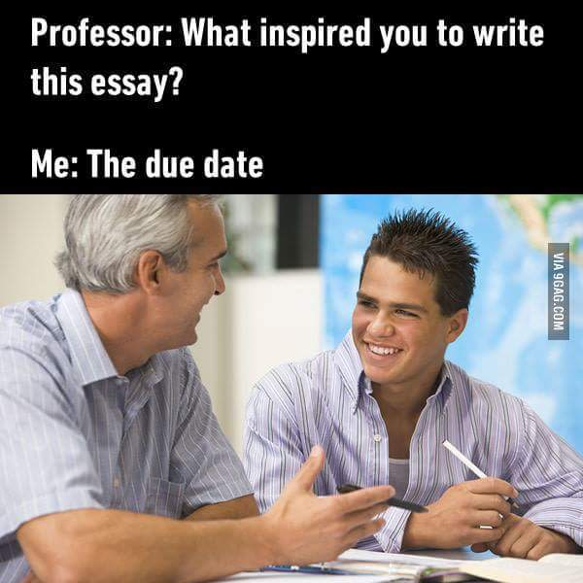
Why Write Essays?
Submission from ENG 1100 KK Meme Awards

Slide 16
Why write essays?
To demonstrate you can synthesize information;
To offer your own reasoned consideration of a subject;
To test and strengthen your ability to communicate effectively;
To show that you grasp complex ideas;
To discuss these ideas using the specialized language of your research field.
Notes:
Why do we ask students to write essays?
Writing an essay allows students to synthesize information and offer their own reasoned consideration of a subject that interests them.
To test and strengthen your ability to communicate effectively.
Shows that you grasp complex ideas and know how to discuss them using the specialized language of your research field.

Slide 17
Module 1 To Do:
Complete Brightspace Task: Skills Exercise #1
  Read Adam Gopnik’s “Three Ways to Think About Mass Shootings” and Andrew McKevitt “Guns in America”
  Complete Skill Exercise #1 worksheet + upload to Brightspace

