Slide 1

ANP 1106 (sections A, C)
(Winter, 2019)
Anatomical Terms
Integumentary System
Anatomy of the Skeletal System
Anatomy and Physiology of the Joints
Anatomy of the Muscular System
Anatomy of the Nervous System
Physiology of the Nervous System
J. Carnegie, UofO
All figures are from Human Anatomy & Physiology, by Elaine Marieb. & Katja Hoehn, © 2019 by Benjamin/Cummings Publishing Co. Reproduced by permission.

Slide 2

Course Web Sites

Slide 3
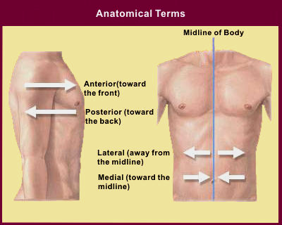
TOPIC #1: ANATOMICAL TERMS
1.1 Become familiar with anatomical nomenclature (pp. 12-20)
http://www.becomehealthynow.com/article/anatom/704/

Slide 4
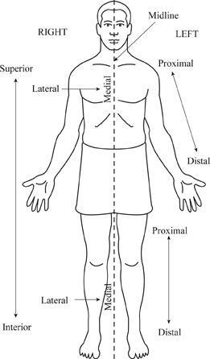
1.1. Describe the anatomical position, the regional and the directional terms as well as planes and sections
The Anatomical Position of the Human Body (see Table 1.1)
to describe body parts/positions precisely & with as few words as possible:
a) an initial reference point = body in standard anatomical position
b) an indication of direction - remember that “right” and “left” refer to the patient or the cadaver, not the observer
The anatomical position is very simple: body erect, feet slightly apart, and palms face forward with thumbs pointing away from body.
J. Carnegie, UofO

Slide 5
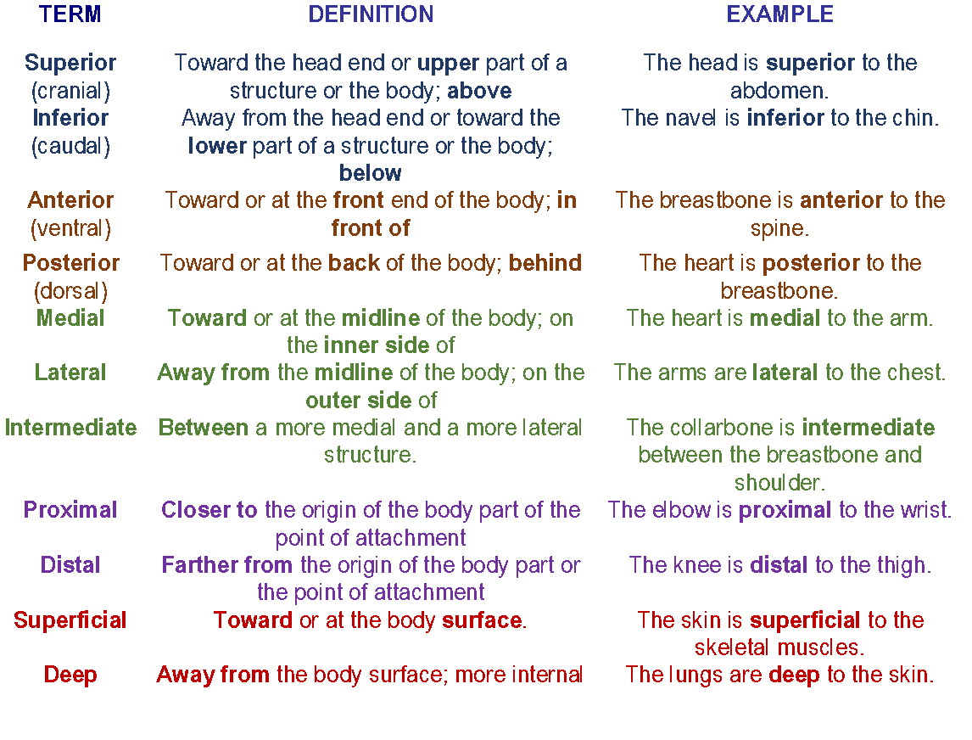

Slide 6
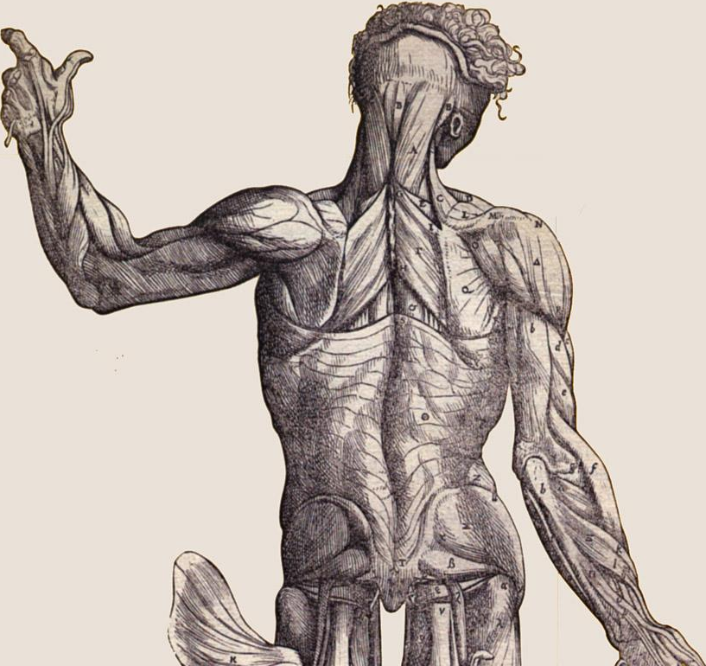
Regional Terms:
2 fundamental divisions of body:
1. axial part: = head, neck & trunk
2. appendicular part: = appendages or limbs attached to axis
then regional terms (see Fig.1.8) used to designate specific areas within the axial or appendicular part of the body
http://graphics.stanford.edu/courses/cs48n-03/

Slide 7
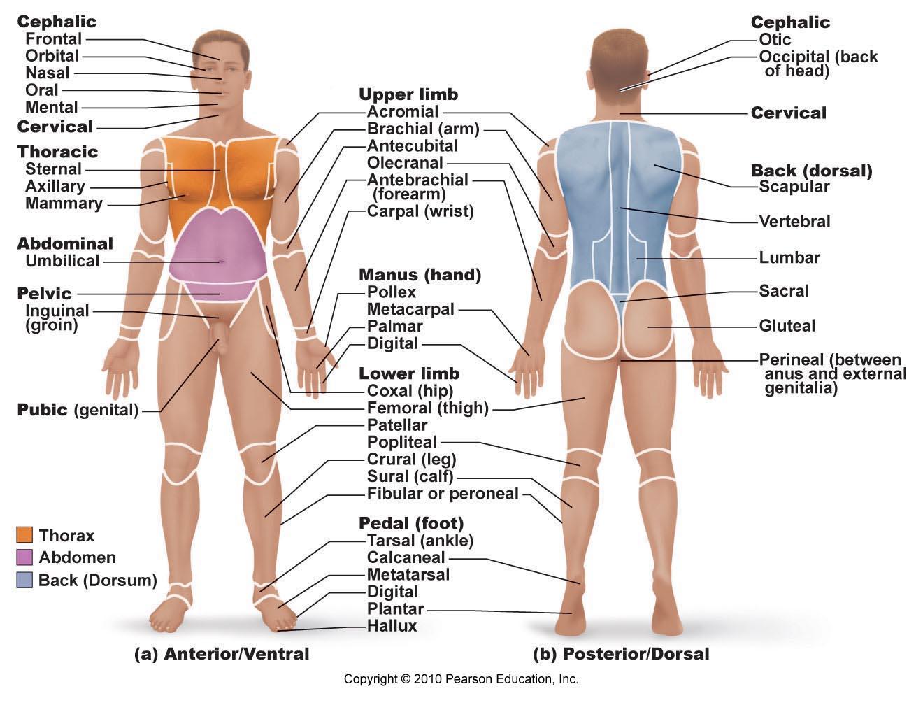
Fig. 1.8

Slide 8
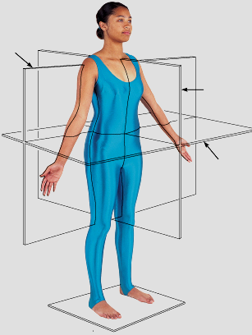
Body Planes & Sections
3 common body planes - 2 are vertical & 1 is horizontal
1) sagittal plane: vertical plane that divides body into right & left parts
Why not right and left halves? What is a midsagittal or median plane? What is a parasagittal plane?
2) frontal plane: vertical plane that divides the body into anterior and posterior parts; also called a coronal plane
3) transverse or horizontal plane: from right to left dividing the body into superior and inferior parts
transverse section = cross-section
What is an oblique section??
Fig. 1.8 (9th edition)
J. Carnegie, UofO

Slide 9
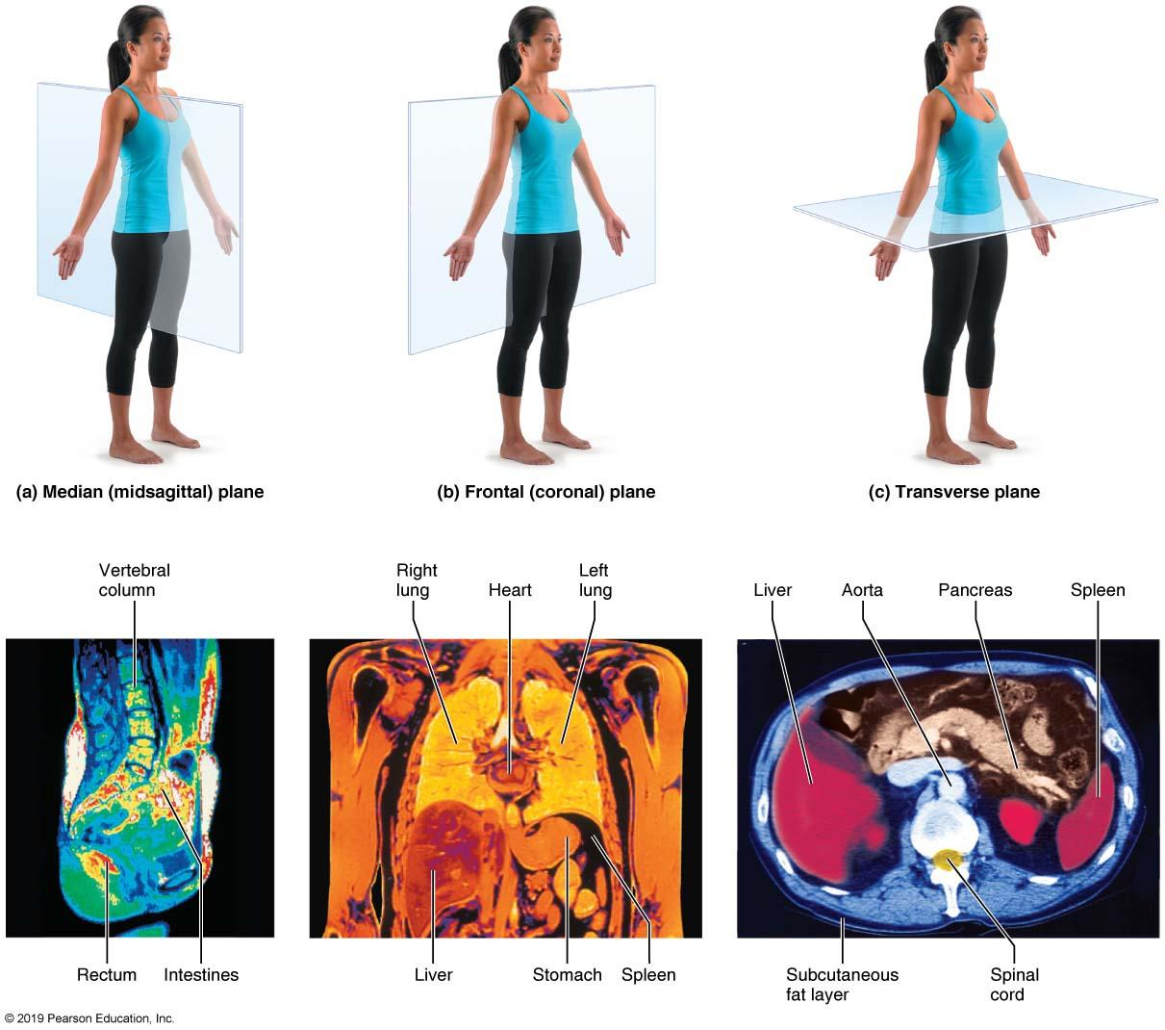
Fig. 1.9
Magnetic resonance imaging (MRI) scans

Slide 10
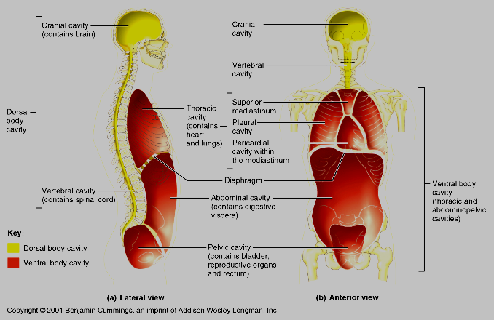
1.2 Describe the body cavities
1. Dorsal body cavity:
cranial cavity: enclosed by and houses the .
vertebral (spinal) cavity: enclosed by and houses the .
Both cavities are continuous and well-protected
Fig. 1.10
J. Carnegie, UofO

Slide 11
2. Ventral body cavity:
larger; houses the viscera
thoracic cavity: 2 lateral pleural cavities + central pericardial cavity
abdominopelvic cavity: superior abdominal cavity (stomach, intestines, spleen, liver) & inferior pelvic cavity (bladder, some reprod organs, rectum)
J. Carnegie, UofO
Fig. 1.10

Slide 12
What structure separates the thoracic and abdominopelvic cavities?? The abdominal and pelvic cavities??
In which body cavity do the organs receive the least protection from physical trauma??

Slide 13
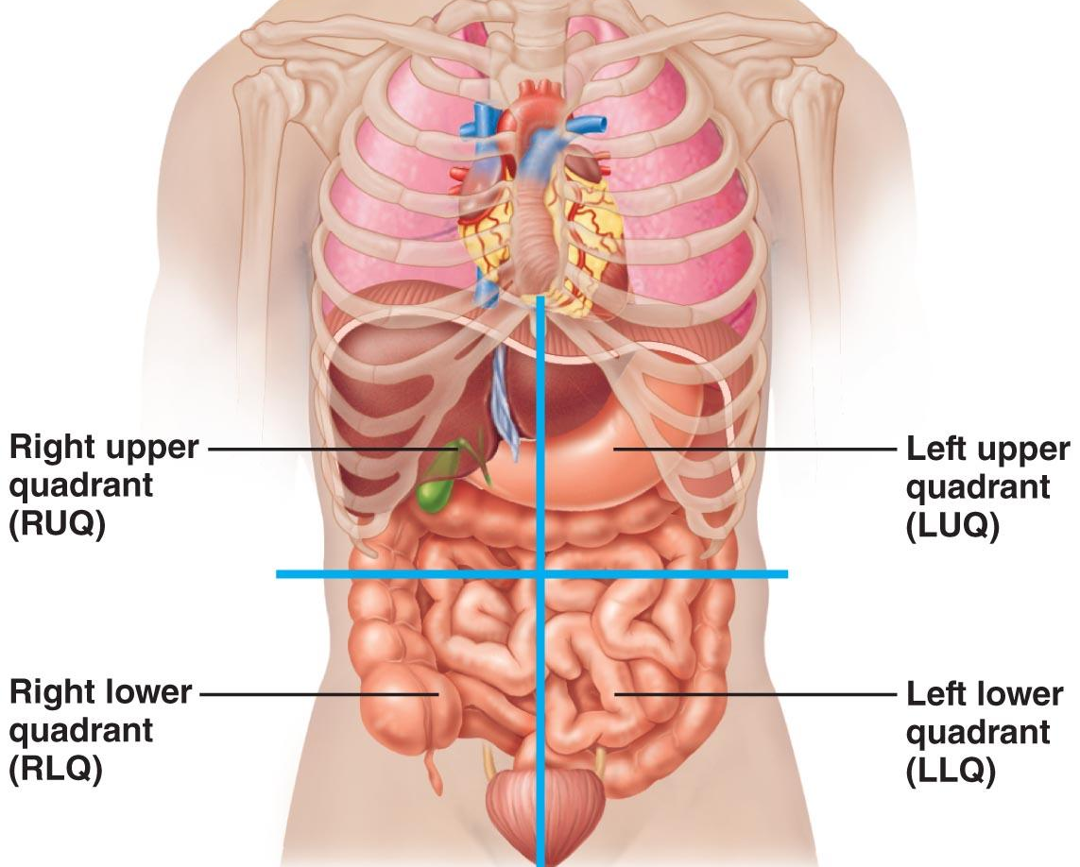
Abdominopelvic Quadrants
Fig. 1.12: Transverse and median planes intersect at the umbilicus

Slide 14
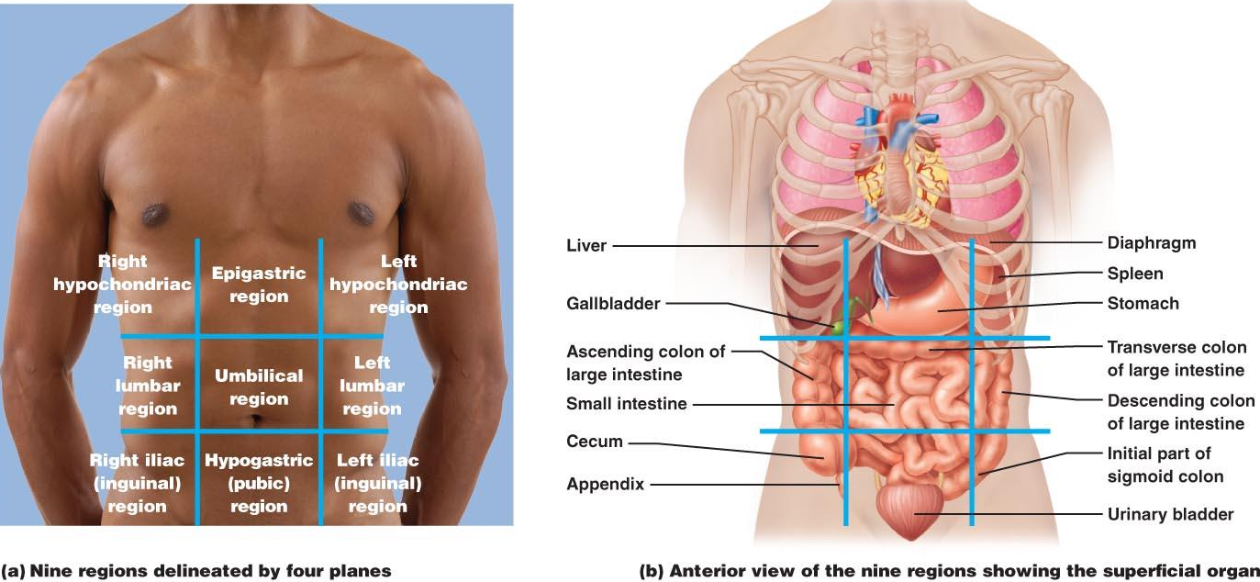
Nine abdominopelvic regions
Fig. 1.13: This division method is used primarily by anatomists

