Slide 1

Lecture #2 Quantification of community structure:
BIOL 353 – Communities and Ecosystems
species composition, species richness, relative abundance and dominance, indices of diversity and evenness
jp.lessard@concordia.ca
Notes:
Community is a set of species that co-occur in a habitat. A population is the individuals of a single species
These words are different components of a community and we use them to study communities.

Slide 2
Outline
What is community ecology?
Quantifying community structure
Notes:
Community ecology Science that understands the processes that govern the variation in communities structure in time and space and describing the patterns in communities.

Slide 3
Chapter 16 COMMUNITY STRUCTURE
A broad definition of ecological community is a group of species that occupy a given area, interacting either directly or indirectly
– A spatial concept
Notes:
Interacting directly or indirectly.
Interaction of dispersal of seeds.
Making arbitrary decisions and starting from there.

Slide 4
COMMUNITY STRUCTURE
What are the components of the structure of ecological communities?
The number of species in the community (Species richness)
The total number of individuals in the community (Abundance)
The spread of individuals among species (Evenness)
The identity of species in a community (Composition)
Notes:
Note: when talking about a population, it means only to one species.
Sometimes, multiple species can be considered a population when studying them.
But can also be specific to one species.
Its tricky when studying trees bcz there can be multiple species in a population of similar looking trees.
Composition: not quantity. Not counting. We are looking for the qualitative aspect of the species. Observe and describe composition for one community.

Slide 5
COMMUNITY STRUCTURE
Why do ecologists care about the structure of ecological communities?
Understand the processes that enable the maintenance, and govern the distribution, of biological diversity (a.k.a. biodiversity)
Biodiversity relates to the diversity of life forms, which has an intrinsic value for many of us, and which provide services to humans
A better understanding of how biodiversity is maintained through time and distributed in space is essential for effective conservation efforts
Notes:
For example; where are the most unique species on the planet? Amazon.. Etc
Intrinsic value to biodiversity. Diversity of life. The pattern and the processes that govern these patterns.
Convincing someone who doesn’t car? Species in many cases have a monetary and social value. Social; psychological studies, if living in green spaces and nature, it has positive value on mental health). Monetary; biodiversity will provide services to humans. Pollination is a prime example. Blueberries are being pollinated and they will be dispersed and more will grow. Preserving forests and maximizing the amount of bees and abundance will ensure this happening. It will increase success of production.
To Conserve biodiversity we need to understand the processes of biodiversity and the patterns.
Maintenance of diversity is about things that happen in a given time. Distribution of diversity is about why are there different communities in some and the difference in richness and evenness.

Slide 6
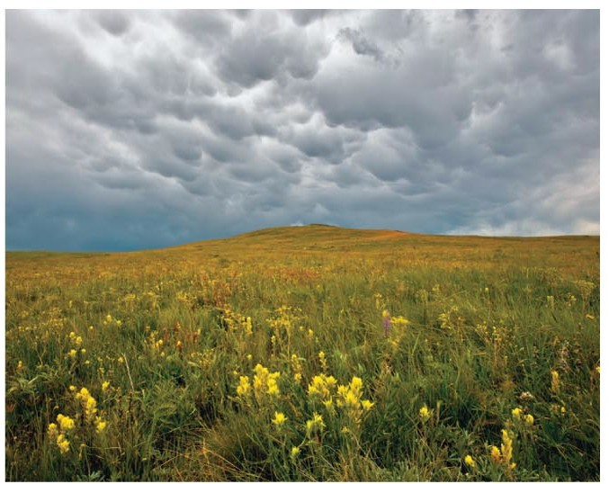
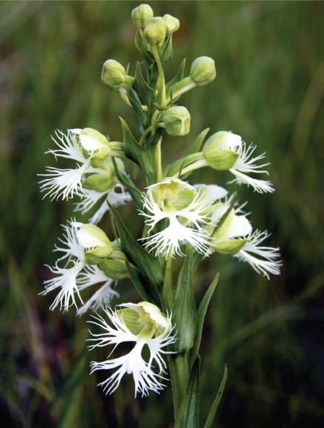
Part Five COMMUNITY ECOLOGY
The prairies of North America once covered a large portion of the continent. Today, less than 1% of the prairie remains intact, mostly in small isolated patches
Western prairie fringed orchid
Notes:
Almost discharged this biome/ecosystem.
A lot of efforts in Canada to recreate and restore this biome.

Slide 7
Part Five COMMUNITY ECOLOGY
In the early 1960s efforts to reverse the loss of prairie ecosystems met with failure due to a poor understanding of
ecological communities
Small populations that were too distant from other patches (preventing pollination)
A lack of understanding of the role of natural disturbances (e.g., fire)
Not the full complement of species diversity
Notes:
These rules must be in consideration when attempting to restore a community.
They didn’t know burning grassland was bad.
Putting a lot of species together and hoping it will work is wrong. Maybe missing some key species. Some plants need specific fungal species to success and survive the nature of the community

Slide 8
Part Five COMMUNITY ECOLOGY
Success in community restoration today is the product of a better understanding of community dynamics
Western prairie fringed orchid

Slide 9
Part Five COMMUNITY ECOLOGY
Attempts at reconstructing communities raise countless questions — questions central to the study of ecological studies:
  What controls the relative abundance of species within the community?
  What determines the composition of species in a community?
  Do species in the community partition niches to coexist?
  Do species all play the same function in the community?
Notes:
Is niche partitioning required?

Slide 10
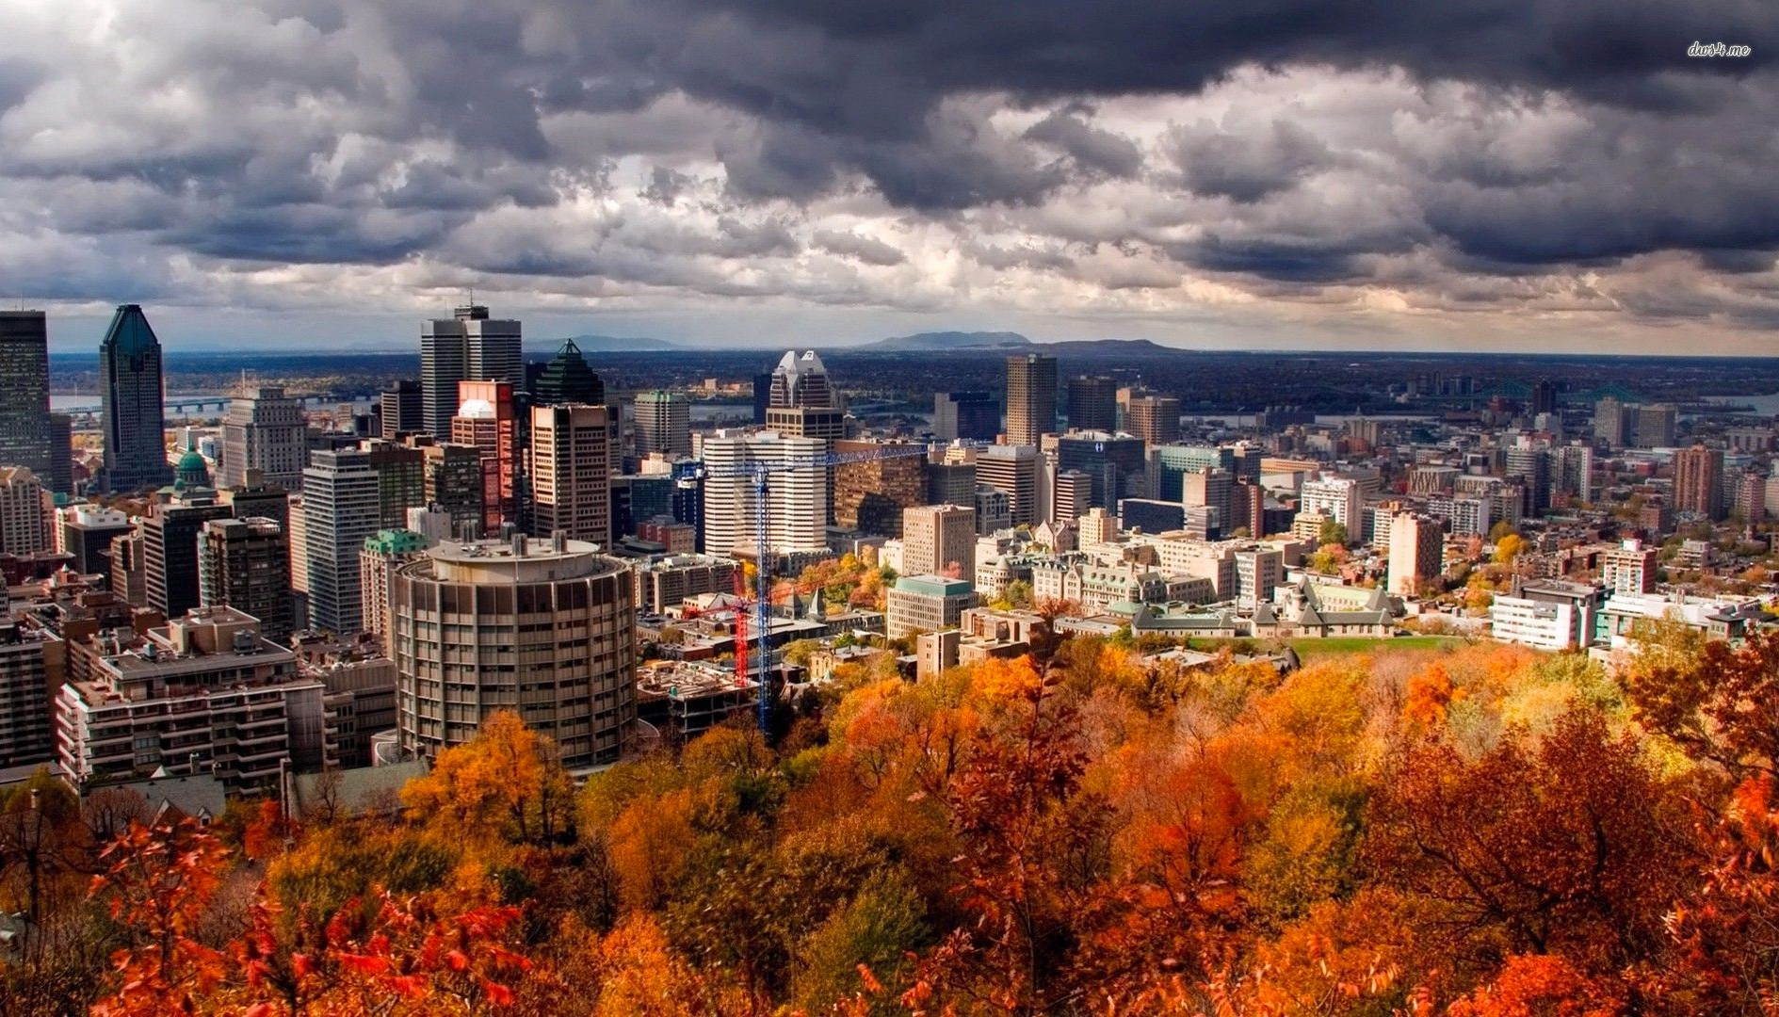
The community of trees on Mont Royal…
Notes:
Different colours allow us to see different species.

Slide 11
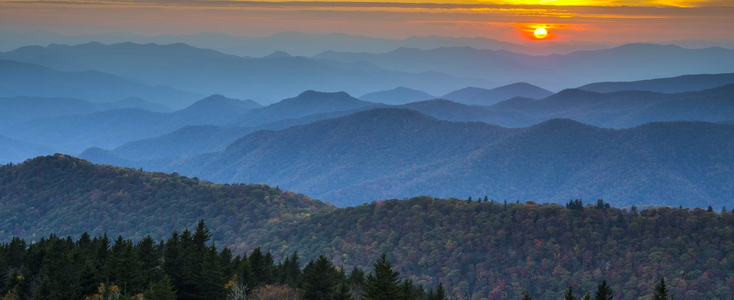
The community of trees in the Blue Ridge Mountains of West Virginia…
Notes:
The question now is about distribution of diversity than maintenance.

Slide 12
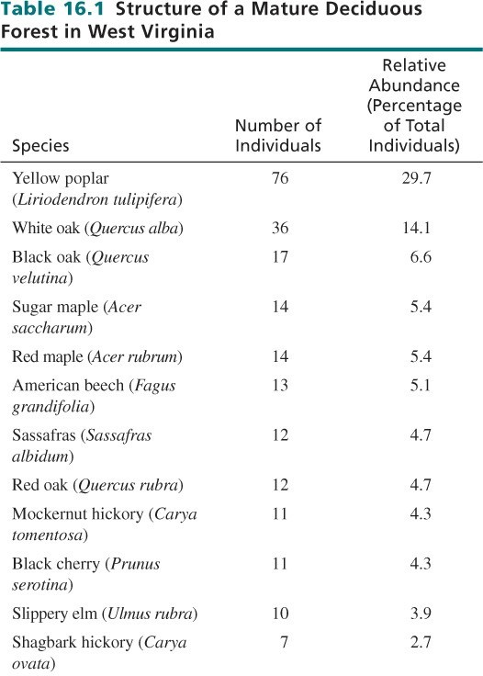
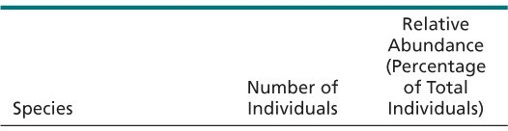
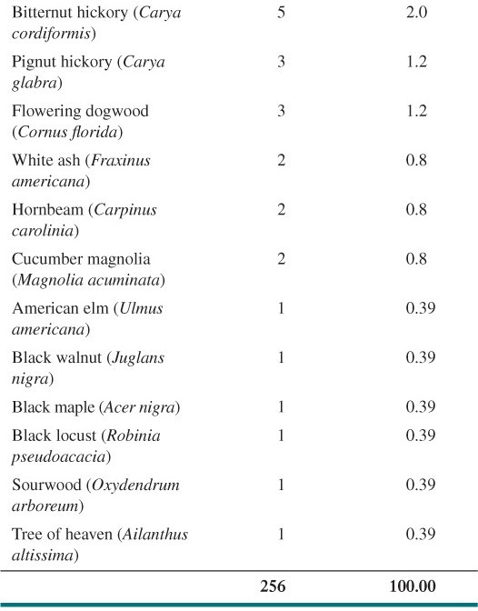
Notes:
256/24 gives 10.7. if there were 10 individuals of the species, then we would have an even community.
If 200 of the individuals belong to yellow poplar, then that species is dominant and low evenness.

Slide 13
16.1
Species richness (S) is the count of the number of species occurring within the community
Abundance (N) is the total number of individuals in a community (all species confounded)
Relative abundance (P) represents the percentage of individuals (n_{i}) each species contributes to the total number of individuals (N) in a community

Slide 14
QUANTIFYING ECOLOGY 16.1 Estimating
Species Richness
Species richness (S) is the simplest measure of diversity
Some consider species richness one of the most important component of community structure
– Robert May (1936 – 2020) famously stated if aliens were to visit the planet and ask how many different life forms exist, we would not be able to give an accurate response
Estimating richness within a single community is less daunting, but even then, we usually rely on an estimate rather than an absolute number
Notes:
We almost never know the exact number of species or living forms.
Trees are a great example because they are easy to see and distinguish.
Insects are tricky because they are hard to easily see and identify. Specific sampling and small area are studied to make a correct guess when quantifying insects or any other complex organisms.
Insects that live in the soil are very hard to find. A device is used to extract the insects and then quantify them and study the richness and species present.
The more shoveling is done, the more information is done.

Slide 15
QUANTIFYING ECOLOGY 16.1 Estimating
Species Richness
To estimate the number of species we need to delineate a sampling area (e.g. site)
More species will be encountered with increasing sampling effort; i.e. the more sample taken at a site, the higher the estimated species richness (S)
We can use « accumulation curves » to asses the completeness of the sampling effort, and therefore our level of confidence in the estimation of S
Notes:
Accumulation curve to get an idea of the completence of the sampling and it tells if we have a good or bad estimate of rischness

Slide 16
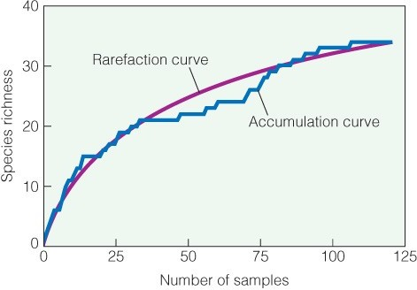
QUANTIFYING ECOLOGY 16.1 Estimating
Species Richness
Notes:
Blue line: the number of samples (x axis – the number of shovels or extracting) so after 25 extractions, 17/18 species are present there. but the more we extract, the more species are present.
So without knowing there is more present, how do we know when to stop extracting more? We look at the slope at 25, it is very steep and so this gives us more reason that there is more species present and to keep on going.
When the slope isn’t steep anymore, that is a good determination that the maximal richness is reached.
We don’t always know when to exactly stop. So, we make an estimated guess based on the accumulation curve and the slope steepness.

Slide 17
QUANTIFYING ECOLOGY 16.1 Estimating
Species Richness
Species accumulation curve:
Where the abscissa (x-axis) = number of samples
Ordinate (y-axis) = estimated species richness (S)
Species richness can be estimated based on the asymptote of the accumulation curve
If no plateau is reached, then we cannot be confident in our estimation of S
Notes:
On the y axis cumulative species richness where new species are added.

Slide 18
Context:
Pretend that you are working for a National Park as a conservation scientist. One area of the park has serpentine soil, which is a type of soil that few plants can grow on. As a result, many of the plants in that area are rare and therefore a concern for conservation.
Question:
In order to convince the Quebec Government to invest funds in protecting this area of the park, you must estimate the number of plant species occurring there.
You therefore carry on a survey by identifying the species found in 20 quadrats. However, your accumulation curve doesn’t reach a plateau. What can you do to improve your estimation of (S)?

Slide 19
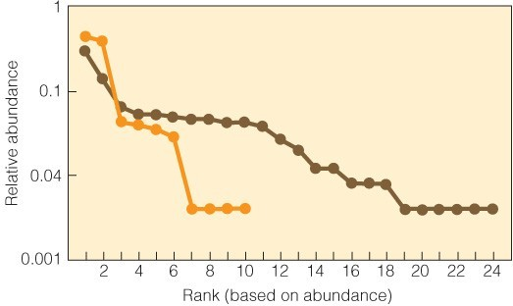
16.1 Rank abundance curves
A common method for comparing patterns of species richness and evenness between communities is
to plot the relative abundance of each species against
rank (called a rank- abundance curve or the Whittaker plot)
Notes:
The brown curve, the slope is more flat, the relative abundance is more even.
The orange is steep, a couple dominant species. Four are intermediate.
Relative abundance is the abundance of a species in relation to the community.

Slide 20
16.3 DOMINANCE
When a single or few species predominate within a community, these species are referred to as dominants
Dominant species are usually defined separately for different taxonomic or functional groups of organisms within the community (e.g., tree versus herbaceous plant species)
A community with a high level of dominance also exhibit low evenness
Notes:
Opposite of evenness is dominance.

Slide 21
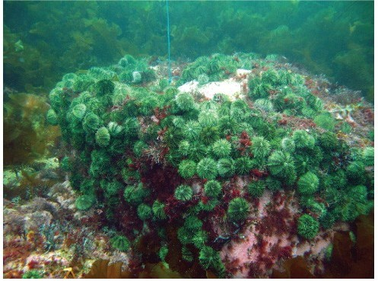
16.3 DOMINANCE
Dominance can reflect the number of individuals, size of individuals, or some combination of characteristics that include both the number and size of individuals
Dominant species are typically the dominant competitors under the prevailing environmental conditions
(N.B. Other factors may also determine dominance within communities)
Notes:
Sometimes dominance isnt referred based on relative abundance, but on biomass. We say X species has a high biomass.
What causes dominance? Ongoing question… mainly a species that has competitive dominance over others.

Slide 22
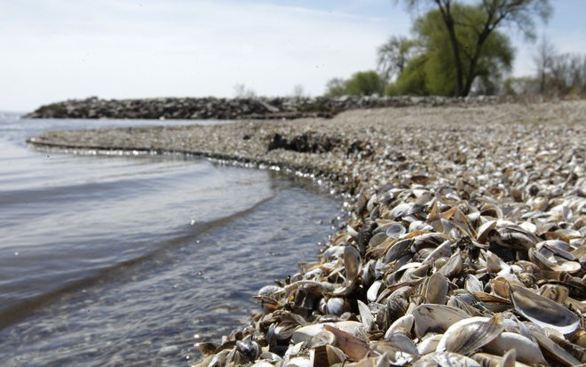
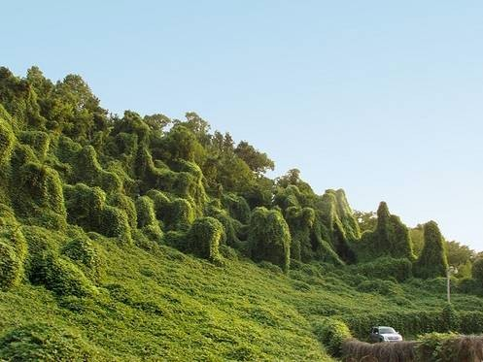
16.3 DOMINANCE
Why are some species dominant?
Zebra mussel: an invasive species
Kudzu: an invasive species
Notes:
Zebra mussel was introduced in great lakes and they invaded. Has high abundance and high biomass. It is changing the chemistry of the water.
Kudzu is also introduced from asia and it covers vegetation. There is nothing that slows this growth and no predator that prevents its abundance.

Slide 23
16.1 SPECIES DIVERSITY
Diversity indices provide a way to quantify the relationship between species richness and relative abundance
  Example of diversity indices:
-Simpson’s diversity index
-Shannon-Wiener diversity index
Notes:
DI is a matrix that was created by people working in conservation. Index that tells us which place I precious.
Combining information in several things.

Slide 24
16.1 SPECIES DIVERSITY
Simpson’s diversity index
D = 1/ΣP ²
i
Σ = summation for all species
P_{i} = relative abundance of each species expressed as a proportion
P_{i} = n_{i} / N
n_{i} = number of individuals of species i
N = total number of individuals of all species
D ranges from 1 to S (D_{max} = species richness)
Notes:
Takes into consideration the species richness and evenness.

Slide 25
16.1 SPECIES DIVERSITY
Species evenness
E = D/D_{max}
  D_{max} = species richness
  D = diversity index
  Is a measure used to determine the equitable distribution of individuals among species in a community
  Ranges from 0 to 1 (maximum evenness indicates the relative abundance of all individuals belonging to n- species is equal)

Slide 26

Which of these communities is more even?
Community A
Community B
Notes:
Community A is more even. It will have a higher D value bcz its more even. The species richness is the same bcz bot have 2 species.

Slide 27
16.5 SPECIES COMPOSITION
Species composition relates to the identity or make up of species in a community
– Sometimes takes into consideration abundance, but the focus is on identity
Species composition can only be quantified in relation to another community
– Similarity in the composition of species between community A and B
Notes:
Quantifying composition is done by comparing species.

Slide 28
Which component of community structure differs between these communities?
Community A
Community B
Notes:
Here they are both even. There are 2 species present bcz there are two species present. Richness is 2. compositional similarities here.

Slide 29
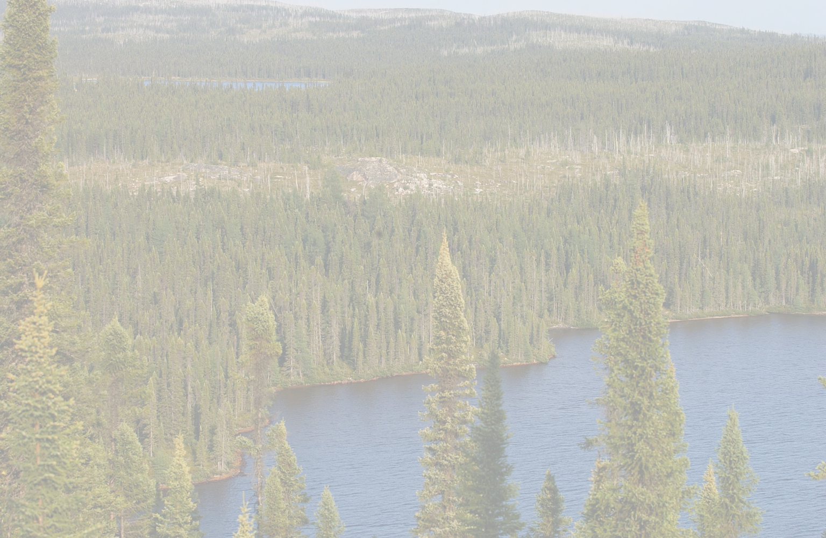
16.5 SPECIES COMPOSITION
Communities may have similar richness and diversity indices but differ in composition
In the southern Boreal forest, variation in stand types (e.g., black spruce stands) can reflect composition of understory species (e.g., lichens and mosses)
– Changes in species composition may indicate differences in substrate conditions

Slide 30
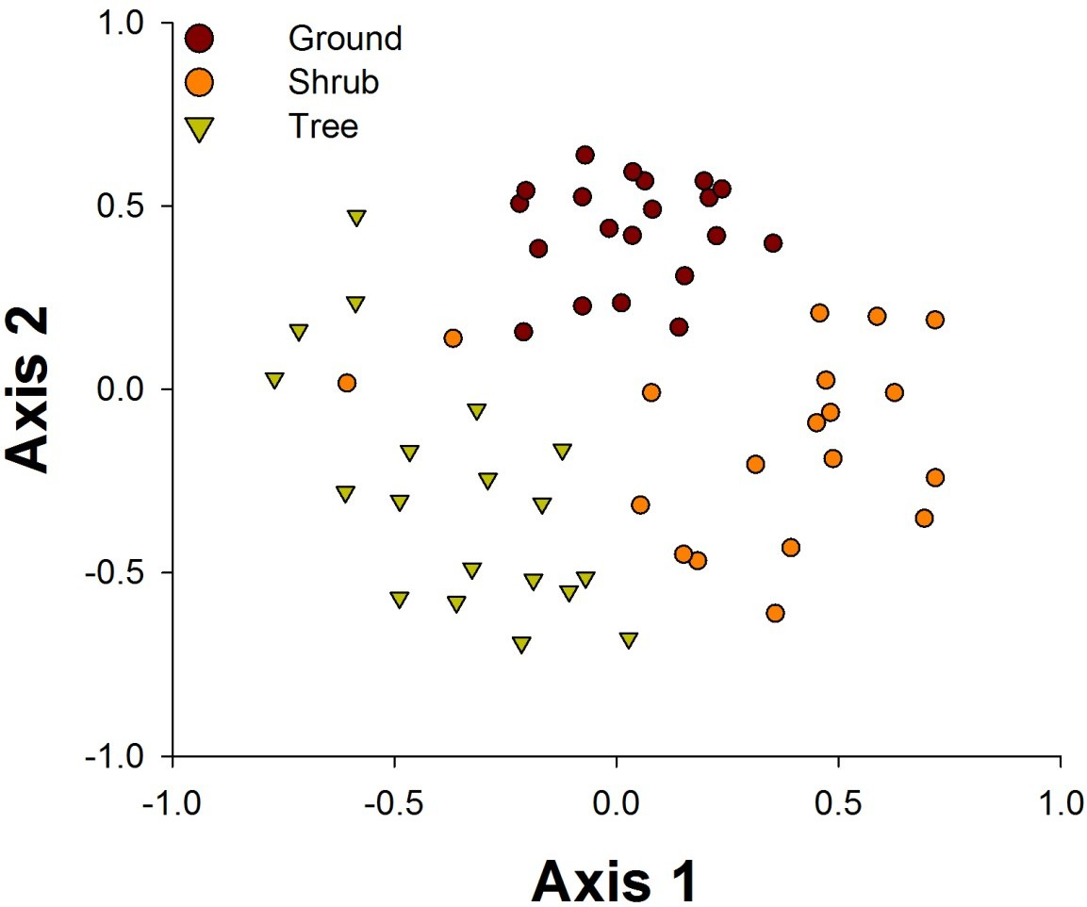
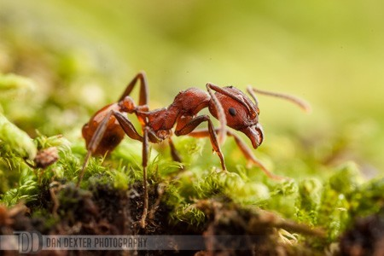
16.5 SPECIES COMPOSITION
Multivariate statistical methods (e.g. Ordination) allow for more sophisticated comparisons of community structure based on species composition
data from Fowler et al. 2014, Journal of Animal Ecology
Notes:
Done by quantifying the distance between both
Each dot is a particular substrate from a particular site. Ants on different substrates. Ordination is used to show how similar the composition of species from different communities is.
If the dots are overlapping, there is similarity. If they are distant, there is no similarity in composition.
Here the red dots are closer, so the composition of the ants from the ground are more similar.
Also, we see some shrub ants in trees. So, different substrates have different ant communities. Influence of substrate on the composition of ant distribution.

