Slide 1
Fall 2021
Checklist:
Assignment 2: Progress Report

Slide 2
Formatting Requirements
Did you observe your assignment’s formatting requirements?
    Margins
    Font size
    Line Spacing

Slide 3
White Space
Are there large chunks of empty white space on your page?
Do you leave a space between units of measurement and numbers, abbreviations for pages and page numbers?

Slide 4
Hierarchical Headings
Did you use second-level headings in your progress report and did you format them properly?
Did you leave one blank line above and below your headings?
Did you capitalize every word in your second-level headings?
Did you provide informative titles for your headings?
Did you avoid widowed headings on your page?

Slide 5
Page Numbering
Did you number your pages?
Did you show the number on the first page?

Slide 6
Assignment Instructions
Have you included two in-text citations (a quotation, summary, or paraphrase)?
Did you use signal phrases to introduce them?
Did you include page numbers for your in-text citations?
Did you use APA documentation style to cite your borrowed information?

Slide 7
Assignment Instructions
Have you included a visual?
Did you label, number, and give short a descriptive title to your visual?
Did you refer to your visual in the text and explained what is shown in it and why the visual is relevant for your report?
Did you place the title of your table above it and the title of your figure below the figure?

Slide 8
Assignment Instructions
Have you left at least two blank lines above and below your visual?
Did you cite the source from which you borrowed your visual?
Did you refer to this visual in your text and explained what is shown on it and how this visual helps you to make an important point?

Slide 9
Assignment Instructions
Did you include a tentative outline of you final report?
Did you observe in this outline the formatting requirements for hierarchical headings?

Slide 10
Tentative Outline
Is your topic for your final report sufficiently narrowed?
Will you be able to answer your specific research question in a five-page report?
Did you use informative phrases as you sections and subsections headings and subheadings?

Slide 11
MEMO
Alignment
Capital letters in the subject line
Informative yet short subject lines

Slide 12
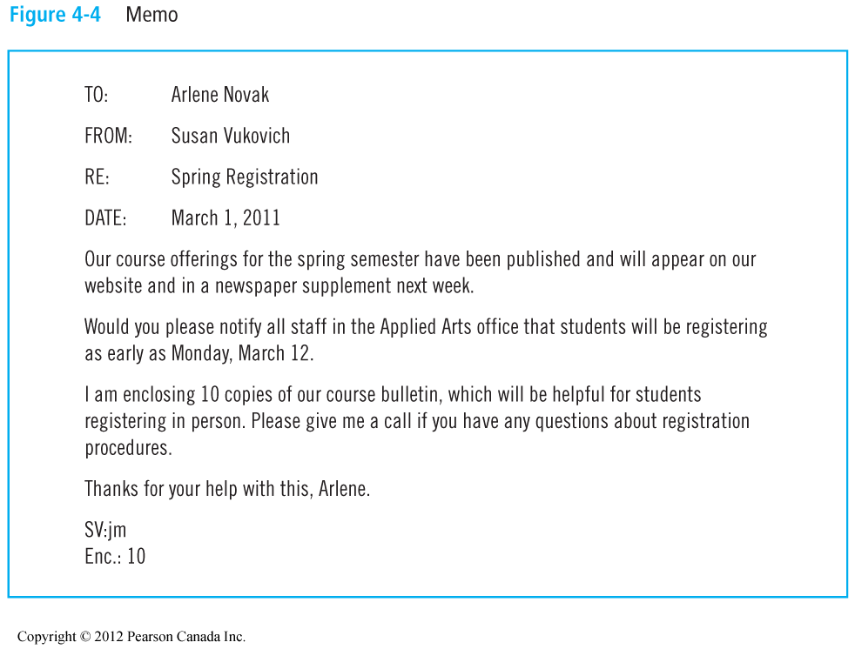
Sample Memo
Impact 8e Copyright © 2012 Pearson Education Canada Inc
Chapter 4 Slide 12

Slide 13
Progress Report
Did you include all sections required in a progress report?
Did you arrange these sections in the conventional order?

Slide 14
Content and Organization
Introduction
Project Description
Project Summary
  what has been done
  what remains to be done
Problems Encountered (optional)
Changes in Requirements (optional)
Overall Assessment of the Project

Slide 15
Introductions
Remember that introductions serve to announce your subject, the purpose of your project, its type (genre), and its audience.
In addition, introductions serve to provide the outline of the content of your report.

Slide 16
Introduction
Does the introduction of your report include all the elements that are required in good introductions, such as audience, overview, purpose?

Slide 17
Introduction
Did you avoid the problem of having too much background in the introduction, or having an introduction that is all background?

Slide 18
Audience
Did you use the terms that your reader may not be familiar with?
Did you provide relevant background information to help your reader benefit from your discussion?

Slide 19
Project Description
Did you include this section?
Did you describe in this section hat your final report is going to do?
Did you clearly state what question your report will answer or what problem it will solve?
Did you explain how your target audience will benefit from reading your report?
Did you avoid providing background information on your subject in this section?

Slide 20
Borrowed Information
Are all listed sources used in the paper as in-text citations?

Slide 21
Sources
Did you cite all borrowed information?
Did you cite it in correct APA style?
Did you cite peer-reviewed sources?
Did you include signal phrases?
Did you provide page numbers for your citations?

Slide 22
Language
Did you use your own wording?
Did you avoid non-specific and non-verifiable statements such as “the best possible method,” “the best medication,” “people,” etc.

Slide 23
Language
Did you avoid conversational language in a formal report?
Did you avoid non-specific statements and vague words in your report?
Did you eliminate wordiness?
Did you observe parallel structure?
Did you avoid dangling modifiers?
Did you avoid comma splices and run on sentences?
Did you use “you” meaning anyone in general”?
Did you avoid shifts in point of view?

