Slide 1
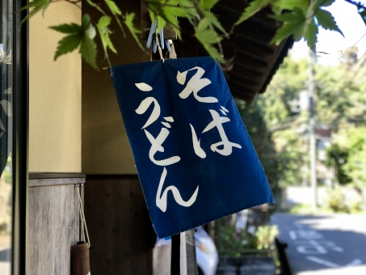
First 15 Hiragana
あ to そ

Slide 2

For Hiragana, see the textbook p20-p23 and p296-p299. The audio material for the textbooks is available through OTO Navi – Sound Navigator, an app for Genki.
How to use OTO-Navi
Scan the QR code on the last page of the textbook and download OTO-Navi from App Store or Google Play.
2. Search for Genki Vol.1 3rd Ed. Within the app.
3. Download the audio material and play it.

Slide 3
Regarding Japanese writing system, please see textbook p20-p27.
☺When you read those pages, please listen to the audio files available in OTO-Nabi.

Slide 4
Useful websites for learning Hiragana
There are many Hiragana learning tools online. The following are just a few of them.
https://www.tofugu.com/japanese/hiragana-chart/
http://japanese-lesson.com/characters/hiragana/hiragana_writing.html
(Hiragana/Katakana practice sheets)
https://drlingua.com/
https://realkana.com/
https://www.tanoshiijapanese.com/home/

Slide 5


Believe it or Not!
In this semester, you will master:
Hiragana (46), Katakana (46), and some Kanji (29).

Slide 6
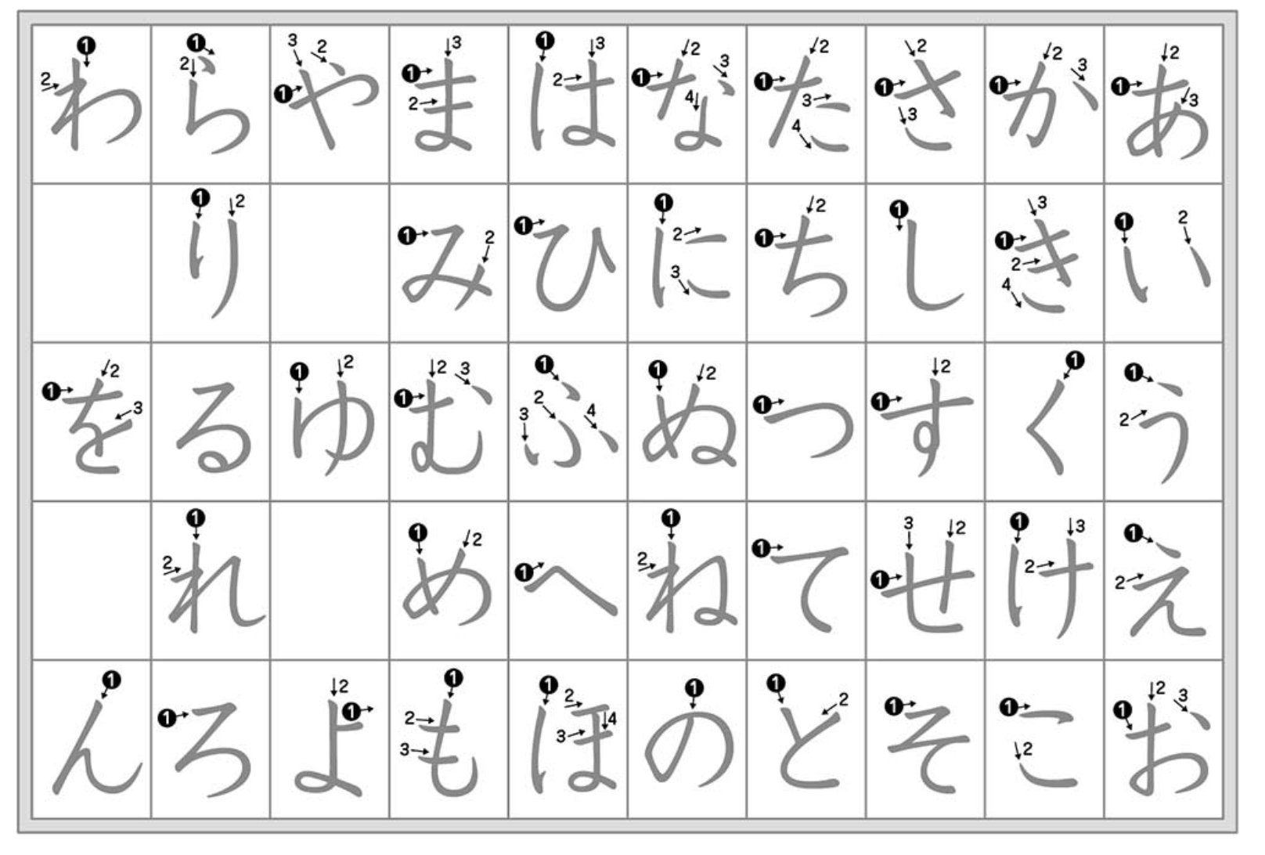
http://sasagami358.blog.fc2.com/blog-entry-593.html

Slide 7
This means….
As of TODAY, if you are going to delay mastering Hiragana, JPN1901 is not for you, since the textbook, all quizzes, tests, exams and assignments are conducted by the Japanese writing system.

Slide 8

Please ask yourself: Do I have time to master one of the most challenging writing systems in the world besides doing my major work?

Slide 9

You need persistence and enthusiasm to study Japanese.
Do you really want to study Japanese?
Then JPN1901 is for you!

Slide 10
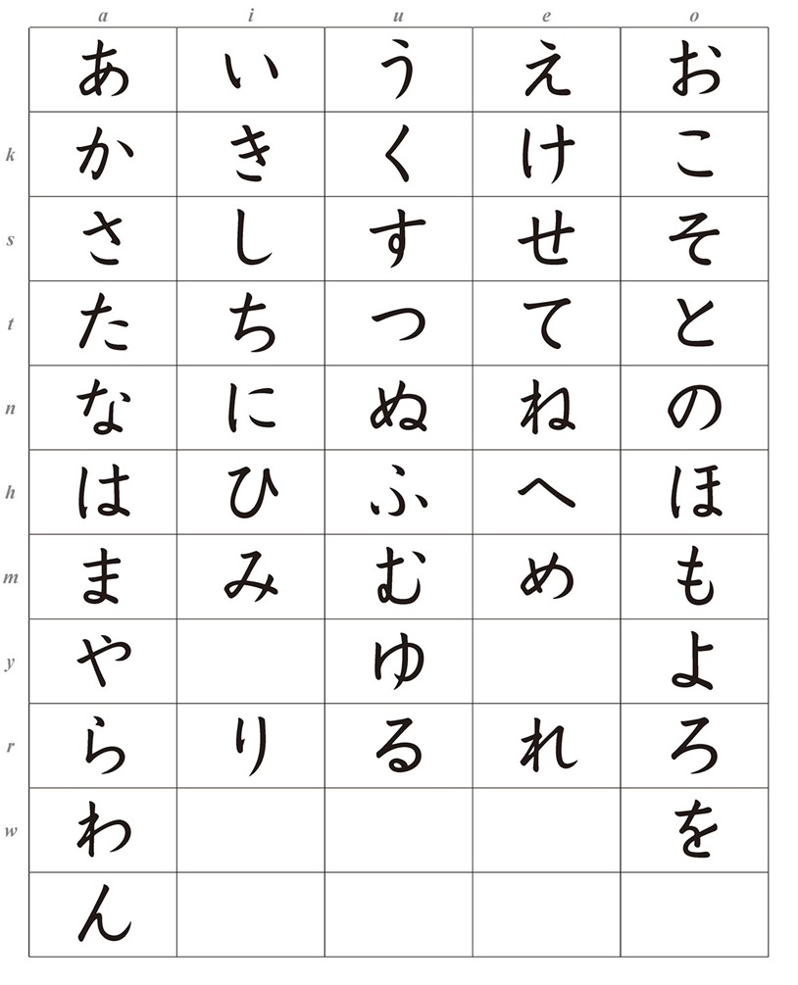
You can listen to the sound of Hiragana on OTO-Navi
(JWS-01 textbook p20)

Slide 11
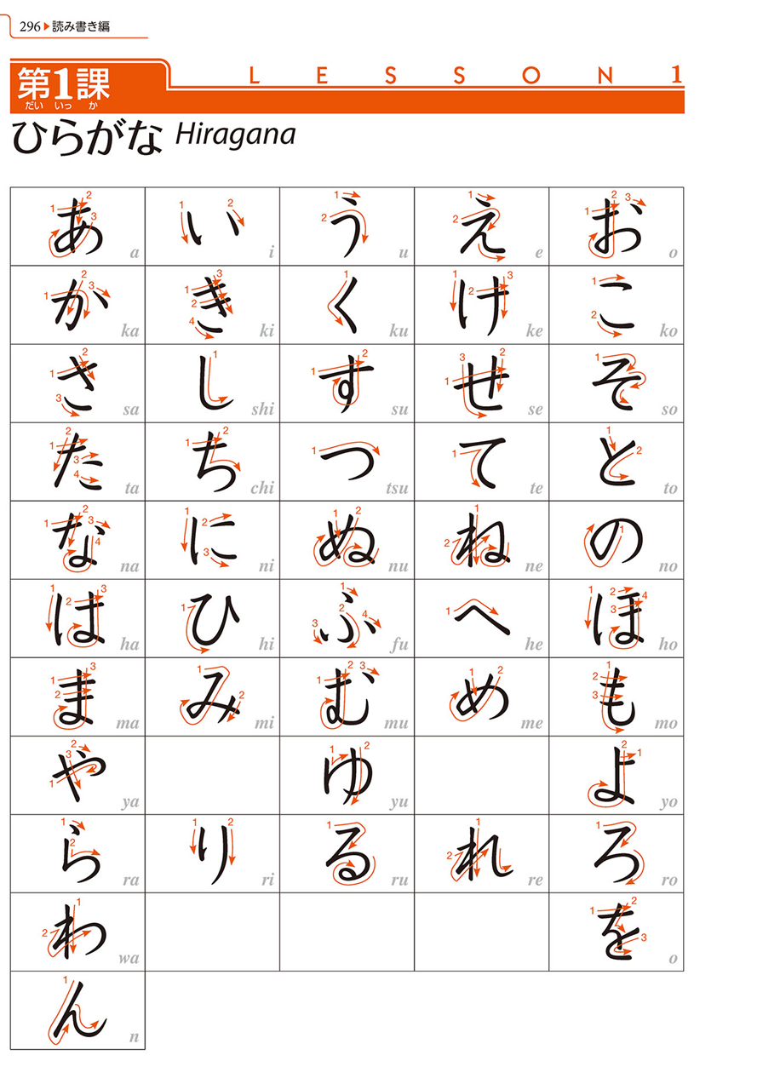
Please see the textbook p. 296 for the Hiragana chart with the correct shapes and the stroke order.
☞

Slide 12
Hiragana Flush Cards
See the Hiragana chart in the workbook p11, and listen to the audio and study the hiragana.
Cut out the cards along the solid lines and practice reading each Hiragana, and check against the romanization on the back.

Slide 13
Printing style and Handwriting style
In your assignments, exams, and quizzes, do not write in the printing style. Please write in the handwriting style (or the Textbook style which is very close to the handwriting style).
(Regarding the various fonts, see textbook p19.)

Slide 14
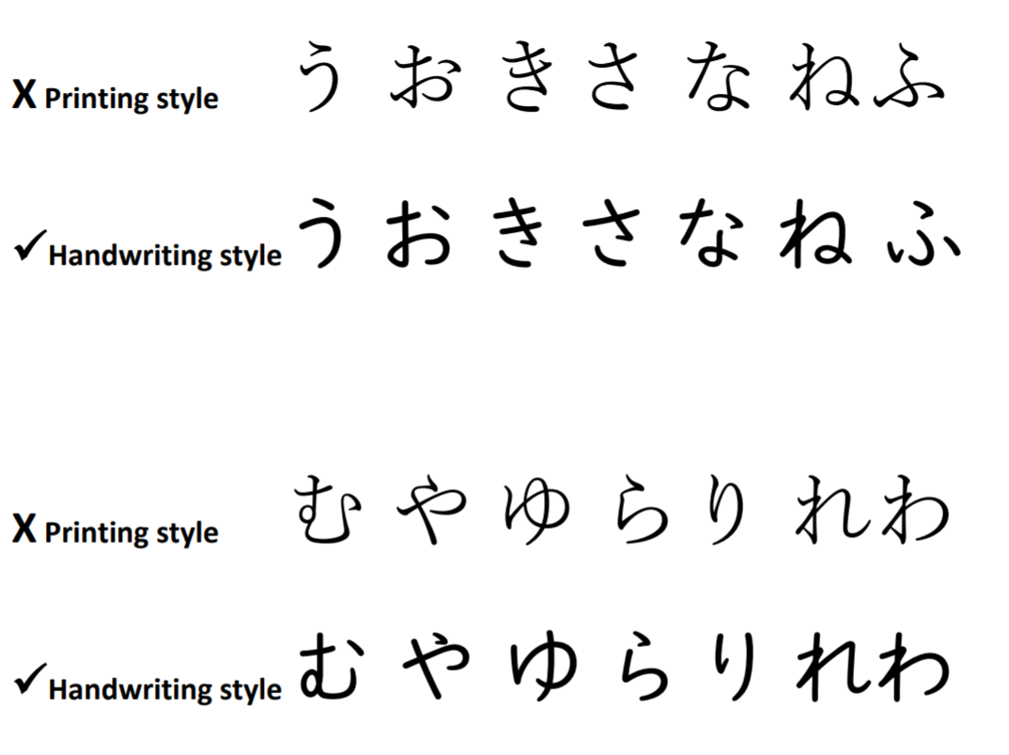

Slide 15
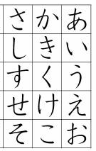
Hiragana is the most basic Japanese system consisted of 46 characters.
Mastering Hiragana and Katakana is a demanding task. Today, you are going to practice the first 15 characters of Hiragana.

Slide 16
Please practice the first 15 Hiragana in the workbook p121-p122.
You will have to do those pages later as part of a class assignment anyway.

Slide 17
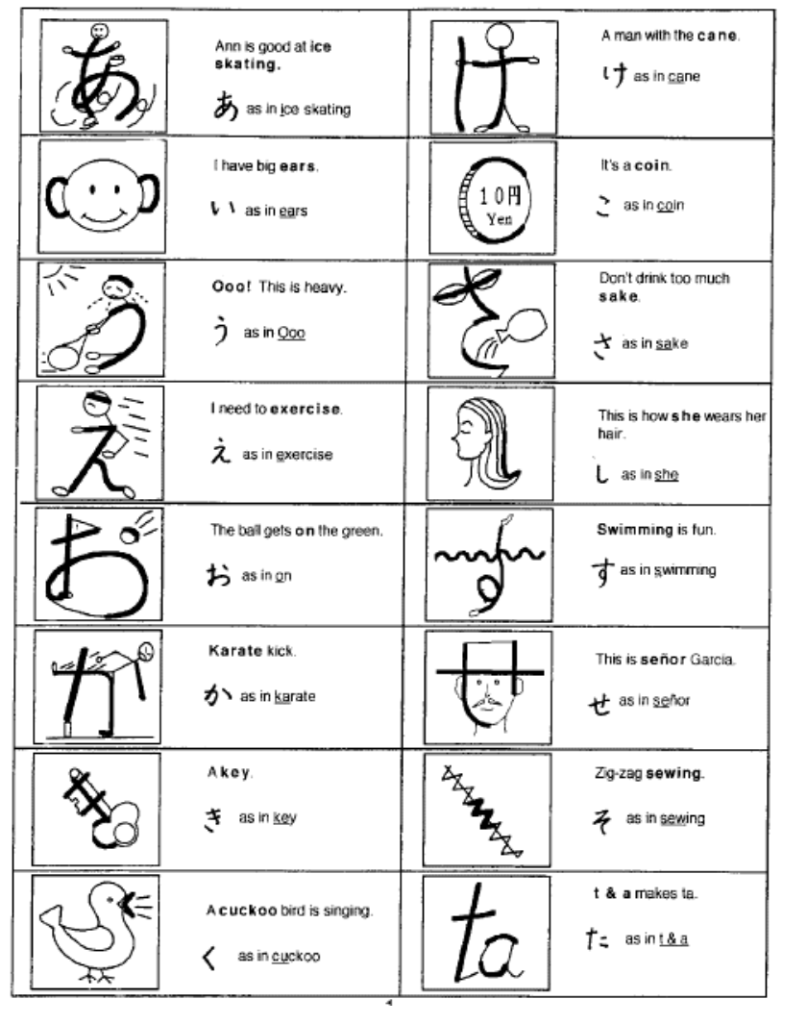
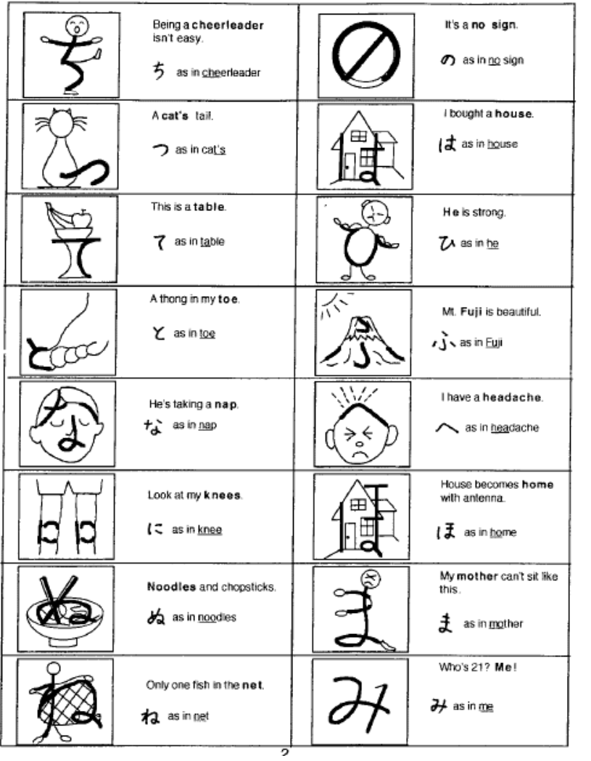
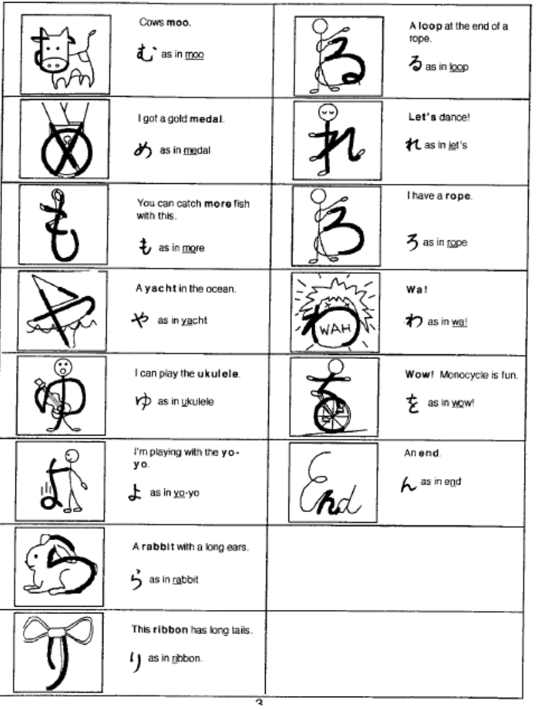
Nakama 1: Japanese Communication, Culture, Context (English and Japanese Edition) by Makino, Seiichi, Hatasa, Yukiko Abe, Hatasa, Kazumi (1998) Houghton Mifflin p.4-12

Slide 18
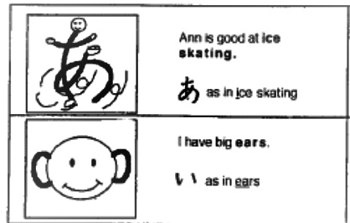
あa
いi

Slide 19
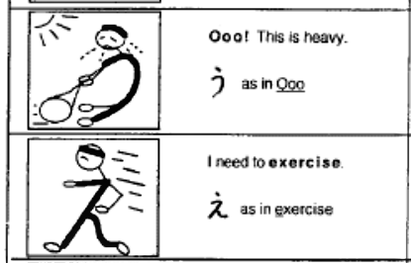
うu
えe

Slide 20
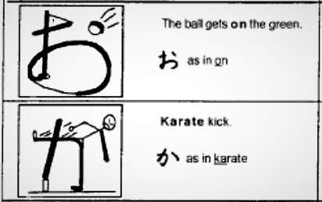
おo
かka

Slide 21
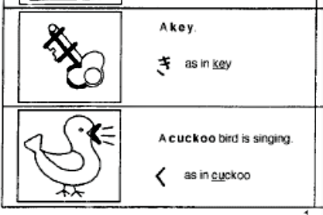
きki
くku

Slide 22
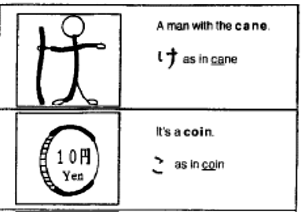
けke
こko

Slide 23
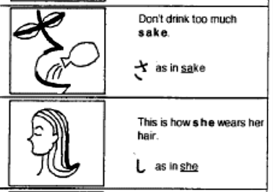
さsa
しshi

Slide 24
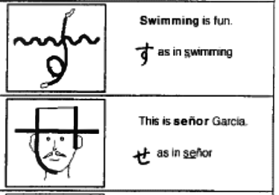
すsu
せse

Slide 25
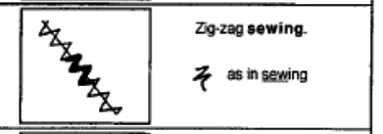
そso

Slide 26
a i
あ
い

Slide 27
u e
う
え

Slide 28
o ka
お
か

Slide 29
sa shi
さ
し

Slide 30
su se
す
せ

Slide 31
so
そ

Slide 32
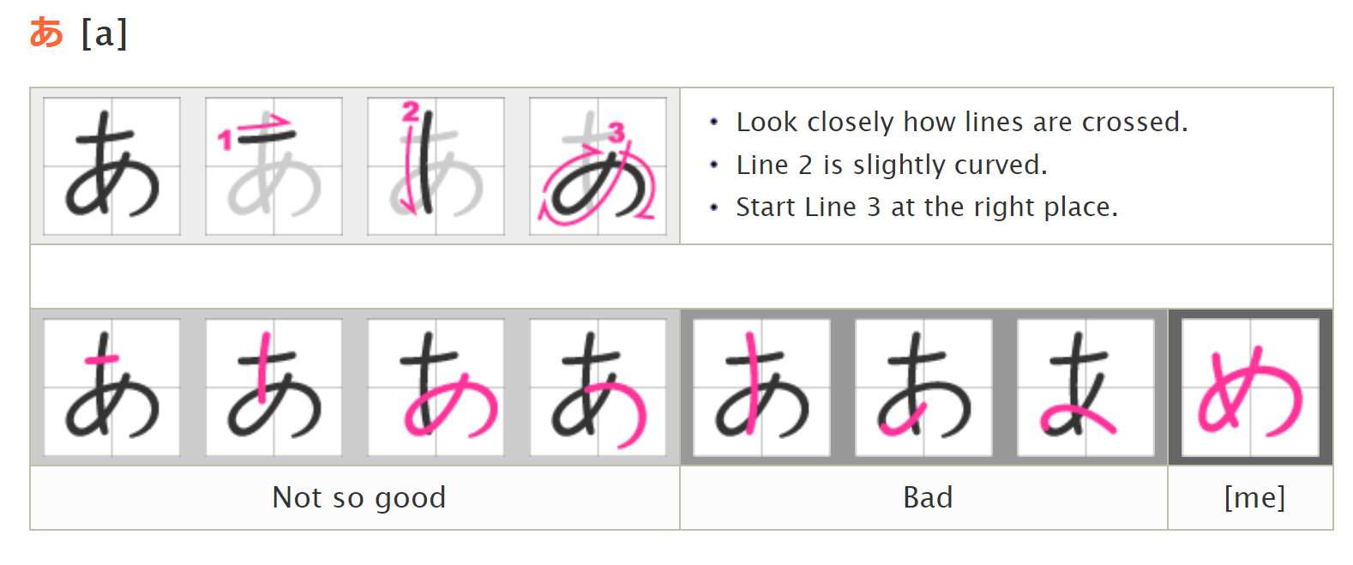
http://japanese-lesson.com/characters/hiragana/hiragana_writing.html

Slide 33
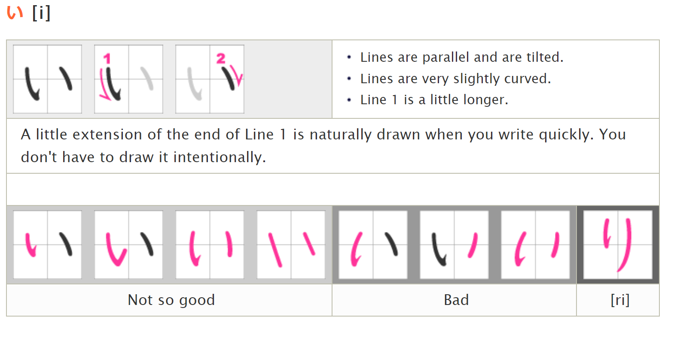

Slide 34
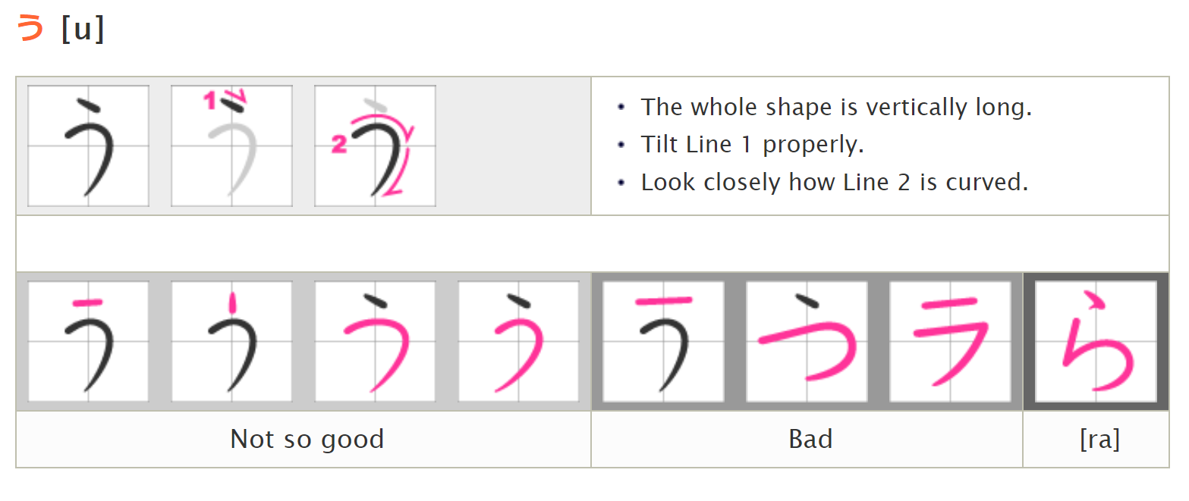

Slide 35
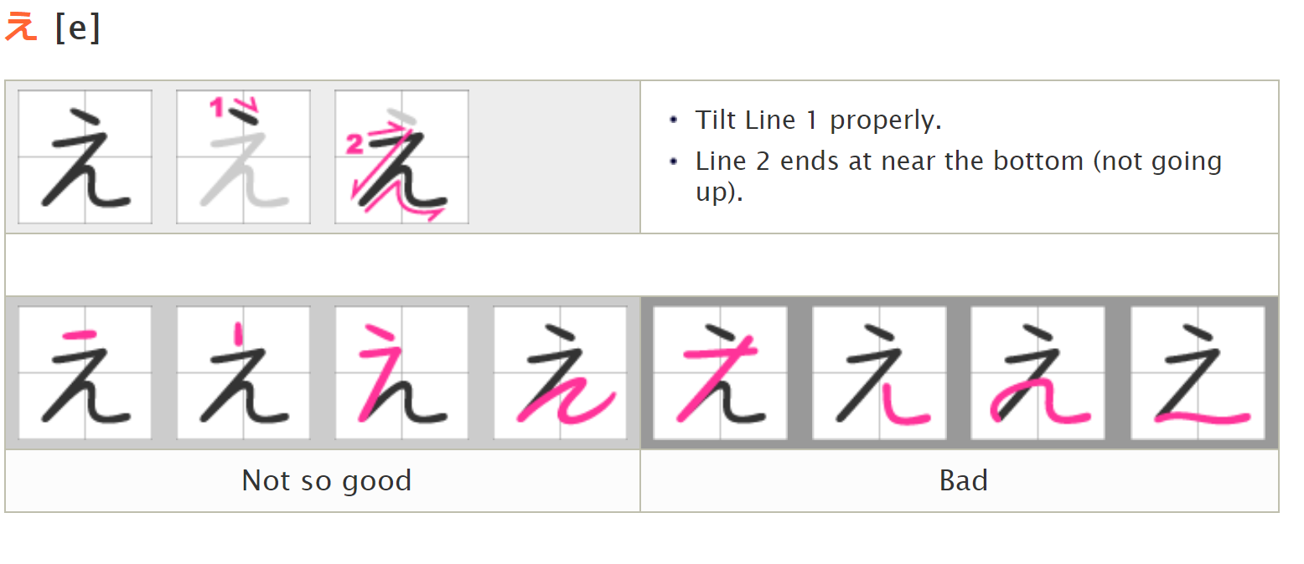

Slide 36
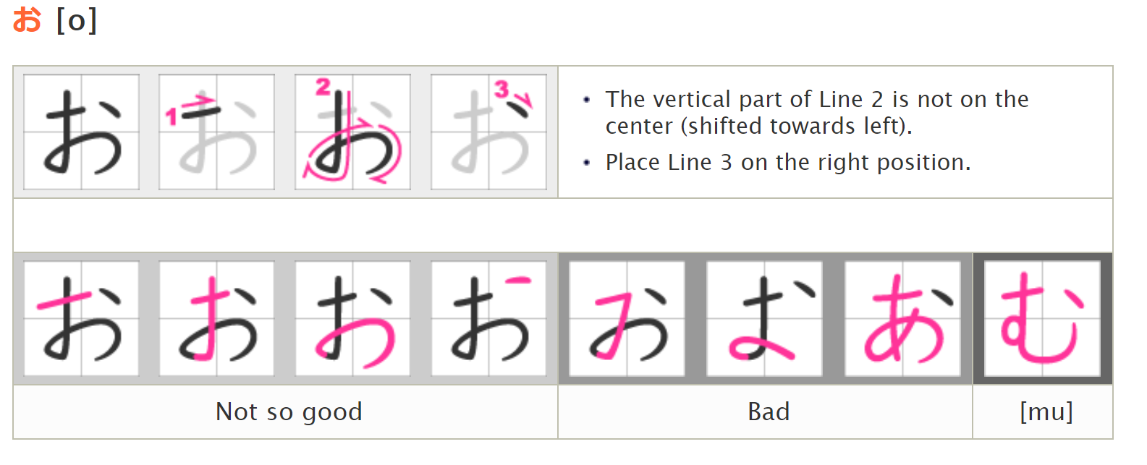

Slide 37
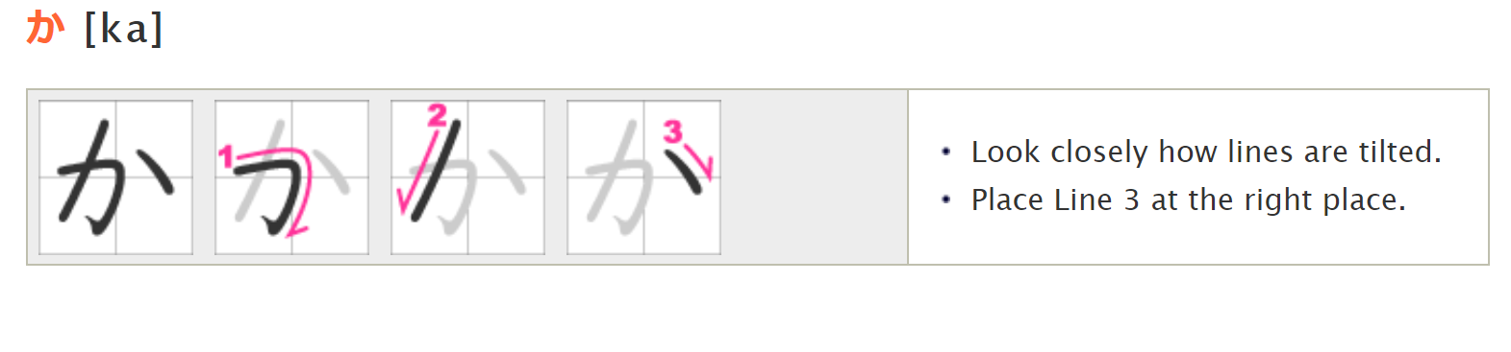

Slide 38
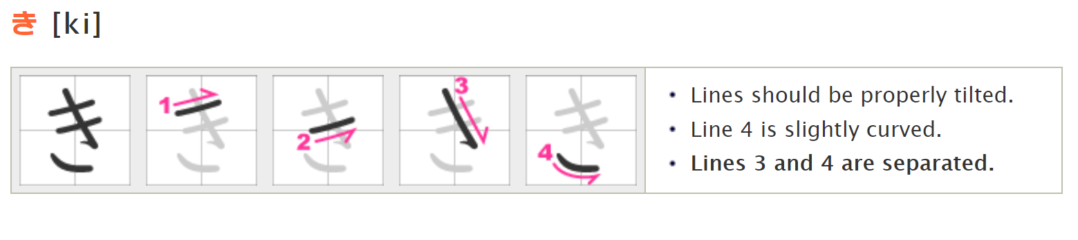

Slide 39
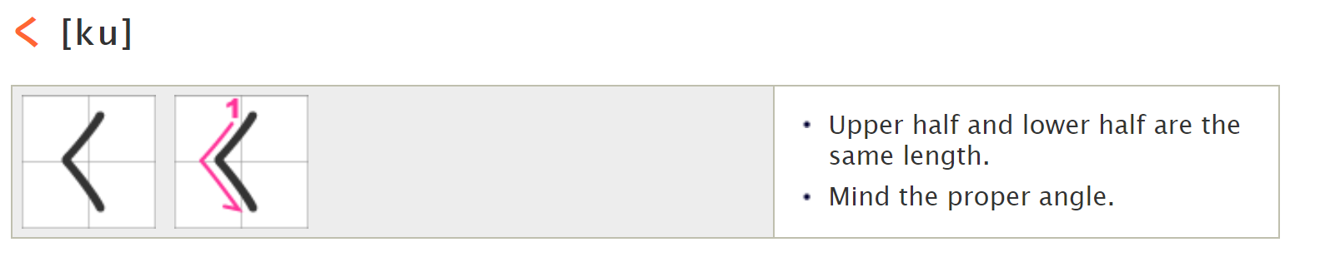

Slide 40
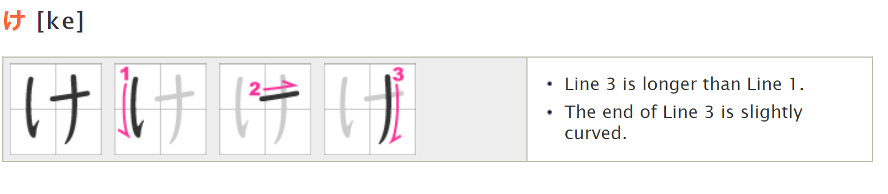

Slide 41
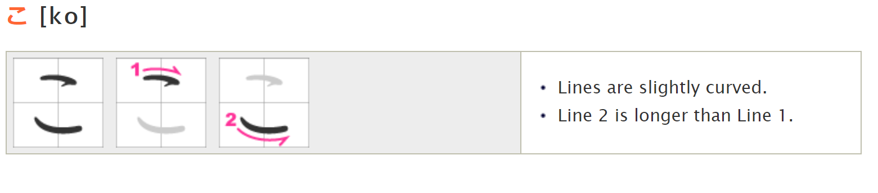

Slide 42
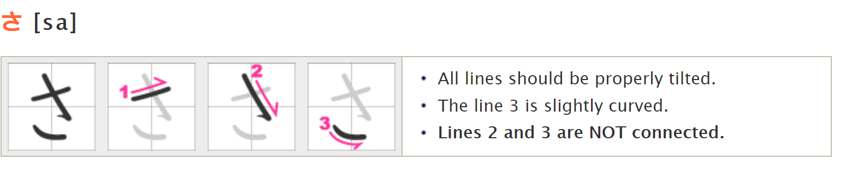

Slide 43
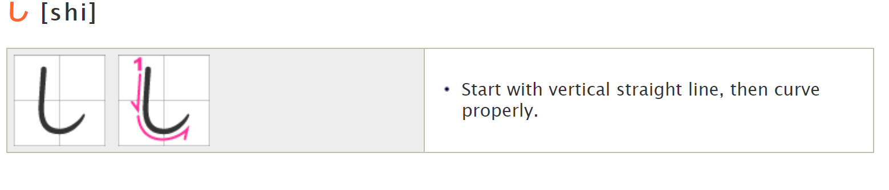

Slide 44
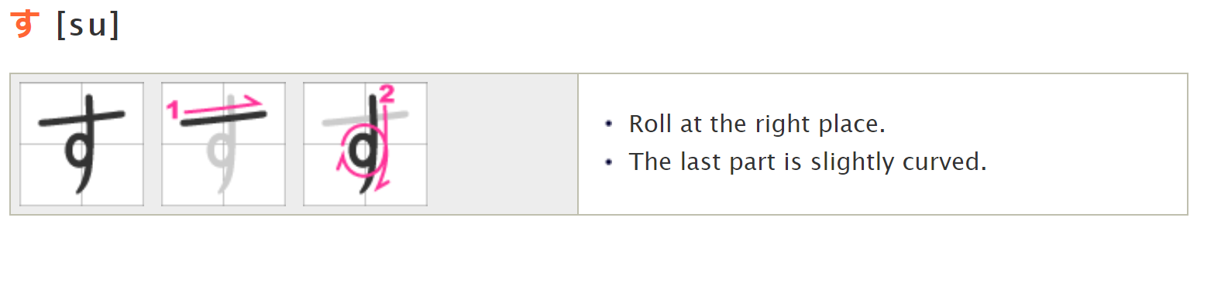

Slide 45
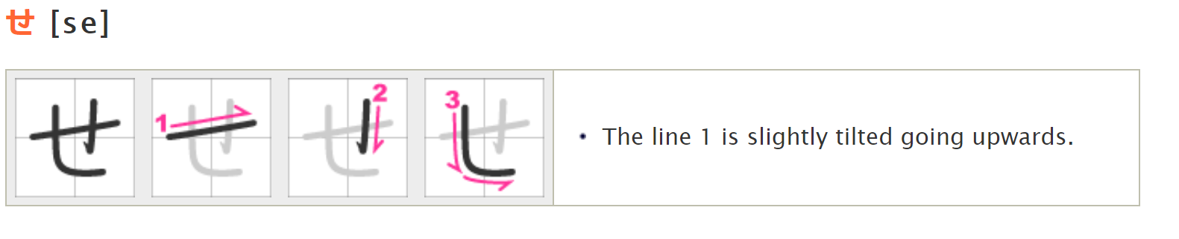

Slide 46
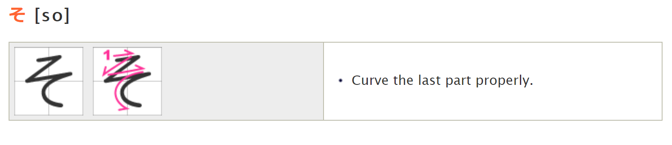

Slide 47

Can you read the following Hiragana?

Slide 48
so ka su e ko i u shi a i su shi ke su shi ki ko e
1. そか
2. すえ
3. こい
4. うし
5. あい
6. すし
7. けす
8. しき
9. こえ

Slide 49
10. くき
11. おう
12. そし
13. うく
14. くせ
15. けさ
16. かい
17. えき
18. せい
ku ki
o u
so shi
u ku
ku se
ke sa
ka i
e ki
se i

Slide 50
i ki sa i su so so se i a sa ka ku sa ka a ka ke su
19. いき
20. さい
21. すそ
22． そせい
23. あさ
24. かく
25. さか
26. あか
27. けす

Slide 51
ke su se ki shi so ko ke o ku so ko ki se ki se ki ku ko
28. けす 29. せき 30. しそ 31. こけ 32. おく 33. そこ 34. きせき 35. せき 36． くこ

Slide 52

Please listen to your teacher and write the Hiragana you hear. You will hear two characters combined (No. 1 - No. 15).

Slide 53

In the next class, you will learn the second 15 Hiragana (ta –ho). I will expect you to have mastered the first 15 hiragana by then. がんばってね！(Good luck!)

