Slide 1
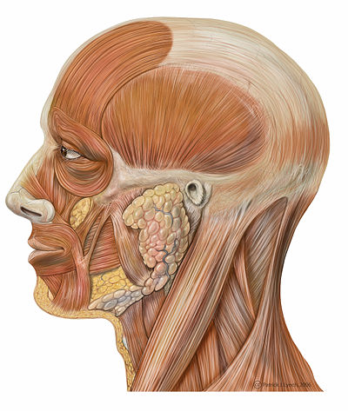
Topic 5: Anatomy of the
Muscular System
Part 1
Chapter 10
http://en.wikibooks.org/wiki/Human_Physiology/The_Muscular_System

Slide 2
5.1 GROSS ANATOMY OF A SKELETAL MUSCLE
• recall that muscle fiber is the name of a single muscle tissue cell
• several different levels of connective tissue (CT) wrapping
1) endomysium: fine layer of CT that surrounds each muscle fiber (cell)
2) perimysium: sheath around a fascicle
3) epimysium: dense, fibrous CT that surrounds & holds together a group of fascicles = outside layer of a single muscle
5) deep fascia: still coarser layer of dense CT that binds muscles into functional groups »» eg: hamstrings vs quadriceps
a bundle of muscle fibres

Slide 3
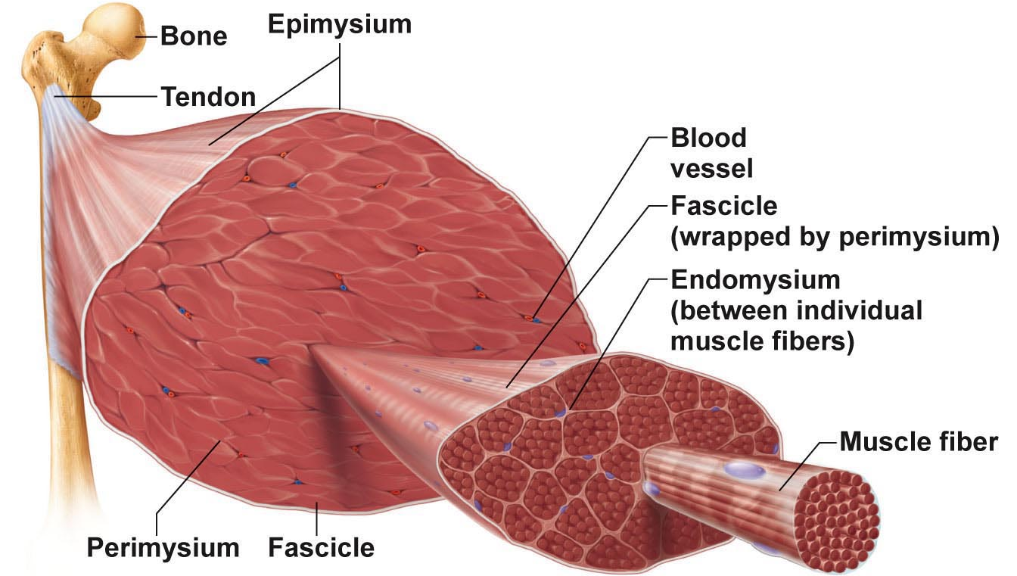
Fig. 9.1a
MUSCLE ATTACHMENTS
• most muscles span joints
• most muscles are attached to bones in at least 2 places
origin: bone that anchors the muscle, bone that doesn’t move
insertion: bone moved by action of muscle
Most attachments are indirect attachments involving either a tendon or an aponeurosis
tendon -> narrow, strong, rope-like
aponeurosis -> large flattened sheet that connects 2 muscles together, deep to skin, found in skull

Slide 4
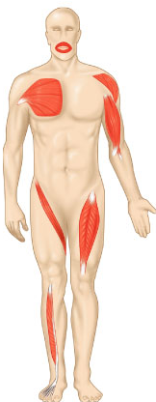

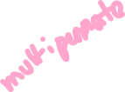


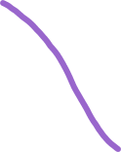


ARRANGEMENT OF FASCICLES
• all skeletal muscles have fascicles
• 4 basic patterns:
Parallel:
• can be straplike (sartorius) or fusiform (biceps brachii)
Pennate: unipennate (eg: extensor digitorum longus)
bipennate (eg: rectus femoris)
multipennate (eg: deltoid)
Convergent: muscle is triangular or fan-shaped (eg: pectoralis major)
Circular: concentric rings surround external openings; contract to close opening (eg: obicularis oris)
feather-like ->
Fig. 10.1

Slide 5
5.2 INTERACTIONS OF SKELETAL MUSCLES
• muscles can work together or in opposition
• 4 functional groups: prime movers, antagonists, synergists & fixators
1) Prime Mover:
• the muscle that is primarily responsible for a movement
• eg: biceps brachii in elbow flexion
2) Antagonist:
• control extent to which movement is happening
• can provide resistance to prevent overshoot or control rate of movement
• a single muscle can be a prime mover for one action & an antagonist for another action - eg: biceps brachii & triceps brachii -> elbow flexion and extension
3) Synergists:
• muscles that help the prime mover (helpful but not essential) by:
a) promoting the same movement
b) reducing undesirable movements (eg: finger flexor muscles cross both wrist & phalangeal joints)
4) Fixators:
• immobilize a bone - eg: muscles involved in posture

Slide 6
Naming Skeletal Muscles
Location of muscle: bone or body region – eg: temporalis, intercostal
Shape of muscle: eg: deltoid (triangular), right & left trapezius muscles form a trapezoid
Relative size of muscle: maximus, minimus, longus, brevis (shorter) – eg: gluteus maximus & gluteus minimus
Direction of muscle fibers: eg: rectus = straight, parallel to midline (rectus femoris); also transversus abdominis, oblique
Number of origins: biceps, triceps, quadriceps (2,3,4 origins) – eg: biceps brachii
Location of muscle’s origin and/or insertion: if both indicated, origin always indicated first – eg: sternocleidomastoid (neck region – dual origin on sternum and clavicle & insertion on mastoid process of temporal bone)
Action of the muscle: flexor, extensor, adductor – eg: adductor longus for thigh adduction & supinator muscle in forearm
What can we say about the extensor carpi radialis longus???
-> wrist extensor, so posterior, thumb side (radialis), long muscle

Slide 7
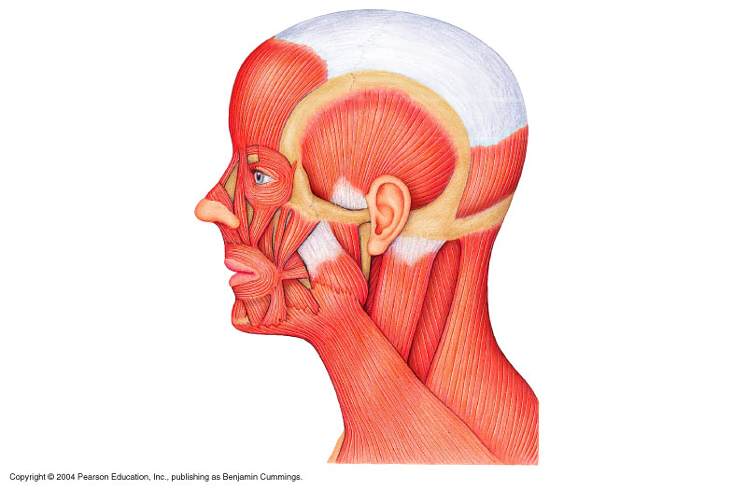



5.3 Muscles of the Head – Facial Expression
• insert into skin or other muscles, not bones; innervated by the facial nerve
epicranius = main muscle of scalp – consists of:
(i) frontalis (frontal belly): raises eyebrows, wrinkles forehead
(ii) occipitalis (occipital belly): pulls scalp posteriorly
orbicularis oculi: surrounds rim of orbit; protects eyes from light/injury – blinking, squinting, also draws eyebrows down
zygomaticus (cheek to corner of mouth):
smiling muscle
orbicularis oris:
lips; multi-layered; closes, purses, protrudes lips
mentalis (mandible to chin):
V-shaped pair – protrudes lower lip; wrinkles chin
ʘ buccinator (mandible/maxilla to orb.oris): deep to masseter – whistling, sucking; hold food in place when chewing; especially in nursing infants
platysma (fascia of chest to mandible):
helps depress mandible; tenses skin of neck
epicranius
aponeurosis
orb. oris = orbicularis oris
buccinator (small part of it)
Fig. 10.6

Slide 8
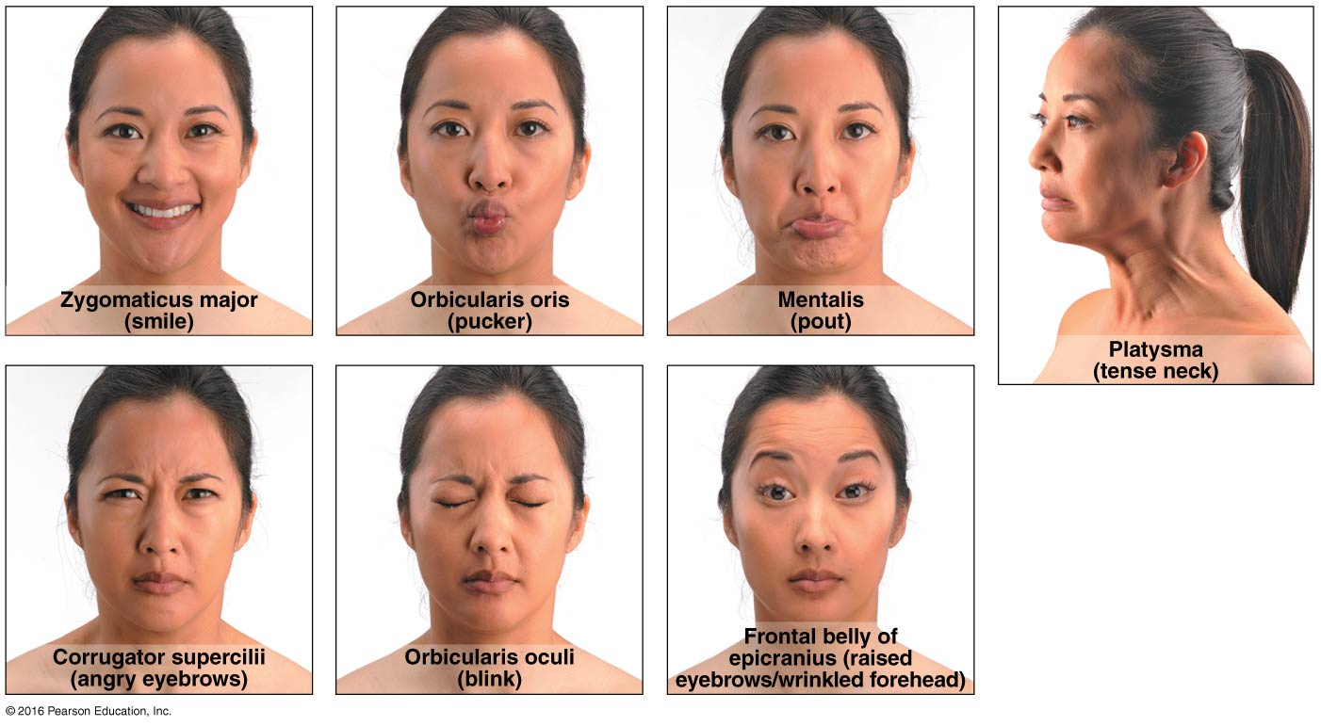
Fig. 10.7

Slide 9
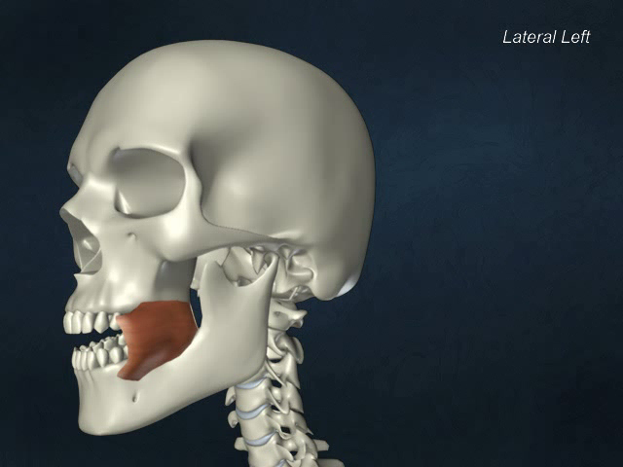
Buccinator

Slide 10
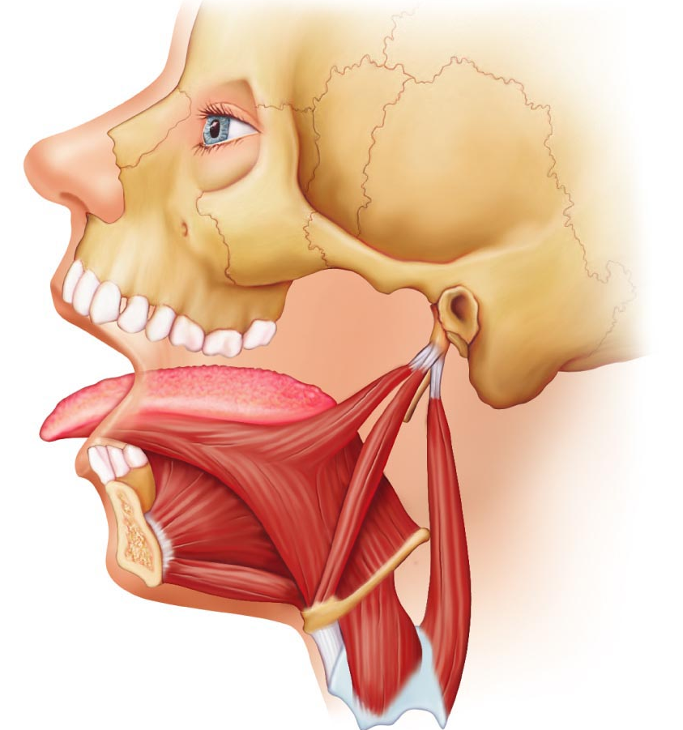
5.4 Muscles that move the tongue
glossus = tongue
genioglossus (mandible to inferior tongue & hyoid bone): prime mover of tongue protrusion; anchors tongue to prevent obstruction of respiration
hyoglossus (hyoid bone to inferolateral tongue): depresses tongue, especially lateral margins
styloglossus (styloid process of temporal bone to inferolateral tongue): retracts & elevates tongue
styloglossus
hyoglossus
genioglossus
Fig. 10.8c

Slide 11
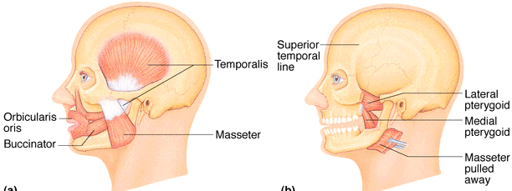
Muscles of the Head: Mastication, etc
• 4 pairs of muscles involved in chewing; all innervated by mandibular division of cranial nerve V
ʘ masseter (zygomatic to mandible): prime mover of jaw closure (powerfully)
ʘ temporalis (temporal to mandible): elevates and retracts mandible (closes jaw); maintains closed jaw at rest (resting level of tension)
medial and lateral pterygoid (sphenoid to mandible (coronoid process): both two-headed; additional jaw movements (eg: side-to-side grinding movements)
buccinator (mandible/maxilla to orbicularis oris): helps keep food between grinding surfaces of teeth during chewing
Fig. 10.8
-> attached to pterygoid process of sphenoid bone
Notes:
not gonna ask to distinguish between ‘synergists’ vs. ‘prime movers’, just know the main players in major movements

Slide 12
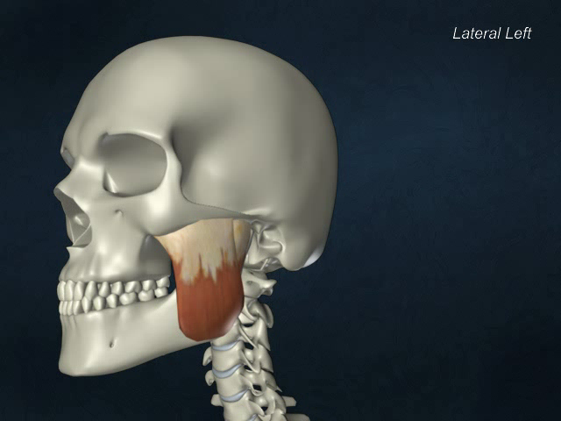
Masseter

Slide 13
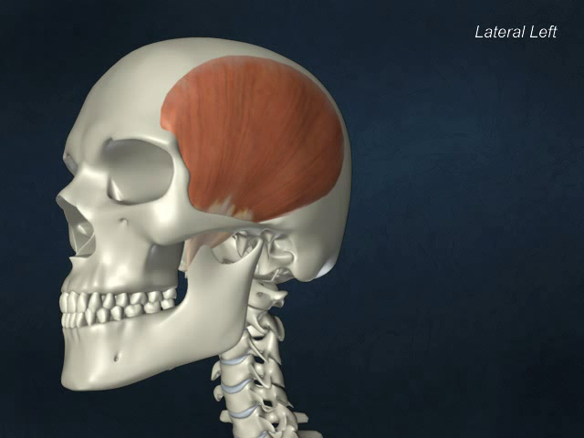
Temporalis

Slide 14
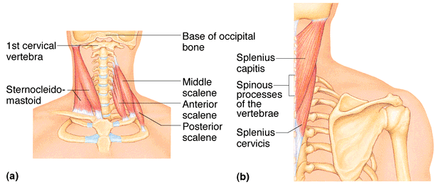
5.5 Muscles of the Neck & Vertebral Column: Head & Trunk Movements
• head moved by muscles originating from axial skeleton
sternocleidomastoid (manubrium/clavicle to mastoid process of temporal): 2-headed (2 origins); deep to platysma; prime mover (both muscles) of head flexion; individual muscle action for head rotation to side, head tilts
scalenes (cervical vertebrae to 1st 2 ribs): more laterally and deep to platysma & sternocleidomastoid – elevate first 2 ribs, role in coughing, flex & rotate neck
ʘ splenius (vertebrae to mastoid process of temporal): superficial; “bandage muscle”; head extension (both sides) or rotation, tilts, ‘capitis’ = head
Fig. 10.10a,b
posterior
anterior
Notes:
sternocleidomastoid and scalenes are on both sides, on sternocleidomastoid removed to better view

Slide 15
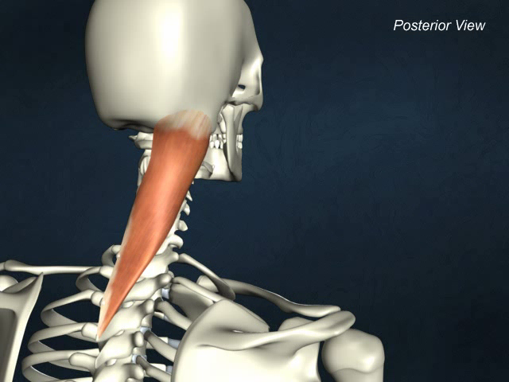
Splenius capitis

Slide 16
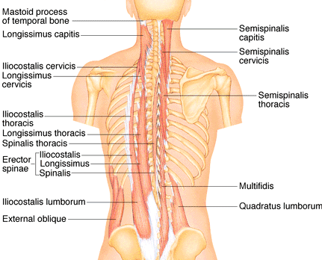

5.6 Muscles of the Neck & Vertebral Column: Head & Trunk Movements
erector spinae: prime mover of back extension; consists of 3 columns of muscles (iliocostalis, longissimus, spinalis); resistance to bending forward & extensors for return to erect position
ʘ semispinalis: deeper, composite muscle from thoracic region to head; extends vertebral column & head, rotation of head, synergistic with sternocleidomastoid muscles
quadratus lumborum (iliac crest to lumbar vertebrae): individual muscles flex vertebral column laterally; jointly to extend lumbar spine & fix 12th rib; maintain upright posture
Fig. 10.10d
Notes:
don’t worry about area of muscle (‘thoracis’, ‘cervicis’) just

Slide 17
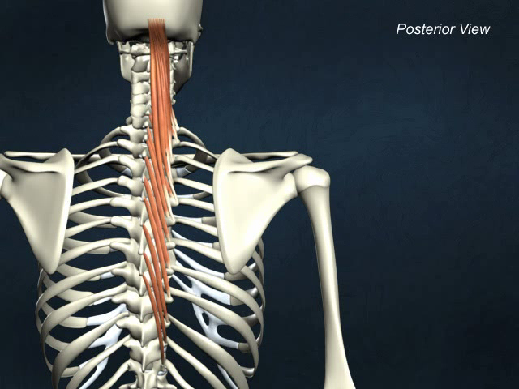
Semispinalis capitis

Slide 18
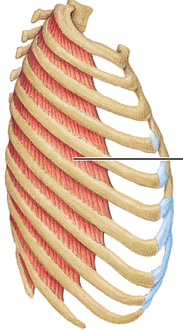
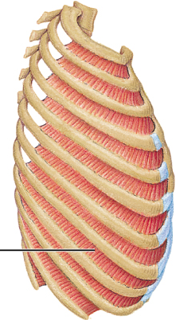
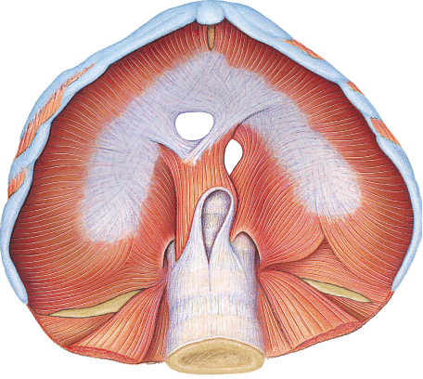
Fig. 10.11
External
Internal
5.7a Muscles of Respiration
ʘ external intercostals -> inspiration: 11 pairs, between ribs; oblique; pull ribs together to elevate rib cage (inspiration;1st ribs fixed by scalene muscles)
internal intercostals -> expiration: 11 pairs, between ribs; ⊥ external intercostals; draw ribs together to depress rib cage (expiration; 12th ribs fixed by quadratus lumborum)
diaphragm: dome-shaped when relaxed; prime mover of inspiration

Slide 19
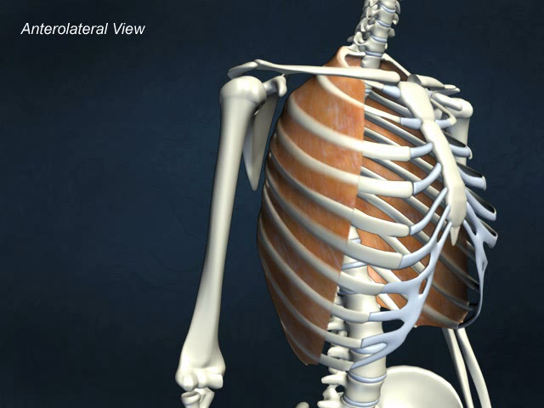
External intercostals

Slide 20
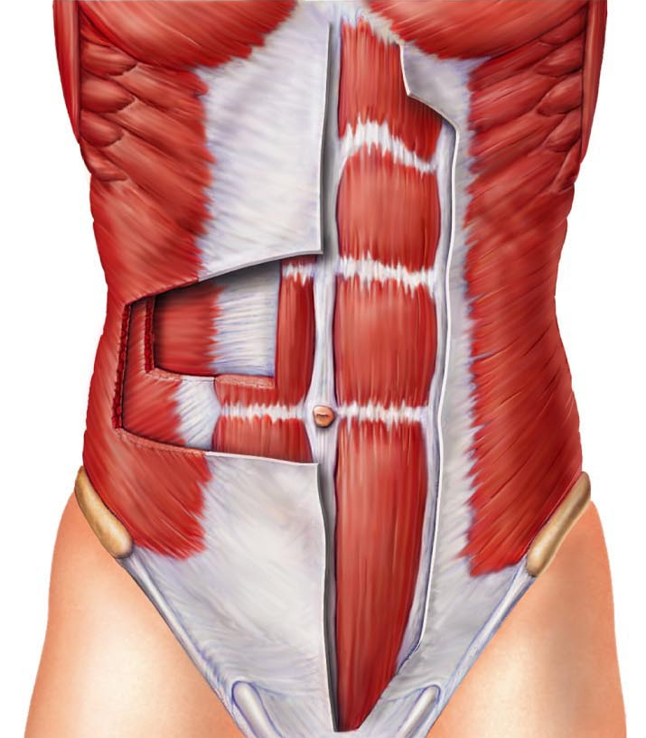
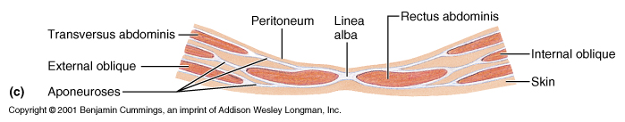
5.7b Muscles of Abdominal Wall
ʘ rectus abdominis – medial superficial; pubis to rib cage; lumbar rotation, fix & depress ribs, stabilize pelvis during walking
external oblique – largest & most superficial lateral muscle; together ➢ increase ab pressure, flex vertebral column; individual ➢ rotation
internal oblique – deeper, but same actions as ext obliques
ʘ transversus abdominis – deepest; compresses abdominal contents
Notes:
either diagram can be on an exam

Slide 21
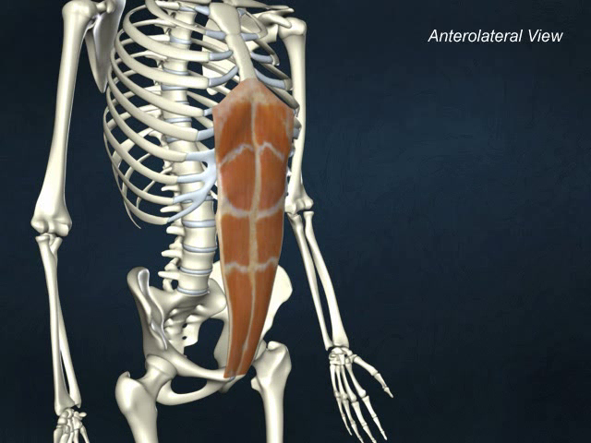
Rectus abdominis

Slide 22
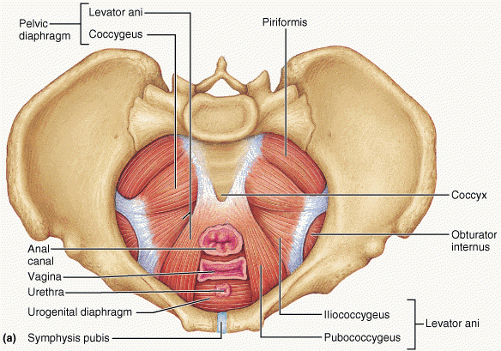
5.8 Muscles of the pelvic floor and perineum
levator ani (pubis to inner coccyx): supports pelvic viscera & forms supportive sling at anorectal junction & vagina; resists increases in intra-abdominal pressure
coccygeus (spine of ischium to sacrum & coccyx): supports pelvic viscera & coccyx
urogenital diaphragm: supports pelvic viscera and constricts urethra
levator ani & coccygeus = pelvic diaphragm

Slide 23
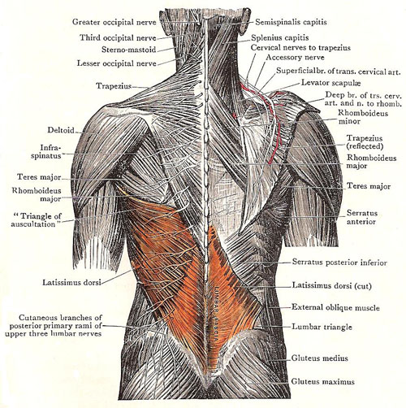
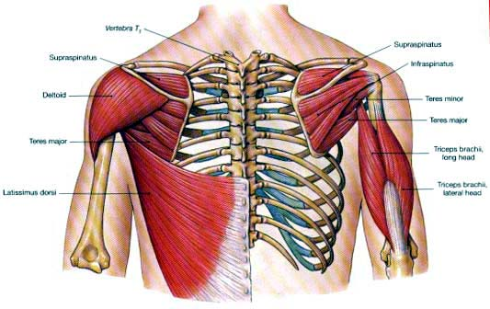
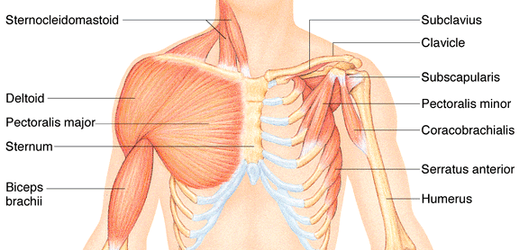
5.10 Superficial Muscles of Thorax:arm movements
ʘ pectoralis major (sternum/rib cartilages to humerus): prime mover of arm flexion; rotates arm medially; adducts arm; climbing, throwing, pushing
ʘ latissimus dorsi (vertebrae to humerus): broad, flat back muscle; prime mover of arm extension, arm adductor, rotates arm at shoulder, rowing, swimming
ʘ deltoid (clavicle/scapula to humerus): thick, rounded, site of IM injection, prime mover of arm abduction (all fibers); also lateral & medial rotations, flexion or extensions if only some fibers used; swinging arm when walking
Fig. 10.14

Slide 24
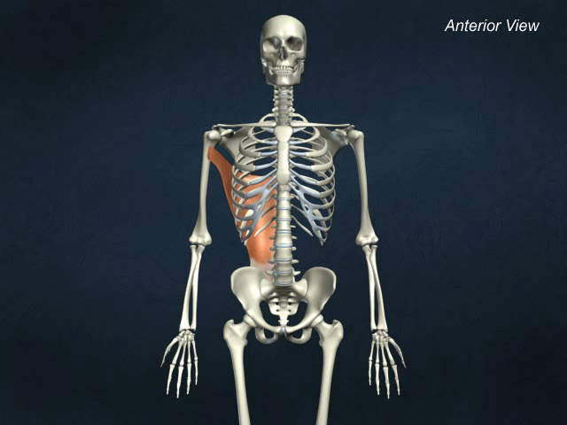
Latissimus dorsi

Slide 25
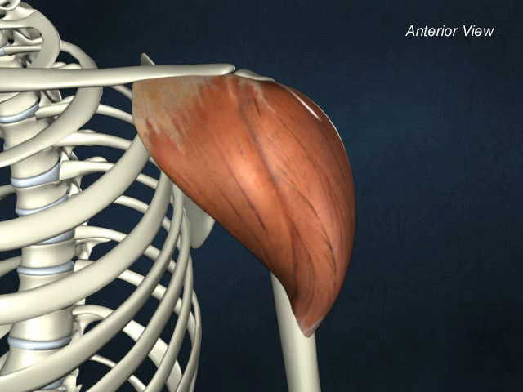
Deltoid

Slide 26
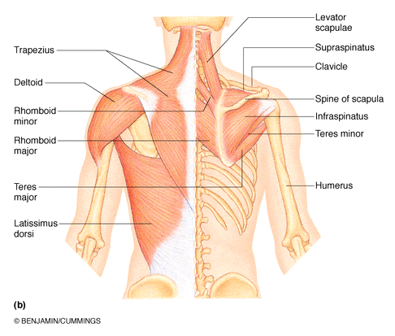

ʘ trapezius (occipital & vertebrae to scapula): superficial, stabilizes, raises, retracts, rotates scapula
rhomboids (vertebrae to scapula): deep to trapezius; aid in scapula movements (eg: squaring shoulders, rotation when lowering arm)
+ subscapularis = rotator cuff muscles
Fig. 10.14

