Slide 1
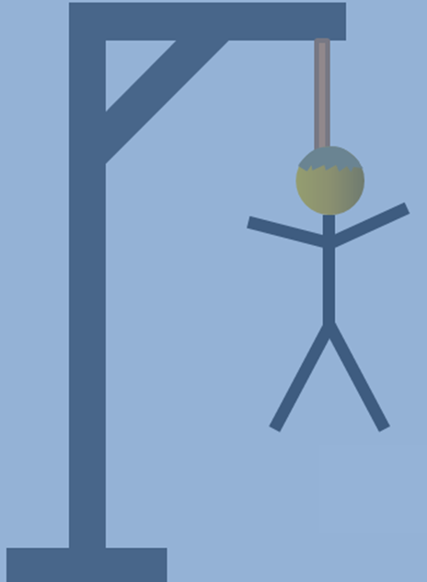
Muscle Hangman

Slide 2
Question
I am well developed in nursing infants.

Slide 3
Preparing Game:

Slide 4
YOU LOST!
Click for another go.
No! Click to go on.
X
Well Done!
Click here to go on.
b
u
c
c
i
n
a
t
o
r
Q
W
E
R
T
Y
U
I
O
P
A
S
D
F
G
H
J
K
L
Z
X
C
V
B
N
M

Slide 5
Question 2
I consist of the frontal and occipital bellies.

Slide 6
Preparing Game:

Slide 7
YOU LOST!
Click for another go.
No! Click to go on.
X
Well Done!
Click here to go on.
e
p
i
c
r
a
n
i
u
s
Q
W
E
R
T
Y
U
I
O
P
A
S
D
F
G
H
J
K
L
Z
X
C
V
B
N
M

Slide 8
Question 3
The sternocleidomastoid muscle originates on the manubrium of the sternum and the . . . . .

Slide 9
Preparing Game:

Slide 10
YOU LOST!
Click for another go.
No! Click to go on.
X
Well Done!
Click here to go on.
c
l
a
v
i
c
l
e
Q
W
E
R
T
Y
U
I
O
P
A
S
D
F
G
H
J
K
L
Z
X
C
V
B
N
M

Slide 11
Question 4
The erector spinae muscle group consists of the iliocostalis, spinalis and …………………………………….. muscles.

Slide 12
Preparing Game:

Slide 13
YOU LOST!
Click for another go.
No! Click to go on.
X
Well Done!
Click here to go on.
l
o
n
g
i
s
s
i
m
u
s
Q
W
E
R
T
Y
U
I
O
P
A
S
D
F
G
H
J
K
L
Z
X
C
V
B
N
M

Slide 14
Question 5
I contribute to the pelvic floor and surround the anorectal junction.

Slide 15
Preparing Game:

Slide 16
YOU LOST!
Click for another go.
No! Click to go on.
X
Well Done!
Click here to go on.
l
e
v
a
t
o
r
a
n
i
Q
W
E
R
T
Y
U
I
O
P
A
S
D
F
G
H
J
K
L
Z
X
C
V
B
N
M

Slide 17
Question 6
I am a prime mover of forearm extension.

Slide 18
Preparing Game:

Slide 19
YOU LOST!
Click for another go.
No! Click to go on.
X
Well Done!
Click here to go on.
t
r
i
c
e
p
s
b
r
a
c
h
i
i
Q
W
E
R
T
Y
U
I
O
P
A
S
D
F
G
H
J
K
L
Z
X
C
V
B
N
M

Slide 20
Question 7
I am the forearm flexor that inserts into the ulna.

Slide 21
Preparing Game:

Slide 22
YOU LOST!
Click for another go.
No! Click to go on.
X
Well Done!
Click here to go on.
b
r
a
c
h
i
a
l
i
s
Q
W
E
R
T
Y
U
I
O
P
A
S
D
F
G
H
J
K
L
Z
X
C
V
B
N
M

Slide 23
Question 8
I am the hip flexor that is a composite of two muscles.

Slide 24
Preparing Game:

Slide 25
YOU LOST!
Click for another go.
No! Click to go on.
X
Well Done!
Click here to go on.
i
l
i
o
p
s
o
a
s
Q
W
E
R
T
Y
U
I
O
P
A
S
D
F
G
H
J
K
L
Z
X
C
V
B
N
M

Slide 26
Question 9
I am a thigh adductor.

Slide 27
Preparing Game:

Slide 28
YOU LOST!
Click for another go.
No! Click to go on.
X
Well Done!
Click here to go on.
g
r
a
c
i
l
i
s
Q
W
E
R
T
Y
U
I
O
P
A
S
D
F
G
H
J
K
L
Z
X
C
V
B
N
M

Slide 29
Question 10
My fascicles have a bipennate organization and I can be both a hip flexor and a knee extender.

Slide 30
Preparing Game:

Slide 31
YOU LOST!
Click for another go.
No! Click to go on.
X
Well Done!
Click here to go on.
r
e
c
t
u
s
f
e
m
o
r
i
s
Q
W
E
R
T
Y
U
I
O
P
A
S
D
F
G
H
J
K
L
Z
X
C
V
B
N
M

Slide 32
Question 11
I insert into the calcaneal tendon.

Slide 33
Preparing Game:

Slide 34
YOU LOST!
Click for another go.
No! Click to go on.
X
Well Done!
Click here to go on.
s
o
l
e
u
s
Q
W
E
R
T
Y
U
I
O
P
A
S
D
F
G
H
J
K
L
Z
X
C
V
B
N
M

Slide 35
Question 12
We link the abdominal muscles together.

Slide 36
Preparing Game:

Slide 37
YOU LOST!
Click for another go.
No! Click to go on.
X
Well Done!
Click here to go on.
a
p
o
n
e
u
r
o
s
e
s
Q
W
E
R
T
Y
U
I
O
P
A
S
D
F
G
H
J
K
L
Z
X
C
V
B
N
M

Slide 38
Well done! Good luck with midterm #2!!

