Slide 1
Respiratory System
Gas exchange

Slide 2
Why do we breathe? Think of all the reasons why we need a respiratory system.
I
N
T
RO
D
U
C
T
I
O
N

Slide 3
Warning: terminology!
“Respiration” is used several different ways:
  Cellular respiration is the aerobic breakdown of glucose in the mitochondria to make ATP.
  Respiratory systems are the organs in animals that exchange gases with the environment.
  “Respiration” is an everyday term that is often used to mean “breathing.”

Slide 4
Respiratory system function
Respiratory systems allow animals to move oxygen (needed for cellular respiration) into body tissues and remove carbon dioxide (waste product of cellular respiration) from cells.

Slide 5
Gills exchange gases in fish. What is the site of gas exchange in mammals?
Alveoli
Tracheids
Bronchi
Esophagus

Slide 6
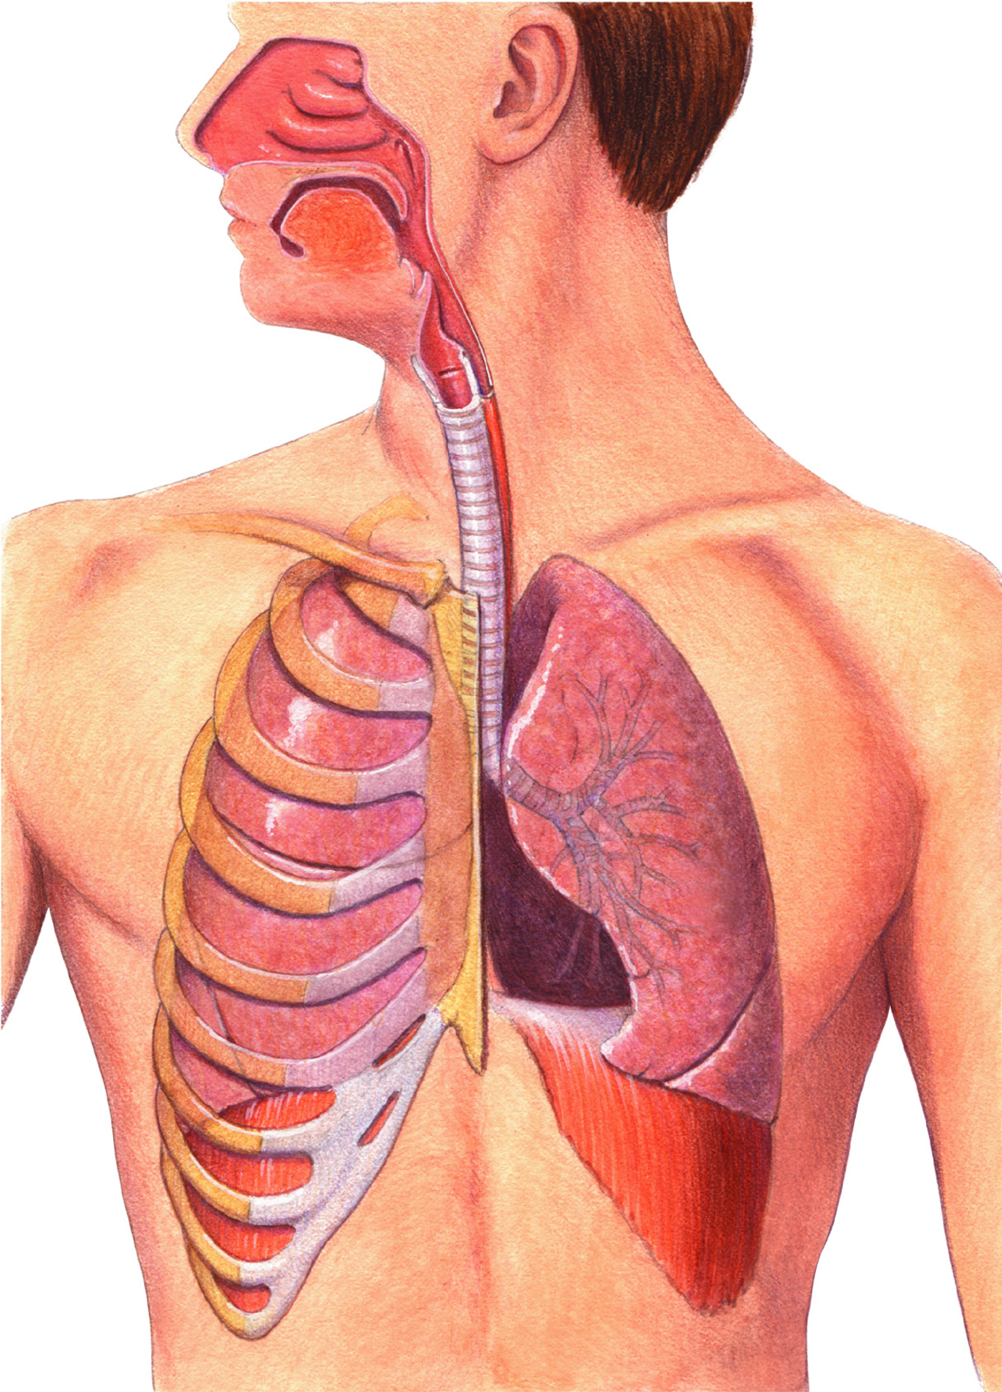
Label the parts!

Slide 7
Human Respiratory System
Pharynx
Nose
Larynx
Mouth
Trachea
Epiglottis
Lungs
Bronchus
Bronchioles
Diaphragm
Notes:
The respiratory system is responsible for the exchange of oxygen and carbon dioxide. Air moves through the nose, pharynx, larynx, trachea, and lungs. After reaching the lungs, the trachea branches into smaller and smaller tubes called bronchioles, which end in alveoli, or air sacs.

Slide 8
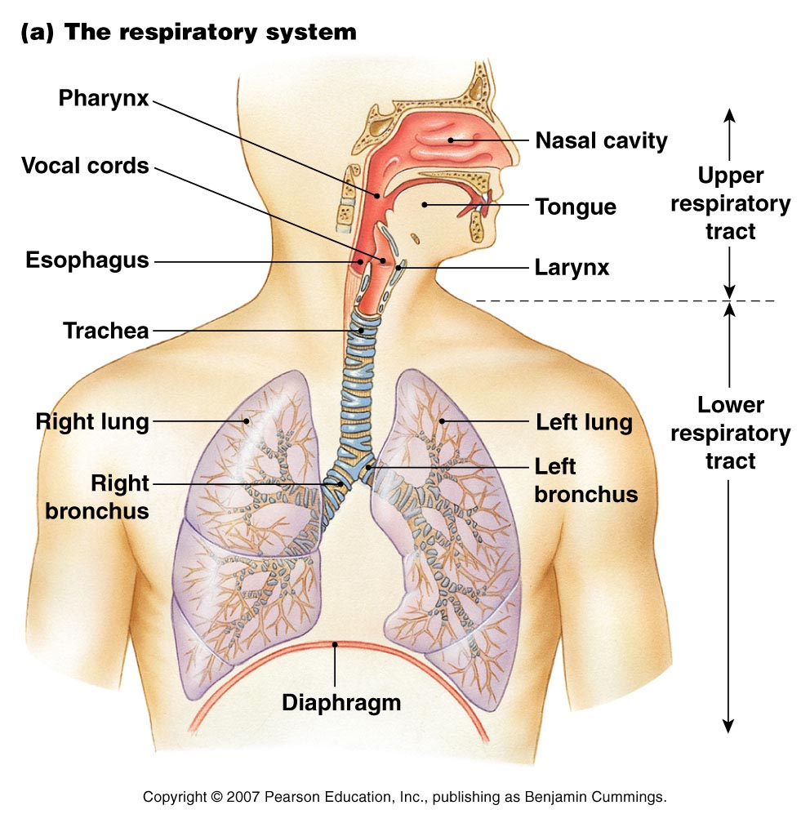
Respiratory System

Slide 9
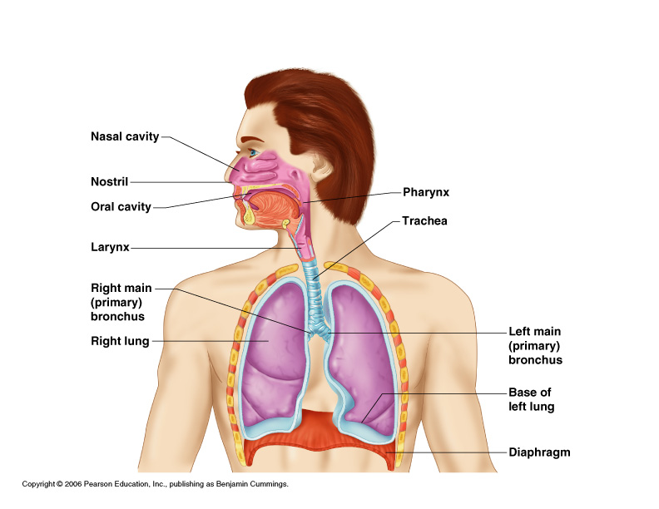
Organs of the Respiratory system
Nose
Pharynx
Larynx
Trachea
Bronchi
Lungs –
bronchioles &
alveoli

Slide 10
The Nose
The only externally visible part of the respiratory system
Air enters the nose through the external nares (nostrils)
The interior of the nose consists of a nasal cavity divided by a nasal septum

Slide 11
Anatomy of the Nasal Cavity
Olfactory receptors are located in the mucosa on the superior surface
The rest of the cavity is lined with respiratory mucosa
    Moistens air
    Traps incoming foreign particles

Slide 12
Pharynx (Throat)
Muscular passage from nasal cavity to larynx
Three regions of the pharynx
  Nasopharynx – superior region behind nasal cavity
  Oropharynx – middle region behind mouth
  Laryngopharynx – inferior region attached to larynx
The oropharynx and laryngopharynx are common passageways for air and food

Slide 13
Larynx (Voice Box)
Routes air and food into proper channels
Plays a role in speech
Made of eight rigid hyaline cartilages and a spoon-shaped flap of elastic cartilage (epiglottis)
Vocal cords - vibrate with expelled air to create sound (speech)

Slide 14
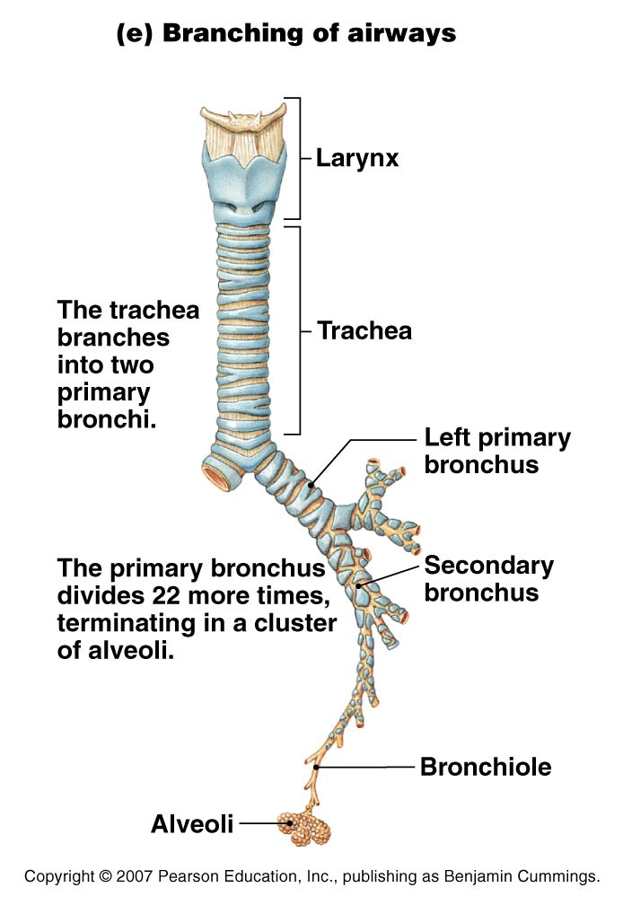
Structures of the Larynx
  Largest hyaline cartilage
  Protrudes anteriorly (Adam’s apple)
Epiglottis
  Superior opening of the larynx
  Routes food to the larynx and air toward the trachea
Glottis – opening between vocal cords

Slide 15
Trachea (Windpipe)
Connects larynx with bronchi
Lined with ciliated mucosa
  Beat continuously in the opposite direction of incoming air
  Expel mucus loaded with dust and other debris away from lungs
Walls are reinforced with C-shaped hyaline cartilage

Slide 16
Primary Bronchi
Formed by division of the trachea
Enters the lung at the hilus
(medial depression)
Right bronchus is wider, shorter,
and straighter than left
Bronchi subdivide into smaller
and smaller branches

Slide 17
Lungs
Occupy most of the thoracic cavity
  Apex is near the clavicle (superior portion)
  Each lung is divided into lobes by fissures
    Left lung – two lobes
    Right lung – three lobes

Slide 18
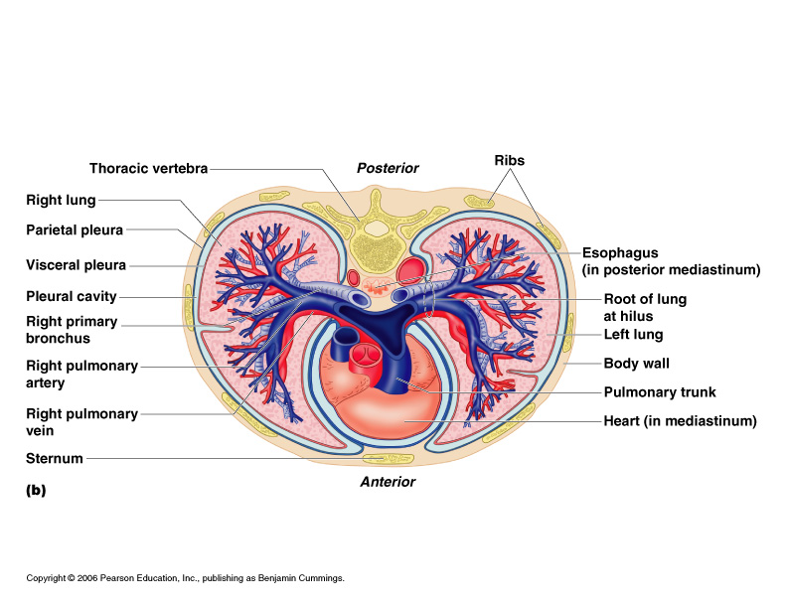
Lungs

Slide 19
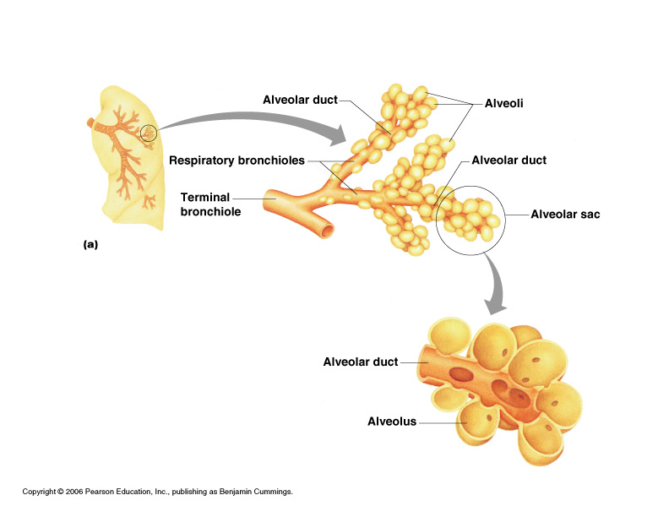
Bronchioles
Smallest branches of the bronchi
All but the smallest branches have reinforcing cartilage
Terminal bronchioles end in alveoli

Slide 20
Alveoli
Structure of alveoli
  Alveolar duct
  Alveolar sac
  Alveolus
Gas exchange takes place within the
alveoli in the respiratory membrane
Covered with pulmonary capillaries on external surfaces

Slide 21
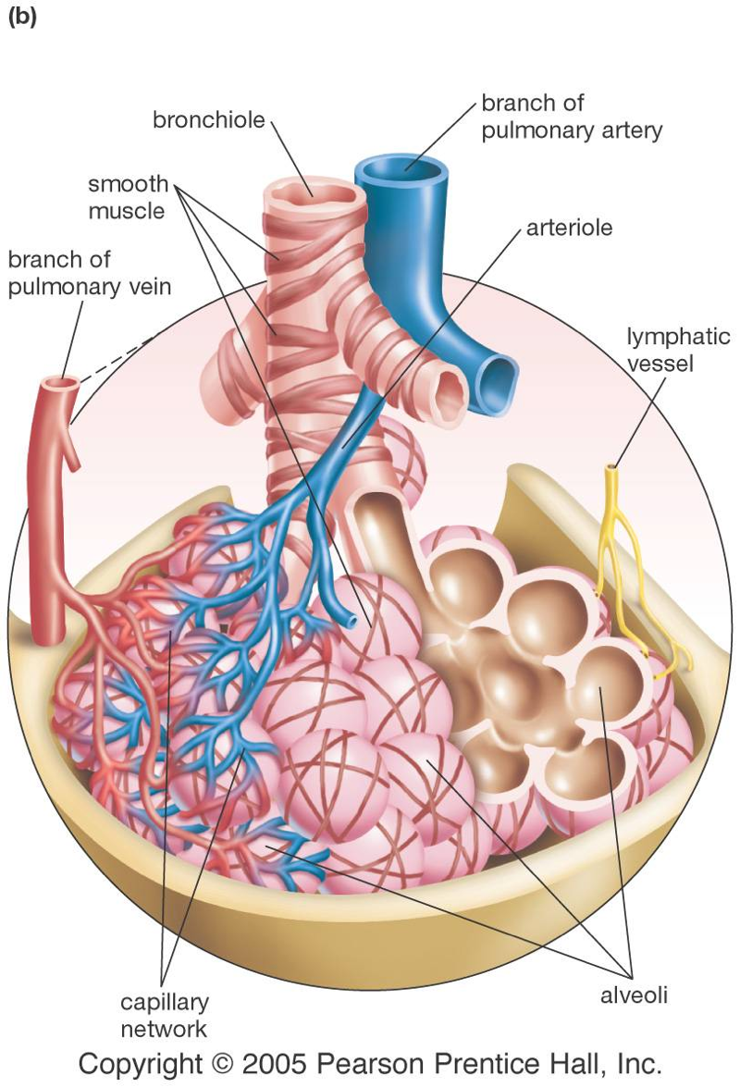
Alveoli
The alveoli are moist, thin-walled pockets which are the site of gas exchange.
A slightly oily surfactant prevents the alveolar walls from collapsing and sticking together.

Slide 22
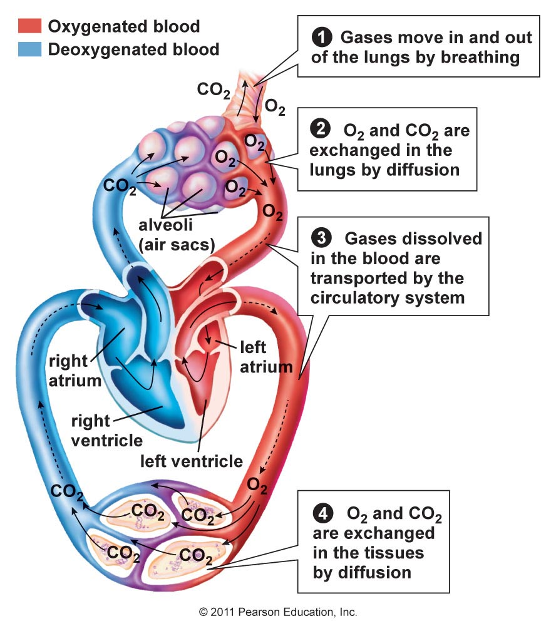
Circulation and Gas Exchange
Recall the interconnection between circulation and the respiratory system.
Gas exchange at the lungs and in the body cells moves oxygen into cells and carbon dioxide out.

Slide 23
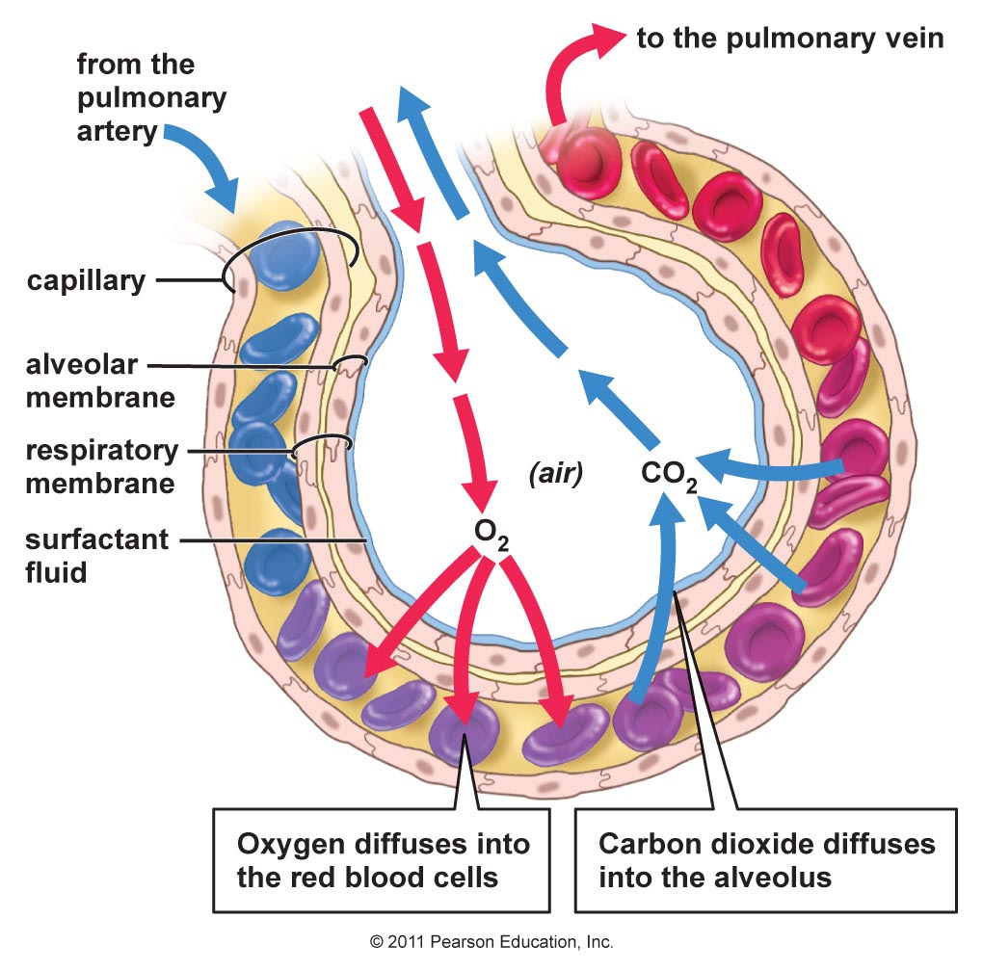
In the alveolus
The respiratory surface is made up of the alveoli and capillary walls.
The walls of the capillaries and the alveoli may share the same membrane.

Slide 24
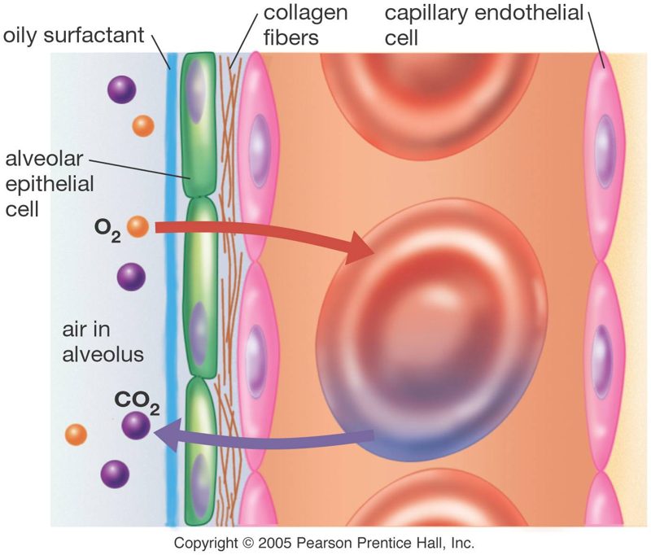
Gas exchange
Air entering the lungs contains more oxygen and less carbon dioxide than the blood that flows in the pulmonary capillaries.
How do these differences in concentrations assist gas exchange?

Slide 25
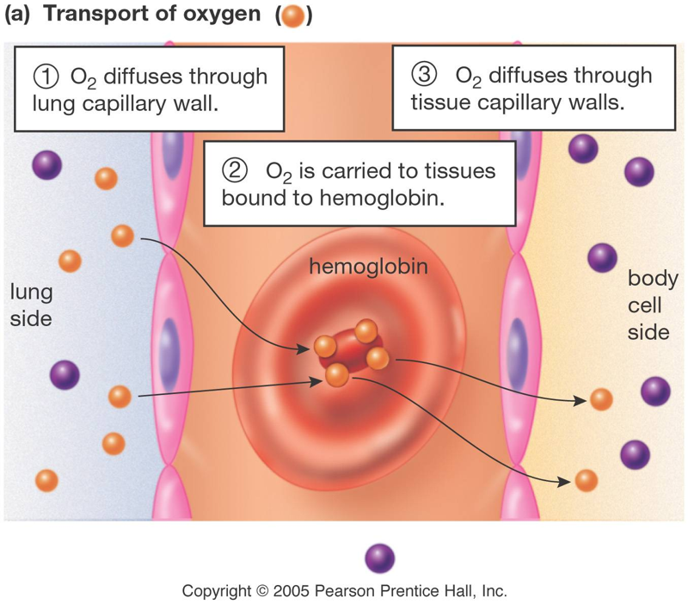
Oxygen transport
Hemoglobin binds to oxygen that diffuses into the blood stream.
What are some advantages to using hemoglobin to transport oxygen?

Slide 26
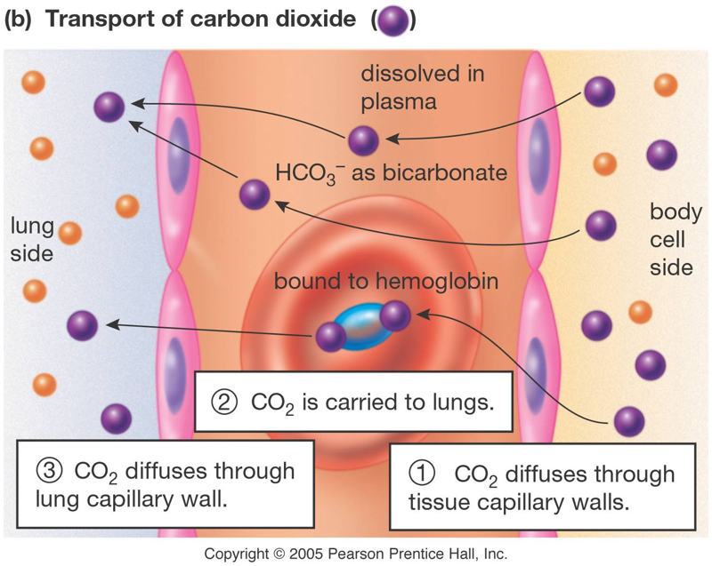
Carbon dioxide transport
Carbon dioxide can dissolve in plasma, and about 70% forms bicarbonate ions.
Some carbon dioxide can bind to hemoglobin for transport.

Slide 27
At the cells
Cells use up oxygen quickly for cellular respiration. What does this do to the diffusion gradient? How does this help cells take up oxygen?
Cells create carbon dioxide during cellular respiration, so CO2 levels in the cell are higher than in the blood coming to them. How does this help cells get rid of oxygen?

Slide 28
Most of the oxygen in blood is:
In the white cells.
Bound to hemoglobin.
Combined with carbon to make carbon dioxide.
Dissolved in the plasma.

Slide 29
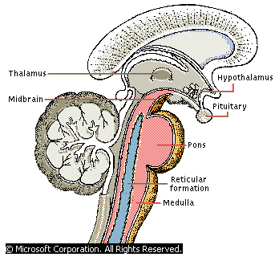
How Breathing Is Controlled
    Breathing is controlled by the medulla oblongata.
    The medulla oblongata monitors carbon dioxide in the blood.
    As carbon dioxide increases, nerve impulses make the diaphragm contract, bringing air into the lungs.
    The higher the carbon dioxide level, the stronger the impulses.

Slide 30
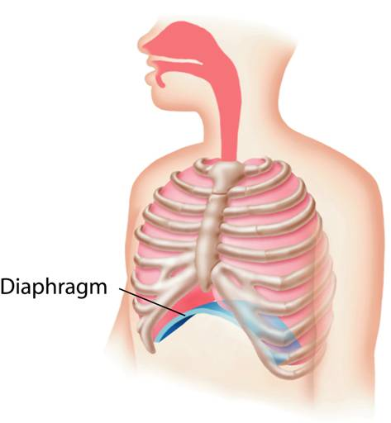
Breathing
    BREATHING
    Lungs are sealed in pleural membranes inside the chest cavity.
    At the bottom of the cavity is a large, flat muscle known as the diaphragm.
Notes:
During inhalation the rib cage rises and the diaphragm contracts, increasing the size of the chest cavity.

Slide 31
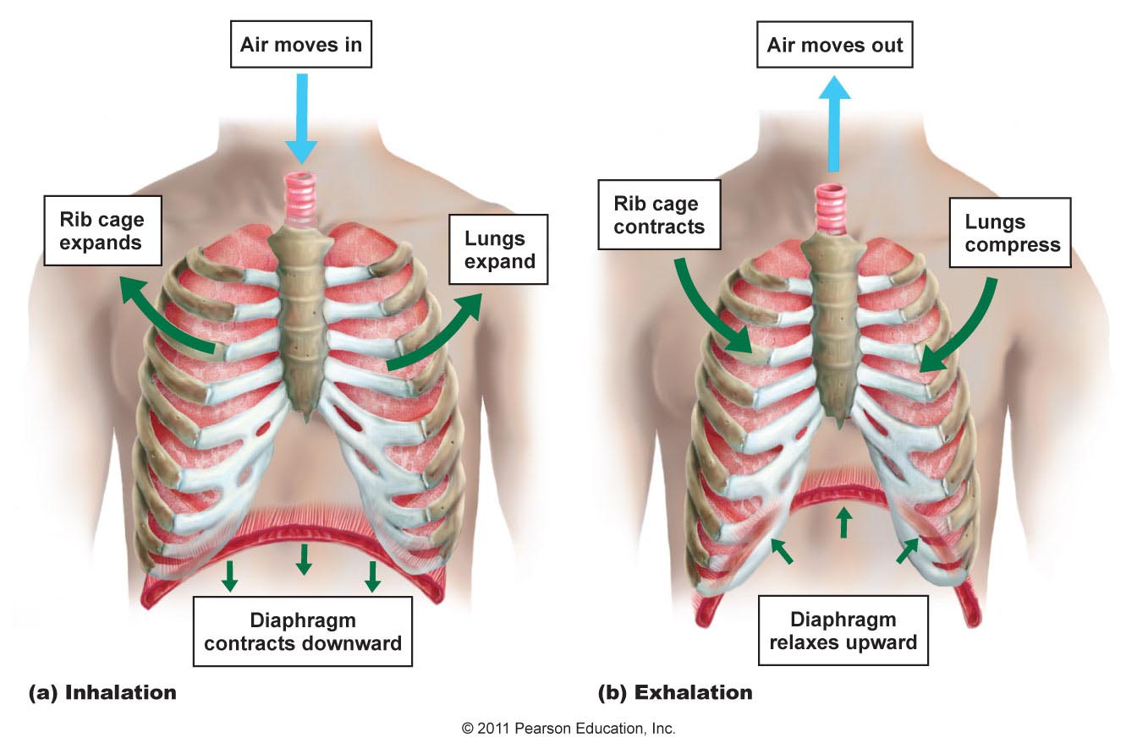
Moving air in and out
During inspiration (inhalation), the diaphragm and intercostal muscles contract.
During exhalation, these muscles relax. The diaphragm domes upwards.

Slide 32
What happens when you breathe in?
The rib muscles relax.
The diaphragm contracts.
Air leaves the alveoli.
Air moves between the chest wall and the lung.

Slide 33
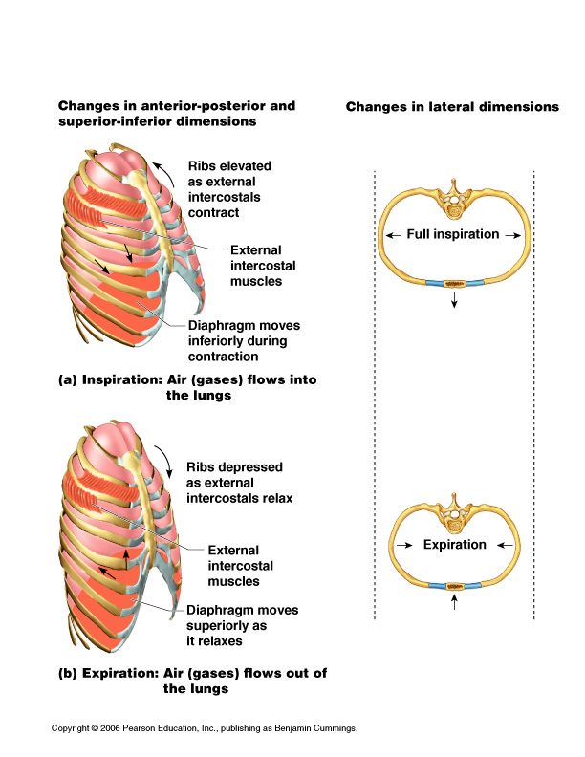
Inspiration/Inhalation
Diaphragm and intercostal muscles contract
The size of the thoracic cavity increases
External air is pulled into the lungs due to an increase in intrapulmonary volume

Slide 34
Expiration
Passive process dependent upon natural lung elasticity
As muscles relax, air is pushed out of the lungs
Forced expiration can occur mostly by contracting internal intercostal muscles to depress the rib cage

Slide 35
Expiration/Exhalation

Slide 37
Ailments of the Respiratory system

Slide 38
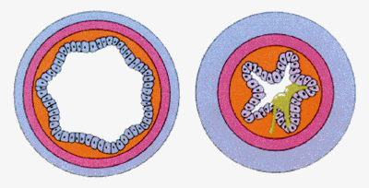
Asthma
Chronic inflammation if the bronchiole passages
Response to irritants with dyspnea, coughing, and wheezing

Slide 39
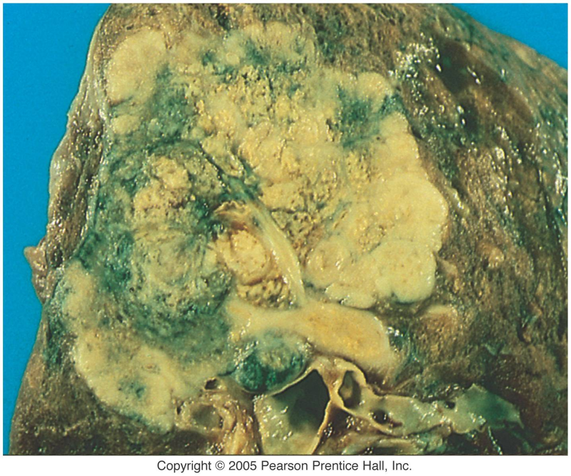
Effects of smoking
Inhaled smoke contains:
CO₂, which affects the CO₂ diffusion gradient.
carcinogenic chemicals that can trigger tumors.
toxic nicotine, which paralyzes cilia that normally clean the lungs.
Gross, isn’t it?

Slide 40
Lung Cancer
Increased incidence associated with smoking
Three common types
  Squamous cell carcinoma
  Adenocarcinoma
  Small cell carcinoma

Slide 41
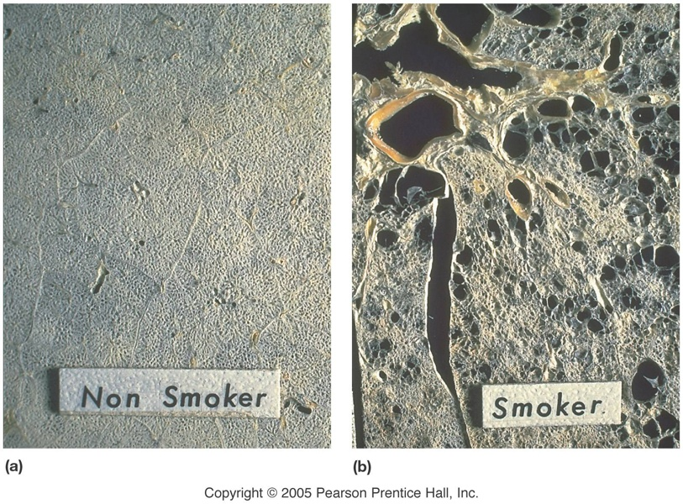
Emphysema
Besides cancer, smoking can also lead to emphysema. Alveoli become dry and brittle, and eventually rupture.
Both active and passive smoking (“second-hand” smoke) can lead to lung problems.
All types of smoke, not just tobacco, can cause cancers and emphysema.

Slide 42
“Two lies and a truth” – which one is true?
Cigarette smoke cures colds because it kills bacteria in the lungs.
Nicotine is one of the most potent neurotoxins on earth.
“Passive” smoking is less harmful than “regular” smoking.

Slide 43
When people quit smoking, if the lungs are not damaged they can often clean themselves because the cilia are no longer paralyzed. People with cystic fibrosis have trouble with lung infections because their lung mucus is thick and sticky. What roles do cilia and mucus play in lung health?
A
P
P
L
I
C
A
T
I
O
N

Slide 44
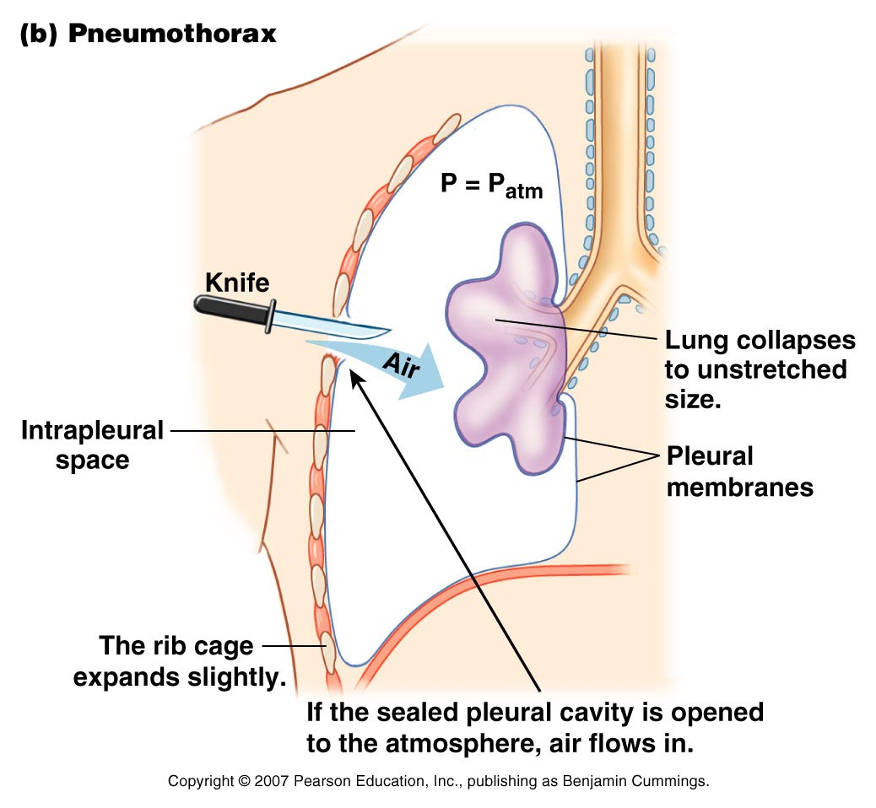
Stab wound in the chest
Results in collapsed lung that can not function normally

