Slide 1
Engineering Economics
ECO 1192
Topic 12: Risk and Uncertainty
Claude Théoret
University of Ottawa

Slide 2
Recommended Reading
Fraser et al. chapter 12
  Newnan et al. Engineering Economics, Canadian Edition, chapter 10
  Park chapter 10
  Riggs, Bedworth, Randhawa and Khan Engineering Economics, 2nd Canadian edition, McGraw-Hill Ryerson, Toronto, 1997

Slide 3
Introduction
Uncertainty
  Sensitivity analysis
Risk Analysis
  Expected value
  Decision Trees
  Monte Carlo Simulations

Slide 4
Introduction
Previous lectures assumed that future project cash flows were known without risk and uncertainty as to their
  timing and magnitude
But these cash flows are essentially “best estimates” and subject to errors.
Future events may be uncertain or risky
  Uncertain if we do not have information about the probability that the event will happen (or not)
  Risky if we have some information about the probability of a future event’s occurrence
This lecture examines decision-making in a risk environment.
  But first some uncertainty rules and principles.

Slide 5
Uncertainty

Slide 6
Uncertainty
Identification of future events (states of nature) is possible
Insufficient information (or unwillingness) to assign the probability of occurrence of the future events.

Slide 7
Sensitivity Analysis
Analysis of the effect on project summary measures (e.g., PW, FW or AEW) of changes to key project input variables (e.g., initial cost, annual revenues and costs, MARR)
Methods include:
  Sensitivity graphs
  Breakeven analysis
  Scenario Analysis

Slide 8
Why perform a sensitivity analysis?
Make better decisions.
Focus managerial attention on key variables.
Identify variables that merit refinement.

Slide 9
Why Actual and Projected Cash Flows Differ
Technological change (changes to production costs)
Changes in the size and number of competing firms
Introduction of new products (substitutes or complements)
Changes to key macroeconomic variables (e.g., inflation, unemployment, economic growth, exchange rate)
International events (globalization)
Three methods are commonly used by analysts to better understand the effect of uncertainty or errors in key project parameters (P; SV, …) on economic decisions
  each method is an example of sensitivity analysis.

Slide 10
Sensitivity (spider) graphs or tables
Provide a measure of the sensitivity of a project’s summary measure (e.g., PW , FW or AEW) to changes in key project parameters
In its most basic form, only one of the key project parameters is changed at a time.

Slide 11
Example: Sensitivity Analysis
  Base Case
    P = $10,000
    SV = $2,000
    AOR = $5,000
    AOC = $1,000
    N = 5 years
    MARR = 10%

Slide 12
Example: Sensitivity Analysis
Annual revenues = $5,000
Annual expenses = $1,000
Salvage value = $2,000
Useful life = 5 years
Initial investment = $10,000
MARR = 10%
NET PRESENT WORTH VALUES (NPW)
 | -15% | -10% | -5% | Base Case | +5% | +10% | +15%
P | 7905 | 7405 | 6905 | 6405 | 5905 | 5405 | 4905
SV | 6219 | 6281 | 6343 | 6405 | 6467 | 6529 | 6591
AOR | 3562 | 4510 | 5457 | 6405 | 7353 | 8300 | 9248
AOC | 6974 | 6784 | 6595 | 6405 | 6215 | 6026 | 5836
N | 4657 | 5253 | 5836 | 6405 | 6961 | 7503 | 8033
MARR | 7093 | 6858 | 6629 | 6405 | 6185 | 5970 | 5760
NPW = 6,405 = -10,000+(5,000-1,000)(P/A,10%,5)+2,000(P/F,10%,5)

Slide 13
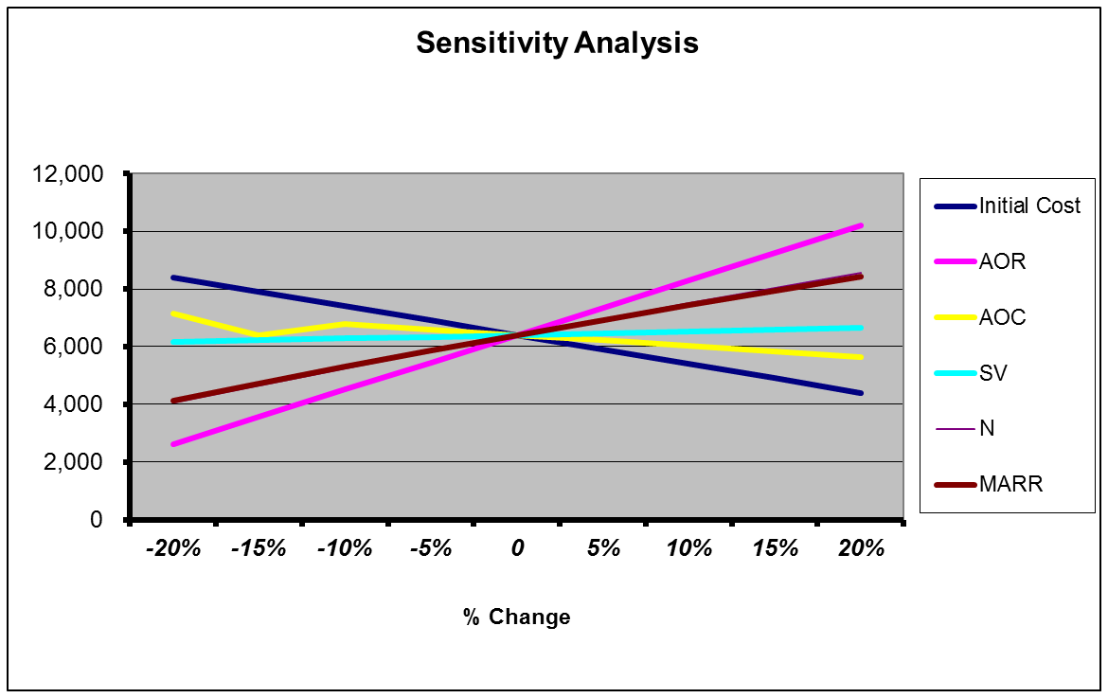
Annual revenues = $5,000
Annual expenses = $1,000
Salvage value = $2,000
Useful life = 5 years
Initial investment = $10,000
MARR = 10%
NPW = $6,405

Slide 14
Sensitivity Indicators
Gross sensitivity
  % ∆ in NPW (or AEW) resulting from ∆⁺ = 10% (for example) to a project parameter (P; SV; MARR …)
Range of influence
  % ∆ in NPW (or AEW) when a project parameter undergoes a change, for example, from -15% to +15%.
Switching value: Does criterion (NPW or AEW) become negative in the +/- 15 percentage change? Yes? No?
  Range of influence includes NPW or AEW
  ≤ $0?

Slide 15
Sensitivity Indicators (cont’d)
4. Switching Ratio
  The percentage (or absolute) change to a parameter to reach a switching value?
    For example, the change to AOR base value to switch PW or AEW from a positive to a negative (or nil) value.
5. Switching Probability
  How likely is the variable to reach its switching value?

Slide 16
Sensitivity Indicators
Annual revenues = $5,000
Annual expenses = $43,000
Salvage value = $2,000
Useful life = 5 years
Initial investment = $10,000
MARR = 10%
Indicators | P | AR | AC | N | MARR
1. Gross Sensitivity [e.g., ∆⁺10%] | -16% | +30%¹ | -6% | +17% | -6%
2. Range of Influence (-/+ 15%) | 47%² | 260% | -16% | +73% | -19%
3. Switching Value | NO | NO | NO | NO | NO
4. Switching ratio | ∆⁺ = 6,405 (+64%) | ∆⁻ = 1,690 (-33.8%) | ∆⁺ = 1,690 (+169%) | ∆⁻ = 2.52 yrs Or -50.4% | ∆⁺ = 214 points Or +214%
5. Switching Probability | 0% | 25% | 10% | 40% | 0%
For notes 1, 2 and 3 : See next slide

Slide 17
Sensitivity Indicators
  Base Case
P = $10,000; SV = $2,000
AR = $5,000; AC = $1,000
N = 5 years; MARR = 10%
If AR increased by 10% (i.e., from $5000 to $5500), PW would increase from $6405 to $8300 ➔ 29.6% (30%) increase
∆⁺15% in P ➔ ∆⁻ PW = (4905-6405) = -1500
  ∆⁻15% in P ➔ ∆⁻ PW
  = (7905-6405) = +1500
  Total change
  (-15%/+15%)
  = 1500+1500 = 3000
PRESENT WORTH VALUES (NPW)
 | -15% | -10% | -5% | Base Case | +5% | +10% | +15%
P | 7905 | 7405 | 6905 | 6405 | 5905 | 5405 | 4905
SV | 6219 | 6281 | 6343 | 6405 | 6467 | 6529 | 6591
AR | 3562 | 4510 | 5457 | 6405 | 7353 | 8300 | 9248
AC | 6974 | 6784 | 6595 | 6405 | 6215 | 6026 | 5836
N | 4657 | 5253 | 5836 | 6405 | 6961 | 7503 | 8033
MARR | 7093 | 6858 | 6629 | 6405 | 6185 | 5970 | 5760

Slide 18
Breakeven value of the initial cost (P*)
Given:
NPW = -P + (AR - AC)(P/A,MARR,N)
+ SV(P/F,MARR,N)
Let x = (P/A,MARR,N) and y = (P/F,MARR,N)
For the NPW = $0
  P* = x(AR-AC) + ySV; or P* = P + NPW

Slide 19
Breakeven value of the annual revenue (AR*)
Given:
NPW = -P + (AR - AC)(P/A,MARR,N)
+ SV(P/F,MARR,N)
Let x = (P/A,MARR,N) and y = (P/F,MARR,N)
  AR* = AC + [(P - y.SV) ÷ x]

Slide 20
Breakeven value of the annual cost (AC*)
Given:
NPW = -P + (AR - AC)(P/A,MARR,N)
+ SV(P/F,MARR,N)
Let x = (P/A,MARR,N) and y = (P/F,MARR,N)
  AC* = AR - [(P - y.SV) ÷ x]

Slide 21
Breakeven value of the salvage value (SV*)
Given:
NPW = -P + (AR - AC)(P/A,MARR,N)
+ SV(P/F,MARR,N)
Let x = (P/A,MARR,N) and y = (P/F,MARR,N)
NPW = -P + x(AR - AC) + y(SV)
  Breakeven: $0 = -P + x(AR - AC) + y(SV)
  Or y(SV) = P - x(AR - AC)
  SV* = [P – x(AR-AC)] ÷ y
  where SV* = Breakeven SV

Slide 22
Switching value of the project’s life (N*)
0 = -P +[(AR-AC)(P/A,MARR,N)]+ SV(P/F,MARR,N)
0 = -P +(AR-AC){(1+MARR)^{N} -1)} ÷{MARR(1+MARR)^{N}} + SV(1+MARR)^{-N}
(1+MARR)^{N} = {SV-((AR-AC)÷MARR)}÷{(P – (AR-AC)÷MARR}
  N* = log10{(SV-(AR-AC)÷MARR)÷(P-(AR-AC)÷MARR)} ÷ log10(1+MARR)

Slide 23
Breakeven value of the project’s discount rate (MARR*)
MARR* = Project’s IRR

Slide 24
Breakeven analysis
Allows the analyst to ask specific questions about the values of key project parameters required to provide zero profits
  used to determine the best competing alternative for specific ranges of project inputs
  for example, would leasing be preferred to buying a truck for specific ranges of truck use (measured in ton-miles during a year)?
The main disadvantage of break-even analysis is that it cannot capture interdependencies among variables
  For example, assuming that operating costs are constant as total sales are changed e.g., increased by +15%) may facilitate the analysis but could lead to incorrect results.

Slide 25
Breakeven analysis (cont’d)
Two methods
  Conventional: the level of a project’s economic activity at which
Costs = Revenues
  Note that a project’s costs and revenues are both considered in determining break-even.
  Modern (Modified): Find the level of economic activity at which the costs of competing alternatives are equal.
  Note that revenues are assumed to be common to all projects and, as a result, are not considered.

Slide 26
Conventional Breakeven Method
Find the level of economic activity at which Costs = Revenues
Types
  linear approach: constant price and unit variable cost; both revenues and costs are linear
  non-linear approach: either the price or the unit variable cost (or both) is variable

Slide 27
Linear Breakeven: Conventional Method
Revenues = $5Q; Variable Cost = $3Q; Fixed Cost = $100

Slide 28
Conventional Method: Non-linear Approach
Three possibilities:
  Linear revenues and non-linear costs
    Revenues = $5Q; Costs = 500 + 10Q + 0.02Q²
  Non-linear revenues and linear costs
    Revenues = 10Q – 2Q²; Costs = 500+10Q
  3. Non-linear revenues and non-linear costs
    Revenues = 10Q – 2Q²
    Costs = 500 + 10Q + 0.02Q²

Slide 29
Non-linear Breakeven : Conventional Approach (Non-linear revenues & costs)

Slide 30
Non-linear Breakeven : Conventional Approach (Linear revenues & non-linear costs)
Revenues,
Costs
Total Revenues
Variable Cost
Total Cost
Fixed Cost
Break
-
even
Economic variable

Slide 31
Non-linear Breakeven : Conventional Approach
(Linear Costs & Non-Linear Revenues)

Slide 32
Revenues,
Costs
Total Revenues
Variable Cost
Total Cost
Fixed Cost
Break
-
even
Economic variable

Slide 33
Linear Breakeven
  Assumptions
no unknowns; no risks
short term analysis (planning horizon) ➔ fixed costs
Costs
  fixed: independent of the level of economic activity (e.g., property taxes, interest on debt)
  variable: vary directly or indirectly with the level of economic activity (e.g., salaries; costs of materials)
  total = total fixed cost + total variable cost
Revenues = price x quantity (product PQ)
  linear approach: constant price (horizontal demand curve)
  non-linear approach: variable price (downward sloping demand curve)

Slide 34
Algebra of Profits (Linear Model)
Revenue = Cost
Profit = Revenue – Cost = n x p - (F + n x V)
where n = quantity;
F = fixed cost; p=price; V=unit variable cost
  Breakeven Algebra
Let B* represent the breakeven point quantity
Therefore, B*p = F + B*V, where 0 < B* < N
Solve for B*: B* = F\(p - V),
where (p - V) is known as unit contribution to fixed cost and profits
Also
B* = np - nV - F = np – nV - n(p-V)
B* = (n-n*)(p-V) where 1 ≤ n* ≤ N

Slide 35
Example : Skate-making plant
Purchase price (P) = $3,710,400; SV = $371,040 in 20 years
N = 20 years; MARR (before-tax) = 20 per cent
Skates: variable production costs = $30.52; selling price = $55
Find breakeven point (i.e., number of skates) using AEW Method
Let "N" represent the number skates produced
  Annual fixed cost
= -3,710,040(A/P,20%,20) + 371,040(A/F,20%,20)
= -$759,830
  Total variable cost = $30.52N
  Total revenues =$55N

Slide 36
Example: Linear revenues and costs
Purchase skate making plant
At breakeven: Costs = Revenues
$759,830 + $30.52N = 55N
N = 31,040 pairs of skates

Slide 37
Modified Breakeven Method: Costs Only (No revenues)
Option 2
Costs
Option 1
Breakeven
Economic variable
-
  1. Find the level of economic activity at which the costs of competing alternatives are
  equal.
  2. Revenues are the same for all projects and, as a result, are not considered.

Slide 38
Example: Costs only
Costs
Breakeven
Economic variable
-
Parameter | New Truck | Old Truck
First Cost ($) | 85,000 | 32,000
O+M ($) | 0.25/ton-mile | 0.33/ton-mile
Life (years) | 15 | 5
Salvage Value ($) | 0 | 0
MARR (%) | 10 | 10

Slide 39
Example: Costs Only
Find breakeven in ton-miles
Costs
Using the Annual Equivalent Method:
Let "X" represent the ton-miles per year
  Annual fixed cost:
  New truck: 85,000(A/P,10,15) = $11,175/yr
  Old truck: 32,000(A/P,10,5) = $ 8,442/yr
  Total annual cost:
  New truck: $11,175/yr + (0.25/ton-mile)(X ton-mile/year)
  Old truck: $8,442/yr + (0.33/ton-mile)(X ton-mile/year)
  Cost of new truck = Cost of old truck
  $11,175/yr + (0.25/ton-mile)(X ton-mile/year)
  = $8,442/yr + (0.33/ton-mile)(X ton-mile/year)
X = 34,163 ton-miles/year
Breakeven
Economic variable
-

Slide 40
Decision: Breakeven in ton-miles
If you expect to
  exceed 34,160 Ton-miles per year, you should consider the New Truck.
  fall short of 34,160 Ton-miles per year, you should consider the Old Truck.
  need a truck for exactly 34,160 Ton-miles per year, you would be indifferent between the Old and the New Truck.

Slide 41
Methods A, B and C to produce widgets (“N” = annual production)
Paramete | A | B | C
P ($) | 5,000 | 10,000 | 8,000
N (years) | 7 | 7 | 7
SV ($) | 0 | 2,000 | 2,000
V ($) | 0.20/unit | 0.15/unit | 0.25/unit
MARR (%) | 8 | 8 | 8
Using AEW Criterion
A: 960.50 + 0.20N
B: 1,696.80 + 0.15N
C: 1,312.60 + 0.25N
where “V” is the unit variable cost

Slide 42
Methods A, B and C to produce widgets (“N” = annual production)
Method C has a higher fixed cost and a higher variable cost than method A
Therefore, Method A will have a lower cost than Method C over the entire range of V
DROP Method C from further consideration given that cost are to be minimized.
Compare the costs of Methods A & B

Slide 43
Methods A, B and C to produce widgets (“N” = annual production)
  Compare Methods A & B
960.50 + 0.20N = 1,696.80 + 0.15N
Solve for break-even: N = 14,726/year
Decision
If the expected annual production volume is less
than 14,726 units per year, implement Method A;
otherwise, implement Method B.

Slide 44
Example: A, B and C are three methods to produce widgets (“N” = annual production)
C
A
Linear Breakeven : Modern Approach
B
Costs
Project B
Project A
0
Breakeven=14,746

Slide 45
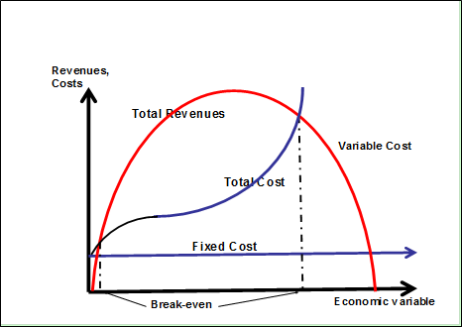
Example: Non-linear breakeven
Revenues = -0.005Q² + 25Q
Total Cost = 0.002Q² +3Q + 2
Find
Breakeven production levels (Q1 & Q2)
Production level for maximum profits (Q*)
Fixed cost at Q*
Variable cost at Q*
Total cost at Q*

Slide 46
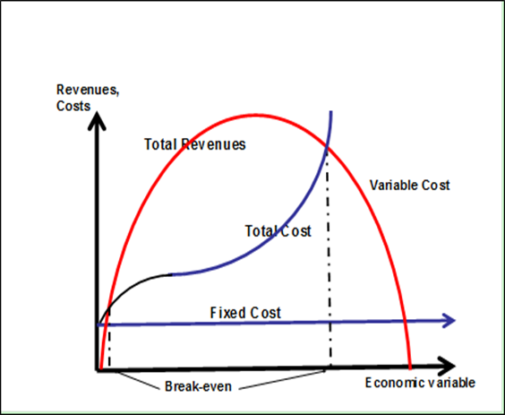
Example: Non-linear breakeven
At break-even, Revenues = Costs
-0.005Q² +25Q - 0.002Q² - 3Q - 2 = 0
-0.007Q² + 22Q - 2 = 0
Hence, Q² – 3142.9Q + 285.7 = 0
[AQ² +BQ + C = 0]
Quadratic Formula
Q1 and Q2 = [-B +/- {B² - 4AC}^{0.5}]/(2A)
[+3142.9 +/- {3142.92 – 4(1)(285.7)}0.5]/(2)
Q1 =3142.9 – 3142.7 ≈ 0; Q2 = 3,143

Slide 47
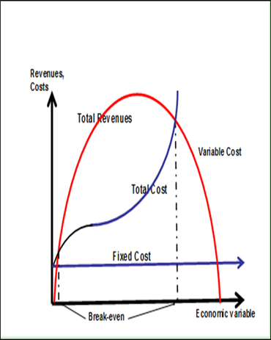
Example: Non-linear Breakeven
From [AQ² + BQ + C = 0]
2. The profit maximizing production level
= -b/2a = -(-3142.9)/2 = 1,572 units
3. Maximum profit = [-b²/4a] + c
= (-3142.9²/4) + 285. 7
= $2,469,740
4. Fixed Cost (at Q=1571.5) = $2
5. Variable Cost (Q=1571.5) = 0.002Q² + 3Q
= 0.002(1571.5²) + 3(1571.5) = $9,654

Slide 48
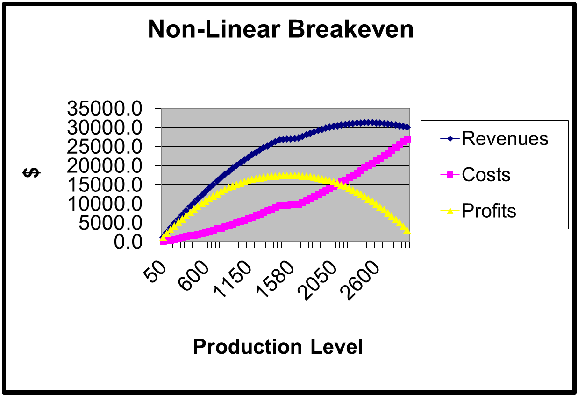

Slide 49
Scenario Analysis
A pessimistic scenario usually contains
  Higher project-related costs (cash outflows)
  Lower project-related benefits (cash inflows)
An optimistic scenario usually contains
  Lower project-related costs (cash outflows)
  Higher project-related benefits (cash inflows)
The expected or most probable scenario usually reflects
A pessimistic scenario usually shows the most likely project-related costs and benefits (obtained the best information currently available).

Slide 50
Scenario Analysis
XYZ Company must decide between projects A and B.
Three scenarios have been developed for each project.
Given the information below, which project would you recommend?

Slide 51
Scenario Analysis: Project A
PROJECT A | Pessimistic Scenario | Expected Scenario | Optimistic Scenario
Project Parameters | MARR = 15%; N = 7 years
Annual capital cost recovery ($) | 52.9 | 48.1 | 45.7
AE fixed cost ($) | 18 | 16.5 | 13
Annual variable cost ($) | 2.35 | 2.25 | 2.2
Annual equivalent salvage value ($) | 0.181 | 0.452 | 0.633
Production volume (thousands of units) | 40 | 50 | 80
Net annual revenues ($) | -34.7 | -14.1 | 26.0

Slide 52
Scenario Analysis: Project B
PROJECT B | Pessimistic Scenario | Expected Scenario | Optimistic Scenario
Project Parameters | MARR = 15%; N = 10 years
Annual capital cost recovery ($) | 72.7 | 69.7 | 63.8
AE fixed costs ($0) | 45 | 35.5 | 25
Annual variable costs ($) | 1.1 | 1.06 | 1.01
Annual equivalent salvage value ($) | 0.837 | 0.985 | 1.13
Production volume (thousands of units) | 40 | 50 | 80
Net annual revenues ($) | -30.9 | 5.2 | 91.6

Slide 53
Scenario Analysis: A and B
Project A
  Has negative annual equivalent revenues for the pessimistic and expected scenarios
  Offers a higher risk of losses than project B
Project B
  In an optimistic environment, B’s profits exceed A’s profits
  profits would be experienced under the expected and optimistic scenarios
Conclusion
  Project A’s bottom line is less attractive than B’s bottom line.

Slide 54
Scenario Analysis: A and B
Decision on the better of projects A and B can be based on weighted averages where the most probable (likely scenario is given more importance (weight)
Weighted Average =
  {Pessimistic value + 4(Most probable value)
  + Optimistic value}/6
Project A = {-34.7+ 4(-14.1)+26}/6} = -10.8
Project B = {-30.9+ 4(5.2)+91.6}/6= 13.6
  Decision: Project B is better than A.

Slide 55
Sensitivity Methods: Pros & Cons
Breakeven Analysis
Pro
  enables quick comparisons (based on one variable) between competing alternatives.
Limitation
  focuses on one parameter and (like sensitivity analysis) does not account for interdependencies among project parameters.

Slide 56
Sensitivity Methods: Pros & Cons
Sensitivity Graphs & Tables
Pros
Identify project parameters that have a significant impact on the performance measure
Target parameters for which reliable estimates are crucial
Limitations
Does not capture interdependencies among project parameters (captured to some degree by a 2-variable sensitivity analysis)
  for example, assuming that operating costs are constant as total sales are changed by 10% or so may facilitate the analysis but could lead to incorrect results.

Slide 57
Sensitivity Methods: Pros & Cons
Scenario Analysis
Pro
  allows for the analysis of
interdependencies among project parameters
Limitation
  Does not allow for the analysis of
the sensitivity of the performance measure (e.g., NPW) to individual project parameters.

Slide 58
Risk Analysis

Slide 59
Risk
Future events are known.
Sufficient information and willingness to impute the probability of occurrence of each future event.

Slide 60
Risk aversion
The individual’s utility (satisfaction) is given by:
U(r = 0%) = 0
U(r = 2%) = 200
U(E[r]) = U(r = 6%) = 600
U(r = 10%) = 800
U
A’
800
U
600
500
200
A
E[U(r)]= 0.5x200 + 0.5x800
= 500 < U(E[r])
2
6
10
r(%)

Slide 61
Other attitudes to risk
Utility
Utility
U
B’
U
C’
500
500
300
225
200
B
100
C
50
2
6
10
r(%)
2
6
10
r(%)
Risk neutral
E[U(r)] = U(E[r])
Risk loving
E[U(r)] > U(E[r])

Slide 62
Sensitivity analysis and probability analysis
We have already examined the sensitivity of a project’s decision criterion (e.g., NPW, AEW) to a range of values of key project parameters (P, SV, N …)
The next logical step would consist of imputing probabilities to each project parameter value.

Slide 63
Probability Analysis
Random variable
  different values
  probability or chance assigned to each value
Discrete random variable (applied in this course)
  finite values
    outcome of football or hockey game: win, loose or draw; tosses of a coin; accidents per year
Continuous random variable
  any real value in a given interval
    soft drinks sold at a football game

Slide 64
Synthesis of probability information
Knowledge of a random variable’s probability distribution will allow us to make more precise project statements.
Not unlike project summary measures used thus far in this course (e.g., NPW, IRR), it would be advantageous to calculate summary measures to summarize a stochastic variable and its distribution.
  Expected value
  Variance and standard variation

Slide 65
Expected value
Weighted average of the stochastic variable based on the probabilities of occurrence of different values of the variable
  E[X] = μ = Σp_{j}x_{j} for all j
  p ≡ probabilities
  x ≡ discrete value of the stochastic variable
The expected value is the centre of the probability “mass”.

Slide 66
Example: Expected value
Scenario | Annual Revenues ($) | Probability
A | 85,000 | 0.2
B | 112,000 | 0.5
C | 314,000 | 0.3
 |  | Σ = 1.0
Expected Value of Annual Revenues
= 0.2(85,000)+0.5(112,000)+0.3(314,000)

Slide 67
Measures of variability:
Variance and standard deviation
The variance indicates the spread or distribution of the expected value
  high variance ➔ high dispersion
  Var[X] = Σ(x_{j} – μ)²p_{j} = E[X²] – (E[X])²
  where μ ≡ expected value
The standard deviation = Var[X]^{0.5}

Slide 68
Expected value, variance and standard deviation
Scenario | Annual Revenues ($) | Probability | p_{j}(x_{j} – μ)²
A | 85,000 | 0.2 | 0.2(85,000 – 167,663)² = $1,356.3 B
B | 112,000 | 0.5 | 0.5(112,000 – 167,663)² = $1,531.8 B
C | 314,000 | 0.3 | 0.3(314,000- 167,663)² = $6,496 B
Expected Value =167,664 |  | Variance = $9,384 B Standard Deviation = $96,871

Slide 69
Example
Project A Projected Cash Flows | Project B Projected Cash Flows | Probability
900 | 400 | 0.2
1000 | 1000 | 0.6
1100 | 1600 | 0.2
Expected Value (A) = 0.2(900)+0.6(1000)+0.2(1100) = $1,000 Expected Value (B) = 0.2(400)+0.6(1000)+0.2(1600) = $1,000 Var(A) = 0.2(900)²+0.6(1000)²+0.2(1100)²-1000² = $4,000 Var(B) = 0.2(400)²+0.6(1000)²+0.2(1600)²-1000² = $144,000 SD(A) = $63.25 SD(B) = $379.47 Var = variance; SD = standard deviation

Slide 70
Example: Threat of Flooding
Some quarters of a large city are below the normal water level of a major river.
To prevent flooding, the city has built minimum retaining walls.
Based on data from the last 70 years, the city experienced flooding of various degrees 42 times.
It is possible to build walls to completely negate the probability of flooding but the building cost is simply prohibitive.

Slide 71
Threat of Flooding

Slide 72
Threat of Flooding: Cost of Wall Construction
AEC of wall (m=0) = 135,000(A/P,10,10) = $21,971
AEC of wall (m=2) = 200,000(A/P,10,10) = 32,550
AEC of wall (m=4) = 280,000(A/P,10,10) = 45,570
AEC of wall (m=6) = 370,000(A/P,10,10) = 60,218
AEC of wall (m=8) = 450,000(A/P,10,10) = 73,238
1. Please note that “m” stands for meters above the
minimum wall height (which is m=0)
2. AEC ≡ annual equivalent cost

Slide 73
Threat of Flooding

Slide 74
Threat of Flooding

Slide 75
Expected Value of Perfect Information
EXPECTED VALUE | ALTERNATIVE | NET PROFITS
 |  | RAIN (prob. = 0.1) | SUNSHINE (prob. = 0.9)
24(0.1)+30(0.9) = $29,400 | Interior (Auditorium) | 24,000 | 30,000
-27(0.1)+90(0.9) = $78,300 | Outside (Lawn) | -27,000 | 90,000
Expected value of perfect information = 24,000(0.1) + 90,000(0.9) = $83,400
Value of perfect information = $83,400 - $78,300 = $5,100

Slide 76
Decision Tree Analysis
A decision tree is a logical structure of a decision problem in terms of the sequence of decisions and outcomes of chance events.
  Example
    Demand for a new household product will depend on the availability and quality of substitutes, household incomes ….

Slide 77
Decision Tree Analysis
Decisions depending on the outcomes of random events force decision makers to anticipate what those outcomes might be as part of the process of analysis.
Decision tree analysis is particularly suited to decisions and events that have a natural sequence in time or space.

Slide 78
Decision Tree Analysis
Basic expected value analysis takes the weighted average over all contingencies.
This can be extended to situations where costs and benefits accrue over several years, as long as the risks in each year are independent of the actions in the previous year.
This cannot be done when either the net benefits or probability of a contingency depend on contingencies that have previously occurred. Decision tree analysis is used in these situations.

Slide 79
Decision Tree Analysis
A decision tree grows from left to right and usually begins with a decision node
  Represents a decision required by the decision maker ➔ a square
Branches extending from the decision node represent decision options available to the decision maker.
A chance node (circles) represents events whose outcomes are uncertain.

Slide 80
Decision Tree Analysis
Branches extending from a chance node (circles) represent the possible outcomes from a chance event
  each branch has an associated probability
It is important that all branches from decision or chance nodes constitute sets of
  mutually exclusive and
  collectively exhaustive consequences

Slide 81
Decision Tree Analysis
When a chance node follows a decision node, the decision maker must anticipate the future risk in decision making.
When a decision node follows a chance node, a decision must be made assuming a particular chance event has occurred.
The rightmost branches are the terminal positions of a decision tree indicating all possible outcomes of the overall decision situation represented by the tree.

Slide 82
Decision Tree Procedure
Develop decision tree.
Execute the rollback procedure (backward induction) on the decision tree from right to left
  Compute the expected value of the possible outcomes at each chance node.
  Select the option with the best expected value. This is the value associated with the decision node and the branch on the left of that node
  Continue rollback process until the leftmost node is reached
Conclusion: Select expected value associated with the final node

Slide 83
Decision Tree Analysis
Profit/unit ($)
Demand High
15
0.6
2
Produce
Demand Low
7
0.4
1
Unit cost increase
8
0.3
Outsource
Constant unit cost
10
3
0.55
Unit cost decrease
12
0.15

Slide 84
Decision Tree Analysis
Profit/unit ($)
Demand High
15
E2=$11.80
0.6
2
Produce
7
E1=$11.80
Demand Low
0.4
1
Price Increase
8
E3=$9.70
0.3
Outsource
Same Price
10
3
0.55
Price Decrease
12
E1 = Max {9.70,11.80} = $11.80
E2 = 0.6(15) + 0.4(7) = $11.80
E3 = 0.3(8) + 0.55(10) + 0.15(12) = $9.70
0.15

Slide 85
Portfolio Decision-Making
High
$500
(0.6)
Low
- $300
High Risk
EV = $180
(0.4)
High
$200
(0.6)
Low Risk
EV = $180
EV = $140
Low
$50
(0.4)
Bank Savings
(No risk)
$100
EV = $100

Slide 86
St. Jacobs Cheese Factory (SJCF)
St. Jacobs Cheese Factory (SJCF) is getting ready for a busy tourist season. SJCF wants to either increase production or produce the same amount as last year, depending on the demand level expected for the coming season. SJCF estimates the probabilities for high, medium, and low demands to be 0.4, 0.35, and 0.25, respectively, on the basis of the number of tourists forecasted by the local recreational bureau.
If SJCF increases production, the expected profits corresponding to high, medium, and low demands are $750 000, $350000, and $100 000, respectively.
If SJCF does not increase production, the expected profits are $500 000, $400 000, and $200 000, respectively.
Construct a decision tree for SJCF.
On the basis of EV, what should SJCF do?
Source: Fraser et al. Engineering Economics, Pearson Education, 6th edition, 2017

Slide 87
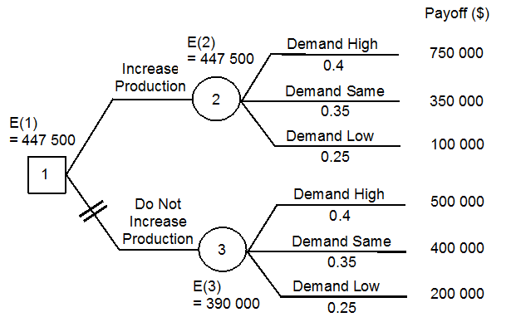
St. Jacobs Cheese Factory (SJCF)
E(2) = Pr{high demand}(750 000) + Pr{medium demand}(350 000)
+ Pr{low demand}(100 000)
= 0.4(750 000) + 0.35(350 000) + 0.25(100 000)
= 447 500
E(3) = 0.4(500 000) + 0.35(400 000) + 0.25(200 000) = 390 000
E(1) = E(2) = 447 500 because E(2) > E(3)
SJCF should increase their production

Slide 88
LOTell Company
LOTell has two options for a new internet service package:
  introduce a combined rate for the residential phone line and the internet access; or
  offer various add-on internet service rates in addition to the regular phone rate.
LOTell has estimated that if it introduces the
  combined rate, it would gain 30 percent, 15 percent, and 3 percent of the market share with rapid, steady, or slow market
  add-on rates, it gains 15 percent, 10 percent, and 5 percent of the market share with rapid, steady, or slow market growth.
Construct a decision tree to assist LOTell in maximizing its market share growth?
Source: Fraser et al. Engineering Economics, Pearson, 6th edition, 2017

Slide 89
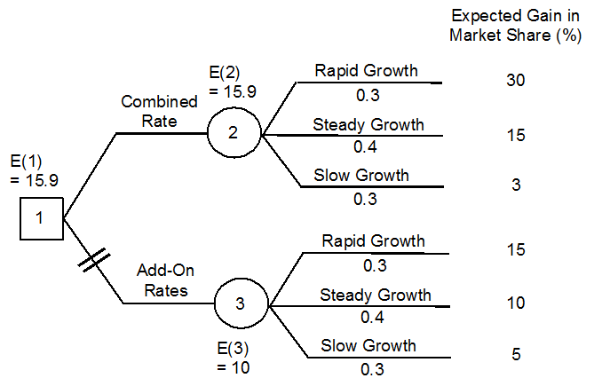
LOTell Company

Slide 90
LOTell Company
E(2) = Pr{rapid growth}(30) + Pr{steady growth}(15) + Pr{slow growth}(3)
= 0.3(30) + 0.4(15) + 0.3(3) = 15.9
E(3) = 0.3(15) + 0.4(10) + 0.3(5) = 10
E(1) = E(2) = 15.9 because E(2) > E(3)
LOTell should introduce the combined rate.

Slide 91
Monte Carlo Simulation
The outcome of a project with one or more random variables is itself a random variable.
  For example, each key project parameter P, SV, MARR …may be a random variable
When several variables or inputs are random variables, the outcome is random and may be difficult to characterize.
Adapted from Fraser et al. Engineering Economics

Slide 92
Pharma-Excel
A pharmaceutical company studying the feasibility of a research project that involves the improvement of vitamin C pills.
Data on the optimistic, expected, and pessimistic scenarios for this project are shown below.
What is the expected annual cost of the vitamin C project assuming that Pharma-Excel’s MARR is 15 percent?

Slide 93
Pharma-Excel
Details | Optimistic | Expected | Pessimistic
Research and development costs at the end of research | $75,000 | $240,000 | $500,000
Lead time to production (years) | 1 | 2 | 3
Probability | 0.15 | 0.5 | 0.35

Slide 94
Pharma-Excel
AW(optimistic, public accept)
= 1 000 000(A/F, 15%, 1) − AC(optimistic)
= 1 000 000(1) − 75 000 = $925 000
AW(optimistic, not accept)
= 200 000(A/F, 15%, 1) − AC(optimistic) = $125 000
AW(expected, public accept)
= 1 000 000(A/F, 15%, 2) − AC(expected)
= 1 000 000(0.46512) − 111 629 = $353 491
AC(optimistic) = 75 000; AC(expected) = $111 629; AC(pessimistic) = $143 990

Slide 95
Pharma-Excel
AW(expected, not accept)
= 200 000(A/F, 15%, 2) − AC(expected) = −$18 605
AW(pessimistic, public accept)
= 1 000 000(A/F, 15%, 3) − AC(pessimistic)
= 1 000 000(0.28798) − 143 990 = $143 990
AW(pessimistic, not accept)
= 200 000(A/F, 15%, 3) − AC(pessimistic) = −$86 394
AC(optimistic) = 75 000; AC(expected) = $111 629; AC(pessimistic) = $143 990

Slide 97
Monte Carlo Simulation
Monte Carlo simulation attempts to construct the probability distribution of an outcome performance measure of a project (e.g., NPW, IRR…) by repeating sampling from the input random variable probability distributions.
The sample frequency distribution generated by Monte Carlo simulation can be a good estimate for the probability distribution of the event outcomes.

Slide 98
Monte Carlo Simulation
In Monte Carlo simulation, the probability distributions of the individual random variables are known in advance.
By randomly sampling values from the random variables from the probability distributions, Monte Carlo simulation produces a sample of the overall performance measure of a project.
Process is seen as imitating the randomness in the performance measure as a result of the randomness of the project variables or inputs.

Slide 99
Monte Carlo Simulation Procedure
Analytical Model
  Identify all input random variables that affect the performance measure of the project.
Probability Distributions
  Provide a probability distribution for each input random variable.
Random Sampling
  Sample a value for each input random variable from its associated probability distribution.

Slide 100
Monte Carlo Simulation Procedure
3. Random Sampling (cont’d) for a discrete random variable
  Create tables relating possible outcomes, associated probabilities and corresponding number assignment ranges
  Use a Table lookup function (in Excel) to assign the appropriate outcomes within given ranges.

Slide 101
Monte Carlo Simulation Procedure
4. Repeat Sampling
  Continue step 3 until a sufficient sampling size is obtained (300 simulations).
5. Summary
  Summarize the frequency distribution of the sample outcomes using a frequency distribution.

Slide 102
Monte Carlo Simulation: Example
A project’s MARR, economic life and salvage value are known with total certainty.
  MARR = 15%
  Life = 10 years
  SV = $0
However, probability distributions are associated with the project’s
  first cost and net annual revenues
Draw the project’s frequency distribution of random NPW values.

Slide 103
Monte Carlo Simulation: Example
First Cost | Probability | Annual Revenues | Probability
1 000 000 | 0.2 | 100 000 | 0.125
1 250 000 | 0.2 | 350 000 | 0.125
1 500 000 | 0.2 | 600 000 | 0.125
1 750 000 | 0.2 | 850 000 | 0.125
2 000 000 | 0.2 | 1 100 000 | 0.125
 |  | 1 350 000 | 0.125
0.2 = 1/5 |  | 1 600 000 | 0.125
0.125 = 1/8 |  | 1 850 000 | 0.125

Slide 104
Monte Carlo Simulation: Example
First Cost ($) | Probability Z₁ | Random Number Assignment Range (Z₁)
1 000 000 | 0.2 | 0 ≤ Z < 0.2
1 250 000 | 0.2 | 0.2 ≤ Z < 0.4
1 500 000 | 0.2 | 0.4 ≤ Z < 0.6
1 750 000 | 0.2 | 0.6 ≤ Z < 0.8
2 000 000 | 0.2 | 0.8 ≤ Z < 1

Slide 105
Monte Carlo Simulation: Example
Annual Revenues ($) | Probability (Z₂) | Random Number Assignment Range (Z₂)
100 000 | 0.125 | 0 ≤ Z₂ < 0.125
350 000 | 0.125 | 0.125 ≤ Z₂ < 0.25
600 000 | 0.125 | 0.25 ≤ Z₂ < 0.375
850 000 | 0.125 | 0.375 ≤ Z₂ < 0.5
1 100 000 | 0.125 | 0.5 ≤ Z₂ < 0.625
1 350 000 | 0.125 | 0.625 ≤ Z₂ < 0.75
1 600 000 | 0.125 | 0.75 ≤ Z₂ < 0.875
1 850 000 | 0.125 | 0.875 ≤ Z₂ < 1

Slide 106
Monte Carlo Simulation: Example
RAND(..)
VLOOKUP(..)
RAND(..)
VLOOKUP(…)

Slide 107
Monte Carlo Simulation: Example

Slide 108
Monte Carlo Simulation: Example

Slide 109
Monte Carlo Simulation: Example
Based on the random assignment of P and AOR values, the project
assumed a negative Present Worth in 34 of 200 trials or 17%.
The project would probably get the green light given that it shows
a positive NPW 86% of the time.

Slide 110
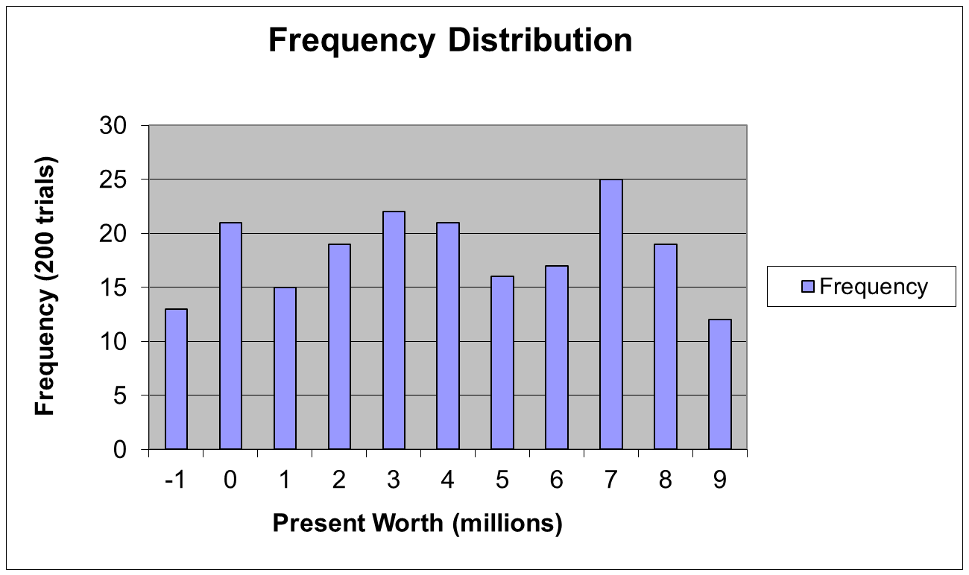
Monte Carlo Simulation: Example

Slide 111
Project Variables
See Excel file for details.

Slide 112
NPW (Expected Values) = $14,126
NPW(EV) = -7400+3900(P/A,7%,6.4)+3000(P/F,7%,6.4) = $14,126

Slide 113
Monte Carlo Simulations = $14,927

Slide 114
Engineering Economics
ECO 1192
Topic 12: Risk and Uncertainty
Claude Théoret
University of Ottawa

