Slide 1
Engineering Economics
ECO 1192
Topic 11: Project Management
Claude Théoret
University of Ottawa

Slide 2
Outline
1. Introduction
2. Project Management Lifecycle (one of many approaches)
  Initiation
  Planning
  Execution
  Monitoring and Controlling
  Closure
3. Project Management Tools
  Work Breakdown Structure
  Gantt Charts
  The Critical Path Method:
    Activity Completion Times
    Time Project Scheduling and the Critical Path Method
    Project Crashing and Time-Cost Tradeoffs

Slide 3
References
Kerzner, Harold Project Management, John Wiley & Sons, 10th edition, 2009.
Meredith, J.R., S. J. Mantel, Jr., Project Management, A Managerial Approach, John Wiley & Sons, 7th edition, 2009.
Pinto, J.K., Project Management, Achieving Competitive Advantage, Pearson, 3rd edition, 2013.
Verzuh, Eric, Fast Forward MBA in Project Management, 3rd edition, Wiley, 2008.

Slide 4
1. Introduction
A project
  A temporary activity that is carried out to deliver a specific product or service; OR
  Organized work toward a predefined goal or objective that requires resources and effort, a unique venture with a budget and schedule.
  … Many other similar definitions.
Project Management
  planning projects
  monitoring their processes
  Implementing deliverables
Challenge
  to bring about goals and objectives of project within constraints of time, scope and budget.

Slide 5
2. Project Management Lifecycle
Dividing work into stages aids the Project Manager (PM) plan resources for each stage, gauge achievements, justify project
Stages (see Fraser textbook)
  Initiation: nature and scope defined (project charter)
  Planning: broken down into modules, sequence, resources
  Execution: work carried out to deliver product or service
  Monitoring and Control
  Closure: ensure customer satisfaction and agreement
Some projects may pass through several iterations when events require “going back to the drawing board”.

Slide 6
2.a) Initiation
Initiated by an “idea” that Management feels worthwhile.
Sponsor identified: project “champion” with resources.
Sponsor leads development of a Project Charter which includes the following components:
  Background: Why? Who benefits?
  Objectives: Key project goals – are they measurable?
  Methodology: What methodology will be used?
  Justification: Is it feasible? Do benefits outweigh costs?
  Requirements: What are the required features and functions?
  Constraints: What restrictions are there (i.e. time and budget requirements)
  Assumptions: What factors are considered “true”?
  Risks: What uncertainties would impact the project? Controllable?
  Deliverables: What outcomes are necessary to meet objectives?

Slide 7
2.b) Planning
With approval of the Initiation Phase, the PM is responsible for developing a detailed project plan (from the project charter).
Project Plan includes
  Project Scope
  Project Team
  Work Breakdown Structure (WBS)
  Project Schedule
  Budget
  Risk Plan
  Communication Plan

Slide 8
2.c) Execution
Perform actual work on the project.
Initiating processes defined in the project plan.
PM selects the team and coordinates people and resources to produce the deliverables.

Slide 9
2.d) Monitoring and Controlling
This process takes place through the execution stage.
PM tracks progress such that potential problems are identified and corrective action taken.
This stage includes:
  Reviewing project activities.
  Monitoring project constraints.
  Identifying corrective actions.
  Implementing changes.

Slide 10
2.e) Closure
Closure
  occurs when all activities in the project charter are completed
  the project is signed off with the sponsor.
  the team is disbanded.
  a report documents the conclusion of the project, assessing its performance.
“Lessons learned” should be noted.
Includes documents that indicate that the sponsor has accepted final deliverables.

Slide 11
3. Project Management Tools
This is the stage at which project viability is analyzed.
Three tools are considered:
  Work Breakdown Structure (WBS)
  Gantt Chart
  CPM Networks

Slide 12
3.a) Work Breakdown Structure (WBS)
Used to organize all project work
  Decomposes a project into smaller units.
Lowest level is “work package” representing a deliverable.
Useful tool to avoid potential duplication of activities.
Two depictions:
  Diagram (chart) that resembles an organizational chart.
  Indented list.

Slide 13
Example: Fraser et al. Figure 11.1
Primary activities in constructing a simple Beam Bridge:
  Setting up site services.
  Preparing the site.
  Building the substructure.
  Building the superstructure.
  Building the deck.
  Site clean-up.
  Figure 11.1 depicts the first two levels of the WBS.
  Table 11.1 shows an indented view of same.

Slide 14
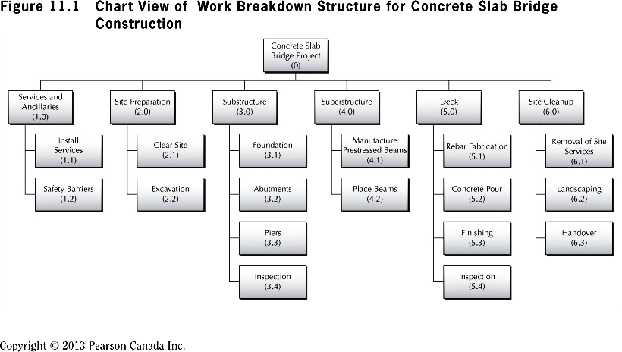
Figure 11.1 Chart View of WBS for Concrete Slab Bridge Construction

Slide 15
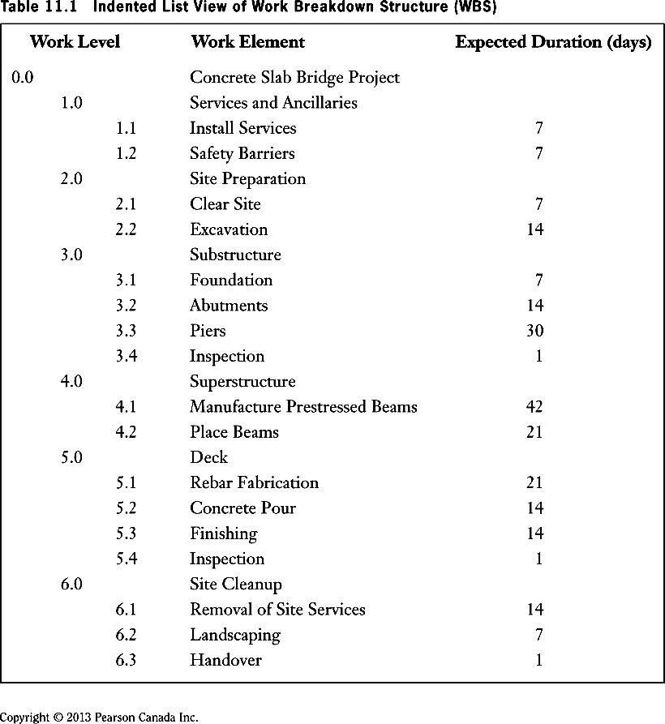

Slide 16
3.b) Gantt Charts
Gantt charts
  depict timing and sequence of project activities.
  simplest, most fundamental tools available.
  consist of a list of work items and a diagram indicating when each item begins and ends.
  start from the Work Breakdown Structure (WBS).
Figure 11.2 is a Gantt chart for the concrete slab bridge project of Example 11.1
One activity ➔ one row.
Bars indicate the start and finish times of activities.
Diamonds indicate an event.

Slide 17
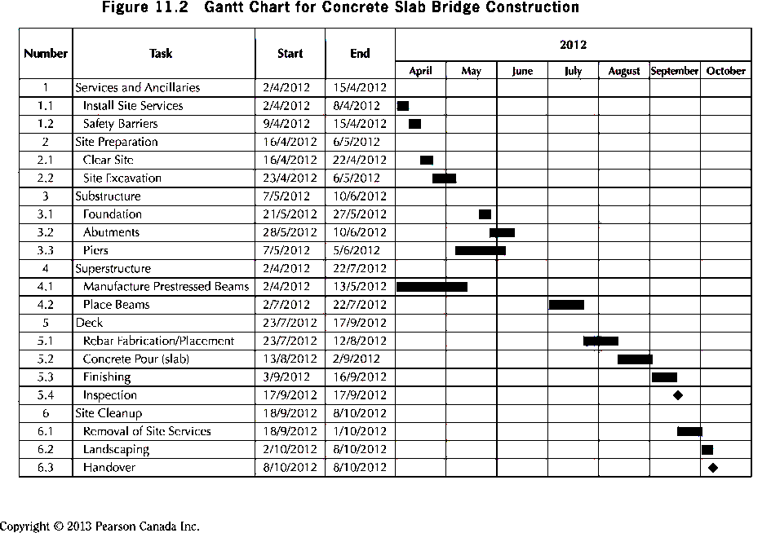
Gantt Chart for Concrete Slab Bridge Construction

Slide 18
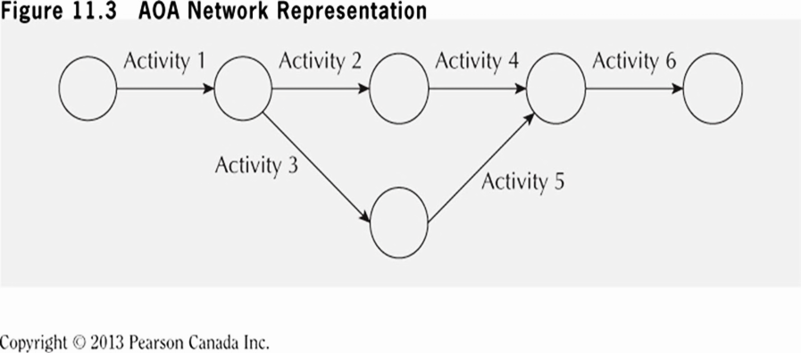
3.c) The Critical Path Method (CPM)
Gantt has lead to development of more sophisticated scheduling methods:
  CPM (Critical Path Method)
  PERT (Project Evaluation and Review Technique)
PERT is designed to add uncertainty to task times.
The two have been integrated into present PERT/CPM.
Project activities are represented by “nodes” and “arcs”
See Fraser et al. Figure 11.3.3 AOA.

Slide 19
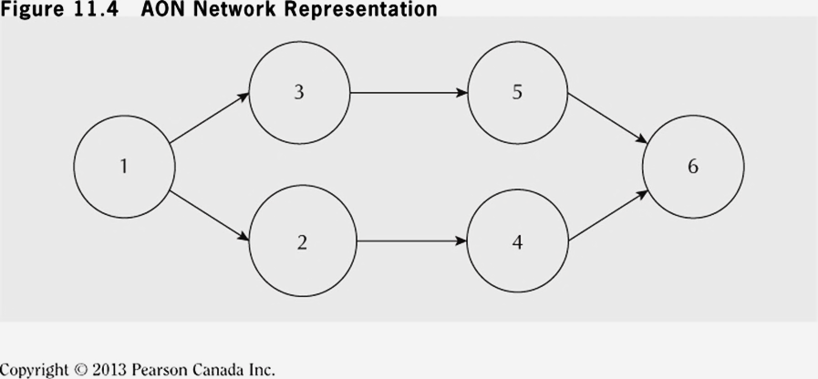
3.c) The Critical Path Method (cont’d)
Second style is “activity on node” (AON)
Nodes represent the activities instead of the arcs.
Has become most popular method – used from now on.
See Fraser et al. Figures 11.3 and 11.4.

Slide 20
Your Turn!!! [Fraser 11.15]
Activity | 1 | 2 | 3 | 4 | 5 | 6 | 7 | 8 | 9 | 10
Predecessor | - | 1 | 2 | 2 | 4 | 3,5 | 6 | 3,5 | 7,8 | 9
Duration | 6 | 4 | 6 | 7 | 9 | 3 | 3 | 5 | 3 | 2
Construct an
1. AOA network representation for the project.
2. AON network representation for the project.

Slide 21
New Pickling Plant
Activity | Description | Expected Completion Time (weeks) | Predecessor Activities
1 | Obtain RFPs | 6 | ----
2 | Select vendor | 4 | 1
3 | Order Equipment | 6 | 2
4 | Design new layout | 7 | 2
5 | Implement layout | 9 | 4
6 | Install computers | 3 | 3,5
7 | Configure Software | 3 | 6
8 | Install equipment | 5 | 3,5
9 | Test system | 3 | 7,8
10 | Train users | 2 | 9
Fraser and Jewkes, Engineering Economics, 5th edition, Pearson Education, 2015.

Slide 22
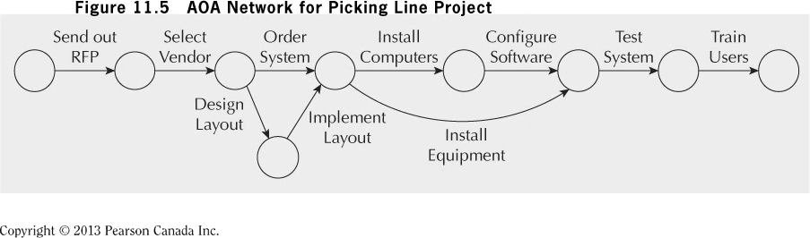
Fraser and Jewkes, Engineering Economics, 5th edition, Pearson

Slide 23
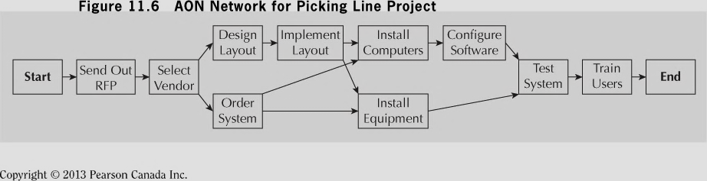
Fraser and Jewkes, Engineering Economics, 5th edition, Pearson

Slide 24
Gantt Chart
Activity | 1 | 2 | 3 | 4 | 5 | 6 | 7 | 8 | 9 | 10
Predecessor | - | 1 | 2 | 2 | 4 | 3,5 | 6 | 3,5 | 7,8 | 9
Duration | 6 | 4 | 6 | 7 | 9 | 3 | 3 | 5 | 3 | 2

Slide 25
Selected Definitions
Earliest start (ES) date
  The earliest possible time an activity can start based on network logic and schedule constraints
  Can change as the project progresses.
  Determined by working forward in the network of activities
  ES = Maximum (EF of immediate predecessors)
Earliest finish (EF) date = ES + activity duration
Latest start (LS) date
  The latest possible time an activity may begin without delaying a milestone.
  Determined by working backward on the network of activities
Latest finish (LF) = LS + activity duration
LF = Minimum (LS of successor activities)
Predecessors
  Activities that must be completed before initiation of another or other activities.
Successors
  Future activities that cannot begin (start) until previous activities are completed.

Slide 26
Selected Definitions
Path
  A sequence of activities defined by the project logic.
Critical Path (Activities for which ES=LS and EF=LF)
  The project path (start to finish) with the longest duration.
  Activities on the critical path have no slack (float).
  Can change activity completion (at a higher than normal cost) if “crashable”.
Slack (float)
  The amount of time an activity can be delayed without delaying the completion of the project.
  Slack = (LS-ES) = (LF-EF)

Slide 27
Forward Pass (from start to end)
Add all activity times along each path as you move through the network (left to right).
Carry the EF time to the activity nodes immediately succeeding the last completed node.
  the EF of the previous node becomes the ES of the next node unless the next node is a merge
    two or more preceding activities must be completed before this activity can begin.
    at a merge point, the largest EF becomes the ES for that node.

Slide 28

Burst Activity A
B
Burst Activity A
C
D
Activities B, C and D can begin only upon completion of activity A

Slide 29
Backward Pass (from end to start)
Subtract activity times along each path as you move through the network.
Carry back the LS time to the activity nodes immediately preceding the successor node
  That LS becomes the LF of the next node unless the preceding activity is a burst point.
  At a burst point, the smallest LS becomes the LF for that node.

Slide 30
Merge Activity D
Activity D
Its earliest start (ES) is equal to the LATEST earliest finish (EF) of activities A,B and C.
A
B
Merge Activity D
C
Activity D cannot begin until activities A, B and C have been completed.

Slide 31
Selected Formulas
EF = ES + T
LS = LF - T
ES = Maximum (EF of immediate predecessors)
LF = Minimum (LS of successor activities)
Slack (S) = LS – ES = LF – EF
ES = earliest start; EF = earliest finish
LS = latest start; LF = latest finish

Slide 32
Keeping Track of Activity Information
One method: used by Pinto
ES | ID | EF
Slack | Description of activity
LS | Duration | LF
Method used by Fraser et al.
Duration Of Activity | Activity number and description
 | ES | EF
 | LS | LF

Slide 33
3.c) Project Scheduling and the Critical Path Method
Network representation along with precedence relationships enables PM to identify critical path
Critical path
  set of activities that must be completed exactly as planned to keep project on schedule
  no slack time or “wiggle” room.
Delaying any one activity will cause Project Delay.
Finding critical path involves two passes through the network
  Forward Pass (1st pass: left ➔ right)
    earliest start/finish (ES/EF) times for each activity is determined
  Backward Pass (2nd pass: right ➔ left)
    starts with completion time (established in 1st pass) and computes latest time each activity can start and finish (LS/LF)

Slide 34
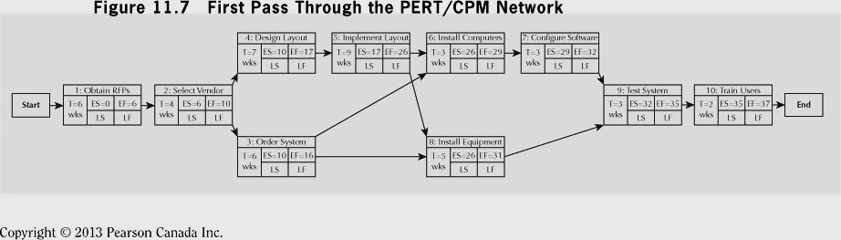
Complete ES and EF
Source: Fraser and Jewkes, Engineering Economics, 5th edition, Pearson

Slide 35
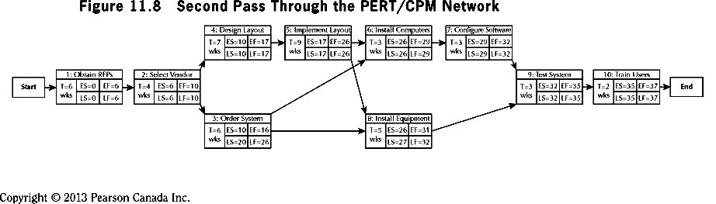
EF = ES + T; LS = LF - T
ES = Max(EF of immediate predecessors)
LF = Min(LS of successor activities)
S = LS – ES = LF - EF
Determine LS and LF
Fraser and Jewkes, Engineering Economics, 5th edition, Pearson

Slide 36
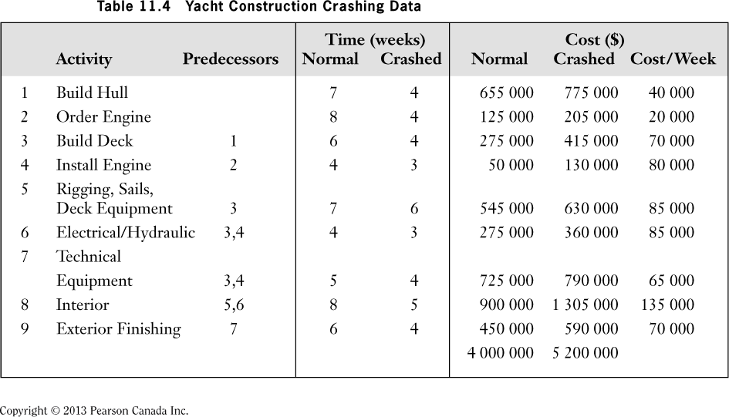
Table 11.4 Yacht Construction Data

Slide 37
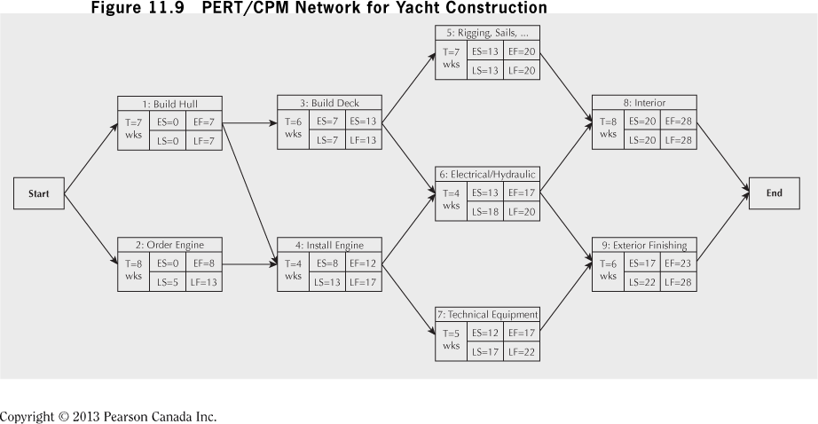
PERT/CPM Network for Yacht Construction
Critical Path
The CPM network presented below shows completion time of 28 weeks
Critical Path: Activities 1-3-5-8; Time required = 28 weeks

Slide 38
Duration estimations
Experience
  What worked in the past may not necessarily work today
  Possible use of outdated or distorted information
Expert opinion
  Some caveats
Mathematical derivation
  Based on
    best-case, most likely case and worst-case scenarios.
    probability distributions
      Symmetrical (normal distributions)
      Asymmetrical (Beta distributions)
  Least subjective of three estimations.
Not examination material

Slide 39
Normal distribution
The probability of an event taking the most likely time is centered on the mean
  The pessimistic and optimistic cases are
    symmetrical about the mean
    at opposite ends of the distribution (at the 95% confidence level) and cancel each other.
  The mean duration = expected duration.
Not examination material

Slide 40
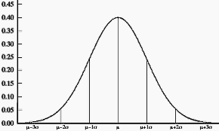
Normal Distribution
Not examination material

Slide 41
Beta distribution
Unlikely that the optimistic and pessimistic durations are symmetrical about the mean.
  Example
    the optimistic duration may lie within 1 standard deviation from the mean;
    the pessimistic duration may lie several deviations from the mean.
Not examination material

Slide 42
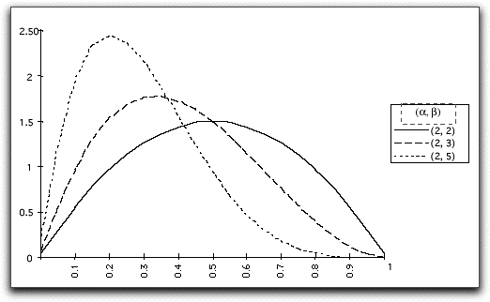
Beta Distributions
Not examination material
Asymmetric distributions are obtained by choosing alpha and beta to be different.
The picture shows several cases with alpha held constant at 2.
The greater the difference between alpha and beta the greater the asymmetry.
The asymmetric examples are all skewed to the right because alpha is less than beta.
To obtain distributions skewed to the left choose alpha greater than beta.

Slide 43
Beta Distribution
TE = estimated time for completing an activity.
a = most optimistic time for completing an activity
b = most pessimistic time for completing an activity
m = most likely time for completing an activity.
Assumptions
  A spread of 6 standard deviations (3 on each side of the mean) gives a 99.7% confidence level.
  Using Beta distributions (as opposed to normal distributions)
      Variance (S²) = [(b-a)/6]²
      TE = (a+4m+b)÷6
Not examination material

Slide 44
Estimates of Activity Durations
Note: The project’s critical activities are shown in yellow boxes.
Activity | Description | Optimistic (a) | Likely (m) | Pessimistic (b) | Estimated Time (TE) | Variance
A | Contract signing | 3 | 4 | 11 | (3+11+4x4)/6 = 5 | 1.78
B | Questionnaire | 2 | 5 | 8 | (2+8+4x5)/6 = 5 | 1.00
C | Target Market ID | 3 | 6 | 9 | (3+9+4x6)/6 = 6 | 1.00
D | Survey Sample | 8 | 12 | 20 | (8+20+4x12)/6 = 12.7 | 4.00
E | Presentation | 3 | 5 | 12 | 5.8 | 2.25
F | Analysis | 2 | 4 | 7 | 4.2 | 0.69
G | Demographic analysis | 6 | 9 | 14 | 9.3 | 1.78
H | Final presentation | 1 | 2 | 4 | 2.2 | 0.25
 | See Pinto, Project Management, Tables 9.2 and 9.3
Not examination material

Slide 45
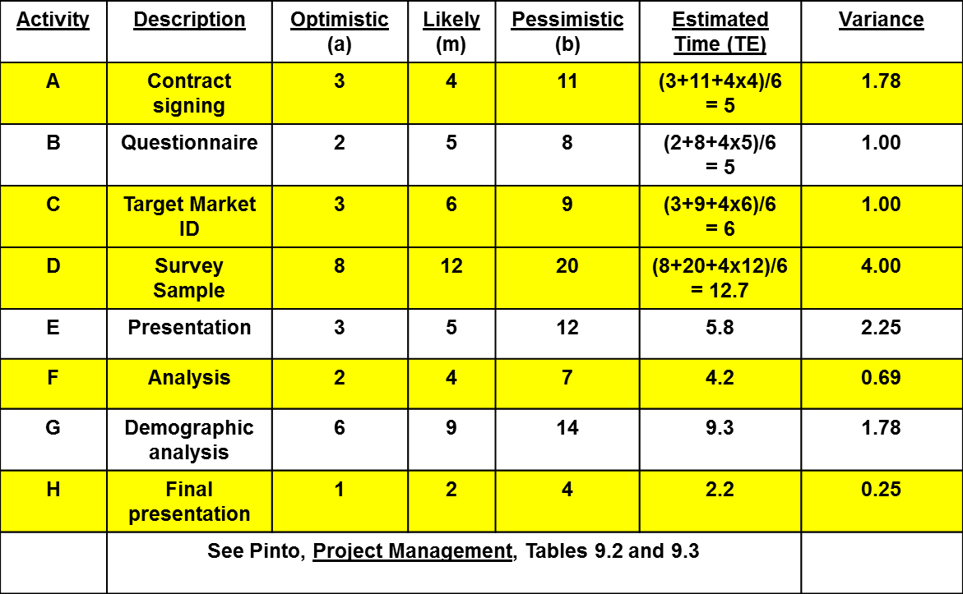
Possible Project Duration Times
Project variance = Σ variances of activities on critical path
= 1.78 + 1.00 + 4.00 +0.69 + 0.25 = 7.72
Project standard deviation = 7.72^{0.5} = 2.78 weeks
Assume that the project’s critical path = 30 weeks.
  This means that there is a 50-50 chance that the project will be completed in
    30+2.78 = 32.78 weeks; OR
    30-2.78 = 27.22 weeks.
Not examination material

Slide 46
What is the probability that the project would be completed within a critical time?
Our most likely activity durations indicate that the project would be completed in 30 weeks (=critical path).
However, it could take more or less time to complete.
Assume that the project MUST BE COMPLETED in 32 weeks
  Example: a major contract would be lost if not completed in 32 weeks.
The project’s standard deviation = 2.78 weeks.
What is the chance that the project will be completed within the absolute maximum time of 32 weeks?
Not examination material

Slide 47
What is the probability that the project would be completed within a critical time?
Assume a normal distribution.
The standard normal equation is
Z = (Maximum completion time - Expected date of completion) / standard deviation
Z = (32-30)/2.78 = 0.72
From the normal distribution table, a Z score of 0.72 translates as a 72.42% chance that the project would be completed within 32 weeks.
Probability (T≤ 32 weeks) = 72.42%
Not examination material

Slide 48
Some options for reducing the critical path
Eliminate tasks on critical path.
Reconfigure serial paths to parallel paths.
Overlap sequential paths.
Shorten critical path tasks.
Shorten longest tasks.
Shorten easiest tasks.
Shorten least costly tasks.
…

Slide 49
Yacht Construction Crashing Data
Activity 1 crash cost per week = (775 000-655 000)/(7-4) = $40 000

Slide 50
Project Crashing and Time-Cost Trade-offs
Strength of CPM is mechanism for crashing project.
  i.e. reduce completion time with additional resources
Resources can be overtime, extra equipment, additional staff – all at greater cost.
  ===================================
Tasked with Project Management of building a yacht
Overall budget is $4M (see Table 11.4)
Planned completion is 28 weeks, but customer has asked for price on speeding delivery up by 5 weeks
Table 11.4 shows how much each activity can be crashed and its crash costs.

Slide 51
Project Crashing and Time-Cost Trade-offs
To deliver the yacht earlier, one or more activities on the critical path (CP) must be crashed according to procedure:
Identify activities least expensive to shorten
Shorten max amount (or until another CP occurs)
Repeat until desired project completion is attained
Use crash cost/unit time to know activities to crash
Crash Cost/unit time
= (Crash cost-Normal cost)/(Crash time-Normal time)
Assumes a linear relationship as shown in Figure 11.10
From Table 11.4 cheapest activity to crash is Activity 1
But…how much? Ensure another CP isn’t created!

Slide 52
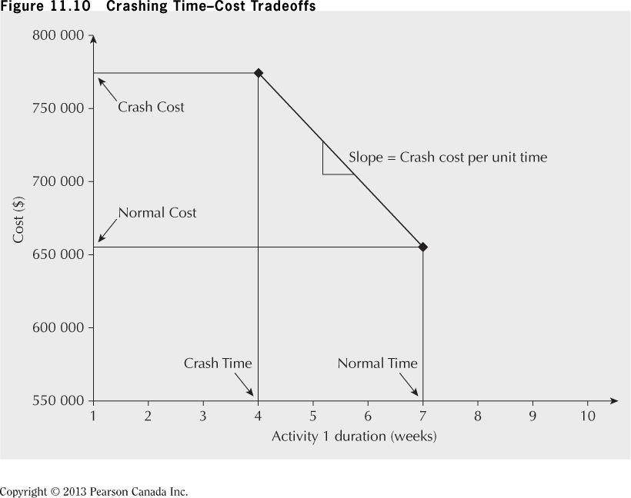
Crashing Time Cost Trade-offs

Slide 53
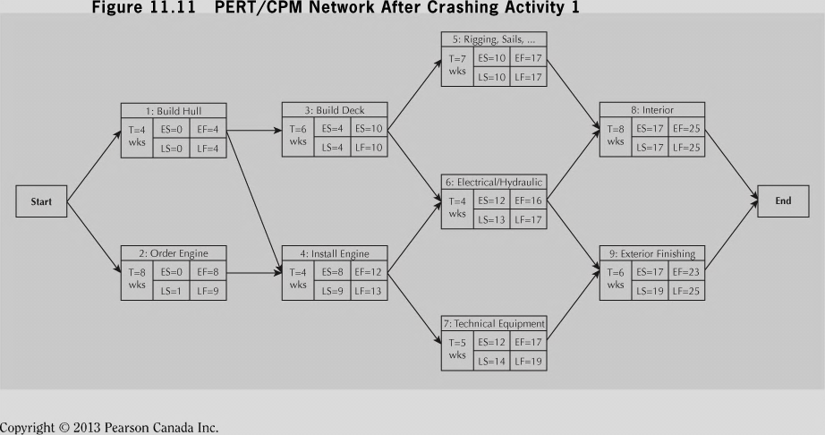
Example 11.5 (cont’d)
Activity 1 can be fully crashed to 4 weeks ($40 000 per week)
Update diagram to reflect new schedule.
PERT/CPM Network after Crashing Activity 1

Slide 54
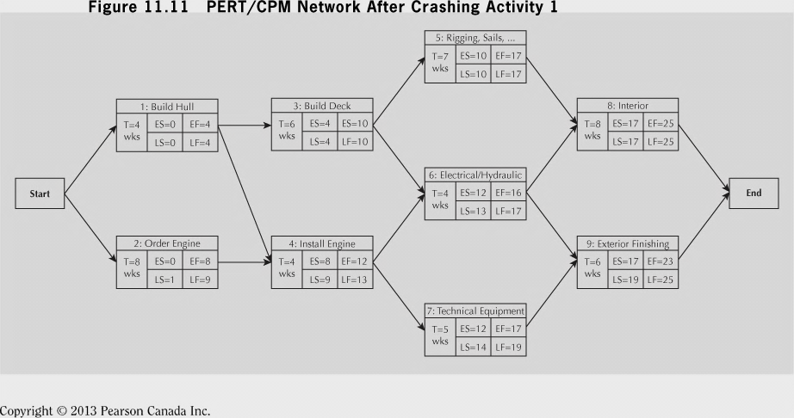
After completely crashing activity 1
New completion time is now 25 weeks and critical path is still 1-3-5-8
Slack in activities 2, 4, 6 is one week; 7, 9 is two weeks
From Table 11.4, next cheapest activity is Activity 2
Can be crashed two weeks at $70 000 per week
BUT… duration can only be reduced 1 week before other critical path opens! (Activity 4, 6 become active)
Figure 11.12 shows result of crashing Activity 3 by 1 week – tow critical paths open, 1-3-5-8 and 2-4-6-8
Both have duration of 24 weeks.

Slide 55
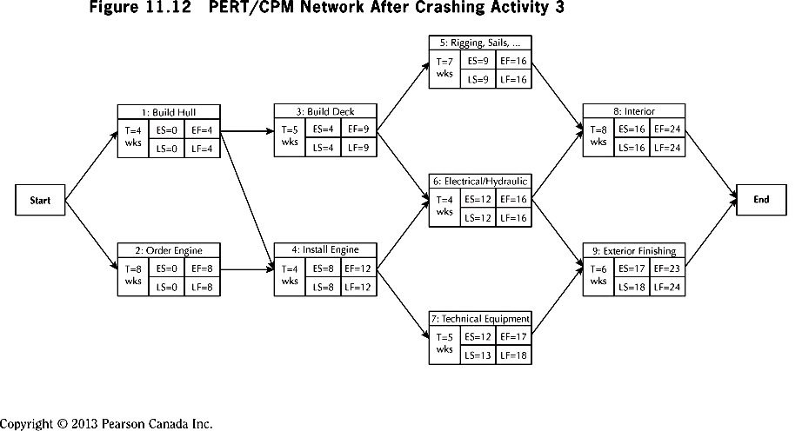
PERT/CPM Network after Crashing Activity 3

Slide 56
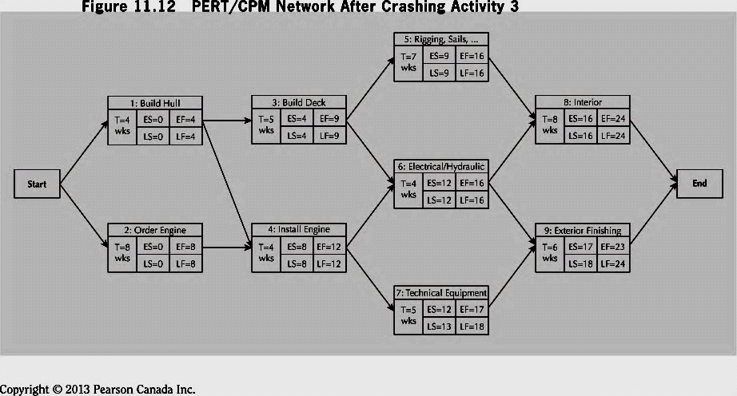
PERT/CPM Network after Crashing Activity 3
When two paths are simultaneously critical, both paths must crashed for least total cost.
Inspection of Figure 11.12 reveals:
Reduce Activities 3 and 4 by 1 week each for $150 000
Reduce Activities 5 and 6 by 1 week each for $170 000
Reduce Activity 8 by one week for $135 000
Reason only 1 week required is that Activity 8 is common to both paths.
Despite higher individual cost it is least expensive option to reduce the project by the extra week!

Slide 57
Your Turn!!! [Fraser et al. 11.11]
Activity | 1 | 2 | 3 | 4 | 5 | 6 | 7 | 8 | 9
Predecessor | - | - | 1 | 1,2 | 1,2 | 3 | 4,5 | 5,7 | 6,8
Duration | 3 | 2 | 4 | 4 | 2 | 4 | 8 | 3 | 1
(a) Construct a Gantt chart assuming each activity starts at the earliest time possible.
(b) How long will the project take to complete?
(c) Compute the ES, EF, LS, and LF times for each activity using a CPM network.
(d) What is the critical path?
(e) Which activities have slack?
(f) How much slack does each activity have?

Slide 58
Activity | 1 | 2 | 3 | 4 | 5 | 6 | 7 | 8 | 9 | 10 | 11 | 12 | 13 | 14 | 15 | 16 | 17 | 18 | 19 | 20
1
2
3
4
5
6
7
8
9
10
Activity | 1 | 2 | 3 | 4 | 5 | 6 | 7 | 8 | 9
Predecessor | - | - | 1 | 1,2 | 1,2 | 3 | 4,5 | 5,7 | 6,8
Duration (T) | 3 | 2 | 4 | 4 | 2 | 4 | 8 | 3 | 1

Slide 59
Critical Path = 19 weeks
Activity 7: Duration=8 wks
ES=7 EF=15
Activity 3: Duration=4 wks
Activity 5: Duration=2 wks
LS= 7 LF=15
ES=3 EF=7
ES=3 EF=5
LS= 10 LF=14
LS=5 LF=7
Activity 1: Duration=3 wks
S
T
A
R
T
ES=0 EF=3
Activity 8: Duration=3 wks
LS=0 LF=3
Activity 6: Duration=4 wks
ES=15 EF=18
ES=7 EF=11
LS=15 LF=18
Activity 2: Duration=2 wks
LS=14 LF=18
ES=0 EF=2
LS=1 LF=3
Activity 9: Duration=1 wk
E
N
D
Activity 4: Duration=4 wks
ES=18 EF=19
ES=3 EF=7
LS=18 LF=19
LS=3 LF=7
Activity | 1 | 2 | 3 | 4 | 5 | 6 | 7 | 8 | 9
Predecessor | - | - | 1 | 1,2 | 1,2 | 3 | 4,5 | 5,7 | 6,8
Duration | 3 | 2 | 4 | 4 | 2 | 4 | 8 | 3 | 1

Slide 60
Normal Cost Activities
Activity | Time | ES | EF | LS | LF | S
1 | 3 | 0 | 3 | 0 | 3 | 0
2 | 2 | 0 | 2 | 1 | 3 | 1
3 | 4 | 3 | 7 | 10 | 14 | 7
4 | 4 | 3 | 7 | 3 | 7 | 0
5 | 2 | 3 | 5 | 5 | 7 | 2
6 | 4 | 7 | 11 | 14 | 18 | 7
7 | 8 | 7 | 15 | 7 | 15 | 0
8 | 3 | 15 | 18 | 15 | 18 | 0
9 | 1 | 18 | 19 | 18 | 19 | 0
Critical Path = 1,4,7,8,9

Slide 61
Your Turn!!
Activity | Optimistic (a) | Likely (m) | Pessimistic (b) | Immediate Predecessors
A | 1 | 4 | 7 | --
B | 2 | 6 | 10 | --
C | 3 | 3 | 9 | B
D | 6 | 13 | 14 | A
E | 4 | 8 | 14 | A,C
F | 6 | 6 | 16 | B
G | 2 | 5 | 8 | D,E,F
See Pinto, Project Management, Chapter 9, Problem 6.
Not examination material

Slide 62
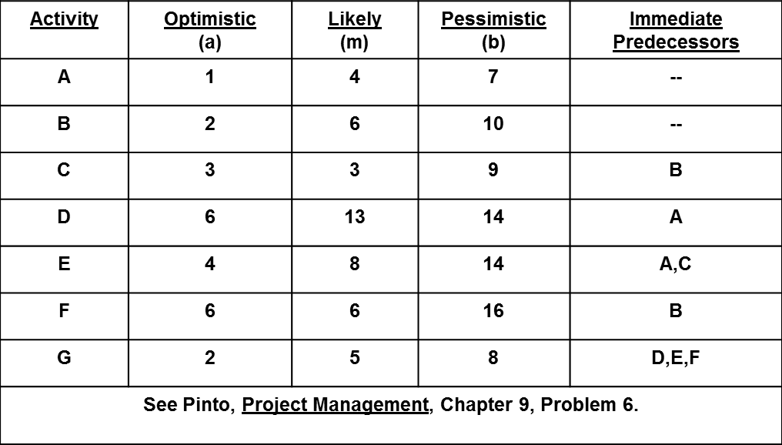
Calculate the expected activity times (TE).
Identify the critical activities.
Calculate the total project length (critical path).
Identify the project’s burst and merge activities.
Given the activity variances, what is the likelihood that the project will finish on week 24?
If you wanted to be 99% confident in the project finishing on time, how many additional weeks would you need to negotiate for in order to gain the 99% confidence level?
Not examination material

Slide 63
Your Turn!!
Activity | Optimistic (a) | Likely (m) | Pessimistic (b) | Immediate Predecessors | Expected Completion Times (TE)
A | 1 | 4 | 7 | --
B | 2 | 6 | 10 | --
C | 3 | 3 | 9 | B
D | 6 | 13 | 14 | A
E | 4 | 8 | 14 | A,C
F | 6 | 6 | 16 | B
G | 2 | 5 | 8 | D,E,F
See Pinto, Project Management, Chapter 9, Problem 6.
Not examination material

Slide 64
Summary
Project management lifecycle:
  Initiation
  Planning
  Execution
  Monitoring and Controlling
  Closure
Important project management tools:
  Work Breakdown Structure
  Gantt Charts
  CPM
  Project Scheduling and the Critical Path
  Project Crashing and Time-Cost Tradeoffs

Slide 65
Engineering Economics
ECO 1192
Topic 11: Project Management
Claude Théoret
University of Ottawa

