Slide 1
Engineering Economics
ECO 1192
Topic 7: Depreciation, Accounting and Financial Analysis (Ch. 6)
Claude Théoret
University of Ottawa

Slide 2
Recommended Reading
Fraser et al.* chapter 6
  Newnan et al. chapter 18
  Park chapter 13

Slide 3
Lecture Focus
Accounting
  financial
  management
Performance Measurement
  the balance sheet
  the income statement
  the statement of changes in financial position
Analysis of financial statements
  financial ratios

Slide 4
Lecture Focus
Preparing a Business Plan
  Executive Summary
  Company Description
  Market Analysis/Future Outlook
  Management and Organization
  Funding Requirements
  Sales and Marketing

Slide 5
Financial Accounting
Recording and organizing business financial data
  revenues and expenses and
  levels (resources and claims on resources at a given time)
Used for budgeting, cash management, and management of long-term debt
  By external users (investors, creditors) to make rational choices about a business
Includes the preparation of:
    Balance sheets
    Income statements
    Changes in financial position

Slide 6
Management Accounting
Analysis of the costs and benefits of business activities
  provides managers with information for decision-making
Engineers are increasingly involved in business decision-making
  need both financial and management accounting

Slide 7
Performance Measurement
Flow of money in a firm is like the flow of water in a pipe or electricity in a wire
  water pressure and voltage are “across variables” measured at a point in time (a snapshot)
  water and electrical flow are measured as “through variables” over time (a second; week; etc)
Income statement
  a “through variable” or “flow” variable
  measures the flow of income and expenses during a specific period of time (over time such as a year, a quarter …)
Balance sheet
  an “across variable” or “stock” variable
  measures assets, liabilities and net worth at a point in time (i.e., a snapshot)

Slide 8
Assets, Liabilities and Equity
Assets
  Anything of value that a business possesses and can use to produce a profit.
Liabilities
  Debt of the business i.e., amounts owed to non-owners.
Owner’s equity
    Property rights of of stockholders calculated as total assets minus total liabilities aka « Net Assets ».

Slide 9
Financial Accounting Statement: Balance Sheet
Assets (business resources)
  Current
  Long term
Liabilities (business debt)
  Current
  Long term
Equity (ownership)

Slide 10
Balance Sheet: Assets
  Economic resources of a business
Current assets
  can be converted to cash within a short time (one year for this course)
    Example: accounts receivable
Long-term assets
  not expected to be converted to cash in the relatively near future (over one year for this course)
    Example: equipment, land and buildings
Total Assets = Current Assets + Long-Term Assets

Slide 11
Balance Sheet: Liabilities
Claims other than those of the owners on business assets
Current liabilities (debt)
  Claims due (to be repaid) within a short period of time (e.g., 1 year)
    accounts and taxes payable
Long-term liabilities (debt)
  Claims not expected to draw on current assets
    bonds and loans
Total liabilities = Current + long term liabilities

Slide 12
Balance Sheet: Equity
Personal stake of the owners in the firm’s total assets
= firm’s total assets minus its total liabilities
Two components:
  Par value capital (capital raised from the initially authorized shares of the firm)
  Retained earnings include
    the cumulative sum of earnings from normal operations from past years;
    Cash from the sale of plant assets over the years.

Slide 13
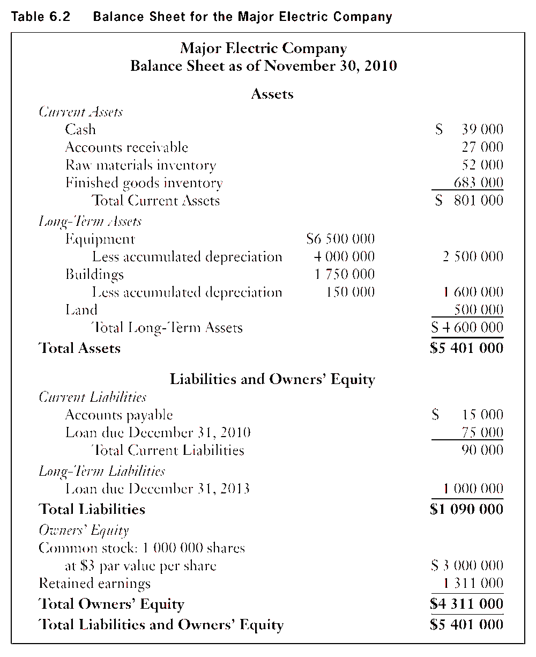


Slide 14
Balance Sheet: Typical Current Assets
CURRENT ASSETS (a firm’s resources that can be “readily” converted to cash)
Cash
Accounts Receivable
Raw Materials Inventory
Finished Goods Inventory
A. TOTAL CURRENT ASSETS

Slide 15
Balance Sheet: Typical Long-Term Assets
(Assets = Resources owned by a firm)
LONG-TERM ASSETS
Gross Equipment (Purchase price)
Less total depreciation since purchased
= Net Equipment (Purchase price minus total depreciation)
Gross Buildings (Purchase price)
Less total depreciation since purchased
= Net Buildings
Land Note: Land is NOT depreciable.
B. TOTAL LONG-TERM ASSETS
C. TOTAL ASSETS (Short + Long-Term Assets)

Slide 16
Balance Sheet: Typical Liabilities
(Liabilities = Resources owed = debt)
CURRENT LIABILITIES
Accounts Payable ($ owed suppliers)
Loan due in 6 months (short-term loan from bank)
D. TOTAL CURRENT LIABILITIES
LONG-TERM LIABILITIES
Loan due in 2 years (medium- to long-term loan from bank)
E. TOTAL LONG-TERM LIABILITIES
F. TOTAL LIABILITIES = Short- + long-term liabilities

Slide 17
Balance Sheet: Owner Equity
(Resources owned by shareholders/stakeholders)
OWNER EQUITY
Common and other capital stock
Retained Earnings
G. TOTAL OWNER EQUITY
H. TOTAL LIABILITIES AND EQUITY (F+G)

Slide 18
Balance Sheet: Assets
XYZ Company Balance Sheet at December 31, 2015 | Thousands $
Current Assets
Accounts receivable | 30,000
Cash | 4,200
Inventories | 36,000
Prepaid expenses (due in 3 months) | 6,000
Total Current Assets | 76,200
Long Term Assets
Long term bond investments | 9,000
Land | 6,000
Gross plant and equipment | 37,000
Less: Accumulated depreciation on plant and equipment | -22,000
Net plant and equipment | 15,000
Total Long Term Assets | 30,000
TOTAL ASSETS | 106,200

Slide 19
Balance Sheet: Liabilities
XYZ Company Balance Sheet at December 31, 2015 | Thousands $
Current Liabilities
Accounts payable | 20,000
Accrued wages | 8,000
Income taxes payable in 6 months | 8,000
Working capital Loan | 4,000
Property taxes payable in 6 months | 6,200
Total Current Liabilities | 46,200
Long Term Liabilities
Mortgage on building (5-year) | 40,000
Total Long term liabilities | 40,000
TOTAL LIABILITIES | 86,200

Slide 20
Balance Sheet: Equity
XYZ Company Balance Sheet at December 31, 2015 | Thousands $
Common shares | 10,000
Retained Earnings | 10,000
Total Owner Equity | 20,000
TOTAL LIABILITIES & OWNERS’ EQUITY | 106,200

Slide 21
Income & Expense Statements
Summarizes business revenues and expenses over a specified accounting period (e.g., one year)
Operating revenues
  less Operating costs
= Income or profit before taxes
  less Income Taxes
= Net Profit (Profit after taxes)

Slide 22
Income & Expense Statements
Operating revenues
  sales of goods and services
  investment income
    interest and dividends generated by investments in bonds, shares ….)
Operating Expenses
  Salaries and wages, utilities, rent, interest paid on loans, ….
  Purchases of goods and services
  Depreciation (wear and tear) of capital assets

Slide 23
Income & Expense Statement
Speedy Electric Company
Calendar year 2014
Revenues
  Sales
  + Investment Income (interest, dividends …)
= Total Revenues
Expenses
  Cost of goods sold
  + Depreciation charges
  + Selling costs (salaries, commissions, advertising …)
  + Administrative expenses
  + Interest paid on loan
= Total Expenses
Profit before income taxes
- Income taxes (at t% = tax rate)
= Net Income or Net Profit After Taxes

Slide 24
Changes in a Firm’s Financial Position During a Specific Period of Time
(Source and Application of Funds)
Source of funds: cash generated from
Regular business operations
Investment income (from financial assets such as bonds, stocks ..)
The sale of long-term assets such as buildings and equipment.
Application of funds: cash used to
Pay dividends to shareholders and interest owing on bonds.
Purchase land, buildings, equipment and the financial assets (e.g., bonds and stocks) of other firms.

Slide 25
Statement of Changes in Financial Position
Calendar Year 2015
Sources of cash
Cash from operations
Net profit after taxes
+ depreciation charges (no corresponding cash flow)
- increase (+ if decrease) in materials inventory
- increase (+ if decrease) in finished goods inventory
+ cash from financing activities (loans)
= Total Sources of Cash (A)

Slide 26
Statement of Changes in Financial Position
January 1, 2015 to December 31, 2015
Cash Applications (Uses)
Purchases of plant, machinery and equipment
+ Dividends paid to shareholders
= Total Applications of Cash (B)
Increase (decrease) in cash = (A - B)

Slide 27
Investments in working capital
Most projects require an investment in non-depreciable assets to support day-to-day operations
Working capital
  A business investment (not unlike the initial investment (P)
  Ties up funds that cannot generate investment income ➔ constitutes a cost of doing business
  The size and composition of working capital will vary by project size and type.
  Working capital = Current assets – current liabilities

Slide 28
Net Income and Cash Flow Approaches
 | Years
 | 0 | 1 | 2 | 3
Income After Taxes (From the Income and Expense Statement) |  | X | X | X
2. Capital Cost Allowance (CCA) (a.k.a. depreciation; not a cash flow) |  | X | X | X
Investment Activities
Initial investment | X
Salvage value |  |  |  | X
Tax effects on project dissolution |  |  |  | X
Working Capital | X |  |  | X
= Net Cash Flow | X | X | X | X

Slide 29
Capital Gains (or Losses) and Recaptured Depreciation
XYZ Company
  purchases building on January 1, 2011 for $1,000,000.
  Sells building for $1,200,000 on December 31, 2015 (5 years later).
  Book Value (BV) of building on December 31, 2015 is $600,000 (= Purchase Price – Σdepreciation over 5 years)

Slide 30
Capital Gains (or Losses) and Recaptured Depreciation
XYZ Company
purchases building on January 1, 2011 for $1,000,000.
Sells building for $1,200,000 on December 31, 2015 (5 years later).
Book Value (BV) of building on December 31, 2015 = $600,000 (= Purchase Price – Σdepreciation charges over 5 years)
Capital Gains
= 1.2M-1M=$0.2M
Taxes Payable
= 50%(0.2M) = $0.1M
Recaptured Depreciation
= 1,0M-0.6M = $0.4M
Taxes Payable
= 50%(0.4) = $0.2M
Tax Rate = 50%

Slide 31
Capital Gains (or Losses) and Recaptured Depreciation
XYZ Company
purchases building on January 1, 2011 for $1,000,000.
Sells building for $900,000 on December 31, 2015 (5 years later).
Book Value (BV) of building on December 31, 2015 = $600,000 (= Purchase Price – Σdepreciation charges over 5 years)
Capital Loss
= 1.0M-0.9M=$0.1M
Tax Credit (From a Capital Loss)
= 50%(0.1M) = $50,000
Recaptured Depreciation
= 0.9M-0.6M = $0.3M
Taxes Payable
= 50%(0.3) = $150,000
Tax Rate = 50%

Slide 32
 | Paradise Pond Company
 | Item | 2012 | 2013 | Statement
1. | Accounts Receivable | $675 | $638 | B? IE?
2. | Accumulated depreciation | 1500 | 1800 | B? IE?
3. | Accounts payable | 300 | 225 | B? IE?
4. | Bonds | 900 | 900 | B? IE?
5. | Cash | 300 | 225 | B? IE?
6. | Common shares | 450 | 450 | B? IE?
7. | Contributed capital | 900 | 900 | B? IE?
8. | Cost of goods sold | 1750 | 2125 | B? IE?
9. | Depreciation expense | 550 | 500 | B? IE?
10. | Income taxes | 200 | 300 | B? IE?
11. | Interest expense | 125 | 150 | B? IE?
12 | Inventories | 825 | 938 | B? IE?
13. | Net plant and equipment | 1800 | 2100 | B? IE?
B = Balance Sheet; IE = Income & Expense Statement

Slide 33
 | Paradise Pond Company Paradise Pond Paradise Pond Company
 | Item | 2012 | 2013 | Statement
11. | Net Revenue from sales | $1250 | $1500 | B? IE?
12. | Operating expenses | 75 | 100 | B? IE?
13. | Plant and equipment | 3300 | 3900 | B? IE?
14. | Profit after taxes | 300 | 450 | B? IE?
15. | Profit before taxes | 500 | 750 | B? IE?
16. | Retained earnings | 1050 | 1200 | B? IE?
17. | Sales | 3000 | 3625 | B? IE?
18. | Total assets | 3600 | 3900 | B? IE?
19. | Total current assets | 1800 | 1800 | B? IE?
20. | Total current liabilities | 300 | 450 | B? IE?
21. | Total expenses | 750 | 750 | B? IE?
22 | Total liabilities and owners’ equity | 3600 | 3900 | B? IE?
23. | Total long-term assets | 1800 | 2100 | B? IE?
B = Balance Sheet; IE = Income & Expense Statement

Slide 34
 | Paradise Pond Company
 | Item | 2012 | 2013 | Statement
24. | Total long-term liabilities | 900 | 900 | B? IE?
25. | Total owners’ equity | 2400 | 2550 | B? IE?
26. | Working capital loan | 0 | 225 | B? IE?
B= Balance Sheet; IE = Income & Expense Statement

Slide 35
Paradise Bond Income and Expense Statement Calendar Years 2012 and 2013
Revenues 2012 2013
Sales 3 000 3 625
Cost of goods sold 1 750 2 125
Gross profit 1 250 1 500
Expenses
Operating expenses 75 100
Depreciation expense 550 500
Interest expense 125 150
Total expenses 750 750
Net income before taxes 500 750
Income taxes 200 300
Net income after taxes 300 450
Source: Fraser and Jewkes, Engineering Economics, Pearson Education, 5th edition, 2013

Slide 36
Comparative Balance Sheets for Paradise Pond Co.:
Ending 2012 and 2013 (in $000s)
Current assets
Cash 300 225
Accounts receivable 675 638
Inventories 825 938
Total current assets 1 800 1 800
Long-term assets
Plant and equipment 3 300 3 900
Less accumulated depreciation 1 500 1 800
Net plant and equipment 1 800 2 100
Total long-term assets 1 800 2 100
Total assets 3 600 3 900

Slide 37
Comparative Balance Sheets for Paradise Pond Co.:
Ending 2012 and 2013 (in $000s)
Current liabilities
Accounts payable 300 225
Working capital loan 0 225
Total current liabilities 300 450
Long-term liabilities
Bonds 900 900
Total long-term liabilities 900 900
Total liabilities 1 200 1 350
Owners’ Equity
Common shares 450 450
Contributed capital 900 900
Retained earnings 1 050 1 200
Total owners’ equity 2 400 2 550
Total liabilities and owners’ equity 3 600 3 900

Slide 38
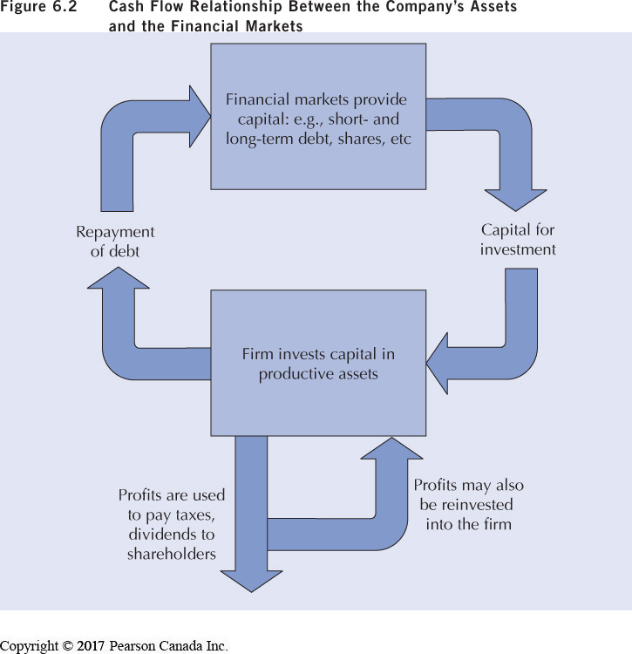
Cash Flow Relationship Between the Company’s Assets and the Financial Markets

Slide 39
Salvador Industries
Source: Fraser and Jewkes Engineering Economics, 5th Edition, Pearson, 2013.
Salvador Industries bought land and built its plant 20 years ago.
Buildings
  depreciation based on the straight-line method
  life of 30 years and a salvage value of $50 000.
Equipment
  purchased at the same time the plant was constructed
  Depreciation based on declining-balance at 20 percent.
Salvador Industries has two outstanding loans:
  one for $50 000 due December 31, 2015, and
  one for which the next payment is due in four years.

Slide 40
Salvador Industries
Source: Fraser and Jewkes Engineering Economics, 5th Edition, Pearson, 2013.
Bought land and built its plant 20 years ago.
Buildings
  depreciation based on the straight-line method
  life of 30 years and a salvage value of $50 000.
Equipment
  purchased at the same time the plant was constructed
  Depreciation based on declining-balance at 20 percent.
Salvador has two outstanding loans:
$50 000 due December 31, 2015,
another one for which the next payment is due in four years.
Balance Sheet as of June 30, 2015
Assets
Short-Term Assets
Cash: $ 350 000
Accounts receivable: 2 820 000
Inventories: 2 003 000
Prepaid services: 160 000
Total Current Assets = $
Long-Term Assets
Building: $200 000
- Less accumulated depreciation
Equipment: $480 000
- Less accumulated depreciation
Land: 540 000
Total Long-Term Assets = $
Total Assets = $

Slide 41
Salvador Industries
Source: Fraser and Jewkes Engineering Economics, 5th Edition, Pearson, 2013.
Bought land and built its plant 20 years ago.
Buildings
  depreciation based on the straight-line method
  life of 30 years and a salvage value of $50 000.
Equipment
  purchased at the same time the plant was constructed
  Depreciation based on declining-balance at 20 percent.
Salvador has two outstanding loans:
$50 000 due December 31, 2015,
another one for which the next payment is due in four years.
Balance Sheet as of June 30, 2015
Assets
Liabilities and Owners’ Equity
Current Liabilities
Accounts payable: 921 534
Accrued taxes: 29 000
Total current liabilities =
Long-Term Liabilities
Mortgage: $1 200 000
??????? = 318 000
Total Long-Term Liabilities =
Total Owners’ Equity
Capital stock: 1 920 000
Total Owners’ Equity =
Total Liabilities and Owners’ Equity
=

Slide 42
Salvador Industries
Source: Fraser and Jewkes Engineering Economics, 5th Edition, Pearson, 2013.
During April 2015, there was a flood in the building because a nearby river overflowed its banks after unusually heavy rain.
Cleaning up and business losses cost Salvador $100,000.
Income Statement
Gross income from sales
= 8 635 000
Less ?????????? = 7 490 000
Total income =
Depreciation = 70 000
Interest paid = 240 000
Other expenses = 100 000
Total expenses = ??
Income before taxes = ??
Taxes at 40% = ??
Net income = ??

Slide 43
Financial Ratio Analysis
The analysis of a firm’s financial data can provide answers to questions such as:
  Can the firm meet its short-term commitments?
  Do assets generate sufficient profits?
  How dependent is the firm on creditors?
Financial ratios
  derived from financial statements
  their calculation is usually easy but their interpretation may be more difficult.
A good interpretation of financial ratios normally requires comparisons with industry standards (thresholds) and with the firm’s previous year ratios (trend analysis).

Slide 44
Financial Ratios (for this course)
Liquidity (2 ratios)
Leverage or debt-management
Effectiveness (asset-management) (2 ratios)

Slide 45
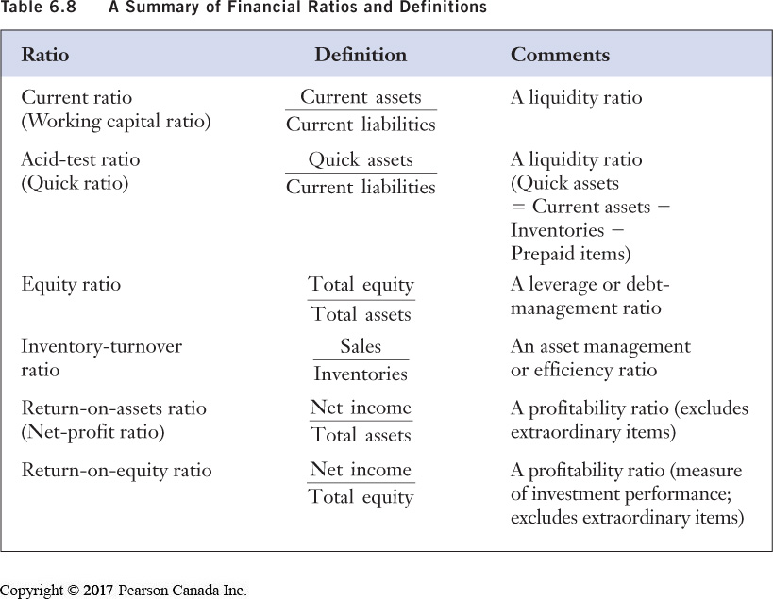

Slide 46
Liquidity Ratios
A measure of a firm’s ability to meet unforeseen cash flow fluctuations.
  the larger the liquidity ratio, the more likely a firm can meet unforeseen cash flow fluctuations
Liquidity ratios
1. Current ratio (or working capital ratio)
  = current assets ÷ current liabilities
2. Acid-test ratio (or quick ratio)
= quick assets ÷ current liabilities
Quick assets = cash + accounts receivable + notes receivable
+ short term investments in marketable securities (excludes
inventory and prepaid expenses).

Slide 47
Leverage or debt-management ratio
The extent to which a firm relies on debt Bank loans, bonds ..) The higher the ratio the lower the risks.
Equity Ratio | = total owner equity÷ total assets

Slide 48
Effectiveness (asset-management) ratios: Inventory Turnover Ratio
The efficiency with which a firm uses its resources to manage its inventories
  higher ratio ➔ higher efficiency (better management of inventory)
  Inventory Turnover Ratio = Total Sales/Inventory
Concerns with this ratio:
  Sales are generated over a period of time while inventories are measured at a point in time; better to use an average inventory concept.
  Sales refer to market prices while costs are based on historical prices
  This ratio overstates the true turnover of inventories during a year.

Slide 49
Effectiveness or asset-management ratios: Return-on-total-assets or net profit ratio
Measures the productivity of assets to
generate profits.
Profitability ratio
= profits after taxes ÷ total assets

Slide 50
Cautionary Notes on Financial Ratios
Financial statements are frequently approximations ➔ financial ratios must be interpreted accordingly
May be difficult to find a perfect industry fit for a specific firm
  could result in poor industry comparisons and erroneous conclusions.
Seasonality and economic cycles or fluctuations (the cycle can affect firms differently) could cause significant fluctuations in financial data and, as result, incorrect ratios and comparisons.

Slide 51
Other Financial Ratios
Short-term solvency – the firm’s ability to meet its short-term obligations.
Activity – the firm’s ability to control its investment in assets.
Financial Leverage – the extent to which a firm relies on debt financing.
Profitability – the extent to which a firm is profitable.
Value – the value of the firm
Not Required For This Course

Slide 52
1. Short-Term Solvency
Current Ratio | Current Assets ÷ Current Liabilities
2. Quick Ratio | Quick Assets ÷ Current Liabilities

Slide 53
2. Activity
1. Total Asset Turnover | Total Operating Revenues/Average Total Assets Where average assets = (Assets on Jan 1 + Assets on Dec31)/2
2.a Receivables Turnover | Total Operating Revenues/Average Receivables
2.b Average Collection Period | Days in Inventory/Receivables Turnover
3.a Inventory Turnover | Cost of Goods Sold/Average Turnover
3.b Days in Inventory | Days in Period/Inventory Turnover
Not Required For This Course

Slide 54
3.. Financial Leverage
1.a Debt Ratio | Total Debt/Total Assets
1.b Debt Equity Ratio | Total Debt/Total Equity
1.c Equity Multiplier | Total Assets/Total Equity
2. Interest Coverage | Earnings Before Interest and Taxes/ Interest Expense
Not Required For This Course

Slide 55
4. Profitability
1.a Net Profit Margin (ROA) | Net Income/Total Operating revenues where [ROA = Profit Margin x Asset Turnover]
1.b Gross Profit Margin | Earnings Before Interest and Taxes/Total Operating Revenues
2.a Net Return on Assets | Net Income/Average Total Assets
2.b Gross Return on Assets | Earnings Before Interest and Taxes/Average Total Assets
3. Return on Equity (ROE) | Net Income/Average Shareholders’ Equity [ROE = Profit Margin x Asset Turnover x Equity Multiplier]
4. Payout ratio | Cash Dividends/Net Income
5. Retention Ratio | Retained Earnings/Net Income where Retained earnings = Net Income - Dividends
Not Required For This Course

Slide 56
5. Market-Value Ratios
Not Required For This Course

Slide 57
Problem 1
ABC Company’s income statement and balance sheet entries for calendar year 2014 are shown in Table 1
Assumption
  The cut-off period for short-term assets and liabilities for this course is one year
    a bank loan that must be repaid in 6 months
    purchases of goods by the firm that must be paid within 90 days.

Slide 58
Problem 1: Table 1
Selected Balance Sheet and Income Statement Items for ABC Company Limited (2014) | Thousand $
1. Accounts Payable | 7,500
2. Accounts Receivable | 15,000
3. Accrued wages | 2,850
4. Cumulative depreciation on plant and equipment | 15,450
5. Cash | 2,100
6. Common shares | 150
7. Contributed capital | 3,000
8. Cost of goods sold | 57,000
9. Outstanding Income Taxes for 2014 (deferred 6 months) | 2,250
10. Depreciation expense in 2014 | 750
11. Long-Term Financing (Bonds) | 4,350
12. Long-Term Bond Purchases by ABC | 4,500
13. General operating expense | 8,100

Slide 59
Problem 1: Table 1
Selected Balance Sheet and Income Statement Items for ABC Company Limited (2014) | Thousand $
14. Gross plant and equipment | 18,450
15. Income taxes payable in 1 year | 2,250
16. Interest Expense | 1,500
17. Inventories end of 2014 | 18,000
18. Land | 3,000
19. Mortgage on building and equipment (5-year) | 9,450
20. Net Sales of goods and services in 2014 | 76,500
21. Prepaid Expenses in 2014 | 450
22. Retained Earnings | 12,300
23. Selling Expenses (e.g., advertising) in 2014 | 4,650
24. Treasury Bills (3-month) owned by ABC | 450
25. Working Capital Loan | 4,650

Slide 60
Balance Sheet and Income Statement Items for ABC Company Limited (2007) | Thousand $
1. Accounts Payable | 7,500
2. Accounts Receivable | 15,000
3. Accrued wages | 2,850
4. Cumulative depreciation on plant and equipment | 15,450
5. Cash | 2,100
6. Common shares | 150
7. Contributed capital | 3,000
8. Cost of goods sold | 57,000
9.Outstanding Income Taxes for 2014 (deferred 6 months) | 2,250
10. Depreciation expense in 2014 | 750
11. Long-Term Financing (Bonds) | 4,350
12. Long-Term Bond Purchases by ABC | 4,500
13. General operating expense | 8,100
14. Gross plant and equipment | 18,450
15. Income taxes payable in 1 year | 2,250
16. Interest Expense | 1,500
17. Inventories end of 2014 | 18,000
18. Land | 3,000
19. Mortgage on building and equipment (5-year) | 9,450
20. Net Sales in 2014 | 76,500
21. Prepaid Expenses in 2014 | 450
22. Retained Earnings | 12,300
23. Selling Expenses in 2014 | 4,650
24. Treasury Bills (3-month) owned by ABC | 450
25. Working Capital Loan | 4,650

Slide 61
Balance Sheet
Complete ABC’s Balance Sheet at December 31, 2007 from the information in Table 1.

Slide 62
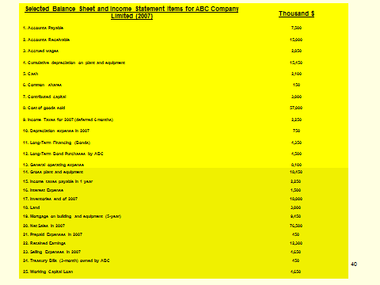
ABC Company BALANCE SHEET (December 31, 2007)
ASSETS (Thousand $)
Current Assets
Accounts receivable (2); (2) is the Table reference | 15,000
Cash (5) | 2,100
Treasury Bills (24) | 450
Inventories (17) | 18,000
Prepaid expenses (due in 3 months) (21) | 450
Total Current Assets | 36,000
Long Term Assets
Long term bond investments by ABC (12) | 4,500
Land (18) | 3,000
Gross plant and equipment (14) | 18,450
Less: Accumulated depreciation on plant and equipment (4) | 15,450
Net plant and equipment (14) minus (4) | 3,000
Total Long Term Assets | 10,500
TOTAL ASSETS | 46,500

Slide 63
ABC Company BALANCE SHEET (December 31, 2007)
LIABILITIES (Thousand $)
Current Liabilities
Accounts payable (1) | 7,500
Accrued wages (3) | 2,850
Taxes Payable Within 6 months | 2,250
Working capital loan (25) | 4,650
Total Current Liabilities | 17,250
Long Term Liabilities
Long-Term Financing (Bonds) (11) | 4,350
Mortgage on building (10-year) (19) | 9,450
Total Long term Liabilities | 16,050
TOTAL LIABILITIES | 31,050
OWNER EQUITY
Common shares (6) | 150
Contributed capital (7) | 3,000
Retained Earnings (22) | 12,300
Total Owner Equity | 15,450
TOTAL LIABILITIES & OWNER EQUITY | 46,500

Slide 64
Income Statement
Complete ABC’s Income Statement for calendar year 2014 (from the information in Table 1).

Slide 65
Income and Expense Statement for ABC Company from Calendar Year 2014 | Thousand $
REVENUES
Net Sales (20) | 76,500
(-) Cost of Goods Sold (8) | 57,000
OPERATING EXPENSES
Depreciation expense (10) | 750
+ General operating expense (13) | 8,100
+ Selling expenses (23) | 4,650
+ Interest expense (16) | 1,500
TOTAL EXPENSES | 15,000
INCOME BEFORE TAXES | 4,500
Income Taxes (40% of Income before taxes) | 1,800
PROFIT AFTER TAXES (Net Income) | 2,700

Slide 66
Complete ABC’s Income Statement for Calendar Year 2014

Slide 67
Income and Expense Statement for ABC Company from Calendar Year 2014 | Thousand $
REVENUES
Net Sales (20) | 76,500
(-) Cost of Goods Sold (8) | 57,000
OPERATING EXPENSES
Depreciation expense (10) | 750
+ General operating expense (13) | 8,100
+ Selling expenses (23) | 4,650
+ Interest expense (16) | 1,500
TOTAL EXPENSES | 15,000
INCOME BEFORE TAXES | 4,500
Income Taxes (40% of Income before taxes) | 1,800
PROFIT AFTER TAXES (Net Income) | 2,700

Slide 68
Change in ABC’s Financial Position in 2014
Cash from operations
+ Net profit after taxes: $2,700
+ depreciation charges: $750
- increase in materials inventory: $250
+ decrease in finished goods inventory: $100
+ cash from financing activities (loans): $1,000
Total Source of Cash in 2014 = $4,600

Slide 69
Change in ABC’s Financial Position in 2014
Cash Application (use)
Purchases of equipment: $2,000
+ Dividends paid to shareholders: $500
Total Uses of Cash in 2014 = $2,500
Net increase in cash in 2014 (from 2013)
= $4,600 - $2,500 = $2,100

Slide 70
Industry Sector & ABC’s Financial Ratios
Complete the Table below
Industry Norms and Financial Ratios For ABC Company
Ratio | Industry Norms | ABC Ratios | ABC Meets Industry Norm? Yes/No
Current ratio | 2.5 | ? | Yes/No
Acid-test ratio | 1.75 | ? | Yes/No
Equity Ratio | 0.6 | ? | Yes/No
Inventory-turnover ratio | 2.2 | ? | Yes/No
Return-on-total-assets ratio | 0.08 (8%) | ? | Yes/No

Slide 71
ABC’s Financial Ratios
1. Current Ratio | = Current assets ÷ Current liabilities = 36 000 ÷ 17 250 = 2.09
2. Acid-test Ratio | = Quick assets ÷ Current liabilities = (36 000 – 18 000 – 450) ÷ 17 250 = 1.02
3. Equity Ratio | = owner equity/{total liabilities and equity} = 15 450 ÷ 46 500 = 0.33 or 33%

Slide 72
ABC’s Financial Ratios
4. Inventory turnover ratio | = Sales ÷ Inventory = 76 500 ÷ 18 000 = 4.25
5. Return-on-total-assets or net profit ratio (profitability ratio) | = Profits after taxes ÷ Total assets = 2 700 ÷ 46 500 = 0.058 or 5.8%

Slide 73
Financial Ratios
Ratio | Key Ratio characteristic
Current ratio | The better the more it exceeds unity (1).
Acid-test ratio | The better the more it exceeds unity (1).
Equity Ratio (%) | The closer to 100% the better (although reaching 100% is impossible for large projects).
Inventory-turnover ratio | The bigger the better.
Return-on-total-assets ratio (%) | The bigger the better.

Slide 74
ABC’s Financial Ratios
Industry Sector & ABC’s Financial Ratios
Ratio | Industry Norms | ABC Ratios (2014) | ABC Meets Industry Norm? Yes/No
1. Current ratio | 2.5 | 2.4 | No
2. Acid-test ratio | 1.75 | 1.17 | No
3. Equity Ratio (%) | 60 | 33 | No
4. Inventory-turnover ratio | 2.2 | 4.25 | Yes
5. Return-on-total-assets ratio (%) | 8 | 6 | No

Slide 75
ABC’s Trend Analysis
?
?
?
?
?
?
Ratio | 2007 | 2006 | 2005
Current | 2.4 | 1.9 | 1.6
Acid-test | 1.17 | 0.9 | 0.75
Equity (%) | 33% | 40% | 55%
Inventory-turnover | 4.25 | 7 | 12
Return-on-assets (%) | 6 | 8 | 10
Increasing reliance on debt capital
Assets tied up for longer periods of time
Decreasing return on resources

Slide 76
ABC’s Trend Analysis
Positive Trends
  ABC’s current and acid-test ratios.
Negative Trends
  Share of equity capital, inventory-turnover and return-on-assets ratios
  Omens of potential problems.

Slide 77
Your Turn
A friend recommended that you purchase “Petit Ourson Ltd” shares.
You have the 2006 and 2007 financial statements for the company and the standards for this industry.
Perform a financial analysis of the company.
Are there any apparent trends your analysis?
(Fashioned after Fraser et al. Engineering Economics, Pearson, 2009)

Slide 78
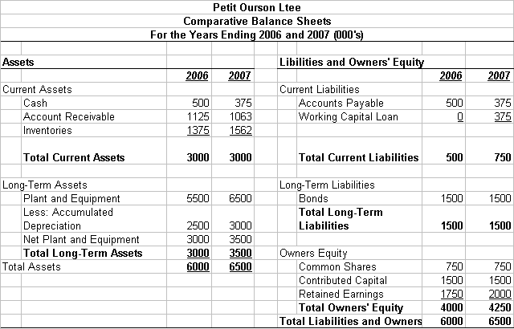
Your Turn cont’d

Slide 79
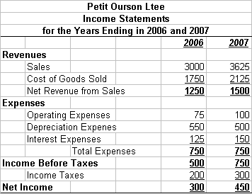
Your Turn cont’d

Slide 80
Your Turn cont’d
Ratios for 2006
Current ratio | Current assets ÷ Current liabilities | 3000 ÷ 500 | 6.00
Acid-test ratio | Quick assets ÷ Current liabilities | 1625 ÷ 500 | 3.25
Equity ratio | Total equity ÷ Total assets | 4000 ÷ 6000 | 0.667
Inventory turnover ratio | Sales ÷ inventories | 3000 ÷1375 | 2.182
Return on assets ratio | Net income ÷ Total assets | 300 ÷ 6000 | 0.05 or 5%

Slide 81
Your Turn cont’d
Ratios for 2007
Current ratio | Current assets ÷ Current liabilities | =
Acid-test ratio | Quick assets ÷ Current liabilities | =
Equity ratio | Total equity ÷ Total assets | =
Inventory turnover ratio | Sales ÷ inventories | =
Return on assets ratio | Net income ÷ Total assets | =

Slide 82
What is a Business Plan?
A 3-to-5 year road map of the operating, financial and HR status/intentions of a business.
Helps business owners to understand cash flows for hiring or investing in assets.
Presents a firm’s intentions and future revenue to attract investors.
First step in starting a business.
Firms with a track record will use their balance sheet, income statement, ratios, etc. to outline their financial status.

Slide 83
So why should you write a business plan?
(Publicity from a major Canadian Bank)
A business plan can give you:
an opportunity to consider, and plan for, the right work-life balance for you.
a user-friendly guide to your business for employees, investors, suppliers, and advisors.
a yardstick to measure your business' progress.
a method for identifying opportunities and challenges.
a tool for thinking through future staffing and financing needs.
a foundation for a loan application.

Slide 84
Key elements of a Business Plan
(Publicity from a major Canadian Bank)
1. Executive Summary: highlights key information and insights from your entire business plan (the last section written and the first one read)
2. Business Description: presents background information, defines what's important for you and your business, establishes specific milestones for measuring success in the future, and introduces your product or service.
3. Marketplace: positions your business in a larger context, identifies and examines your competition, and describes the type of customer your business targets.
4, Sales & Marketing: focuses on your business' strategy for attracting and keeping customers.
5. Business Operations: outlines how your business works, including supplier and staffing issues.
6. Financial Information: considers your personal financial plan and provides financial statements for your business.

Slide 85
Key Components of a Business Plan**
Executive Summary
Company Description
Market Analysis/Future Outlook
Management and Organization
Funding Requirements
Sales and Marketing
** One of many business plan component breakdowns.

Slide 86
Key Components of a Business Plan:
1. Executive Summary
Intended
  to attract investor interest in the company and to convince investors to read the entire Plan.
  To convince investor of future company success
Most important features:
  Company’s mission statement.
  Products and services provided by the company.
  Company’s financial health.
  Future plans.

Slide 87
Key Components of a Business Plan:
2. Company Description
High level overview of company and operations
  Products/services and market needs
    Outlines the need for the company and its products
    Who are its customers? Its competitors?
  Company’s human resource (HR) capabilities
    Key employees
      Experience and education
      Alignment with corporate goals
  Competitive advantages of the company
    Technology, location, production capability, personnel

Slide 88
Key Components of a Business Plan:
3. Market Analysis / Future Outlook
Description of industry and growth plans of company
  Market demand: discussion of target market
  Future trends: customer demand, technology and market share
  Market share: present / future share compared to competitors
    Weaknesses and strengths
    IT and technology advances
    Geographical location
    Financial situation
    Experience and human factors
  4. Pricing, revenue and cash flow predictions
  5. Regulatory environment

Slide 89
Key Components of a Business Plan:
4. Management and Organization
Explanation of structure of business in detail
  Sole proprietorship, partnership or corporation.
  Key corporate employee information provided
    Experience, education, qualifications
  Functional groups, corporate structure, job titles
    How this structure suits corporate mission and future growth.

Slide 90
Key Components of a Business Plan:
5. Funding Requirements
Discussion of where the funding will originate
  Owners and investors.
  Banks and other financial institutions.
  How company will attract investors for new projects or expansion.

Slide 91
Key Components of a Business Plan:
6. Sales and Marketing
Strategies to penetrate target markets.
Creation / maintaining of customers
  Recognition and fulfillment of needs.
  Communication mechanisms (surveys, advertisements).
  Promotions

Slide 92
Engineering Economics
ECO 1192
Topic 7: Depreciation, Accounting and Financial Analysis (Ch. 6)
Claude Théoret
University of Ottawa

