Slide 1
Reflection questions
Select one of the following sub-cultures: Chinese-Canadians, South Asians-Canadians, AfroCabibbean, or some other subculture you are familiar with and describe all the aspects Marketers should consider in order to market effectively to them. Be specific.
Using the hierarchy of needs theory described in the textbook and presented in the prerecorded lecture, indicate, with justification, which of the needs the following brands are targeting: Nike (Just do it), uber (everyone's private driver), BMW (for driving pleasure), subaru (confidence in motion), Salvation Army (we see what others don’t), L’Oreal (because you’re worth it. You may use other information sources to justify your answer.
You apply for an entry-level job as a marketing analyst with consumer-packaged goods firm. At the job interview the Marketing Director says to you, “over the years, I am amazed at how two consumers looking at the same product or advertisement yet seem to have different experiences”. Can you help explain this behavior to me?
In the recorded lecture, I have asked for examples of marketing actions managers can implement to better serve customers or market their products. Make a note of all the instanced from the presentation (both parts 1 & 2) and come prepared to discuss them in class.
Review the end of chapter concept questions.

Slide 2

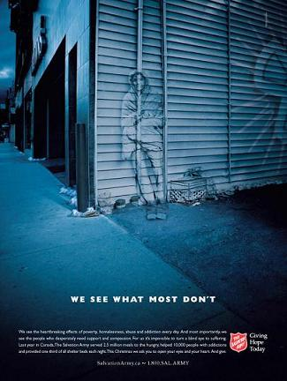


Identify which aspects of the
Hierarchy of Needs these ads
are targeting.

Slide 3
Reflection questions
Take a look at these 3 videos and decide which aspect of consumer attitude they best capture:
http://www.youtube.com/watch?v=sBqxZAf3_FE
http://www.youtube.com/watch?v=f_SwD7RveNE
Bud

