Slide 1
Independent ANOVA- Review
Total Variances
Treatment Variances
Error Variances
Source | Sum of Squares | df | Mean Square | F_{obt} | F_{crit} | Decision | η²
Total
Treatment
Error

Slide 2
Independent ANOVA- Review
Calculations:
Pairwise Comparisons:
Source | Sum of Squares | df | Mean Square
Total |  | N - 1 | SStotal N-1
Treatment |  | k - 1 | SSTreatment k-1
Error |  | N - k | SSError N - k

Slide 3
Independent ANOVA- Review
A sociologist is interested in whether or not level of parental occupation affects anxiety scores among 9th grade students. Below are the scores on a standardized anxiety test for students with parents in 3 different occupation levels. Test the appropriate hypothesis using alpha = .05
OCCUPATION 1 | OCCUPATION 1 | OCCUPATION 3
8 | 23 | 21
6 | 11 | 21
4 | 17 | 22
12 | 16 | 18
16 | 6 | 14
17 | 14 | 21
12 | 15 | 9
10 | 19 | 11
11 | 10
13

Slide 4
5-Steps: Independent ANOVA
Step 1:
Ho: All the population means are the same
(μ₁ – μ₂ – μ₃ … – μn = 0)
Ha: All the population means are not the same
(μ₁ – μ₂ – μ₃ … – μn ≠ 0)
Step 2:
Step 3:
Df numerator: k -1 = 2
Df denominator: N-K = 27 – 3 = 24
F critical = 3.043
Reject Ho if F obtained is greater or equal to +3.043.

Slide 5
Step 4: Calculating F-test
1) Develop a summary table & calculations table
2) Calculate all sums of squares
3) Identify df for each source of variance
4) Calculate mean squares by dividing sum of squares by df
5) Calculate F-obtained

Slide 6
Step 4: Create Summary Table
Source | Sum of Squares | df | Mean Square | F_{obt} | F_{crit} | Decision | Effect Size
Total
Treatment
Error

Slide 7
OCCUPATION 1 | OCCUPATION 1 | OCCUPATION 3
8 | 23 | 21
6 | 11 | 21
4 | 17 | 22
12 | 16 | 18
16 | 6 | 14
17 | 14 | 21
12 | 15 | 9
10 | 19 | 11
11 | 10
13
n | 10 | 9 | 8 | 27
Σx (T) | 109 | 131 | 137 | 377
Σx² | 1339 | 2113 | 2529 | 5981
X-bar | 10.9 | 14.56 | 17.21
s² | 16.78 | 25.78 | 26.12

Slide 8
Step 5: Make a Decision
Therefore, there are significant differences in students’ anxiety scores across parental occupation level.
Source | Sum of Squares | df | Mean Square | F_{obt} | F_{crit} | Decision
Total | 716.96 | 26 | 27.56
Treatment | 176.97 | 2 | 88.49 | 3.93 | 3.04 | Reject Ho
Error | 540.10 | 24 | 22.50

Slide 9
Effect Size
η² = SS_{treatment} / SS_{total}
WHICH GROUPS ARE DIFFERENT?
occ 1: 10.90
occ 2: 14.56
occ 3: 17.21

Slide 10
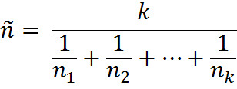

Post-Hoc Test
 | Occ1 (10.90) | Occ2 (14.56) | Occ3 (17.21)
Occ 1 (10.90) | --- | 3.66 | 6.31
Occ 2 (14.56) | --- | ---- | 2.65
Occ 3 (17.21) | ---- | --- | ----
Critical Value
= 5.60
= 8.93

Slide 11
Dependent ANOVA

Slide 12
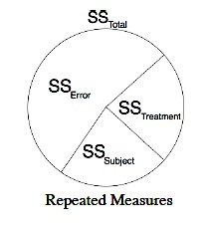
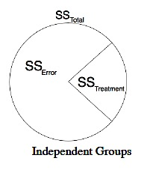
Dependent Groups ANOVA
Individuals in groups are MATCHED based on an extraneous variable OR all participants receive all levels of treatment
Must account for variance within each matched set (block/participant)
Matching reduces degrees of freedom which increases the threshold for rejecting H_{o}
  Larger critical value
Notes:
12
Matching theoretically and practically difficult;
Matching reduces your available degrees of freedom, matching on irrelevant variables decreases power

Slide 13
Dependent Groups
In the following study with independent variable x with k=3 groups, each of the participants are matched on some extraneous variable(s)
Error variance: Random
differences among
Individuals and groups
 | Group 1 | Group 2 | Group 3 | Row total:
 | 5 | 6 | 8 | 19
 | 4 | 5 | 10 | 19
 | 6 | 8 | 12 | 26
 | 5 | 10 | 7 | 22
 | 3 | 4 | 16 | 23
Mean: | 4.6 | 6.6 | 10.6
Error variance:
variance
due to matching
participants
(“Blocks”)
Systematic differences among groups: Treatment variance
Notes:
13

Slide 14

Dependent Groups ANOVA
Total Variance
Treatment Variance (Between Groups)
Block Variance
(Between Matched Pairs)
Error Variance
(Within Groups)
Variance | SS | df | Mean Square | F obt | F crit | Decision | η²
Total
Treatment
Blocks
Error

Slide 15
Dependent ANOVA Example
In a study of smell adaptation, 30 participants are requested to enter a heavily used (and heavily‘scented’) locker room. They are randomly assigned to 3 groups and instructed to rate odor intensity using a 10-point rating scale. A score of 0 represents very low intensity and a score of 9 represents very high intensity. The first group’s rating is made upon first entering the locker room. Group two makes a rating at 1 minute after entry. The third group makes their ratings 1 minute later. The researcher is aware that smell sensitivity decreases in older individuals, thus participants are matched for age. Does smell adaptation occur in this experiment? (use alpha = .05)
Notes:
15

Slide 16
Dependent Groups ANOVA Example
Intensity Ratings by Time Interval:
  Recall: A score of 0 represents very low intensity and a score of 9 represents very high intensity.
Group | 1 | 2 | 3 | 4 | 5 | 6 | 7 | 8 | 9 | 10
0 min | 8.5 | 7.0 | 9.5 | 10.0 | 6.5 | 8.5 | 9.0 | 10.0 | 9.5 | 9.0
1 min | 6.0 | 6.5 | 9.0 | 10.0 | 7.0 | 6.0 | 7.5 | 9.5 | 9.5 | 8.0
2 min | 5.5 | 6.0 | 8.5 | 10.0 | 6.5 | 6.5 | 5.0 | 5.0 | 4.5 | 5.0
Notes:
16

Slide 17
Interpreting the Question
In a study of smell adaptation, 30 participants are requested to enter a heavily used (and heavily‘scented’) locker room. They are randomly assigned to 3 groups and instructed to rate odor intensity using a 10-point rating scale. A score of 0 represents very low intensity and a score of 9 represents very high intensity. The first group’s rating is made upon first entering the locker room. Group two makes a rating at 1 minute after entry. The third group makes their ratings 1 minute later. The researcher is aware that smell sensitivity decreases in older individuals, thus participants are matched for age. Does smell adaptation occur in this experiment? (use alpha = .05)
  independent variable (time to adapt) is discrete→ ANOVA or t-test
  Three groups-→ ANOVA
  Randomly assigned; Matched → Between participants, Dependent Groups
Notes:
17

Slide 18
Step 1: Formulate Hypotheses
Objective of study: determine whether smell adaptation occurs.
  Direction of test: One-tailed.
Hypotheses:
    H_{o}: All of the population means are the same.
    H_{a}: All of the population means are not the same.
Notes:
18

Slide 19
Step 2: Select Test Statistic
The appropriate test is the omnibus F test:
We will have to set up the Within Participants ANOVA table
Notes:
19

Slide 20
Step 3: Identify the Rejection Region
The critical F-ratio is selected according to the degrees of freedom in the
  a) numerator: df = k - 1, where k is the number of levels in the independent variable, and
  b) denominator: df = N - k - b + 1, where N is the total number of participants in the entire experiment and b is the number of blocks.
      N =
      b =
  Critical F-ratio is:
    F(2, 18) =
30
10
3.55
Notes:
20

Slide 21
Step 4: Calculating Test Statistic
Steps for Calculating F-test:
I) Create summary table
II) Develop calculations table
III) Calculate all sums of squares
IV) Identify df for each source of variance
V) Calculate mean squares by dividing sum of squares by df
VI) Calculate F-obtained

Slide 22
Step 4: Compute Test Statistic
1. Create Summary Table
Variance | SS | df | Mean Square | F obt | F crit | Decision | η²
Total
Treatment
Blocks
Error

Slide 23
Step 4: Calculate Test Statistic
SSTotal = s² (N -1)
SS Error = SS_{total} – SS_{treatment} + SS_{block}

Slide 24
Step 4: Calculate Test Statistic
 | 0 min | 1 min | 2 min | Sum (B) | n
1 | 8.5 | 6.0 | 5.5 | 20.0 | 3
2 | 7.0 | 6.5 | 6.0 | 19.5 | 3
3 | 9.5 | 9.0 | 8.5 | 27.0 | 3
4 | 10.0 | 10.0 | 10.0 | 30.0 | 3
5 | 6.5 | 7.0 | 6.5 | 20.0 | 3
6 | 8.5 | 6.0 | 6.5 | 21.0 | 3
7 | 9.0 | 7.5 | 5.0 | 21.5 | 3
8 | 10.0 | 9.5 | 5.0 | 24.5 | 3
9 | 9.5 | 9.5 | 4.5 | 23.5 | 3
10 | 9.0 | 8.0 | 5.0 | 22.0 | 3
Σx (T) | 87.5 | 79.0 | 62.5 | 229
n | 10 | 10 | 10 | 30
Σx² |  |  |  | 1841.5
Mean | 8.8 | 7.9 | 6.3 | 7.6
I. Construct columns of summary calculations:
  Grand ΣX=
  Grand Mean =
  Grand ΣX² =
  S =
229.0
7.7
1841.5
1.8
Notes:
24

Slide 25
Step 4: Calculate Test Statistic
II. Calculate all sums of squares for the different sources of variance:
SS Error = SS_{total} – SS_{treatment} + SS_{block}

Slide 26
Step 4: Calculate Test Statistic
II. Calculate sums of squares total:
  or
= 93.96
Notes:
26

Slide 27
Step 4: Calculate Test Statistic
II. Calculate the sums of squares treatments:
  Note: n is the number of participants in each treatment group (or the number of blocks)
Notes:
27

Slide 28
Step 4: Calculate Test Statistic
II. Calculate the sums of squares blocks (sets of matched participants):
  Note: n is the number of levels of the independent variable (equal to k)
Notes:
28

Slide 29
Step 4: Calculate Test Statistic
II. Calculate the sums of squares error:
  SSError = SSTotal – (SSTreatment + SSBlocks)
  = 93.96 - (32.33 + 34.95)
  = 26.68
Notes:
29

Slide 30

Step 4: Calculate Test Statistic
III. Identify df for each source
    Note: df_{Total} = N - 1; df_{Treatment} = k - 1; df_{Blocks} = b - 1; df_{Error} = N - k - b + 1;
IV. Calculate mean square for each source:
V. Calculate F-obtained
Source | SS | df | MS | Fobt | Fcrit | Decision
Total | 93.96 | 29 | 3.24 | --- | --- | ---
Treatment | 32.33 | 2 | 16.17 | 10.93 | 3.55 | Reject Ho
Blocks | 34.95 | 9 | 3.88 | --- | --- | ---
Error | 26.68 | 18 | 1.48 | --- | --- | ---
Notes:
30

Slide 31
Step 5: Make a Decision
Since obtained value of F exceeds the critical value, reject Ho and accept Ha. Conclude that smell adaptation does occur.
Notes:
31

Slide 32

Within Participants ANOVA Example
Calculate the effect size η²:
  η² = 0.77. This is a large effect size.
  POST-HOC TEST?
371.1
=
= 0.77
482.2
Notes:
32

Slide 33
Post-Hoc Test
 | 2 min (6.3) | 1 min (7.9) | 0 (8.8)
2 min (6.3) | --- | 1.6 | 2.5
1 min (7.9) | --- | ---- | 0.9
0 (8.8) | ---- | --- | ----
Critical Value
= 1.388
= 10

Slide 34
Factorial ANOVA

Slide 35
Factorial Designs
Use to determine…
  Differences between groups when more than one independent variable has been manipulated
  How two or more IVs/factors influence the dependent variable
WHY CAN’T WE JUST DO MULTIPLE ONE-WAY ANOVAS?
  Type I error
  No interaction term

Slide 36
Factorial Designs
  Factor = Grouping/Independent variables
  Each factor is separated by “x”
  Levels= # of ways the independent variable is presented
  The number refers to how many levels the variable/factor has
Two Factors
2 x 3
2 levels of factor I
3 levels of factor II

Slide 37
Factorial Designs
Answers 3 Questions:
Is there a difference in mean performance among participants who received differing levels of Factor 1 regardless of Factor 2?
  Main effect
Is there a difference in mean performance among participants who received differing levels of Factor 2 regardless of Factor 1?
  Main effect
Is there a difference in mean performance among one factor only at certain levels of the other factor?
  Interaction
Notes:
37

Slide 38
Logic of Factorial ANOVA testing
Consider: effects of self-esteem, mood, on cognitive performance (each cell, n=5)
Error variance: Random
Differences among
Individuals and groups
 |  | Self-esteem (SE)
 |  | Low SE | High SE | Mood means:
Mood | Negative | 7 | 5 | 6
 | Positive | 4 | 11 | 7.5
 | SE Means: | 5.5 | 7.5 | 6.63
Treatment variance:
Systematic differences
between ps at different levels of Factor 1
Treatment variance:
Systematic differences
between ps at different levels of Factor 2
Interaction: Under neg mood, low SE ps’ performance higher than high SE ps; under pos mood, high SE ps’ performance higher than low SE ps

Slide 39
Effects of Factorial ANOVA
The effect of each factor independent of the other factor is called the MAIN EFFECT
  The deviation of the mean of that level from the grand mean
The effects of one factor at each level of the other factor is called an INTERACTION
  The deviations of cell means from the grand mean once deviations due to other possible sources are removed

Slide 40
Main Effects
Like separate one-way ANOVAs
Effect of one factor regardless of effect of the other factor
Main effect present if marginal means potentially different
Grand mean
= 11.2
Marginal mean
= 6; 10.5…
Cell mean
= 8, 15, 24…
Practice
 | Once | Five | Ten
Low | 8 | 15 | 24 | 15.7
High | 4 | 6 | 10 | 6.7
 | 6 | 10.5 | 17 | 11.2
Stress

Slide 41
Interaction Effect
Occurs if effects of one factor are not the same at all levels of the other factor
Deviation of cell means from grand mean once deviations due to other possible sources are removed
  vs. main effect?
Differences in levels of one factor when moving across levels of other factor
Grand mean
= 11.2
Marginal mean
= 6; 10.5…
Cell mean
= 8, 15, 24…
Practice
 | Once | Five | Ten
Low | 8 | 15 | 24 | 15.7
High | 4 | 6 | 10 | 6.7
 | 6 | 10.5 | 17 | 11.2
Stress

Slide 42
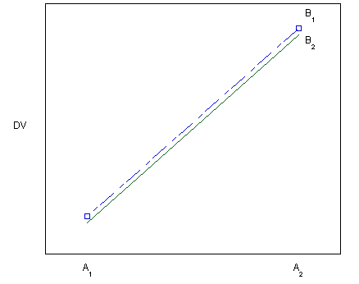
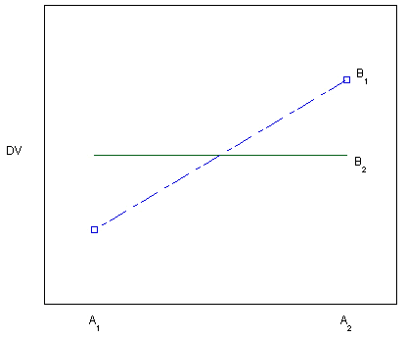
Main Effect of A?
Main Effect of B?
Interaction?
Yes
No
No
Main Effect of A?
Main Effect of B?
Interaction?
Yes
No
Yes

Slide 43
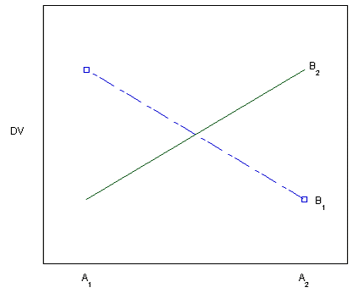
Main Effects & Interaction
No
Main Effect of A?
Main Effect of B?
Interaction?
No
Yes

Slide 44
Matrix of Means
Construct a matrix of means…

Slide 45
Interactions
Interactions take precedence over main effects
  A researcher should attempt to understand or interpret the interaction before any main effects
    What sorts of conclusions would we have had if we considered main effects only?
 |  | Self-esteem (SE)
 |  | Low SE | High SE | Mood means:
Mood | Negative | 7 | 5 | 6
 | Positive | 4 | 11 | 7.5
 | SE Means: | 5.5 | 7.5 | 6.625
Notes:
45

Slide 46
Sources of Variance
Totally Variance
Treatment
Variance
Error Variance
Main Effect A
Main Effect B
Interaction
Variance | SS | df | Mean Square | F obt | F crit | Decision | η²
Total
Main Effect A
Main Effect B
A X B
Error

Slide 47
Sample Question
A social‐developmental psychologist is interested in children’s perception of intelligence in their peers. For example, researchers have shown that children who are of low learning ability can be neglected and/or rejected by their peers. The psychologist would also like to determine perceptions of intelligence are influenced by the gender of the target child. The psychologist randomly selects 30 children attending three grade one classes in a large school. Each child is randomly assigned to one of two levels of a gender congruency condition (Factor A) where one level the target child is the same gender as the participant; in the second level the target child and participant are not the same gender. Within each of the levels of Gender congruency condition, there are 3 learning ability levels (Factor B) where the target child is described as low, average or high in learning ability. Perceptions are measured with a scale of behavioural intent (also called social distance). A high score (maximum = 50) indicates a strong degree of willingness to interact socially with the target child, and a low score (min = 0) indicates little interest in interacting with the target child. Are perceptions influenced by a target gender and learning ability and if so determine which levels? (use alpha = .05)

Slide 48
Sample Question
 | Same Gender (A1) | Different Gender (A2)
Low Learning Ability (B1) | 20, 34, 18, 35 | 10, 18, 15
Average Learning Ability (B2) | 30, 30, 39, 45, 26, 18, 40 | 24, 29, 33, 40, 18, 39, 27
High Learning Ability (B3) | 48, 44, 35, 41 | 30, 17, 21, 25, 21
What type of ANOVA Design?
2 (Gender Congruency) X 3 (Learning Ability)
Factorial ANOVA

Slide 49
Sample Question
 | Same Gender (A1) | Different Gender (A2) | Row Marginal Mean
Low Learning Ability (B1) | 26.8 | 14.3 | 21.4
Average Learning Ability (B2) | 32.6 | 30.0 | 31.3
High Learning Ability (B3) | 42.0 | 22.8 | 31.3
Column Marginal Mean | 33.5 | 24.5 | 29.0

Slide 50
Step 1: Hypotheses
Study Aim: Are perceptions influenced by a target’s gender and learning ability, and if so, determine which levels differ.
H_{O}:
  There are no main effects or interactions
H_{a}:
  There are main effects and/or interactions

Slide 51



Step 2: Test Statistic
Use the factorial ANOVA for a 2X3 design where
  for the main effect of gender congruency,
  for the main effect of learning ability
  for the interaction of gender congruency x
  learning ability.
Notes:
51

Slide 52
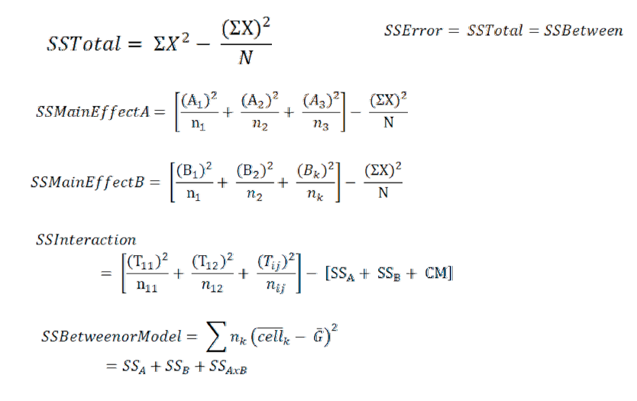
SS Formulas
SS_{Error} = SS_{Total} – (SS_{maineffectA} + SS_{maineffectB}+SS_{interaction})

Slide 53
Step 3: Critical F-ratios
Determine the critical F-ratios for each main effect and interaction
k = a*b = 2*3
F_{critical(A)} = F(df_{a}, df_{error}) =
F_{critical(B)} = F(df_{b}, df_{error}) =
F_{critical(AXB)} = F(df_{axb}, df_{error}) =
DF |  | Sample
Error | N-k* | 30-6 = 24
Main effect A (gender) | a - 1 | 2-1 = 1
Main effect B (learning) | b - 1 | 3-1 = 2
A X B = (a-1) (b-1) | (a-1) (b-1) | 2 x 1 = 2
Total = N-1 | N- 1 | 30 – 1 = 29
4.26
3.40
3.40

Slide 54
Step 3: Critical F
Main effect of Gender – Critical F (1 , 24) = 4.26
  Reject H_{o} if obtained value of F_{A} is > 4.26
Main Effect of Learning ability – Critical F (2,24) = 3.40
  Reject H_{o} if obtained value of F_{B} is > 3.40
Interaction of Gender and Learning – Critical F (2, 24) = 3.40
  Reject Ho if obtained value of F_{AxB} is > 3.40

Slide 55
Step 4: Calculate F-obtained
For all One-Way ANOVAs:
1) Develop a summary table
2) Develop calculations table
  Calculate statistical values for row and column
  Calculate statistical values for all cells
  Calculate total
2) Calculate all sums of squares
3) Identify df for each source of variance
4) Calculate mean squares by dividing sum of squares by df
5) Calculate F-obtained

Slide 56
Step 4: Computations

Slide 57
Notes:
57

Slide 58
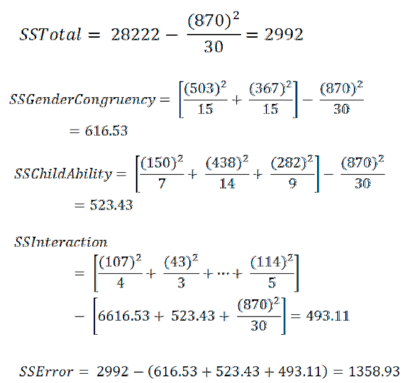
Step 4: Computation

Slide 59
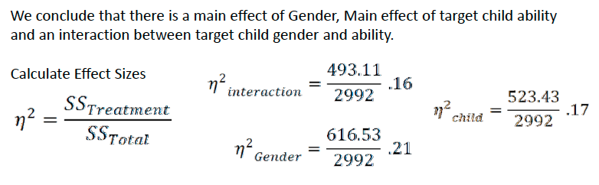
Step 5: Make a Decision
Variance | SS | df | Mean Square | F obt | F crit | Decision | η²
Total | 2992 | 29 | 103.17
Gender | 616.53 | 1 | 616.53 | 10.89 | 4.26
Learning | 523.43 | 2 | 261.77 | 4.62 | 3.40
Gender x Learning | 493.11 | 2 | 246.56 | 4.35 | 3.40
Error | 1358.93 | 24 | 56.62
Reject
.21
Reject
.17
Reject
.16

Slide 60
Graphical Display
Figure 1: Graph displaying mean scores on behavioural intent scale by gender congruency and learning ability.

Slide 61
Step 5 cont’d
Variance | SS | df | MS | F obt | F crit | Decision | η²
Total | 2992 | 29 | 103.17
Gender | 616.53 | 1 | 616.53 | 10.89 | 4.26 | Reject | .21
Learning | 523.43 | 2 | 261.77 | 4.62 | 3.40 | Reject | .17
Gender x Learning | 493.11 | 2 | 246.56 | 4.35 | 3.40 | Reject | .16
Error | 1358.93 | 24 | 56.62
Since all Fobt values fall in the rejection region
Reject Ho and accept Ha for both main effects and the interaction
Conclude that there are significant differences in perceptions of intelligence between gender, learning groups and the interaction of the two variables

Slide 62
Step 5 cont’d
Variance | SS | df | MS | F obt | F crit | Decision | η²
Total | 2992 | 29 | 103.17
Gender | 616.53 | 1 | 616.53 | 10.89 | 4.26 | Reject | .21
Learning | 523.43 | 2 | 261.77 | 4.62 | 3.40 | Reject | .17
Gender x Learning | 493.11 | 2 | 246.56 | 4.35 | 3.40 | Reject | .16
Error | 1358.93 | 24 | 56.62
BUT which learning groups are significantly different from each other?
What are the specific interactions?
Need to conduct pairwise comparisons!

Slide 63

Pairwise Comparison- INTERACTION
Interaction is significant therefore calculate post-hoc test using cells means
Find q with…
  Adjusted k: Look at the bottom of page
    k = 5
    df_{error} = 24
q = 4.17

Slide 64

Pairwise Comparison- INTERACTION
Calculate harmonic mean:
  k is the number of cells in the experiment
    In a 2x3 design, k =
  n is the number of participants in each cell
Tukey HSD = 14.71
  Therefore any mean differences between cells must be greater than 14.71 for it to be significant
4.55
6

Slide 65
Finding Mean Differences
Comparisons between learning ability within gender congruency conditions
Comparisons between gender congruency within learning ability groups
 |  | Same gender |  | Differentgender
Low learning ability |  | 26.8 | (12.5) | 14.3
 |  | (5.8) |  | (15.7)*
Avg learning ability | (15.2)* | 32.6 | (2.6) | 30.0 | (8.5)
 |  | (9.4) |  | (7.2)
High learning ability |  | 42.0 | (19.2) | 22.8

Slide 66
Pairwise Comparison
When the target and participant child are the same gender, there is a difference between low and high learning abilities, and when the target and participant child are different genders, there is a difference between low and average conditions.

Slide 67
Pairwise Comparison- Main Effect
Don’t need to compare gender congruency because only two levels
Conduct Tukey among learning abilities
Therefore, the low group differs from each of the average and high groups. There is no evidence that the latter two differ.
 | Low | Average | High
Low |  | 9.86* | 9.90*
Average |  |  | 0.04
High

Slide 68
Results
The data were analyzed with a 2 x 3 between participants factorial ANOVA. The analysis revealed a significant main effect of gender of the participant [F(1,24)= 10.89, p < .05] with η² = .21 and a significant main effect of intelligence level of the target child [F(2,24) = 4.62, p < .05] with η² = .17. The Main effect of gender resulted from the fact that perception were more favorable when the participant and target child were of the same gender (M = 33.53, SD = 9.75) rather than opposite genders (M = 24.47, SD = 8.64). Tukey’s post hoc tests (alpha = .05) of the main effect of intelligence of target child revealed that both the high (M = 31.33, SD = 11.21) and moderate (M = 31.29, SD = 8.43) groups differed from the low group (M = 21.43, SD = 9.48)
A significant interaction between gender of the participant and the indicated level of target child was also found [F(2,24) = 4.35, p <.05] with effect size of η² = .16. The mean social distance score and standard deviation for each group comprising the interaction is shown in Figure 1. Tukey’s post hoc tests (alpha = .05) were conducted to determine the locus of the interaction. They indicated that when the target child was the same gender as the participant, target child said to be of high intelligence were more favorably perceived than children said to be of low intelligence, but when the target child was of the opposite gender as the participant, children of moderate intelligence were perceived more favorably than children of low intelligence.

