Slide 1
Inclusion-Exclusion Principle with Two Sets
Let A and B be two finite sets. Then
| A ∪ B | = | A | +| B | − | A ∩ B |.
A∩B
A
B
A−B
B− A

Slide 2
Proof of Inclusion-Exclusion Principle with Two sets:
We have A ∪ B = (A − B) ∪ (A ∩ B) ∪ (B − A), and three sets A − B, A ∩ B, and B − A are mutually disjoint. Since (A − B) ∪ (A ∩ B) = A and (B − A) ∪ (A ∩ B) = B, we have
|A ∪ B| = |A − B| + |A ∩ B| + |B − A|
=|A − B| + |A ∩ B| + |B − A| + |A ∩ B| − |A ∩ B|
= |(A − B) ∪ (A ∩ B)| + |(B − A) ∪ (A ∩ B)| − |A ∩ B|
= |A| + |B| − |A ∩ B|.

Slide 3
If A₁ and A₂ are subsets of a set S, then
| S − (A₁ ∪ A₂) | = | S | − (| A₁ | +| A₂ |) + | A₁ ∩ A₂ |.
This formula can be interpreted as follows:
In set S, elements in a subset A₁ have property P₁, and elements in a subset A₂ have property P₂. Then the number of elements in S that does not have either property P₁ or P₂ is |S| − (|A₁| +|A₂|) + |A₁ ∩ A₂|.

Slide 4
Examples
1. In a party, 10 people speak English, and 8 people speak French. 5 people are bilingual. How many people are there in this party?
The total number of people is 10 + 8 − 5 = 13.

Slide 5
2. How many bit strings of length 8 are there that start with 1 or end with 00?
The number of bit strings of length 8 that start with 1 is 2⁷. The number of bit strings of length 8 that end with 00 is 2⁶. The number of bit strings of length 8 that start with 1 and end with 00 is 2⁵.
Hence, the number of bit strings of length 8 that start with 1 or end with 00 is (2⁷ + 2⁶) − 2⁵ = 160.

Slide 6
3. How many ways are there to arrange the letters a, b, c, d, e, f, g and h, in a row such that the pattern “abc” and “defg” do not occur?
If “abc” occurs, regard “abc” as a “super-letter”, we have 6! permutations. If “defg” occurs, there are 5! permutations. If both “abc” and “defg” occur, there are 3! permutations. Since the total number of permutations of 8 letters is 8!, the number of permutations without “abc” or “defg” is 8! − (6! + 5!) + 3! = 39486.

Slide 7
4. How many ways are there to arrange two couples sitting in a row such that no couple is side by side?
The number of ways to arrange 4 people is 4! = 24.
The number of ways so that couple 1 is side by side is
P(3, 3)P(2, 2) = 12.
The number of ways so that couple 2 is side by side is also 12.
The number of ways so that both couples are side by side is
P(2, 2)P(2, 2)P(2, 2) = 8.
The number of ways to arrange these two couples so that no couple is side by side is
24 − (12 + 12) + 8 = 8.

Slide 8
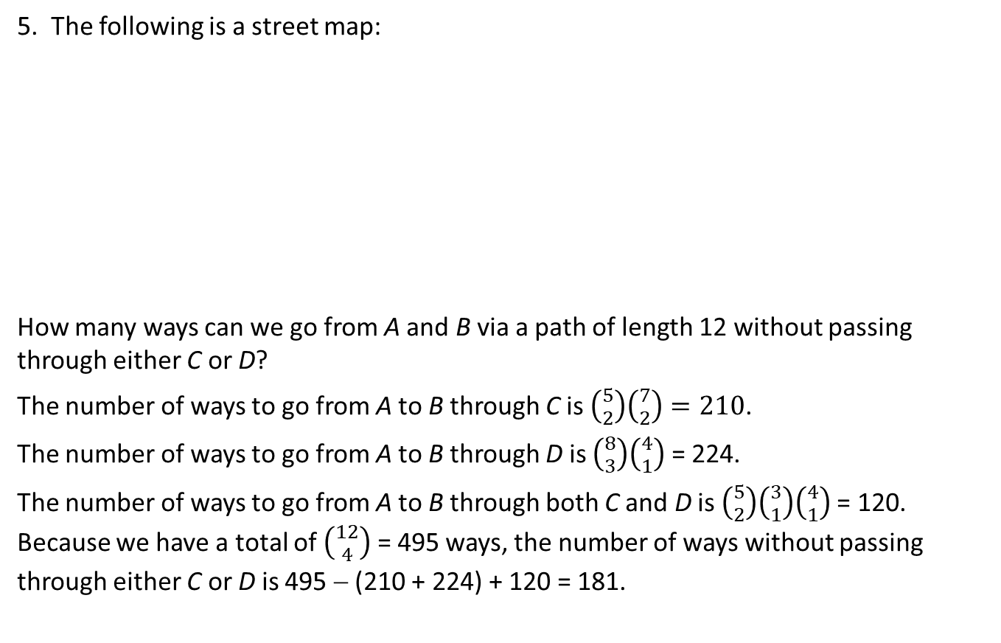
5. The following is a street map:
How many ways can we go from A and B via a path of length 12 without passing through either C or D?
The number of ways to go from A to B through C is $\left({5 \atop 2}\right)\left({7 \atop 2}\right)=210$.
The number of ways to go from A to B through D is $\left({8 \atop 3}\right)\left({4 \atop 1}\right)$ = 224.
The number of ways to go from A to B through both C and D is $\left({5 \atop 2}\right)\left({3 \atop 1}\right)\left({4 \atop 1}\right)$= 120. Because we have a total of $\left({12 \atop 4}\right)$ = 495 ways, the number of ways without passing through either C or D is 495 − (210 + 224) + 120 = 181.
•
B
•
D
•
C
A
•

Slide 9
Generalized Inclusion-Exclusion Principle
Let A₁, A₂, …, A_{n} be n sets. Then

Slide 10
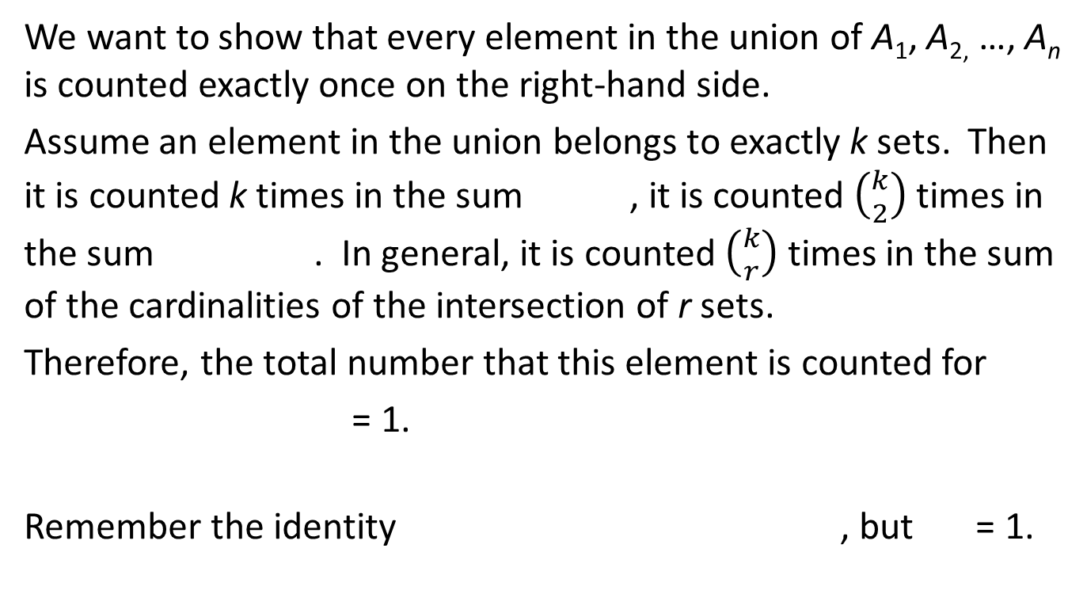
Proof of the Generalized Inclusion-Exclusion Principle
We want to show that every element in the union of A₁, A_{2,} …, A_{n} is counted exactly once on the right-hand side.
Assume an element in the union belongs to exactly k sets. Then it is counted k times in the sum , it is counted $\left({k \atop 2}\right)$ times in the sum . In general, it is counted $\left({k \atop r}\right)$ times in the sum of the cardinalities of the intersection of r sets.
Therefore, the total number that this element is counted for
= 1.
Remember the identity , but = 1.

Slide 11
If A₁, A₂, …, A_{n} are subsets of S. Then
This formula may also be interpreted as follows: In S, elements in a subset A_{i} has property P_{i}, i = 1, 2, …, n. Then, in S, the number of elements that have none of these properties is given by this formula.

Slide 12
Examples
1. Find the number of permutations of the digits 0, 1, 2, 3, 4, and 5, such that 0 is not the first or the last, 1 is not the first and 2 is not the second.
Here we have three properties that a “legitimate” permutation cannot have:
P₁: 0 is the first digit.
P₂: 0 is the last digit.
P₃: 1 is the first digit.
P₄: 2 is the second digit.

Slide 13
Let p_{i} be the number of permutations that satisfy condition P_{i}, p_{ij} be the number of permutations that satisfy conditions P_{i} and P_{j,} p_{ijk} be the number of permutations that satisfy conditions P_{i}, P_{j}, and P_{k}. Obviously, there is no permutation that satisfy all four condition.
Then p₁ = p₂ = p₃ = p₄ = 5!,
p₁₂ = p₁₃ = 0, p₁₄ = p₂₃ = p₂₄ = p₃₄ = 4!,
p₁₂₃ = p₁₂₄ = p₁₃₄ = 0, p₂₃₄ = 3!.
The total number of permutations of six digits is 6!. By the inclusion-exclusion principle, the number of permutations that satisfy the conditions is
6! − (4 × 5!) + (4 × 4!) − 3! = 330.

Slide 14
2. In a meeting, there are ten math students, nine physics students, eight chemistry students, and seven biology students. How many ways are there to select a group of six students including at least one student in each department?
Consider all possibilities to select a group of four students. The total number of ways is C(34, 6).

Slide 15
Define properties:
P₁: no math student is selected.
P₂: no physics student is selected.
P₃: no chemistry student is selected.
P₄: no biology student is selected.
Let p_{i} be the number of selections that satisfy condition P_{i}, p_{ij} be the number of selections that satisfy condition P_{i} and P_{j,} p_{ijk} be the number of selections that satisfy conditions P_{i}, P_{j}, and P_{k}.
Obviously, there is no selection that satisfies all four conditions.

Slide 16
Then p₁ = C(24, 6), p₂ = C(25, 6), p₃ = C(26, 6), p₄ = C(27, 6).
p₁₂ = C(15, 6), p₁₃ = C(16, 6), p₁₄ = C(17, 6), p₂₃ = C(17, 6),
p₂₄ = C(18, 6), p₃₄ = C(19, 6).
p₁₂₃ = C(7, 6), p₁₂₄ = C(8, 6), p₁₃₄ = C(9, 6), p₂₃₄ = C(10, 6).
By the inclusion-exclusion principle, the number of selections that include at least one student in each department is
C(34, 6) − (C(24, 6) + C(25, 6) + C(26, 6) + C(27, 6)) + (C(15, 6) + C(16, 6) + C(17, 6) + C(17, 6) + C(18, 6) + C(19, 6)) − (C(7, 6) + C(8, 6) + C(9, 6) + C(10, 6)) = 1344904 − (134596 + 177100 + 230230 + 296010) + (5005 + 8008 + 12376 + 12376 + 18564 + 27123) − (7 + 28 + 84 + 210) = 590091.

Slide 17
The Floor Function
The floor function ⎣x⎦ is defined for all real numbers x. ⎣x⎦ is the largest integer that is not greater than x.
For examples, ⎣3⎦ = 3, ⎣2.6⎦ = 2, ⎣−2⎦ = −2, ⎣−2.3⎦ = −3.
Because ⎣x⎦ is the greatest integer not more than x, ⎣x⎦ + 1 > x, or ⎣x⎦ > x − 1.

Slide 18
The Ceiling Function
The ceiling function ⎡x⎤ is defined for all real numbers x. ⎡x⎤ is the smallest integer that is not less than x.
For examples, ⎡3⎤ = 3, ⎡3.5⎤= 4, ⎡−2⎤= −2, ⎡−2.3⎤ = −2.
Because ⎡x⎤ is the smallest integer not less than x, ⎡x⎤ − 1 < x, or ⎡x⎤ < x + 1.

Slide 19
3. Find the number of integers from 1 to 10000 that are not multiples of 3, 7 or 11.
Let S be the set of integers from 1 to 10000.
Let A₁ = {x ∈ S | 3|x}, A₂ = {x ∈ S | 7|x}, and A₃ = {x ∈ S | 11|x}.
Then | A₁ | = ⎣10000 / 3⎦ = 3333,
| A₂ | = ⎣10000 / 7⎦ = 1428,
| A₃ | = ⎣10000 / 11⎦ = 909,
| A₁ ∩ A₂| = ⎣10000 / (3 × 7)⎦ = 476,
| A₁ ∩ A₃| = ⎣10000 / (3 × 11)⎦ = 303,
| A₂ ∩ A₃| = ⎣10000 / (7 × 11)⎦ = 129,
| A₁ ∩ A₂ ∩ A₃| = ⎣10000 / (3 × 7 × 11)⎦ = 43.
| S − (A₁ ∪ A₂ ∪ A₃) | = 10000 − (3333 + 1428 + 909) + (476 + 303 + 129) − 43 = 5195.

Slide 20
Number of Surjections
Find the number of surjections from a set D of 6 elements to a set C = {c₁, c₂, c₃, c₄} of four elements.
Consider the set F of all functions from D to C. The cardinality of F is 4⁶. A function f in F is in a subset A_{i} of F if c_{i} is not in the range of f, i = 1, 2, 3, 4. Then
| A_{i} | = 3⁶, i = 1, 2, 3, 4.
| A_{i} ∩ A_{j} | = 2⁶, 1 ≤ i < j ≤ 4.
| A_{i} ∩ A_{j} ∩ A_{k}| = 1⁶, 1 ≤ i < j < k ≤ 4.
| A₁ ∩ A₂ ∩ A₃ ∩ A₄ |= 0.
The number surjections is 4⁶ − 4 × 3⁶ + C(4, 2) × 2⁶ − C(4, 3) × 1⁶
= 1560.

Slide 21
A similar argument gives the following result:
The number of surjections from a set of m elements to a set of n elements, m ≥ n, is
n^{m} − C(n, 1)(n − 1)^{m} + C(n, 2)(n − 2)^{m} − … + (−1)^{n−1}C(n, n − 1)(n − (n − 1))^{m}.

Slide 22
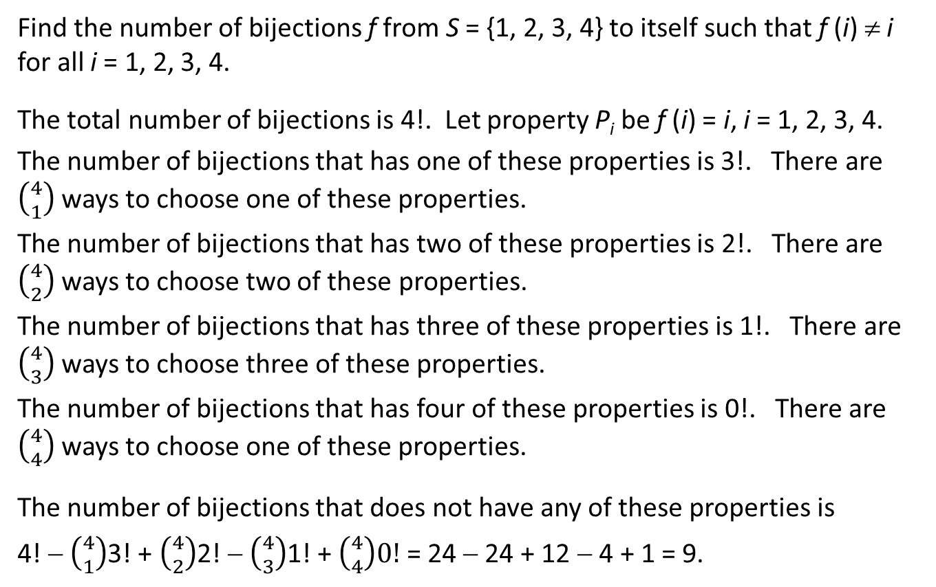
Derangement
Find the number of bijections f from S = {1, 2, 3, 4} to itself such that f (i) ≠ i for all i = 1, 2, 3, 4.
The total number of bijections is 4!. Let property P_{i} be f (i) = i, i = 1, 2, 3, 4.
The number of bijections that has one of these properties is 3!. There are $\left({4 \atop 1}\right)$ ways to choose one of these properties.
The number of bijections that has two of these properties is 2!. There are $\left({4 \atop 2}\right)$ ways to choose two of these properties.
The number of bijections that has three of these properties is 1!. There are $\left({4 \atop 3}\right)$ ways to choose three of these properties.
The number of bijections that has four of these properties is 0!. There are $\left({4 \atop 4}\right)$ ways to choose one of these properties.
The number of bijections that does not have any of these properties is
4! − $\left({4 \atop 1}\right)$3! + $\left({4 \atop 2}\right)$2! − $\left({4 \atop 3}\right)$1! + $\left({4 \atop 4}\right)0!$ = 24 − 24 + 12 − 4 + 1 = 9.

Slide 23
A function f from S_{n} = {1, 2, …, n} to itself with the property that f (i) ≠ i is called a derangement.
An argument similar to this example gives the following result:
The number of derangements from a set of n elements to itself is
C(n, 0)n! − C(n, 1)(n − 1)! + C(n, 2)(n − 2)! − … + (−1)^{n}C(n, n)(n − n)!.

Slide 24
r-Permutations with Repetition
Recall that an r-permutation selected from a set S of n elements is an injective function from the set R = {1, 2, …, r} to S.
An r-permutation p with repetition taken from R is a function from R to S. In other words, an element in S may be the image of more than one element of R. For example, suppose S = {a, b, c}. A 5-permutation with repetition from S could be cabac, i.e., p(1) = p(5) = c, p(2) = p(4) = a, and p(3) = b.
The number of r-permutation with repetition selected from a set of n elements is n^{r}.

Slide 25
Find the number of r-permutations with repetition selected from a set S = {a₁, a₂, …, a_{n}} such that a₁ is used k₁ times, a₂ is used k₂ times, …, a_{n} is used k_{n} times,
k₁ + k₂ + … + k_{n} = r.
Such an r-permutation with repetition can be constructed with the following steps: Among the elements of R = {1, 2, …, r}, choose k₁ elements to be the preimage of a₁. Among the left r − k₁ elements of R, choose k₂ elements to be the preimage of a₂, …. After k₁ + k₂ + … + k_{n−1} = r − k_{n} elements are selected to be the preimages of a₁, a₂, …, a_{n−1}, the k_{n} elements left in R are preimages of a_{n}.

Slide 26
Therefore, the number of r-permutations with repetition selected from a set S = {a₁, a₂, …, a_{n}} such that a₁ is used k₁ times, a₂ is used k₂ times, …, a_{n} is used k_{n} times, k₁ + k₂ + … + k_{n} = r, is
C(r, k₁)C(r − k₁, k₂)…C(r − k₁ − k₂ − … − k_{n−1}, k_{n})
₌
This number is also denoted by C(r; k₁, k₂, …, k_{n}) or

Slide 27
Examples
1. The number of 10-permutations with repetition of 5 red balls, 3 black balls, and 2 green balls. The balls of the same color are identical.
This number is C(10; 5, 3, 2) = = 2520.

Slide 28
2. How many different strings can be obtained by reordering the letters in the word SUCCESS?
In this word, there are two C’s, three S’s, one U, and one E. The number of 7-permutaions that uses C twice, S three times, U once, and E once,
is C(7; 2, 3, 1, 1) = = 420.

Slide 29
Distribution Formulation
The question in previous example can be reformulated as follows:
We have four (distinct) boxes: C, S, U, and E, and we have seven (distinct) positions 1, 2, …, 7.
In the original word SUCCESS, positions 1, 6, and 7, are put into box S, positions 3 and 4 are in box C, position 2 is in box U, and position 5 is in box E.
The number of strings obtained by re-order the letters in this word is the number of ways to put 7 distinct positions into four distinct boxes such that box C has 2 positions, box S has three positions, box U has one position, and box E has one position.

Slide 30
The number of r-permutations selected from a set with n elements a₁, a₂, …, a_{n} such that element a_{i} occurs k_{i} times, i = 1, 2, …, n, can be re-formulated as a distribution problem as follows:
The number of ways to distribute r distinct objects into n distinct boxes such that box i has k_{i} objects, i = 1, 2, …, n, k₁ + k₂ + … + k_{n} = r, is
C(r; k₁, k₂, …, k_{n}) =

Slide 31
How Do We Find (x + y + z)⁴?
(x + y + z)⁴ = (x + y + z)(x + y + z)(x + y + z)(x + y + z).
Every term in the expansion is the product of a term in the first factor, a term in the second factor, a term in the third factor, and a term in the last factor. The degree of this monomial is 4.
What is the coefficient of the term xy²z? This is the number of ways to select x from one of these four factors, select y from two of these factors, and select z from one of these factors.

Slide 32
Multinomial Coefficients
In general we want to find the coefficient of
in the expansion of (x₁ + x₂ + … + x_{n})^{r}.
The coefficient of in the expansion is the number of ways that we can choose x₁ from k₁ factors, choose x₂ from k₂ factors, …, choose x_{n} from k_{n} factors.
In other words, we have n boxes x₁, x₂, …, x_{n}, and r factors in the product. If we choose x_{i} from a factor, then we “put this factor in box x_{i}”. With this interpretation, we see that the coefficient of
is C(r; k₁, k₂, …, k_{n}) =

Slide 33
Example
Find the coefficient of x²y³z in the expansion of (x + 2y + 3z)⁶.
Since ,
the coefficient of x²y³z is 1440.

Slide 34
r-Combinations with Repetition
Start with an example: Suppose we have a bag of identical white balls, a bag of identical red balls, and a bag of identical black balls. How many different combinations of a set of 5 balls can we have?
For example, we may have a 5-combination with one white ball, two red balls, and 2 black balls, or we may have two white balls, 0 red ball, and three black balls.

Slide 35
The following are all possibilities:

Slide 36
Add vertical bars to separate different colors:

Slide 37
Now the colors don’t have to be shown:

Slide 38
Replace each combination by a bit string:
0 0 0 0 0 1 1
0 0 0 0 1 0 1
0 0 0 0 1 1 0
0 0 0 1 0 0 1
0 0 0 1 0 1 0
0 0 0 1 1 0 0
0 0 1 0 0 0 1
0 0 1 0 0 1 0
0 0 1 0 1 0 0
0 0 1 1 0 0 0
0 1 0 0 0 0 1
0 1 0 0 0 1 0
0 1 0 0 1 0 0
0 1 0 1 0 0 0
0 1 1 0 0 0 0
1 0 0 0 0 0 1
1 0 0 0 0 1 1
1 0 0 0 1 0 0
1 0 0 1 0 0 0
1 0 1 0 0 0 0
1 1 0 0 0 0 0

Slide 39
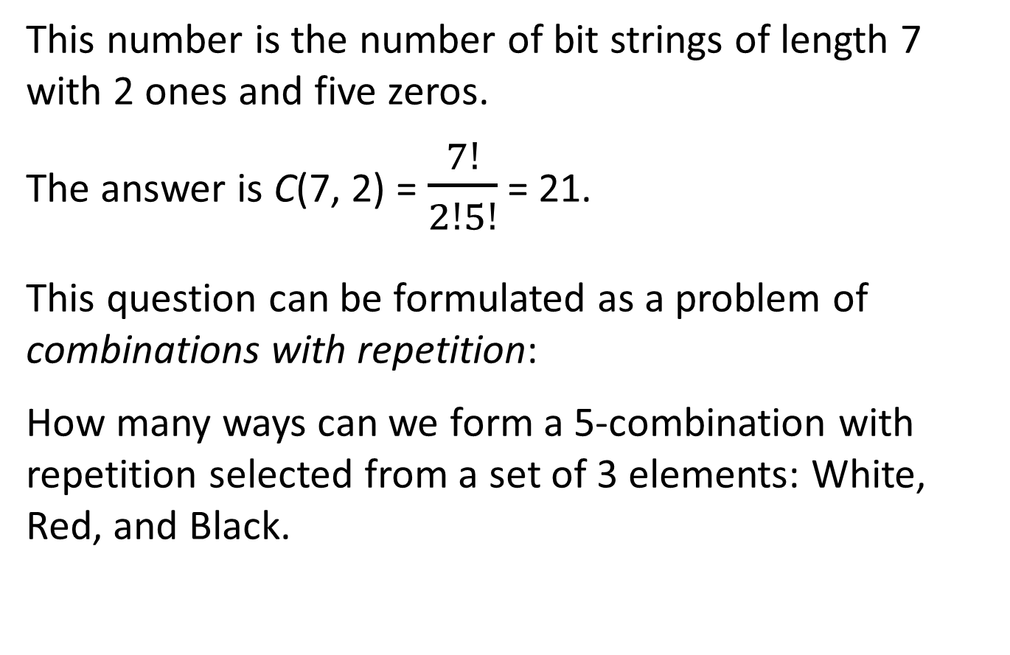
This number is the number of bit strings of length 7 with 2 ones and five zeros.
The answer is C(7, 2) = $\frac{7!}{2!5!}$ = 21.
This question can be formulated as a problem of combinations with repetition:
How many ways can we form a 5-combination with repetition selected from a set of 3 elements: White, Red, and Black.

Slide 40
Combination with Repetition
The number of r-combinations with repetition selected from a
set of n elements is C(r + n − 1, n − 1) = .
To prove this result, let R be the set of all r-combinations with repetition selected from a set with n elements A = {a₁, a₂, …, a_{n}}.
Let S be the set of bit strings of length r + n − 1 with n − 1 ones and r zeros.
We want to establish a bijection from R to S. Then |R| = |S| = C(r + n − 1, n − 1).

Slide 41
Define a function f from R to S as follows:
Let c be an r-combination with repetition from elements in A that has k₁ members being a₁, k₂ members being a₂, …, k_{n} members being a_{n},
k₁ + k₂ + … + k_{n} = r.
Then f (c) is a bit string that starts with k₁ zeros, followed by a one, then k₂ zeros and followed by a one, …, k_{n−1} zeros followed by a one, and ends with k_{n} zeros. This string has k₁ + k₂ + … + k_{n} = r zeros and n − 1 ones. The total length is n + r − 1.

Slide 42
This function f is a bijection.
Indeed, let s is a string of length r + n − 1 with r zeros and n − 1 ones. Construct an r-combination with repetition selected from a set of n elements A = {a₁, a₂, …, a_{n}} as follows: Replace zeros before the first one in s by a₁, replace zeros between the first one and the second one by a₂, …, replace the zeros after the last zero by a_{n}. Then we have an element in R, which is the preimage of s.
Since every element in S has one and only one preimage, function f is a bijection.

Slide 43
For example, if A = {a, b, c, d}, r = 6, and c = aabbbd, then f (c) = 001000110. On the other hand, if s = 010010010 = f (c₁), then c₁ = abbccd.
Since f is a bijection,
|R| = |S| = C(r + n − 1, n − 1) = .

Slide 44
Distribute Identical Balls into Distinct Boxes
We can also formulate the ball problem in another way: Suppose we have three boxes: a white box, a red box, and a black box. In how many ways, can we distribute five identical balls into these three boxes?
If we have w balls in the white box, r balls in the red box, and b balls in the black box. Then w + r + b = 5. This corresponds to a 5-comnbination with repetition that has w white balls, r red balls, and b black balls.

Slide 45
Every way of distribution of r identical objects into n distinct boxes corresponds to an r-combination with repetition selected from a set of n elements.
On the other hand, every r-combination with repetition selected from a set of n elements corresponds to a way to distribute r identical objects into n distinct boxes.
Therefore, the number of ways to distribute r identical objects into n distinct boxes is C(r + n − 1, n − 1).

Slide 46
Example
The number of ways to distribute 10 identical balls into four distinct boxes, B1, B2, B3, and B4, is
C(10 + 4 − 1, 4 − 1) = C(13, 3) = 286.

Slide 47
Equation x₁ + x₂ + … + x_{n} = r
Find the number of non-negative integer solutions of the equation x₁ + x₂ + x₃ = 5.
Let x₁ be the number of white balls, let x₂ be the number of red balls, and let x₃ be the number of black balls. Then a non-negative integer solution of this equation is a 5-combintion with repetition from a set of three elements.
For example, a solution x₁ = 3, x₂ = 0, x₃ = 2 corresponds to a 5-combination with 2 white balls and 3 black balls.

Slide 48
In general, the number of non-negative integer solutions of the equation x₁ + x₂ + … + x_{n} = r is the number of r-combinations with repetition from a set of r elements, C(r + n − 1, n − 1).
For example, the number of non-negative integer solutions to the equation x₁ + x₂ + x₃ = 5 is C(7, 2) = 21.

Slide 49
Examples
1. Find the number non-negative integer solutions of the equation x₁ + x₂ + x₃ + x₄ = 11.
Solution. The number of non-negative integer solutions of this equation is C(11 + 4 − 1, 4 − 1)
= = 364.

Slide 50
2. Find the number of non-negative integers of the equation x₁ + x₂ + x₃ + x₄ = 11 such that x₁ ≥ 5.
Solution. Let x₁* = x₁ − 5. Then x₁* + x₂ + x₃ + x₄ = 6. The number of non-negative integer solutions of this equation is the number of non-negative integer solutions of the original equation with x₁ ≥ 5. This number is C(6 + 4 − 1, 4 − 1) = = 84.

Slide 51
This question can be formulated as a distribution problem: Find the number of ways to distribute 11 identical balls into 4 distinct boxes such that box 1 has at least 5 balls.
We may put 5 balls into box 1 first, and then distribute the rest 6 balls into these boxes. This leads directly to the solution C(6 + 4 − 1, 4 − 1) = 84.

Slide 52
3. Find the number of non-negative integers of the equation x₁ + x₂ + x₃ + x₄ = 11 such that x₁ ≤ 4.
Solution. By the result of the previous examples, this number is 364 − 84 = 280.
This question may also be formulated as a distribution problem: Find the number of ways to distribute 11 identical balls into 4 distinct boxes such that box 1 has at most 4 balls.

Slide 53
4. Find the number of non-negative integers of the equation x₁ + x₂ + x₃ + x₄ = 11 such that x₁ ≤ 4 and x₂ ≤ 2.
Solution. The number of non-negative integer solutions of this equation with x₁ ≥ 5 is C(6 + 4 − 1, 4 − 1) = 84, and similarly, the number of non-negative integer solutions of this equation with x₂ ≥ 3 is C(8 + 4 − 1, 4 − 1) = 165. The number of nonnegative integer solutions of this equation with x₁ ≥ 5 and x₂ ≥ 3 is C(3 + 4 − 1, 4 − 1) = 20.
By the inclusion-exclusion principle, the number of nonnegative integer solutions of this equation with x₁ ≤ 4 and x₂ ≤ 2 is 364 − (84 + 165) + 20 = 135.

Slide 54
The Pigeonhole Principle
Let k be a positive integer. If k + 1 objects are put into k boxes, then at least one box has at least two objects.
The contraposition is obvious that if every box has at most one object, then the total number of objects is no more than k because the total number of boxes is k.

Slide 55
Examples
1. Show that, if five integers are selected from the set S = {1, 2, 3, 4, 5, 6, 7, 8}, then there must be two of them has a sum 9.
Construct four “boxes”: {1, 8}, {2, 7}, {3, 6}, {4, 5}. The sum of two numbers in each box is 9. If five numbers are selected, by the pigeonhole principle, there must be two of them are in the same “box”, and then the sum of these two numbers is 9.

Slide 56
2. A drawer has a dozen of brown socks and a dozen of black socks, all unmatched. A mans take out a number of socks at random in dark. What is the smallest number of socks he has to take out to be sure that he has two socks that are of the same color?
If three socks are taken, they are put into two boxes: Brown and black. By the pigeonhole principle, at least two of them are of the same color. This number 3 is the smallest because if only two socks were taken, then they may have different colors.

Slide 57
3. For any integer n there is a multiple of n whose decimal representation has only 0s and 1s.
Consider n + 1 numbers with only digit 1: a₁ = 1, a₂ = 11, a₃ = 111, …, a_{n+1} = 11….1. The last one has n + 1 ones. Because, when an integer m divided by n, the remainder can only take one of the n values: 0, 1, 2, …, n − 1, there must be a_{i} and a_{j}, 1 ≤ i < j ≤ n + 1, such that, a_{i} ≡ a_{j} (mod n). This means that a_{j} − a_{i} is a multiple of n. Since a_{j} − a_{i} consists of only 0s and 1s, there exists a multiple of n has only 0s and 1s in its decimal representation.

Slide 58
4. If we plot five points in a unit square, then there exist two points such that the distance between these
two points is no more than .
Use a horizontal line and a vertical line to subdivide the unit square into four identical squares. Then the side length of each square is 1/2. By the pigeonhole principle, at least one of these squares contains two points A and B. Since the largest distance of two points in a square of side length 1/2 is . The distance between A and B is at most .

Slide 59
The Generalized Pigeonhole Principle
If N objects are put into k boxes, then there is at least one box that contains at least ⎡N / k⎤ objects.
Indeed, if every box contains at most ⎡N / k⎤ − 1 objects, then the total number of object is at
most objects, a
contradiction.

Slide 60
Examples
1. Show that, among 100 students in a class, there must be at least 9 students who were born in the same month.
Now we want to put 100 students into 12 “boxes”: January, February, …, December. According to the pigeonhole principle, there must be ⎡100 / 12⎤ = 9 people who are in the same “box”.

Slide 61
2. What is the smallest number N such that in a group of N people there must be at least two of them born in the same month?
We want to find the smallest number N such that ⎡N / 12⎤ = 9. Find the largest number M such that ⎡M / 12⎤ = 8. This number is M = 8 × 12 = 96. Therefore, N = M + 1 = 97 is the smallest number such that ⎡N / 12⎤ = 9. In a group of 97 people, there must be at least two people born in the same month.

Slide 62
3. What is the smallest length of a sequence of digits so that there is at least one digit that is used at least 3 times?
Suppose we construct a sequence of digits of length N. Since we have 10 digits, if we put the digits in this sequence into 10 boxes {0, 1, 2, …, 9}, then there must
be one box has at least digits.
In this question, = 3. Because (3 − 1) × 10 = 20 is
the largest integer with ceiling 2, 21 is the smallest integer that has ceiling 3.

Slide 63
4. Let P₁, P₂, …, P₆, be six points on a circle. Use a line segment P_{i}P_{j} to join each pair of points, 1 ≤ i < j ≤ 6. Each of these line segments is colored by black or red. A triangle P_{i}P_{j}P_{k} is said to be monochromatic if all three edges P_{i}P_{j}, P_{i}P_{k}, and P_{j}P_{k} are of the same color.
Show that no matter how the lines are colored, there must exist a monochromatic triangle. In the following example, we have two black triangles but no red triangles:
•
•
•
•
•
•

Slide 64
Look at the lines P₁P₂, P₁P₃, P₁P₄, P₁P₅, P₁P₆. These five lines are in two colors. By the pigeonhole principle, among these five lines, there must be ⎡5/2⎤ = 3 lines are in the same color,, say P₁P₂, P₁P₃, P₁P₄ are in color C (red or black). If, any one of lines P₂P₃, P₂P₄, or P₃P₄ is in color C, there is a monochromatic triangle of color C. Otherwise, none of P₃P₄, P₂P₄, P₃P₄ is in color C, then they are all of the other color, and P₂P₃P₄ is a monochromatic triangle.

Slide 65
The number n = 6 in the previous example is the smallest number that has this property: If each of the lines joining pairs of n points are colored by one of two colors, then there exists a monochromatic triangle. The following is a coloring of lines joining pairs of five points by two colors without a monochromatic triangle:

Slide 66
5. Prove that if {1, 2, 3, 4, 5} is separated into two groups, then there is a group that contains two numbers a and b such that
a − b is in this group.
Proof. Prove by contradiction. Assume that no such group exists.
When five numbers are separated into two groups, by the pigeonhole principle, there is a group, say group 1, that contains three numbers a₁ < a₂ < a₃. By the assumption, b₁ = a₃ − a₁ > b₂ = a₃ − a₂ are not in group 1. Then b₁ and b₂ are in the other group, say group 2. By the assumption again, b₁ − b₂ is not in group 2. However, b₁ − b₂ = (a₃ − a₁) − (a₃ − a₂) = a₂ − a₁. According to the assumption, b₁ − b₂ = a₂ − a₁ is not in group 1 either. This contradiction proves the result.

