Slide 1
VI. Counting

Slide 2
Events
An event is the result or outcome of a process or an experiment. Many counting problems can be formulated as asking how many ways a certain kind of events can occur.
Two events are said to be mutual exclusive if, when one event occurs, the other event cannot occur.

Slide 3
Basic Counting Principles
The sum rule: If sets A_{1,} A₂, …, A_{n} are pairwise disjoint, i.e., A_{i} ∩ A_{j} = ∅, 1 ≤ i < j ≤ n, then
| A₁ ∪ A₂ ∪ … ∪ A_{n} | = | A₁ | + | A₂ | + … + | A_{n} |.
In terms of events, we may say that, if we have a₁ events in group 1, a₂ events in group 2, …, a_{n} events in group n, and no events is in more than one group, then the total number of events is the sum a₁ + a₂ + … + a_{n}.

Slide 4
Example
Suppose we toss two dice. How many ways can we get a sum 6?
We have three groups of such events:
A₁: 3 + 3. There is only one of such event.
A₂: 2 + 4. There are two events, i.e., 2 + 4 and 4 + 2.
A₃: 1 + 5. There are also two events, i.e., 1 + 5 and 5 + 1.
Because these groups are mutually disjoint, the total number is 1 + 2 + 2 = 5.

Slide 5
Product Rule for Two Sets
Let A₁ and A₂ be two finite sets. Then |A₁ × A₂|=|A₁| × |A₂|.
Proof. An element in A₁ × A₂ is an ordered pair (a₁, a₂), where a₁ ∈ A₁ and a₂ ∈ A₂. For every element a₁ in A₁, there are |A₂| choices to choose the second component a₂. Since we have |A₁| elements in A₁, the total number of ways to construct such an ordered pair is |A₁| × |A₂|.
In terms of events, if an event is constructed in two steps. We have a₁ different ways to do the first step, and a₂ different ways to do the second step, then the total number of ways to construct an event is a₁a₂.

Slide 6
Example
In a table tennis team, there are 5 male players and 3 female players. How many ways can this team to form a mixed double team with one male and one female?
There are 5 ways to choose a male player, and 3 ways to choose a female player. The total number of ways to form a mixed double team is 5 × 3 = 15.

Slide 7
Put an L-shaped Domino on a Chessboard
An L-shaped domino consists of three squares as in the following figure. The square at the corner is the center square, and the other two squares are wings.
An n by n chessboard has n² squares. The following is an 8 × 8 chessboard:
The “center square”
Two “wings”

Slide 8
To put an L-shaped domino on a chess board, we can locate the center square first, and then rotate the domino to determine where to fit the wings.
By the product rule, the number of ways to put an L-shaped domino on a chess board is the number of ways to locate the center square multiplied by the number of ways to fit the wings after the center is located.
However, the number of ways to fit the wings depends on where the center is located.
Therefore, we have to consider three different cases:

Slide 9
Case 1. The center square of the domino is at a corner of the chessboard.
In this case, there is four ways to put the center square. After the center square is located, there is only one way to put the wings. The total number of ways is 4 × 1 = 4.

Slide 10
Case 2. The center square in on one side but not at the corner.
In this case, we have 4 × 6 = 24 ways to put the center. After the center is located, there are two ways to arrange the wings. The total number of ways is 24 × 2 = 48.
24 locations to put the center square
two different ways to arrange the other squares

Slide 11
Case 3. The center square is not on the side of the board.
In this case, we have (8 − 2)² = 36 ways to put the center square. When the center square is located, there are four different ways to arrange the wings. The total number of ways is 36 × 4 = 144.
By the sum rule, the total number of ways to put an L-shaped domino on an 8 × 8 chessboard is 4 + 48 + 144 = 196.
four different ways to arrange the other squares
36 locations to put the center square

Slide 12
Generalized Product Rule
Let A₁, A₂, …, A_{n} be n finite sets. Then
|A₁ × A₂ × … × A_{n}| = |A₁| × |A₂| × … × |A_{n}|.
In terms of events, we may say that, if there are n steps to construct an event, step 1 has a₁ ways, step 2 has a₂ ways, …, step n has a_{n} ways. Then the total number of ways to construct such an event is the product a₁a₂…a_{n}.

Slide 13
Proof. Induct on n.
Base case: When n = 1. The result is trivial.
Induction hypothesis: Assume that |A₁ × A₂ × … × A_{n}| = |A₁|× |A₂| × … × |A_{n}| is true for some n ≥ 1.
We want to prove that |A₁ × A₂ × … × A_{n+1}| = |A₁|× |A₂| × … × |A_{n+1}|.
An element (a₁, a₂, …, a_{n}, a_{n+1}) in A₁ × A₂ × … × A_{n+1} can be constructed in two steps: First, construct an element (a₁, a₂, …, a_{n}) in A₁ × A₂ × … × A_{n}, then choose an element a_{n+1} in A_{n+1}, and add it at the end. The first step can be done in |A₁|× |A₂| × … × |A_{n}| ways according to the induction hypothesis, and the second step can be done in |A_{n+1}| ways.
By the product rule,
|A₁ × A₂ × … × A_{n+1}| = |A₁ × A₂ × … × A_{n}| × |A_{n+1}|= |A₁|× |A₂| × … × |A_{n+1}|.

Slide 14
Examples
1. The license plate of a car in Ontario has four letters followed by three digits. How many different license plates may we have?
Because we have 26 ways to choose a letter, there are a total of 26⁴ ways to choose four letters. There are 10 ways to choose a digit. There are 10³ = 1000 different three digit sequences. The total number of license plates is 26⁴ × 1000 = 456,976,000.

Slide 15
2. The cardinality of the power set of a finite set S with n elements is 2^{n}.
Recall that the power set of a set S is the set of subsets of S.
Let x₁, x₂, …,x_{n} be elements in S. To construct a subset T of S, we look at these elements one by one. In step k, we look at element x_{k}. Because we have two ways to make the decision: x_{k} is in T or not in T. The number of ways to do the k-th step is 2. We have n steps. By the product rule, the total number of ways is 2^{n}.

Slide 16
3. Find the number of functions from a set A of m elements to a set B of n elements.
For any a ∈ A, we have n ways to choose an image of a in set B. Since A has m elements, to construct a function f : A → B, we have to choose an image for each of m elements in A. Therefore, the number of functions from A to B is n^{m}.

Slide 17
4. How many different possibilities for 30 people in a party to have their date of birth?
This is the number of functions from a set of 30 people to the set of 365 days in a year. The number of different possibilities is 365³⁰.

Slide 18
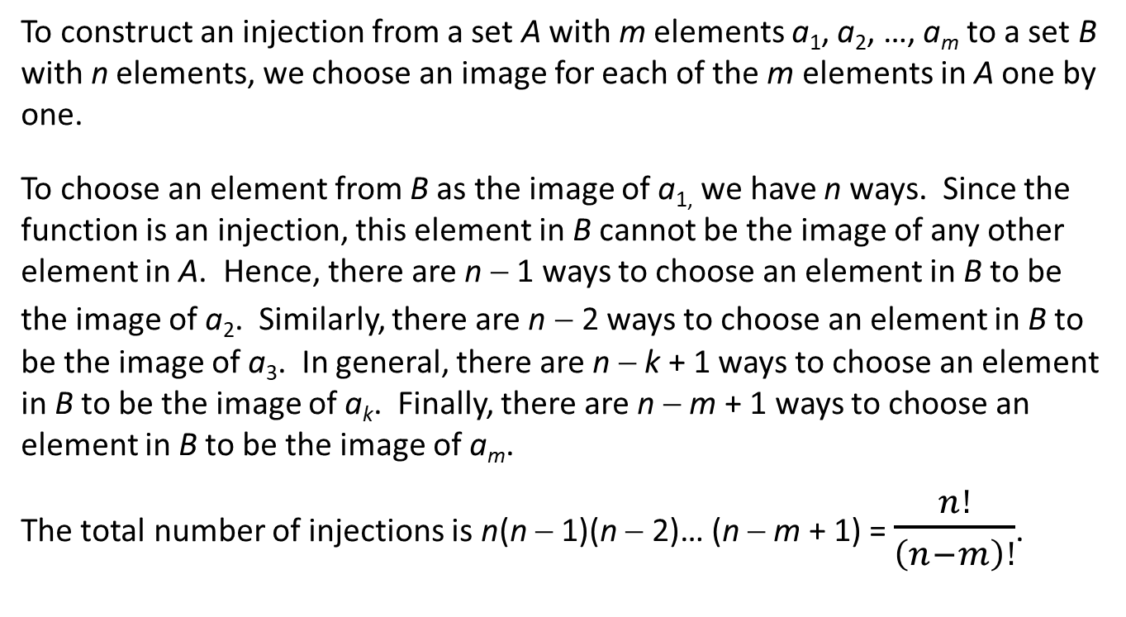
The Number of Injections
To construct an injection from a set A with m elements a₁, a₂, …, a_{m} to a set B with n elements, we choose an image for each of the m elements in A one by one.
To choose an element from B as the image of a_{1,} we have n ways. Since the function is an injection, this element in B cannot be the image of any other element in A. Hence, there are n − 1 ways to choose an element in B to be the image of a₂. Similarly, there are n − 2 ways to choose an element in B to be the image of a₃. In general, there are n − k + 1 ways to choose an element in B to be the image of a_{k}. Finally, there are n − m + 1 ways to choose an element in B to be the image of a_{m}.
The total number of injections is n(n − 1)(n − 2)… (n − m + 1) = $\frac{n!}{\left(n−m\right)!}$.

Slide 19
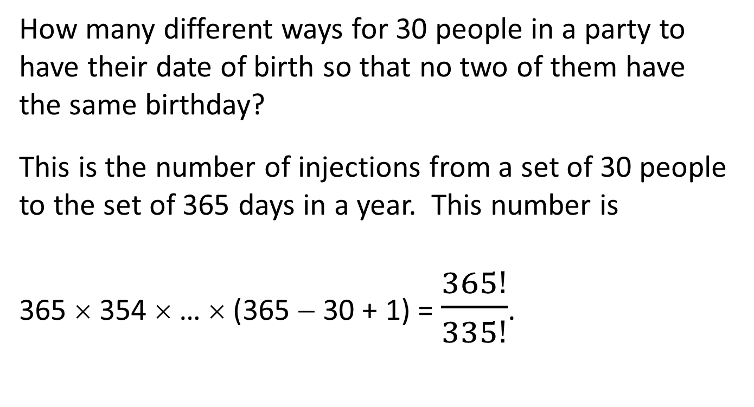
Example
How many different ways for 30 people in a party to have their date of birth so that no two of them have the same birthday?
This is the number of injections from a set of 30 people to the set of 365 days in a year. This number is
365 × 354 × … × (365 − 30 + 1) = $\frac{365!}{335!}$.

Slide 20
Recall that the number of different ways to have birthdays of 30 people in a party is 365³⁰. Now the number of ways to have different birthdays is 365! / 335!. This means that the probability to have all 30 people with different birthdays is
(365! / 335!) / 365³⁰ ≈ 0.294.
In other words, in a party of 30 people, there is 1 − 0.294 = 70.6% probability to have two people with the same birthday.

Slide 21
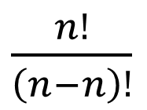
The Number of Bijections
Let A and B be two finite sets such that |A| = |B| = n. Then a function f : A → B is a bijection if and only if it is an injection.
Therefore, the number of bijections from A to B
is = n!.
$\frac{n!}{\left(n−n\right)!}$

Slide 22
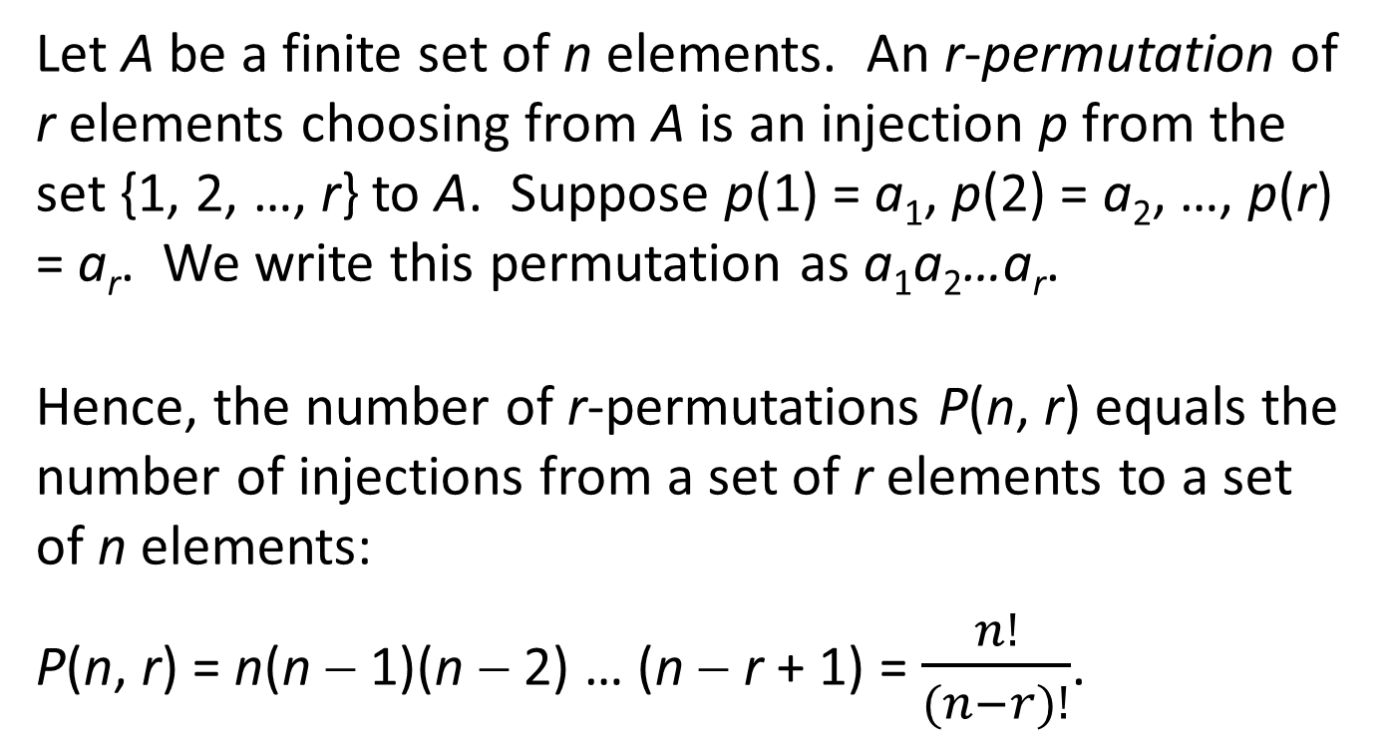
Permutations
Let A be a finite set of n elements. An r-permutation of r elements choosing from A is an injection p from the set {1, 2, …, r} to A. Suppose p(1) = a₁, p(2) = a₂, …, p(r) = a_{r}. We write this permutation as a₁a₂…a_{r}.
Hence, the number of r-permutations P(n, r) equals the number of injections from a set of r elements to a set of n elements:
P(n, r) = n(n − 1)(n − 2) … (n − r + 1) = $\frac{n!}{(n−r)!}$.

Slide 23
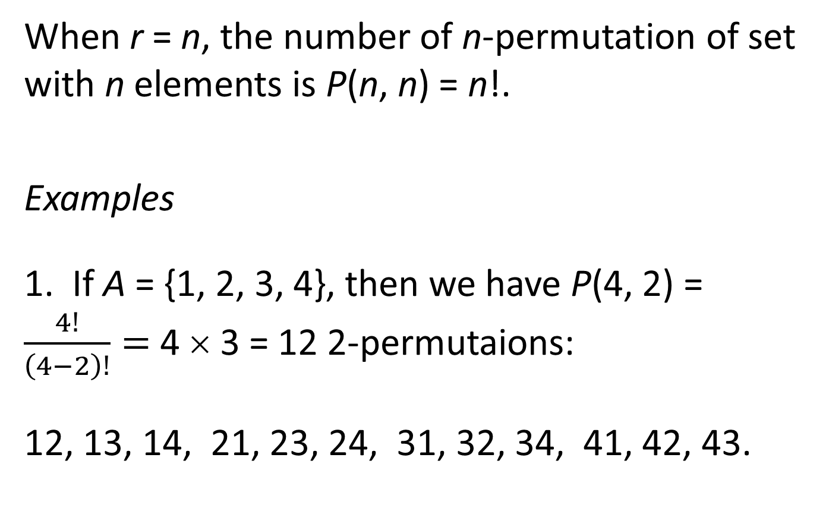
When r = n, the number of n-permutation of set with n elements is P(n, n) = n!.
Examples
1. If A = {1, 2, 3, 4}, then we have P(4, 2) = $\frac{4!}{\left(4−2\right)!}=$ 4 × 3 = 12 2-permutaions:
12, 13, 14, 21, 23, 24, 31, 32, 34, 41, 42, 43.

Slide 24
2. How many ways can we arrange four people A, B, C, and D, sitting in a row, such that A and B must be side by side.
If A and B must be side by side, we can regard the group A and B as one “person”. Then we want to arrange three people (including a “super-man”) in a row. This number is P(3, 3) = 6. Then we have to arrange A and B in the given spot. There are P(2, 2) = 2 ways. The total number of ways is 6 × 2 = 12:
*CD C*D CD* *DC D*C DC*
ABCD, CABD, CDAB, ABDC, DABC, DCAB,
BACD, CBAD, CDBA, BADC, DBAC, DCBA.

Slide 25
3. Suppose we want to arrange 9 people in a row for picture taking. Three of them are in the same family, and two others are in another family. Members of the same family must be arranged side by side. How many ways are there to arrange these people?
Regards a group of people in the same family as one person. In this way, we have to arrange 9 − 3 − 2 + 2 = 6 “people” in a row. There are 6! ways. Now we want to arrange the members of each family within the spot they are located. This gives 3! and 2! ways respectively.
Therefore, the total number of ways is 6!3!2! = 8640.

Slide 26
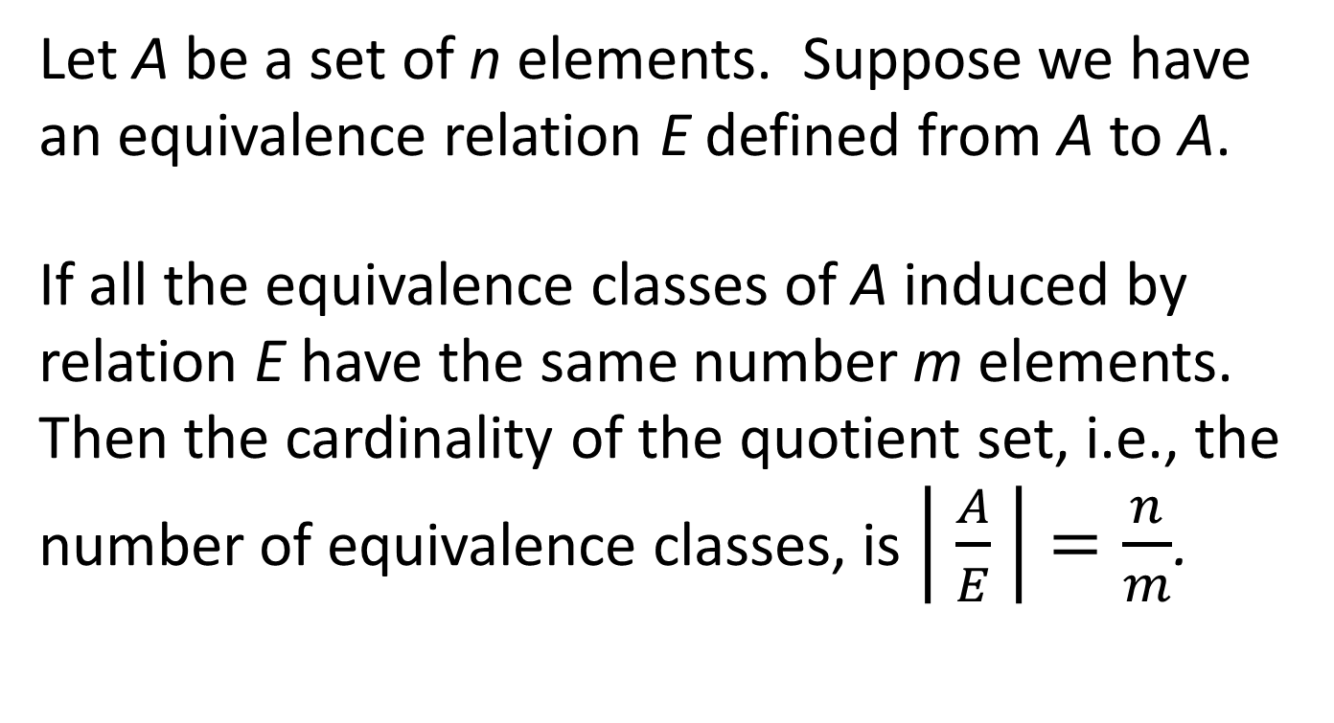
The Division Rule
Let A be a set of n elements. Suppose we have an equivalence relation E defined from A to A.
If all the equivalence classes of A induced by relation E have the same number m elements. Then the cardinality of the quotient set, i.e., the number of equivalence classes, is $\left| \frac{A}{E} \right|=\frac{n}{m}$.

Slide 27
Round Table Permutations
There are n people sitting around a round table. Two seating plans are regarded “essentially the same” if every body keeps his/her left and right neighbors unchanged.
The following are two seating plans of five people that are regarded “essentially the same”:
A
D
B
E
E
C
C
D
A
B

Slide 28
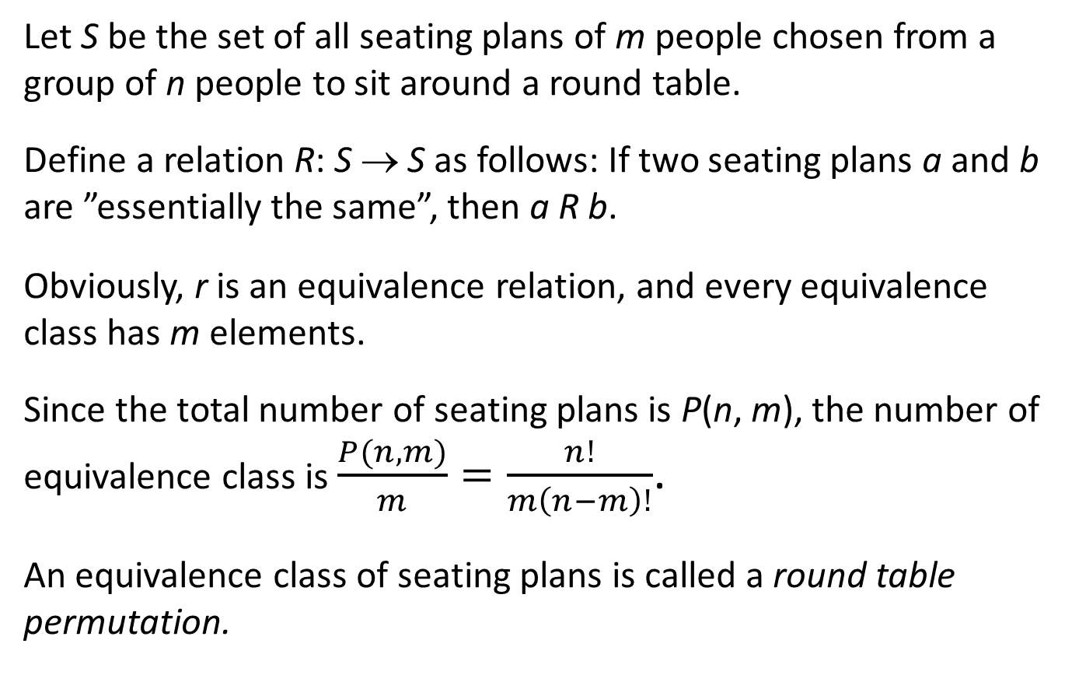
Let S be the set of all seating plans of m people chosen from a group of n people to sit around a round table.
Define a relation R: S → S as follows: If two seating plans a and b are ”essentially the same”, then a R b.
Obviously, r is an equivalence relation, and every equivalence class has m elements.
Since the total number of seating plans is P(n, m), the number of equivalence class is $\frac{P(n,m)}{m}=\frac{n!}{m\left(n−m\right)!}$.
An equivalence class of seating plans is called a round table permutation.

Slide 29
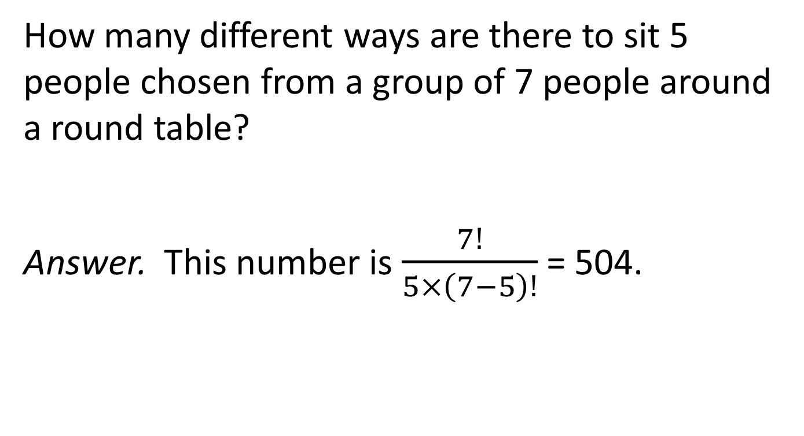
Example
How many different ways are there to sit 5 people chosen from a group of 7 people around a round table?
Answer. This number is $\frac{7!}{5×\left(7−5\right)!}$ = 504.

Slide 30
Combinations
Let A be a set of n elements. A subset of A with r elements is an r-combination of A.
Consider the set P of all r-permutations of A. Then
|P| = P(n, r).
Define a relation R from P to P as follows: If two r-permutations p₁ and p₂ of A uses the same subset of elements of A, then p₁ R p₂.
For example, A = {1, 2, 3, 4}. p₁ = 13 and p₂ = 31 are 2-permutations of A. Since {1, 3} = {3, 1}, p₁ R p₂.

Slide 31
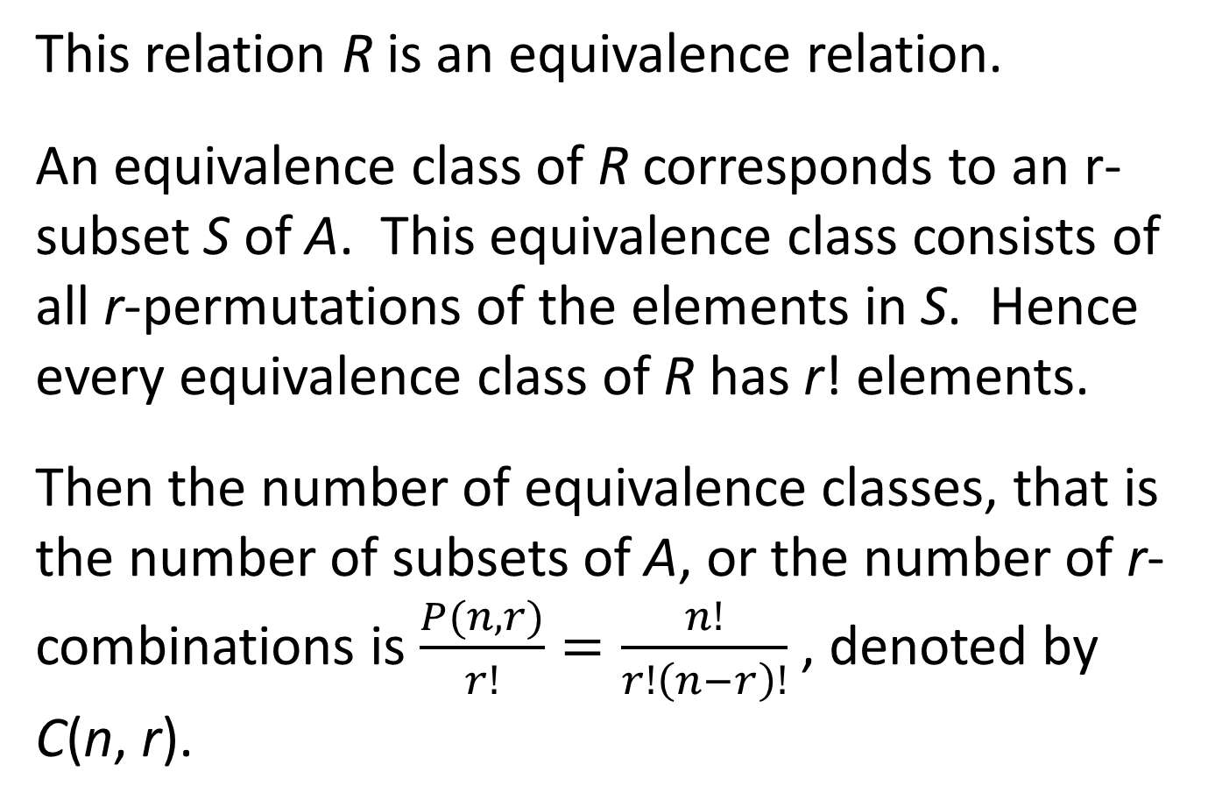
This relation R is an equivalence relation.
An equivalence class of R corresponds to an r-subset S of A. This equivalence class consists of all r-permutations of the elements in S. Hence every equivalence class of R has r! elements.
Then the number of equivalence classes, that is the number of subsets of A, or the number of r-combinations is $\frac{P(n,r)}{r!}=\frac{n!}{r!\left(n−r\right)!}$ , denoted by C(n, r).

Slide 32
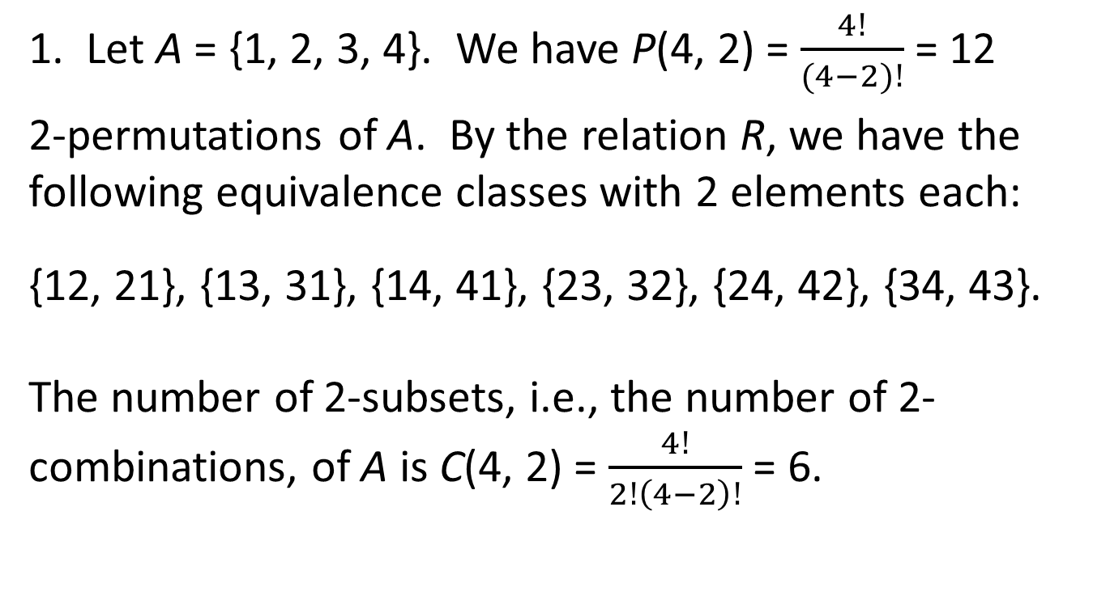
Examples
1. Let A = {1, 2, 3, 4}. We have P(4, 2) = $\frac{4!}{(4−2)!}$ = 12
2-permutations of A. By the relation R, we have the following equivalence classes with 2 elements each:
{12, 21}, {13, 31}, {14, 41}, {23, 32}, {24, 42}, {34, 43}.
The number of 2-subsets, i.e., the number of 2-combinations, of A is C(4, 2) = $\frac{4!}{2!\left(4−2\right)!}$ = 6.

Slide 33
Lottery 649
2. How many ways can we choose 6 numbers from 49 numbers?
Answer. C(69, 9) = 13,983,618.
This means that the probability to win the jackpot of a 649 draw is approximately 1 out of 14,000,000.

Slide 34
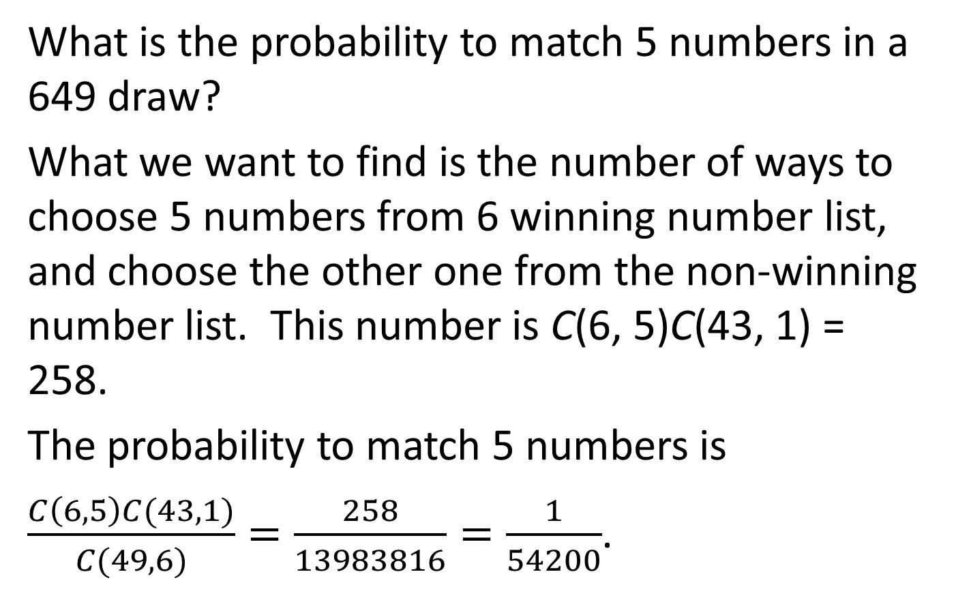
What is the probability to match 5 numbers in a 649 draw?
What we want to find is the number of ways to choose 5 numbers from 6 winning number list, and choose the other one from the non-winning number list. This number is C(6, 5)C(43, 1) = 258.
The probability to match 5 numbers is
$\frac{C\left(6,5\right)C(43,1)}{C(49,6)}=\frac{258}{13983816}=\frac{1}{54200}$.

Slide 35
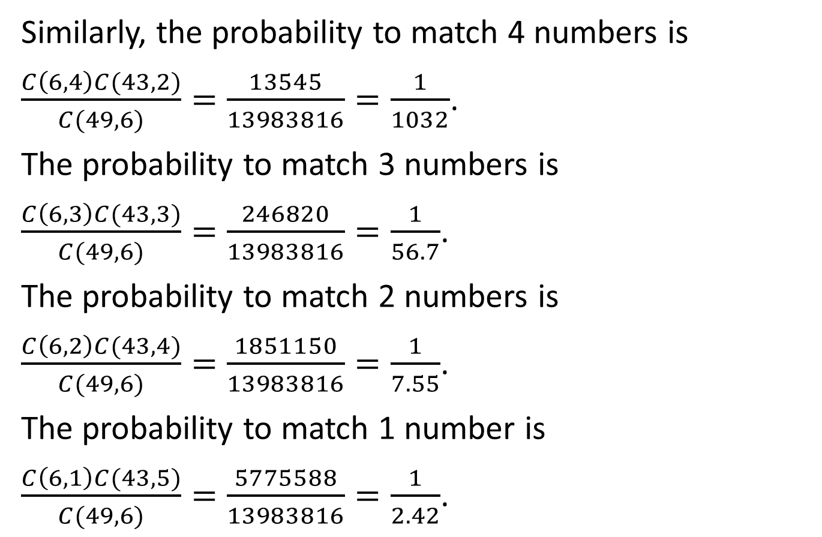
Similarly, the probability to match 4 numbers is
$\frac{C\left(6,4\right)C(43,2)}{C(49,6)}=\frac{13545}{13983816}=\frac{1}{1032}$.
The probability to match 3 numbers is
$\frac{C\left(6,3\right)C(43,3)}{C(49,6)}=\frac{246820}{13983816}=\frac{1}{56.7}$.
The probability to match 2 numbers is
$\frac{C\left(6,2\right)C(43,4)}{C(49,6)}=\frac{1851150}{13983816}=\frac{1}{7.55}$.
The probability to match 1 number is
$\frac{C\left(6,1\right)C(43,5)}{C(49,6)}=\frac{5775588}{13983816}=\frac{1}{2.42}$.

Slide 36
3. Suppose we have a bag of 7 distinct red balls, and a set of 5 distinct blue balls. How many ways are there to construct a set of 3 red balls and 2 blue balls?
We have C(7, 3) ways to choose 3 red balls from a set of 7 red balls, and we have C(5, 2) ways to choose 2 blue balls from a set of 5 blue balls. By the product rule, the number of ways to construct a set of 3 red balls and 2 blue balls is C(7, 3)C(5, 2) = 350.

Slide 37
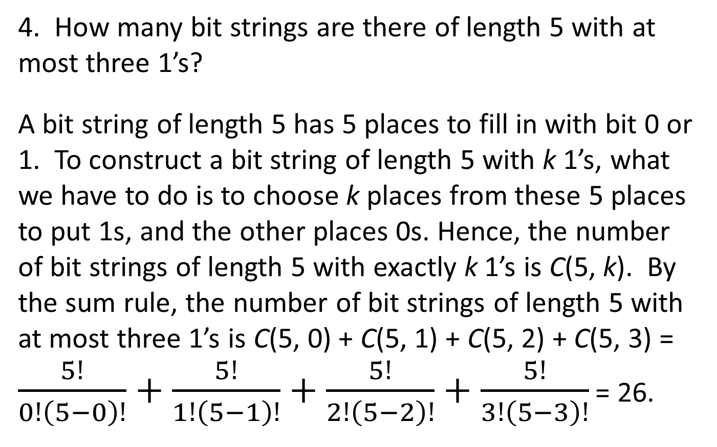
4. How many bit strings are there of length 5 with at most three 1’s?
A bit string of length 5 has 5 places to fill in with bit 0 or 1. To construct a bit string of length 5 with k 1’s, what we have to do is to choose k places from these 5 places to put 1s, and the other places 0s. Hence, the number of bit strings of length 5 with exactly k 1’s is C(5, k). By the sum rule, the number of bit strings of length 5 with at most three 1’s is C(5, 0) + C(5, 1) + C(5, 2) + C(5, 3) = $\frac{5!}{0!\left(5−0\right)!}+\frac{5!}{1!\left(5−1\right)!}+\frac{5!}{2!\left(5−2\right)!}+\frac{5!}{3!\left(5−3\right)!}$ = 26.

Slide 38
5. The following is a street map of a city:
The shortest distance to go from A to B is 12. But one may go by different paths from A to B with the same distance. Three different paths are shown in the figure.
The question is: How many different ways are there to go from A to B with a distance 12?
B
•
A
•

Slide 39
Use a 0 to represent a horizontal line segment of the unit length, and use a 0 to represent a vertical line segment of the unit length. Then a path going from A to B can be represented by a bit string. For example, the paths shown in the figure are represented by
Blue Line: 000000001111.
Red Line: 010010000110.
Green Line: 11001001111.

Slide 40
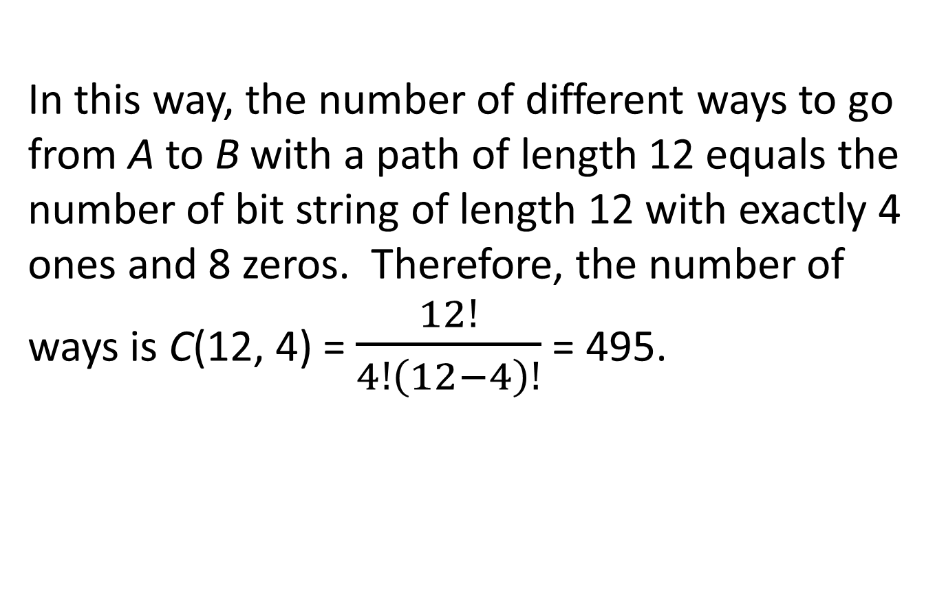
In this way, the number of different ways to go from A to B with a path of length 12 equals the number of bit string of length 12 with exactly 4 ones and 8 zeros. Therefore, the number of ways is C(12, 4) = $\frac{12!}{4!\left(12−4\right)!}$ = 495.

Slide 41
6. How many bit strings with 3 ones and 5 zeros are there such that no two ones are side by side?
Separated by zeros, we have 6 spots to allocate ones, as shown in the following figure:
0 0 0 0 0
What we have to do is to choose 3 spots to put ones. Hence, the number of such bit strings is C(6, 3) = 120.

Slide 42
7. How many ways are there to arrange 3 men and 5 women so that no two men are side by side?
We have C(6, 3) bit strings with 3 ones and 5 zeros without two ones side by side. In each of these bit strings, use a man to replace a one, and a woman to replace a zero.
For example, the following is a bit string with 3 ones and 5 zeros with no two ones side by side:
0 1 0 0 1 0 0 1
W M W W M W W M
The number of ways to arrange the men is 3!, and the number of ways to arrange the women is 5!.
By the general product rule, the total number of ways is
C(6, 3) × 3! × 5! = 86400.

Slide 43
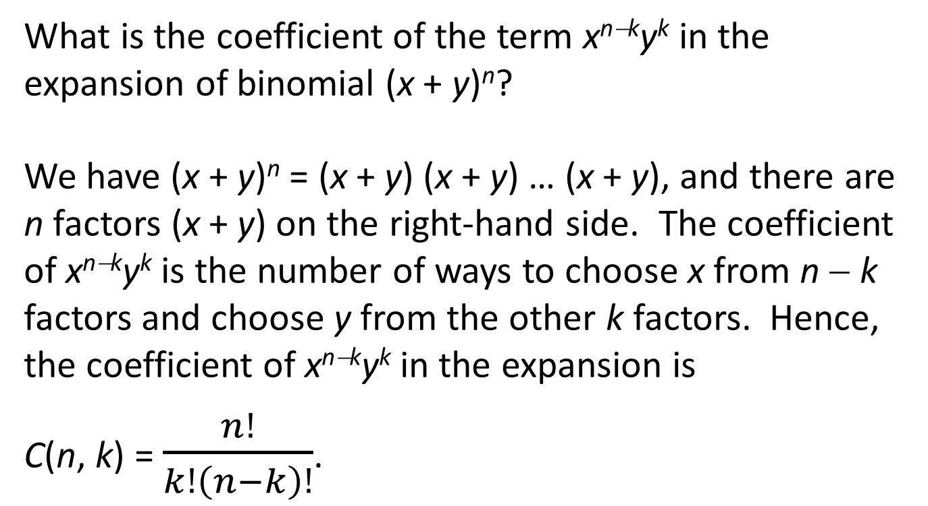
Binomial Theorem
What is the coefficient of the term x^{n−k}y^{k} in the expansion of binomial (x + y)^{n}?
We have (x + y)^{n} = (x + y) (x + y) … (x + y), and there are n factors (x + y) on the right-hand side. The coefficient of x^{n−k}y^{k} is the number of ways to choose x from n − k factors and choose y from the other k factors. Hence, the coefficient of x^{n−k}y^{k} in the expansion is
C(n, k) = $\frac{n!}{k!\left(n−k\right)!}$.

Slide 44
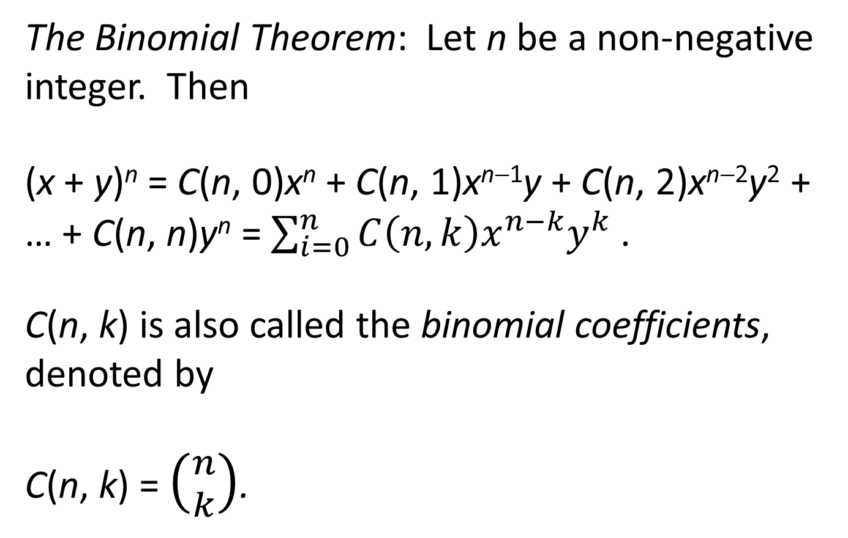
The Binomial Theorem: Let n be a non-negative integer. Then
(x + y)^{n} = C(n, 0)x^{n} + C(n, 1)x^{n−1}y + C(n, 2)x^{n−2}y² + … + C(n, n)y^{n} = $\sum_{i=0}^{n}{C\left(n,k\right)x^{n−k}y^{k}}$ .
C(n, k) is also called the binomial coefficients, denoted by
C(n, k) = $\left({n \atop k}\right)$.

Slide 45
Corollaries
Let x = y = 1 or x = 1 and y = −1 in the binomial theorem, we have the following:
(1) Let n be a non-negative integer. Then
(2) Let n be a non-negative integer. Then

Slide 46
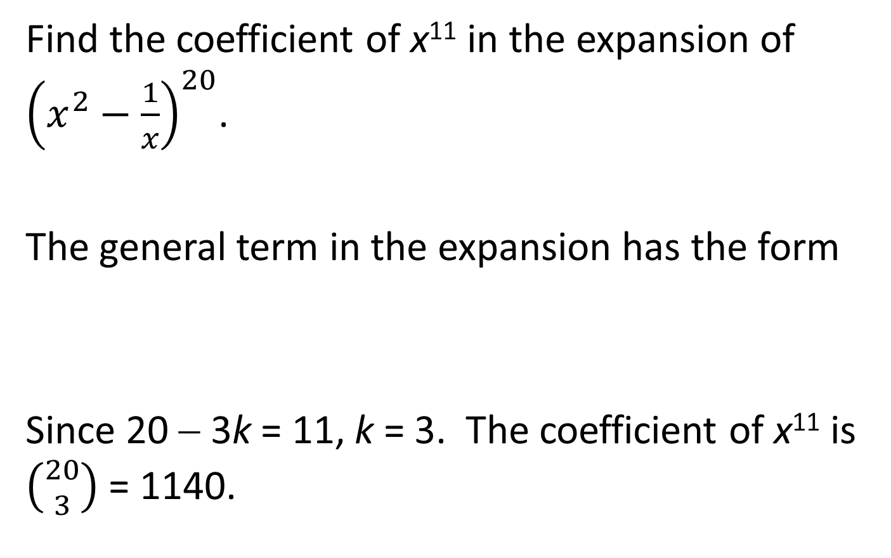
Find the coefficient of x¹¹ in the expansion of ${\left(x^{2}−\frac{1}{x}\right)}^{20}$.
The general term in the expansion has the form
Since 20 − 3k = 11, k = 3. The coefficient of x¹¹ is $\left({20 \atop 3}\right)$ = 1140.

Slide 47
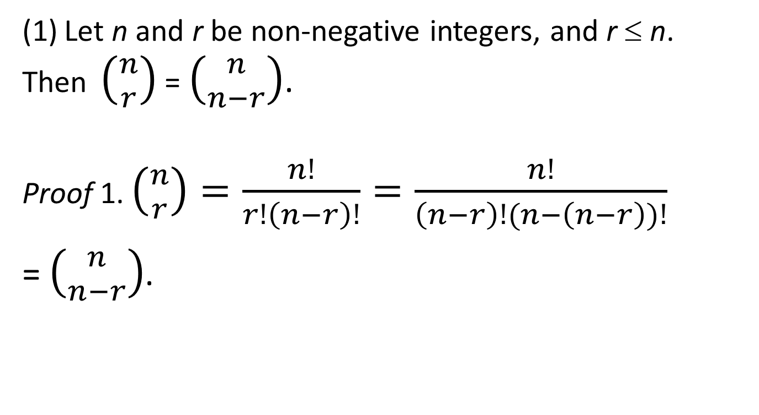
Binomial Identities
(1) Let n and r be non-negative integers, and r ≤ n. Then $\left({n \atop r}\right)$ = $\left({n \atop n−r}\right)$.
Proof 1. $\left({n \atop r}\right)=\frac{n!}{r!\left(n−r\right)!}=\frac{n!}{\left(n−r\right)!(n−\left(n−r\right))!}$
= $\left({n \atop n−r}\right)$.

Slide 48
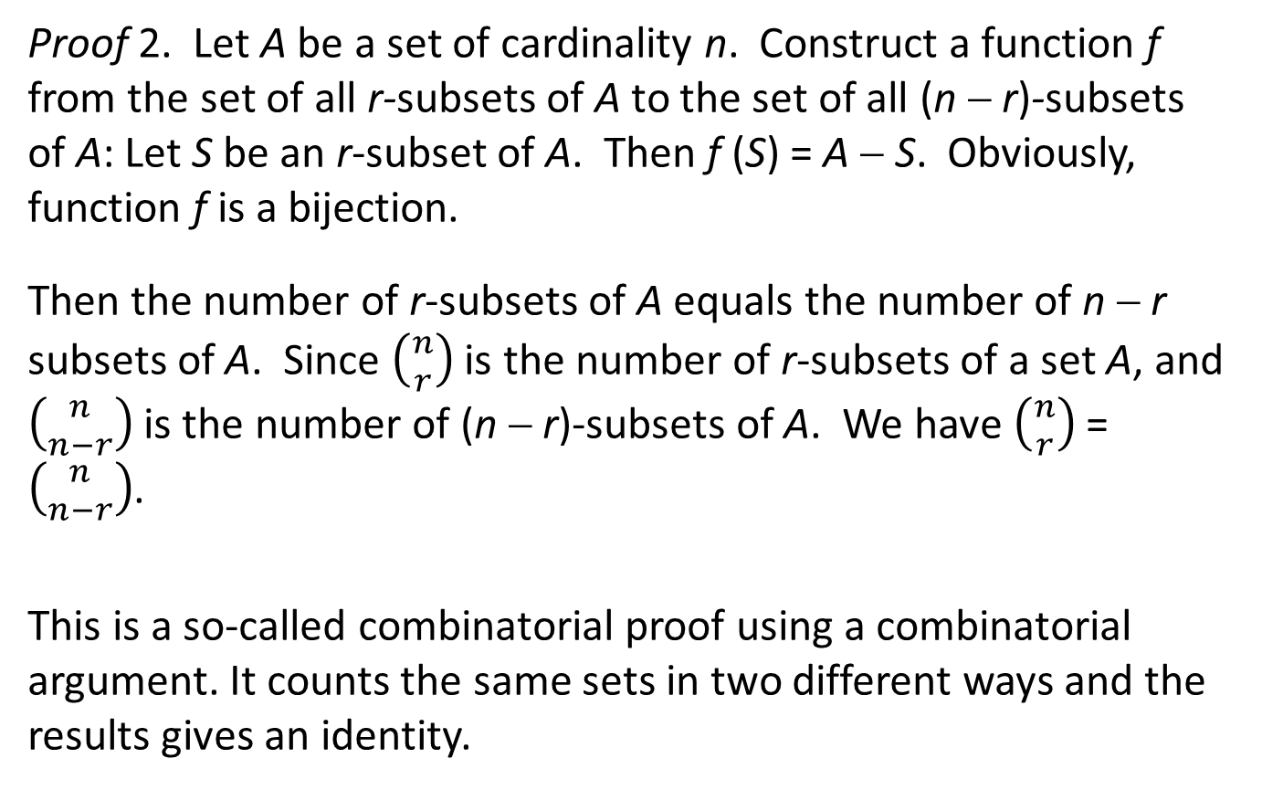
Proof 2. Let A be a set of cardinality n. Construct a function f from the set of all r-subsets of A to the set of all (n − r)-subsets of A: Let S be an r-subset of A. Then f (S) = A − S. Obviously, function f is a bijection.
Then the number of r-subsets of A equals the number of n − r subsets of A. Since $\left({n \atop r}\right)$ is the number of r-subsets of a set A, and $\left({n \atop n−r}\right)$ is the number of (n − r)-subsets of A. We have $\left({n \atop r}\right)$ = $\left({n \atop n−r}\right)$.
This is a so-called combinatorial proof using a combinatorial argument. It counts the same sets in two different ways and the results gives an identity.

Slide 49
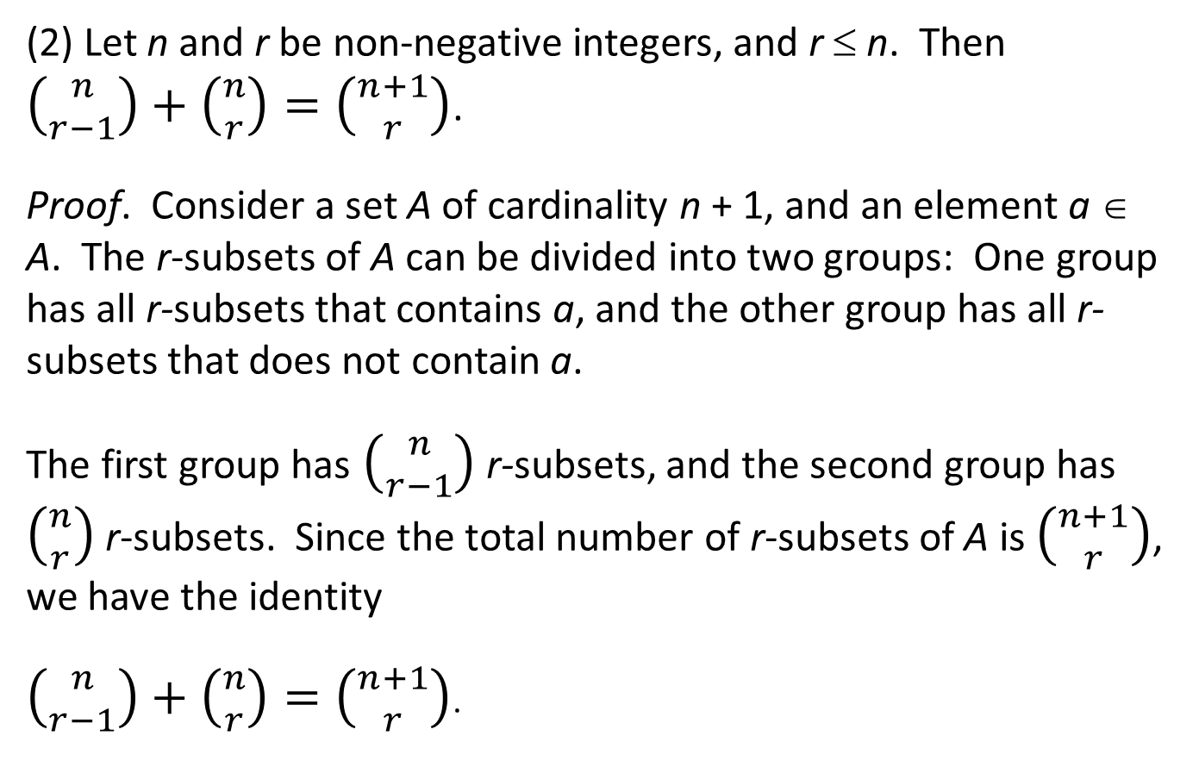
(2) Let n and r be non-negative integers, and r ≤ n. Then $\left({n \atop r−1}\right)+\left({n \atop r}\right)=\left({n+1 \atop r}\right)$.
Proof. Consider a set A of cardinality n + 1, and an element a ∈ A. The r-subsets of A can be divided into two groups: One group has all r-subsets that contains a, and the other group has all r-subsets that does not contain a.
The first group has $\left({n \atop r−1}\right)$ r-subsets, and the second group has $\left({n \atop r}\right)$ r-subsets. Since the total number of r-subsets of A is $\left({n+1 \atop r}\right)$, we have the identity
$\left({n \atop r−1}\right)+\left({n \atop r}\right)=\left({n+1 \atop r}\right)$.

Slide 50
Pascal’s Triangle
By this property, we can construct a triangle to calculate binomial coefficients recursively:
C(0,0)
C(1,0) C(1,1)
C(2,0) C(2,1) C(2,2)
C(3,0) C(3,1) C(3,2) C(3,3)
C(4,0) C(4,1) C(4,2) C(4,3) C(4,4)
…

Slide 51
Pascal’s Triangle
By this property, we can construct a triangle to calculate binomial coefficients recursively:
1
1 1
1 2 1
1 3 3 1
1 4 6 4 1
…

Slide 52
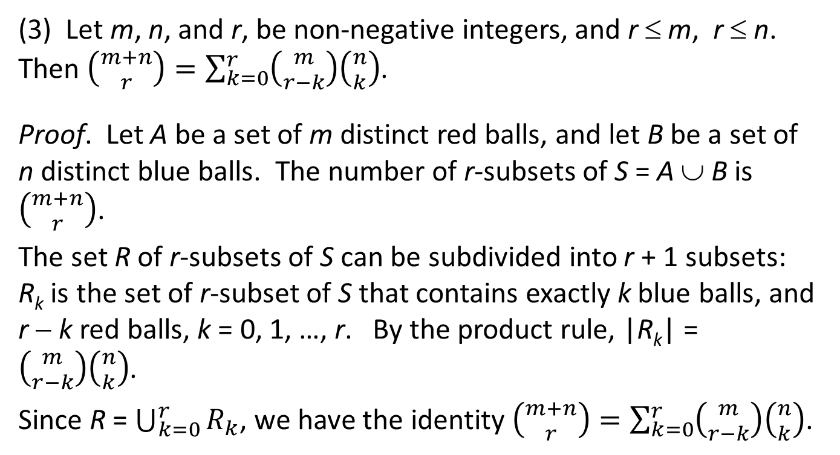
Vandermonde’s Identity
(3) Let m, n, and r, be non-negative integers, and r ≤ m, r ≤ n. Then $\left({m+n \atop r}\right)=\sum_{k=0}^{r}{\left({m \atop r−k}\right)\left({n \atop k}\right)}$.
Proof. Let A be a set of m distinct red balls, and let B be a set of n distinct blue balls. The number of r-subsets of S = A ∪ B is $\left({m+n \atop r}\right)$.
The set R of r-subsets of S can be subdivided into r + 1 subsets: R_{k} is the set of r-subset of S that contains exactly k blue balls, and r − k red balls, k = 0, 1, …, r. By the product rule, |R_{k}| = $\left({m \atop r−k}\right)\left({n \atop k}\right)$.
Since R = $\bigcup_{k=0}^{r}{R_{k}}$, we have the identity $\left({m+n \atop r}\right)=\sum_{k=0}^{r}{\left({m \atop r−k}\right)\left({n \atop k}\right)}$.

Slide 53
When m = n = r, Vandermonde’s identity becomes

Slide 54
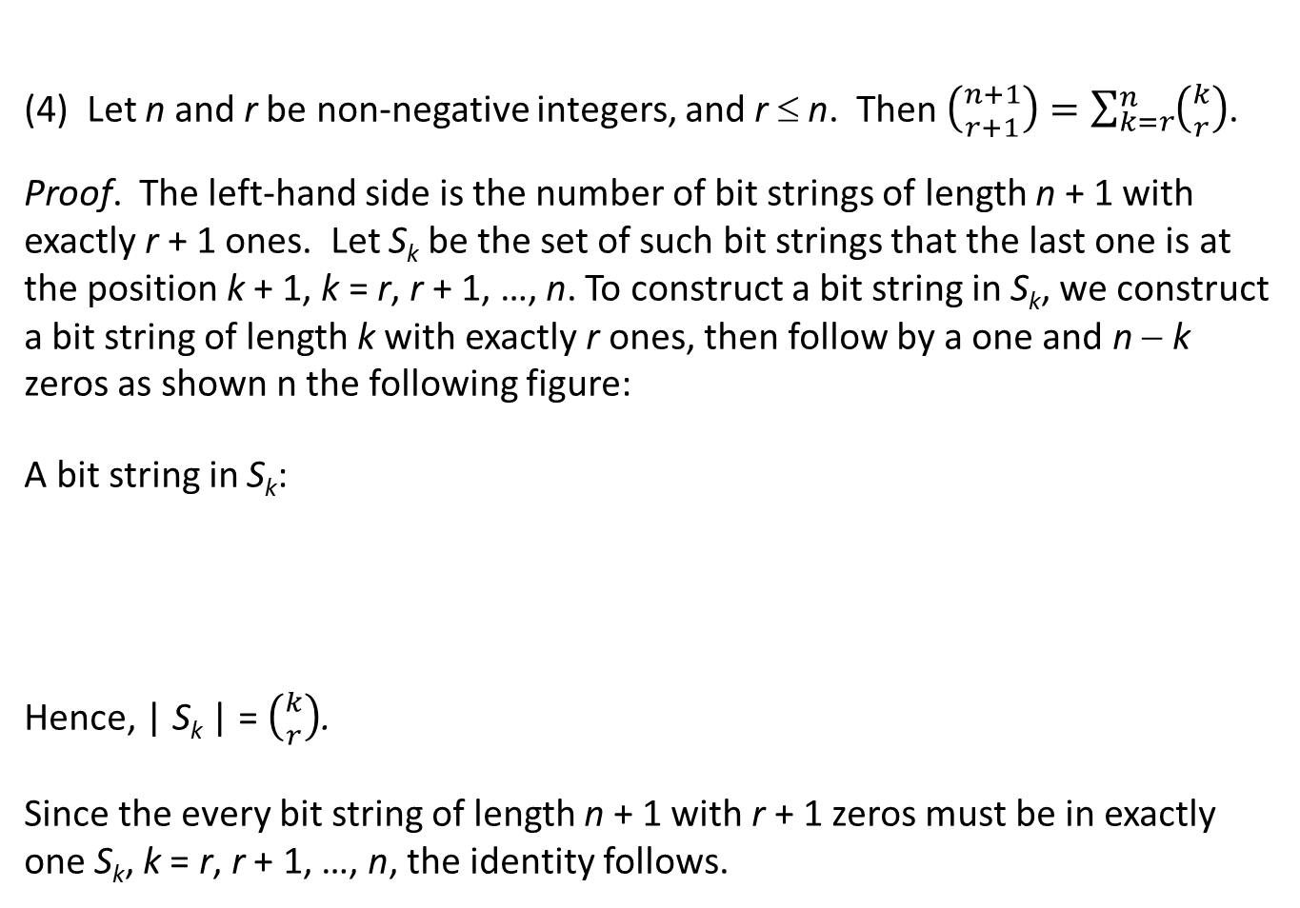
(4) Let n and r be non-negative integers, and r ≤ n. Then $\left({n+1 \atop r+1}\right)=\sum_{k=r}^{n}{\left({k \atop r}\right)}$.
Proof. The left-hand side is the number of bit strings of length n + 1 with exactly r + 1 ones. Let S_{k} be the set of such bit strings that the last one is at the position k + 1, k = r, r + 1, …, n. To construct a bit string in S_{k}, we construct a bit string of length k with exactly r ones, then follow by a one and n − k zeros as shown n the following figure:
A bit string in S_{k}:
Hence, | S_{k} | = $\left({k \atop r}\right)$.
Since the every bit string of length n + 1 with r + 1 zeros must be in exactly one S_{k}, k = r, r + 1, …, n, the identity follows.
1
a k-string with r ones
n−k zeros
The last one

