Slide 1
IV. Integers

Slide 2
Representations of Integers
The common representation of integers is the decimal representation, i.e., representation with base 10. In other words, if we write an integer x = 34567, we mean the integer
x = 3 × 10⁴ + 4 × 10³ + 5 × 10² + 6 × 10 + 7.
But we may use another integer to be the base.

Slide 3
Integer Representation with Base b
We can represent an integer x with any integer
b > 1 as the base, so that, if
x = a_{n}b^{n} + a_{n−1}b^{n−1} + … + a₂b² + a₁b + a₀,
where 0 ≤ a_{i} ≤ b − 1, i = 0, 1, …, n, then we write
x = (a_{n}a_{n−1}…a₂a₁a₀)_{b}.

Slide 4
If x < b, x = a₀ is the base b representation.
To find the representation of a positive integer x ≥ b with base b, divide x by b.
x = q₁b + a₀,
q₁ = q₂b + a₁,
…
q_{n−1} = q_{n}b + a_{n−1},
q_{n} = a_{n}, when q_{n} < b.
Then x = (a_{n}a_{n−1}…a₁a₀)_{b}.

Slide 5
Example
Write the decimal integer 19290 in base 8 representation.
19290 = 2411 × 8 + 2,
2411 = 301 × 8 + 3,
301 = 37 × 8 + 5,
37 = 4 × 8 + 5.
The base 8 representation of 19290 is (45532)_{8.}

Slide 6
Binary, Octal, and Hexadecimal Representations
In computer science, binary (base 2), octal (base 8) and hexadecimal (base 16) representations are frequently used.
In binary representation, use digits 0 and 1, called bits.
In octal representation, use digits 0, 1, 2, 3, 4, 5, 6, 7.
In hexadecimal representation, because we don’t have digit to represent 10, 11, 12, 13, 14, and 15,use A = 10, B = 11, C = 12, D = 13, E = 14, and F = 15.

Slide 7
Examples
(1) What is the decimal integer represented by (101011)₂?
(101011)₂ = 1 + 2 + 2³ + 2⁵ = 43.

Slide 8
(2) Write (10101011)₂ in Octal form.
Separate the binary digits into triples from right to left, add leading 0s if needed: 010,101,011.
Use one octal digit to represent each triple.
Since (010)₂ = (2)_{8,} (101)₂ = (5)₈, and (011)₂ = (3)₈, (10101011)₂ = (253)₈.

Slide 9
(3) Write (6A0E2)₁₆ in binary form.
Since (6)₁₆ = (0110)₂, (A)₁₆ = (1010)₂, (0)₁₆ = (0000)₂, (E)₁₆ = (1110)₂, and (2)₁₆ = (0010)₂, we have
(6A0E2)₁₆ = (110 1010 0000 1110 0010)₂.
The leading 0 is omitted.

Slide 10
(4) Write x = (4573)₈ in hexadecimal form.
We convert x to binary form first. Since (4)₈ = (100)₂, (5)₈ = (101)₂, (7)₈ = (111)₂ , and (3)₈ = (011)₂,
x = (100 101 111 011)₂.
Then convert this number to hexadecimal form. Group the bits of x four in a group from right to left:
x = (1001 0111 1011)_{2.} In hexadecimal form, (1001)₂ = (9)₁₆, (0111)₂ = (7)₁₆, and (1011)₂ = (B)₁₆, the hexadecimal representation is x = (97B)₁₆.

Slide 11
Binary Addition
Let x = (a_{m}a_{m−1} … a₁a₀)₂ and y = (b_{n}b_{n−1} … b₁b₀)₂.
To find x + y, add digit by digit from right to left. If the sum of two digits at the same place is 10, carry it to the next place on the left. This is the same as adding two decimal numbers.
Example. 111101 + 10101.
111101
+ 10101
1010010

Slide 12
Binary Multiplication
The product of two binary numbers is found by shifting as in the following example:
Find 11010 × 101.
11010
× 101
11010
00000
11010
10000010

Slide 13
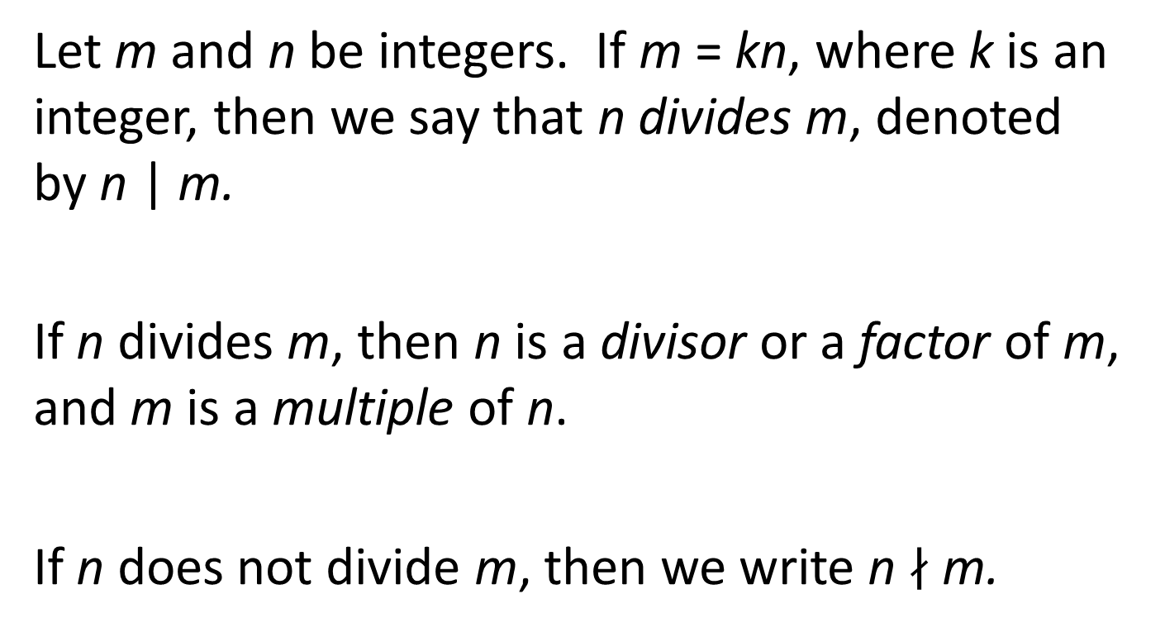
Division
Let m and n be integers. If m = kn, where k is an integer, then we say that n divides m, denoted by n | m.
If n divides m, then n is a divisor or a factor of m, and m is a multiple of n.
If n does not divide m, then we write n $∤$ m.

Slide 14
Properties of Divisors
(1) If a | b and a | c, then a | (b + c).
Indeed, if a | b, then there is an integer b’ such that b = ab’. Similarly, since a | c, there is an integer c’ such that c = ac’. Hence, b + c = ab’ + ac’ = a(b’ + c’), where b’ + c’ is an integer. Then a | (b + c).

Slide 15
(2) If a | b, then a | bc for any integer c.
Indeed, a | b implies that there exist an integer b’ such that b = ab’. Hence, bc = a(b’c), where b’c is an integer. Then a | bc.

Slide 16
Combining properties (1) and (2), we see that, if a | b and a | c, then for any integers m and n,
a | (mb + nc).
Indeed, from property (2), we know a | mb and a | nc. Then, from property (1), we have
a | (mb + nc).
mb + nc is called an (integer) linear combination of b and c.

Slide 17
(3) If a | b and b | c, then a | c.
Indeed, a | b implies b = ab’, and c = bc’, where b’ and c’ are integers. Hence, c = a(b’c’), and
a | c.

Slide 18
The Division “Algorithm”
Let a be an integer and d a positive integer. Then there exist unique integers q and r, 0 ≤ r < d, such that
a = qd + r.
Note that the quotient may be negative, but the remainder is always positive.
For example, when a = −17 and d = 4, the quotient is −5, and the remainder is 3: −17 = (−5) × 4 + 3.

Slide 19
The proof of this result based on an important property of non-negative integers:
Well-ordering Property: Every non-empty set of non-negative integers has a least number.

Slide 20
Let A = {a − bd | b is an integer, a − bd ≥ 0}.
If a ≥ 0, let b = 0, then a − bd = a ≥ 0; if a < 0, let b = a, then a − bd = a(1 − d) > 0. Hence, set A is not empty. By the well-ordering property, A has a least number r corresponding to b = q:
r = a − qd. Then a = qd + r. Since r ∈ A, r ≥ 0. If r ≥ d, then r − d = (a − qd) − d = a − (q + 1)d ≥ 0. This contradicts the fact that r is the least number in A. Hence, r < d.

Slide 21
To show the uniqueness, assume we have
a = q₁d + r₁, and a = q₂d + r₂.
Then (q₁ − q₂)d + (r₁ − r₂) = 0, or (q₁ − q₂)d = r₂ − r_{1.} Then d | r₂ − r₁. Since 0 ≤ r₁ < d and 0 ≤ r₂ < d, | r₂ − r₁ | < d.
This is possible only if r₂ − r₁ = 0, or r₁ = r₂. Then (q₁ − q₂)d = 0. Since d > 0, we must have q₁ − q₂ = 0, or q₁ = q₂.

Slide 22
The Greatest Common Divisor
Let a and b be integers, not both zero. The greatest common divisor of a and b is the largest d such that d | a and d | b, denoted by gcd(a, b).
If gcd (a, b) = 1, a and b are relatively prime.
Let a₁, a₂, …, a_{n} be n integers. They are pairwise relatively prime if a_{i} and a_{j} are relative prime for all (i, j), 1 ≤ i ≤ j ≤ n.

Slide 23
Euclidean Algorithm
Let a and b be integers. The division algorithm gives a = qb + r, where q is the quotient and r is the remainder. Then gcd (a, b) = gcd (b, r).
Indeed, if d | a, and d | b, then d | a − qb = r. On the other hand, if d | r and d | b, then d | qb + r = a. In other words, every common divisor of a and b is a common divisor of b and r, and every common divisor of b and r is a common divisor of a and b. Hence,
gcd (a, b) = gcd (b, r).

Slide 24
Using this result, we can find the common divisor by the Euclidean Algorithm:
Let a = r₀ and b = r₁. Do divisions:
r₀ = r₁q₁ + r₂, 0 ≤ r₂ < r₁,
r₁ = r₂q₂ + r₃, 0 ≤ r₃ < r₂,
…
r_{n−2} = r_{n−1}q_{n−1} + r_{n}, 0 ≤ r_{n} < r_{n−1},
r_{n−1} = r_{n}q_{n}.
Then gcd (a, b) = r_{n}.

Slide 25
Find the greatest common divisor of 414 and 1074
1074 = 414 × 2 + 246,
414 = 246 × 1 + 168,
246 = 168 × 1 + 78,
168 = 78 × 2 + 12,
78 = 12 × 6 + 6,
12 = 6 × 2.
gcd(414, 1072) = 6.

Slide 26
Theorem: For any positive integers a and b, there exist integers s and t such that gcd (a, b) = sa + tb.
Integers s and t can be obtained by backward substitution in Euclidean Algorithm as shown in the following example:
Find integers s and t such that 1072s + 414t = 6.
From The second-last division in Euclidean algorithm, we have
6 = 78 − 12 × 6.
= 78 − (168 − 78 × 2) × 6 = 168 × (−6) + 78 × 13,
= 168 × (−6) + (246 − 168) × 13 = 246 × 13 + 168 × (−19),
= 246 × 13 + (414 − 246) × (−19) = 414 × (−19) + 246 × 32,
= 414 × (−19) + (1074 − 414 × 2) × 32 = 1074 × 32 + 414 × (−83).
s = 31, t = −83: 1072 × 31 + 414 × (−83) = 6.

Slide 27
Corollaries:
(1) If a and b are relatively prime, then there exist integers s and t such that sa + tb = 1.
(2) If a and b are relatively prime and a | bc, then a | c.
From (1), we have integers s and t such that sa + tb = 1. Since a | bc, a | tbc. Obviously, a | sac. Hence, a | sac + tbc = c.

Slide 29
Primes
An integer p > 1 is a prime if the only positive factors are 1 and p. An integer that is not a prime is a composite.
The smallest few primes are 2, 3, 5, 7, 11, 13, 17, 19, 23.

Slide 30
If p is a prime, and p | a₁a₂…a_{n}. Then there p | a_{i} for some i, 1 ≤ i ≤ n.
Prove by mathematical induction on n.
The base case n = 1 is trivial.
Assume that the conclusion is true for all k, 1 ≤ k ≤ n, and
p | a₁a₂…a_{n+1}. Since p is a prime, gcd (p, a_{n+1}) = 1 or gcd (p, a_{n+1}) = p.
If gcd (p, a_{n+1}) = 1, i.e., p and a_{n+1} is relatively prime, then
p | a₁a₂…a_{n}. The conclusion follows from the induction hypothesis.
If gcd (p, a_{n+1}) = p, then p | a_{n+1}.

Slide 31
Fundamental Theorem of Arithmetic
Every integer greater than 1 is either a prime, or it can be expressed as a product of powers of primes. The expression is unique if the primes factors are in decreasing order.
For example, 19 is a prime, and
2520 = 2³ × 3² × 5 × 7.

Slide 32
Proof of the Fundamental Theorem of Arithmetic
We first prove that every integer n > 1 is either a prime or it is a product of powers of primes.
This is proved by the strong version of mathematical induction.
The base case: n = 2 is a prime.
Induction hypothesis: Assume that every integer k, 2 ≤ k ≤ n is a prime or a product of powers of primes.
We want to prove that integer n + 1 is a prime or a product of powers of primes.

Slide 33
If n + 1 is a prime, the conclusion is true.
If n + 1 is not a prime, then n + 1 = a × b, where a and b are integers, 1 < a ≤ n and 1 < b ≤ n. By the induction hypothesis, a and b can be expressed as products of powers of primes. Hence, n + 1 can be expressed as powers of primes.

Slide 34
Proof of the Uniqueness
Next, we want to prove the factorization of an integer n > 1 into a product of powers of primes is unique.
Assume that we have two different factorizations
By cancelling common factors on both sides, we may assume p₁, p₂, …, p_{u}, q₁, q₂, … q_{v}, are all different, and r₁ ≠ 0. Then p₁ divides one of q₁, q₂, …, q_{v}, which is impossible because a prime cannot be a factor of another prime.

Slide 35
GCD and Prime Factor Representation
If a and b are two positive integers. By adding powers of exponent 0, we may assume they are product of the same set of primes.
For example, 168 = 2³ × 3¹ × 7¹, and 150 = 2¹ × 3² × 5². We may write both integers as products of powers of 2, 3 and 5: 168 = 2³ × 3¹ × 5⁰ × 7¹, and 150 = 2¹ × 3² × 5² × 7⁰.

Slide 36
Let and . Then
gcd (a, b) = .
For example,
gcd (168, 150) = 2^{min(3, 1)}3^{min(1, 1)}5^{min(0,} ²⁾7^{min(1, 0)} = 2¹3¹5⁰7⁰ = 6.

Slide 37
Least Common Multiplier
Let a and b be two positive integers. The least common multiplier of a and b is the smallest positive integer N such that a | N and b | n, denoted by lcm (a, b).
If a and b are expressed as products of powers of the same set of primes, and
. Then
lcm (a, b) =

Slide 38
Finding lcm (a, b)
Since, for any integers s and t,
min(s, t) + max(s, t) = s + t,
gcd (a, b) lcm (a, b)
=
=
=
Hence, lcm (a, b) = ab / gcd (a, b).

Slide 39
Example
Since gcd (168, 150) = 6,
lcm (168, 150) = 168 × 150 / 6 = 4200.

Slide 40
Modular Arithmetic
Recall the congruence relation modulo m from Z to Z, where m is a positive integer:
An integer a has this relation with another integer b if the remainders of a divided by m and b divided by m are equal, denoted by a ≡ b (mod m).

Slide 41
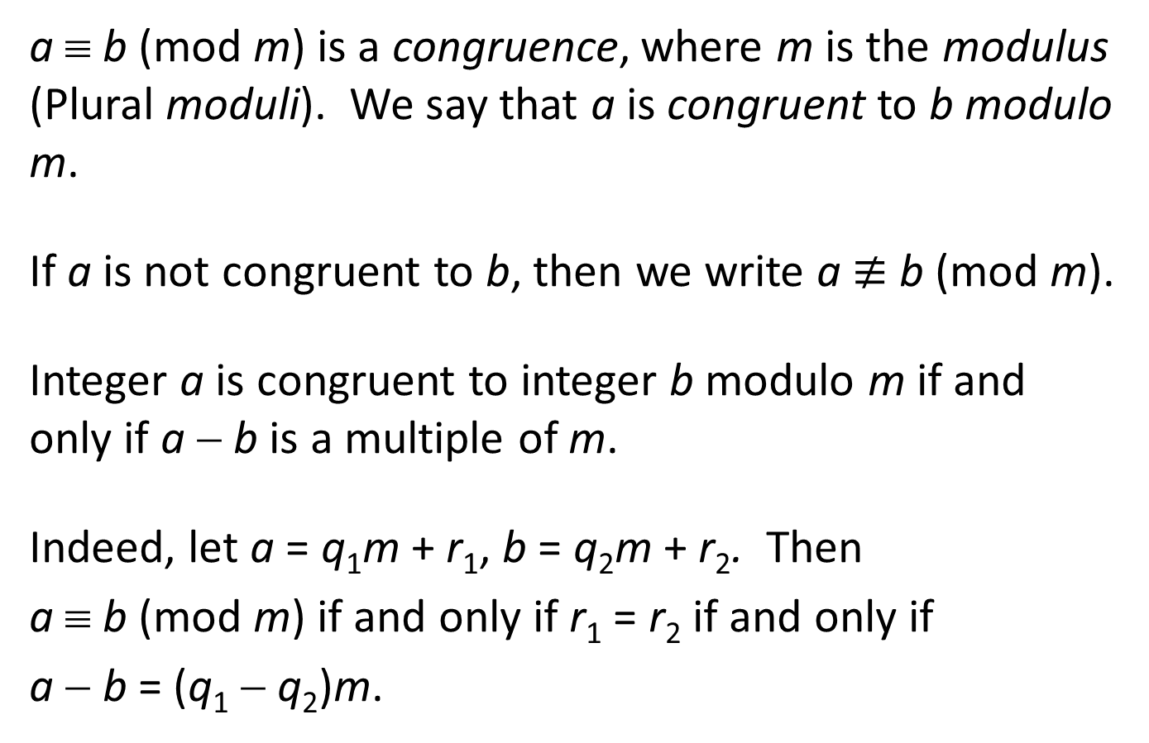
a ≡ b (mod m) is a congruence, where m is the modulus (Plural moduli). We say that a is congruent to b modulo m.
If a is not congruent to b, then we write a $≢$ b (mod m).
Integer a is congruent to integer b modulo m if and only if a − b is a multiple of m.
Indeed, let a = q₁m + r₁, b = q₂m + r₂. Then
a ≡ b (mod m) if and only if r₁ = r₂ if and only if
a − b = (q₁ − q₂)m.

Slide 42
Properties of Congruences
If a₁ ≡ b₁ (mod m), and a₂ ≡ b₂ (mod m), then
(1) a₁ + a₂ ≡ b₁ + b₂ (mod m);
(2) a₁a₂ ≡ b₁b₂ (mod m).
Let a₁ = q₁₁m + r_{1,} a₂ = q₂₁m + r_{2,} b₁ = q₁₂m + r₁, b₂ = q₂₂m + r₂. Then
a₁ + a₂= (q₁₁ + q₂₁)m + (r₁ + r₂),
b₁ + b₂= (q₁₂ + q₂₂)m + (r₁ + r₂).
Hence, a₁ + a₂ ≡ b₁ + b₂ (mod m).
a₁a₂= q₁₁q₂₁m² + (q₁₁r₂ + q₂₁r₁)m + r₁r₂,
b₁b₂= q₁₂q₂₂m² + (q₁₂r₂ + q₂₂r₁)m + r₁r₂.
Hence, a₁a₂ ≡ b₁b₂ (mod m).

Slide 43
Inverse Modulo m
If ab ≡ 1 (mod m), then b is said to be the inverse of a modulo m.
If a and m are relatively prime, then there exists an inverse of a modulo m.
Indeed, there are integers s and t such that sa + tm = 1. Then sa ≡ 1 (mod m), and s is the inverse of a modulo m.

Slide 44
Solving Linear Congruences
Linear congruence: ax ≡ b (mod m), where a and m are relatively prime.
Let c be the inverse of a modulo m. Then
(ca)x ≡ x ≡ bc (mod m).
The solution to this congruence is x ≡ bc (mod m).
In particular, if b = 0, then the solution is x ≡ 0 (mod m).
In other words, x is a multiple of m.

Slide 45
Example
Solve 3x ≡ 4 (mod7).
3 and 7 are relatively prime. 7 − 3 × 2 = 1.
The inverse of 3 mod 7 is −2.
Hence, (−2) × 3x ≡ x ≡ (−2) × 4 (mod 7). The solution is x ≡ (−8) (mod 7) ≡ 6 (mod 7).
We may also write x = 7t + 6, where t is any integer.

Slide 46
Chinese Remainder Theorem
The system of linear congruences
x ≡ a₁ (mod m₁),
x ≡ a₂ (mod m₂),
…
x ≡ a_{n} (mod m_{n}),
where m₁, m₂, …, m_{n}, are pairwise relatively prime, has a solution that is unique modulo
m = m₁m₂…m_{n}.

Slide 47
Let M_{k} = m / m_{k}, k = 1,2, …, n. Then M_{k} and m_{k} are relatively prime. Let y_{k} be the inverse of M_{k} modulo m_{k}.
Then x ≡ a₁M₁y₁ + a₂M₂y₂ + ... + a_{n}M_{n}y_{n} is a solution to this system.
Indeed, a_{k}M_{k}y_{k} is a multiple of m_{i}, i ≠ k. Hence,
a₁M₁y₁ + a₂M₂y₂ + ... + a_{n}M_{n}y_{n} ≡ a_{k}M_{k}y_{k} (mod m_{k})
≡ a_{k} (mod m_{k}).

Slide 48
Back Substitution
Solve the system
x ≡ 2 (mod 3), (1)
x ≡ 3 (mod 5), (2)
x ≡ 2 (mod 7). (3)
From (1), x = 3r + 2.
Plug this into (2): 3r + 2 ≡ 3 (mod 5), or 3r ≡ 1 (mod 5). Solving this congruence, r ≡ 2 (mod 5), or r = 5s + 2. Then x = 3r + 2 = 15s + 8.
Plug this into (3): 15s + 8 ≡ 2 (mod 7), or 15s ≡ −6 ≡ 1 (mod 7). Solving this congruence, s ≡ 1 (mod 7). Then s = 7t + 1.
Backward substitute:
x = 15s + 8 = 15(7t + 1) + 8 = 105t + 23.
In other words, x ≡ 23 (mod 105), or x = 23 + 105t, where t is an integer.

Slide 49
Modulo m Integers
The congruence relation modulo m is an equivalence relation. Denote this relation by ≡_{m}. The elements of the quotient set
Z / ≡_{m}, denoted by Z_{m}, are called the modulo m integers.
For example, let m = 5. Then the elements of the quotient set
Z / ≡₅ are
[0] = {…, −20, −15, −10, −5, 0, 5, 10, 15, 20, …},
[1] = {…, −19, −14, −9, −4, 1, 6, 11, 16, 21, … },
[2] = {…, −18, −13, −8, − 3, 2, 7, 12, 17, 22, …},
[3] = {…, −17, −12, −7, −2, 3, 8, 13, 18, 23, … },
[4] = {…, −16, −11, −6, −1, 4, 9, 14, 19, 24, …}.

Slide 50
Arithmetic Modulo m
Let a = [x] and b = [y] be two modulo m integers.
The modulo m integer [x + y] is called the sum of [x] and [y], denoted by a + b, and the modulo m integer [xy] is called the product of [x] and [y], denoted by ab.
For example, let m = 5. a = [3], b = [4].
Then a + b = [3 + 4] = [7] = [2], and ab = [3 × 4] = [12] = [2].

Slide 51
Independence of the Choice of Representatives
Let a and b be two modulo m integers. Let x₁, x₂ ∈ a, and y₁, y₂ ∈ b.
Since x₁ ≡ x₂(mod m), and y₁ ≡ y₂(mod m), by the properties of congruences, x₁ + y₁ ≡ x₂ + y₂(mod m), and x₁y₁ ≡ x₂y₂(mod m).
Hence, [x₁ + y₁] = [x₂ + y₂], and [x₁y₁] = [x₂y₂].

Slide 52
Example
The addition table of arithmetic modulo 5: (To simplify the notation, write n instead of [n].)
0 1 2 3 4
0 0 1 2 3 4
1 1 2 3 4 0
2 2 3 4 0 1
3 3 4 0 1 2
4 4 0 1 2 3
For example, 2 + 4 = 1, and 3 + 4 = 2.

Slide 53
The multiplication table of arithmetic modulo 5: (to simplify the notation, write n instead of [n].)
0 1 2 3 4
0 0 0 0 0 0
1 0 1 2 3 4
2 0 2 4 1 3
3 0 3 1 4 2
4 0 4 3 2 1
For example, [2][3] = [6] = [1], [3][4] = [12] = [2].

Slide 54
Multiplication table modulo 6
0 1 2 3 4 5
0 0 0 0 0 0 0
1 0 1 2 3 4 5
2 0 2 4 0 2 4
3 0 3 0 3 0 3
4 0 4 2 0 4 2
5 0 5 4 3 2 1
The cancellation law fails: 2 × 2 = 2 × 5.
Zero divisors: 2 × 3 = 0.

Slide 55
Properties of Arithmetic Modulo m
Let a, b, c ∈ Z_{m}. the following properties are easily proved by the properties of congruences:
(1) Commutativity: a + b = b + a, ab = ba.
(2) Associativity: (a + b) + c = a + (b + c), (ab)c = a(bc).
(3) Distributivity: a(b + c) = ab + ac.
(4) Additive Identity Element: For any a ∈ Z_{m}, [0] + a = a + [0] = a. [0] is called the additive identity (element) of Z_{m}.
(5) Additive Inverses: For any element a = [x]∈ Z_{m},
a + [m − x] = [m] = [0]. [m − x] is called the additive inverse of [x].

