Slide 1
III. Sets, Relations, and Functions

Slide 2
Sets and Elements
A set is a collection of objects.
An object e in a set S is called an element of this set, denoted by e ∈S. We say that e belongs to S.
If e is not in S, we say that e does not belong to S, denoted by e ∉S.

Slide 3
A Set Is Like a Box
A set may contain anything in it. In particular, an element of a set can itself be a set.
For example, you may have a set that contains numbers and sets of numbers.
The only thing that cannot be an element of a set S is the set S itself.

Slide 4
Finite Sets and Cardinality
If a set has a finite number of elements, it is a finite set; otherwise, it is an infinite set.
The number of elements in a finite set S is the cardinality of S, denoted by | S |.

Slide 5
Notation of a Set
If a set S has a finite number of elements e₁, e₂, …, e_{n}, we write:
S = {e₁, e₂, …, e_{n}}.
We may also use a condition and a general expression to define a set. For example,
S₁ = {2x + 1 | x is an integer},
S₂ = {a² | a is an odd number}.

Slide 6
Sets of Integers and Real numbers
The set of natural numbers is denoted by N:
The set of integers is denoted by Z.
The set of real numbers is denoted by R.

Slide 7
Subsets
Let A and B be two sets.
If e ∈ A implies e ∈ B, then A is a subset of B, or A is included in B, denoted by A ⊆ B. In this case, B is a superset of A, or B includes A, denoted by B ⊇ A.
Obviously, N ⊆ Z ⊆ R.

Slide 8
Set Equality
If A ⊆ B, and B ⊆ A, then A and B are equal, denoted by A = B.
In other words, A = B if and only if every element in A is in B, and every element in B is in A.
If A and B are not equal, write A ≠ B.

Slide 9
Proper Subsets
Let A and B be two sets. If A ⊆ B, but A ≠ B, then A is a proper subset of B, denoted by A ⊂ B.

Slide 10
The Empty Set
A set without any element is the empty set, denoted by ∅.
_{|∅| = 0.}
The empty set is a subset of any set.
_{{∅} is not an empty set.} It has one element, the empty set.
{∅, {∅}} is a set with two elements: one is the empty set, and the other is a set that contains an empty set.

Slide 11
The Power Set
Let S be a set. The set of all subsets of S is the Power set of S, denoted by Pow (S)
For example, if S = {1, 2, 3}, then
Pow(S) = {∅, {1}, {2}, {3}, {1, 2}, {2, 3}, {1, 3}, {1, 2, 3}}
If S is a finite set with n elements, then
| Pow(S) | = 2^{n}.

Slide 12
Set Operations
Let A and B be two sets. Then
A ∪ B = {e | e ∈ A or e ∈ B} is the union of A and B.
A ∩ B = {e | e ∈ A and e ∈ B} is the intersection of A and B.
A – B = {e | e ∈ A and e ∉ B} is the difference of A and B.
A ⊕ B = (A – B) ∪ (B – A) is the symmetric difference of A and B. A ⊕ B may also be denoted by A Δ B.

Slide 13
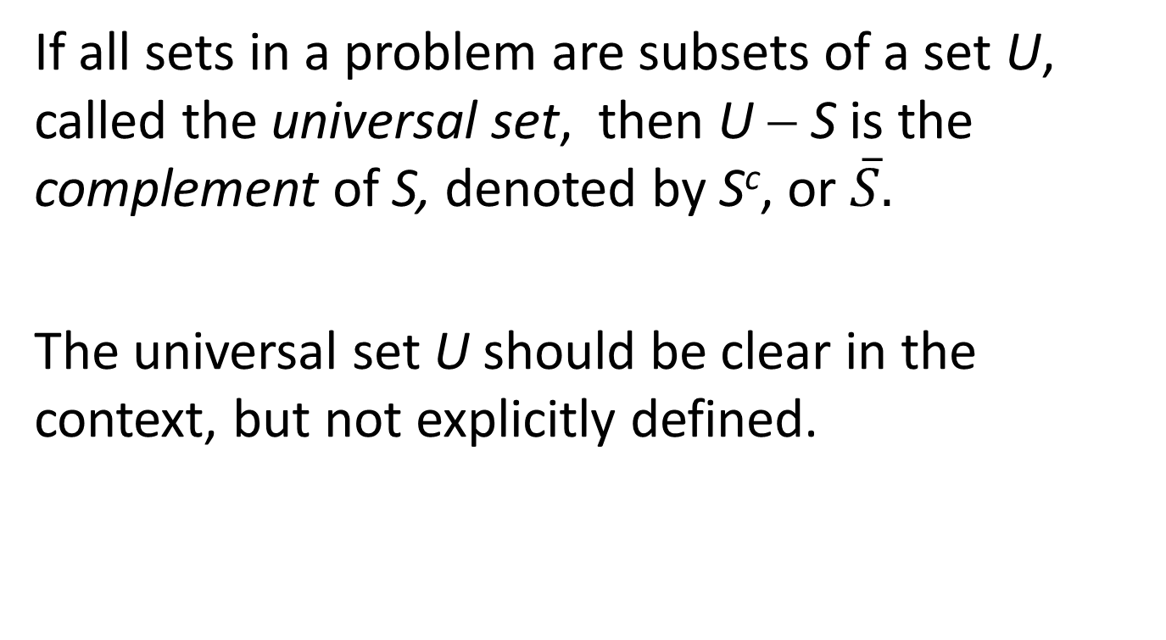
The Complement
If all sets in a problem are subsets of a set U, called the universal set, then U − S is the complement of S, denoted by S^{c}, or $\overline{S}.$
The universal set U should be clear in the context, but not explicitly defined.

Slide 14
Venn’s Diagrams
The Union:
A
A ∪ B
B

Slide 15
The intersection:
A
A ∩ B
B

Slide 16
The difference:
A
B
A − B

Slide 17
The symmetric difference:
A
A ⊕ B
B

Slide 18
The complement:
U
A^{C}
A

Slide 19
Properties
(i) A ∪ B = B ∪ A, (commutative law)
(ii) A ∩ B = B ∩ A, (commutative law)
(iii) A ∪ (B ∪ C) = (A ∪ B) ∪ C, (associative law)
(iv) A ∩ (B ∩ C) = (A ∩ B) ∩ C, (associative law)

Slide 20
(v) A ∪ (B ∩ C) = (A ∪ B) ∩ (A ∪ C), (distributive law)
(vi) A ∩ (B ∪ C) = (A ∩ B) ∪ (A ∩ C), (distributive law)
(vii) A ⊕ B = (A ∪ B) – (A ∩ B),
(viii) A ∪ ∅ = A,
(ix) A ∩ ∅ = ∅.

Slide 21
Disjoint Sets, Union and Intersection of more than Two Sets
If A ∩ B = ∅, then A and B are disjoint.
By the associative law, when we have the union or intersection of more than two sets, the order is irrelevant. We may write A ∪ B ∪ C, or A ∩ B ∩ C without specifying the order.

Slide 22
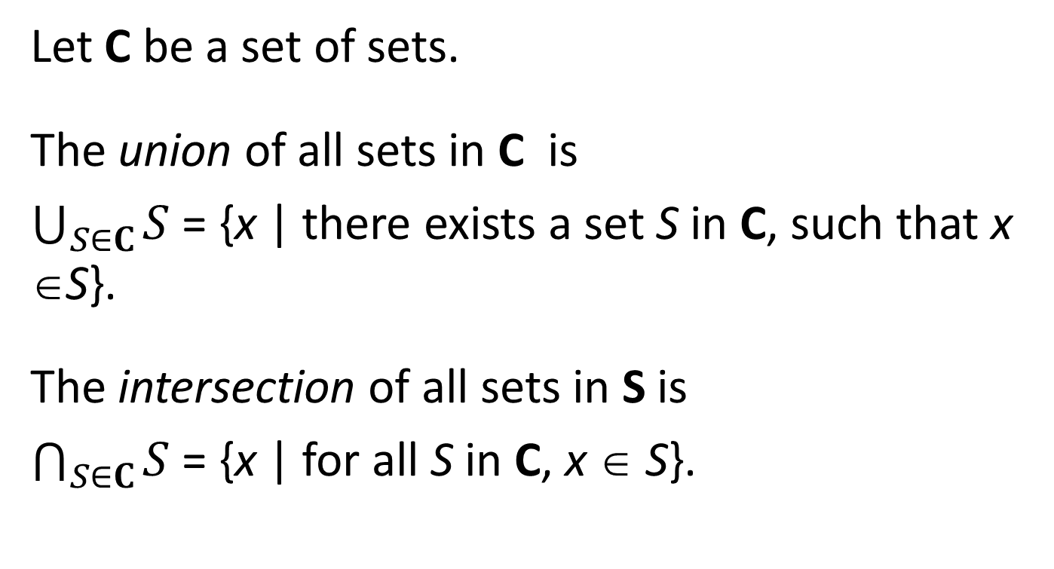
Generalized Union and Intersection
Let C be a set of sets.
The union of all sets in C is
$\bigcup_{S∈C}{S}$ = {x | there exists a set S in C, such that x ∈S}.
The intersection of all sets in S is
$\bigcap_{S∈C}{S}$ = {x | for all S in C, x ∈ S}.

Slide 23
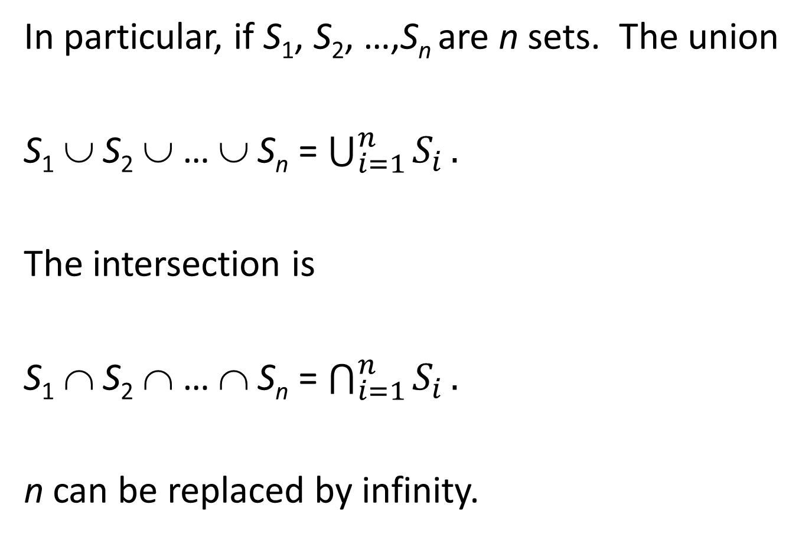
In particular, if S₁, S₂, …,S_{n} are n sets. The union
S₁ ∪ S₂ ∪ … ∪ S_{n} = $\bigcup_{i=1}^{n}{S_{i}}.$
The intersection is
S₁ ∩ S₂ ∩ … ∩ S_{n} = $\bigcap_{i=1}^{n}{S_{i}}.$
n can be replaced by infinity.

Slide 24
Proving Set Identities
A = B if and only if A ⊆ B, and B ⊆ A. We have to show in two directions: If x ∈ A, then x ∈ B. On the other hand, if x ∈ B, then x ∈ A.

Slide 25
Prove the Distributive Law
A ∪ (B ∩ C) = (A ∪ B) ∩ (A ∪ C)
Let x ∈ A ∪ (B ∩ C). Then x ∈ A or x ∈ B ∩ C.
If x ∈ A, then x ∈ A ∪ B and x ∈ A ∪ C. Hence,
x ∈ (A ∪ B) ∩ (A ∪ C).
If x ∈ B ∩ C, then x ∈ B and x ∈ C. Since x ∈ B implies x ∈ A ∪ B, and x ∈ C implies x ∈ A ∪ C, we have x ∈ (A ∪ B) ∩ (A ∪ C).
Then A ∪ (B ∩ C) ⊆ (A ∪ B) ∩ (A ∪ C).

Slide 26
Prove the Distributive Law
A ∪ (B ∩ C) = (A ∪ B) ∩ (A ∪ C)
Let x ∈ A ∪ (B ∩ C). Then x ∈ A or x ∈ B ∩ C.
If x ∈ A, then x ∈ A ∪ B and x ∈ A ∪ C. Hence,
x ∈ (A ∪ B) ∩ (A ∪ C).
If x ∈ B ∩ C, then x ∈ B and x ∈ C. Since x ∈ B implies x ∈ A ∪ B, and x ∈ C implies x ∈ A ∪ C, we have x ∈ (A ∪ B) ∩ (A ∪ C).
Then A ∪ (B ∩ C) ⊆ (A ∪ B) ∩ (A ∪ C).

Slide 27
Prove the Distributive Law
A ∪ (B ∩ C) = (A ∪ B) ∩ (A ∪ C)
Let x ∈ A ∪ (B ∩ C). Then x ∈ A or x ∈ B ∩ C.
If x ∈ A, then x ∈ A ∪ B and x ∈ A ∪ C. Hence,
x ∈ (A ∪ B) ∩ (A ∪ C).
If x ∈ B ∩ C, then x ∈ B and x ∈ C. Since x ∈ B implies x ∈ A ∪ B, and x ∈ C implies x ∈ A ∪ C, we have x ∈ (A ∪ B) ∩ (A ∪ C).
Then A ∪ (B ∩ C) ⊆ (A ∪ B) ∩ (A ∪ C).

Slide 28
On the other hand, if x ∈ (A ∪ B) ∩ (A ∪ C), then x ∈ A ∪ B and x ∈ A ∪ C.
If x ∈ A, then x ∈ A ∪ (B ∩ C).
If x ∉ A, we must have both x ∈ B and x ∈ C. Then
x ∈ B ∩ C. We also have x ∈ A ∪ (B ∩ C).
Hence, (A ∪ B) ∩ (A ∪ C) ⊆ A ∪ (B ∩ C).
Finally, we have A ∪ (B ∩ C) = (A ∪ B) ∩ (A ∪ C).

Slide 29
On the other hand, if x ∈ (A ∪ B) ∩ (A ∪ C), then x ∈ A ∪ B and x ∈ A ∪ C.
If x ∈ A, then x ∈ A ∪ (B ∩ C).
If x ∉ A, we must have both x ∈ B and x ∈ C. Then
x ∈ B ∩ C. We also have x ∈ A ∪ (B ∩ C).
Hence, (A ∪ B) ∩ (A ∪ C) ⊆ A ∪ (B ∩ C).
Finally, we have A ∪ (B ∩ C) = (A ∪ B) ∩ (A ∪ C).

Slide 30
On the other hand, if x ∈ (A ∪ B) ∩ (A ∪ C), then x ∈ A ∪ B and x ∈ A ∪ C.
If x ∈ A, then x ∈ A ∪ (B ∩ C).
If x ∉ A, we must have both x ∈ B and x ∈ C. Then
x ∈ B ∩ C. We also have x ∈ A ∪ (B ∩ C).
Hence, (A ∪ B) ∩ (A ∪ C) ⊆ A ∪ (B ∩ C).
Finally, we have A ∪ (B ∩ C) = (A ∪ B) ∩ (A ∪ C).

Slide 31
Membership Table
In a membership table, every column represents a set. In a column, use 1 to mean an object is in this set, and 0 to mean it is not in this set.
We can use the membership table to prove the identity of two sets.

Slide 32
A ∪ (B ∩ C) = (A ∪ B) ∩ (A ∪ C)
A B C B∩C A∪(B ∩ C) A∪B A∪C (A∪B)∩(A∪C)
0 0 0 0 0 0 0 0
0 0 1 0 0 0 1 0
0 1 0 0 0 1 0 0
0 1 1 1 1 1 1 1
1 0 0 0 1 1 1 1
1 0 1 0 1 1 1 1
1 1 0 0 1 1 1 1
1 1 1 1 1 1 1 1
The column of A∪(B ∩ C) and the column of (A∪B)∩(A∪C) are identical. The identity is proved.

Slide 33
Cartesian Product
Let A and B be two sets. The Cartesian Product of A and B, denoted by A × B, is the set of all ordered pairs (a, b) where a ∈ A and b ∈ B:
A × B = {(a, b) | a ∈ A, b ∈ B}.
{1, 2} × {1, a, b} = {(1, 1), (1, a), (1, b), (2, 1), (2, a), (2, b)}.
If A = ∅ or B = ∅, then A × B = ∅.

Slide 34
Cartesian Product of More Than One Set
Let S₁, S₂, …, S_{n}, be n sets. The Cartesian product
S₁ × S₂ × … × S_{n} is the set of n-tuples: (a₁, a₂, …, a_{n}), where a_{i} ∈ S_{i}, i = 1, 2, …, n.
For example, if S₁ = S₂ = … = S_{n} = {0, 1}, then
S₁ × S₂ × … × S_{n} is the set of all 0-1 n-tuples, i.e., 0-1 sequences of length n.

Slide 35
Cardinality of Cartesian Product
Let S₁, S₂, …, S_{n}, be n finite sets. Then the cardinality of the Cartesian product is
|S₁ × S₂ × … × S_{n}|= |S₁| × |S₂| × … × |S_{n}|.
In particular, if A and B are finite sets, then
| A × B | = | A | × | B |.

Slide 36
Relations
A relation R from a set A to a set B is a subset of the Cartesian product A × B.
If (a, b) ∈ R, then we say that a has relation R with b, denoted by a R b.

Slide 37
Example
Consider sets A = {1, 2} and B = {1, a, b}. Then
A × B = {(1, 1), (1, a), (1, b), (2, 1), (2, a), (2, b)}.
R = {(1, 1), (1, a), (2, 1), (2, b)} is a subset of A × B.
Then 1 R 1, 1 R a, 2 R 1, and 2 R b.

Slide 38
More Examples of Relations
1. Parent-Child relation P: A is a set of adults, and B is a set of children.
a ∈ A, b ∈ B, a P b if a is a parent of b.
2. Building-Room relation Q: A is a set of buildings, and B is a set of rooms.
a ∈ A, b ∈ B, a Q b if room b is in building a.

Slide 39
3. Divisor relation D: A = B = Z is the set of integers.
a, b ∈ Z, a D b if a divides b.
This relation is also denoted by a | b.

Slide 40
4. Congruence (modulo m) relation M: A = B = Z is the set of integers, and m is a fixed positive integer.
x, y ∈ Z, x M y if the remainders when x and y divided by m are equal.
This relation is also denoted by x ≡ y (mod m).

Slide 41
5. Mutual Friendship relation F: A = B = S is a set of people.
x, y ∈ S, x F y if x and y are mutual friends.

Slide 42
6. The rational relation r: Let N be the set of natural numbers. The Cartesian product G = N × N is the positive grid set, i.e., G is the ordered pairs of positive integers.
Define a relation r from G to G:
(n₁, d₁), (n₂, d₂) ∈ G, (n₁, d₁) r (n₂, d₂)
if n₁d₂ = n₂d₁.

Slide 43
Relations from a Set to Itself
Let S be a set, and let R be a relation from S to itself.
R is said to be reflexive if for all a ∈ S, a R a.
R is said to be symmetric if, for all a, b ∈ S, a R b implies b R a.
R is said to be transitive if, for all a, b, c ∈ S, a R B and b R c, implies a R c.

Slide 44
Examples
The divisor relation D is reflexive and transitive, but not symmetric.
For any integer x, x divides itself. D is reflexive.
If x D y, and y D z, then there exist integers a and b such that y = ax, and z = by. Then z = bax, and x divides z, i.e., x D z. D is transitive.
2 divides 4, but 4 does not divide 2, D is not symmetric.

Slide 45
The congruence relation M is reflexive, symmetric and transitive.
It is obviously reflexive and symmetric.
If x and y divided by m have the same remainder, and y and z divided by m have the same remainder, then x and z divided by m have the same remainder. Relation M is transitive.

Slide 46
The mutual friendship relation F is symmetric, but not reflexive nor transitive.
We don’t think a person is a friend of himself. F is not reflexive.
Because the definition is about mutual friendship, this relation is symmetric.
Even if a and b are friends, and b and c are friends, a and c does not have to be friends.

Slide 47
The Rational Relation r
(n₁, d₁) r (n₂, d₂) if and only n₁d₂ = n₂d₁, where n₁, n₂, d₁, d₂ are positive integers.
(1) Relation r is reflexive.
Indeed, if (n₁, d₁) = (n₂, d₂), then n₁ = n₂ and d₁ = d₂. Hence, n₁d₂ = n₂d₁, and (n₁, d₁) r (n₂, d₂).

Slide 48
(n₁, d₁) r (n₂, d₂) if n₁d₂ = n₂d₁, where n₁, n₂, d₁, d₂ are positive integers
(2) Relation r is symmetric.
Suppose (n₁, d₁) r (n₂, d₂). Then n₁d₂ = n₂d₁.
Hence, n₂d₁ = n₁d₂, and (n₂, d₂) r (n₁, d₁).

Slide 49
(n₁, d₁) r (n₂, d₂) if n₁d₂ = n₂d₁, where n₁, n₂, d₁, d₂ are positive integers
(3) Relation r is transitive.
Suppose (n₁, d₁) r (n₂, d₂) and (n₂, d₂) r (n₃, d₃). Then we have n₁d₂ = n₂d₁ and n₂d₃ = n₃d₂. Multiplying these two identities, we have
n₁d₂n₂d₃ = n₂d₁n₃d₂. Since n₂ and d₂ are positive integers, divide both sides by n₂d₂, we have n₁d₃ = d₁n₃. Hence, (n₁, d₁) r (n₃, d₃) and r is transitive.

Slide 50
(n₁, d₁) r (n₂, d₂) if n₁d₂ = n₂d₁, where n₁, n₂, d₁, d₂ are positive integers
(3) Relation r is transitive.
Suppose (n₁, d₁) r (n₂, d₂) and (n₂, d₂) r (n₃, d₃). Then we have n₁d₂ = n₂d₁ and n₂d₃ = n₃d₂. Multiplying these two identities, we have
n₁d₂n₂d₃ = n₂d₁n₃d₂. Since n₂ and d₂ are positive integers, divide both sides by n₂d₂, we have n₁d₃ = d₁n₃. Hence, (n₁, d₁) r (n₃, d₃) and r is transitive.

Slide 51
(n₁, d₁) r (n₂, d₂) if n₁d₂ = n₂d₁, where n₁, n₂, d₁, d₂ are positive integers
(3) Relation r is transitive.
Suppose (n₁, d₁) r (n₂, d₂) and (n₂, d₂) r (n₃, d₃). Then we have n₁d₂ = n₂d₁ and n₂d₃ = n₃d₂. Multiplying these two identities, we have
n₁d₂n₂d₃ = n₂d₁n₃d₂. Since n₂ and d₂ are positive integers, divide both sides by n₂d₂, we have n₁d₃ = d₁n₃. Hence, (n₁, d₁) r (n₃, d₃) and r is transitive.

Slide 52
(n₁, d₁) r (n₂, d₂) if n₁d₂ = n₂d₁, where n₁, n₂, d₁, d₂ are positive integers
(3) Relation r is transitive.
Suppose (n₁, d₁) r (n₂, d₂) and (n₂, d₂) r (n₃, d₃). Then we have n₁d₂ = n₂d₁ and n₂d₃ = n₃d₂. Multiplying these two identities, we have
n₁d₂n₂d₃ = n₂d₁n₃d₂. Since n₂ and d₂ are positive integers, divide both sides by n₂d₂, we have n₁d₃ = d₁n₃. Hence, (n₁, d₁) r (n₃, d₃) and r is transitive.

Slide 53
Equivalence Relation
Let E be a relation from a set S to itself. E is said to be an equivalence relation if it is reflexive, symmetric, and transitive.
The congruence relation M, and the rational relation r are equivalence relations.

Slide 54
Equivalence Class
Let E be an equivalence relation from a set S to itself. Let x ∈ S.
The set [x] = {a ∈ S | x E a} is an equivalence class. The element x is a representative of this equivalence class.
Because E is reflexive, x ∈ [x].

Slide 55
Properties of Equivalence Classes
1. If y ∈ [x], then [x] = [y].
Since E is symmetric, y ∈ [x] implies that y E x. If z ∈ [x], then x E z. By transitivity, y E z, and z ∈ [y].
Conversely, if z ∈ [y], then y E z. y ∈ [x] means x E y. Because E is transitive, x E y and y E z implies x E z. Hence, z ∈ [x].
This means that every element in an equivalence class can be used as the representative.

Slide 56
2. If x does not have a relation with y, then [x] and [y] are disjoint.
Indeed, if z ∈ [x] ∩ [y], then x E z and y E z. Since E is symmetric and transitive, we have x E y, a contradiction.
From this property, we see that every element a ∈ S is in one and only one equivalent class.

Slide 57
The Quotient Set
Let E be an equivalence relation from a set S to itself. The set of equivalence classes determined by relation E is called the quotient set of S induced by (equivalence) relation E, denoted by S / E.

Slide 58
Examples
1. Let S = {0, 1, 2, 3, …, 20}, and let M₃ be the congruence relation from S to itself with modulo 3. The quotient set is
S / M₃ = {{0, 3, 6, 9, 12, 15,18},
{1, 4, 7, 10, 13, 16, 19},
{2, 5, 8, 11, 14, 17, 20}} = {[0], [1], [2]}.

Slide 59
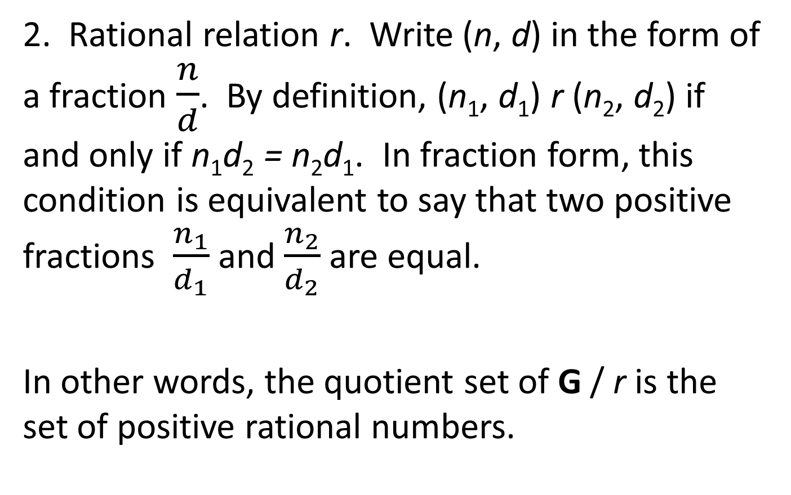
2. Rational relation r. Write (n, d) in the form of a fraction $\frac{n}{d}$. By definition, (n₁, d₁) r (n₂, d₂) if and only if n₁d₂ = n₂d₁. In fraction form, this condition is equivalent to say that two positive fractions $\frac{n_{1}}{d_{1}}$ and $\frac{n_{2}}{d_{2}}$ are equal.
In other words, the quotient set of G / r is the set of positive rational numbers.

Slide 60
Functions
Let D and C be two sets. A function (also called a mapping), from D to C is a relation f that assigns a unique element of C to every element of D, denoted by f : D → C.
D is the domain of f, and C is the codomain of f.

Slide 61
Suppose x is an element of D, and y is the element of C assigned to x, then y is the image of x, and x is a preimage of y, denoted by y = f (x).
Every element in D has a unique image in C. An element in C may have any number of preimages in D. In particular, an element in C may not have any preimages in D.
R = {y ∈ C | there exists x ∈ D such that f (x) = y}
is called the range of f.

Slide 62
Restriction of a Function
Let f be a function from A to B. C is a subset of A. A function f_{C} defined from C to B such that, for every element x in C, f_{C}(x) = f (x) is called the restriction of f to C. The range of f_{C} in B is a subset of the range of f.
Function f and f_{C} are identical when x is in C. However, they are different functions because they have different domains.

Slide 63
Example
Let D = C be the set of real numbers. Function
f (x) = x² is defined from D to C.
Every y in C may have 0, 1, or 2 preimages. The range of f is the set of non-negative numbers.
Let R⁺ be the set of all positive real numbers. The restriction of f to R⁺ is the function f*(x) = x² defined only on positive real numbers. The range of f* is the set of all positive numbers.

Slide 64
Composition of Two Functions
Let f : A → B, and g: B → C be two functions. Then the function from A to C defined by g(f (x)) is called the composition of g and f, denoted by
g ° f:
(g ° f )(x) = g(f (x)).

Slide 65
Surjections
A function f : D → C is surjective, or a surjection, if the range of f is C.
In other words, f is surjective if every element in its codomain has at least one preimage.
A surjection is also called an onto function.

Slide 66
Injections
A function f : D → C is injective, or an injection, if every element in C has at most one preimage.
In other words, if we have x₁, x₂ in D such that
f (x₁) = f (x₂), then x₁ = x₂.
An injection is also called an one-to-one function.

Slide 67
Bijections
A function f : D → C is bijective, or a bijection, if it is injective and surjective.
In other words, if f is a bijection, then every element in its codomain has exactly one preimage. The codomain of a bijection is the range of this function.
A bijection is also called a one-to-one correspondence.

Slide 68
Properties
Let f : A → B and g: B → C be two functions. Then
g ° f is a function from A to C.
(i) If g ° f is surjective, then g is surjective.
Let z ∈C. Since g ° f is surjective, we have x in A such that (g ° f )(x) = g(f (x)) = z. Then u = f (x) in B is a preimage of z of function g, g(u) = z. Function g is surjective.

Slide 69
(ii) If g ° f is injective, then f is injective.
Suppose x₁, x₂ ∈ A and f (x₁) = f (x₂). We want to show x₁ = x₂.
In deed, (g ° f )(x₁) = g(f (x₁)) and (g ° f )(x₂)
= g(f (x₂)). Since f (x₁) = f (x₂), we have g(f (x₁))
= g(f (x₂)), and (g ° f )(x₁) = (g ° f )(x₂).
Since g ° f is injective, we have x₁ = x₂.
Then f is injective.

Slide 70
Note that if g is surjective, g ° f may not be surjective, and if f is injective, g ° f may not be injective.
Examples. Let A = B = C = {1, 2}.
Define functions f from A to B and g from B to C such that f (1) = f (2) = 1, g(1) = 1, g(2) = 2. Then g is surjective, but (g ° f)(1) = g(f (1)) = g(1) = 1, and (g ° f )(2) = g(f (2)) = g(1) = 1. The composition g ° f is not surjective.

Slide 71
Note that if g is surjective, g ° f may not be surjective, and if f is injective, g ° f may not be injective.
Examples. Let A = B = C = {1, 2}.
(i) Define function f such that f (1) = f (2) = 1, g(1) = 1, g(2) = 2. Then g is surjective, but (g ° f)(1) = g(f (1)) = g(1) = 1, and (g ° f )(2) = g(f (2)) = g(1) = 1. The composition g ° f is not surjecti
Define functions f from A to B and g from B to C such that f (1) = 1, f (2) = 2, g(1) = g(2) = 1.
Then (g ° f )(1) = g(f (1)) = g(1) = 1 and (g ° f )(2)
= g(f (2)) = g(2) = 1.
The composition g ° f is not injective.

Slide 72
(iii) If f and g are surjective, then g ° f is surjective.
Let z ∈C. Since g is surjective, z has a preimage y in B. Since f is surjective, y has a preimage x in A. Then x is the preimage of z of the function
g ° f.
The composition g ° f is surjective.

Slide 73
(iv) If f and g are injective, then g ° f is injective.
Let x₁, x₂ ∈ A such that (g ° f )(x₁) = (g ° f )(x₂). We want to show x₁ = x₂.
We have g(f (x₁)) = g(f (x₂)). Since g is injective, we must have f (x₁) = f (x₂). Since f is injective, then we have x₁ = x₂.
The composition g ° f is injective.

Slide 74
Combine the previous properties, we have
(v) If f and g are bijective, then g ° f is bijective.

Slide 75
Inverse Functions
Let f : A → B be a bijection. Since every element in B has exactly one preimage, then we can define a function g from B to A such that, for an element x in B, let g(x) = y ∈ A such that f (y) = x.
This function is called the inverse of function f , denoted by f ⁻¹.
The inverse of a bijection is a bijection.

Slide 76
Properties
Let f : A → B be a bijection.
(i) B is the domain of f ⁻¹, and A is the codomain of f ⁻¹.
(ii) (f ⁻¹)⁻¹ = f.
(iii) For every element x in A, (f ⁻¹ ° f )(x) = x.
(iv) For every element y in B, (f ° f ⁻¹)(y) = y.

Slide 77
Cardinality of an Infinite Set
Let A and B be two sets.
If there is a bijection from A to B, we say that A and B has the equal cardinality, denoted by |A| = |B|.
bijection
A
B

Slide 78
If there is a bijection from A to a subset of B, we say that the cardinality of A is less than or equal to the cardinality of B, denoted by |A| ≤ |B|.
bijection
A
B

Slide 79
If there is a bijection from a subset of A to B, we say that the cardinality of A is greater than or equal to the cardinality of B, denoted by |A| ≥ |B|.
|A| ≥ |B| if and only if |B| ≤ |A|.
bijection
A
B

Slide 80
These definitions are also true for finite sets.
Let A and B be two finite sets.
A = {a₁, a₂, …, a_{m}}. | A | = m.
B = {b₁, b₂, …, b_{n}}. | B | = n.
When m ≤ n, function f (a_{i}) = b_{i} is a bijection from A to a subset {b₁, b₂, …, b_{m}} of B.

Slide 81
Transitivity of Inequality
Let A, B, and C, be three sets. If |A| ≤ |B| ≤ |C|, then |A| ≤ |C|.
Indeed, |A| ≤ |B| means that there is a bijection f from A to a subset B₁ of B, and |B| ≤ |C| means that there is bijection g from B to a subset C₁ of C. The restriction of g on B₁ is a bijection g₁ from B₁ to a subset C₂ of the range of g in C.

Slide 82
The composition g₁ ° f is a bijection from A to a subset of C. Hence, |A| ≤ |C|.
f
g
B₁
C₁
g₁
A
A
B
C
C₂

Slide 83
Symmetry and Transitivity of Equality
Let A and B be two sets. If |A| = |B|, then |B| = |A|.
Let A, B, and C be three sets. If |A| = |B| and |B| = |C|, then |A| = |C|.
These properties follow directly from the properties of bijections.

Slide 84
Bernstein Theorem
Bernstein Theorem. Let A and B be two sets. If there exists a bijection from a subset of A to B, and a bijection from A to a subset of B, then there exists a bijection from A to B.
In terms of cardinality, this theorem says that if |A|≥ |B| and |A|≤ |B|, then |A|= |B|.
(The proof is beyond the scope of this course.)

Slide 85
Corollary. If A ⊆ B ⊆ C, and |A| = |C|, then |A| = |B| = |C|.
Indeed, define a function f from A to B such that
f (a) = a for every a in A. Then |A| ≤ |B|.
Since |A| = |C|, there is a bijection g from C to A. The restriction of g on B is a bijection from B to a subset of A. Then |B| ≤ |A|.
Hence, we have |A| = |B| = |C|.

Slide 86
Strict Inequalities
Let A and B be two sets.
Similar to numbers, if |A| = |B| is not true, we write |A| ≠ |B|.
If |A| ≤ |B| and |A| ≠ |B|, we write |A| < |B|.
If |A| ≥ |B| and |A| ≠ |B|, we write |A| > |B|.

Slide 87
Cardinality of the Power Set of an Infinite Set
Let S be an infinite set. We will show |S| < |Pow(S)|.
Obviously, the function f (x) = {x} defines a bijection from S to Pow(S). Hence, |S| ≤ |Pow(S)|.
Suppose we have a bijection g(x) from S to Pow(S). Hence, x is an element of S and g(x) is subset of S.
Let G be a subset of S such that G = {x ∈ S| x ∉ g(x)}.
Since g is a bijection, we have x* ∈ S such that g(x*) = G.
Consider two cases:
1. x* ∉ g(x*). According to the definition of G, we must have x* ∈ G = g(x*).
2. x* ∈ g(x*). Again according to the definition of G, we must have x* ∉ G = g(x*).
In both cases, we have a contradiction. The conclusion is proved.

Slide 88
Cardinality of the Power Set of an Infinite Set
Let S be an infinite set. We will show |S| < |Pow(S)|.
Obviously, the function f (x) = {x} defines a bijection from S to Pow(S). Hence, |S| ≤ |Pow(S)|.
Suppose we have a bijection g(x) from S to Pow(S). Hence, x is an element of S and g(x) is subset of S.
Let G be a subset of S such that G = {x ∈ S| x ∉ g(x)}.
Since g is a bijection, we have x* ∈ S such that g(x*) = G.
Consider two cases:
1. x* ∉ g(x*). According to the definition of G, we must have x* ∈ G = g(x*).
2. x* ∈ g(x*). Again according to the definition of G, we must have x* ∉ G = g(x*).
In both cases, we have a contradiction. The conclusion is proved.

Slide 89
Cardinality of the Power Set of an Infinite Set
Let S be an infinite set. We will show |S| < |Pow(S)|.
Obviously, the function f (x) = {x} defines a bijection from S to Pow(S). Hence, |S| ≤ |Pow(S)|.
Suppose we have a bijection g(x) from S to Pow(S). Hence, x is an element of S and g(x) is subset of S.
Let G be a subset of S such that G = {x ∈ S| x ∉ g(x)}.
Since g is a bijection, we have x* ∈ S such that g(x*) = G.
Consider two cases:
1. x* ∉ g(x*). According to the definition of G, we must have x* ∈ G = g(x*).
2. x* ∈ g(x*). Again according to the definition of G, we must have x* ∉ G = g(x*).
In both cases, we have a contradiction. The conclusion is proved.

Slide 90
Cardinality of the Power Set of an Infinite Set
Let S be an infinite set. We will show |S| < |Pow(S)|.
Obviously, the function f (x) = {x} defines a bijection from S to Pow(S). Hence, |S| ≤ |Pow(S)|.
Suppose we have a bijection g(x) from S to Pow(S). Hence, x is an element of S and g(x) is subset of S.
Let G be a subset of S such that G = {x ∈ S| x ∉ g(x)}.
Since g is a bijection, we have x* ∈ S such that g(x*) = G.
Consider two cases:
1. x* ∉ g(x*). According to the definition of G, we must have x* ∈ G = g(x*).
2. x* ∈ g(x*). Again according to the definition of G, we must have x* ∉ G = g(x*).
In both cases, we have a contradiction. The conclusion is proved.

Slide 91
Cardinality of the Power Set of an Infinite Set
Let S be an infinite set. We will show |S| < |Pow(S)|.
Obviously, the function f (x) = {x} defines a bijection from S to Pow(S). Hence, |S| ≤ |Pow(S)|.
Suppose we have a bijection g(x) from S to Pow(S). Hence, x is an element of S and g(x) is subset of S.
Let G be a subset of S such that G = {x ∈ S| x ∉ g(x)}.
Since g is a bijection, we have x* ∈ S such that g(x*) = G.
Consider two cases:
1. x* ∉ g(x*). According to the definition of G, we must have x* ∈ G = g(x*).
2. x* ∈ g(x*). Again according to the definition of G, we must have x* ∉ G = g(x*).
In both cases, we have a contradiction. The conclusion is proved.

Slide 92
Cardinality of the Power Set of an Infinite Set
Let S be an infinite set. We will show |S| < |Pow(S)|.
Obviously, the function f (x) = {x} defines a bijection from S to Pow(S). Hence, |S| ≤ |Pow(S)|.
Suppose we have a bijection g(x) from S to Pow(S). Hence, x is an element of S and g(x) is subset of S.
Let G be a subset of S such that G = {x ∈ S| x ∉ g(x)}.
Since g is a bijection, we have x* ∈ S such that g(x*) = G.
Consider two cases:
1. x* ∉ g(x*). According to the definition of G, we must have x* ∈ G = g(x*).
2. x* ∈ g(x*). Again according to the definition of G, we must have x* ∉ G = g(x*).
In both cases, we have a contradiction. The conclusion is proved.

