Slide 1
III. Proofs

Slide 2
What is a Proof
Mathematic is based on Logic. All the statements, such as Lemmas, Theorems, or Corollaries, must be formally proved.
A proof uses axioms or known results to justify that the required conclusion is correct.

Slide 3
Existence Statements
Existence statements. Such statement asserts that there exists an object that satisfies a number of conditions. To prove an existence statement, the best way is, of course, construct an object (called an example) that satisfies all the conditions, or give a method to find such an object. However, in some cases, we can show the object that satisfies the conditions does exist without actually construct a complete object.

Slide 4
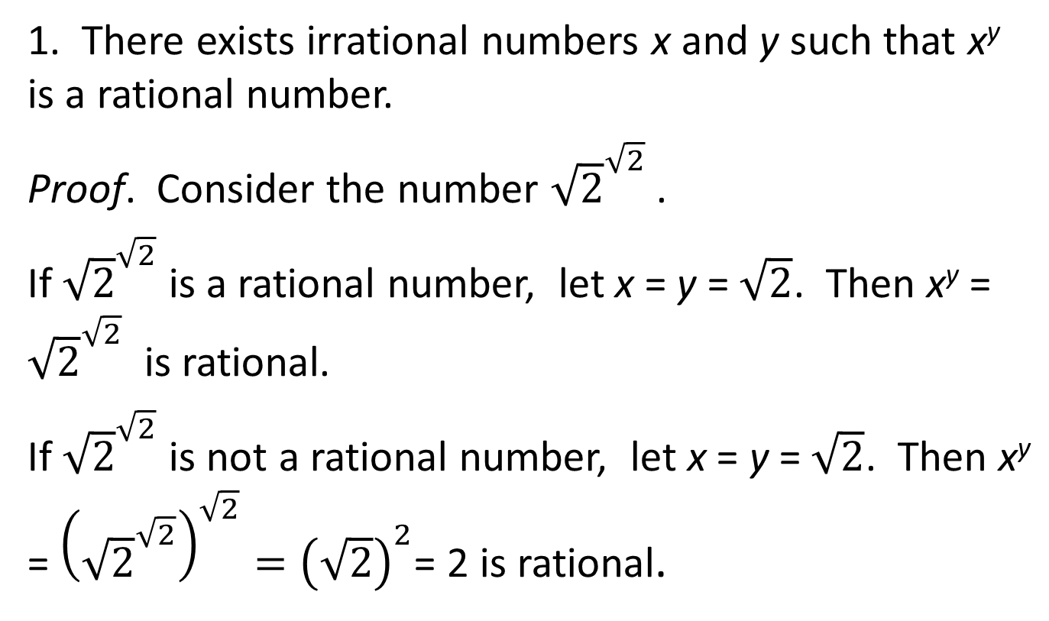
Examples
1. There exists irrational numbers x and y such that x^{y} is a rational number.
Proof. Consider the number ${\sqrt{2}}^{\sqrt{2}}$.
If ${\sqrt{2}}^{\sqrt{2}}$ is a rational number, let x = y = $\sqrt{2}$. Then x^{y} = ${\sqrt{2}}^{\sqrt{2}}$ is rational.
If ${\sqrt{2}}^{\sqrt{2}}$ is not a rational number, let x = y = $\sqrt{2}$. Then x^{y} = ${\left({\sqrt{2}}^{\sqrt{2}}\right)}^{\sqrt{2}}={\left(\sqrt{2}\right)}^{2}$= 2 is rational.

Slide 5
2. For any pair of natural numbers x and y, x > 2y, there exists a natural number z such that x > z > y.
Proof. In this case, since x and y are not specified, we cannot find a particular natural number z to prove this result. However, we can give a way to find this z from x and y.
Indeed, we can let z = y + 1 > y. Then z is a natural number, and, z = y + 1 ≤ y + y = 2y < x.

Slide 6
3. Let {a₁, a₂, …} be a sequence of numbers. A Theorem (called Bounded Monotonic Sequence Theorem) in calculus says that, if this sequence is increasing and, there is a number N such that a_{i} < N for all i = 1, 2, … , then there exists a finite number L such that .
According to this Theorem, we can show that the sequence {a_{i}} defined recursively by
a₁ = , a_{i+1} = , i ≥ 1, has a limit when i approaches infinity.

Slide 7
3. Let {a₁, a₂, …} be a sequence of numbers. A Theorem (called Bounded Monotonic Sequence Theorem) in calculus says that, if this sequence is increasing and, there is a number N such that a_{i} < N for all i = 1, 2, … , then there exists a finite number L such that .
According to this Theorem, we can show that the sequence {a_{i}} defined recursively by
a₁ = , a_{i+1} = , i ≥ 1, has a limit when i approaches infinity.

Slide 8
First, a₁ = , and a₂ = > a₁. If a_{i} > a_{i−1} , i = 2, 3, … , then a_{i+1} = =a_{i} . By induction (which we are going to talk in detail later), we know this sequence is increasing.
Furthermore, it is obvious that a₁ < 2. If a_{i} < 2, i ≥ 1, then a_{i+1} = = 2. We see that a_{i} < 2 for all i = 1, 2, … .
By the Bounded Monotonic Sequence Theorem, this sequence has a finite limit, although this proof did not actually find what the limit is.

Slide 9
Universal Statements
A universal statements asserts that all objects that satisfy a certain set of conditions has some properties.
A universal statement CANNOT be proved by examples.
To prove a universal statement, we must deduce the required property from the conditions.

Slide 10
Examples
For all natural number n, when n² is divided by 4, the remainder is 0 or 1.
Proof. Consider two cases:
When n = 2m – 1 is odd, n² = (2m – 1)² = 4m² – 4m + 1. When n² is divided by 4, the remainder is 1.
When n = 2m is even, n² = 4m². When n² is divided by 4, the remainder is 0.

Slide 11
Universal Statements Cannot be Proved by Examples
A proof of a universal statement must conclude that the statement is correct in general. Only some examples are not enough to prove the conclusion.

Slide 12
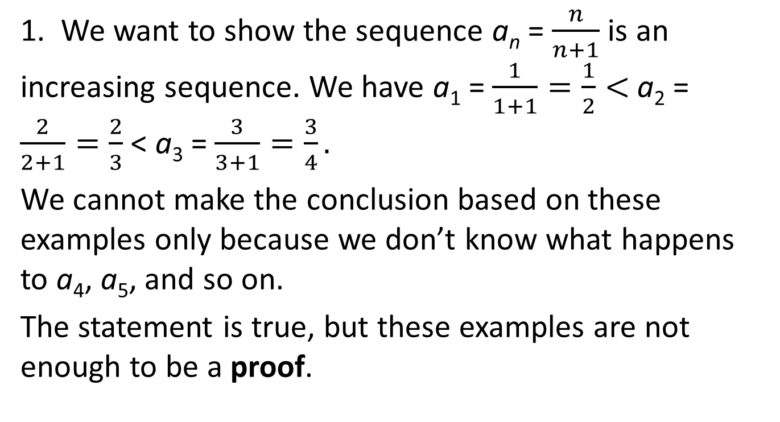
Examples
1. We want to show the sequence a_{n} = $\frac{n}{n+1}$ is an increasing sequence. We have a₁ = $\frac{1}{1+1}=\frac{1}{2}<$ a₂ = $\frac{2}{2+1}=\frac{2}{3}$ < a₃ = $\frac{3}{3+1}=\frac{3}{4}.$
We cannot make the conclusion based on these examples only because we don’t know what happens to a₄, a₅, and so on.
The statement is true, but these examples are not enough to be a proof.

Slide 13
2. Statement: For any natural number n, n² + n + 41 is a prime number.
Indeed, n = 1, n² + n + 41 = 43; n = 2, n² + n + 41 = 47;
n = 3, n² + n + 41 = 53; n = 4, n² + n + 41 = 61;
n = 5, n² + n + 41 = 71; n = 6, n² + n + 41 = 85;
n = 7, n² + n + 41 = 97.
These are all prime numbers. The result is true even for n = 8, 9, …, 39.
Unfortunately, the result is not true in general. When n = 40, n² + n + 41 = 1681 = 41². This is not a prime number. The statement is false.

Slide 14
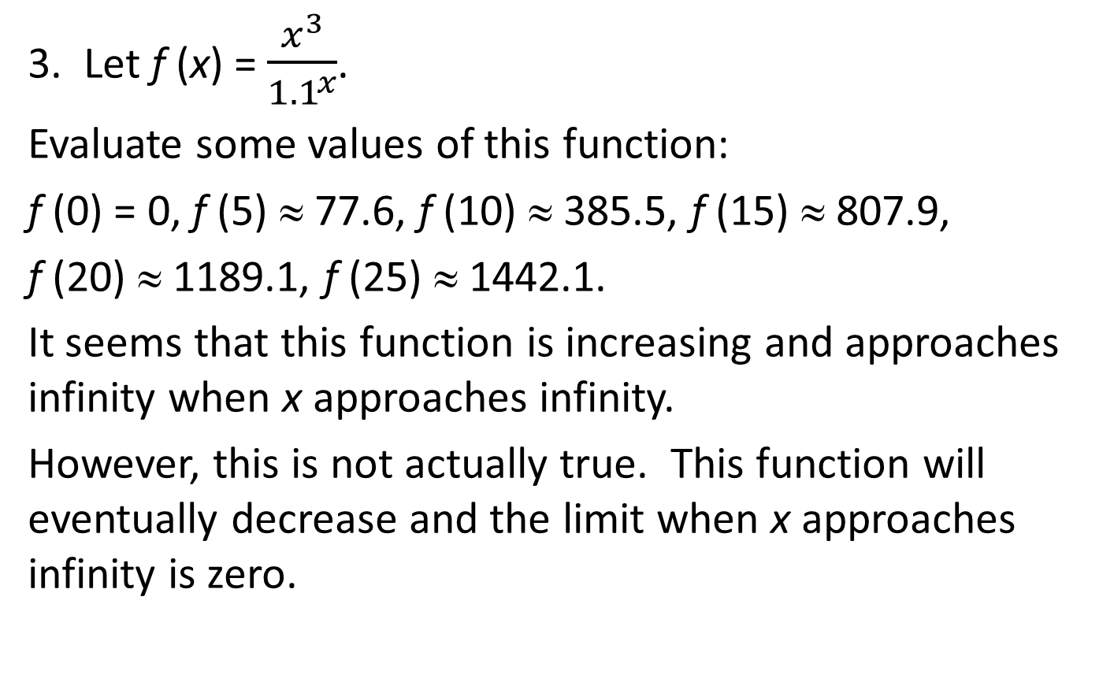
3. Let f (x) = $\frac{x^{3}}{{1.1}^{x}}$.
Evaluate some values of this function:
f (0) = 0, f (5) ≈ 77.6, f (10) ≈ 385.5, f (15) ≈ 807.9,
f (20) ≈ 1189.1, f (25) ≈ 1442.1.
It seems that this function is increasing and approaches infinity when x approaches infinity.
However, this is not actually true. This function will eventually decrease and the limit when x approaches infinity is zero.

Slide 15
Disprove a Universal Statement
Recall that a universal statements asserts that all objects that satisfy a certain set of conditions has some properties.
If we want to show that this statement is not true, we can find an object that satisfies all the conditions but the conclusion is not true.
This object is called a counter-example.

Slide 16
Examples
1. Statement: For all natural numbers n, 7n + 2 is a perfect square.
This statement is false because when n = 3, 7 × 3 + 2 = 32 is not a perfect square.

Slide 17
2. Statement: For any pair of natural numbers x and y, x ≥ 2y, there is a natural number z such that x > z > y.
This result is not true. A counter-example is x = 2 and y = 1. We have x = 2y, but there is no natural number between 1 and 2.

Slide 18
Prove by Contradiction
Suppose we want to prove a statement S is true.
First, we assume, to the contrary, that S is false. Then, starting from the assumption that S is false, we deduce a contradiction.
This means that the assumption that S is false is not true. Hence, the S must be true.

Slide 19
Prove by Contraposition
Suppose a statement has the form of implication: If A is true, then B is true.
A proof by contradiction assumes that B is false. From this assumption, if we can show that A is false, then this contradicts the condition that A is true.
In other words, we proved that B is false implies the A is false. This the contraposition of the original statement.
In Part I, we see that the contraposition of an implication proposition is equivalent to the original proposition.

Slide 20
Examples
1. If n > 3 is a prime number, then n + 1 is not a perfect square.
Proof. Assume, to the country, that n + 1 IS a perfect square, then n + 1 = m², where m is an integer, m > 2. Now n = m² – 1 = (m + 1)(m – 1). Hence, n is NOT a prime number.
This contradicts the condition that n is a prime number. Hence, n + 1 is not a perfect square.

Slide 21
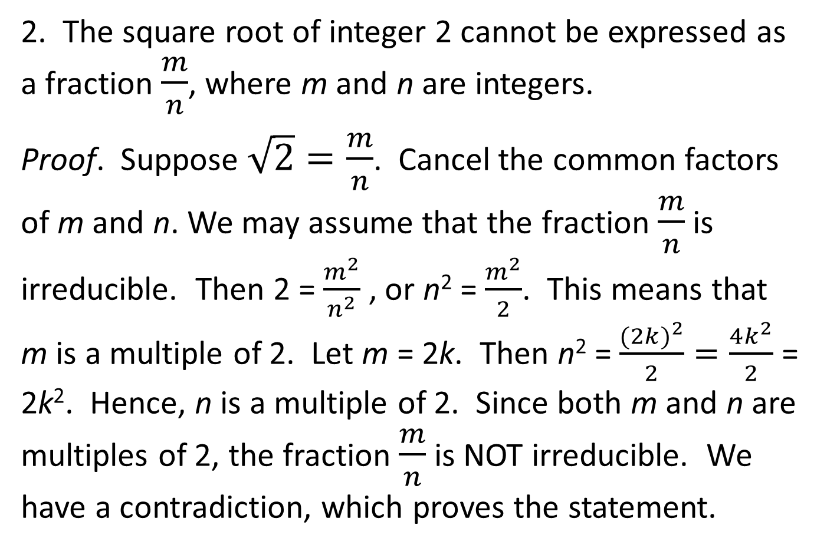
2. The square root of integer 2 cannot be expressed as a fraction $\frac{m}{n}$, where m and n are integers.
Proof. Suppose $\sqrt{2}=\frac{m}{n}$. Cancel the common factors of m and n. We may assume that the fraction $\frac{m}{n}$ is irreducible. Then 2 = $\frac{m^{2}}{n^{2}}$ , or n² = $\frac{m^{2}}{2}$. This means that m is a multiple of 2. Let m = 2k. Then n² = $\frac{{(2k)}^{2}}{2}=\frac{4k^{2}}{2}$ = 2k². Hence, n is a multiple of 2. Since both m and n are multiples of 2, the fraction $\frac{m}{n}$ is NOT irreducible. We have a contradiction, which proves the statement.

Slide 22
3. There exists infinitely many prime numbers.
Proof. Assume that there exists only a finite number of prime numbers. Let p₁ < p₂ < … < p_{m} be the list of ALL prime numbers, where p_{m} is the greatest prime number.
Let N = p₁p₂…p_{m} + 1. When divide N by any number p_{i}, i = 1, 2, …, m, the remainder is 1. Hence, N cannot be divided by any p_{i}. N is a prime number greater than p_{m}. We have a contradiction.

Slide 23
Mathematical Induction
(week version)
Base case: Suppose a statement S(n) is true for n = n₀.
Induction Step: Assume S(n) is true for some n, (called the induction hypothesis), then we can prove that S(n + 1) is true.
Then S(n) is true for all n ≥ n₀.

Slide 24
Examples
1. Show that 1² + 2² + … + n² = n(n + 1)(2n + 1).
Proof. Base case:
When n = 1, 1² = × 1 × (1 + 1) × (2 × 1 + 1).
Induction hypothesis: Assume this formula is true for n. We want to show that
1² + 2² + … + (n + 1)² = (n + 1)(n + 2)(2n + 3).
Indeed,
1² + 2² + … + (n + 1)² = n(n + 1)(2n + 1) + (n + 1)²
= (n + 1)(n(2n + 1) + 6(n + 1)) = (n + 1)(2n² + 7n + 6)
= (n + 1)(n + 2)(2n + 3).

Slide 25
2. Show that 2^{n} > n² for all n ≥ 5.
Proof. Base case: When n = 5, 2⁵ = 32 > 5² = 25.
Induction hypothesis: Assume that 2^{n} > n² for some n ≥ 5.
Then 2^{n+1} = 2 × 2^{n} > 2 × n² = n² + n² > n² + 2n + 1
= (n + 1)², because n² > 2n + 1 for all n ≥ 5.
Indeed, n² ≥ 5n = 2n + 3n > 2n + 1.
The statement is true by induction principle.

Slide 26
3. A (round-robin) tournament is a competition in which every player plays with every other player once and only once to determine a winner and a loser. There is no tie. If A is the winner and B is the loser, we say A beats B.
Statement: In a tournament with n players, there is always a way to number the players a₁, a₂, …, a_{n} such that a_{i} beats a_{i+1}, i = 1, 2, …, n − 1 .

Slide 27
Proof. When n = 1. The result is trivial.
Suppose that the statement is true for every tournament with n players. Let a be a player in a tournament with n + 1 players. Removing this player, we have a tournament with n players. According to the induction hypothesis, we can number these player as a₁, a₂, …, a_{n} such that a_{i} beats a_{i+1}, i = 1, 2, …, n − 1 . If a_{n} beats a, let a = a_{n+1}, and we have a numbering of n + 1 players. Otherwise, a beats a_{n}. Let a_{k} be the first player that a beats, 1 ≤ k ≤ n. Then insert a in front of a_{k}, and we have a numbering of n + 1 players.

Slide 28
The following diagrams illustrate these two cases:
•
a=a_{n+1}
…
•
a₁
a₂
a₃
a_{n−1}
a_{n}
a
…
…
•
•
•
a₁
a₂
a_{k−1}
a_{k}
a_{k+1}
a_{n−1}
a_{n}

Slide 29
Mathematical Induction
(strong version)
Base case: Suppose a statement S(n) is true for n = n₀.
Induction Step: Assume S(k) is true for all k, n₀ ≤ k ≤ n (called the induction hypothesis), then we can prove that S(n + 1) is true.
Then S(n) is true for all n ≥ n₀.

Slide 30
Examples
1. Show that every natural number n > 1 is a product of a number of primes.
Proof. Base case: When n = 2. It is a prime number.

Slide 31
Induction hypothesis: Assume that every natural number k, 2 ≤ k ≤ n is a product of prime numbers.
If n + 1 is a prime number. The conclusion is true. If n + 1 is not a prime number, then n + 1 = ab, where a and b are factors of n + 1, a ≥ 2, b ≥ 2. By induction hypothesis, a and b are products of prime numbers: a = p₁p₂ … p_{s}, and b = q₁q₂ … q_{t}. Then n + 1 = p₁p₂ … p_{s}q₁q₂ … p_{t} is a product of prime numbers.

Slide 32
2. In a tournament, a player a is said to beat b indirectly, if there is a player c such that a beats c, and c beats b. A player in a tournament is a king, if this player beats everybody in the tournament directly or indirectly.
Statement: Every tournament has a king.
Of course, this statement did not allege that the king is unique.

Slide 33
Proof.
Base case:
If the tournament has only one player. This player is a king.

Slide 34
Induction hypothesis: Assume that every tournament with at most n players has a king.
Let a be a player in a tournament with n + 1 players.
If a beats everybody in the tournament, then a is a king. Otherwise, the players who beat a form a tournament with at most n players. According the induction hypothesis, this tournament has a king b.
Since b beats a and b beats everybody a beats indirectly, b is a king of the entire tournament.

Slide 35
The following diagram illustrates this situation:
a
b •
players who beat a
players whom a beats

Slide 36
3. A polygon is convex if all the diagonals are inside the polygon.
Two diagonals of a convex polygon are disjoint if they share at most a common end.
A triangulation of a convex polygon is a set of disjoint diagonals that subdivide the polygon into triangles.

Slide 37
This polygons are not convex:

Slide 38
A triangulation of a convex polygon:

Slide 39
Statement: Every triangulation of a convex polygon with n sides has n − 3 diagonals.
Proof. Base case: When n = 3. The result is trivial.
Induction hypothesis: Assume every triangulation of a convex polygon with at most n sides has n − 3 diagonal.

Slide 40
Let P be a convex polygon with n + 1 sides, and let T be a triangulation of P. We want to show that T has (n + 1) − 3 = n − 2 diagonals.
Let d be a diagonal in T. Diagonal d subdivides P into two convex polygons P₁ with n₁ sides, and P₂ with n₂ sides. Since d is used by both P₁ and P₂ as a side,
n₁ + n₂ = n + 3.
According to the induction hypothesis, triangulation T has n₁ − 3 diagonals in P₁ and n₂ − 3 diagonals in P₂. The total number of diagonals in T is (n₁ − 3) + (n₂ − 3) + 1 = n₁ + n₂ − 5 = n − 2.

