Slide 1


Chapter 7: The Vitamins
Professor Jennifer Broxterman, MSc, RD
Department of Foods & Nutritional Sciences
Brescia University College
FN1021: Nutrition for Modern Living

Slide 2
Definition & Classification of Vitamins
____________
  ___________ compounds vital to life
  Indispensable to body functions
  Needed in minute amounts
  Non-_________ essential nutrients
  The only disease a vitamin can cure is the one caused by a deficiency of that vitamin!
Precursors/Provitamins
  Compounds in foods converted to _______ vitamins
Summary of information for each vitamin: Table 7.3 pp 251-252 (fat-soluble vit), Table 7.4 pp 253-255 (water soluble vit), including other names, deficiency & toxicity symptoms
FN1021 – Chapter 7

Slide 3
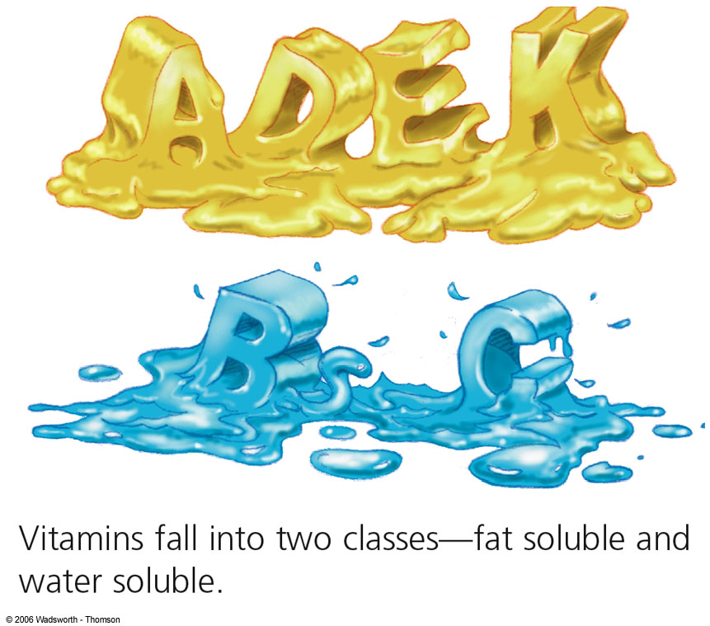
Fat-Soluble & Water-Soluble Vitamins
Fat-soluble vitamins
  Vitamins ___________
Water-soluble vitamins
  ___ vitamins (thiamin [B1], riboflavin [B2], niacin [B3], folate, B12, B6, biotin, pantothenic acid
  Vitamin ___
Factors that destroy vitamins
  Acids, bases, ________, UV light, ______
FN1021 – Chapter 7

Slide 4
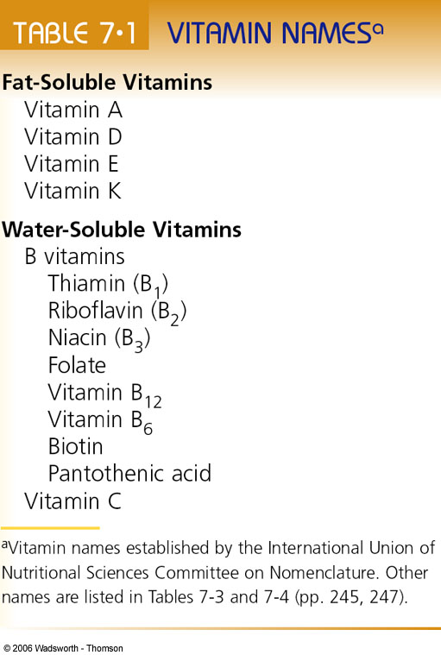
FN1021 – Chapter 7

Slide 5

Fat Soluble Vitamins
FN1021 – Chapter 7

Slide 6
Characteristics of Fat-Soluble Vitamins
Vitamins A, D, E, K
  Absorbed into the _______, travel in the blood in association with protein carriers
  Dissolve in _______
  Require ______ for absorption
  Stored in the liver & body tissues
  May be toxic in excess from supplements (A, D, K)
  Deficiencies occur with low intake or _____ malabsorption
FN1021 – Chapter 7

Slide 7
Vitamin A
FN1021 – Chapter 7

Slide 8
Vitamin A
Three active forms in the body
  _________ (stored in the liver),
  Retinal & retinoic acid (converted by cells from retinol)
_______________
  Plant-derived precursor
Good food sources
  Liver, fortified milk
  Deep _______ fruits/veggies & dark _____ leafy vegetables (sweet potatoes, carrots, squash, spinach, bok choy, broccoli, apricots, mango, cantaloupe)
FN1021 – Chapter 7

Slide 9
Beta-Carotene
Most abundant ________________ precursor for vitamin A
Dietary ______________
Measured in retinol activity equivalents (____)
  Convert B-carotene [& other carotenoids] to retinol
  Takes 12 ug B-carotene to equal 1 ug retinol for the body
FN1021 – Chapter 7

Slide 10
Beta-Carotene
B-carotene in excess
  ___________ compared to retinol
  Turns people bright ______________ if eaten in excess (due to build up in fat tissues beneath the skin)
Rich sources of B-carotene
  Carrots, sweet potatoes/yams, pumpkins, ________, cantaloupe, spinach, broccoli
  Other colorful veggies: red cabbage, beets, yellow corn, white yam = poor sources of B-carotene
FN1021 – Chapter 7

Slide 11
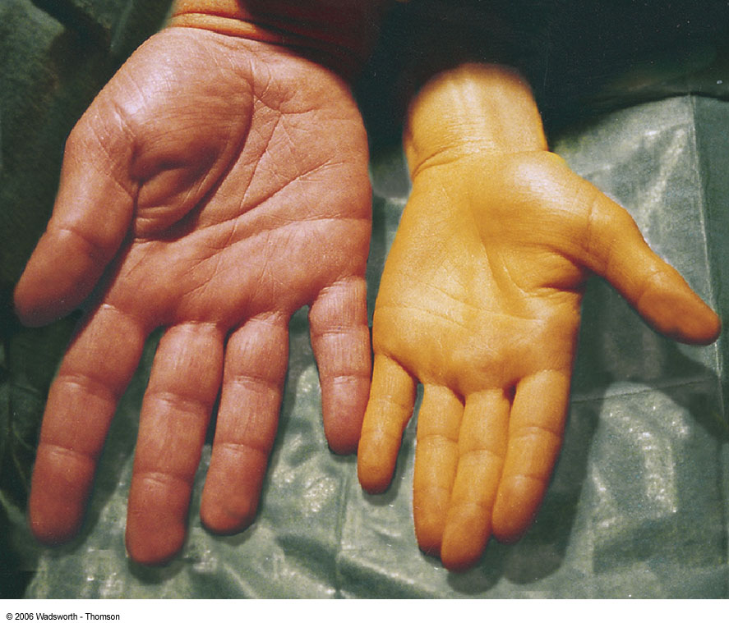
FN1021 – Chapter 7

Slide 12
Functions of Vitamin A
Eyesight and Vitamin A
  Light perception at the retina (pigment _________ contains vitamin A)
  Maintains healthy crystal-clear cornea
Process of Eyesight
  When light hits the eye, it bleaches the rhodopsin and a piece of vitamin A _________, which conveys the sensation of sight to the optic center of the brain
  New vitamin A is needed to replace the part that breaks off
  If deficient in vitamin A: lack in recovery of vitamin A = flash of light occurs = _____________________
FN1021 – Chapter 7

Slide 13
Vitamin A Deficiency & Eyesight
Progressive with Deficiency
  Keratinization of the cornea: protein “_____” accumulates in the cornea
  ___________: drying of the cornea
  Xerophthalmia: thickening of the cornea and permanent blindness
  _________ degeneration (in the elderly): loss of the central focus of vision in the retina; macula’s protective yellow pigment provided by B-carotene & other carotenoids
Prevention
  Capsules providing 60,000 ug 2x a year; regular intake of F&V
FN1021 – Chapter 7

Slide 14
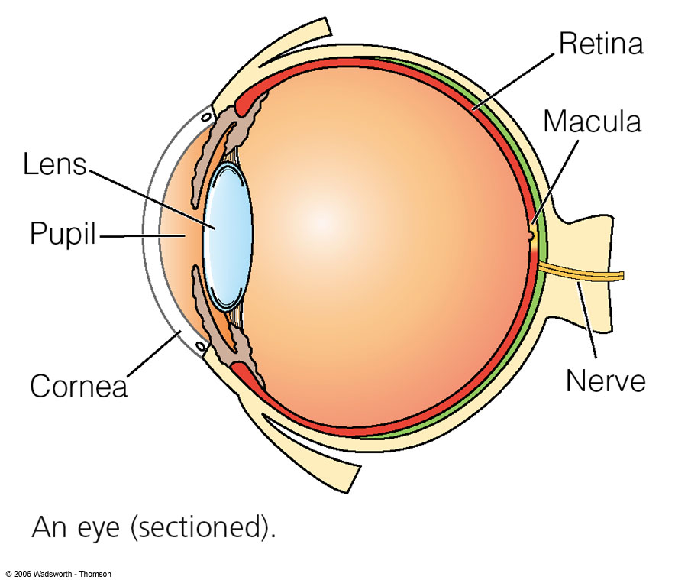
FN1021 – Chapter 7

Slide 15
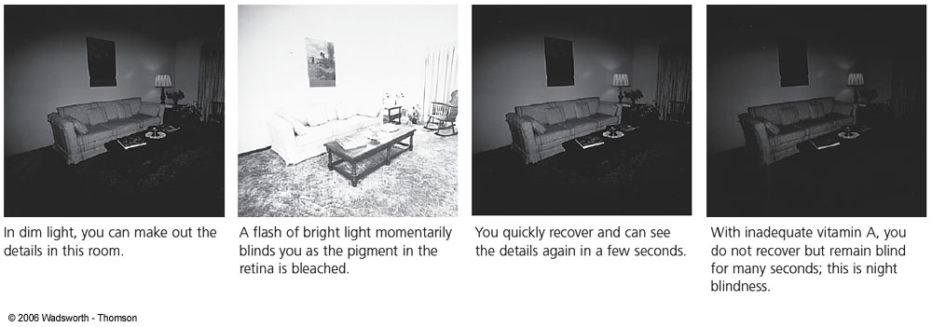
FN1021 – Chapter 7

Slide 16
Functions of Vitamin A
Gene expression
  ______________ regulates activities of genes that direct the synthesis of proteins & enzymes (thus, affecting metabolic activities of tissues)
  Analogy:
    Car alone can’t take you across town – need a key in the ignition to start the motor
    Having the machinery to make genes is not enough, need retonoic acid to activate and deactivate ________
FN1021 – Chapter 7

Slide 17
Functions of Vitamin A
Skin & body linings
  ____________ cells (external skin & protective linings of the lungs, intestines, vagina, urinary tract, & bladder) need vitamin A
  Serve as protective barriers to infection by bacteria and to damage from other sources
Major antioxidant
    ____________ (together with vitamins C & E, selenium)
FN1021 – Chapter 7

Slide 18
Functions of Vitamin A
_______________________
  Allows each type of cell to mature and perform a particular function, e.g., goblet cells produce mucus (in lungs) to protect it from respiratory infections
  Keratinization can occur in the wrong place (see next slide)
    Makes the surface hard/dry/cracked, which can increase risk of ______________
  Links to ______, esp. role of retinoic acid in regulating genes that may suppress or even reverse malignant cell changes
FN1021 – Chapter 7

Slide 19
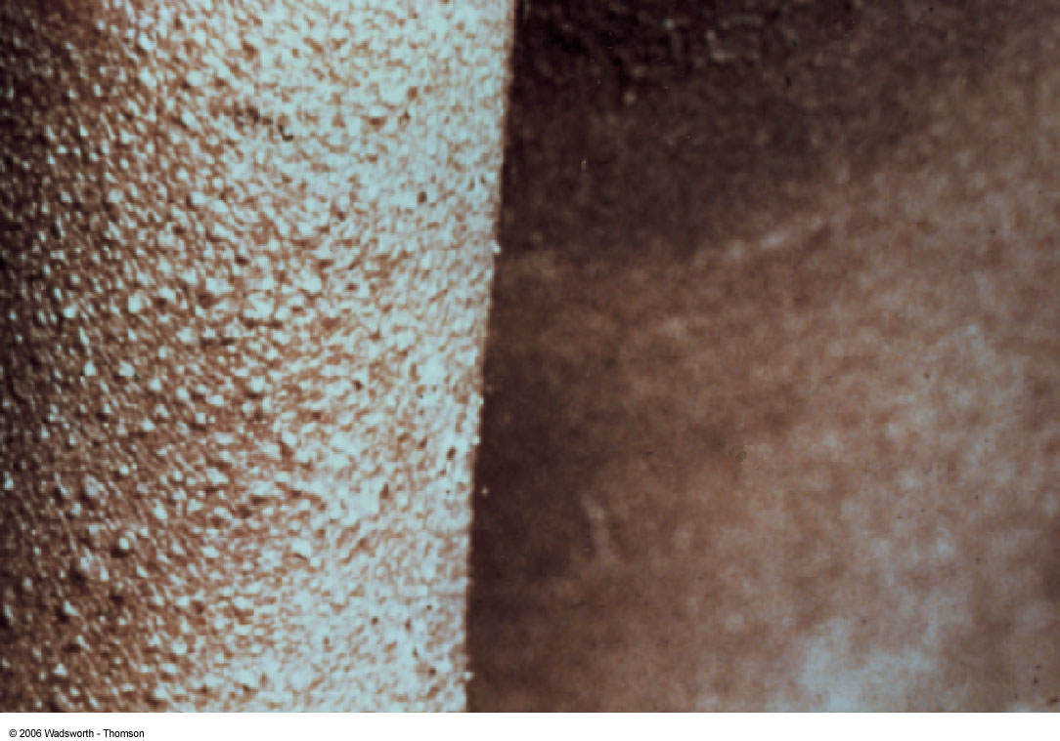
FN1021 – Chapter 7

Slide 20
Functions of Vitamin A
____________
  “Anti-infective” vitamin due to many roles in body’s defenses
  Epithelial tissue
  Regulation of genes that produce proteins involved in immunity
_________
  Assists in dismantling of bone for remodeling (supports bone growth)
  Deficiency in __________ evidenced in poor growth
FN1021 – Chapter 7

Slide 21
Vitamin A Recommendations
Amounts of vitamin A needed is proportional to _______________
RDA – 700 ug RAE/day (females); 900 ug RAE/day (males)
  RAE = retinol activity equivalents (considers amounts from B-carotene & precursors)
_________ in the body, so average intake does not need to be from daily intake, but overall intake
FN1021 – Chapter 7

Slide 22
Vitamin A Recommendations
UL – 3000 ug RAE/day
  From ________ (preformed vitamin) only – avoid supplements exceeding this (adults 18 yrs +)
IU (international unit) = 0.3 ug retinol
  Ensure you convert appropriately between food and supplements
Recommendations easily reached through _____ ______ in healthy balanced diet from retinol and beta-carotene
FN1021 – Chapter 7

Slide 23
Vitamin A Toxicity
Via __________ or _______________ (and liver)
Early symptoms of overdose
  Loss of appetite, blurred vision, growth failure in children, headache, itching of the skin, irritability, ________________
Other signs
  Abdominal pain, hair loss, joint pain, stunted growth, bone & muscle soreness, cessation of menstruation, nausea, diarrhea, rashes, damage to the liver, enlargement of the spleen
FN1021 – Chapter 7

Slide 24
Vitamin A Toxicity
3-4x RDA in pregnancy
  ________ to fetus (malformations); single dose of 100x will cause toxic reactions; beware of heavily fortified foods!
________
  Vitamin A will not cure acne
  Accutane derived from vitamin A but chemically altered & doses controlled
Increased activity of bone-dismantling cells - reduced bone density & pain
FN1021 – Chapter 7

Slide 25
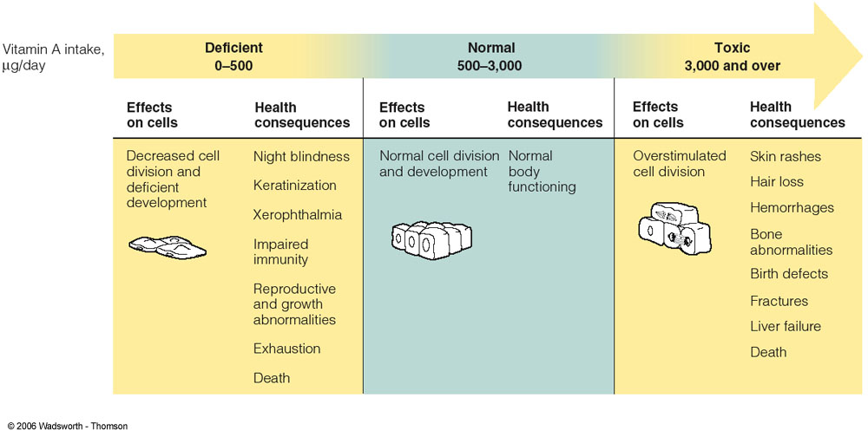
FN1021 – Chapter 7

Slide 26
Vitamin A Deficiency in the World
Vitamin A deficiency statistics
  3-10M children suffer from ________________, diarrhea, reduced food intake
  275M children suffer from milder deficiency (impairs immunity & promotes infections)
Vitamin A supplementation
  Recommended for protection against _______, malaria, lung diseases, HIV
  Countries with Vit. A supplementation = child mortality cut in half
WHO & UNICEF
  Lead international agencies fighting against Vit. A deficiency
FN1021 – Chapter 7

Slide 27
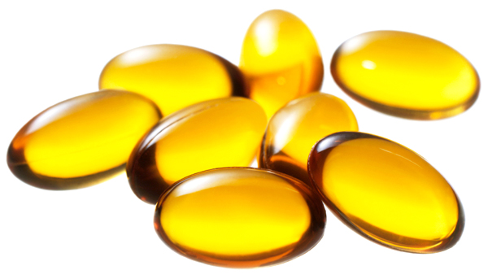
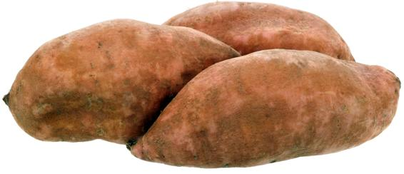
Vitamin A Deficiency in the World
Vitamin A ______________
Orange Flesh ______________
FN1021 – Chapter 7

Slide 28
Vitamin D
FN1021 – Chapter 7

Slide 29

Vitamin D
Body can synthesize it with the help of _______
  UV light shines on 7-dehydrocholesterol in the skin
  7-DC transformed to inactive vit. D3 precursor absorbed directly into the blood
  ______ & _______ convert precursor to active 1,25-hydroxy vit. D3
FN1021 – Chapter 7

Slide 30
Vitamin D Functions
Functions relate to ________ balance & ______ health
  Helps with absorption of dietary Ca & P (from skeleton, digestive tract, kidneys) to maintain bone integrity
  Acts as a _________ to raise level of blood Ca when dietary Ca is lacking
  Affects health of bones & teeth (ensures sufficient Ca & P available in blood)
Also stimulates maturation of _____, especially cells of the immune system to fight off infections & some cancers (colon, prostate)
FN1021 – Chapter 7

Slide 31
Vitamin D Recommendations
AI – 15 μg/day (600 IU/day) from ages 1-70 yo, 20 μg/day (800 IU/day) for ages > 70 yo
  The DRIs for vitamin D are set based on the assumption of _________________________
UL – 100 μg/day (4000 IU/day)
Vitamin D conversion factor
  1 μg = ____ IU
Good food sources
  Fortified milk, _________, shrimps, fortified soy beverages
FN1021 – Chapter 7

Slide 32

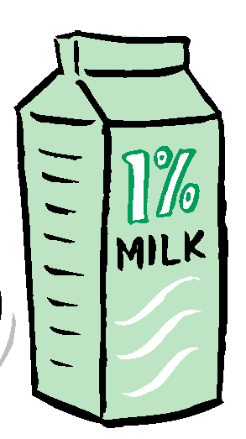
Vitamin D Health Claims
Diet-related ______ ______
  “A healthy diet with adequate ___ & vit D & regular PA helps to achieve strong bones & may reduce the risk of osteoporosis.”
  “Vit D helps in the absorption & use of Ca & ___.”
FN1021 – Chapter 7

Slide 33
Vitamin D Deficiency Symptoms
____________ in children
  Protruding or ‘pigeon’ chest, beaded ribs, protruding belly, bowed legs
  All breastfed healthy term infants supplemented with ___ μg of vitamin D
____________ in adults
  Weak or soft bones in the legs & spine
FN1021 – Chapter 7

Slide 34
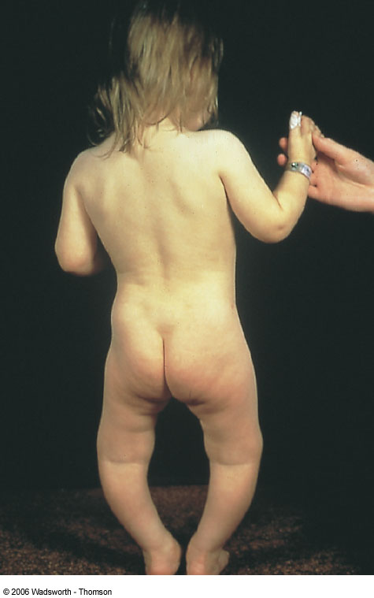
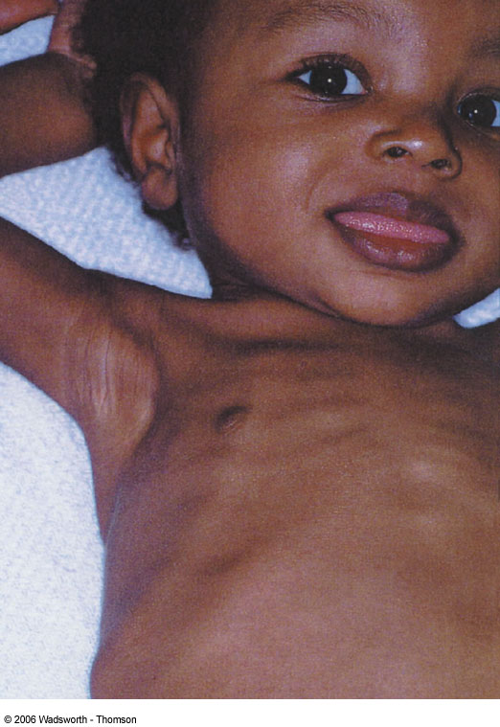
FN1021 – Chapter 7

Slide 35
Vitamin D Toxicity Symptoms
Vitamin D toxicity
  Most potentially _____ of the fat-soluble vitamins; excess can cause loss of appetite, N & V, severe psychological depression, ___ deposits in heart, arteries, kidneys, brain, nerves, bones
  Intakes ___x - associated with toxicity; problems with over-supplementation & wrong fortification doses
FN1021 – Chapter 7

Slide 36
Factors Affecting Sun Exposure & Vitamin D Synthesis
Air pollution: clouds, smog, smoke
City living: tall buildings, window glass, window screen
__________: darker vs. lighter colours
Homebound / institutionalized / night shift work
Dark skin: need longer exposure vs. lighter skin
_________: warmer summers; no risk of toxicity from sunlight
Sunscreen: SPF____ prevents synthesis
______________: mid-day hours are best
Geography: lack of direct sunlight, Sept. – March (Canada), Nov. – Feb. (USA)
Sunbathing: risks of premature wrinkling, skin cancer
FN1021 – Chapter 7

Slide 37
Vitamin E
FN1021 – Chapter 7

Slide 38
Vitamin E
Need for vitamin E increases as intakes of ________ increases (anti-oxidant function)
_____ destroys vitamin E, therefore no vitamin E from the oils in in fried foods
Good food sources
  _________ oils (canola, safflower), products made from these oils (salad dressings), nuts & seeds (sunflower), fortified cereals, wheat germ
  Note: ________ fats are not a good source
FN1021 – Chapter 7

Slide 39
Vitamin E Recommendations
DRI – 15 mg/day (α-___________ equivalent)
UL – 1000 mg/day (supplemental α-TE & fortified foods)
Vitamin E conversion factor
  1 a-TE = 1 mg active vitamin E
  To find IU, divide a-TE by ____
FN1021 – Chapter 7

Slide 40
Vitamin E Functions
______________
  Body’s defender against oxidative damage from free radicals
  Protects all ________ & related compounds (e.g. vitamin A) from oxidation (by itself being oxidized)
  Special anti-oxidant effect in ______ (cells exposed to high O2 concentrations) & _______
Helps defend against CVD & some cancers; assists normal nerve development; protects WBCs against disease
Supplements found to improve immunity response among healthy elderly
FN1021 – Chapter 7

Slide 41
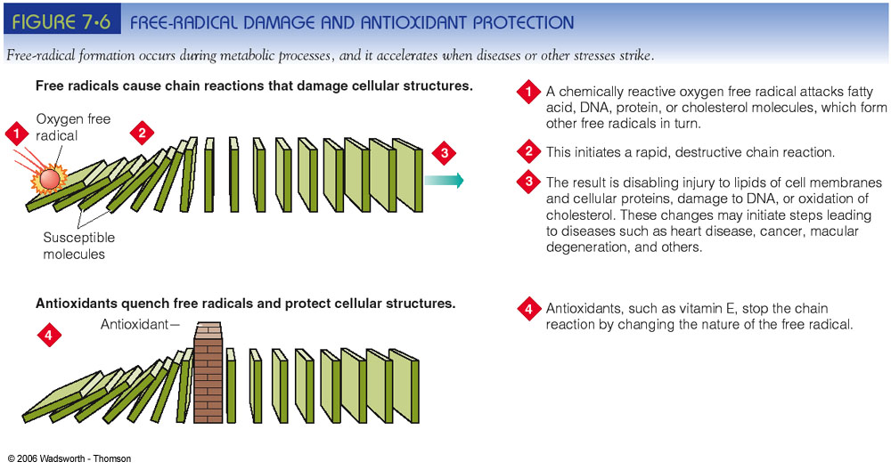
FN1021 – Chapter 7

Slide 42
Vitamin E Toxicity
Population at risk
  Those taking _______________ medication used to oppose unwanted blood clotting (risk of uncontrollable bleeding); vitamin E ___________ effects of anti-coagulants = blood may become too thin
For some, long-term use of even low doses of vitamin E is linked to brain _____________ (a form of stroke)
FN1021 – Chapter 7

Slide 43
Vitamin E Deficiency Symptoms
_____ deficiencies in humans
  Vitamin E found in so many foods; body stores readily in tissues; cells _________ their working supply of vitamin E
Classic deficiency in __________ babies
  Babies born before transfer of vitamin E from mother to fetus in last weeks of pregnancy
  RBCs rupture (erythrocyte hemolysis) & infant becomes _________
Few deficiency symptoms in ________
  Loss of muscle coordination & reflexes; impaired movement, vision, speech – corrected by vitamin E treatment
FN1021 – Chapter 7

Slide 44
Vitamin E Deficiency Symptoms
Vitamin E deficiency associated with _____ malabsorption
  Due to disease or injury to the liver (bile production), gall bladder (delivery of bile to the intestines), pancreas (production of lipases)
  Deficiencies most likely seen in those who for years eat diets extremely low in fat, use fat ________ (e.g. diet margarines, fat-free salad dressings), consume diets of highly processed or ‘convenience’ foods
Vitamin E and athletic performance
  Research has ___________ claims that vitamin E improves athletic endurance & skill, enhances sexual performance, or cures sexual dysfunction in males
FN1021 – Chapter 7

Slide 45
Vitamin K
K stands for the Danish word “Koagulation” (clotting)
FN1021 – Chapter 7

Slide 46
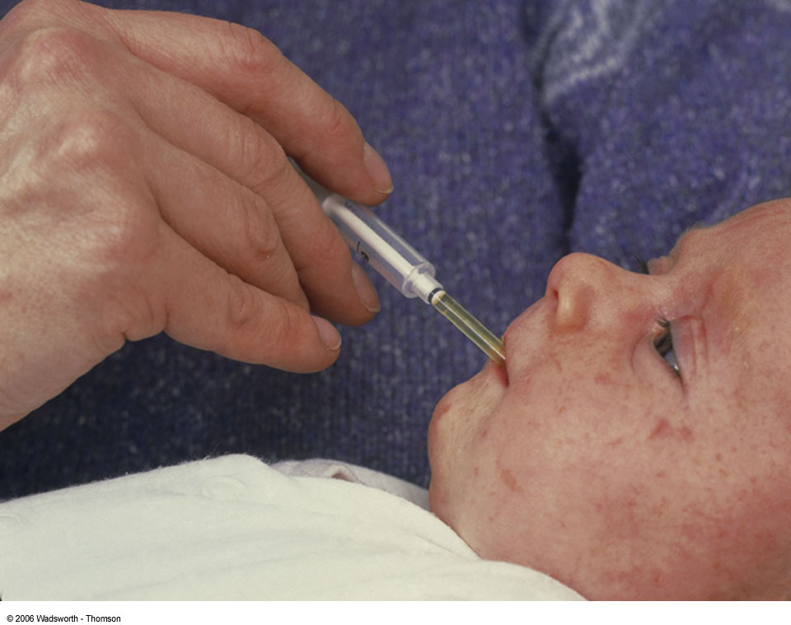
Vitamin K
Vitamin K and infants
  At _______ newborns are given a dose of vitamin K to hold them until vitamin K producing __________ establish themselves in their intestinal tract (occurs after a few weeks of life)
FN1021 – Chapter 7

Slide 47
Vitamin K
AI – 90 ug/day (females); 120 ug/day (males)
UL – not determined
Good food sources
  Dark green leafy vegetables (spinach), _________ family, broccoli, cauliflower, Brussels sprouts, liver, eggs, milk, canola & soybean oils
  Also synthesized from ____________________
Those taking ____________ that kill intestinal bacteria may be at risk
FN1021 – Chapter 7

Slide 48
Vitamin K Functions
Help synthesize proteins that _____ ______
  Measured before surgery and may supplement if levels are low
  Needed by people taking “__________” or dicumarol if uncontrolled bleeding occurs
    Dicumarol used for ‘thinning’ the blood to prevent formation of blood clots
Necessary for the synthesis of protein needed in bone formation together with vitamin ___
  May play a part in reducing hip fractures
FN1021 – Chapter 7

Slide 49
Vitamin K Toxicity
Toxicity with supplements of ________ version if given to ________ or ___________ women
Toxic symptoms
  _________ skin due to breakage of RBCs
  Liver releases bilirubin into the blood instead of excreting it into the bile (__________)
  May result in brain damage or death of infants
FN1021 – Chapter 7

Slide 50
Homework
Read Chapter 7
Assignment 2 – varying due dates
Prepare for the December Exam (Mon. Dec. 17, 2012 @ 2pm, worth 25%)
FN1021 – Chapter 7

Slide 51
Chapter 7: The Vitamins
(continued)
Professor Jennifer Broxterman, MSc, RD
Department of Foods & Nutritional Sciences
Brescia University College
FN1021: Nutrition for Modern Living

Slide 52
Water soluble vitamins
FN1021 – Chapter 7

Slide 53
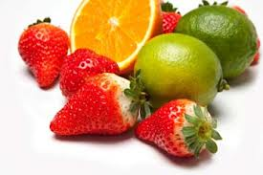
Water-Soluble Vitamins
___ vitamins and vitamin ___
  Dissolve in water; cooking & washing with water can ______ them out of foods
  Easily absorbed into the bloodstream & excesses excreted in the _______
  Not stored extensively in body tissues
  __________ reach toxic levels
  High doses of supplements = expensive urine
FN1021 – Chapter 7

Slide 54
Vitamin C
FN1021 – Chapter 7

Slide 55
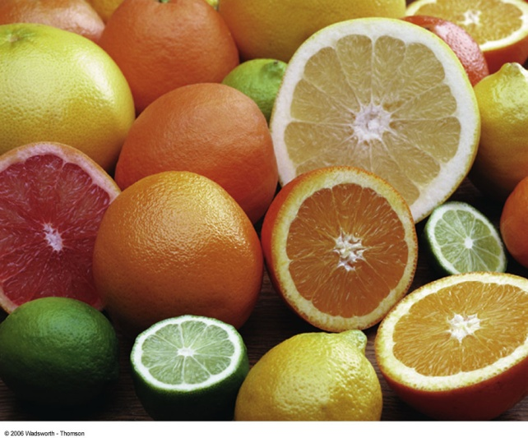
Vitamin C Requirements
__________ acid; ‘no-scurvy acid’
RDA – 75 mg/day (females); 90 mg/day (males)
  +____mg/day for smokers (smoking introduces oxidants)
  Max. plasma levels reached with 60-100 mg/day, then urine levels rise sharply
  Canadians consume ~ 100 mg/day
UL – 2000 mg/day
  Acts as a _______________
FN1021 – Chapter 7

Slide 56
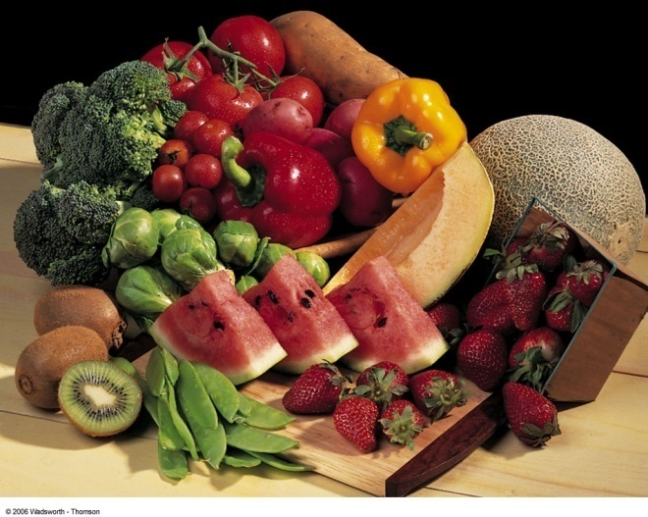
Vitamin C Food Sources
Good food sources
  ________ fruits (grapefruit), OJ, strawberries, red & green bell peppers, __________, bokchoy, sweet potato
  Many fortified products available (e.g. Rose Hips)
Sample vitamin C-rich day
  300 mg of vitamin C in a day:
    250 mL orange juice for breakfast
    Salad for lunch
    Stalk of broccoli
    A potato for dinner
FN1021 – Chapter 7

Slide 57
Vitamin C Functions
Antioxidant
  Prevents oxidation and cell damage
  Protects and recycles vitamin ___ to its active form
Supports ______ absorption
  Keeps _______________ in the form needed for absorption
Structural role
  Causes __________ formation in bones, teeth, tendons
  Collagen forms scar tissue, offers structure to mend fractures, supporting material for capillaries (prevents bruises)
FN1021 – Chapter 7

Slide 58
Vitamin C Functions
Affects health of _______ and _______
Co-factor
  Vitamin C acts as a co-factor in producing _______, which is important for transporting fatty acids within cells
FN1021 – Chapter 7

Slide 59
Vitamin C & the Common Cold
Vitamin C and the common cold
  __________ supported by research
  May experience milder symptoms and a cold that lasts a shorter duration
Two grams of vitamin C per day for two weeks seems to reduce blood ___________
  The substance responsible for sneezing, runny or stuffy nose, swollen sinuses
  At these doses, vitamin C may work like a weak antihistamine
  Or its ____________ or other activities may improve the body’s immunity
FN1021 – Chapter 7

Slide 60
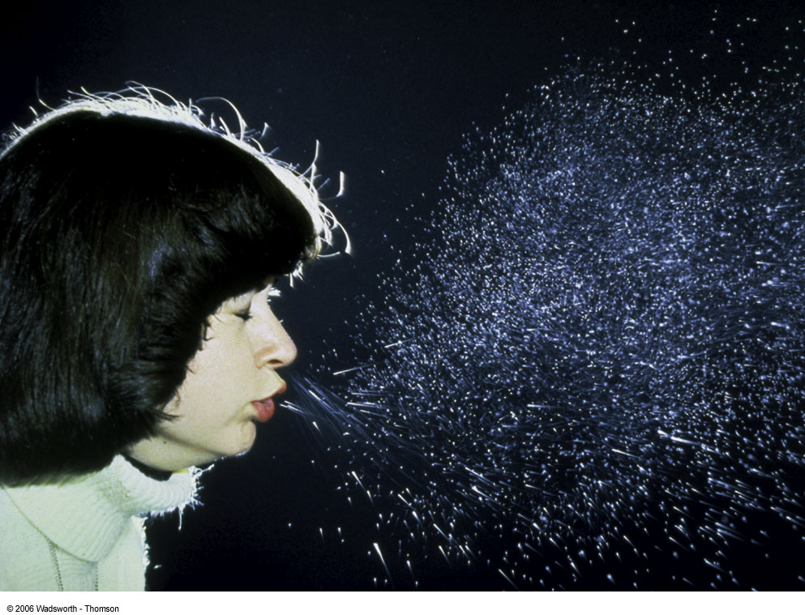
Vitamin C & the Common Cold
The _________ effect
  In one study, half the experimental subjects received a placebo but thought they were receiving vitamin C
  This group reported having fewer colds than the group that had received the vitamin C but they they were receiving the placebo
FN1021 – Chapter 7

Slide 61
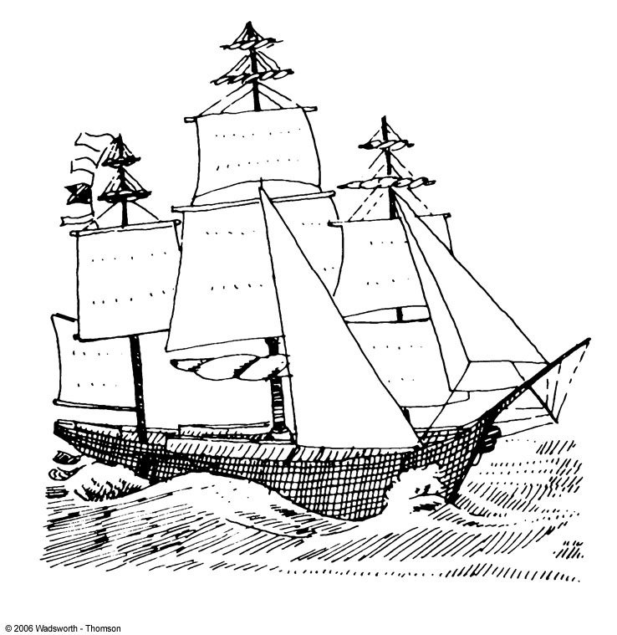

Vitamin C Deficiency
_________
  Vitamin C (ascorbic acid) deficiency
  Hazard of long distance seagoing journeys of 200+ years ago
  To avoid scurvy, British sailors were given ____________
FN1021 – Chapter 7

Slide 62
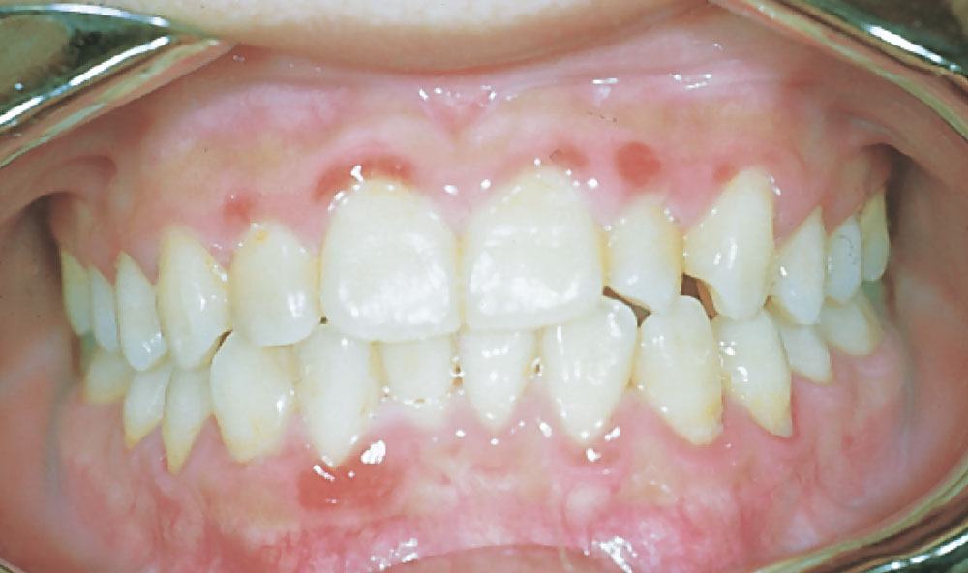
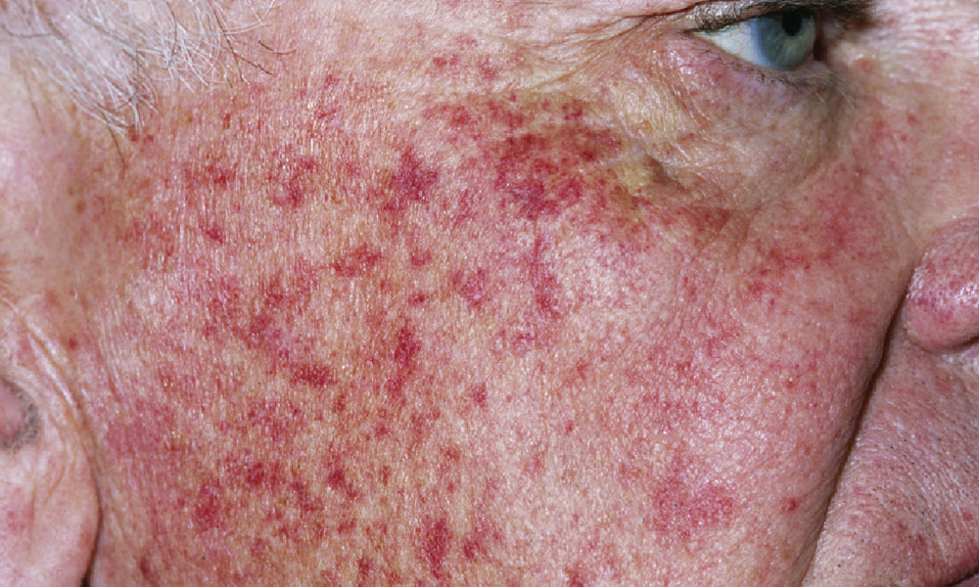
Vitamin C Deficiency
Deficiency symptoms
  _________
  Loss of appetite
  Bleeding _______
  Growth cessation
  Tenderness to touch
  Weakness
  Swollen ankles & joints
  Pinpoint _______________
  Anemia
FN1021 – Chapter 7

Slide 63
Vitamin C Toxicity
Too much vitamin C
  ____________
  Activates oxidizing elements (_____ & ________)
  Dangerous in cases of iron overload
  Altered _______ response to CHO
  Digestive upsets (nausea, abdominal cramps, excessive gas, diarrhea)
  May interfere with medications to prevent blood clotting
FN1021 – Chapter 7

Slide 64
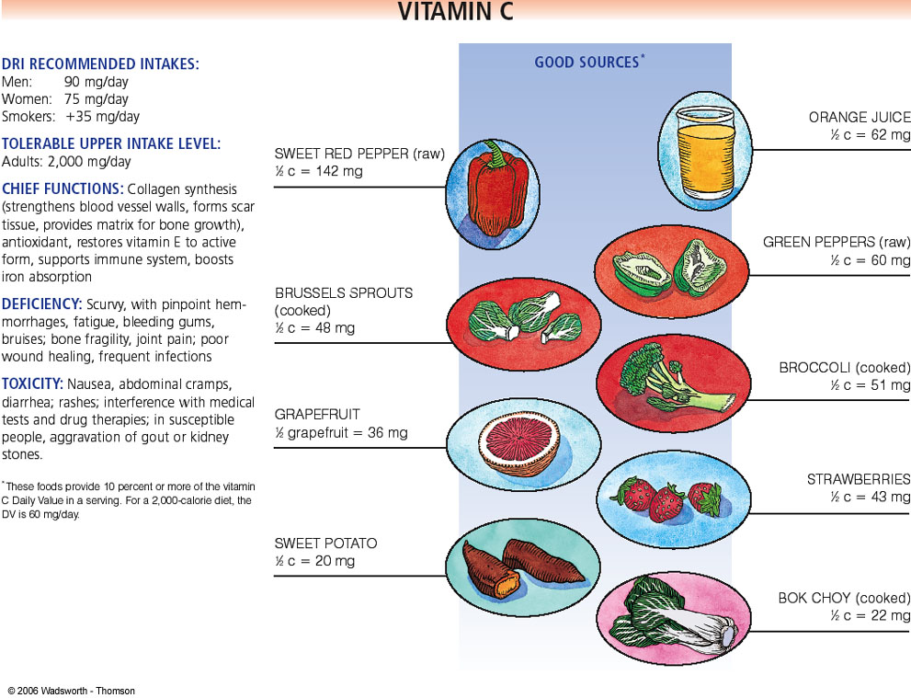
FN1021 – Chapter 7

Slide 65
B Vitamins
FN1021 – Chapter 7

Slide 66
B Vitamins
Check Fig 7.10 of text
Examples of roles of B vitamins in metabolism
  B vitamins are ‘helper’ nutrients; directly or indirectly help the body use energy from _____________________
  Thiamin, riboflavin, niacin, pantothenic acid, and biotin all participate in the release of energy from protein, CHO, & fat
  Vitamin B6 helps the body use AA to make protein
  Folate & vitamin _____ help cells __________
FN1021 – Chapter 7

Slide 67
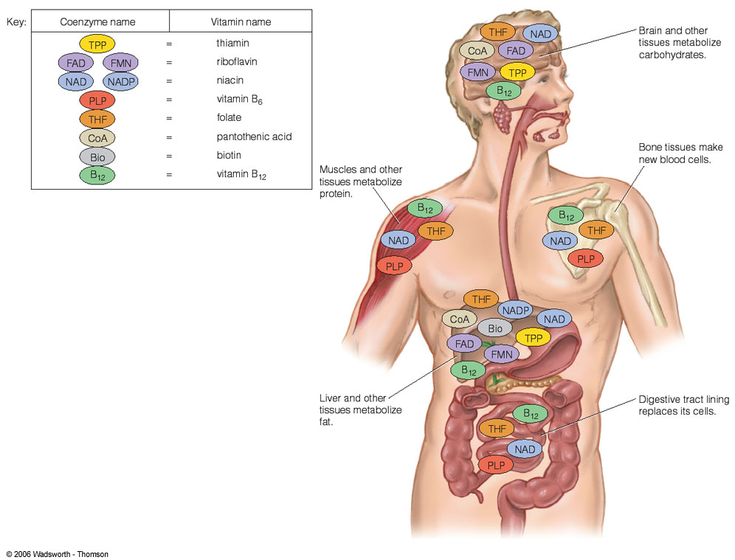
FN1021 – Chapter 7

Slide 68
B Vitamin Deficiencies
General symptoms of B vitamin deficiencies include
  Nausea, severe ____________, irritability
  Depression, forgetfulness, loss of appetite & weight
  Pain in ________, impairment of the immune response, loss of control of the limbs, abnormal heart action
  Teary or bloodshot eyes, swollen red tongue, severe skin problems
  Cell renewal of the digestive tract & _______ affected
A deficiency of any one B vitamin seldom shows up by itself, since nutrients are not eaten singly
FN1021 – Chapter 7

Slide 69
Thiamin (Vitamin B₁)
Functions
  ____________ in energy (CHO & protein) metabolism
  Thiamin helps release energy from _________
  Affects nerve function (special site on nerve cell membrane)
  Needed for metabolism of _________
Good food sources
  ___________, enriched cereals/wheat flour, pork chop, legumes (black beans), green peas, sunflower seeds
FN1021 – Chapter 7

Slide 70
Thiamin (B₁) Requirements
RDA – 1.1 mg/day (females); 1.2 mg/day (males)
  0.8 mg/day minimum
  Needs increase with increased ________ intake
UL – not determined
FN1021 – Chapter 7

Slide 71
Thiamin (B₁) Deficiency
___________ (wet or dry)
  Characterized by loss of sensation in the hands and feet; muscular weakness; advancing _________; abnormal heart action in adults; during growth, permanent _______ damage may result
___________________ syndrome
  Affects brain tissues; associated with alcohol abuse; characterized by apathy, irritability, mental confusion & disorientation, loss of memory, jerky eye movements, staggering gait
FN1021 – Chapter 7

Slide 72
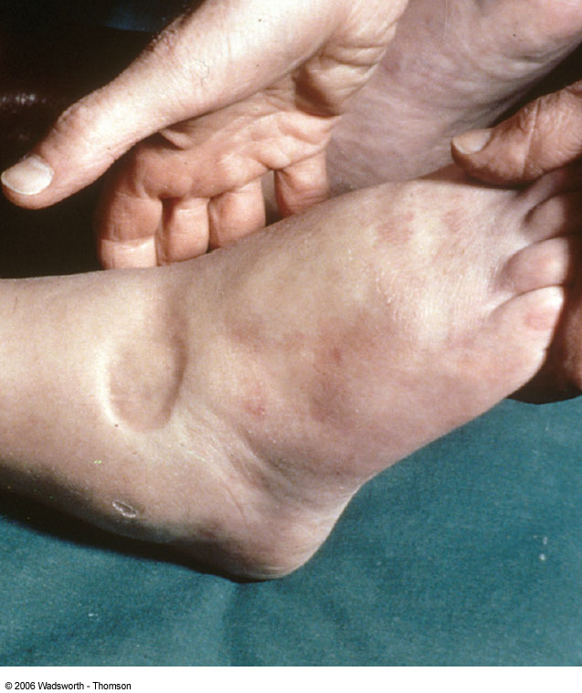
FN1021 – Chapter 7

Slide 73
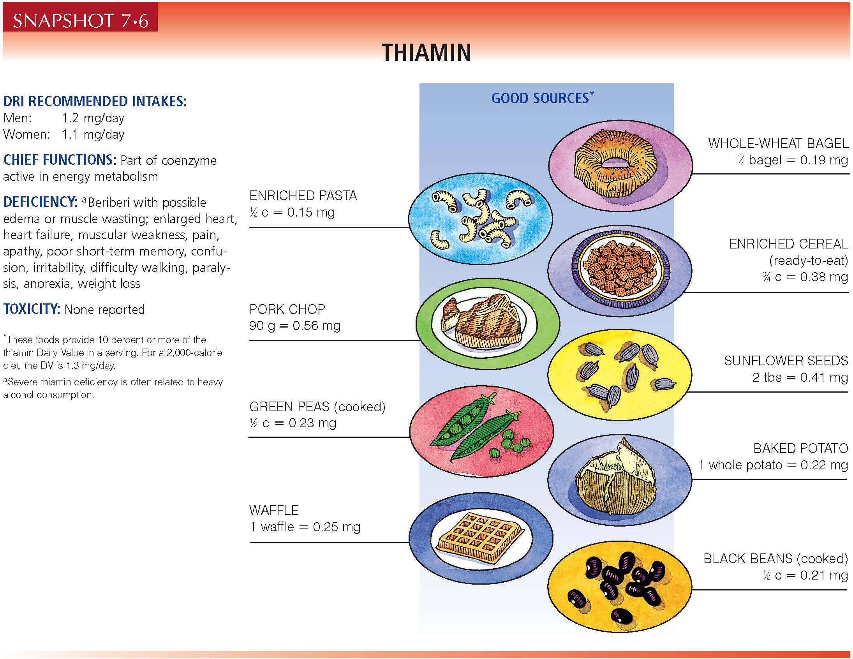
FN1021 – Chapter 7

Slide 74
Riboflavin (Vitamin B₂)
Functions
  Co-enzyme for energy (CHO, fat, & protein) metabolism
  Protects skin & eyes; interacts with vitamin ___ & folic acid
Good food sources
  Whole grains & enriched cereals, milk & milk products (yogurt), ______, meats (beef liver), green leafy vegetables (spinach/kale), ____________
FN1021 – Chapter 7

Slide 75
Riboflavin (B₂) Requirements
RDA – 1.1 mg/day (females); 1.3 mg/day (males)
  Needs increase with increased ________ intake
  When _________ is deficient, riboflavin may also be lacking
UL – not determined
FN1021 – Chapter 7

Slide 76
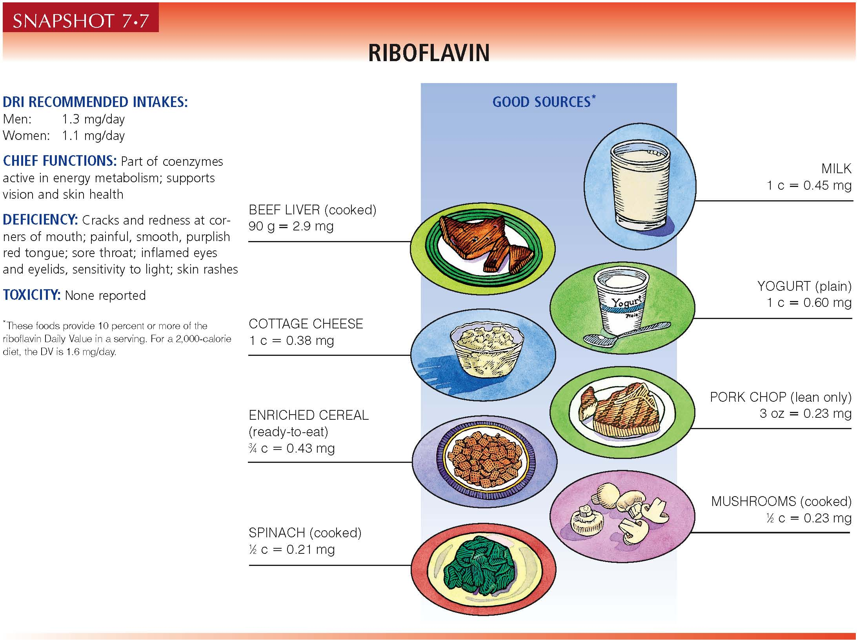
FN1021 – Chapter 7

Slide 77
Niacin / Nicotinic Acid (Vitamin B₃)
Functions
  Co-enzyme for energy (CHO, protein, fat, & alcohol) metabolism
  Needed in >40 reactions
  Interacts with vitamin A in ________ cycle
Good food sources
  ____, fish, nuts, whole grains, enriched cereals, mushrooms, baked potato, tuna
  Adequate _________ intake = no niacin deficiency
  Diet of corn meal, salted pork fat, molasses = deficiency
FN1021 – Chapter 7

Slide 78
Niacin (B₃) Requirements
RDA – 14 mg/day (females); 16 mg/day (males)
  Niacin equivalents: some can be made from ____________
  Needs increase with increased energy & _________ intakes
UL – 35 mg/d (from fortified foods & supplements)
Niacin excess 2-3x DRI
  ______________: dilation of the capillaries of the skin with painful tingling
  Drug-like effect: large doses given for atherosclerosis and diabetes; could injure the liver, cause peptic ulcers, and vision loss
FN1021 – Chapter 7

Slide 79
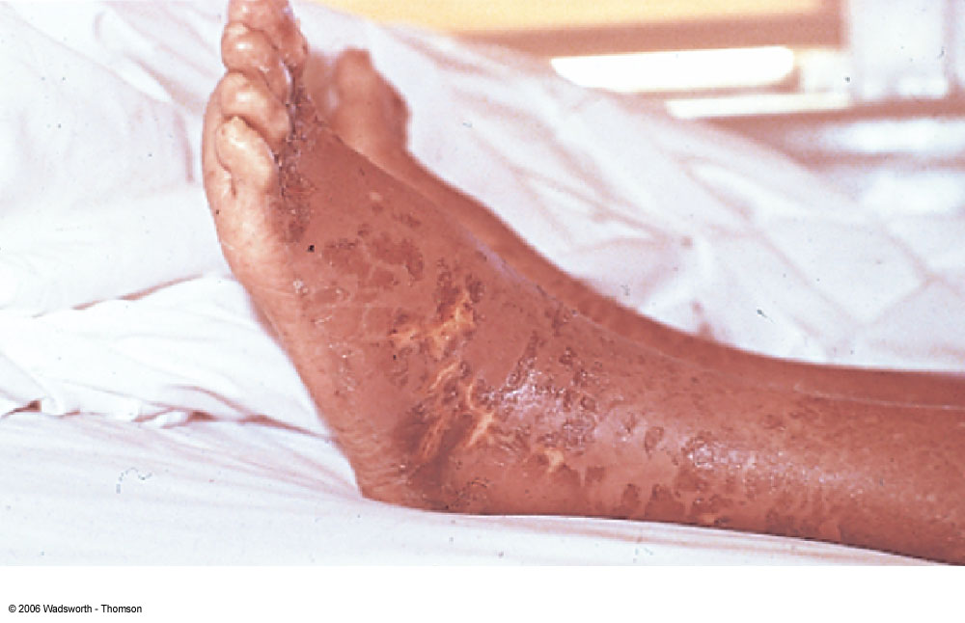
Niacin Deficiency
Pellegra
  4D’s = __________________________________________
  Can be prevented by adequate protein because tryptophan can be converted to niacin in the body
FN1021 – Chapter 7

Slide 80
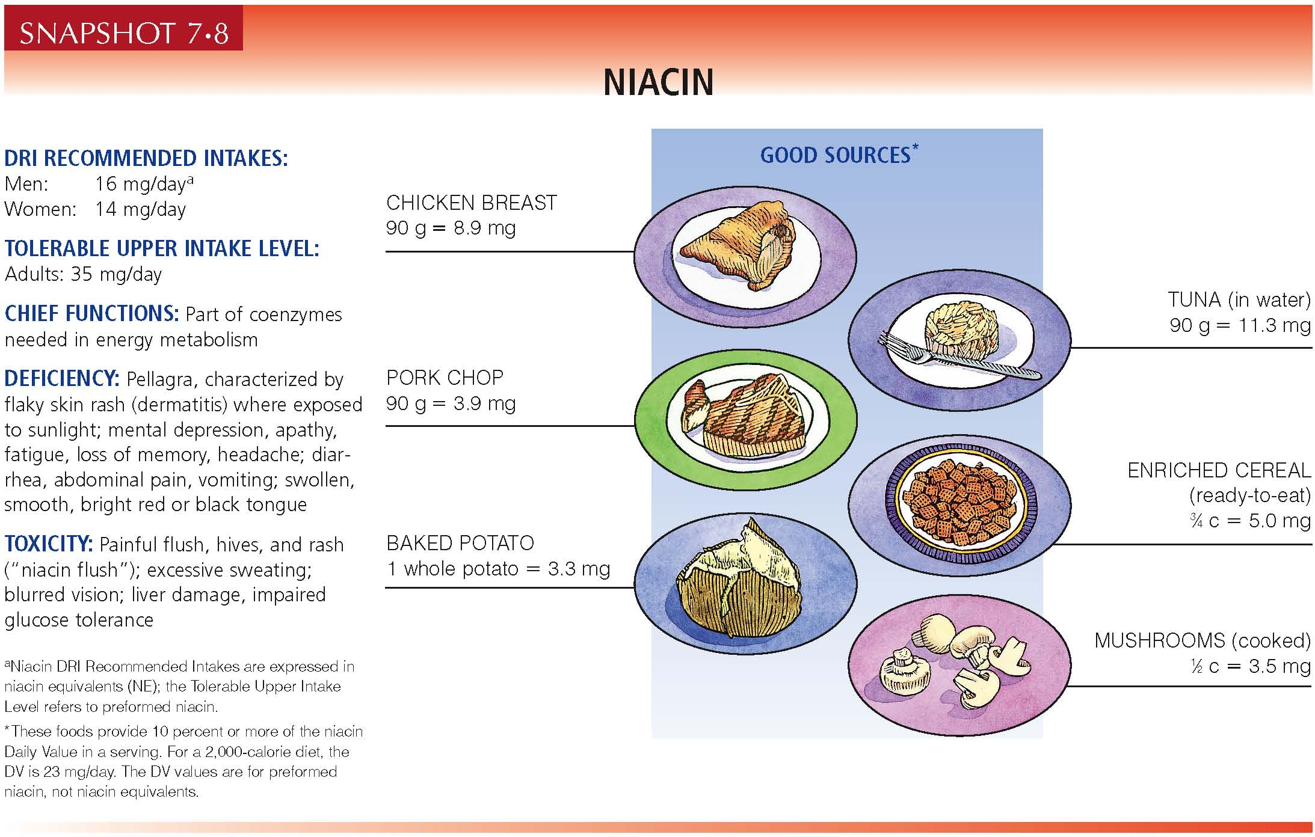
FN1021 – Chapter 7

Slide 81
Folic Acid / Folate / Folacin
Functions:
  Required to make all new cells (_____ cells & digestive tract most vulnerable to deficiency)
  Aids metabolism of _____ & _____ (genetic material)
  Aids homo-cysteine metabolism (increased blood levels highly correlated with CVD)
  Prevents folate-deficiency anemia (related to pernicious anemia of vit B12 malabsorption)
Good food sources
  Green leafy vegetables (spinach, kale), ______, pinto beans, asparagus, avocado, beets, beef liver, enriched grains, cantaloupe, orange juice
FN1021 – Chapter 7

Slide 82
Folate Recommendations
RDA – 400 μg/day
  Peri-conceptual nutrition = 400 μg/day (from synthetic form, folic acid) reduces the risk of _______
  RDA in _____________ = 600 μg/day
  RDA during lactation = 500 μg/day
  DFE = dietary folate equivalents
UL – 1000 μg/day (from synthetic forms only; supplements & fortified foods)
  High intake can _____ blood symptom of vit ____ deficiency, but will not prevent nerve damage
FN1021 – Chapter 7

Slide 83
Folate Deficiency
_______, diminished immunity, abnormal digestive function
Elevated risk for ____ & colon cancer, & cervical cancer in women
Neural tube defects (NTDs)
  __________, anencephaly, mental retardation, severely diminished brain size, death shortly after birth
Low RBC levels along with high plasma H-Cys
Deficiencies may result from inadequate intake, illnesses, excretion, medication interactions (aspirin, anti-convulsants, barbiturates, antacids)
FN1021 – Chapter 7

Slide 84
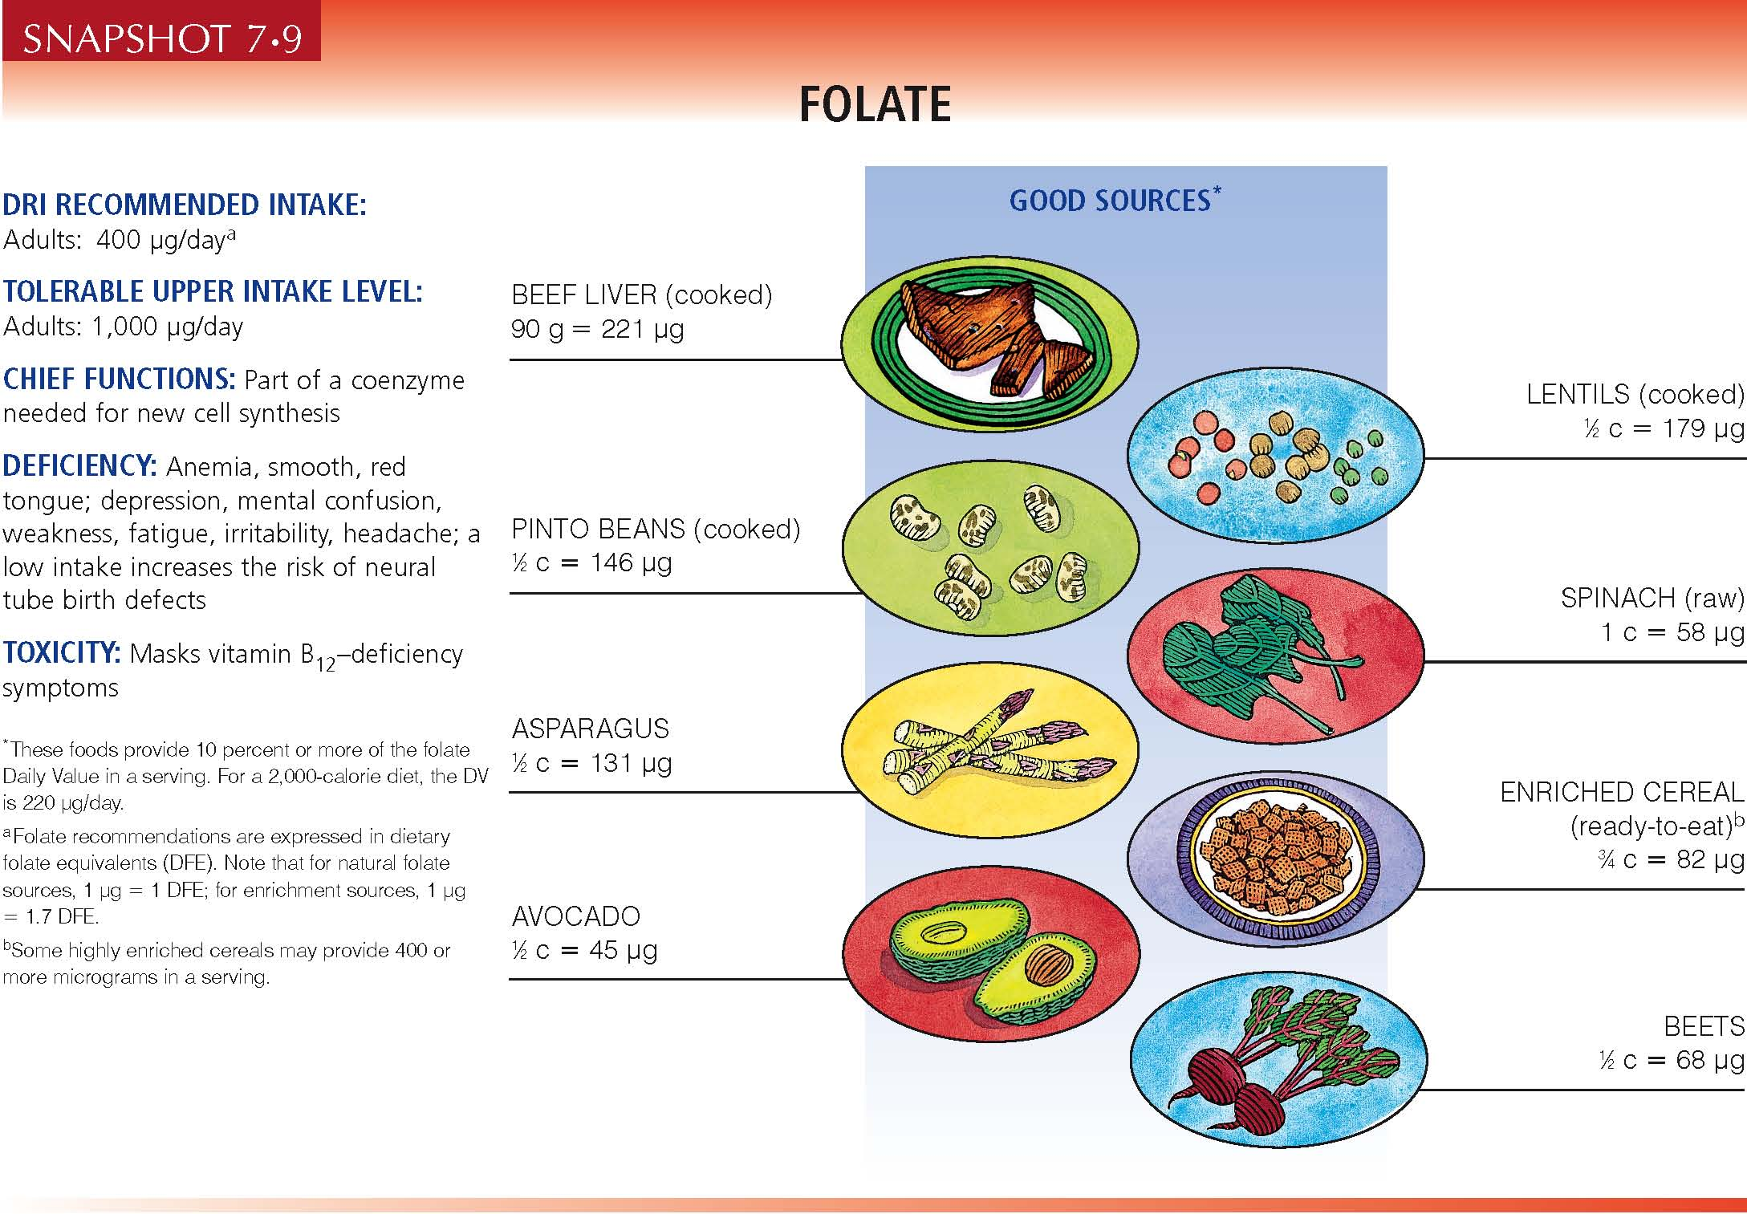
FN1021 – Chapter 7

Slide 85
Vitamin B₁₂ / Cobalamin
Functions
  Converts _______ to its active form
  Helps folate make _______
  Aids DNA & RNA metabolism
  Maintains nerve fiber sheaths
Good food sources
  Foods of _________ origin (chicken liver, sirloin steak, pork roast, Swiss cheese, cottage cheese, sardines, tuna)
Absorption requires _____________ (IF) from stomach lining
  What if this is lacking?
FN1021 – Chapter 7

Slide 86
Vitamin B₁₂ Recommendations
RDA – 2.4 μg/d
UL – not determined
Deficiency – ____________________
  Large immature ______
  Damaged nerve sheaths
  Creeping __________
  General malfunctioning of nerves & muscles
Who is at risk for inadequate intake?
FN1021 – Chapter 7

Slide 87
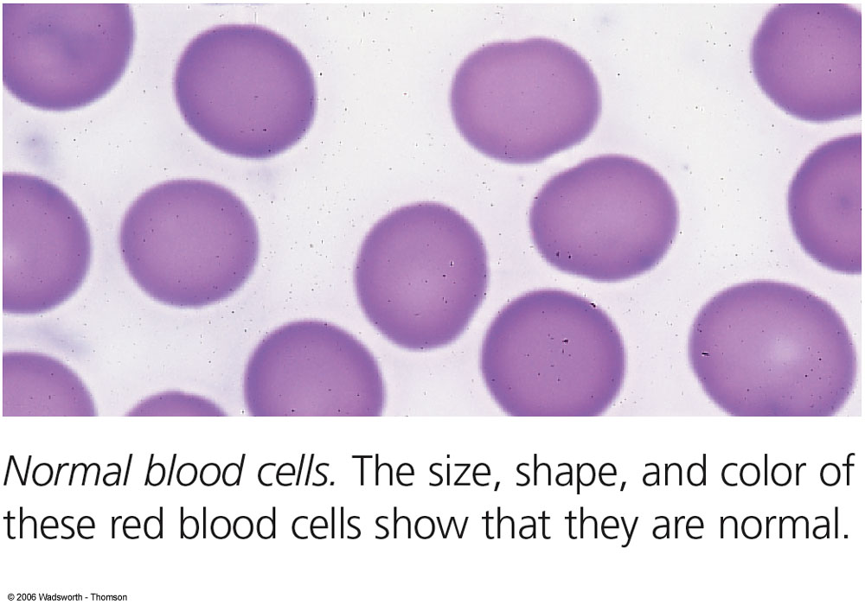
FN1021 – Chapter 7

Slide 88
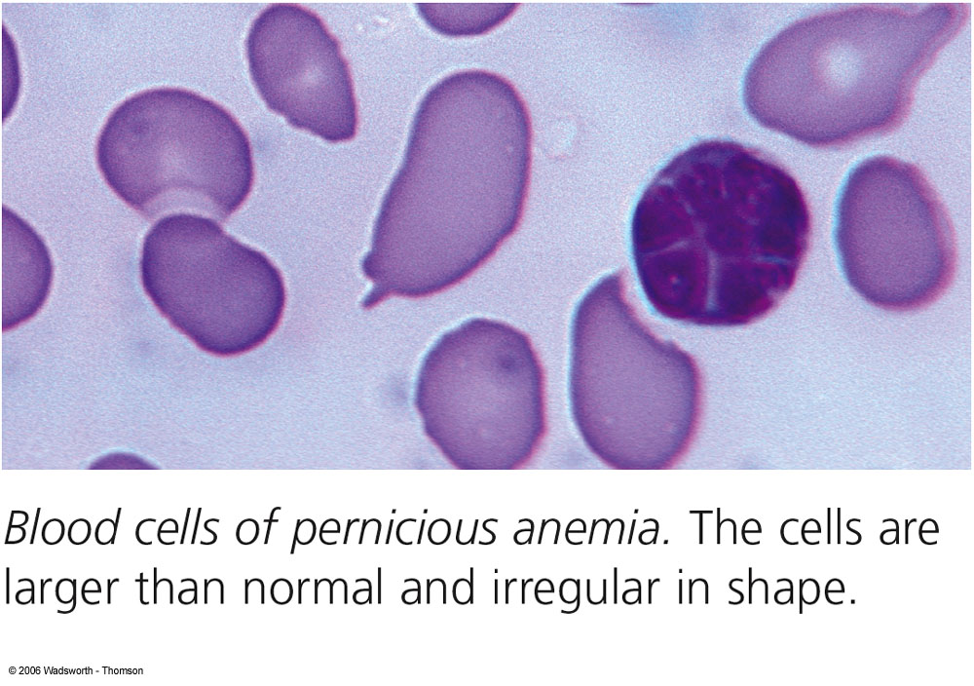
FN1021 – Chapter 7

Slide 89
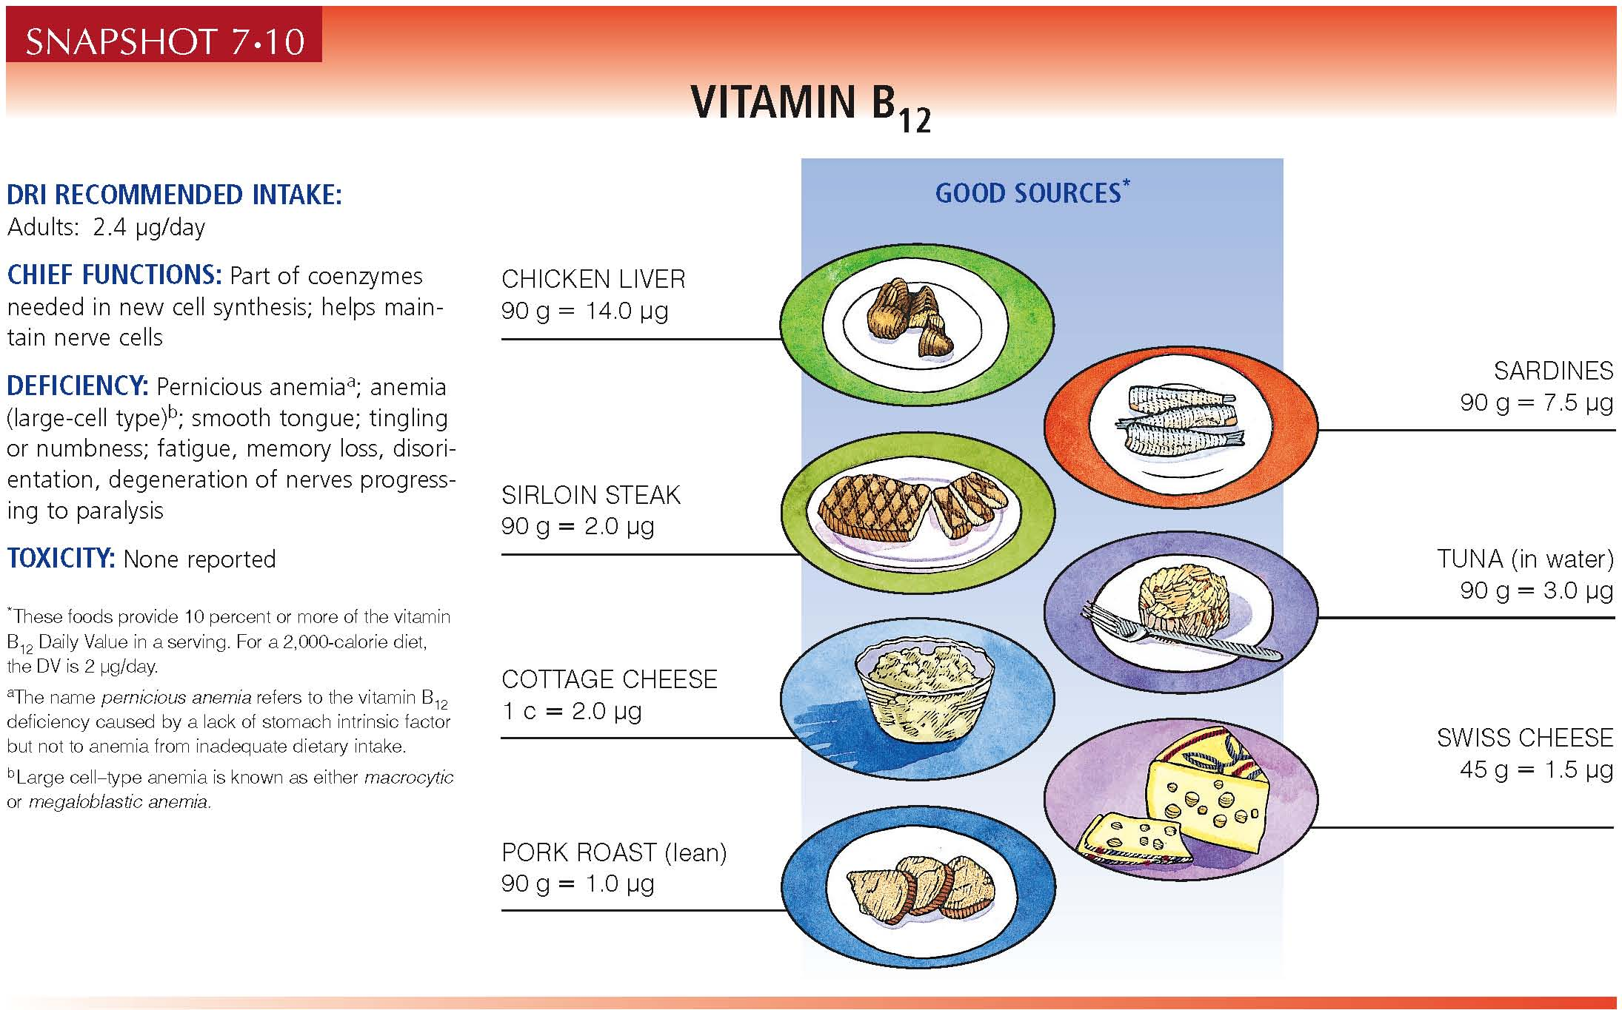
FN1021 – Chapter 7

Slide 90
Vitamin B₆
___ active forms
  Pyridoxine, pyridoxal, pyridoxamine
Functions
  Required for >___ reactions in the body; aids in metabolism of amino acids & protein, e.g. hemoglobin & neurotransmitters
  Synthesis of non-essential & other AA metabolism, e.g. tryptophan to niacin or serotonin, H-Cys metabolism
  Has roles in immune function & ________________ activity
  Assists in releasing stored glucose form __________
  Critical to developing brain & nervous system of fetus
FN1021 – Chapter 7

Slide 91
Vitamin B₆ Recommendations
Good food sources
  Most high _________ foods: MFP, potatoes, green leafy vegetables (e.g. spinach), _________, sweet potato
RDA – 1.3 mg/day
  Needs related to ________ intake & _________ metabolism
UL – 100 mg/day
FN1021 – Chapter 7

Slide 92
Vitamin B₆
Deficiency
  __________, psychological depression, irritability, confusion, insomnia, greasy dermatitis, anemia, convulsions; weakened immune response, increased incidence of _____
Toxicity
  Nerve damage causing _______________ of feet & hands; muscle weakness leading to inability to walk, skin lesions, depression, fatigue, impaired memory, irritability, headache
Together, deficiencies of folate, vitamin B12 , B6 are linked to increased H-Cys & a severe early form of CVD
FN1021 – Chapter 7

Slide 93
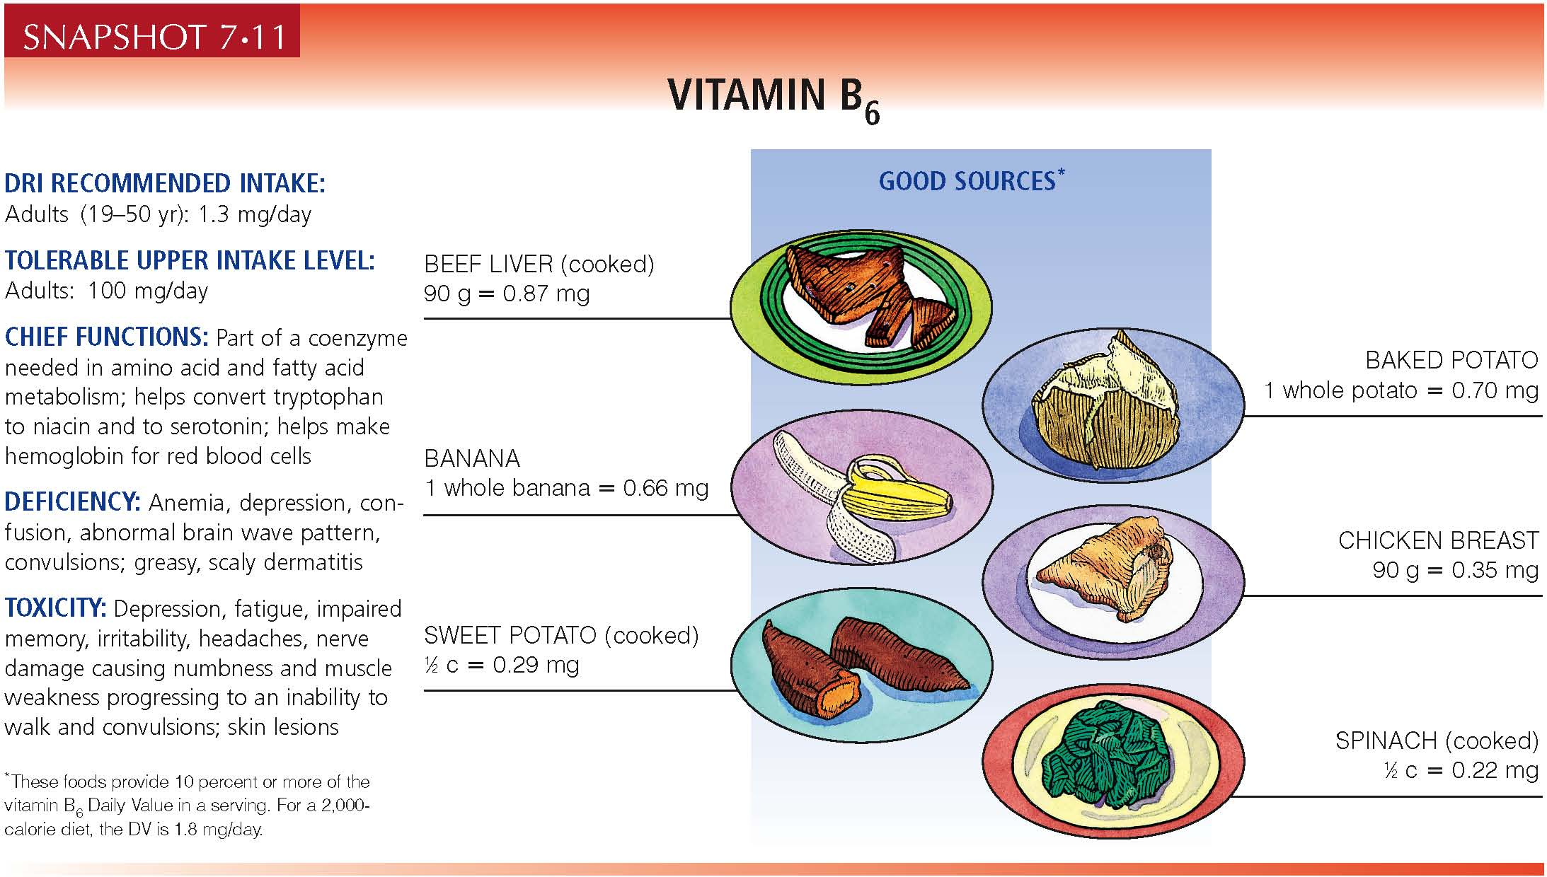
FN1021 – Chapter 7

Slide 94
Pantothenic Acid & Biotin
Functions
  Co-enzymes for energy (CHO, protein, fat) metabolism
  Pantothenic acid also participates in the synthesis of _____, steroid hormones, neurotransmitters, & ____________
Good food sources
  Most foods of plant & animal origin
AI (pantothenic acid) – 5 mg/day; no UL
  Needs increase with increased ________ intake
AI (biotin) – 30 μg/day; no UL
FN1021 – Chapter 7

Slide 95
Vitamin-like bioactive compounds
FN1021 – Chapter 7

Slide 96
Vitamin-Like Bioactive Compounds
_________
  Nonessential nutrient used to make lecithin & other molecules
___________
  Nonessential nutrient that functions in cellular activities
________, Lipoic acid
  Nonessential nutrients
Beware of many others being marketed for _____!
Most are used to make formulas appear more ‘complete’, but offer no physiological benefit
FN1021 – Chapter 7

Slide 97
Choosing Foods Rich in Vitamins
In Canada
  Wheat flour is bleached & fortified with _________________ __________________________
  Vitamins A & D are not permitted to be added to cereals, but we can get these nutrients in fortified milk
Eat a _______ of foods to provide nutrient needs - foods work in harmony
Remember ABCDMV principles of diet planning
FN1021 – Chapter 7

Slide 98
This person has low iron & osteoporosis. What dietary changes can we suggest?
Breakfast: Banana on the run
Morning Snack: Latte
Lunch: TH Muffin with chocolate milk
Afternoon Snack: Apple
Supper: Pasta with Tomato Sauce
Evening Snack: Popcorn
FN1021 – Chapter 7

Slide 99
Homework
Read Chapter 7
Prepare for the December Exam (Mon. Dec. 17, 2012 @ 2pm, worth 25%)
FN1021 – Chapter 7

