Slide 1
CST8234 – C Programming
Week 6a –Malloc & Free

Slide 2
Allocating Memory
Two flavours
  void *malloc( int nBytes );
  void *calloc( int numElements, int nBytesPerElement );
calloc is frequently interchangeable with malloc, e.g.,
  malloc( numElements * nBytesPerElment )
  But calloc initializes all memory to 0!
Note that when allocating space for structs, use sizeof( myStruct ) to figure it number of bytes per element
  don’t assume you can just manually add up each member
    There may padding/alignment bytes

Slide 3
Re-allocating Memory
If your memory needs are changing (e.g., need to append some characters onto the end of an string, and so need some more space), you can call
  char *pMessage = “Hello!”;
  pMessage = realloc( pMessage, 16 );
  strcat( pMessage, “ Goodbye!” );
This does the following
  allocates a new chunk of memory (of the specified size)
  copies the bytes from the old chunk to the new chunk
  calls free on the old chunk
  returns the new chuck

Slide 4
Re-allocating Memory
Hey… if pointers have no information about the number of bytes they’re pointing at, how does the system know how many bytes to copy?
  The heap manager knows how big each chunk is, and copies over that many bytes
    But it doesn’t know (or care) how much stuff you had in that chunk!

Slide 5
Re-allocating Memory
You have to be careful that you don’t introduce bugs:
    char *pMessage = “Hello!”;
    char *pOrigMessage = pMessage;
    pMessage = realloc( pMessage, 16 );
    strcat( pMessage, “ Goodbye!” );
    :
    printf( “%s”, pOrigMessage ); ← huh?
In the example above, pMessage was reallocated, which means its chunk was free’d. Therefore, pOrigMessage is now pointing to a chunk of memory that might still be valid… or might have been reassigned already!
  You simply don’t know
You have to build your applications to work with a single pointer, or very carefully count your references
  Java’s built-in reference counting makes this a non-issue!

Slide 6
Freeing Memory
When you’re done with an allocated chunk of memory, you must call free
  Failure to do so will result in a gradual accumulation of ‘in use’ chunks of memory
    your heap can fill up and collide with your stack
    i.e., bad things happen!
You cannot assume that the recently free‘d memory contains the same information that it did before being free’d
  It could have been reallocated to some other process
  It could have been wiped
  Once you call free, never use the memory again!

Slide 7
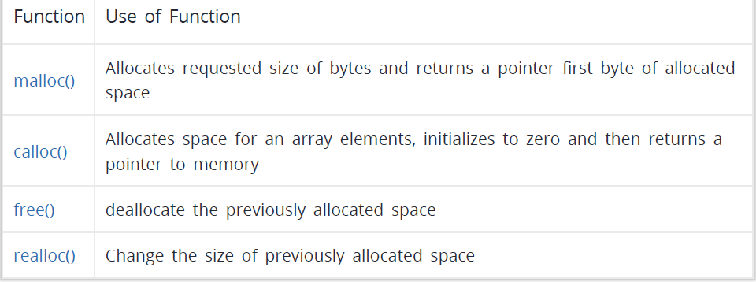
Summary of functions

