Slide 1
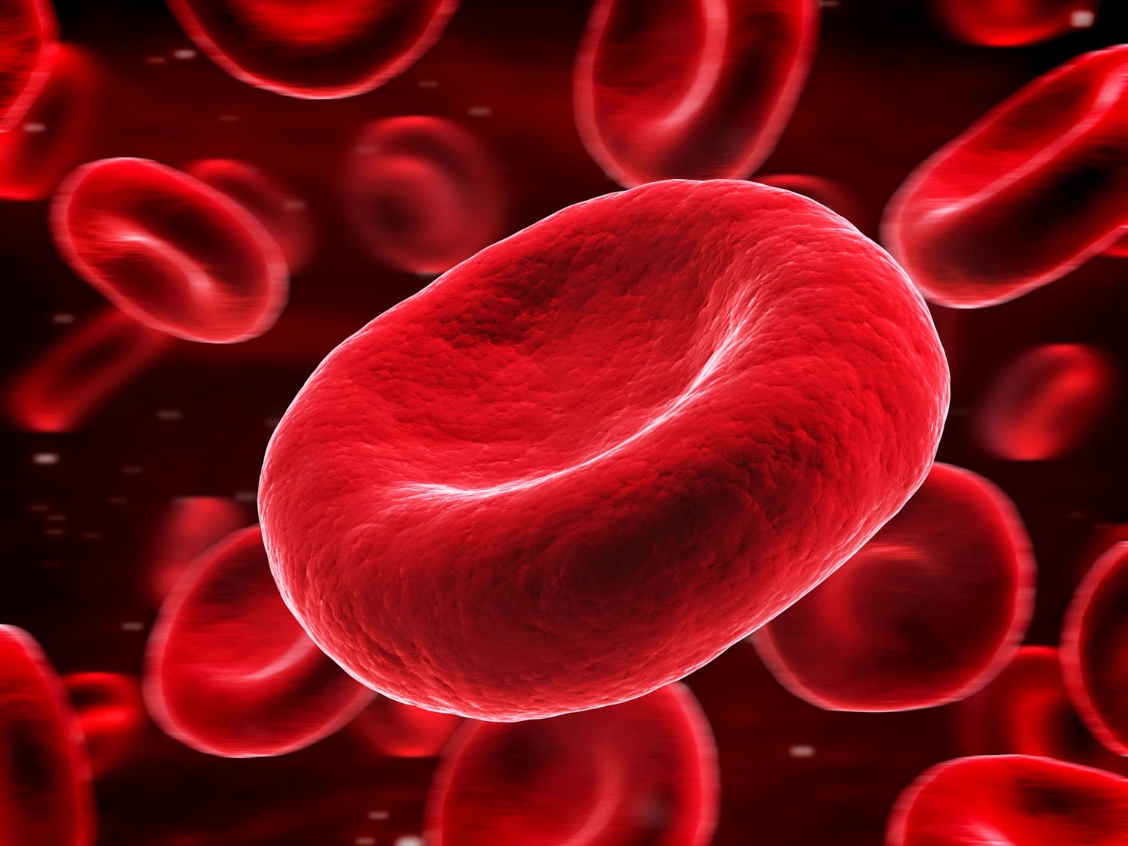
BIO1140 Lab 2
Permeability of the Red Blood Cell
Notes:
Source: http://3.bp.blogspot.com/-9Ori-Um0ixI/VSonA7z-BwI/AAAAAAAAArU/emOWUEHI3eM/s1600/0914_BLOOD_lg.jpg

Slide 2
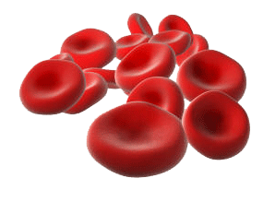
Objectives
Measure the rates of penetration of various non-electrolytes across the red blood cell (RBC) membrane using hemolysis
Identify factors affecting the penetration and the speed at which solutes cross the RBC membrane.
Observe and measure red blood cells under different osmotic conditions.
Microscopically witness hemolysis.

Slide 3
Part I: RBC Permeability Experiments
Each student pair will be assigned one of the following sets of solution:
Series 1: bi-distilled water (ddH₂0), Glycerol, Ethylene Glycol, Sucrose and urea.
Series 2: ddH₂O, Thiourea, Triton X-100, Dextrose and Ethanol.
(concentration: 0.3M each)
Time budget
60
min.

Slide 4

Procedure:
Split content of 5 flasks into 3 test tubes (3x5ml) each using the graduated plastic tubes
Label all tubes (1.1, 1.2 etc…)
Get one plastic cap ready to use
Add a drop of blood on the side of the tube.
Quickly place parafilm on top of test tube, invert ONCE to homogenize (this is t=0), and observe in front of white cardboard (10cm away from the card).

Slide 5
Procedure:
Record hemolysis time (when edge of the line on the index card becomes clearly visible) in seconds
If hemolysis occurs instantaneously, record “<2” as a result in your notes (use 2 for your calculations)
If no hemolysis occurs after 5 minutes, examine your test tube at 30-second intervals up to 20 minutes.
If no hemolysis was observed after 20 minutes, record your value as “>1200” seconds (use 1200 for your calculations)

Slide 6

Recording your Data
Repeat procedure for all 5 solutions to be tested
Calculate the arithmetic mean (m) and standard error (SE) of hemolysis time for all 5 solutions
See demonstration on how to use Excel to calculate the mean and SE

Slide 7
Part II: RBCs & Salt solutions
Set up the compound microscope:
Carefully connect the camera to your computer
Make sure you connect YOUR microscope to YOUR computer (no cross-connections)
Open Infinity Capture and take a test picture to make sure the system is working properly
Save as JPEG in:
My Documents/BIO1140/BIO1140XX
(XX = your section)

Slide 8
Part II: RBCs & tonicity series
Time budget
50
min.
Procedure:
Place a small quantity (see TA demonstration) of blood on a clean microscope slide.
Add one small drop of NaCl solution. Do not add too much liquid or RBCs will be washed away
Add coverslip
Place slide on microscope stage.

Slide 9
Part II: procedure
Adjust focus, condenser, light intensity and set the colour balance (see guide Biolabo).
Observe the shape and measure diameter of RBC in micrometers (µm) under the 40x objective
Clean up lenses if needed (ask your TA how to)
  TIP: To clearly see shape of RBCs, adjust the aperture iris diaphragm on the microscope:
    closed → more contrast, less light
    open → less contrast more light and colors.
  Try different apertures.

Slide 10
Part II: procedure (end)
Repeat the above procedures and observations using the three NaCl solutions (0.350M, 0.145M and 0.065M).
Your TAs will circulate during the lab and evaluate your ability at taking a good picture. Make sure you:
    Adjust light intensity
    Adjust white balance
    Save pictures as JPEG in proper folder

Slide 11
Cell diameter Measurement
Open a picture showing the RBCs.
Use the known width of the picture to calculate cell diameter (ex: 40x = 180µm)
Use computer zoom if needed
Do not use the 100x objective (tech marks will be taken off)

Slide 12
Evaluation: Report
Read the instruction file on lab website.
Content of report (3 pages total):
1- Title page (see example in lab manual)
2- Table presenting hemolysis times for all solutions tested (mean et standard error)
Read the lab manual appendix to know how to make a proper table.
Solution | Time | standard error
A | 12 | 1
B | 1 | 0.3
C | 3 | 0.7
D | 4 | 1
E | 5 | 0.8
←NO!

Slide 13
Evaluation: Report (cont’d)
3- Answer these 2 questions:
  1- What are the factors that affect the diffusion of the solutes tested in the permeability experiment?
  2- How do each of the factors listed in (1) affect the diffusion of solutes?
  Max 1 page (should be shorter)
Report is individual – beware of plagiarism (“I didn’t know” doesn’t work)
Read instruction file in Lab2 page of website.

Slide 14
Reminders (tech skills mark !)
Clean up:
  place pipettes and microtubes (plastic) in biohazard bags (red)
  Rinse test tubes and pour remaining liquids into waste liquid beakers. Leave tubes in tube rack on bench.
  Put slides and cover slips in the broken glass beaker.
  Clean your workbench and microscope stage
  wash your hands
  clean optical surfaces of your microscope with humid KimWipe.
  Return your microscope to the cupboard (on 4x objective).
→Prelab quiz at the beginning of lab 3 on text of the Amoeba lab. Be on time!

