Slide 1
KIN 371:
Introduction to Statistics in Kinesiology
www.ubc.ca
Classes 4 & 5: Examining Data
January 13 & 15, 2020
Thenextweb.com
ubyssey.ca
Digitalspy.co.uk

Slide 2
Examining Data
http://freerangestock.com/details.php?gid=&sgid=&pid=1521

Slide 3
Reading
Chapter 2: Examining Data: Tables and Figures

Slide 4
Learning Objectives
By the end of this class, students should be able to:
Explain why it is important to examine data
Distinguish between and explain when to examine data using a bar chart, pie chart, histogram, and frequency polygon
Describe how the scaling of the y-axis effects the interpretation of figures
Identify the modality of a distribution
Identify positively or negatively skewed data
Describe the characteristics of the normal distribution

Slide 5
Plan for Today
Examining Data
  Why examine data?
  Tables
  Figures
  Describing distributions

Slide 6
Why Examine Data?
1

Slide 7
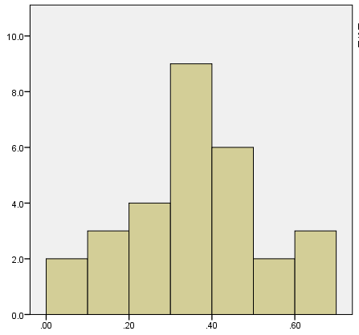
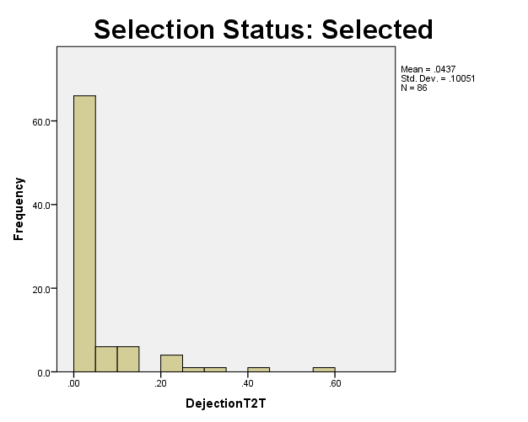
Why Examine Data?
Gain an initial sense of the data
Dejection scores for athletes who were not selected
Dejection scores for athletes who were selected
Frequency
Frequency
Dejection Time 2
Dejection Time 2
Notes:
Examining data helps researchers gain an initial sense of the data they have collected and whether the data are in line with their expectations
Examining data also provides a way of confirming the results of later statistical analyses. We’ve found that students’ errors in their calculations could have been avoided had they first looked at the set of data.
For example, examining data will help you avoid making statements such as, “The MPG for the cars in my sample ranged from 10 to 324 MPG,” “The average GPA in my sample of college students was 6.36,” or “The students in my sample owned an average of 13.24 cellphones.”
??? HUH

Slide 8
Why Examine Data?
Detecting data entry errors or data coding errors
Notes:
examining data before conducting statistical analyses is to detect any errors in the coding of data that have been collected
Ex) student conduct a 20 item math test and each students score on the test is the number of correct answers
Once test scores are calculated the data is entered in a computer
it’s crucial to ensure that no mistakes are made in calculating the test scores or in data entry
Left unattended, seemingly minor errors can lead to a great loss of time and energy—including the need, in some cases, to repeat the statistical analysis of the data.

Slide 9
Why Examine Data?
To identify outliers
  Rare, extreme scores that are outside the range of most other scores in the data set
Notes:
Ex) if most students had 8-16 correct answers, yet one student received 0, that would be an outlier
If not identified, outliers may distort conclusions researchers draw about their sample and their data, particularly when the sample is relatively small.
the single score of 0 might lead an observer to conclude the class as a whole performed more poorly on the test than they actually did.

Slide 10
Why Examine Data?
To evaluate research methodology
  Very similar scores may indicate problems with the measure used
To determine whether data meet statistical criteria and assumptions
Notes:
4)
useful in assessing the effectiveness of the methods researchers use to collect their data.
Ex) If the majority of students got 16/20 on the test it could be suspected that the test is too easy and isn’t a good measure to test intelligence
By comparing the collected data for a variable with the range of possible values, researchers are able to evaluate and modify their measurement tools
5)
These procedures generally assume, for example, that in most data sets, the majority of the data points will fall in the middle of the range of possible values, with a relatively small amount of data at the highest and lowest possible values.
Ex) math test: it is expected that most scores will be in the middle – between 7-13
When assumptions such as this are not met, it is more likely a researcher may draw inappropriate conclusions from any statistical analyses that are conducted.

Slide 11
Examining Data Using Tables
2

Slide 12
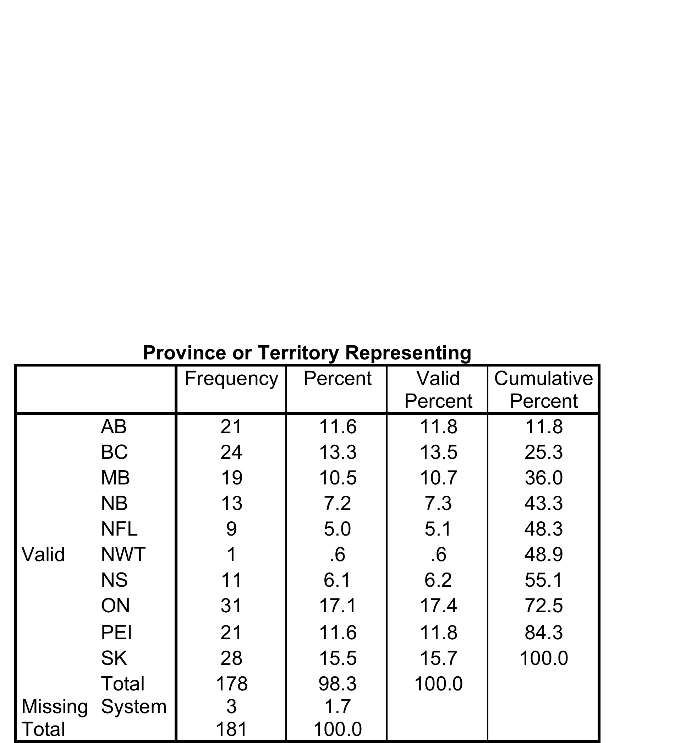
Frequency distribution table
Summarizes the number and percentage of participants for the different values of the variable

Slide 13
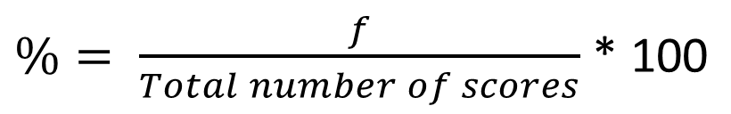
Creating Frequency Distribution Tables
Identify all possible values for the variable
  Looking at all data points
Determine the frequency of participants who report each value
Calculate the percentage for each value
Notes:
2) One way to determine the frequencies for a variable is to sort the data into the different values and then count the number of participants having each value using a “tick mark method.”
the number of tick marks and therefore the frequency ( f )
3)
Frequency is important however it isn’t always informative
the interpretation of frequencies depends on the size of the sample, it is useful to calculate the percentage of the sample having each value of a variable. These percentages can be calculated using the following formula:
F = frequency (number you determined in step 2)

Slide 14
Looking for data problems
Frequency tables can identify “problem data”
  Incorrect entry: e.g. BMI – 333
  Restricted range/ truncated range
  Highly skewed data
  Missing data
What do you do with such data?
  Delete?
  Correct?
  Replace with mean?
  Trim? (delete top and bottom 5-10%)
Notes:
Restricted range – if all answers are out of 7 but everyone is scoring 3-5, there isn’t enough variability
Highly skewed – participants are mostly on the higher or lower end of the scale
Missing data: participant is in a sample, but omitted a couple because they didn’t know how to answer – or if you're doing a long-term study and they missed one of the sessions
When you identify:
Delete – is most common if you can't determine the mechanism (ex: can’t tell If someone entered the BMI of 333, was it computer glitch…?)
Correct – only if you know if was a data entry error – you need to be able to see the raw data and entry it was an entry error
Replace with mean: less common, has a lot of problems because you are are assuming something about the person that might not be correct, especially if there are only small amounts of missing data is less problematic to delete than replace with a value that may or not be correct
Trim?: if there is an extreme value, they will take the top 5-10% from the top (ex: minutes of physical activity in a week, someone might have an extreme level that is common in the rest of the population?
Best option is to delete
Other 3 need really good justification

Slide 15
Smoking behaviour in young females
Participants: 702 grade 9 students
Smoking behaviour: 7 categories
  1 – no cigarettes
  2 - < 1/day
  3 – 1- 5
  4 – 6-10
  5 – 10-20
  6 – 20-40
  7 - > 40
Notes:
Asked to rate the number of cigarettes they smoked on a scale from 1 – 7
Data is ordinal – clear quantitative data – not equivalent intervals between them
7 categories

Slide 16
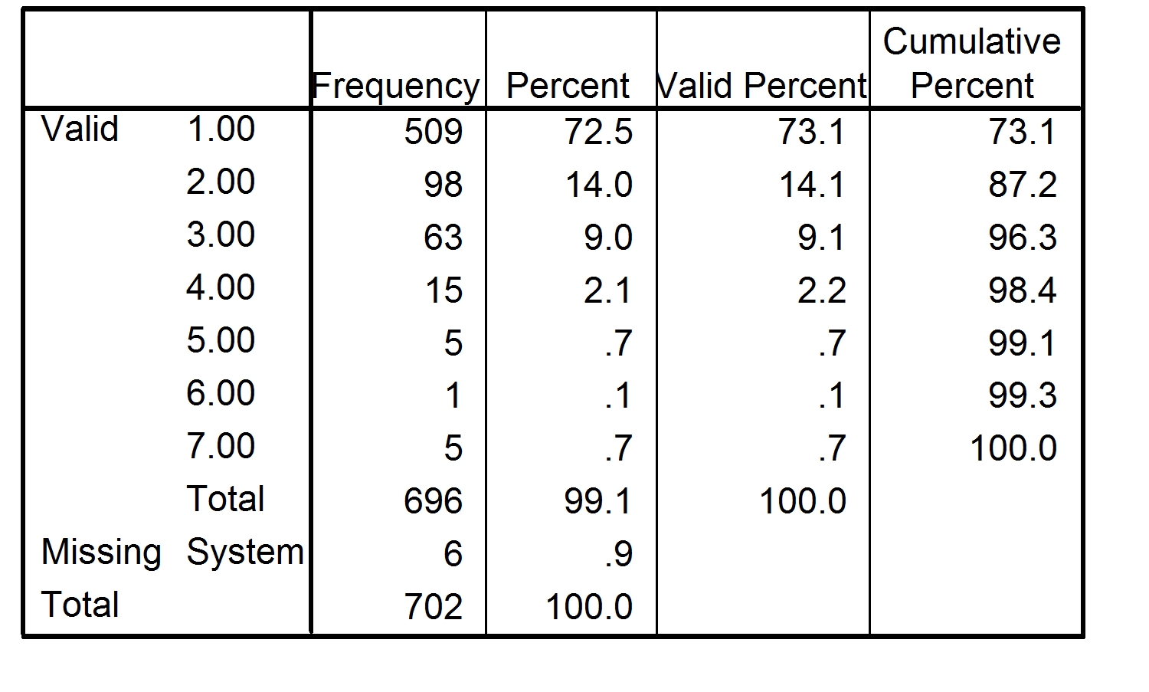
Smoking behaviour in young females
Notes:
509/702 =
509/696 participants (
Cumulative percentage – looking at adding up as you go along
This could be improved by adding more clear tables

Slide 17
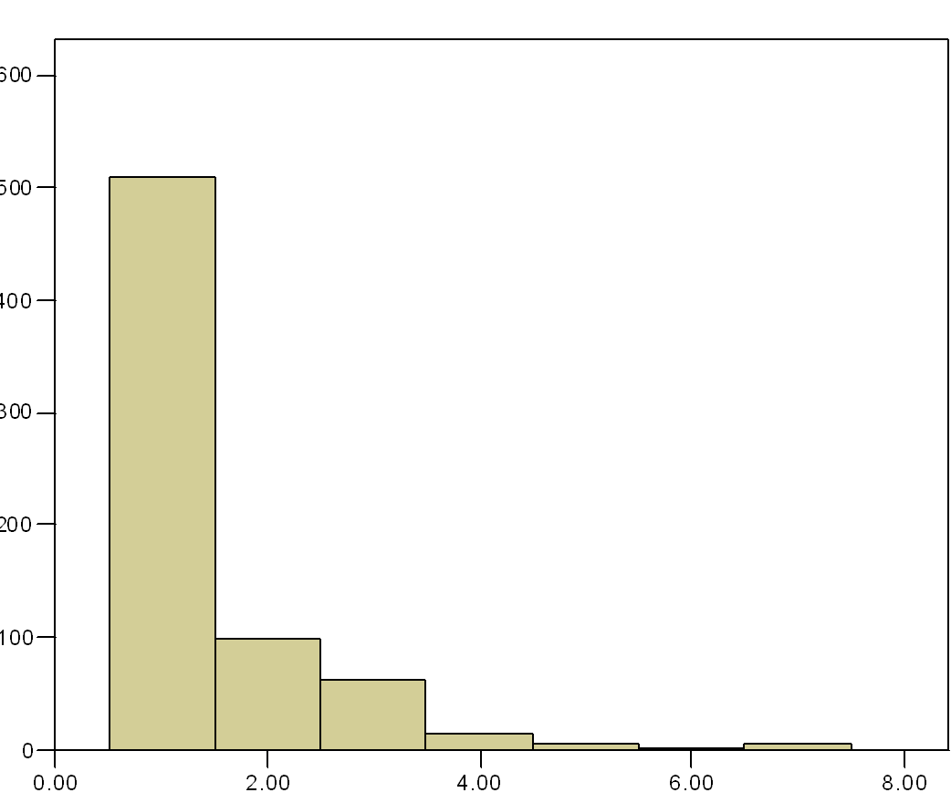
Smoking behaviour in young females
Frequency
Smoking behaviour category
Notes:
This data is very skewed because most students are in the no cigarettes category

Slide 18
Grouped frequency distribution table
A table that groups interval or ratio values of a variable into smaller numbers of intervals
Frequencies and percentages are calculated within the intervals
Notes:
To examine a variable with a large number of values, it is often useful to construct a grouped frequency distribution table, a table that groups the values of a variable measured at the interval or ratio level of measurement into a small number of intervals and then provides the frequency and percentage for each interval.
Ex) a large data set such as gpa – it’s from 0-4 with many options in between
Try to group into intervals, and put them into tables to make it more meaningful, point by point would be too crazy lol

Slide 19
Grouped frequency distribution table
Life Satisfaction | Frequency | Percent
10-12 | 1 | .58%
13-15 | 1 | .58%
16-18 | 4 | 2.31%
19-21 | 13 | 7.51%
22-24 | 15 | 8.67%
25-27 | 27 | 15.61%
28-30 | 50 | 28.90%
31-33 | 34 | 19.65%
34-36 | 28 | 16.18%
Total | 173 | 100%
real lower limit :
Smallest value of a variable that would be grouped in a particular interval
real upper limit:
Largest value of a variable that would be grouped into a particular interval
Notes:
The real limits of an interval are the values of the variable that fall halfway between the top of one interval and the bottom of the next interval. For example, because of how values of GPA are rounded, the lowest value of GPA that would lead someone to be placed in the interval 2.30–2.59 is not 2.30 but rather 2.295, which is halfway between the top of the 2.00–2.29 interval and the bottom of the 2.30–2.59 interval.
Rather than 26 intervals, make them smaller to have a better visualization
Real upper limit: is 18.4 –
Ex) GPA
2.0 – 2.4
2.5 – 2.9
3.0 – 3.4 – real lower limiti = 2.95 – it’s one decimal place less – real upper limit is 3.44
3.4 – 4.0
Precision of measurement?
????

Slide 20
Creating Grouped Frequency Distribution Tables
Variables are grouped into approximately 10 intervals.
The number of intervals should accurately represent the data.
Intervals should be of equal size.
Intervals should not overlap.
Notes:
Cumulative Percentages
In addition to determining the percentage of the sample that has each individual value or interval for a variable, it is sometimes useful to combine these percentages. For the GPA example, you may be interested in knowing, “What percentage of the sample had GPAs less than 2.60?” To answer this question, the percentages in the “%” column of the frequency distribution table must be combined. This type of percentage is referred to as a cumulative percentage, defined as the percentage of a sample at or below a particular value of a variable.
2. Ex) majority of participants are in the middle you can’t just have intervals be in the middle, all the data needs to be
3) Smoking example, we saw that each category was different sizes – if dealing with raw data the intervals need to be equal in size
4) A common mistake is 1-5, 5-10, needs to be 1-5, 6-10, 11-15 …

Slide 21
Examining Data Using Figures
3
Notes:
choice depends on level of measurement that we are measuring are variable of interest on

Slide 22
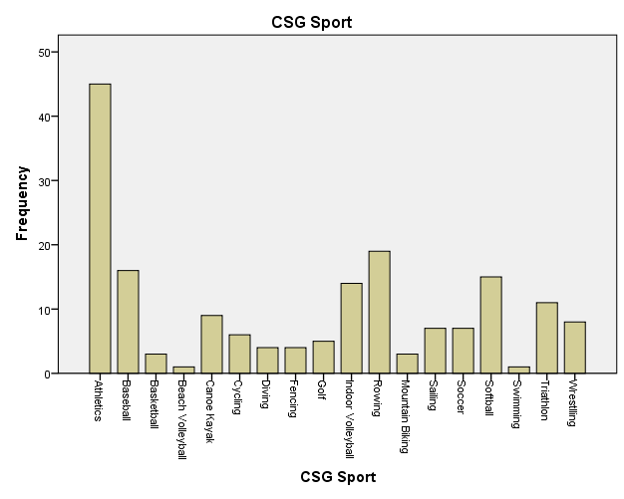
Nominal and Ordinal Data
Bar charts and pie charts
Bar Chart:
Use bars to represent the frequency or percentage of values
Canada Summer Games Sport
Frequency
Canada Summer Games Sport
Notes:
Bar chart
Bars do not touch each other
The height corresponds to the frequency
The gap between bars indicates that the values of the variable represent distinct groups or categories that cannot be connected together along a numeric continuum.

Slide 23
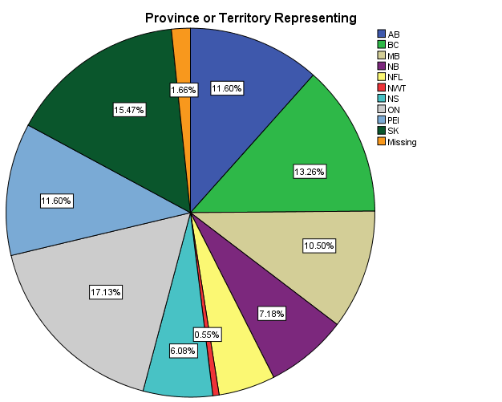
Nominal and Ordinal Data
Bar charts and pie charts
Pie Chart:
Represent the percentage of the sample corresponding to the value
Notes:
Portions represent the percentage of the sample for each value of a variable
Based on portions

Slide 24
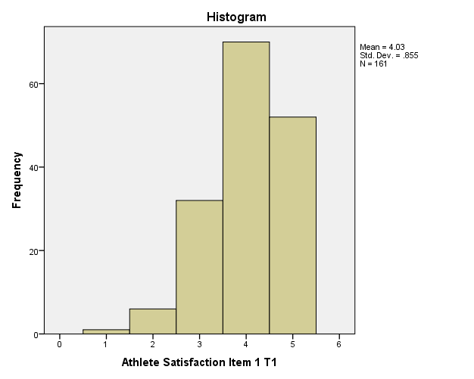
Interval and Ratio Data
Histograms and frequency polygons
Histogram:
Use bars to represent the frequency of values
Bars touch – indicates an interval variable
Athlete Satisfaction in CSG Hopefuls
Frequency
Athlete Satisfaction
Notes:
Interval and ratio variables have values equally spaced along a numeric continuum and are identical to each other with one exception: Ratio scales possess a true zero point, for which the value of zero represents the complete absence of the variable.
A histogram is a figure in which bars are used to represent the frequency of each value of a variable, with the different bars touching each other. The values of the variable are located on the X-axis, and the frequency or percentage for each value is on the Y-axis. Histograms are similar to bar charts, with one important difference: The bars in a histogram touch each other, indicating that the values of the variable are connected to each other along a numeric continuum.
Problems – no one was strongly disagreeing or opposite – implies there is a restrictive range – participants weren’t answering all values
- Scale is not a meaningful zero – it doesn’t mean there is an absense of satisfaction it just means that it is low

Slide 25
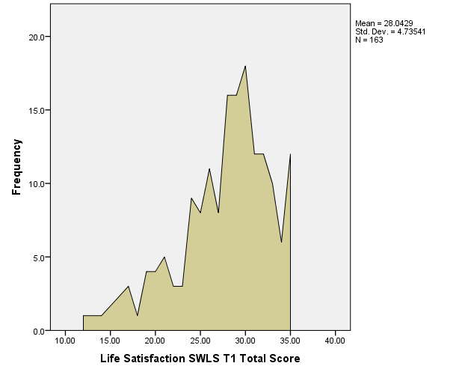
Interval and Ratio Data
Histograms and frequency polygons
Frequency polygon:
Are line graphs that use data points to represent frequencies
Life Satisfaction in CSG Hopefuls
Frequency
Life Satisfaction
Notes:
A frequency polygon is a line graph that uses data points to represent the frequency of each value of a variable, with lines connecting the data points. In a frequency polygon, the X-axis represents the values of the variable, while the Y-axis represents the frequency for each value.
Although a frequency polygon like the one in may look jagged as it moves from one data point to the next, it provides a general sense of the shape of the distribution of scores for a variable.

Slide 26
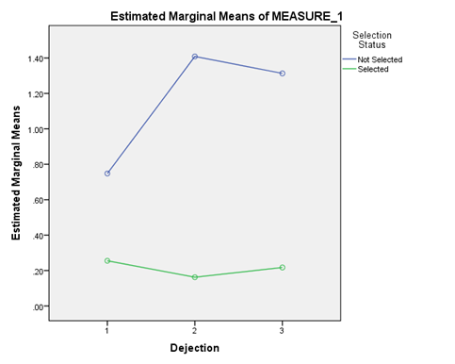
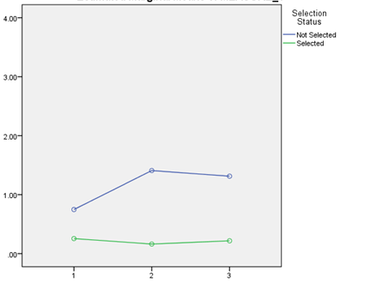
Inappropriate Conclusions from Figures
Poorly designed figures might lead to inappropriate or misleading conclusions:
Same data, but different y-axes!
Dejection in CSG Hopefuls
Dejection in CSG Hopefuls
Mean
Mean
Time
Time
Notes:
include y axis that are represented of the data?
Some people change y axis to make it seem like it’s more blown up then it is
One of right is more real

Slide 27
Describing Distributions
4
Notes:
Frequency distributions –
Typically it is sample data

Slide 28
Modality
Values with the highest frequency
  Unimodal, bimodal, multimodal
  Bimodal – has to have a valley between the two peaks
p. 43 there is a chart
Notes:
Modality – distinction between mode and modality
Symmetry
Variability
Unimodal: If you were to look at a histogram there is only one obvious peak In the data
In a bimodal distribution - there are two peaks in the distribution
Looking at ratio or interval levels of measurement – think
The values of the variable go on the X-axis
y axis has frequency and count
A continuous variable with two peaks in distribution: time on y – axis, and frequency of number of people going to a restaurant (example) – you have lulls throughout the day
Multimodal – there are multiple peaks
We might see

Slide 29
Symmetry
Symmetric distributions have frequencies that change in a similar manner moving away from the mode
p. 43
Notes:
Tails in distribution: you have a chunk of the data in the middle, and as you move down towards the axis “data moves towards the axis”
- If you fold in it half would it be symmetrical

Slide 30
Symmetry
Asymmetric distributions have outliers that skew the shape of the distribution
Positively skewed – tail that is longer on right, tail that is shorter on left (imagery – the tail is going to keep going on positively)
Negatively skewed – if you were to cross the y-axis you would go into negative numbers
p. 43
Notes:
One tail is longer than the other tail
Asymmetric is caused by outliers, it pulls the tail of the distribution towards them
When describing distributions, describe them with nuance “approximately negatively skewed, or slight deviation from symmetrical distribution”
Use this language for the assignment

Slide 31
Quantifying Skewness
Skewness Statistic
Positive statistic = positive skew
Negative statistic = negative skew
0 = perfectly symmetrical distribution
The further the skewness statistic is from 0 the more skewed the distribution
Notes:
Skewness statistic – measures skewness – only need to know how to interpret, not calculate
Ex) skewness of 0.6, vs 3.6 – 3.6 is more positively skewed
Rule of thumb: we care about skewness because the assumption of symmetry is important, we are concerned about statistics that have a distribution that have a skewness of greater than 2 or less than negative 2 **

Slide 32
Variability
The amount of differences in the distribution of a variable
Are the scores different from or similar to one another?
Peaked
Flat
p. 45
Notes:
Most interested in, in statistics
How much to people differed and why do they differ
Flat distribution: means there is more variability in your data
Peaked distribution: means there is less variability in your data
Leptokurtic – less variability in the scores – if you put two kangaroos together, they like to to leap, huh?
Mesokurtic – neither peaked nor flat – medium
Platykurtic – more of flat distribution – a platypus is a flat animal
Mode
Value of variable on x-axis, and frequency on the y-axis
Ex) bench press scores
Flat means that people are scoring all over the place – low frequency – everyone is scoring something different
Peak distribution – they are scoring fewer values – maybe between 100 and 150 – there are more people scoring similar values

Slide 33
Quantifying Kurtosis
Kurtosis Statistic
Positive statistic = indicates leptokurtic distribution
Negative statistic = indicates platykurtic distribution
0 = perfectly normal distribution
The further the kurtosis statistic is from 0 the more likely the distribution is to be not normal
Notes:
In a statistic greater than 2 there isn’t a lot of variably in the data
A kurtosis statistic of .22 – is approx. a mesokurtic distribution, however It might have a bit less variability than a meso and it is trending to a

Slide 34
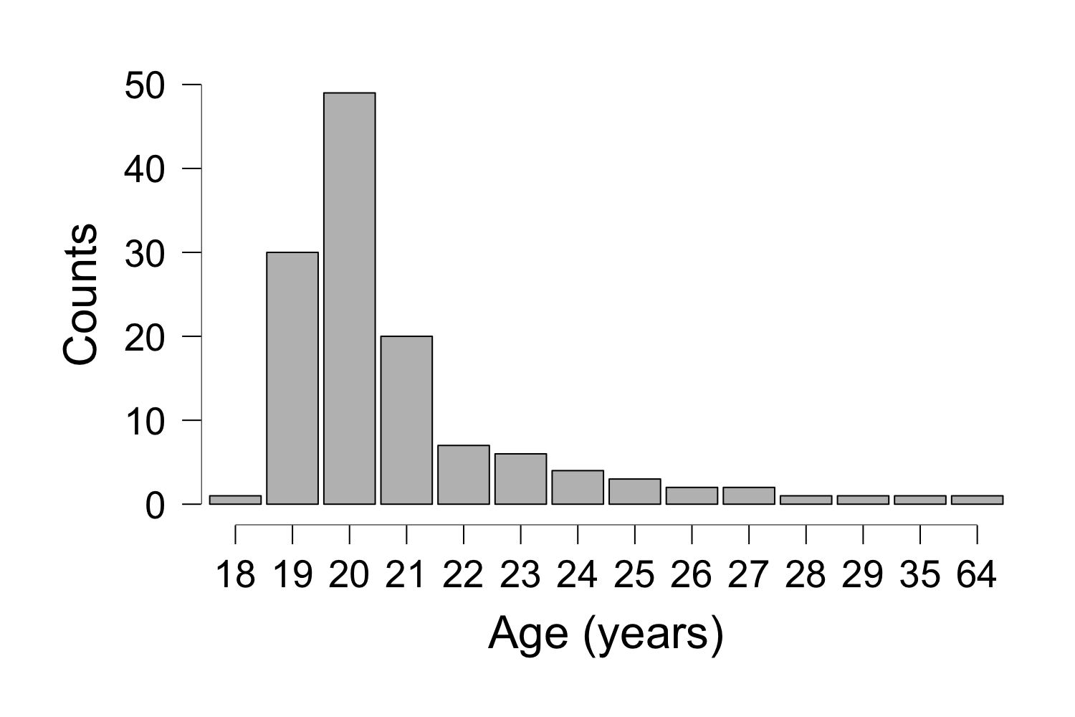
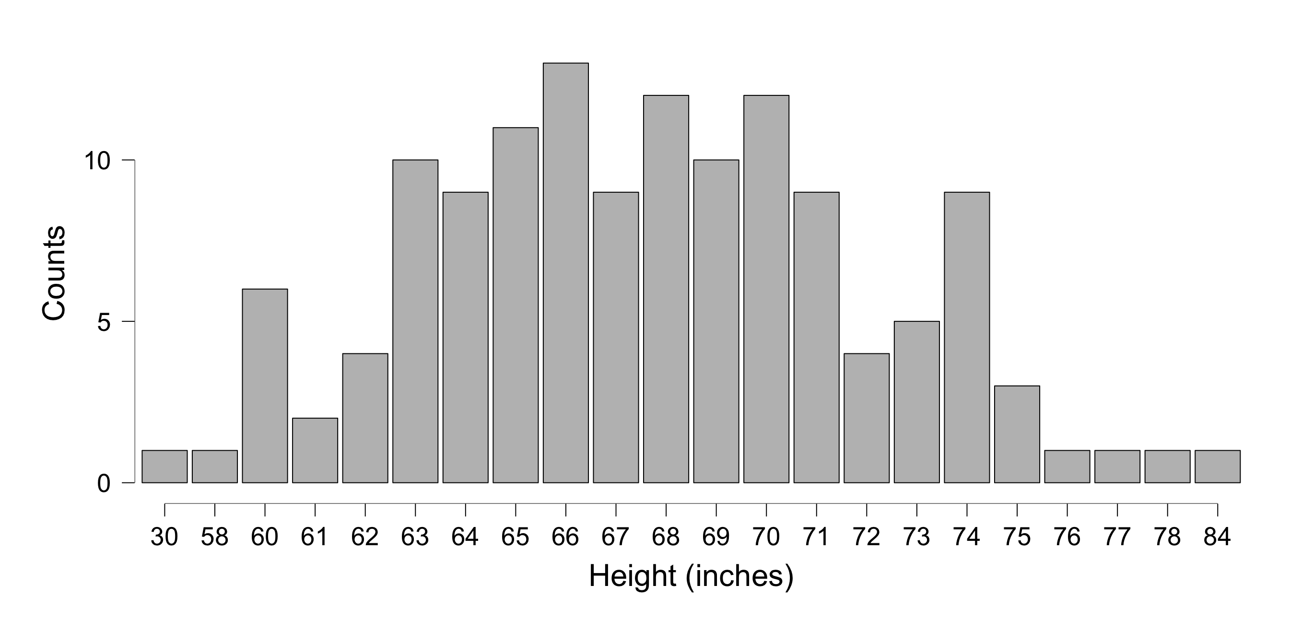
Quantifying Skewness & Kurtosis
Descriptive Statistics
 | Height (inches) | Age (Years)
Skewness | .25 | 7.72
Kurtosis | 1.21 | 65.66
Notes:
1st diagram – approx. symmetrical, but there is a slight positive skew – tail pulling right (.25, 1.21)
2nd – is positively skewed
If looking at age – skewness is 7.72 =positive (7.72 would indicate a significant positive skew) – long tail
Kurtosis – 65.66 – is a massive 65.66 = peaked distribution – higher frequency, more people with fewer values

Slide 35
The Normal Curve
Unimodal
Symmetrical
Neither peaked nor flat
p. 45

Slide 36
For Next Class Read:
Chapter 3: Measures of Central Tendency

