Slide 1

ADM 1100
Introduction to business management
October 31

Slide 2
Agenda
Group Projects – lessons learned
Midterm Exam
Chapter 11
Chapter 12 & 13– next week

Slide 3
CHAPTER 11

Slide 4
Defining Organizational Structure
Organizing
Arranging and structuring work to accomplish an organization’s goals.
Organizational Structure:
  How job tasks are formally divided, grouped, and coordinated within an organization.

Slide 5
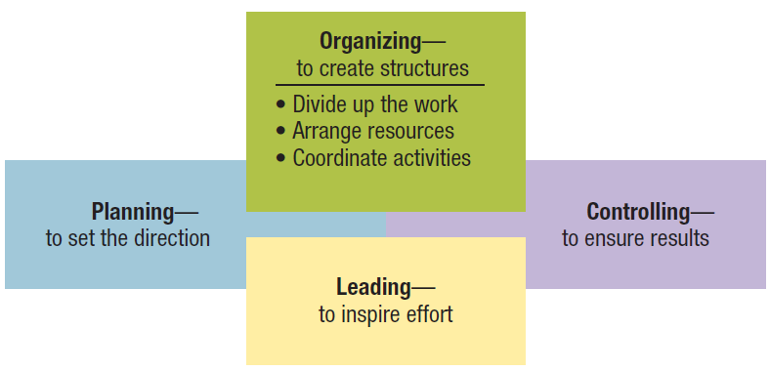
Figure 8.1 Organizing viewed in relationship with the other management functions.
Management 3e - Chapter 8
5

Slide 6
Defining Organizational Structure
Organizational Design:
  A process involving decisions about six key elements:
    Work specialization Departmentalization
    Chain of command Span of control
    Centralization. Formalization
Notes:
]

Slide 7
Defining Organizational Structure
Work Specialization:
The degree to which activities in an organization are subdivided into separate job tasks; also known as division of labour.

Slide 8
Purposes of Organizing
Divides work to be done into specific jobs and departments. Assigns tasks and responsibilities associated with individual jobs. Coordinates diverse organizational tasks. Clusters jobs into units. Establishes relationships among individuals, groups, and departments. Establishes formal lines of authority. Allocates and deploys organizational resources.

Slide 9
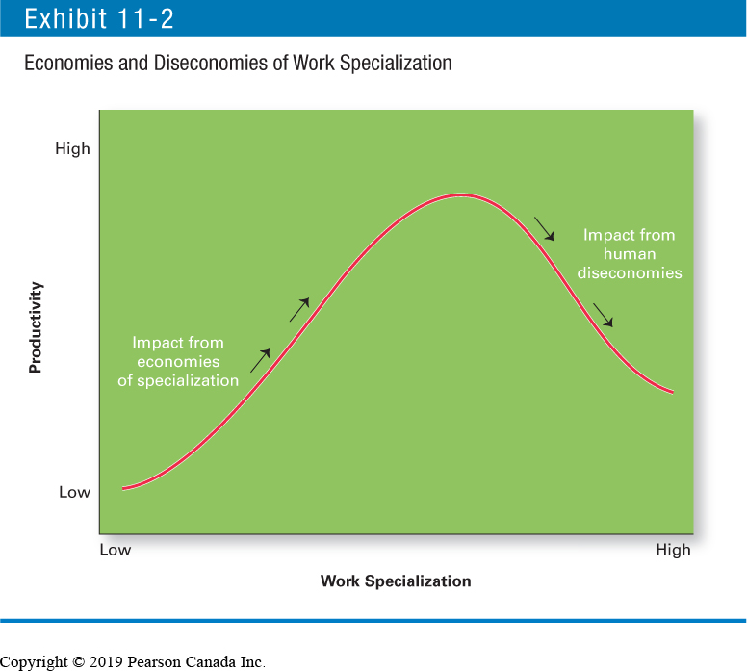
Economies and Diseconomies of Work Specialization

Slide 10
Defining Organizational Structure
Departmentalization:
The basis on which jobs are grouped together.

Slide 11
The Five Common Forms of Departmentalization
Functional
  Grouping jobs by functions performed.
Product
  Grouping jobs by product line.
Geographical
  Grouping jobs on the basis of territory or geography.
Process departmentalization
  Grouping jobs on the basis of product or customer flow.
Customer departmentalization
  Grouping jobs on the basis of common customers.

Slide 12
Defining Organizational Structure
Cross Functional Teams:
Work teams made up of individuals who are experts in various functional specialties together.

Slide 13
Defining Organizational Structure)
Chain of Command:
  The continuous line of authority that extends from the top of the organization to the lowest level and clarifies who reports to whom.
  Authority
  Responsibility
  Unity of Command

Slide 14
Defining Organizational Structure
Authority:
The rights inherent in a managerial position to tell people what to do and to expect them to do it.
Acceptance theory of authority (Chester Barnard) :
  The view that authority comes from the willingness of subordinates to accept it.

Slide 15
Acceptance Theory of Authority
Conditions:
They understand the order.
They feel the order is consistent with the organization’s purpose.
The order does not conflict with their personal belief
They are able to perform the task as directed.

Slide 16
Defining Organizational Structure – forms of authority
Line Authority:
Authority that entitles a manager to direct the work of an employee.
Decision making
Staff Authority:
  Positions with some authority that have been created to support, assist, and advise those holding line authority.

Slide 17
Defining Organizational Structure
Responsibility:
The obligation or expectation to perform any assigned duties.
Unity of Command:
The management principle that each person should report to only one manager.
Does this still apply today?

Slide 18
Defining Organizational Structure
Span of Control:
The number of employees who can be effectively and efficiently supervised by a manager.
- 5 or 6 to no specific number

Slide 19
Defining Organizational Structure
  Width of span is affected by:
Skills and abilities of the manager and the employees
Characteristics of the work being done
Similarity of tasks
Complexity of tasks
Proximity
Information systems
Standardization of tasks
Preferred style of the manager

Slide 20
Defining Organizational Structure
Centralization:
The degree to which decision making is concentrated at upper levels of the organization.
  Organizations in which top managers make all the decisions and lower-level employees simply carry out those orders.
Decentralization:
The degree to which lower-level employees provide input or actually make decisions.

Slide 21
Centralization or Decentralization
More Centralization | More Decentralization
Environment is stable. Lower-level managers are not as capable or experienced at making decisions as upper-level managers. Lower-level managers do not want a say in decisions. Decisions are relatively minor. Organization is facing a crisis or the risk of company failure. Company is large. Effective implementation of company strategies depends on managers retaining say over what happens. | Environment is complex, uncertain. Lower-level managers are capable and experienced at making decisions. Lower-level managers want a voice in decisions. Decisions are significant. Corporate culture is open to allowing managers a say in what happens. Company is geographically dispersed. Effective implementation of company strategies depends on managers having involvement and flexibility to make decisions.
Source: Data from H. Mintzberg, Power In and Around Organizations (Upper Saddle River, NJ: Prentice Hall, 1983); and J. Child, Organization: A Guide to Problems and Practices (London, UK: Kaiser & Row, 1984).

Slide 22
Defining Organizational Structure
  Trend towards decentralization…
Employee empowerment:
  Giving employees more authority (power) to make decisions.

Slide 23
Defining Organizational Structure
Formalization:
The degree to which jobs within the organization are standardized and the extent to which employee behaviour is guided by rules and procedures.
  Highly formalized jobs offer little discretion over what is to be done.
  Low formalization means fewer constraints on how employees do their work.

Slide 24
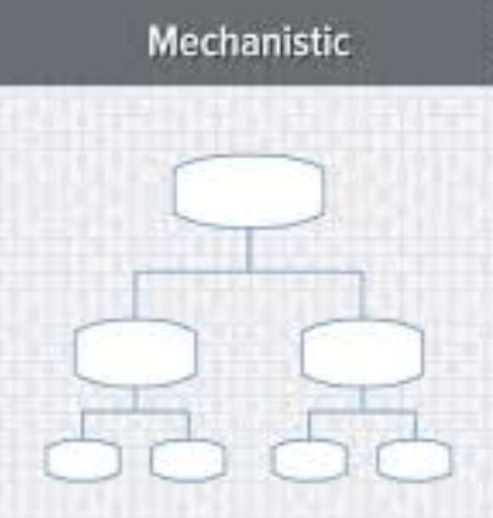
Mechanistic and Organic Structures
Mechanistic Organization :
An organizational design that is rigid and tightly controlled.
High specialization
Rigid departmentalization
Narrow spans of control

Slide 25
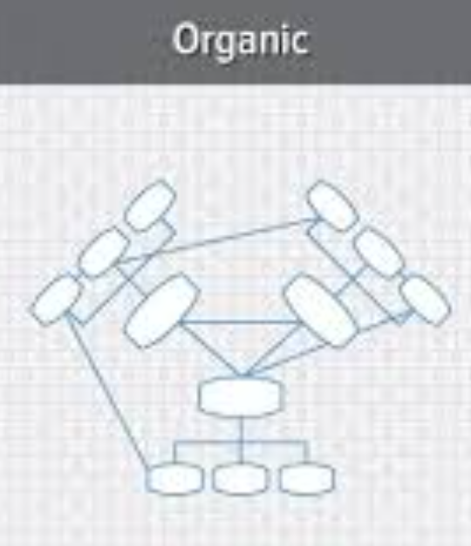
Mechanistic and Organic Structures
Organic Organization :
An organizational design that is highly adaptive and flexible.
Non-standardized jobs
Fluid team-based structure
Little direct supervision
Minimal formal rules
Open communication network
Empowered employees

Slide 26
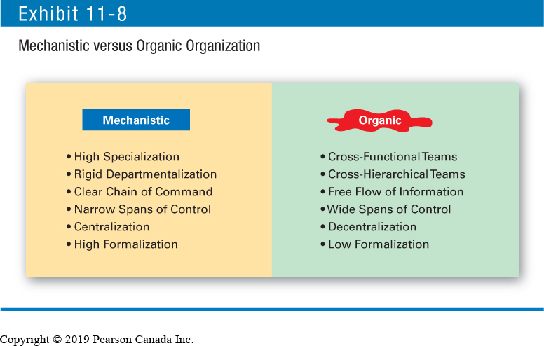
Mechanistic versus Organic Organization

Slide 27
Contingency Factors Affecting Structural Choice
Structural decisions are influenced by:
Top managers typically put a great deal of thought into designing an appropriate structure; which is dependent upon:
  the organization’s strategy
  size
  technology
  degree of environmental uncertainty.

Slide 28
Contingency Factors Affecting Structural Choice
Structural decisions are influenced by:
  Strategy and Structure
  Organizational structure follows strategy
  Size and Structure
  Firms change from organic to mechanistic organizations as they grow in size

Slide 29
Contingency Factors Affecting Structural Choice
Structural decisions are influenced by:
  Technology and Structure
  Firms adapt their structure to the technology they use
  Environmental Uncertainty and Structure
  Dynamic environments require organic structures; mechanistic structures need stable environments

Slide 30
Woodward’s Findings on Technology, Structure, and Effectiveness
Blank | Unit Production | Mass Production | Process Production
Structural characteristics | Low vertical differentiation | Moderate vertical differentiation | High vertical differentiation
Blank | Low horizontal differentiation | High horizontal differentiation | Low horizontal differentiation
Blank | Low formalization | High formalization | Low formalization
Most effective structure | Organic | Mechanistic | Organic
Source: Based on J. Woodward, Industrial Organization: Theory and Practice (London, UK: Oxford University Press, 1965).

Slide 31
Contingency Factors Affecting Structural Choice
Environmental Uncertainty and Structure:
Some organizations face relatively stable and simple environments; others face dynamic and complex environments. Because uncertainty threatens an organization’s effectiveness, managers will try to minimize it.

Slide 32
Traditional Organizational Designs
Simple Structure:
An organizational structure with low departmentalization, wide spans of control, authority centralized in a single person, and little formalization.
- Small business
  Functional Structure:
An organizational structure that groups similar or related occupational specialties together.
Example: Human resources, R&D, Sales & Marketing, Production, Finance etc.

Slide 33
Common Organizational Designs
  Divisional structure:
An organizational structure that consists of separate business units or divisions.
Example: cosmetics, footwear, outerwear etc.

Slide 34
Traditional Organizational Designs
Structure | Strengths | Weaknesses
Simple Structure | Fast; flexible; inexpensive to maintain; clear accountability. | Not appropriate as organization grows; reliance on one person is risky.
Functional Structure | Cost-saving advantages from specialization (economies of scale, minimal duplication of people and equipment); employees are grouped with others who have similar tasks. | Pursuit of functional goals can cause managers to lose sight of what’s best for overall organization; functional specialists become insulated and have little understanding of what other units are doing.
Divisional Structure | Focuses on results—division managers are responsible for what happens to their products and services. | Duplication of activities and resources increases costs and reduces efficiency.

Slide 35
Contemporary Organizational Designs
  Contemporary Organizational Designs:
    Team Structure
    Matrix-Project
    Boundaryless Structure
    Learning Structure

Slide 36
Contemporary Organizational Designs
  Team Structure:
An organizational structure in which the entire organization is made up of work groups or teams.

Slide 37
Contemporary Organizational Designs
Matrix Structure:
An organizational structure that assigns specialists from different functional departments to work on one or more projects.

Slide 38
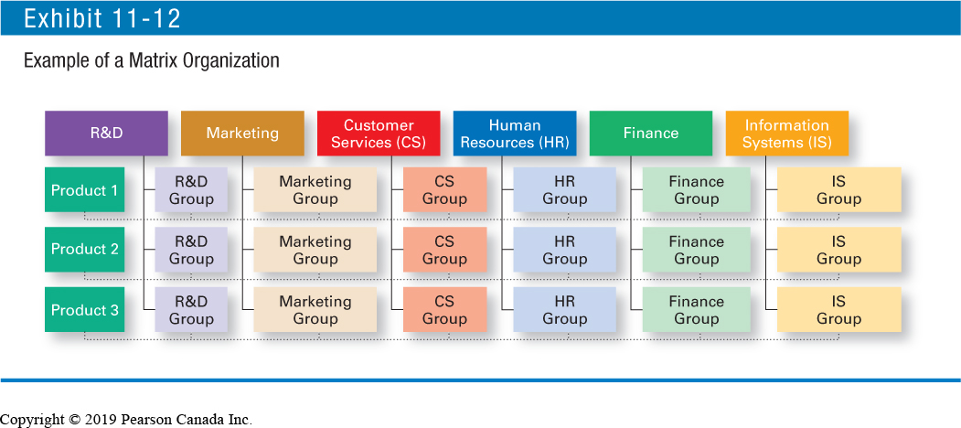
Example of a Matrix Organization

Slide 39
Contemporary Organizational Designs
  Project Structure:
An organizational structure in which employees continuously work on projects.

Slide 40
Contemporary Organizational Designs
  Boundaryless Organization:
An organization whose design is not defined by, or limited to, the horizontal, vertical, or external boundaries imposed by a predefined structure..
Removes internal (horizontal) boundaries:
  Eliminates the chain of command
  Has limitless spans of control
  Uses empowered teams rather than departments
Eliminates external boundaries:
  Uses virtual, network, and modular organizational structures to get closer to stakeholders

Slide 41
Contemporary Organizational Designs - Types
  Virtual Organization:
An organization that consists of a small core of full-time employees and outside specialists temporarily hired as needed to work on projects.

Slide 42
Contemporary Organizational Designs – Types
  Network Organization:
An organization that uses its own employees to do some work activities and networks of outside suppliers to provide other needed product components or work processes.
Example: Ericsson contracts R&D and manufacturing
  Concentrate on what they do best and contract out other activities to companies that can do those activities best.

Slide 43
Contemporary Organizational Designs
  Learning Organization:
An organization that has developed the capacity to continuously learn, adapt, and change.
Sharing of information and collaboration
Empowered teams and employees

Slide 44
Contemporary Organizational Designs
Team Structure | Blank
What it is: Advantages: Disadvantages: | A structure in which the entire organization is made up of work groups or teams. Employees are more involved and empowered. Reduced barriers among functional areas. No clear chain of command. Pressure on teams to perform.
Matrix-Project Structure | Blank
What it is: Advantages: Disadvantages: | In a matrix structure, specialists from different functional areas are assigned to work on projects and then return to their areas when the project is completed. In a project structure, employees continuously work on projects. As one project is completed, employees move on to the next project. Fluid and flexible design that can respond to environmental changes. Faster decision making. Complexity of assigning people to projects. Task and personality conflicts.
Notes:
Learning Outcome 5: Describe contemporary organizational designs.

Slide 45
Contemporary Organizational Designs
Boundaryless Structure | Blank
What it is: Advantages: Disadvantages: | A structure not defined by or limited to artificial horizontal, vertical, or external boundaries; includes virtual and network types of organizations. Highly flexible and responsive. Utilizes talent wherever it’s found. Lack of control. Communication difficulties.
Learning Structure | Blank
What it is: Advantages: Disadvantages: | A structure in which employees continually acquire and share new knowledge and apply that knowledge. Sharing of knowledge throughout organization. Sustainable source of competitive advantage. Reluctance on part of employees to share knowledge for fear of losing their power. Large numbers of experienced employees on the verge of retiring.
Notes:
Learning Outcome 5: Describe contemporary organizational designs.

Slide 46
NEXT CLASS
INDIVIDUAL PROJECT
CHAPTER 12 &13

